Slide 1
History of Pharmacy SIG
Teaching History of Pharmacy According to the AIHP Guidelines:
C. Pharmacy Regulation via State and Federal Governance
Created by David M. Baker,
BS Pharm, MBA, JD
Western New England University College of Pharmacy & Health Sciences
Developed by the Teaching History of Pharmacy Committee of the History of Pharmacy SIG, 2017-18
Picture: Pharmacist at People’s Drug Store No. 5, Washington, DC, c. 1920. Library of Congress Prints and Photographs, LC-USZ62-129891

Slide 2
State Pharmacy Law Development
Initially, in early 1800s, the few attempts at “regulation” of profession were typically limited to local level laws
As slowly moved toward state level regulation, early attempts often were developed in combination with medical practice laws.

Slide 3
State Pharmacy Law Development
1808 - Territory of Orleans (became Louisiana in 1812): pharmacists had to prove qualifications; examined by Board of Physicians; banned sale of deteriorated drugs; restricted sale of poisons
1840 - 1st state board of pharmacy
1852 - pharmacy act was repealed

Slide 4
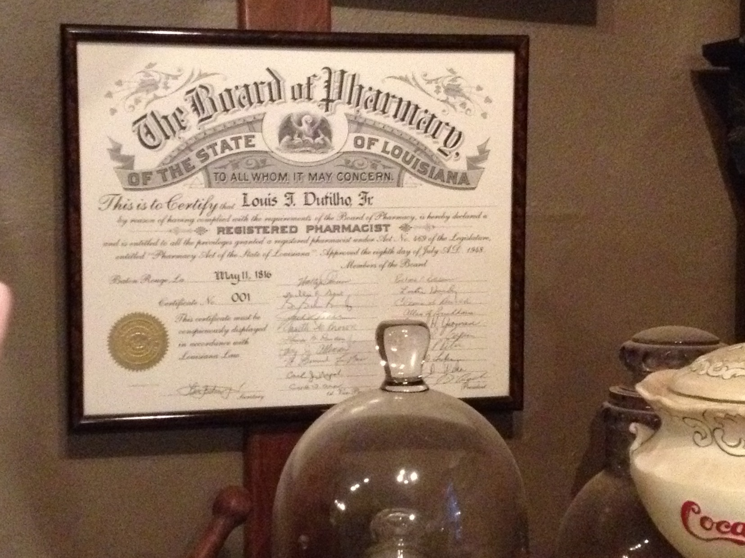
One of the First State-Licensed Pharmacists

Slide 5
State Pharmacy Law Development
Other State Pharmacy Acts:
1817 - South Carolina
  1838 - penalty component was repealed
1825 - Georgia
1852 - Alabama

Slide 6
State Pharmacy Law Development – Common Law
Thomas v. Winchester, 6 N.Y. 397 (N.Y. 1852) – established duty to dispense (label) correctly
Fleet and Semple v. Hollenkemp, 52 Ky. (1 B Mon.) 219 (1852) – changed pharmacy purchases from caveat emptor to caveat vendor
Burgess v. Sims Drug Co., 86 NW 307 (Iowa 1901) – pharmacists & employers equally liable
Peters v. Johnson, 41 SE 190 (W.Va. 1902) – high degree of care & prevent foreseeable harm

Slide 7
State Pharmacy Law Development
State regulation of pharmacy practice prior to 1870 did not typically involve pharmacists directly:
  against drug adulteration
  restricted poison sales
  prohibited advertising or selling of abortifacients

Slide 8
State Pharmacy Law Development
1869 - APhA Meeting: after much rancorous debate concerning rural areas without pharmacies and a fear of bureaucracy, a model state pharmacy act was drafted. This would quickly be adopted by states as their state law.

Slide 9
State Pharmacy Law Development
Adoption of Model Pharmacy Act, creating Pharmacy Boards and standards for pharmacists and pharmacy practice:
  1870 - Rhode Island first
  By 1878 - 8 more states and D.C.
  In the 1880s - 21 more states
  In the 1890s - 12 more states

Slide 10
State Pharmacy Law Development
In 1900, the Model Pharmacy Practice Act was revised by APhA without any controversy.
Currently, the Model Pharmacy Practice Act is updated and maintained by the National Association of Boards of Pharmacy.

Slide 11
Federal Pharmacy Law Development
Precipitating Events:
  Fraudulent production, advertising and distribution of fake smallpox vaccine, at extravagant prices.
Vaccine Act of 1813
  Purpose was to encourage and increase smallpox vaccinations.
  Created a single federally-appointed agent, whose responsibilities were to:
  preserve the genuine smallpox vaccine matter; and
  to furnish the same to any citizen of the United States, whenever it may be applied for, through the medium of the post-office (carried free of charge by the post office).
  Repealed May 4, 1822 - result of an 1821 outbreak of smallpox in North Carolina, which was traced to contaminated vaccines provided by Dr. John Smith while in the capacity of the federal agent charged with preserving and distributing genuine vaccine.
Notes:
NEVER ON SLIDE:
FIRST federal law concerning drugs and/or pharmacy.

Slide 12
Federal Pharmacy Law Development
Precipitating Events:
  Complaints by pharmacies that drug products (crude product) were adulterated or not of specified concentrations.
  Claim was that this was primarily IMPORTED product.
Drug Importation Act of 1848:
  Examined all imported products for quality, purity and fitness for purpose.
  Established Pharmacopoeia of the U.S. and U.S. Dispensatory as official standards.
  Administered by the Department of the Treasury.
Notes:
NOT ON SLIDE:
Precipitating Events:
Complaints by pharmacies that drug products (crude product) were adulterated or not of specified concentrations.
Claim was that this was primarily IMPORTED product.

Slide 13
Federal Pharmacy Law Development
Precipitating Events:
  Tetanus contamination in diphtheria vaccine.
  Most vaccines produced on farms using production animals (horses, cattle).
Biologics Control Act of 1902:
  Treasury Department licensed and inspected biologics manufacturers, and regulated production and labeling of biologics.
  National Sanitary Board (the Surgeon-Generals of the Army, Navy and Marine-Hospital Service) promulgated regulations.
Notes:
NOT ON SLIDE:
Precipitating Events:
Tetanus contamination in diphtheria vaccine.
Most vaccines produced on farms using production animals (horses, cattle).

Slide 14
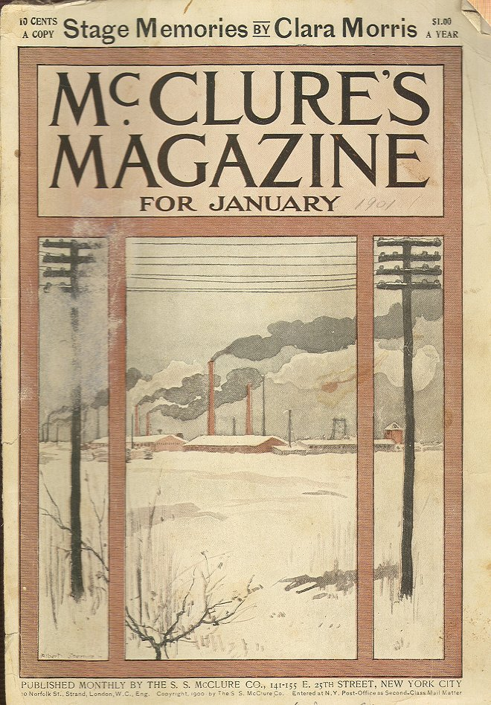

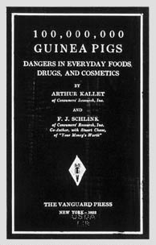
Federal Pharmacy Law Development
Muckraking Journalism – Early 20th Century

Slide 15
Federal Pharmacy Law Development
Precipitating Events:
  Muckraking journalism: Upton Sinclair’s The Jungle (meat packers) and Samuel Hopkins Adams’ Great American Fraud (patent medicines)
  Harvey Wiley’s advocacy (worked in Agriculture Dept.’s Bureau of Chemistry)
Pure Food and Drug Act of 1906:
  Defined “drug,” and regulated the adulteration or misbranding of drugs.
  Regulations promulgated jointly by the Treasury, Agriculture, and Commerce & Labor Departments; Bureau of Chemistry (in Ag. Dept.) performed any necessary tests.
  Established U.S. Pharmacopoeia and National Formulary as drug standards.
Notes:
NOT ON SLIDE:
Precipitating Events:
Muckraking journalism: Upton Sinclair’s The Jungle (meat packers) and Samuel Hopkins Adams’ Great American Fraud (patent medicines)
Harvey Wiley’s advocacy (worked in Agriculture Dept.’s Bureau of Chemistry)

Slide 16
Federal Pharmacy Law Development
Precipitating Events:
  Realization of the extent of addiction to opiates and other narcotics among the general public through prescription and patent remedies.
  International Treaty concerning addictive substances at the Hague in 1912, to which the U.S. was a signatory.
Harrison Anti-Narcotic Act of 1914:
  Established control over the manufacture, distribution and dispensing of certain addictive substances (e.g., opium, morphine and cocaine) in high concentrations, primarily through taxation and required labeling.
Notes:
NOT ON SLIDE:
Precipitating Events:
Realization of the extent of addiction to opiates and other narcotics among the general public through prescription and patent remedies.
International Treaty concerning addictive substances at the Hague in 1912, to which the U.S. was a signatory.

Slide 17
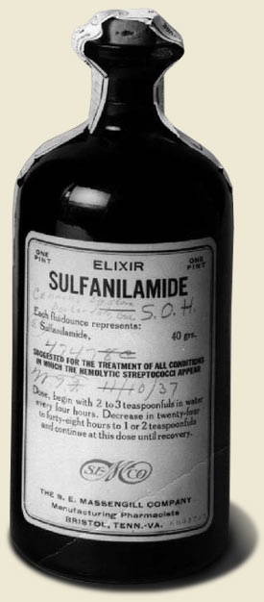
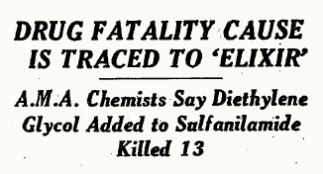
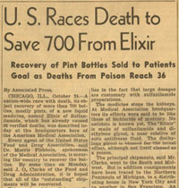
Federal Pharmacy Law Development

Slide 18
Federal Pharmacy Law Development
Precipitating Events:
  Many had advocated for new law for years due to ineffectiveness of 1906 law – could only prosecute fraudulent, not misleading labelling, due to 1911 US Supreme Court decision
  Sulfanilamide Elixir (Massengill) tragedy of 1937 – used diethylene glycol as solvent; 107 deaths plus suicide death of creator
Food, Drug and Cosmetic Act of 1938:
  Definition of “drug” expanded
    to include affecting body structures even in the absence of disease (prevention); and
    by addition of the Homeopathic Pharmacopoeia of the U.S. as a drug standard.
Notes:
NOT ON SLIDE:
Precipitating Events:
Many had advocated for new law for years due to ineffectiveness of 1906 law – could only prosecute fraudulent, not misleading labelling, due to 1911 US Supreme Court decision
Sulfanilamide Elixir (Massengill) tragedy of 1937 – used diethylene glycol as solvent; 107 deaths plus suicide death of creator
NEVER ON SLIDE:
Primary author and sponsor of law = Senator Royal S. Copeland, a homeopathic physician. First introduced in 1933. Bill was signed June 25, 1938 by FDR; Sen. Copeland had collapsed in Senate chambers and died June 17, 1938.

Slide 19
Federal Pharmacy Law Development
Food, Drug and Cosmetic Act of 1938 (continued):
  Drug labeling requirements became more strict
  A drug could not be sold unless an application for approval was on file with the FDA.
  The newly created Food and Drug Administration (FDA) was given general administrative powers.

Slide 20
Federal Pharmacy Law Development
Precipitating Events:
  No standard as to what required a prescription. Previously, decision was left to individual manufacturer to make.
Durham-Humphrey Amendment or Prescription Drug Amendment of 1951:
  Established two classes of drugs - prescription and over-the-counter
  Established label and labeling requirements unique to prescription drugs (exempted from “adequate directions for use” requirement)
Notes:
NOT ON SLIDE:
Precipitating Events:
- No standard as to what required a prescription. Previously, decision was left to individual manufacturer to make.

Slide 21
Federal Pharmacy Law Development
Precipitating Events:
  - Use of thalidomide in pregnant women for morning sickness from 1957 to 1962 (Europe) –teratogenic effects: death and phocomelia (estimated 10–20,000 cases worldwide)
Drug Efficacy Amendment of 1962 (or Kefauver-Harris Amendment):
  Established Good Manufacturing Practices (“GMPs”)
  Transferred regulation of prescription drug advertising from the Federal Trade Commission (“FTC”) to the FDA
Notes:
NOT ON SLIDE:
- Use of thalidomide in pregnant women for morning sickness from 1957 to 1962 (Europe) – was not commonly accepted that drugs could pass through the “placental barrier” – teratogenic effects: death and phocomelia (10 – 20,000 cases worldwide)

Slide 22
Federal Pharmacy Law Development
Drug Efficacy Amendment of 1962 (continued):
  Required informed consent of all human research subjects.
  Required reporting of adverse drug reactions by manufacturers to FDA.
  New drug approval now required proof of efficacy in addition to safety.

Slide 23
Federal Pharmacy Law Development
Federal Comprehensive Drug Abuse Prevention and Control Act or Controlled Substances Act of 1970
  Established the Drug Enforcement Administration (DEA) from four different federal agencies, including BNDD (Bureau of Narcotics & Dangerous Drugs).
  Created five controlled substance schedules, and prescription limitations for each class.
  Established criminal liability for illegal possession or trafficking in controlled substances.

Slide 24
Federal Pharmacy Law Development
Poison Prevention Packaging Act of 1970
  Requires child-resistant (= 80% of children <5 y.o. cannot open but 90% of adults can), NOT child-proof, packaging for all drugs and cosmetics (and various other hazardous household substances) unless the product is:
    on a list of excepted products;
    a one size OTC product for elderly or handicapped patients; or
    a prescription drug, and the prescriber or patient requests noncompliant packaging (it is recommended to obtain such requests in writing).

Slide 25
Federal Pharmacy Law Development
Medical Device Amendment of 1976
  FDA has the responsibility of classifying all medical devices as: Class I - general controls, ex.= sphygmomanometer; Class II - specific performance standards, ex.= IV fluid pump Class III - pre-market approval since are life-supporting or life-sustaining, ex.= heart pacemaker

Slide 26
Federal Pharmacy Law Development
Medical Device Amendment of 1976 (continued)
  FDA must establish standards of performance for all medical devices.
  FDA must establish a system of premarket testing and review for Class III medical devices.
  FDA must develop a system of post-market surveillance of medical devices.

Slide 27
Federal Pharmacy Law Development
Federal Anti-Tampering Act of 1982
  Precipitating Event:
    Drug tampering of Tylenol cases that occurred in the Chicago area during 1982. Seven deaths occurred due to lacing with potassium cyanide.
  Requires certain (not all) OTC drugs, cosmetics and devices to be manufactured in tamper-resistant (not tamper-proof) packaging, or it will be considered misbranded and/or adulterated by the FDA.
Notes:
NOT ON SLIDE:
- Drug tampering of Tylenol cases that occurred in the Chicago area during 1982. Seven deaths occurred due to lacing with potassium cyanide.

Slide 28
Federal Pharmacy Law Development
Orphan Drug Act of 1983
  Precipitating Events:
    Diseases affecting small population numbers – the culminating disorder: AIDS
  Provides tax and exclusive licensing incentives to manufacturers to develop and produce drugs intended for diseased populations of < 200,000 people within the U.S.
Notes:
NOT ON SLIDE:
- Diseases affecting small population numbers – the culminating disorder: AIDS

Slide 29
Federal Pharmacy Law Development
Drug Price Competition and Patent-Term Restoration Act (Waxman-Hatch Amendment of 1984)
  Precipitating Event:
    FDA had created a “side” method of approval without real authority
  Made into law the Abbreviated New Drug Application (“ANDA”) process for generic drug manufacturers.
  Extended the term of patents from 17 years to 20 years for the manufacture of brand name pharmaceuticals.
Notes:
FDA had created a “side” method of approval without real authority – big drive for cheaper generics – brand name companies complaining about short-cuts, demanding full review of generic drugs = compromise bill

Slide 30
Federal Pharmacy Law Development
Prescription Drug Marketing Act of 1987
  States must license drug wholesalers.
  Reimportation of drugs is banned, unless is emergency or is performed by manufacturer
  Banned the sale, trade or purchase of drug samples.
  Mandated storage, handling and record keeping requirements for drug samples.

Slide 31
Federal Pharmacy Law Development
Prescription Drug Marketing Act of 1987 (continued)
  Banned the trafficking in or counterfeiting of drug coupons.
  Prohibited the resale of prescription drugs purchased by nonprofit hospitals or health care facilities with only a few exceptions: returns to drug wholesalers or drug manufacturers.

Slide 32
Federal Pharmacy Law Development
Omnibus Budget Reconciliation Act (“OBRA”) of 1990
  Pharmacists (or their agents) must offer to counsel all Medicaid patients on every new or refilled prescription.
  States must establish Drug Utilization Review (“DUR”) programs for Medicaid.

Slide 33
Federal Pharmacy Law Development
Nutrition Labeling and Education Act of 1990
  Authorized the FDA to establish standardized nutritional labeling, and requirements to make health claims, regarding food products and dietary supplements.

Slide 34
Federal Pharmacy Law Development
Prescription Drug User Fee Act of 1992
  Established fees to be submitted to the FDA with all NDAs, applicable to all drug manufacturers with the exception of orphan drugs and small manufacturers.
  Provided that the fees could only be used by Congress to supplement the FDA’s existing budget. Therefore, the fees could only be used to increase the FDA’s NDA review capabilities.

Slide 35
Federal Pharmacy Law Development
Dietary Supplement Health and Education Act of 1994
  Defined “dietary supplement” (D.S.)
  Allows D.S. manufacturers to make four types of substantiated claims, if they notify FDA of their intent to do so within 30 days:
    1. Statements that the product will benefit a nutritional deficiency, if state the prevalence of the deficiency in the U.S.

Slide 36
Federal Pharmacy Law Development
Dietary Supplement Health and Education Act of 1994 (cont’d)
  Statements (continued):
    2. that describe the role the D.S. plays in a body structure or function
    3. that characterize the ways in which the D.S. acts in maintaining the body’s structure or function
    4. describing the general well-being that may be achieved using the D.S.

Slide 37
Federal Pharmacy Law Development
Dietary Supplement Health and Education Act of 1994 (cont’d)
  Statements:
    If do make claims, must place on label: “This statement has not been evaluated by the Food and Drug Administration. This product is not intended to diagnose, treat, cure or prevent any disease.

Slide 38
Federal Pharmacy Law Development
Health Insurance Portability & Accountability Act (HIPAA) of 1996
HIPAA is a federal law with provisions that:
Protects the privacy of patient information
Provides for the electronic and physical security of patient health information
All pharmacies must institute privacy policies with a privacy officer
Requires the “minimum necessary” use and disclosure of private health information
Specifies patients’ rights regarding the approval of access and use of their health information

Slide 39
Federal Pharmacy Law Development
The FDA Modernization Act of 1997
  Renewed Prescription Drug User Fee Act for another 5 more years.
  Motivate drug manufacturers to perform pediatric studies by extending license exclusivity by 6 months.
  Established a fast track drug review process to which manufacturers could apply for innovative drugs needed for life-threatening diseases.

Slide 40
Federal Pharmacy Law Development
The FDA Modernization Act of 1997 (continued)
  Streamlined the process by which a manufacturer gains approval for a new process for an approved drug, and when a supplemental NDA is required.
  Streamlined the clinical data required in an NDA.
  Required FDA to establish scientific advisory panels and to provide guidelines as to their operation.

Slide 41
Federal Pharmacy Law Development
The FDA Modernization Act of 1997 (continued)
  FDA must consolidate the license approval process for biologics and the NDA review process for drugs.
  Exempt pharmaceutical compounding by pharmacists or prescribers if stay within following limits:
    a. being for a prescription, in advance of a prescription, or based on past historical use;

Slide 42
Federal Pharmacy Law Development
The FDA Modernization Act of 1997 (continued)
  Limits (continued):
    b. being compounded from U.S.P., N.F., or FDA approved substances; and
    c. not being an exact copy of a commercially available product.
  Required the FDA to establish regulations regarding sunscreens.

Slide 43
Federal Pharmacy Law Development
The FDA Modernization Act of 1997 (continued)
  Requires a manufacturer to notify the FDA 6 months in advance of discontinuing the production of a drug that is life-supporting, life-sustaining, or for a debilitating disease.
  Modified the process by which health claims for foods can be made.

Slide 44
Federal Pharmacy Law Development
The Health Information Technology for Economic and Clinical Health (HITECH) Act (2009)
Updated HIPAA provisions regarding:
Notification requirements when a privacy breach occurs
Fine and penalty increases for privacy violations by covered entities and business associates
Patients’ right to request copies of their electronic health care record in electronic format
Holding business associates civilly and criminally liable directly for privacy and security violations

Slide 45

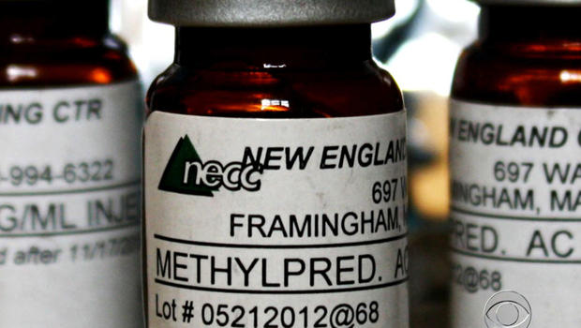
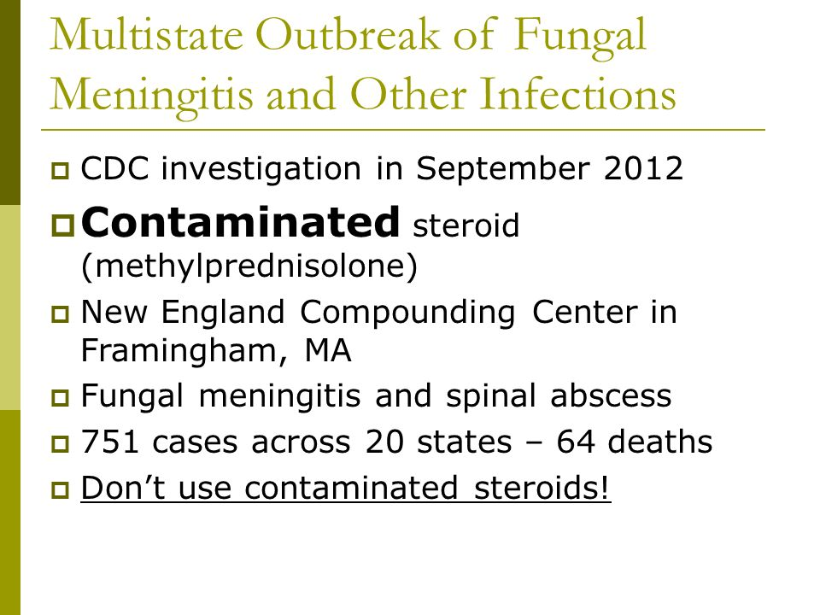
Federal Pharmacy Law Development

Slide 46
Federal Pharmacy Law Development
Drug Quality & Security Act of 2013
  Compounding Quality Act (Title I): amendment to the Federal Food, Drug, and Cosmetic Act (21 U.S.C. 301 et seq.)
    Reinstated §503 of FDCA, exempts state-licensed compounding pharmacies from cGMPs, manufacturer labelling requirements, and NDA or aNDA approvals.
    Exempt sterile or non-sterile compounding based on prescription or limited quantity; compounding based on USP monographs, approved drugs or list from HHS; not copies of commercially available drugs; limits on out-of-state shipments.

Slide 47
Federal Pharmacy Law Development
Drug Quality & Security Act of 2013
  Compounding Quality Act (Title I):
    Created legal authority for FDA licensing and regulation of outsourcing facilities (sterile product production facilities), distinguished from compounding pharmacies: not exempt from cGMPs.
    Established a license fee schedule for outsourcing facilities.
    Re-established pharmacy boards – FDA communications/cooperation.

Slide 48
Federal Pharmacy Law Development
Drug Quality & Security Act of 2013
  Drug Supply Chain Security (Title II):
    Establishes a federal track-and-trace system for all prescription drugs, to be phased in/instituted over the next ten years.
    Purpose is to be able to track all prescription drugs from manufacturer to the dispenser, being able to authenticate them, and therefore, detect and report fraudulent drug.
    Impact on pharmacies: (1) after 1/1/2015, must have transaction history prior to accepting drugs, and (2) after 1/15/2015, must be able to quarantine, investigate and report suspect drugs.

