Slide 1
What is this test (one-way
ANOVA)for?
An analysis of variance (ANOVA) is used to compare the means of two or more independent samples and to test whether the differences between the means are statistically significant.
The one-way analysis of Variance (one-way ANOVA) can be thought of as an extension of a t- test for independent samples. It is used when there are two or more independent groups.

Slide 2
one-way ANOVA
Note:
The independent variable is the categorical variable that defines the groups that are compared. e.g., instructional methods, grade level, or marital status.
The dependent variable is measured variable whose means are being compared e.g., level of job satisfaction, or test anxiety.

Slide 3

What does this test do?
The one-way ANOVA compares the means between the groups you are interested in and determines whether any of those means are significantly different from each other. Specifically, it tests the null hypothesis:
where µ = group mean and k = number of groups. If, however, the one-way ANOVA returns a significant result, we accept the alternative hypothesis (H_{A}), which is that there are at least 2 group means that are significantly different from each other.

Slide 4
One-way ANOVA uses
Example,
a one-way ANOVA is used to understand whether exam performance differed based on test anxiety levels amongst students, dividing students into three independent groups (e.g., low, medium and high-stressed students).
It only tells you that at least two groups were different. Since you may have three, four, five or more groups in your study design, determining which of these groups differ from each other is important. You can do this using a post- hoc test.

Slide 5
One-way ANOVA Assumptions
1: Your dependent variable should be measured at the interval or ratio scales (i.e., they are continuous).
Examples of variables that
meet
this
criterion
hours),
include, revision time (measured in
intelligence (measured using IQ score),
exam performance (measured from 0 to 100), weight (measured in kg).

Slide 6
One-way ANOVA Assumptions
2. Your independent variable should consist of two or more categorical, independent groups. Typically, a one-way ANOVA is used when you have three or more categorical, independent groups, but it can be used for just two groups (but an independent-samples t-test is more commonly used for two groups).
Example independent variables that meet this criterion include ethnicity (e.g., 3 groups: Caucasian, African American
American and Hispanic), physical activity level
(sedentary, low, moderate, high), profession (e.g. 5 groups: surgeon, doctor, nurse, dentist, therapist), and so forth)

Slide 7
One-way ANOVA Assumptions
3. You should have independence of observations, which means that there is no relationship between the observations in each group or between the groups themselves.
For example, it is an important assumption of the one- way ANOVA. If your study fails this assumption, you will need to use another statistical test instead of the one-way ANOVA (e.g., a repeated measures design)

Slide 8
One-way ANOVA Assumptions
4: There should be no significant outliers. Outliers are simply single data points within your data that do not follow the usual pattern.
Example: in a study of 100 students' IQ scores, where the mean score was 108 with only a small variation between students, one student had a score of 156, which is very unusual.
The problem with outliers is that they can have a negative effect on the one-way ANOVA, reducing the validity of your results.

Slide 9
One-way ANOVA Assumptions
5: Your dependent variable should be
each
approximately normally distributed for
category of the independent variable.
One-way ANOVA only requires approximately normal data because it is quite "robust" to violations of normality, meaning that assumption can be a little violated and still provide valid results. You can test for normality using the Shapiro-Wilk test of normality.

Slide 10
One-way ANOVA Assumptions
6: There needs to be homogeneity of variances. You can test this assumption in SPSS Statistics using Levene's test for homogeneity of variances.
If your data fails this assumption, you will need to not only carry out a Welch ANOVA instead of a one-way ANOVA, which you can do using SPSS Statistics, but also use a different post-hoc test.

Slide 11
Setup in SPSS Statistics
In SPSS Statistics, we separated the groups for analysis by creating a grouping variable called Course (i.e., the independent variable), and gave the beginners course a value of "1", the intermediate course a value of "2" and the advanced course a value of "3". Time to complete the set problem was entered under the variable name Time (i.e., the dependent variable).

Slide 12
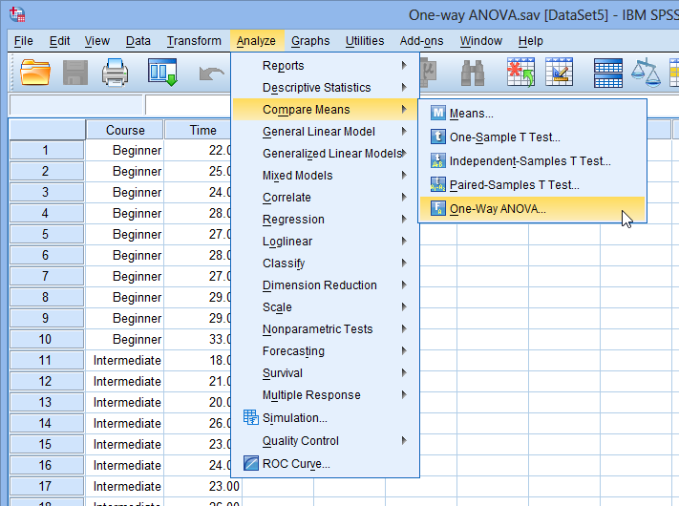
Test Procedure in SPSS Statistics
Click Analyze > Compare Means > One-Way ANOVA.

Slide 13
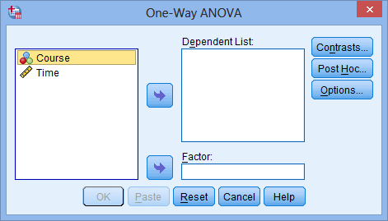
You will be presented with the following screen:

Slide 14
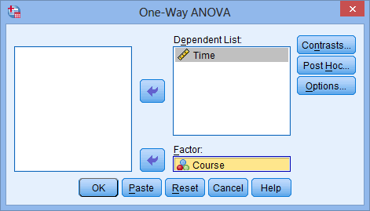
Test Procedure in SPSS Statistics (cont…)
Transfer the dependent variable (Time) into the Dependent List: box and the independent variable (Course) into the Factor: box using the appropriate buttons (or drag-and-drop the variables into the boxes), and click Post Hoc button, as indicted in the diagram below:

Slide 15
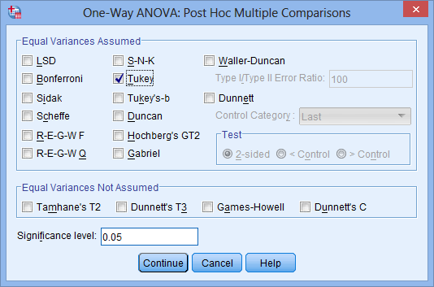
Click the
button, Tick the Tukey checkbox.
Click the button

Slide 16
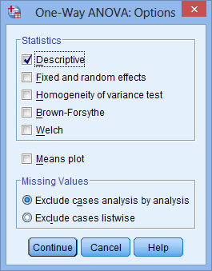
button. Tick the Descriptive checkbox in the –Statistics–area
Click the

Slide 17
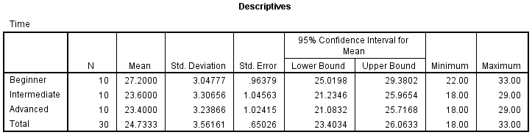
table provides some very useful descriptive statistics, including the mean, SD and 95% confidence intervals for the dependent variable (Time) for each separate group (Beginners, Intermediate and Advanced),

Slide 18
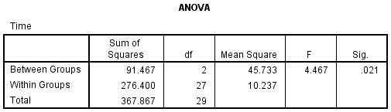
this table shows the output of the ANOVA analysis. We can see that the significance level is 0.021 (p = .021), which is below 0.05. therefore, there is a statistically significant difference in the mean length of time to complete the spreadsheet problem between the different courses taken

Slide 19
Multiple Comparisons table
Multiple Comparisons table, We can see that there is a significant difference in time to complete the problem between the group that took the beginner course and the intermediate course (p = 0.046), as well as between the beginner course and advanced course (p= 0.034).
However, there were no differences between the groups that took the intermediate and advanced course (p= 0.989).

Slide 20
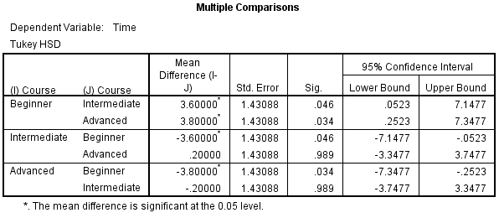
Multiple Comparisons Table

Slide 21
Reporting the output of the
one-way ANOVA
There was a statistically significant difference between groups as determined by one-way ANOVA (F(2,27) = 4.467, p = .021).
A Tukey post-hoc test revealed that the time to complete the problem was statistically significantly lower after taking the intermediate (23.6 ± 3.3 min, p=
.046) and advanced (23.4 ± 3.2 min, p= .034) course
compared to the beginners course (27.2 ± 3.0 min).
There were no statistically significant differences between the intermediate and advanced groups (p = .989).

