Slide 1
CONNECT WITH OTHERS AND YOURSELF

Slide 2
Introduction
According to Maslow’s hierarchy of needs, our need to belong is secondary only to our survival needs (Crandall et al., 2020).
The attachment theory further explains that a trusting connection needs to be there for a child to connect with a caregiver.
As such connecting with others is fundamental just as connecting to oneself.
The absence of the two or any of the two usually has damning effect on an individual’s life. The two always go hand in hand; when one is unable to connect with others it does mean that he or she might have difficulty in knowing himself.
There absence results in stress and anxiety which can be mitigated.
Sometimes anxiety may result to one being a perfectionist especially in instances where is not able to connect with others and sometimes to problems.

Slide 3
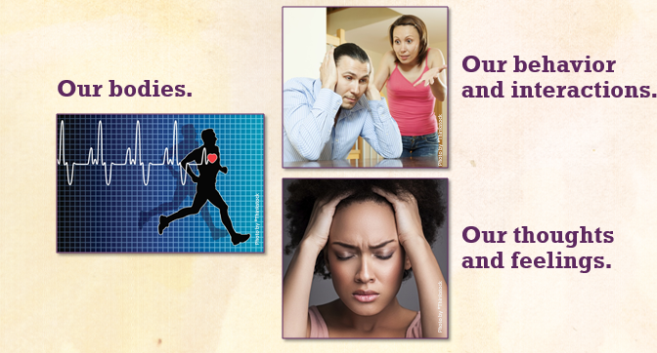
The effects of Anxiety on our Bodies
When one is anxious:
Blood pressure rises
Sleeping becomes more of a problem
Heart rate pulse rises (Radix et al., 2019)
Palpitation
Muscle tension or pain
Chest pain
Fatigue

Slide 4
Mitigating Anxiety
Plan for tomorrow
Write down your dreams
Participate in small repetitive activities
Embrace, Release Your Feelings
Deep breathing
Mindful meditating
Sensory stimulation
Exercise

Slide 5

Plan For Tomorrow
Spending at least fifteen minutes to organize oneself is always helpful in reducing anxiety.
Making a to-do-list or a timetable for the case of student does not just reduce stress but helps one focus on an activity that will make one feel productive.
It reduces confusion and makes one feel more in control. Planning sets a free stress tone for the rest of the day or exam period for students

Slide 6

Write Down Dreams
It is through dreaming that we can receive direct communications from our deeper self.
The stories and images that we create every night answers and offers us insights, clarity, healing, and course corrections.
Though they might be random and nonsensical, dreams are usually deliberate and full of meaning. Thus, the more interest shown, the easily one might remember them, and the more revelatory they will be.
Writing them down gives one a sense of having purpose in life and confidence thus reducing anxiety

Slide 7
Participating in Small Repetitive Activities
Studies have shown that simple, repetitive activities work well at reducing anxiety. This can anything from reading novels, cleaning, to doodling or even travelling. Some even enact this by reciting a persona l mantra.
The key is repetitive physical or mental motions which help your mind focus on an activity that initiates relaxation.

Slide 8
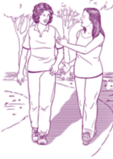
Embrace, Release Your Feelings
This may include daily journaling, or talking to someone close to you about your feeling.
It is usually not a good idea to dwell so much on anxiety . It is advisable that an individual takes few minutes to talk to someone he or she trusts concerning the anxiety issue and how you are dealing with it can be great for reducing stress (Rodriguez et al., 2020).
Talking to another person allows one to confront and understand your feelings and probably suggest a perfect course of action to address the anxiety.

Slide 9
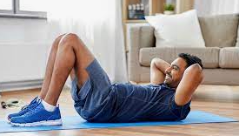
Exercise
One of the most commonly suggested method for easing stress has been doing exercise. Its recommendation has largely been attributed to its proven efficiency in relieving stress. Time and time again.
Even if one does not like doing exercise, it is recommended that an individual sets aside just 15 minutes for stretches, quick work, run or yoga poses to ease stress or any anxiety

Slide 10
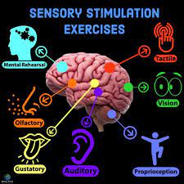
Sensory Stimulation
When one is having a particularly bad bout of anxiety, dwelling too much on the stressful thoughts may not help in relieving the anxiety . The activities that one engages in draws ones mind and focus thus taking off the mind off the anxiety making the individual to cope.

Slide 11

Deep Breathing Techniques
Deep breathing techniques form a vital part of yoga and it does help with panic attacks, and they can also be utilized anytime to help relief one from anxiety, or even make him go to sleep. There are several techniques available, thus one can try and figure out which technique works best.

Slide 12

Mindfulness Meditation
Mindfulness meditation is easy to learn, and it involves a low time commitment. It focuses much about one being aware of oneself. It focuses intently on ones breathing patterns, senses, and body and letting go of worries involving the past and the future.

Slide 13
References
Rodriguez, R. M., Medak, A. J., Baumann, B. M., Lim, S., Chinnock, B., Frazier, R., and Cooper, R. J. (2020). Academic emergency medicine physicians' anxiety levels, stressors, and potential stress mitigation measures during the acceleration phase of the COVID‐19 pandemic. Academic Emergency Medicine, 27(8), 700-707.
Crandall, A., Powell, E. A., Bradford, G. C., Magnusson, B. M., Hanson, C. L., Barnes, M. D., and Bean, R. A. (2020). Maslow’s hierarchy of needs as a framework for understanding adolescent depressive symptoms over time. Journal of Child and Family Studies, 29(2), 273-281.
Radix, A. K., Rinck, M., Becker, E. S., and Legenbauer, T. (2019). The mediating effect of specific social anxiety facets on body checking and avoidance. Frontiers in psychology, 9, 2661.

