Slide 1
Final Presentation
Name:
Course title:
Course Code:
School Affiliation:
Professor:
Date:

Slide 2
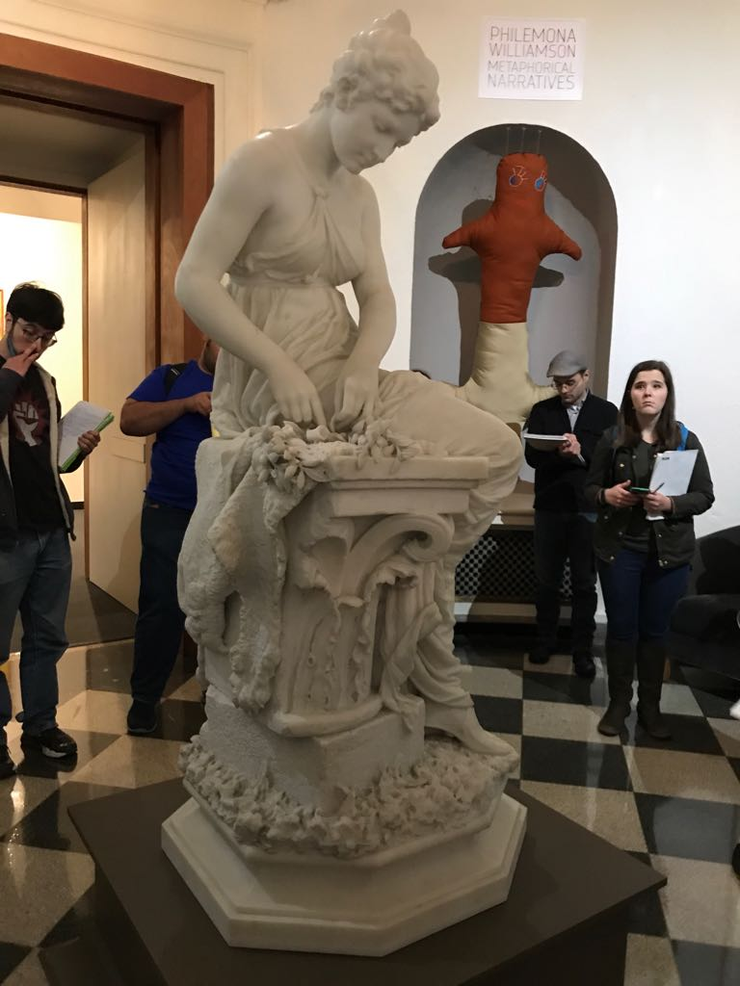
Background
This is the gallery (museum’s Rotunda) it will be used as the designated area for the assignment). the sculpture will be in the center of the gallery. This picture shows on of the four alcoves that designed in the gallery, where we going to display the objects. In this case the objects should be able to fit comfortably in the alcove

Slide 3
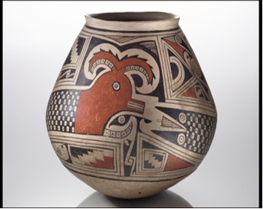
Object handled as a local transit
Native American art work , from the national museum of the American Indian.
                Wear gloves when handling the object with glazed, polished or highly finished surfaces. Cotton gloves are often recommended, but they are not always appropriate because they can make it harder to hold onto slippery glass surfaces. Clean, close-fitting surgical gloves are a good alternative to cotton gloves.
                The object is a fragile object and needs extra care. It needs to be carried in a carrying box. Plastic cube crates are ideal for this. A trolley can also be helpful.

Slide 4
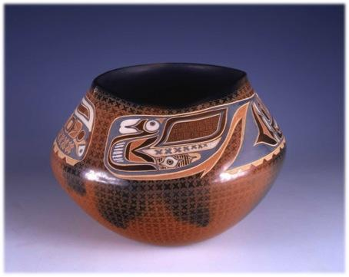
Object treated as coming from the MAM vault
Native American art work , in the MAM (monticair museum)
Since the art work is coming from a vault, the building
might have a series of arches. Underground storage m
may also be used. So it is important to have both the
tools to access the museum storage and store the art
These tools include; a ladder, basket, trolley. When
one could use a carton and a pair of gloves to handle
the art work.

Slide 5
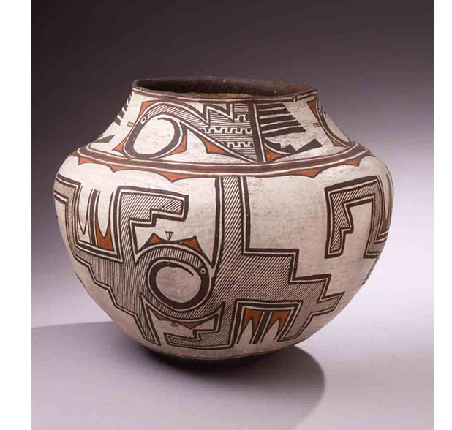
Object treated as if coming from out of state
Native American art work , in the Newark museum. Because this artifact might involve a lot of travelling, it is important to ensure that the time the art work is in travel is safe either by air, road or shipping.
The courier trip will need a suitcase, Polythene bags netting, cargo box/container or crates. The museum management staff an be involved in order to aid in the process.
There is also the need for shipping brokers who will aid in the whole process of booking for the shipment, payment of the rates and taxes, duties and so forth.
The pick up location to MAM Airport will be Brownsville
The desired packing method will be use of a cargo cabinet which will be 50 cm by 50 cm.

Slide 6
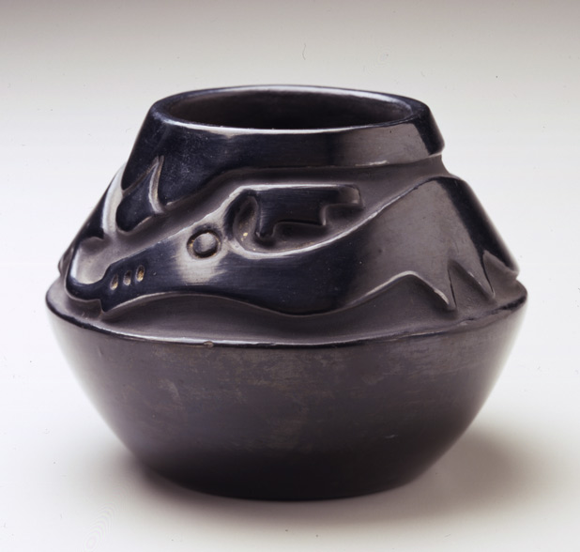
Object ear-marked for acquisition
This object will stay on the premises for longer after if has been accepted by the “Next art committee.”

Slide 7
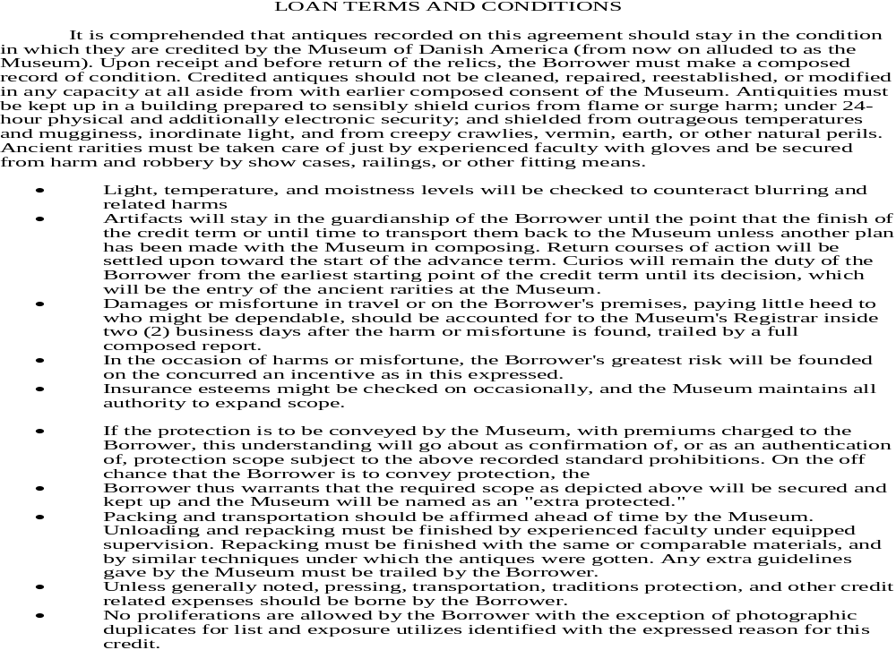
Object ear-marked for acquisition addendum (Cont)

Slide 8
Required documents for submission
1. Illustrated checklist

Slide 9
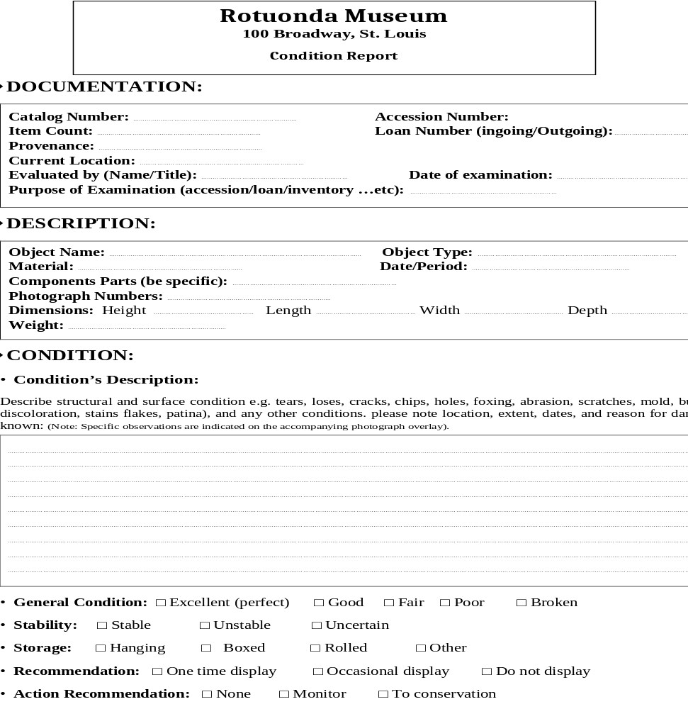
2. Condition reports (Page 1)

Slide 10
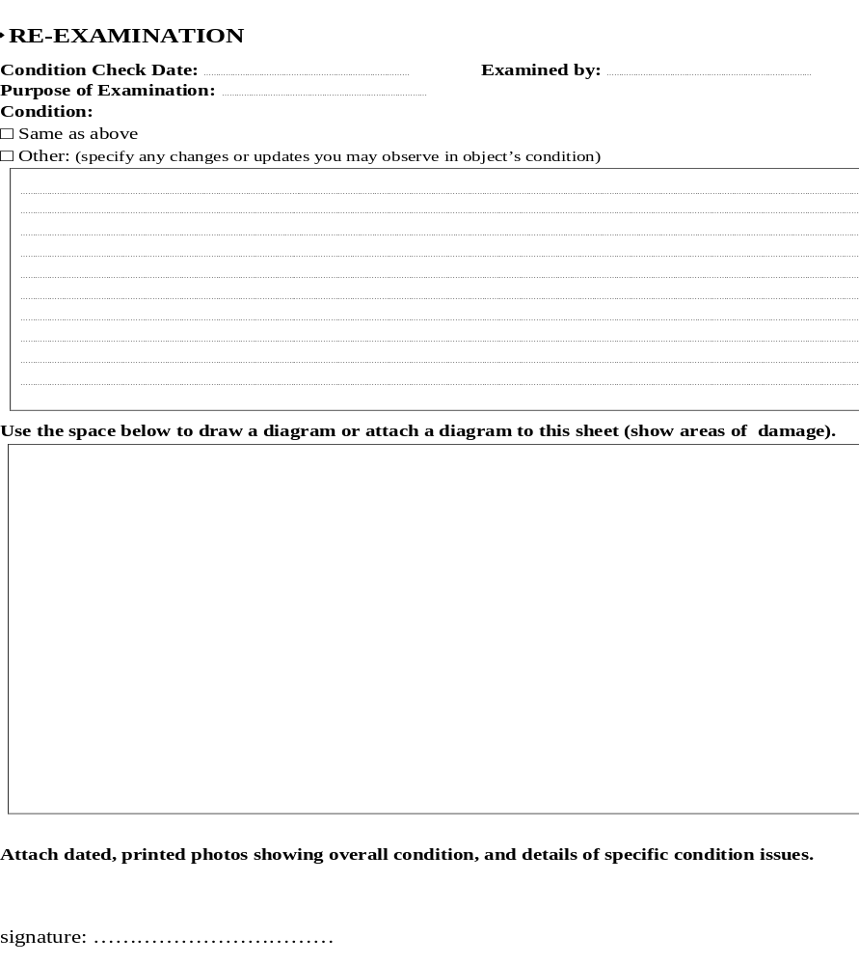
2. Condition reports(Page 2)

Slide 11
3. Annotated checklist

Slide 12
4. Possible conservation needs and conservator submission

Slide 13
5. Installation instructions

Slide 14
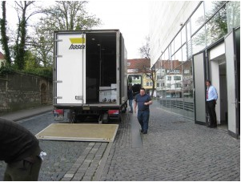
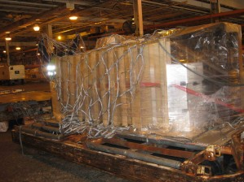
6. Packing method for objects
A cargo container is one of the best methods that can be used to pack the art work. It is safe and secure and breakages of the art works is minimized

Slide 15
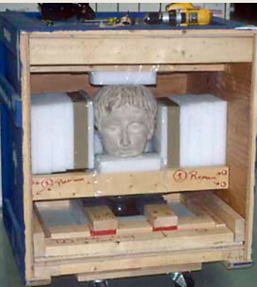
6. Packing method for objects(Continue)
Hard shell crate with removable bottom tray and PE foam blocks attached to inner walls can be used in the packaging of the artifacts. Screws for uncrating are clearly marked in order of importance

Slide 16
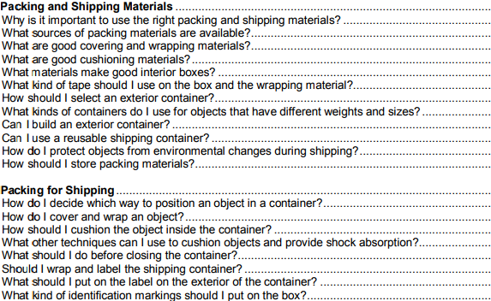
7. Shipping proposal schedule

Slide 17
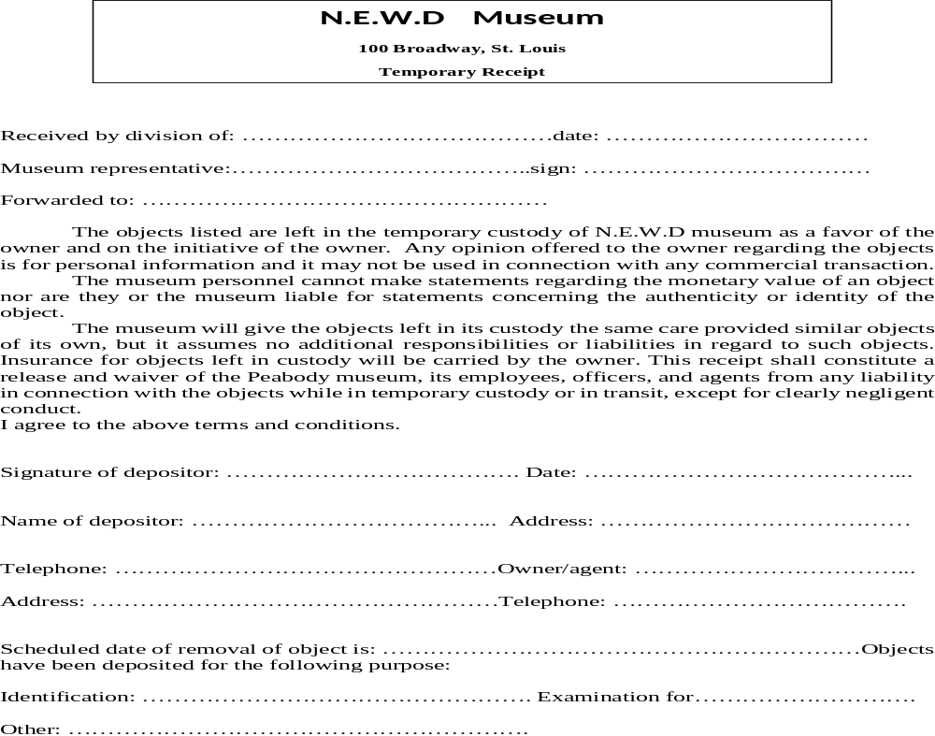
8. Receipts

Slide 18
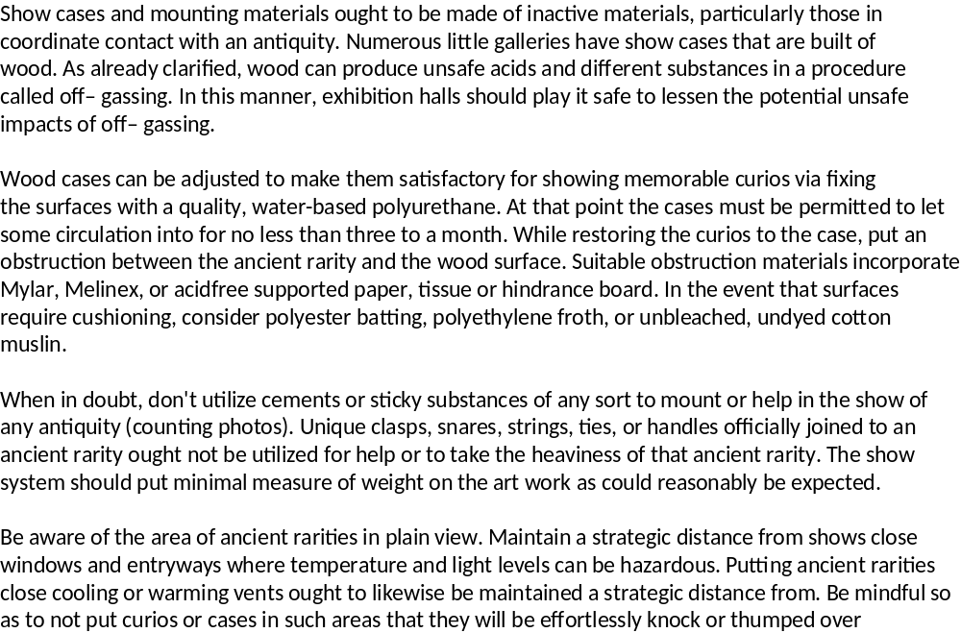
9. Propose display methods

Slide 19
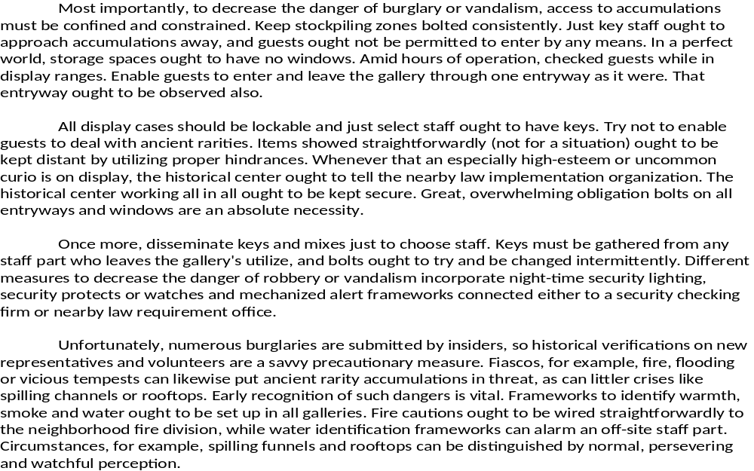
10. Security requirement

Slide 20
11. Installation schedule

Slide 21
12. De-installation schedule

Slide 22
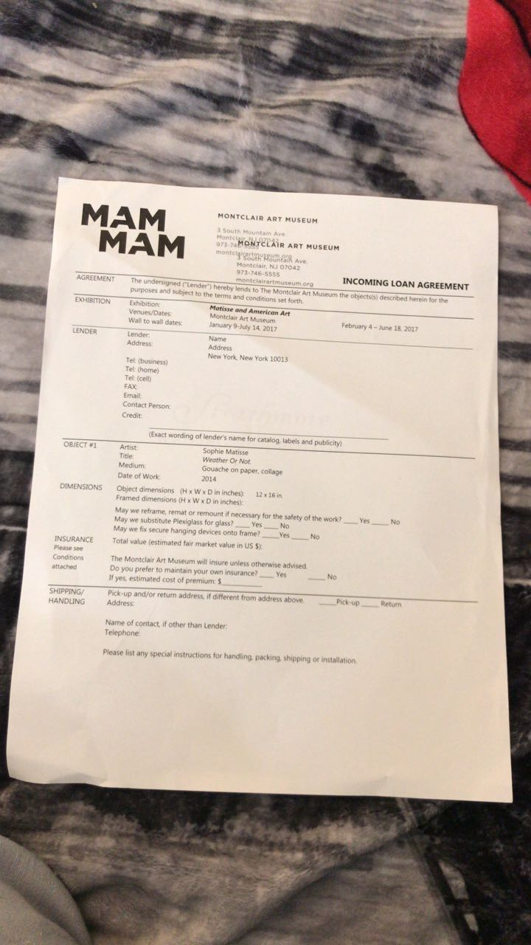
Discussion: Loan agreement
Loan agreement

Slide 23
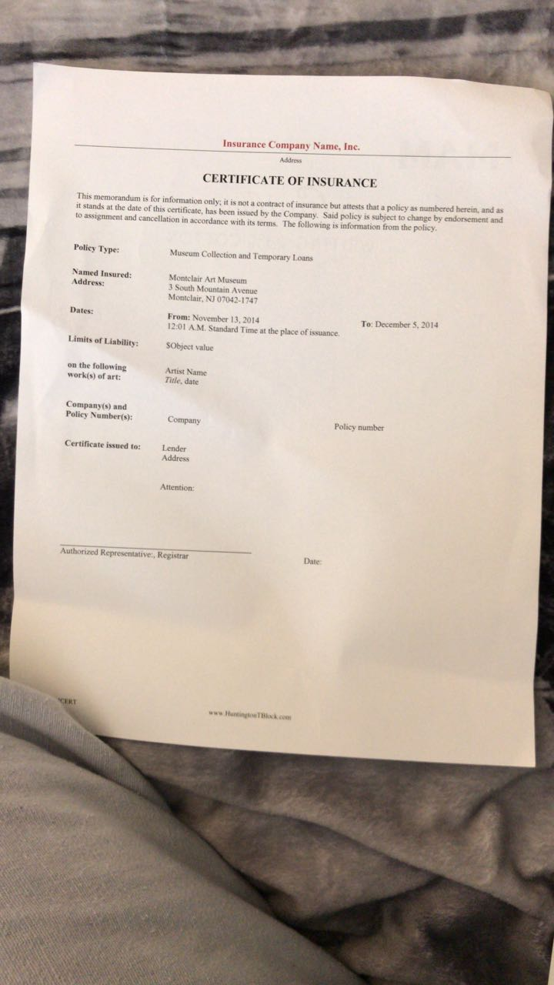
Discussion: Insurance certificate
Loan agreement

Slide 24
Discussion: Receipts
Loan agreement

Slide 25
Q and A
Time for the Audience to asks questions.
Welcome

