Slide 1
ART ACTIVISIM ON POLLUTION
Name:
School:
Professor:
Date:

Slide 2
Pollution and its Effects
Air contamination alludes to the introduction of poisons into the air that are hindering to human wellbeing and the planet at large. Most air contamination originates from energy utilization and manufacturing/production. Consuming non-renewable energy sources discharges gases and chemicals into the air." Air contamination adds to environmental change e.g., the carbon dioxide and methane raises the world's temperature. Another kind of air contamination is intensified warmth: Smog frames when the climate is hotter. Climate change additionally builds the creation of allergenic air toxins and dust. Impacts of air contamination incorporate asthma attack to individuals, death of creatures, body infections, among others (Rao & Rao, 2016).

Slide 3
Consequences of Long-term Pollution
Alongside people, creatures running from modest microorganisms to huge vertebrates are likewise reliant on oxygen that is gotten from the air. At the point when polluted air is breathed in for breathing oxygen, a few hurtful gases are likewise breathed in alongside it. These hurtful gases influence creatures in an indistinguishable way. Specialists additionally propose that the particulate issue that the creatures breathe in causes distress in their tissues and harm their organs over the long haul. Other than breathing in the hurtful contaminants specifically, creatures can likewise interact with these contaminants from the nourishment that they eat and by assimilation through their skin. Imperatively, creatures are more defenseless against this issue when contrasted with us people, as they are not all around prepared to shield themselves from air pollution as we may be. For instance the demise of the Bristol whale subsequent to eating little plastic particles (Chen, et. al, 2016).

Slide 4
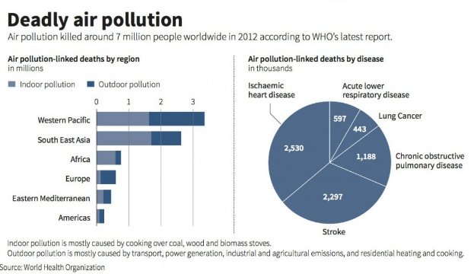
Statistics in diseases that are related to the air (Chen, 2016)

Slide 5
What should worry the world about Air Pollution
What should stress whatever remains of the world is the rate of contamination that is influencing both human and creatures on the planet. At the rate at which the air is being dirtied, these creatures won't get an opportunity to adjust to the adjustments in nature. In the long haul, these impacts will trigger eradication of species, in a steady progression. Thus, will add to our hardships considering that we alongside every one of these creatures, that are in a bad way today, shape the complex natural system wherein all species are reliant on each other (Valentine, 2015).

Slide 6
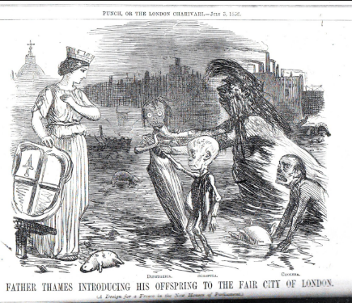
Environmental Pollution Art Activism (Primary Source)
This powerful artistic image on pollution describe the city of London in 1851. It has a powerful image that would become a dominant metaphor for the criticism of the England’s Judicial system for failure to take action on environmental condition of the city. London’s fog resulting from warm air mass and condensation (Poloniecki, et. al, 1997).

Slide 7
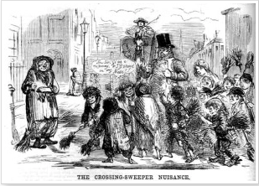
Environmental Pollution Art Activism (Primary Source)
The image below shows a couple of sweepers taking into the London streets in 1856 to sweep the horse manure which had become a menace. It contributed to dust and air pollution which affected human beings and animals in the city. the horse manure contributed to a tainted environment (SSchwartz & Marcus, 1990).

Slide 8
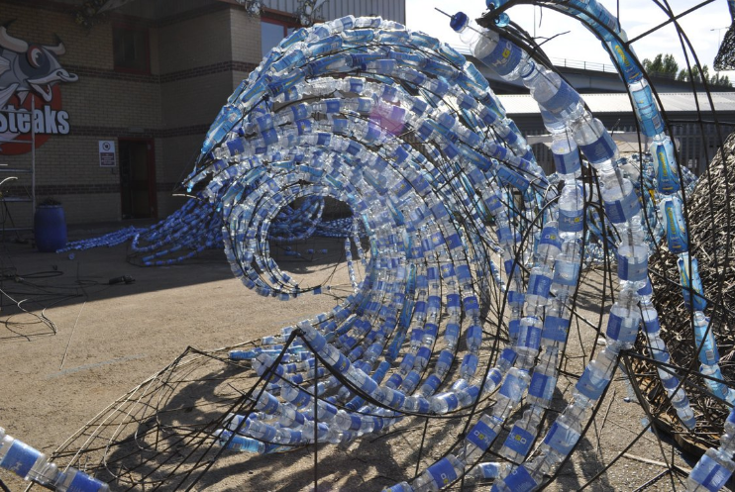
Environmental Pollution Art Activism (Secondary Source)
This artistic work of activism was done after the death of the Bristol whales. It is part of a complain for a greener environment and responsible dirt collection and recycling and particularly to ocean pollution caused by human activities (Marshall, et. al., 2014).

Slide 9
Reference
Chen, W., Zheng, R., Baade, P. D., Zhang, S., Zeng, H., Bray, F., . . . He, J. (2016, January 25). Cancer statistics in China, 2015
Cutts, S. (2012, December 21). MAN.
Marshall, J., Donahue, D. M., Ayers, R., & Hetland, L. (2014). Art-centered learning across the curriculum: Integrating contemporary art in the secondary school classroom.
Poloniecki, J. D., Atkinson, R. W., de Leon, A. P., & Anderson, H. R. (1997). Daily time series for cardiovascular hospital admissions and previous day's air pollution in London, UK. Occupational and environmental medicine, 54(8), 535-540.
Rao, M. N., & Rao, H. V. N. (2016). Air pollution. New Delhi: Tata McGraw-Hill Pub.
SSchwartz, J., & Marcus, A. (1990). Mortality and air pollution j london: a time series analysis. American journal of epidemiology, 131(1), 185-194.teaks, C. (2015, July 30). THE BRISTOL WHALES.
Valentine, K. (2015, August 12). China's Air Pollution Is Traveling To The United States.

