Slide 1
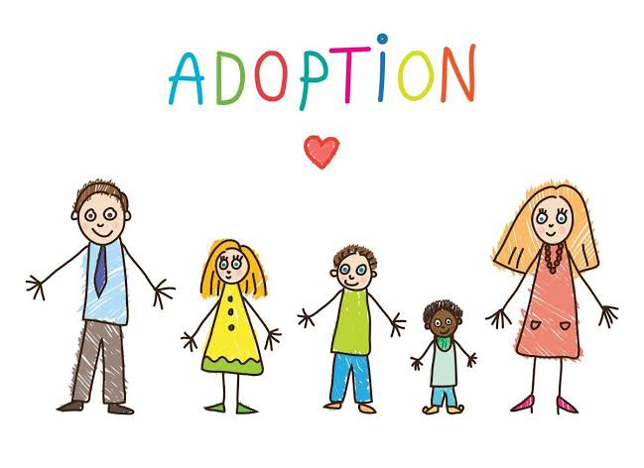
Adoption

Slide 2

Adoption
Adoption is the legal process of taking parenting responsibility of a child biologically belongs to another parent (Selman, 2009).

Slide 3

Relevance of adoption
Adoption gives children an opportunity to children who are orphaned to experience parental care, love and support by being brought up in a family that is full of love.

Slide 4

Relevance of adoption
Adoption is an opportunity for people who wants to take up parental responsibilities by having a child of their own to love and nature (Brodzinsky, 2011).

Slide 5

Relevance of adoption
Adoption gives children a better shot at life in the event their biological parents are not stable enough to cater for their wellbeing and needs (Briggs, 2012).

Slide 6

Challenges of adoption
Adopted children are faced by social stigma. It is for the parent and society to protect such children who never asked to be orphaned or be born a state putting them up for adoption (Brodzinsky, 2011).

Slide 7

Conclusion
Blood is thicker than water in matters family. Adoption is a way to spread hope and happiness to people by bringing together two pieces of a puzzle (a parent and a child) (Selman, 2009).

Slide 8
Reference
Briggs, L. (2012). Somebody's children: The politics of transracial and transnational adoption. Duke University Press.
Brodzinsky, D. M. (2011). Children's understanding of adoption: Developmental and clinical implications. Professional Psychology: Research and Practice, 42(2), 200.
Selman, P. (2009). The movement of children for International adoption. International adoption: Global inequalities and the circulation of children, 32.

