Slide 1
Advance Statistics: Introduction
Statistics and Parameters

Slide 2
Reflections Questions
What are the two major fields of statistics?
List the measures of central tendencies, variability, and relative position?

Slide 3
Chapter 1: Introduction to Statistics
General Field of Statistics: Two Sub-divisions
1. Descriptive Statistics involves techniques for describing data in abbreviated, symbolic fashion. (Examples; ACT score 21 and SAT score 500)
2. Inferential Statistics involves making predictions of values that are not really known. It makes use of a small number of observations to predict to, or infer the characteristics of, an entire group.

Slide 4
Chapter 7 – Statistics and Parameters
Statistcs
Generalizing from the Few to the Many
The main thrust of inferential statistics is based on measuring the few and generalizing to the many. That is, observations are made of a small segment of a group, and then, from these observations, the characteristics of the entire group are inferred.

Slide 5
Chapter 7 – Statistics and Parameters
Key Concepts of Inferential Statistics
Population, or universe, is defined as a entire group of persons, things, or events having at least one trait in common.
Parameter is any measure obtained by having measured an entire population.
Sample is a smaller number of observation taken from the total number making up the population.
Statistic is any measure obtained by having measured a sample

Slide 6
Chapter 7 – Statistics and Parameters
Techniques of Sampling
Random Sampling
Stratified, or Quota, Sampling
Situation Sampling
Sampling Error
Outliers
Bias

Slide 7
Chapter 7 – Statistics and Parameters
Random Sampling demands that each member of an entire population has an equal chance of being included.

Slide 8
Chapter 7 – Statistics and Parameters
Stratified, or Quota, Sampling is a sampling technique wherein the researcher divides the entire population into different subgroups or strata, then randomly selects the final subjects proportionally from the different strata.

Slide 9
Chapter 7 – Statistics and Parameters
Situation Sampling is employed when the researcher collects observations in a variety of settings and circumstances.

Slide 10
Chapter 7 – Statistics and Parameters
Sampling Error occurs whenever a sample is selected assumptions are made that the sample measures will not precisely match those that would be obtained if the entire population were measured.

Slide 11
Chapter 7 – Statistics and Parameters
Outliers occurs when one or two scores in a large random sample fall so far from the mean such as three or four standard deviation units away. Outliers indicate either that the distribution is not normal or that some measurement error has crept in.

Slide 12
Chapter 7 – Statistics and Parameters
Bias occurs whenever the sample differs systematically from the population at large. It is technically defined as a constant difference, in on direction, between the mean of the sample and the mean of the population since researchers deal in averages.

Slide 13
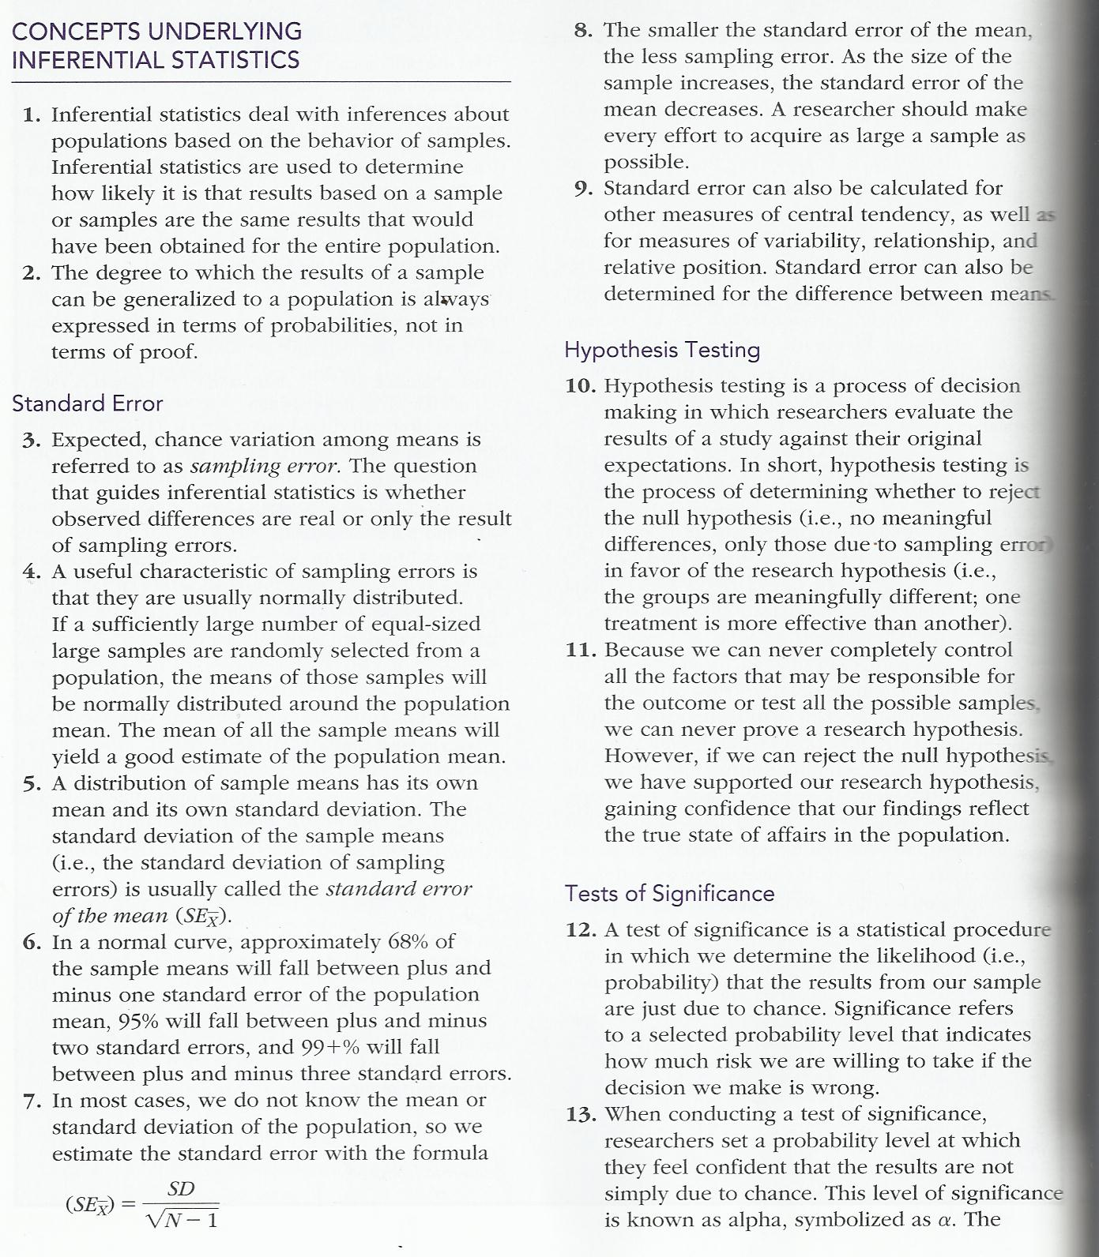
Chapter 7

Slide 14
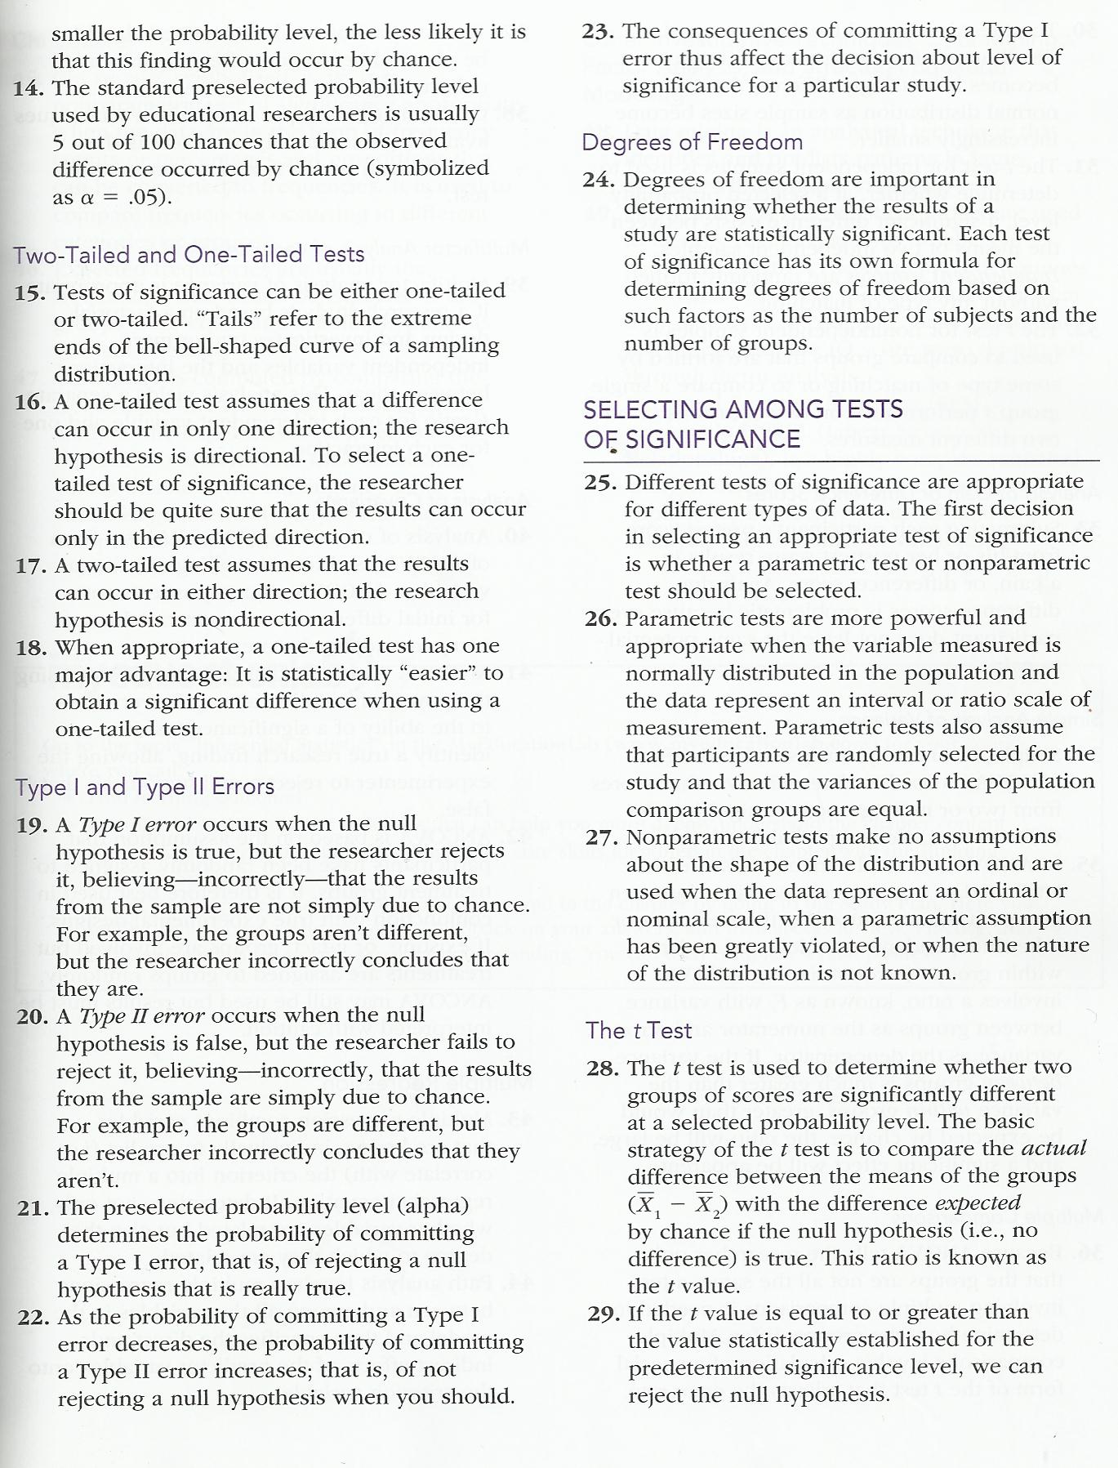
Chapter 7

Slide 15
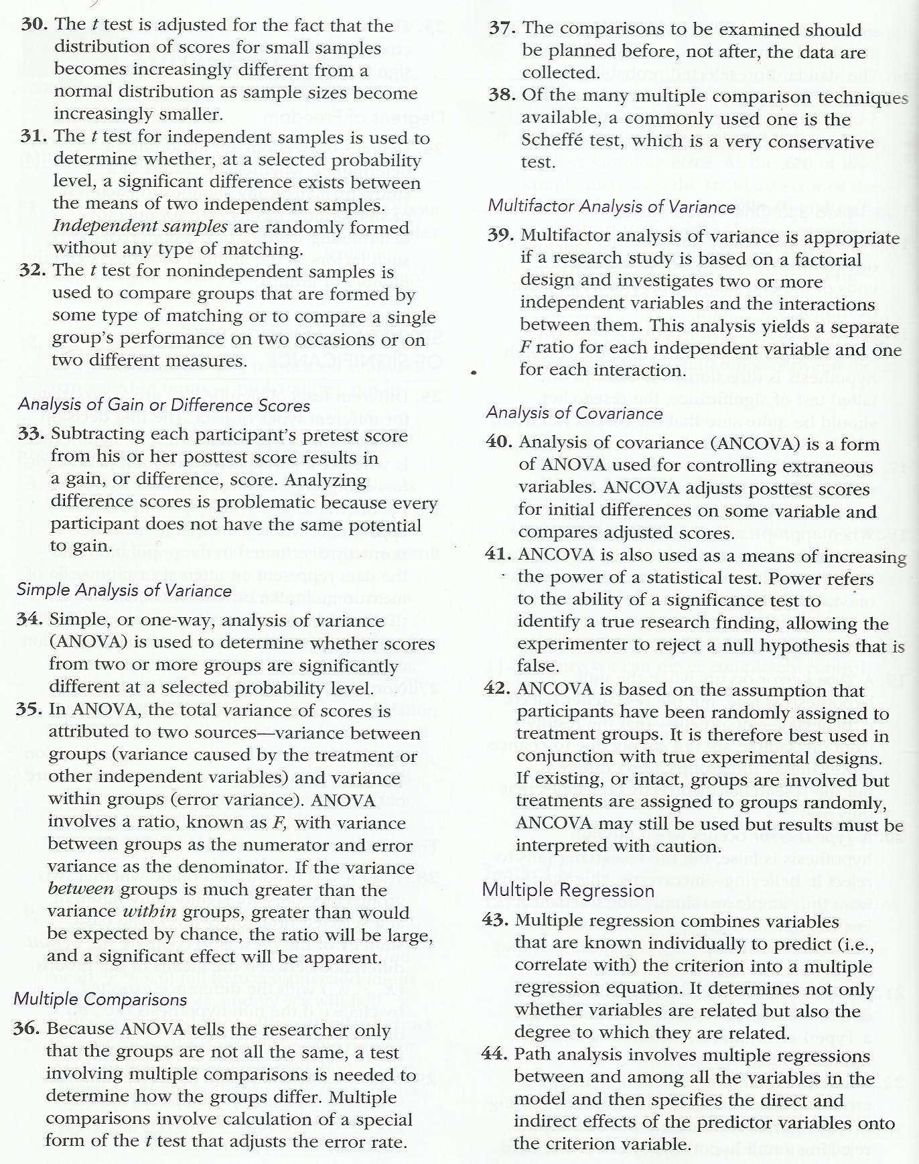
Chapter 7

Slide 16
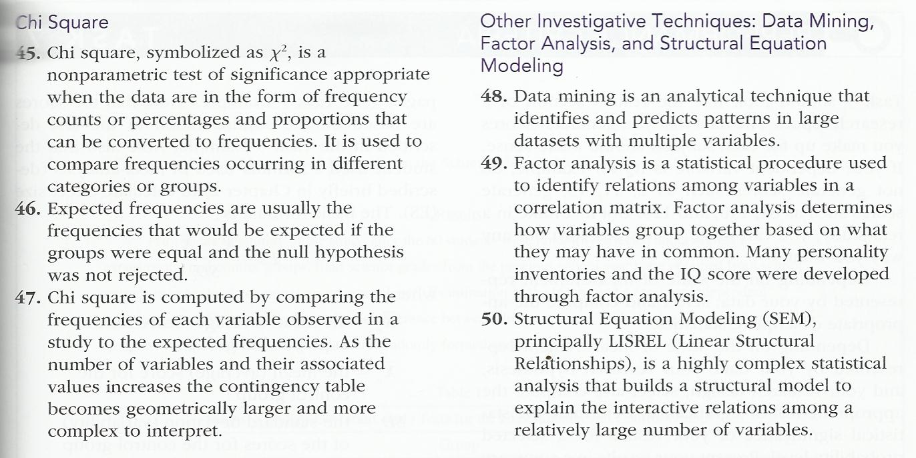
Chapter 7 – Statistics and Parameters

Slide 17
Chapter 7 – Statistics and Parameters
Sampling Distributions
Mean of the Distribution of Means
Standard Deviation of the Distribution of Means
Standard Error of the Mean
Central Limit Theorem

