Slide 1
Creating an Advert
Student’s Name
Institution

Slide 2
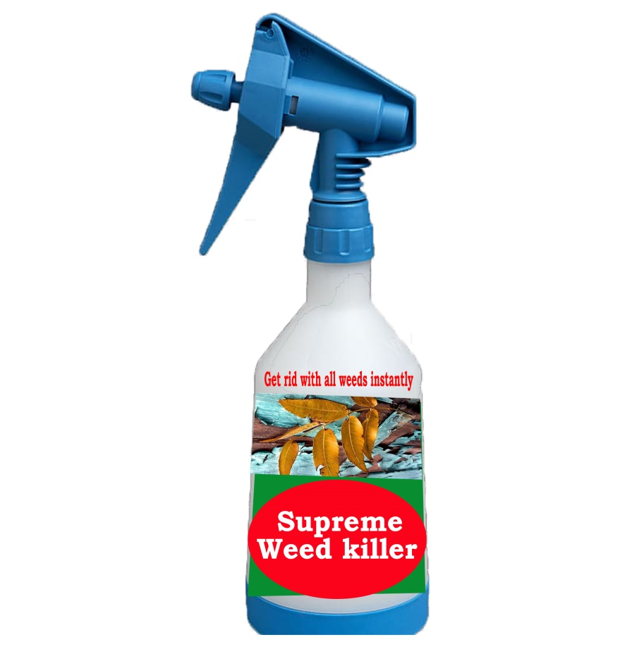
Introduction
Supreme weed killer is a brand new weed killer that kills all types of farm weeds.

Slide 3

Copy
Supreme weed killer will get rid of all farm weeds and increase your farm production. The product is cheap and kills the weeds faster than any other known weed killer.

Slide 4

Layout
This ad has been created using Photoshop software
It is a combination of Google photos combined with shapes and text effects.

Slide 5

Story/Idea
The advert carries a message to the farmers. It gives them a source of solution to stubborn weeds.

