Slide 1



Slide 2
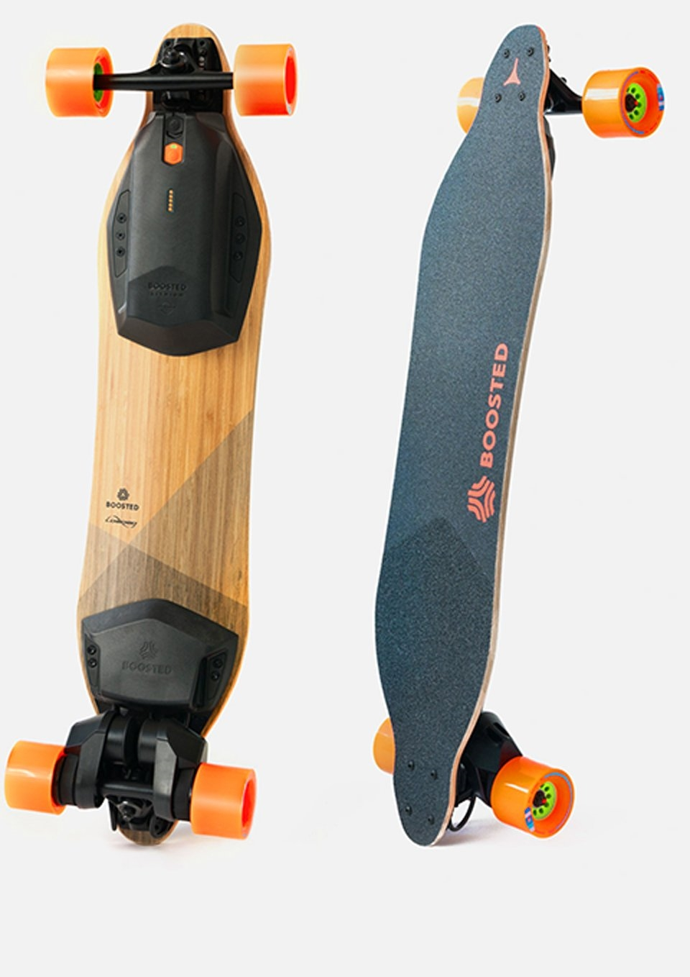
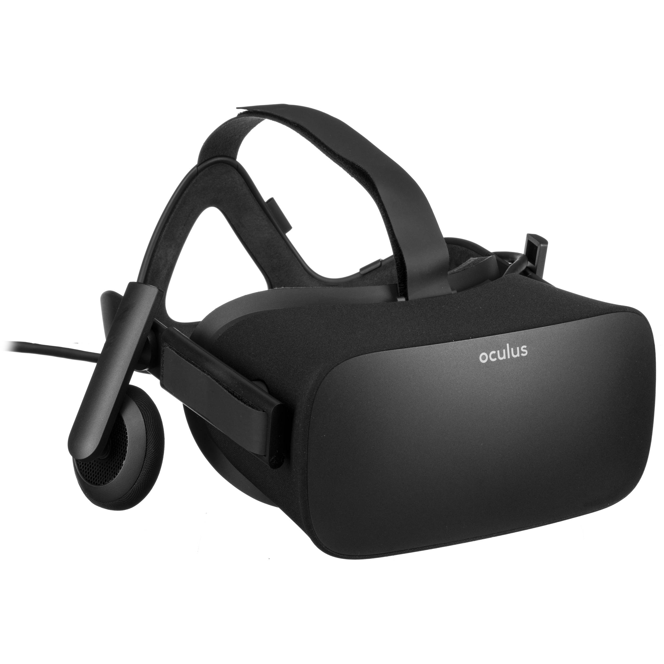

Why This Data Set?
Rise in entrepreneurship
  Crowdfunding is a crucial aspect in the creation of a project
    What does it take, statistically speaking, for a successful launch?
Kickstarter is one of the leading crowdsourcing platforms today
  Focusing on creativity and merchandising
    "[Kickstarter] help[s] bring creative projects to life"
(Mission Statement)
Boosted Board
Oculus Rift

Slide 3
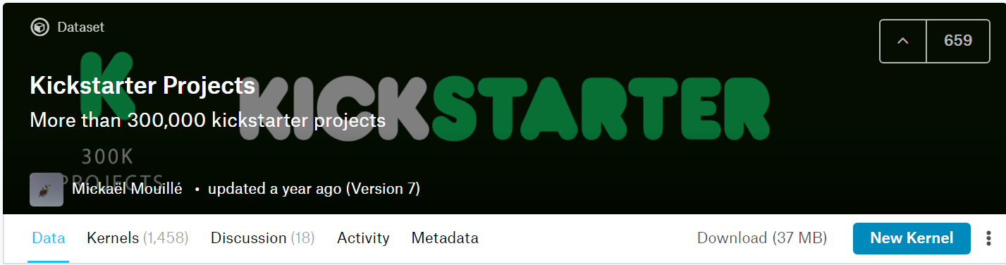
The Data
We used 219,064 cases
  Whole data set = 321,616 cases
Pruning
  Deleted random sample to get 250,000 (Roughly ⅓)
  Deleted observations with states of: live, undefined, suspended, cancelled = 30,936
    Only kept states of: successful and failure
Recode
  State: Successful = 1 ; Failure = 0
New variable created:
  # of Days on Kickstarter = Deadline Date - Launch Date
Notes:
Say why we kept successful and failure

Slide 4
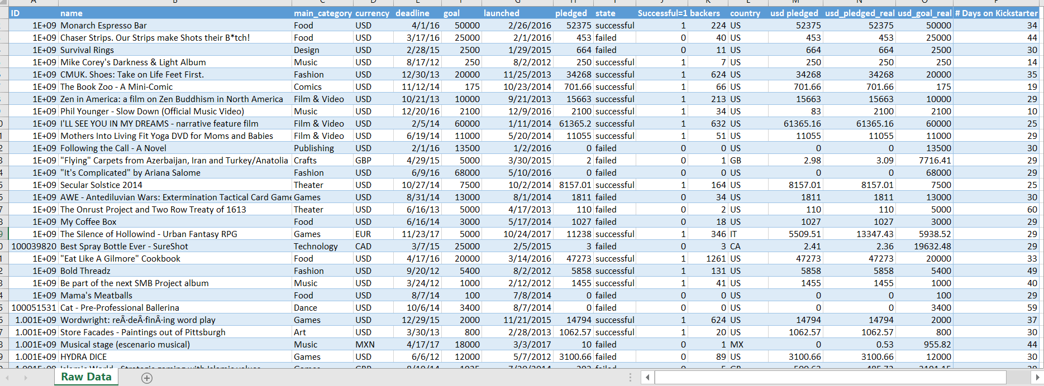
Hypothesis Driven
Hypothesis driven
50% of time = data management
50% of time = data analysis
Outcome Measure:
  Success or Failure
Hypotheses:
  High # of backers led to a successful campaign (Dichotomous Dep. Var.)
  More days on Kickstarter led to a successful campaign

Slide 5
The Variables
Dependent Variable = Successful=1
  Success/failure
Independent Variables:
  Quantitative:
    Goal
    Pledged
    # of Backers
    # of Days on Kickstarter
  Categorical:
    Main Category
    Country

Slide 6
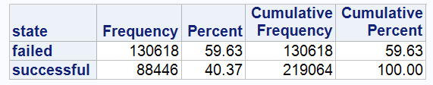
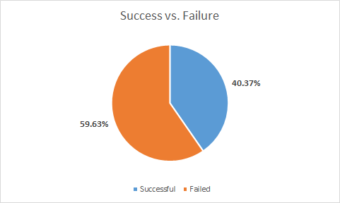

Kickstarter Projects: Failed vs. Successful

Slide 7
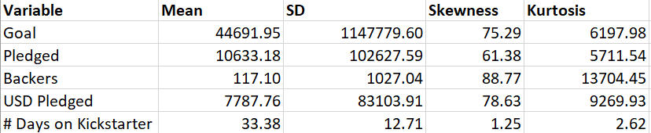
Mean, SD, Skewness, Kurtosis
Mean:
SD:
Skewness: well above 2 as ….
Kurtosis: well above 2 as ….
Notes:
Analysis
Show graph of data set

Slide 8
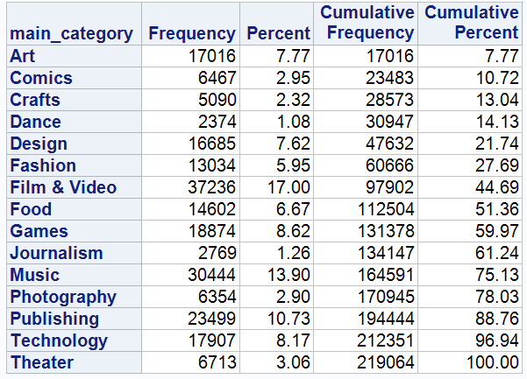
“Main_Category”
Variables
Notes:
Add histogram

Slide 9
T-Test

Slide 10
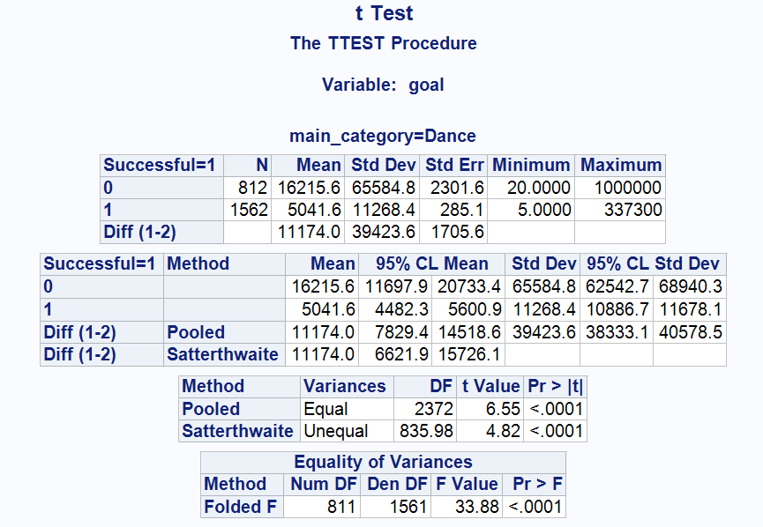
Dance Data
Mean, SD, Skewness, Kurtosis of each

Slide 11
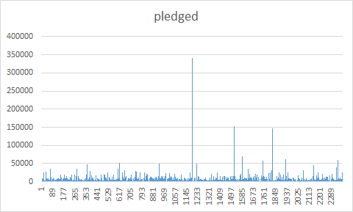
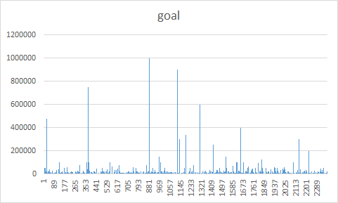
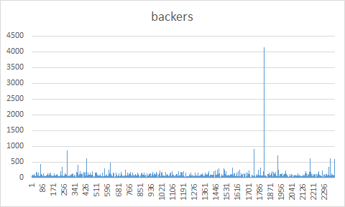
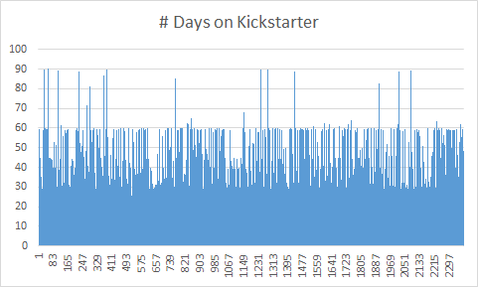
Dance - Histograms

Slide 12
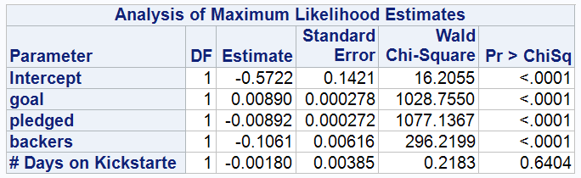
Dance Data - Odds Ratio Analysis
p < .05= stat significant
0.05 < p < .10= trend
.10< p= not significant
No Relationship when overlapping of 1
Goal, pledged & backers are significant
# of Days on Kickstarter is not significant
Notes:
-change to dance + Music

Slide 13
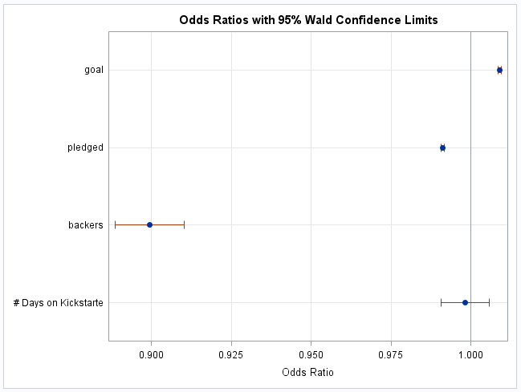
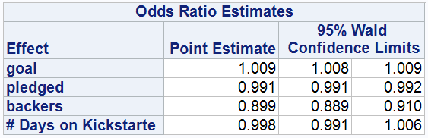
Dance Data - Odds Ratio cont.

Slide 14
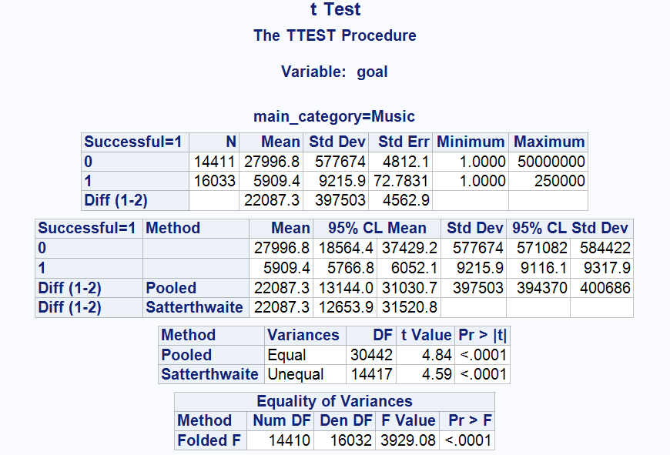
Music Data
Mean, SD, Skewness, Kurtosis of each

Slide 15
Music - Histogram

Slide 16
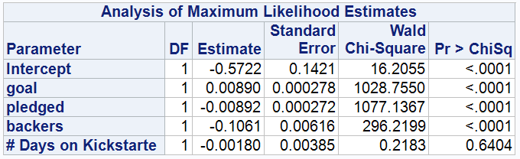
Music Data - Odds Ratio Analysis
p < .05= stat significant
0.05 < p < .10= trend
.10< p= not significant
No Relationship when overlapping of 1
Goal, pledged & backers are significant
# of Days on Kickstarter is not significant

Slide 17
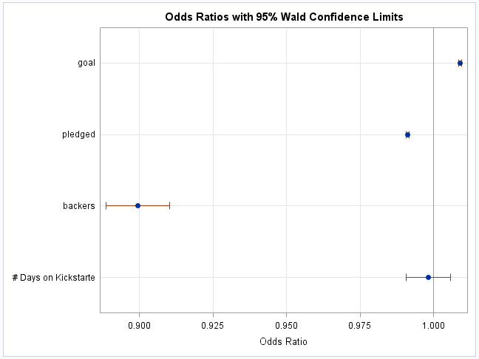
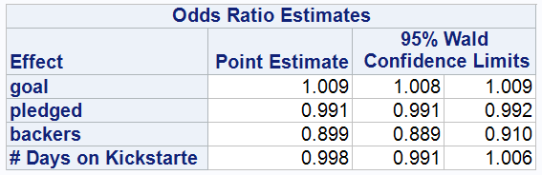
Music Data - Odds Ratio cont.

Slide 18
Theater

Slide 19
Conclusion

Slide 20


