Slide 1
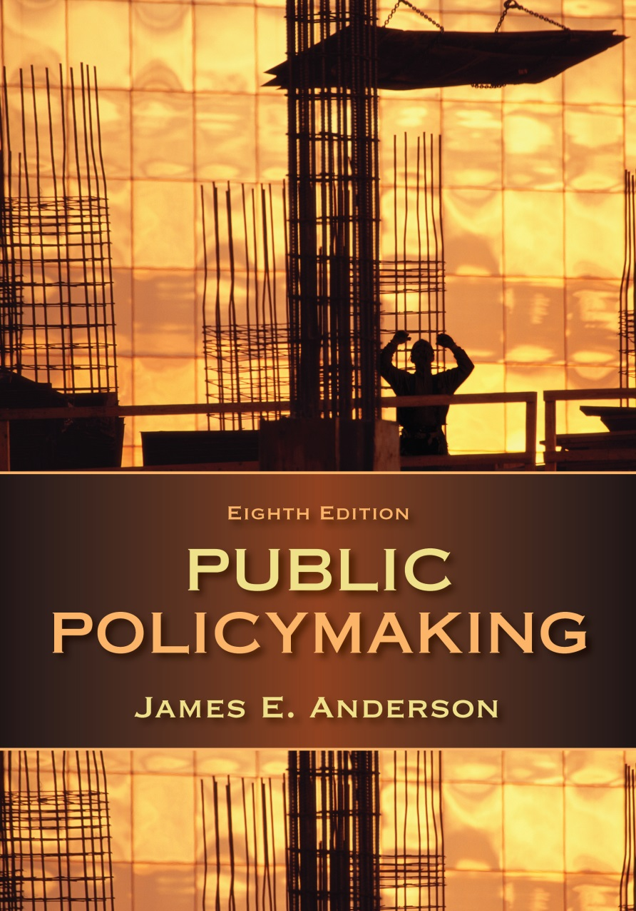
PAD3034
Chapter 4
Policy Adoption

Slide 2
Introduction
Policy adoption: involves action on a preferred alternative that can win approval, not selection from among full-blown alternatives
Adoption process gives policies the “weight of public authority”
  Grants legitimacy to the policy
Notes:
The formal authority to decide rests with public officials: legislators, executives, administrators, and judges.

Slide 3
Today’s Topics
Decision-making
  Theories
  Criteria
  Styles
Presidential decision-making

Slide 4
Theories of Decision-Making₁
Rational-comprehensive
Incrementalism
Mixed scanning
Each entails an empirical description (how decisions are made) and a normative statement (how they should be made)

Slide 5
Theories of Decision-Making₂
Rational-Comprehensive Theory
  Specifies procedures involved in making well-considered decisions
  Goal is to maximize the attainment of goals (personal or organizational)
  Not rational choice theory!
Notes:
Rational decisions may make either large and basic or limited changes in public policies.

Slide 6
Theories of Decision-Making₃
Criticisms of rational-comprehensive theory:
  Decision-makers
    Do not face clearly defined problems
    Lack required intellectual capacity
    Are usually confronted by value conflict, not value agreement
    Face “sunk costs”
    Are not unitary actors
Notes:
What are the barriers to rational action?

Slide 7
Theories of Decision-Making₄
Incremental Theory
  Limited changes or additions to existing policies
    Easier to reach agreement between parties when only minor changes are made to existing programs
  Sequences of incremental changes can result in fundamental changes in public policy
Notes:
Why is incrementalism prevalent in pluralist societies such as the United States?

Slide 8
Theories of Decision-Making₅
Criticisms of incremental theory:
  Too conservative and focused on existing order
  Does not allow for crisis situations
  May discourage the search for or use of readily available alternatives
  Does not eliminate the need for theory in decision making

Slide 9
Theories of Decision-Making₆
Mixed Scanning approach
  Provides “high-order, fundamental policy-making processes which set basic directions and…incremental processes which prepare for fundamental decisions and work them out after they have been reached”
  Allows decision makers to use either rational-comprehensive or incrementalism depending on circumstances
Notes:
Mixed scanning also takes into account differing capacities of decision-makers.

Slide 10
Decision Criteria₁
Decision-making can be either individual or collective process
Influences:
  Values
  Party affiliation
  Constituency interests
  Public opinion
  Deference
  Decision rules

Slide 11
Decision Criteria₂
Values
  Organizational
  Professional
  Personal
  Policy
  Ideological
Notes:
Which type of values are often underestimated in their importance to decision making?

Slide 12
Decision Criteria₃
Political party affiliation
  Party loyalty
  Best predictor to how members of Congress will vote on legislative issues
  Influences the decisions of federal judges
Notes:
In recent years, the average legislator has voted with the majority of his or her party about three-fourths of the time.

Slide 13
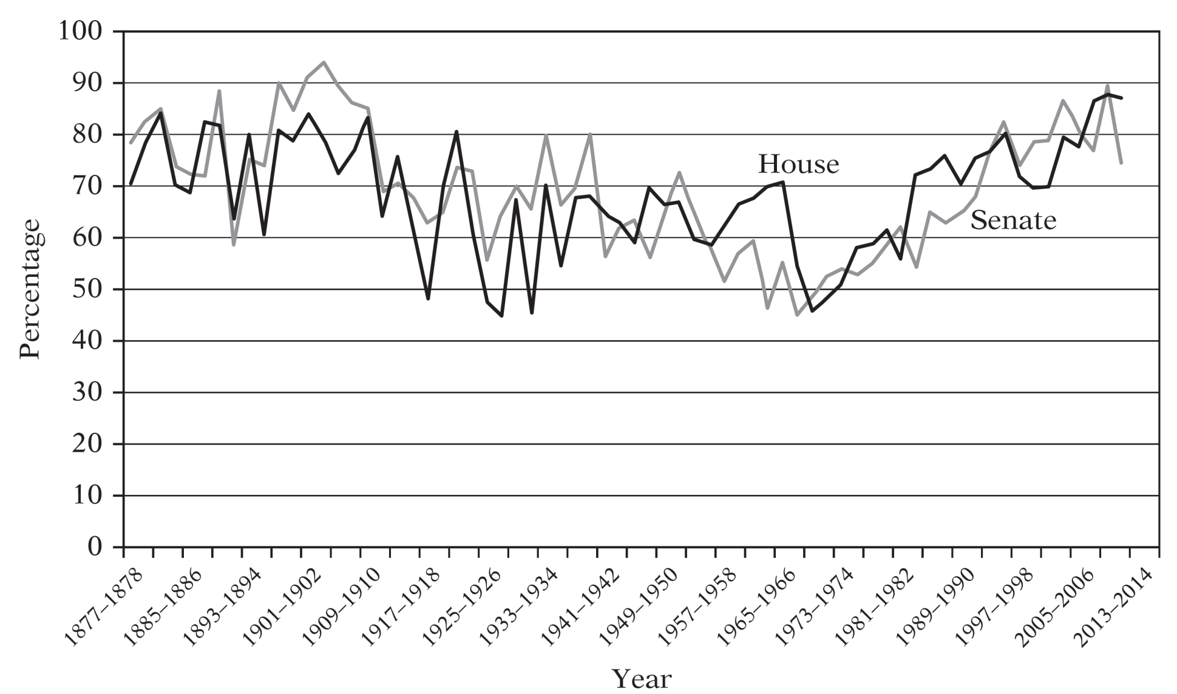
Party-Line Votes in Congress
Notes:
Fig. 4.1
Source: From Jon R. Bond and Kevin B. Smith, Analyzing American Democracy (New York: Routledge, 2013), p. 260.

Slide 14
Decision Criteria₄
Constituency Interests
  Delegate vs. Trustee
  Agencies have constituencies comprised of interest groups

Slide 15
Decision Criteria₅
Public Opinion
  Public perspectives and viewpoints on policy issues that officials consider in making decisions
  Shapes general boundaries & direction of public policy
  Can be permissive
Notes:
Public opinion is also subject to manipulation by public officials, as through the management of the news.

Slide 16
Decision Criteria₆
Deference
  Deferring to the judgment of others who are more experienced
    Other legislators, party leaders, committee chairs, policy experts
  Also used by judges in interpreting a statute

Slide 17
Decision Criteria₇
Decision rules
  Stare decisis
  Per se
  Committee rules
Notes:
Stare decisis: let the precedents stand
Per se: as such

Slide 18
Decision Criteria₈
Science
  Now an important consideration
  Decisions in the face of uncertainty?
    Get more research
    Precautionary principle
Notes:
In which policy areas has science become an important policymaking consideration?

Slide 19
Public Interest
Another criterion for decision making
Normative term, but tricky to define
  Private interests and public interest are not always antithetical
  Can be found in widely shared interests
  Can also be found by looking at the need for organization and procedures to represent and balance interests

Slide 20
Styles of Decision-Making₁
Bargaining
  Most common form of decision-making
  Process where two or more parties in positions of power adjust their goals to formulate acceptable course of action for all involved
  Explicit vs. Implicit bargaining
    Logrolling, side payments and compromise
Notes:
What is the role of social pluralism in making bargaining the most dominant form of decision-making?

Slide 21
Styles of Decision-Making₂
Persuasion
  Seeks to build support without modifying position
    Marshaling of facts, data, and information
    Skillful construction of arguments
    Use of reason and logic to convince another of the correctness and wisdom of one’s position

Slide 22
Styles of Decision-Making₃
Command
  Ability of those in superior positions to make decisions that are binding upon those who come within their jurisdiction
  More characteristic of decision processes in dictatorial rather than democratic societies
Notes:
Within agencies, subordinates often seek to convert command relationships into bargaining relationships. A bureau that gains considerable congressional support may thus put itself into position to bargain with, rather than simply be commanded by, the department head.

Slide 23
Styles of Decision-Making₄
In practice, all three styles run together in decisional situations
Majority Building in Congress
  Decentralization
  Complex procedures
  Majorities must constantly be cobbled together though bargaining to enact important legislation

Slide 24
Presidential Decision-Making
Presidents are policy adopters in their own right
  Recognize foreign government; establish diplomatic relations; execute treaties
  Executive agreements, orders
  Congress delegates authority to the president
Notes:
What recent executive order demonstrates the decision-making authority of the executive office? What other agencies or advisers contributed to this decision?

Slide 25
Presidential Decision-Making cont.
Shaped and limited by
  Permissibility (legality and acceptability)
  Available resources
  Available time
  Previous commitments
  Available information

