Slide 1
Anti-Semitism and Supercessionism

Slide 2
Today:
Final Project
Reckoning with Violence and anti-Semitism

Slide 3
Final Projects
Presentation (optional 10%)
  After the break, sign up for slots to present on the passage of scripture that is part of your final project
  Passage does not need to be central/only thing about your project, but you should explain in 5-10 minutes what the passage says and why it interests you.
  Rubric for help guiding presentations will be posted over spring break (goal is to ENCOURAGE participation)
  2. Topics don’t need to be constrictive…

Slide 4

Is the New Testament violent? Is the God of the New Testament less violent than the God of the Old Testament?
Shelly Matthews, “Violence in the NT”
  “When people imagine an angry male God, dishing out punishments and inflicting suffering, they might identify Him as the God of the Old Testament. When asked to consider stories about inflicting harm, even death, upon others in God’s name, again, they might think they are in Old Testament territory.”
  “Christians have sometimes assumed that the ministry of Jesus reflected a radical shift in the nature of God towards peace and love, and away from anger and wrath.”

Slide 5
Violent NT God and Violent NT People
Matthews notes that “gospel authors told stories of Jesus attacking Jews” who didn’t ascribe to Jesus’s teaching.
“In Matt 23:4-36 Jesus derides Pharisees as the vilest of hypocrites. In John 8:44, Jesus calls “the Jews” the “children of the devil.” While Jews are commonly the target of such name-calling,” others are attacked as well such as in Titus 1:12 where all the people of the island of Crete are dismissed as “liars, vicious brutes, lazy gluttons.”

Slide 6
“New Testament texts often reflect, rather than challenge, the violent household and political structures of the ancient world.” –Matthews
Jesus tells stories affirming the beating and killing of household slaves.
  Luke 12:45-47 But if that slave says to himself, ‘My master is delayed in coming,’ and if he begins to beat the other slaves, men and women, and to eat and drink and get drunk, the master of that slave will come on a day when he does not expect him and at an hour that he does not know, and will cut him in pieces, and put him with the unfaithful. That slave who knew what his master wanted, but did not prepare himself or do what was wanted, will receive a severe beating.

Slide 7
“New Testament texts often reflect, rather than challenge, the violent household and political structures of the ancient world.” –Matthews
Jesus tells stories affirming the beating and killing of household slaves.
Revelation presents hordes of divinely approved violence:
“Come, gather for the great supper of God, to eat the flesh of kings, the flesh of captains, the flesh of the mighty, the flesh of horses and their riders”…the rest were killed by the sword of the rider on the horse… and all the birds were gorged with their flesh.

Slide 8
“New Testament texts often reflect, rather than challenge, the violent household and political structures of the ancient world.” –Matthews
Jesus tells stories affirming the beating and killing of household slaves.
Revelation presents hordes of divinely approved violence
NT texts support slavery and urge slaves to submit to beatings:
  (1 Peter 2) Slaves, accept the authority of your masters with all deference, not only those who are kind and gentle but also those who are harsh. For it is a credit to you if… you endure pain while suffering unjustly. If you endure when you are beaten for doing wrong, what credit is that? But if you endure when you do right and suffer for it, you have God’s approval.
  Wives, in the same way, accept the authority of your husbands,
  (cf. Colossians, Ephesians, Titus, et al.)

Slide 9
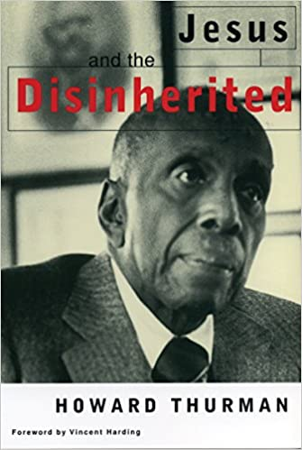
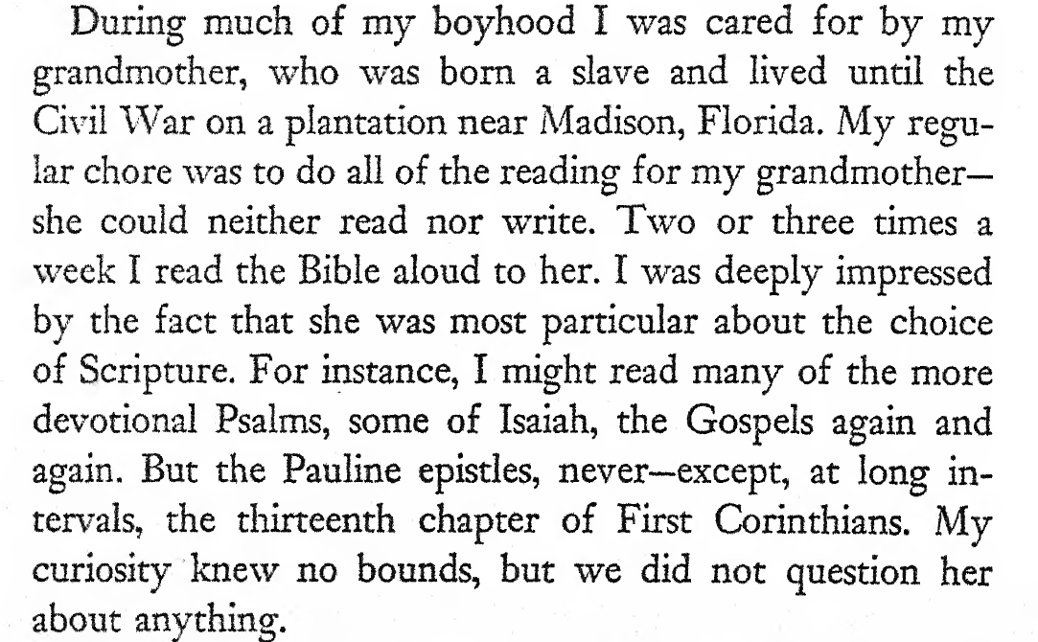
1949

Slide 10
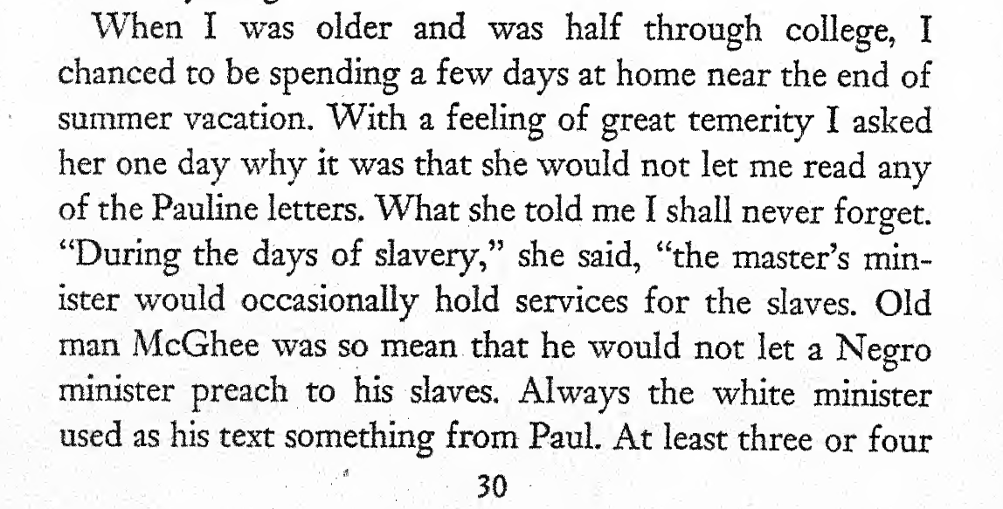
1949

Slide 11
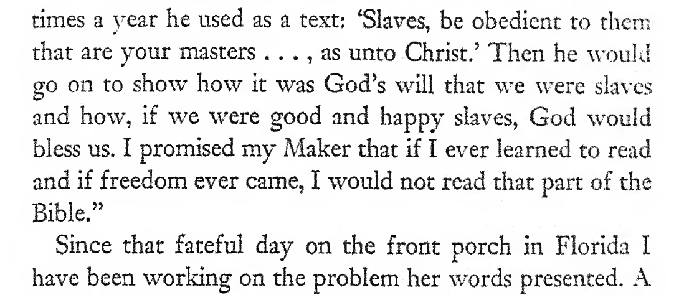
1949

Slide 12
Antisemitism
Working Definition of Anti-Semitism (International Holocaust Remembrance Alliance)
    “Antisemitism is a certain perception of Jews, which may be expressed as hatred toward Jews. Rhetorical and physical manifestations of antisemitism are directed toward Jewish or non-Jewish individuals and/or their property, toward Jewish community institutions and religious facilities.”

Slide 13
Historical examples of Anti-Semitism
Martin Luther, On the Jews and Their Lies (1534)
  “He did not call them Abraham's children, but a "brood of vipers" [Matt. 3:7]. Oh, that was too insulting for the noble blood and race of Israel, and they declared, "He has a demon' [Matt 11:18]. Our Lord also calls them a "brood of vipers"; furthermore in John 8 [:39,44] he states: "If you were Abraham's children ye would do what Abraham did.... You are of your father the devil. It was intolerable to them to hear that they were not Abraham's but the devil's children, nor can they bear to hear this today.”
  If I were to avenge myself on the devil himself I should be unable to wish him such evil and misfortune as God's wrath inflicts on the Jews, compelling them to lie and to blaspheme so monstrously, in violation of their own conscience.”

Slide 14
“What shall we Christians do with this rejected and condemned people, the Jews?” –Martin Luther
First to set fire to their synagogues or schools and to bury and cover with dirt whatever will not burn, so that no man will ever again see a stone or cinder of them. This is to be done in honor of our Lord and of Christendom, so that God might see that we are Christians, and do not condone or knowingly tolerate such public lying, cursing, and blaspheming of his Son and of his Christians.
Second, I advise that their houses also be razed and destroyed.
Third, I advise that all their prayer books and Talmudic writings, in which such idolatry, lies, cursing and blasphemy are taught, be taken from them.
Fourth, I advise that their rabbis be forbidden to teach henceforth on pain of loss of life and limb.
Fifth, I advise that safe­conduct on the highways be abolished completely for the Jews. For they have no business in the countryside,
Sixth, I advise that … all cash and treasure of silver and gold be taken from them and put aside for safekeeping.

Slide 15
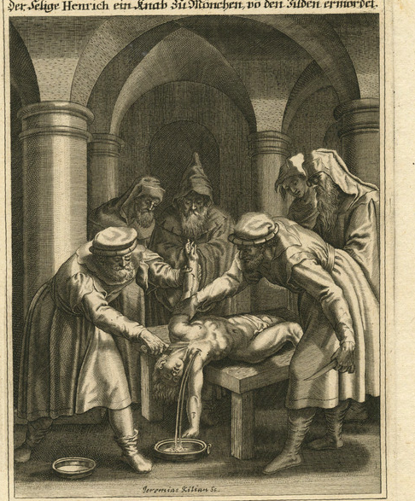
Historical Examples of Anti-Semitism
Blood Libel: [Holocaust Enyclopedia]
      “Historically, blood libels often took place close to Passover, when Jews were charged with using the blood of Christian children to bake matzahs. The proximity of such charges to Easter was thus also often associated with the continuing belief that Jews were responsible for the Passion and Crucifixion of Jesus. Blood libels, together with allegations of well poisoning, were a major theme in Jewish persecution in Europe throughout the Middle Ages and into the modern period. They were a central component in the development of modern antisemitism in the 19th century.”
“[Blessed Heinrich, a boy of Munich murdered by the Jews]”
Kilian, Jeremias, 1665-1730

Slide 16
New Testament Examples of Anti-Semitism?
Handout Text

Slide 17
Contemporary Examples of Anti-Semitism
From International Holocaust Remembrance Alliance
    Calling for, aiding, or justifying the killing or harming of Jews in the name of a radical ideology or an extremist view of religion.
    Making mendacious, dehumanizing, demonizing, or stereotypical allegations about Jews as such or the power of Jews as collective — such as, especially but not exclusively, the myth about a world Jewish conspiracy or of Jews controlling the media, economy, government or other societal institutions.
    Accusing Jews as a people of being responsible for real or imagined wrongdoing committed by a single Jewish person or group, or even for acts committed by non-Jews.
    Holocaust Denial
    Accusing Jewish citizens of being more loyal to Israel, or to the alleged priorities of Jews worldwide, than to the interests of their own nations.
    Denying the Jewish people their right to self-determination, e.g., by claiming that the existence of a State of Israel is a racist endeavor.
    Holding Jews collectively responsible for actions of the state of Israel.

Slide 18
Supercessionism
“The influential idea that Christians (the people of “the new covenant”) have replaced Jews (the people of “the old covenant”) as the people of God.” --Jesper Svartvik, "Supersessionism“
This theology makes easy a complicated reality: Christians share a set of scriptures with Jews and add as authoritative (New Testament) other Jewish texts.

Slide 19
History of anti-Semitic and anti-Jewish readings of the Bible
  By all Christian groups
  Only re-thought systematically post-Shoah
  Catholic formal document Nostra Aetete
  Present today Baltimore:
  “The Associated’s 2020 Community Survey of the region’s Jewish population…found that nearly two out of 10 adults in Baltimore reported personally experiencing anti-Semitism in the past year. The Anti-Defamation League (ADL) and law enforcement report growing numbers of hate crimes and incidents against Jews and other minority groups. Just a few days ago, the FBI noted that there was a 14% increase in anti-Semitic hate crimes last year in the U.S.” –Baltimore Sun Op-ed

Slide 20
A Few Strategies for Reckoning with Christian anti-Semitism
DON’T…
…explain difficult texts away.
Regardless of how you read them now, the history of reading them has caused irreparable harm on Jewish people throughout history. Christian writings in the New Testament come from First Century Jewish writers debating Jewish teachings from within, but that hasn’t stopped Christians from reading inner-Jewish debates as a license to attack the Jewish people.
…forget that Jewish is a Jewish Rabbi, who observes Jewish festivals, reads Jewish scriptures, argues with fellow Jewish teachers, and preaches the salvation of the Jewish people. When you read New Testament texts, you are reading a particular presentation of Jewish debates about the law and covenant of God. Don’t mistake them as straightforward claims to represent historical reality.
DO…
…wrestle, lament, take responsibility for Christian readings and their impact on real Jewish communities throughout history.
…learn from those outside your community, and consider whether some of your own interpretations might reflect anti-Semitic readings rather than challenge them.

