Slide 1


Slide 2
E
WILEY
Time Value of Money
Kimmel ● Weygandt
Survey of Accounting, First Edition

Slide 3
CHAPTER OUTLINE
LEARNING OBJECTIVES
Compute interest and future values.
1
Compute present values.
2
Use a financial calculator to solve time value
of money problems.
3

Slide 4
LEARNING OBJECTIVE
1
Compute interest and future values.
NATURE OF INTEREST
Payment for the use of money.
Difference between amount borrowed or invested (principal) and amount repaid or collected.
Elements involved in financing transaction:
  Principal (p): Amount borrowed or invested.
  Interest Rate (i): An annual percentage.
  Time (n): Number of years or portion of a year that the principal is borrowed or invested.
LO 1

Slide 5
NATURE OF INTEREST
Simple Interest
Interest computed on the principal only.
Illustration: Assume you borrow $5,000 for 2 years at a simple interest rate of 12% annually. Calculate the annual interest cost.
ILLUSTRATION E-1
Interest computations
Interest = p x i x n
2 FULL YEARS
= $5,000 x .12 x 2
= $1,200
LO 1

Slide 6
NATURE OF INTEREST
Compound Interest
Computes interest on
  the principal and
  any interest earned that has not been paid or withdrawn.
Most business situations use compound interest.
LO 1

Slide 7
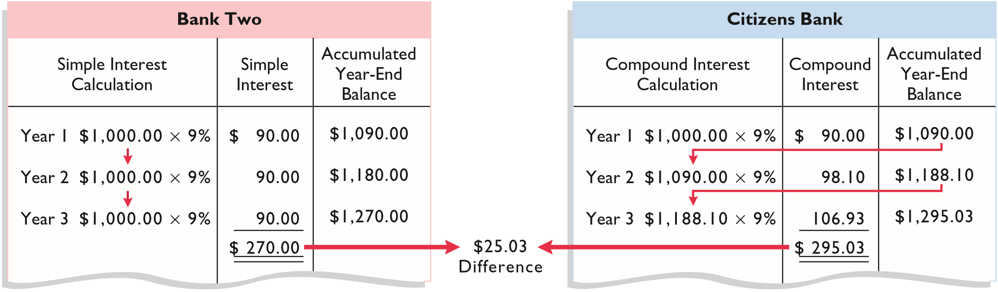
Compound Interest
Illustration: Assume that you deposit $1,000 in Bank Two, where it will earn simple interest of 9% per year, and you deposit another $1,000 in Citizens Bank, where it will earn compound interest of 9% per year compounded annually. Also assume that in both cases you will not withdraw any interest until three years from the date of deposit.
Year 1 $1,000.00 x 9%
$ 90.00
$ 1,090.00
Year 2 $1,090.00 x 9%
$ 98.10
$ 1,188.10
Year 3 $1,188.10 x 9%
$106.93
$ 1,295.03
ILLUSTRATION E-2
Simple versus compound interest
LO 1

Slide 8
Compound Interest
Illustration: Assume that you deposit $1,000 in Bank Two, where it will earn simple interest of 9% per year, and you deposit another $1,000 in Citizens Bank, where it will earn compound interest of 9% per year compounded annually. Also assume that in both cases you will not withdraw any interest until three years from the date of deposit.
ILLUSTRATION E-2
Simple versus compound interest
LO 1

Slide 9
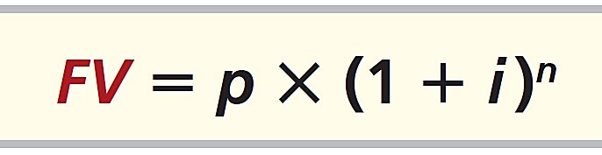
FUTURE VALUE OF A SINGLE AMOUNT
Future value of a single amount is the value at a future date of a given amount invested, assuming compound interest.
ILLUSTRATION E-3
Formula for future value
FV = future value of a single amount
p = principal (or present value; the value today)
i = interest rate for one period
n = number of periods
LO 1

Slide 10
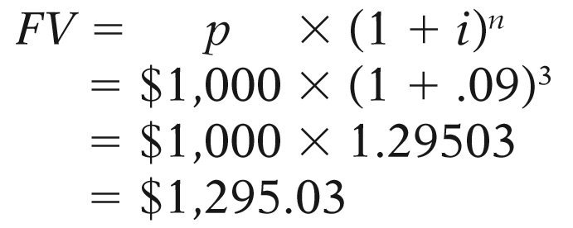
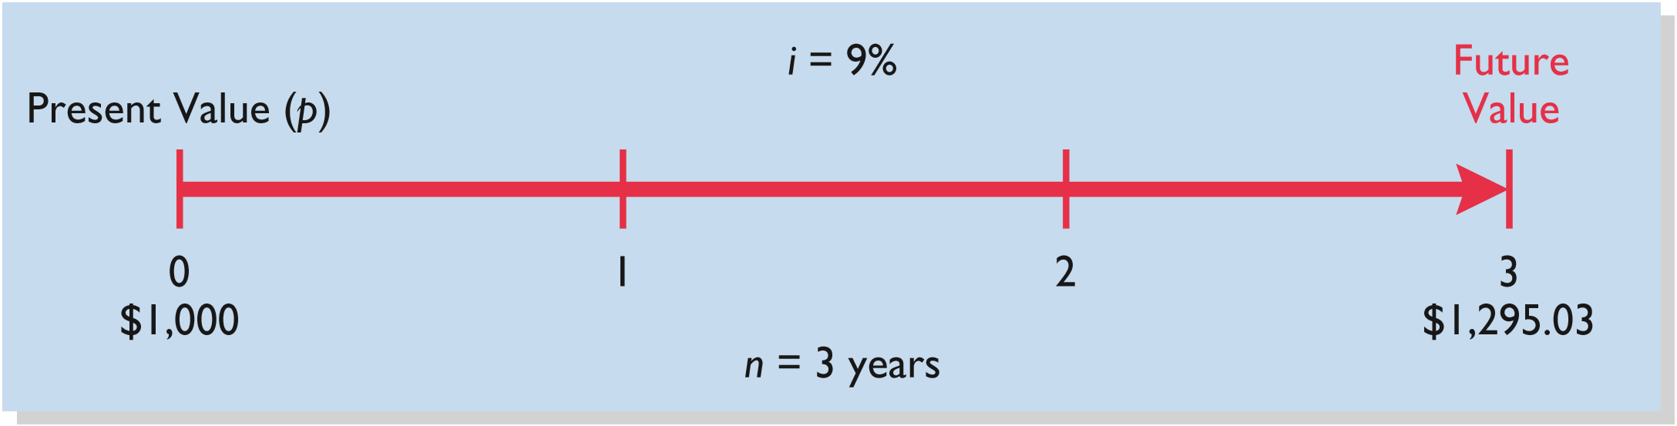
FUTURE VALUE OF A SINGLE AMOUNT
Illustration: If you want a 9% rate of return, you would compute the future value of a $1,000 investment for three years as follows:
ILLUSTRATION E-4
Time diagram
LO 1

Slide 11
FUTURE VALUE OF A SINGLE AMOUNT
Illustration: If you want a 9% rate of return, you would compute the future value of a $1,000 investment for three years as follows:
ILLUSTRATION E-4
Time diagram
What table do we use?
LO 1

Slide 12
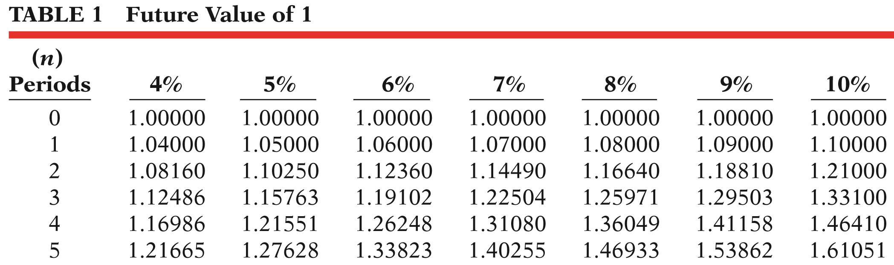
FUTURE VALUE OF A SINGLE AMOUNT
What factor do we use?
$1,000
x 1.29503
= $1,295.03
Present Value
Factor
Future Value
LO 1

Slide 13
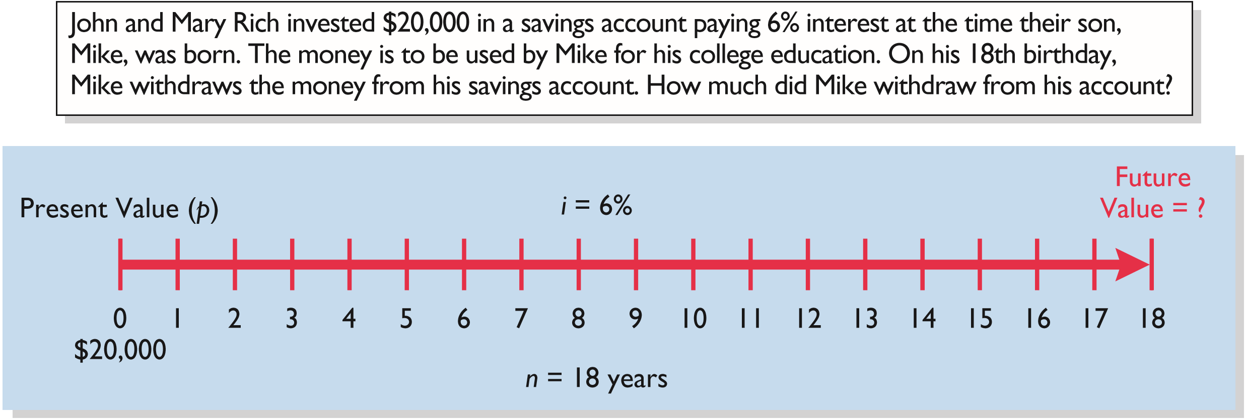
FUTURE VALUE OF A SINGLE AMOUNT
Illustration:
ILLUSTRATION E-5
Demonstration problem—
Using Table 1 for FV of 1
What table do we use?
LO 1

Slide 14
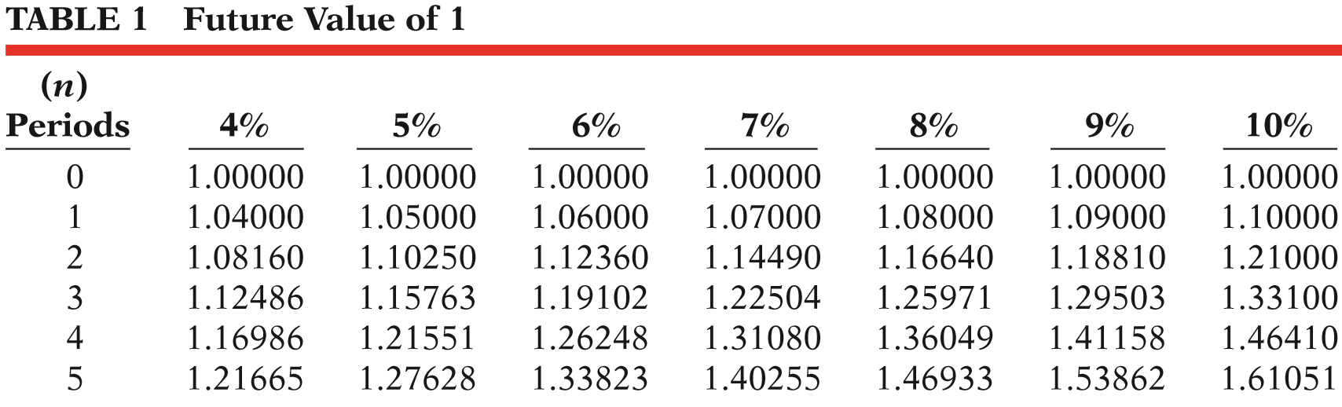
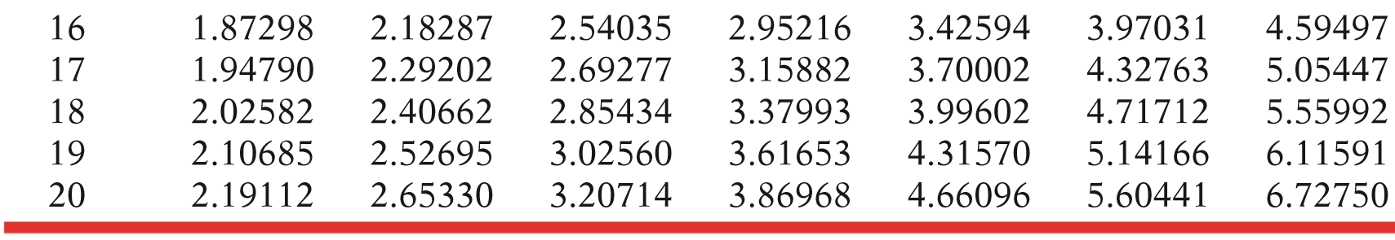
FUTURE VALUE OF A SINGLE AMOUNT
$20,000
x 2.85434
= $57,086.80
Present Value
Factor
Future Value
LO 1

Slide 15
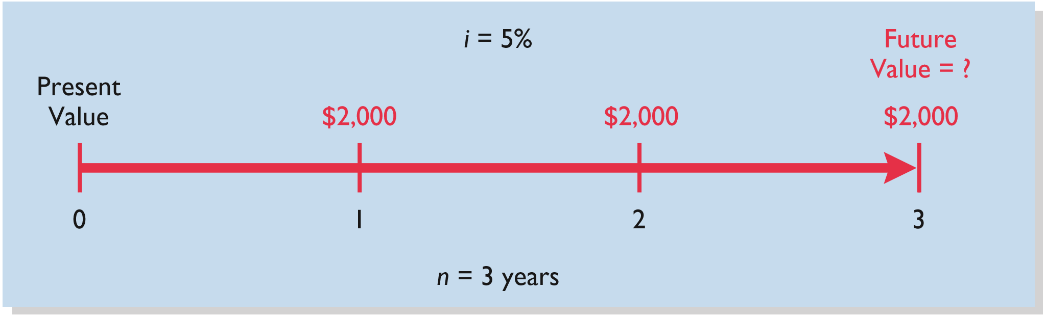
FUTURE VALUE OF AN ANNUITY
Illustration: Assume that you invest $2,000 at the end of each year for three years at 5% interest compounded annually.
ILLUSTRATION E-6
Time diagram for a three-year annuity
LO 1

Slide 16
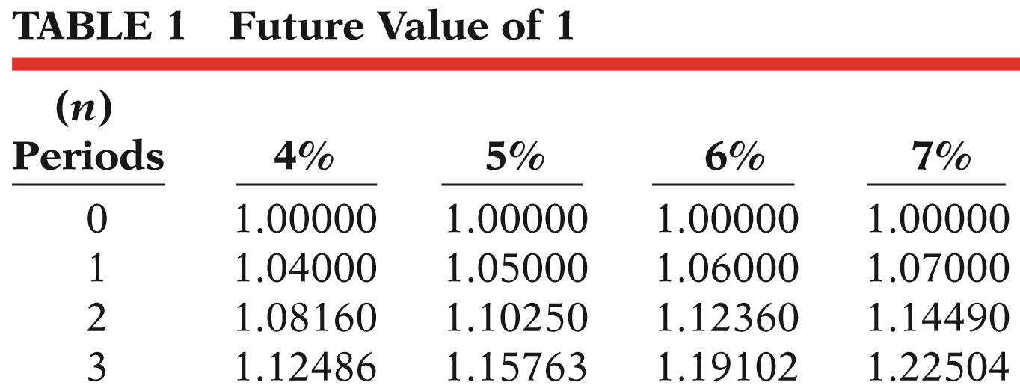
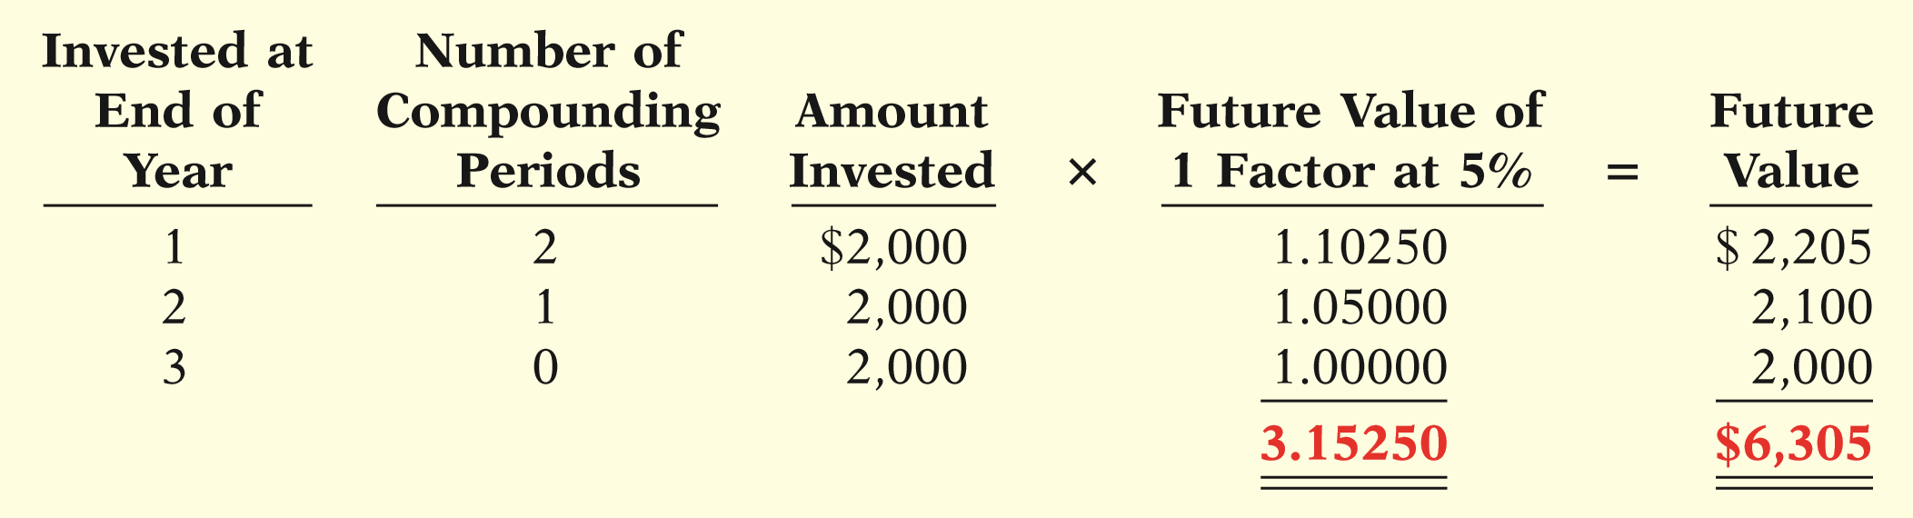
FUTURE VALUE OF AN ANNUITY
Illustration:
Invest = $2,000
i = 5%
n = 3 years
ILLUSTRATION E-7
Future value of periodic payment computation
LO 1

Slide 17
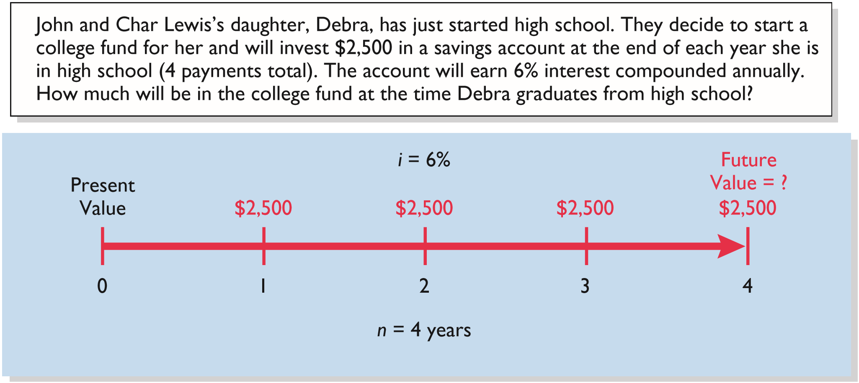
FUTURE VALUE OF AN ANNUITY
When the periodic payments (receipts) are the same in each period, the future value can be computed by using a future value of an annuity of 1 table.
ILLUSTRATION E-8
Demonstration problem—
Using Table 2 for FV of an
annuity of 1
Illustration:
LO 1

Slide 18
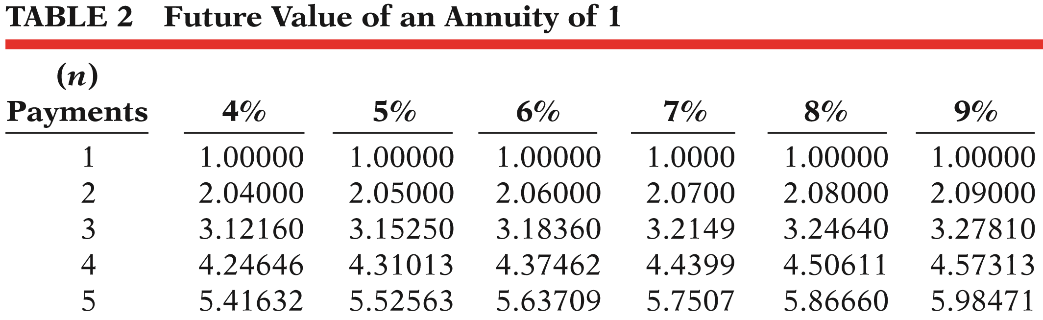
FUTURE VALUE OF AN ANNUITY
What factor do we use?
$2,500
x 4.37462
= $10,936.55
Payment
Factor
Future Value
LO 1

Slide 19
LEARNING OBJECTIVE
2
Compute present values.
PRESENT VALUE VARIABLES
The present value is the value now of a given amount to be paid or received in the future, assuming compound interest.
Present value variables:
  Dollar amount to be received (future amount).
  Length of time until amount is received (number of periods).
  Interest rate (the discount rate).
LO 2

Slide 20
PRESENT VALUE OF A SINGLE AMOUNT
ILLUSTRATION E-9
Formula for present value
Present Value (PV) = Future Value ÷ (1 + i )^{n}
p = principal (or present value)
i = interest rate for one period
n = number of periods
LO 2

Slide 21
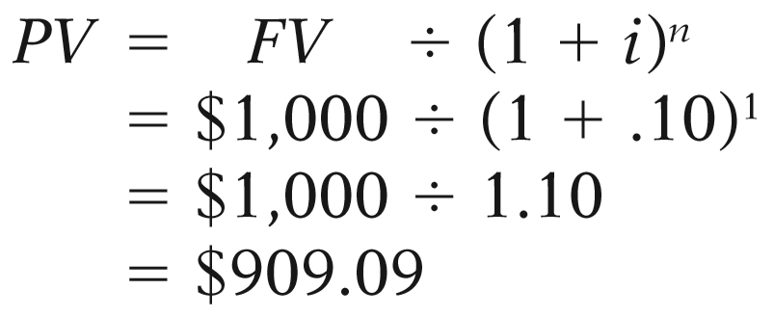
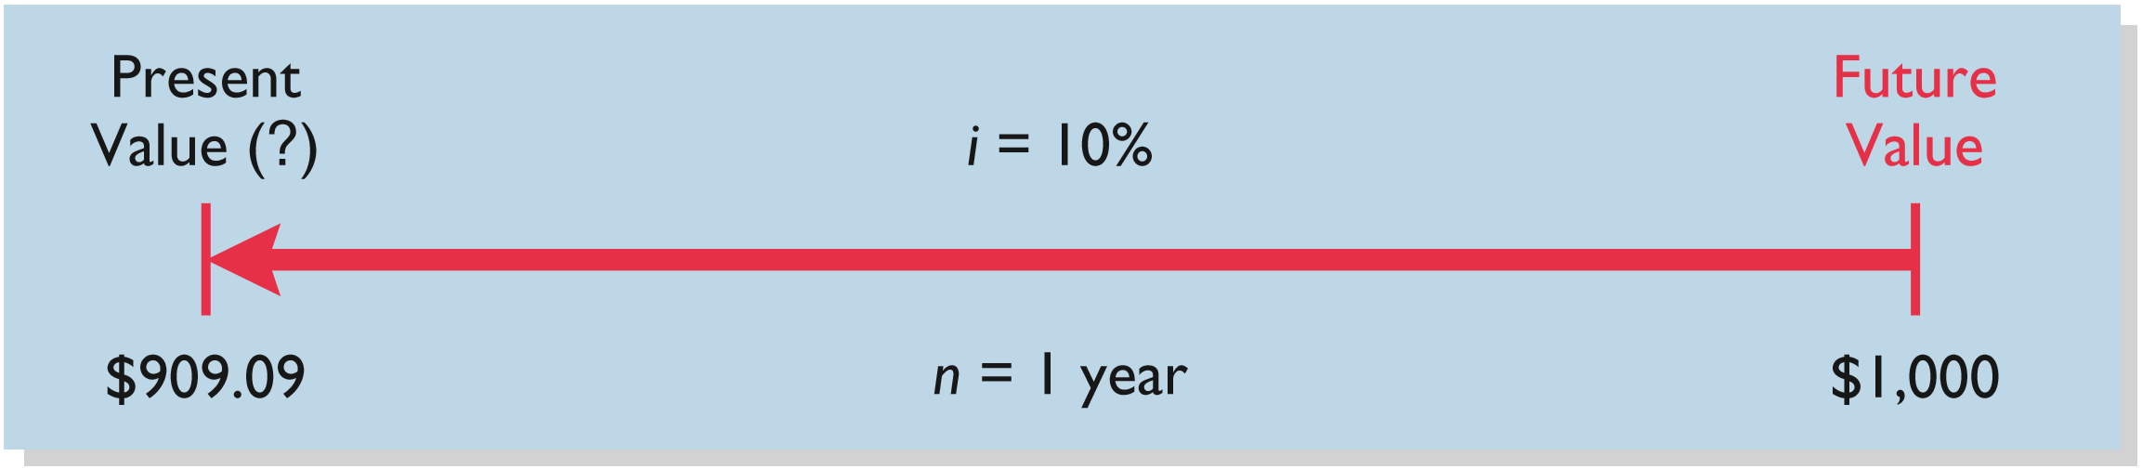
PRESENT VALUE OF A SINGLE AMOUNT
Illustration: If you want a 10% rate of return, you would compute the present value of $1,000 for one year as follows:
ILLUSTRATION E-10
Finding present value if
discounted for one period
LO 2

Slide 22
PRESENT VALUE OF A SINGLE AMOUNT
ILLUSTRATION E-10
Finding present value if
discounted for one period
Illustration: If you want a 10% rate of return, you can also compute the present value of $1,000 for one year by using a present value table.
What table do we use?
LO 2

Slide 23
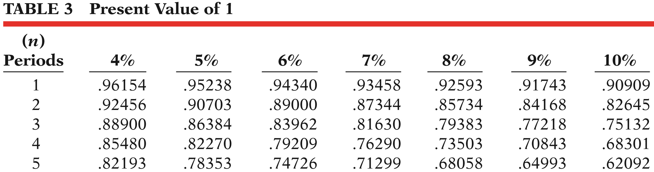
PRESENT VALUE OF A SINGLE AMOUNT
What factor do we use?
$1,000
x .90909
= $909.09
Future Value
Factor
Present Value
LO 2

Slide 24
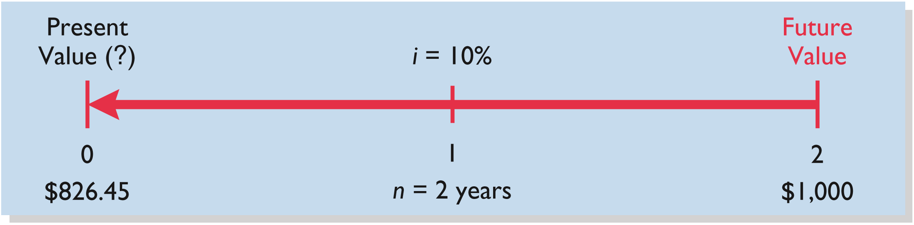
PRESENT VALUE OF A SINGLE AMOUNT
ILLUSTRATION E-11
Finding present value if
discounted for two period
Illustration: If the single amount of $1,000 is to be received in two years and discounted at 10% [PV = $1,000 ÷ (1 + .10²], its present value is $826.45 [($1,000 ÷ 1.21).
What table do we use?
LO 2

Slide 25
PRESENT VALUE OF A SINGLE AMOUNT
What factor do we use?
$1,000
x .82645
= $826.45
Future Value
Factor
Present Value
LO 2

Slide 26
PRESENT VALUE OF A SINGLE AMOUNT
Illustration: Suppose you have a winning lottery ticket and the state gives you the option of taking $10,000 three years from now or taking the present value of $10,000 now. The state uses an 8% rate in discounting. How much will you receive if you accept your winnings now?
$10,000
x .79383
= $7,938.30
Future Value
Factor
Present Value
LO 2

Slide 27
PRESENT VALUE OF A SINGLE AMOUNT
Illustration: Determine the amount you must deposit today in your SUPER savings account, paying 9% interest, in order to accumulate $5,000 for a down payment 4 years from now on a new car.
$5,000
x .70843
= $3,542.15
Future Value
Factor
Present Value
LO 2

Slide 28
PRESENT VALUE OF AN ANNUITY
The value now of a series of future receipts or payments, discounted assuming compound interest.
Necessary to know the:
  Discount rate,
  Number of payments (receipts).
  Amount of the periodic payments or receipts.
LO 2

Slide 29
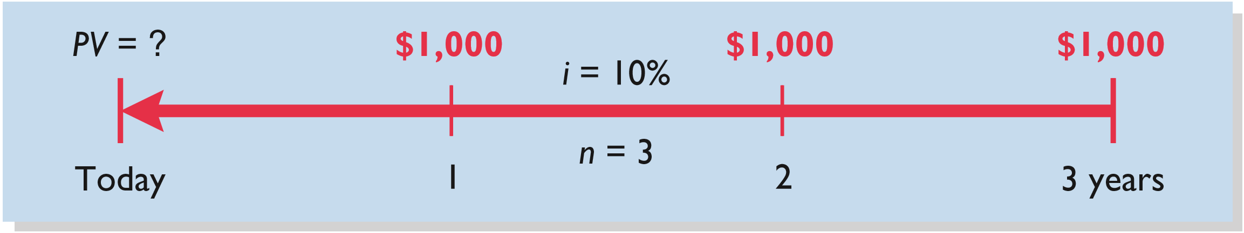
PRESENT VALUE OF AN ANNUITY
ILLUSTRATION E-14
Time diagram for a three-year annuity
Illustration: Assume that you will receive $1,000 cash annually for three years at a time when the discount rate is 10%. Calculate the present value in this situation.
What table do we use?
LO 2

Slide 30
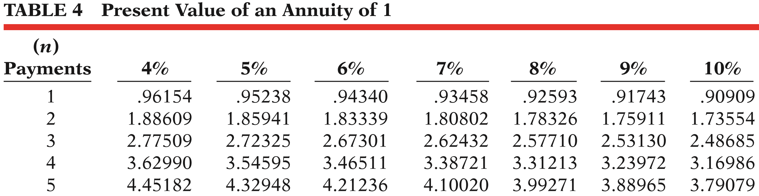
PRESENT VALUE OF AN ANNUITY
What factor do we use?
$1,000 x 2.48685 = $2,486.85
Annual Receipts
Factor
Present Value
LO 2

Slide 31
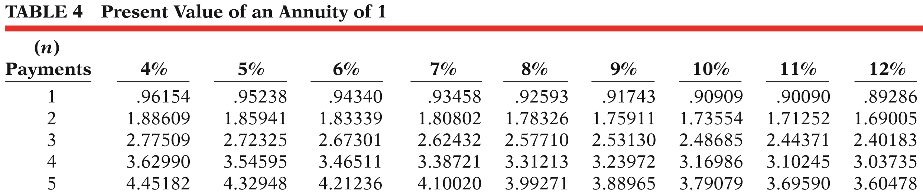
PRESENT VALUE OF AN ANNUITY
Illustration: Kildare Company has just signed a capitalizable lease contract for equipment that requires rental payments of $6,000 each, to be paid at the end of each of the next 5 years. The appropriate discount rate is 12%. What is the amount used to capitalize the leased equipment?
$6,000 x 3.60478 = $21,628.68
LO 2

Slide 32
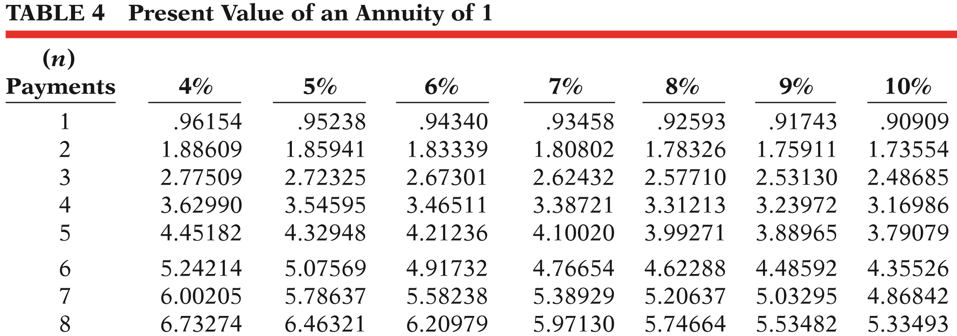
PRESENT VALUE OF AN ANNUITY
Illustration: Assume that the investor received $500 semiannually for three years instead of $1,000 annually when the discount rate was 10%. Calculate the present value of this annuity.
$500 x 5.07569 = $2,537.85
LO 2

Slide 33
PV OF A LONG-TERM NOTE OR BOND
Two Cash Flows:
  Periodic interest payments (annuity).
  Principal paid at maturity (single sum).
100,000
$5,000
5,000
5,000
5,000
5,000
5,000
. . . . .
0
1
2
3
4
9
10
LO 2

Slide 34
PV OF A LONG-TERM NOTE OR BOND
Illustration: Assume a bond issue of 10%, five-year bonds with a face value of $100,000 with interest payable semiannually on January 1 and July 1. Calculate the present value of the principal and interest payments.
$100,000
$5,000
$5,000
$5,000
$5,000
$5,000
$5,000
. . . . .
0
1
2
3
4
9
10
LO 2

Slide 35
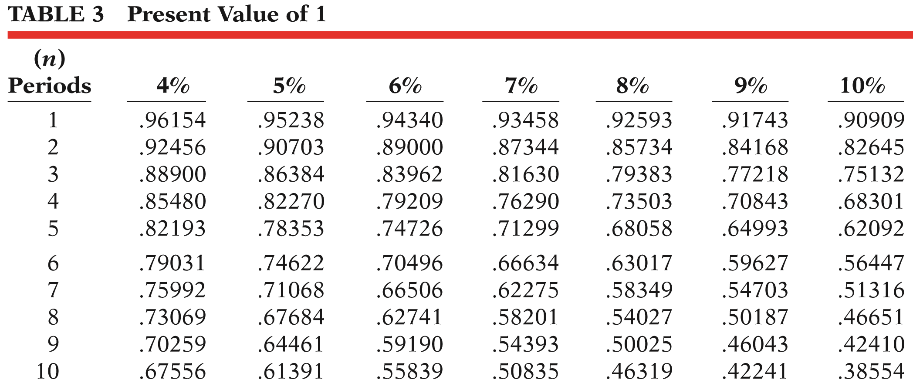
PV OF A LONG-TERM NOTE OR BOND
PV of Principal
$100,000 x .61391 = $61,391
Principal
Factor
Present Value
LO 2

Slide 36
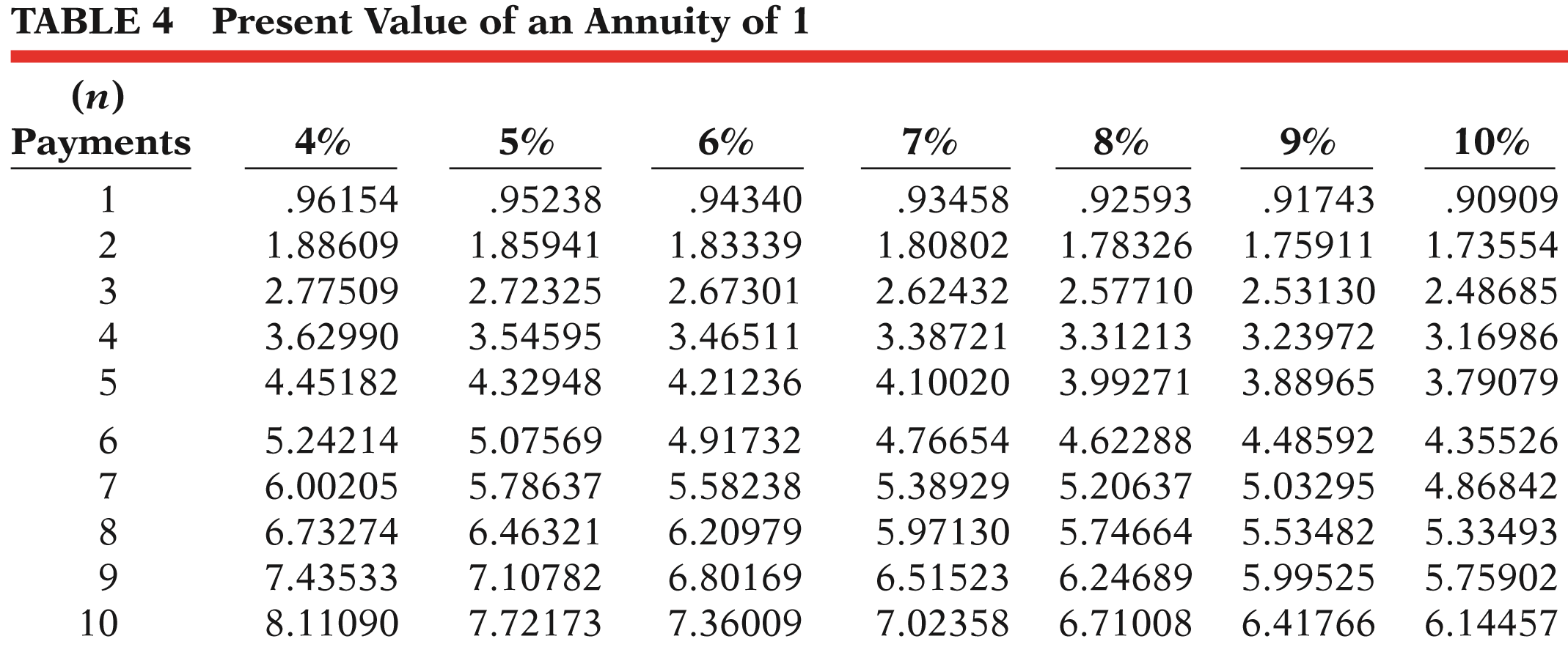
PV OF A LONG-TERM NOTE OR BOND
PV of Interest
$5,000 x 7.72173 = $38,609
Payment
Factor
Present Value
LO 2

Slide 37
PV OF A LONG-TERM NOTE OR BOND
Illustration: Assume a bond issue of 10%, five-year bonds with a face value of $100,000 with interest payable semiannually on January 1 and July 1.
Present value of Principal $61,391
Present value of Interest 38,609
Bond current market value $100,000
LO 2

Slide 38
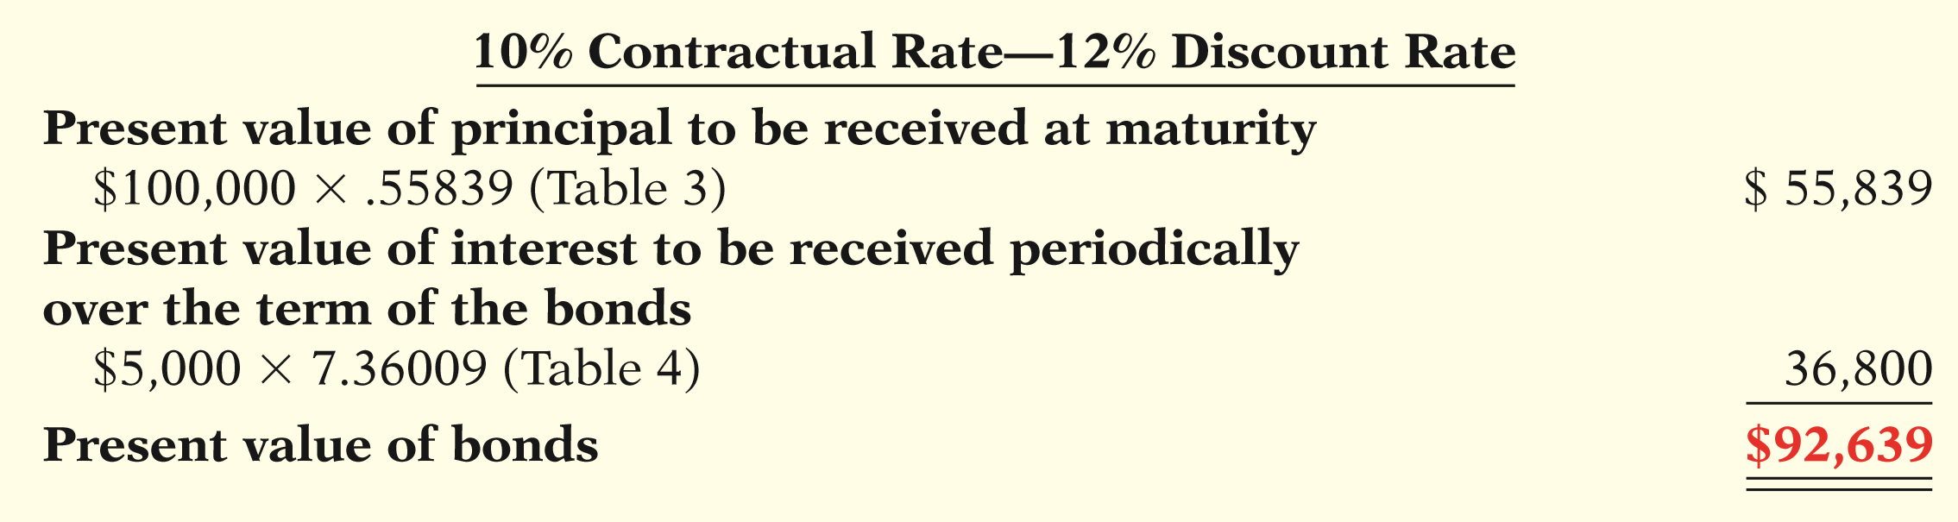
PV OF A LONG-TERM NOTE OR BOND
Illustration: Now assume that the investor’s required rate of return is 12%, not 10%. The future amounts are again $100,000 and $5,000, respectively, but now a discount rate of 6% (12% ÷ 2) must be used. Calculate the present value of the principal and interest payments.
ILLUSTRATION E-20
Present value of principal and interest—discount
LO 2

Slide 39
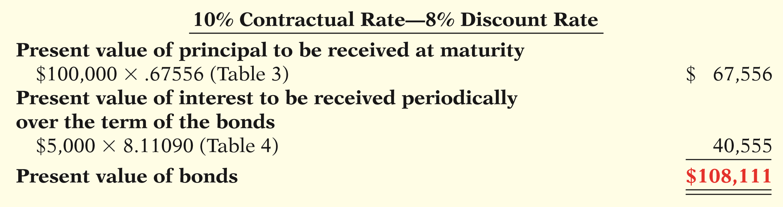
PV OF A LONG-TERM NOTE OR BOND
Illustration: Now assume that the investor’s required rate of return is 8%. The future amounts are again $100,000 and $5,000, respectively, but now a discount rate of 4% (8% ÷ 2) must be used. Calculate the present value of the principal and interest payments.
ILLUSTRATION E-21
Present value of principal and interest—premium
LO 2

Slide 40
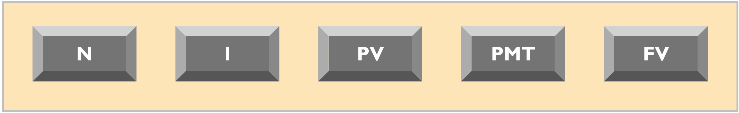
LEARNING OBJECTIVE
3
Use a financial calculator to solve time value of money problems.
ILLUSTRATION E-22
Financial calculator keys
N = number of periods
I = interest rate per period
PV = present value
PMT = payment
FV = future value
LO 3

Slide 41
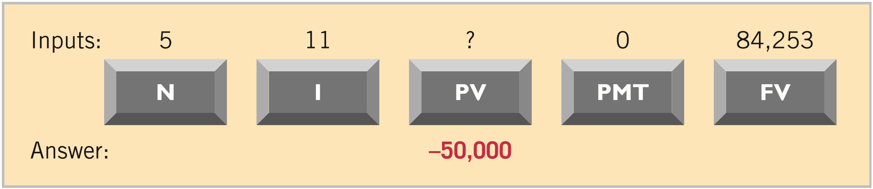
Using Financial Calculators
PRESENT VALUE OF A SINGLE SUM
Assume that you want to know the present value of $84,253 to be received in five years, discounted at 11% compounded annually.
ILLUSTRATION E-23
Calculator solution for present value of a single sum
LO 3

Slide 42
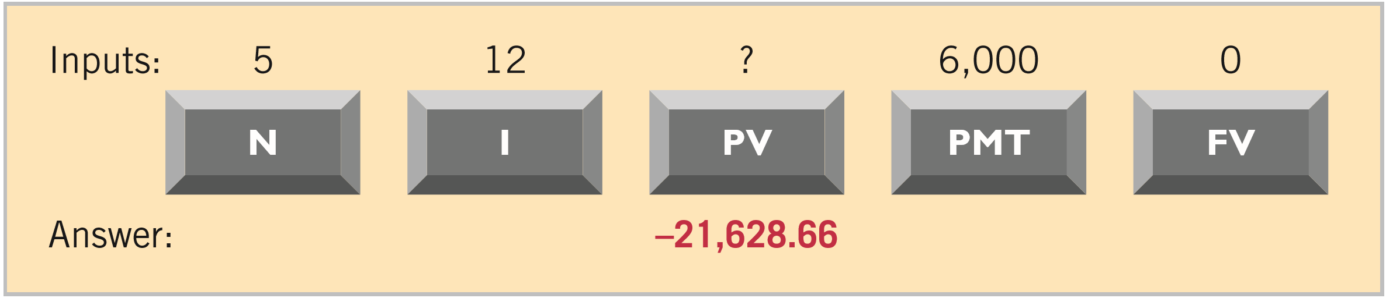
Using Financial Calculators
PRESENT VALUE OF AN ANNUITY
Assume that you are asked to determine the present value of rental receipts of $6,000 each to be received at the end of each of the next five years, when discounted at 12%.
ILLUSTRATION E-24
Calculator solution for present value of an annuity
LO 3

Slide 43
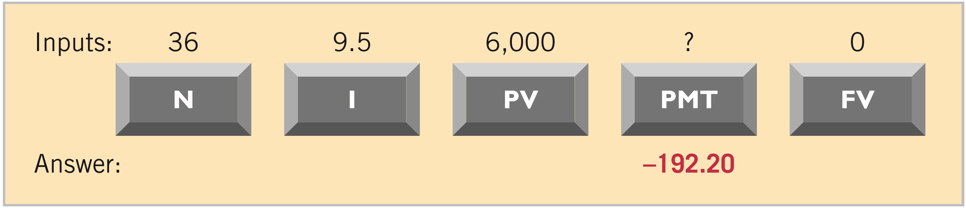
Using Financial Calculators
USEFUL APPLICATIONS – Auto Loan
The loan has a 9.5% nominal annual interest rate, compounded monthly. The price of the car is $6,000, and you want to determine the monthly payments, assuming that the payments start one month after the purchase.
ILLUSTRATION E-25
Calculator solution for auto loan payments
LO 3

Slide 44
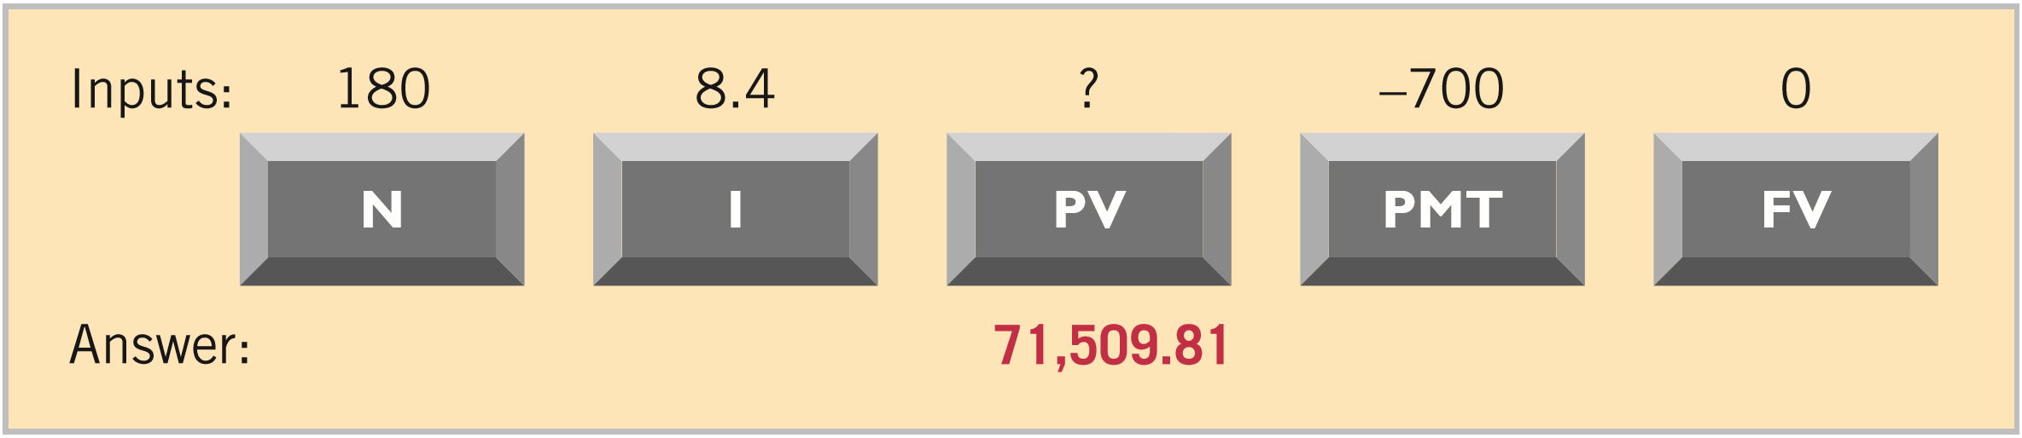
Using Financial Calculators
USEFUL APPLICATIONS – Mortgage Loan
You decide that the maximum mortgage payment you can afford is $700 per month. The annual interest rate is 8.4%. If you get a mortgage that requires you to make monthly payments over a 15-year period, what is the maximum purchase price you can afford?
ILLUSTRATION E-26
Calculator solution for mortgage amount
LO 3

Slide 45
COPYRIGHT
“Copyright © 2017 John Wiley & Sons, Inc. All rights reserved. Reproduction or translation of this work beyond that permitted in Section 117 of the 1976 United States Copyright Act without the express written permission of the copyright owner is unlawful. Request for further information should be addressed to the Permissions Department, John Wiley & Sons, Inc. The purchaser may make back-up copies for his/her own use only and not for distribution or resale. The Publisher assumes no responsibility for errors, omissions, or damages, caused by the use of these programs or from the use of the information contained herein.”

