Slide 1


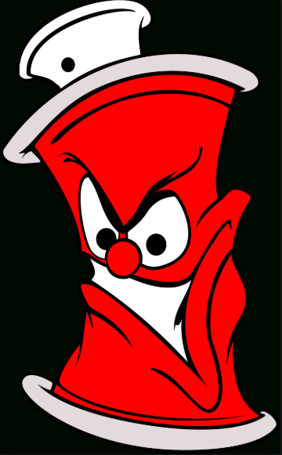
American Street art
Travis Mayo
Columbia Southern University
10/16/2018

Slide 2
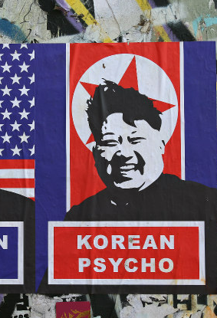
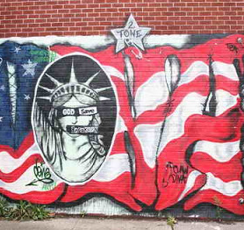
American Street art
I have always been fascinated with street art and graffiti. It is my favorite form of artistic expression second to music. Now, I am no artist by any means, but to me graffiti is a rebellious form of making a statement or sending a message and street art brings life to plain walls, tunnels, and alleys. In my opinion graffiti and street art means a more colorful world, or more interesting scenery, and adds character to our country. It makes for a scenic ride to work or walk around the block. I Look forward to learning more about how artist do street art, what medium do they use, and how that challenges them in their work.

Slide 3
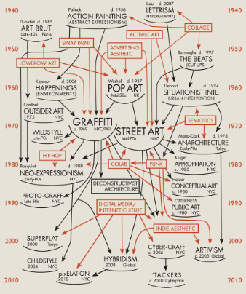
American Street art
Street art has been around for many years, as early as the time of our ancestors who’s form of street art was done on cave walls and with soot or charred wood/bone. Evolution of street wall moved to graffiti and through to the 21st century evolved in to much more. The evolution of street art evolved into interdisciplinary forms of artistic expression from graffiti, stencils, prints, and murals. The movement of street art even includes large scale paintings and projects artist collaborating. (Bojan, Maric(2014).

Slide 4
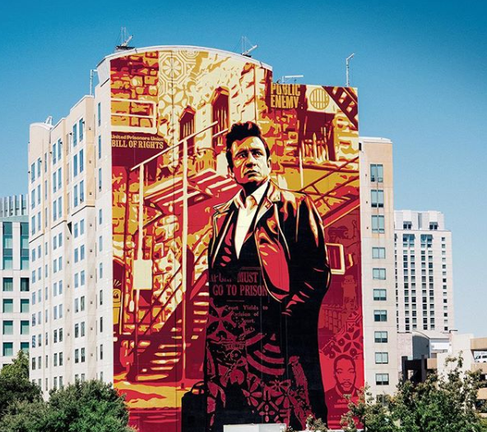
Tribute for the 50th anniversary of Johnny Cash’s Live at Folsom Prison album
Shepard Fairey
8/20/2018
Paint
(Fairey, 2018)
Notes:
Include citation

Slide 5
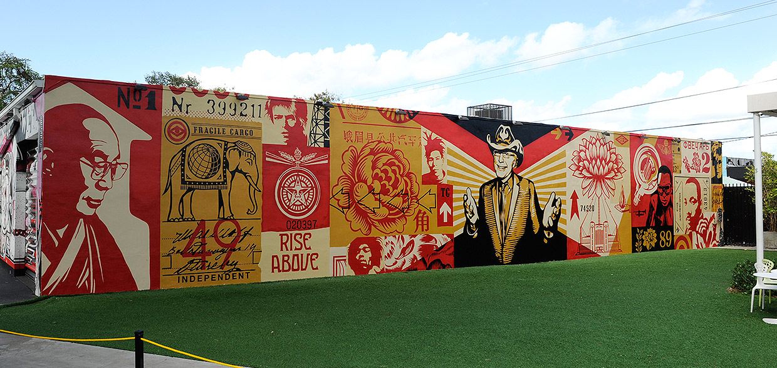
Tony goldman mural
sheppard fairey
wheat paste – 12/03/2012
(Fairey, 2012)

Slide 6
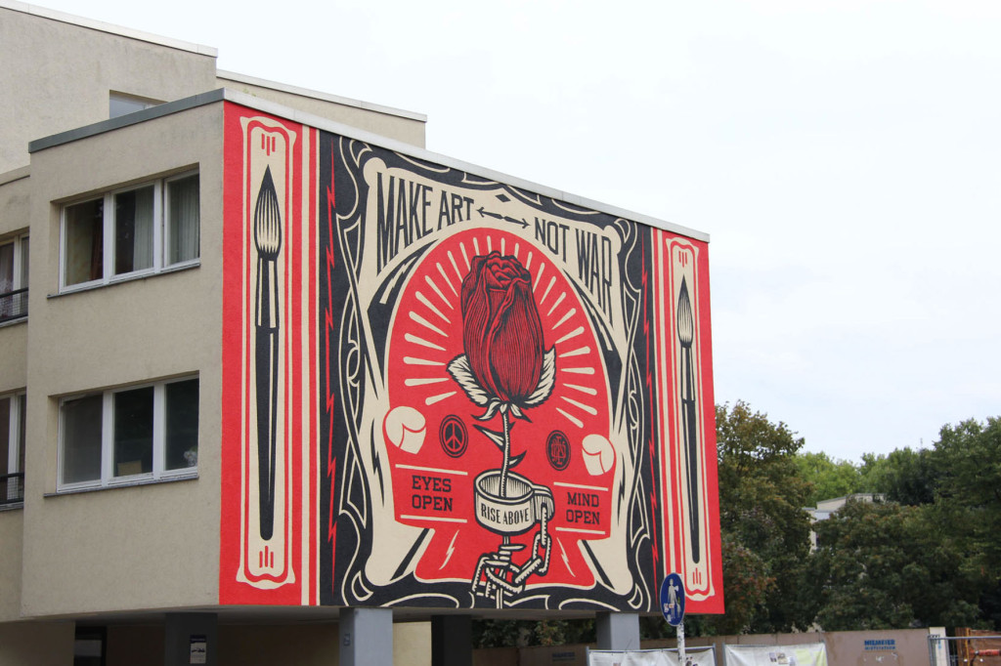
Make art not war
Shepard Fairey
September 2014 paint
(Fairey, 2014)

Slide 7
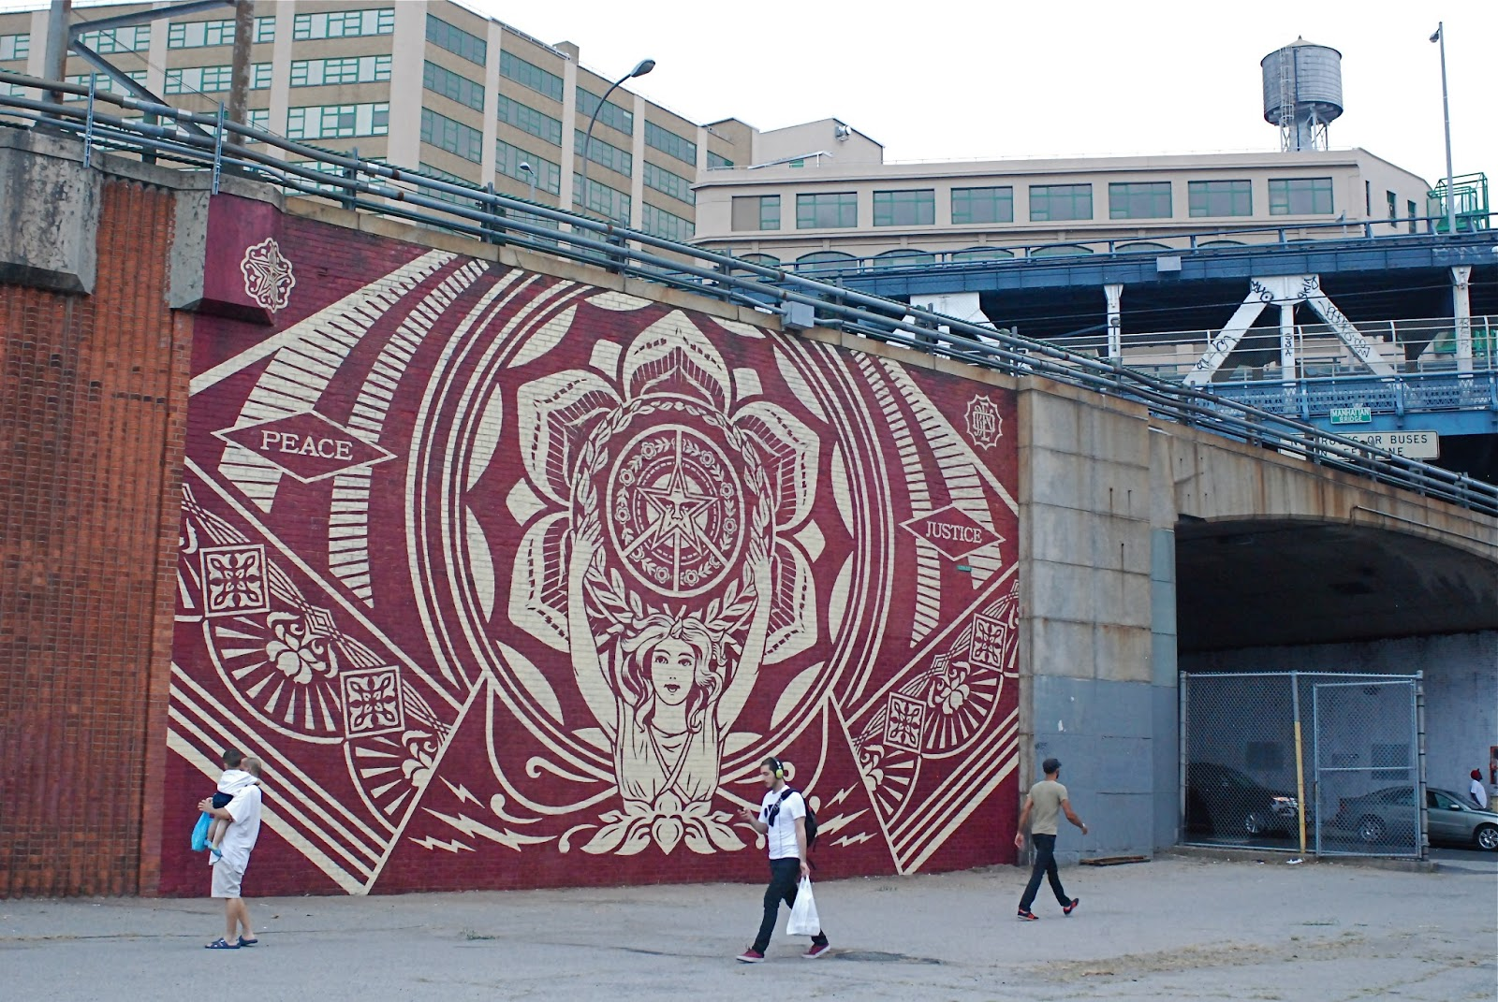
Dumbo nyc mural
8-16-2013
shepard fairey
paint
(Fairey, 2013)

Slide 8
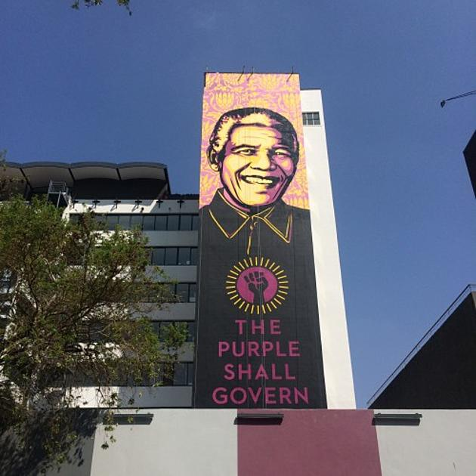
Nelson mandela mural shepard fairey
September 2014 paint
(Fairey, 2014)

Slide 9
Tribute for the 50th anniversary of Johnny Cash’s Live at Folsom Prison album
Visual Elements:
Line: There are a combination of thick and thin lines horizontal and vertical on the stairway, scaffold, and balconies portrayed in the mural
Shape: You will notice rectangle shapes in the scaffold, circular shape in the face of Johnny Cash and more square shapes in the windows
Light: light is coming from the backdrop on the building with Johnny cash painted in a darker tone in the front of the mural
Color: You will see a combination of orange & red hue fades along with black and a yellowish tan color which can also be a shade of orange.
Texture: no noticeable pattern, but possibly an impasto application due to the application on ta building wall.
Mass: The artwork is heavier with the noticeable black on Johnny cash

Slide 10
Tribute for the 50th anniversary of Johnny Cash’s Live at Folsom Prison album
Unity: The picture of Johnny Cash captured at Folsom prison is integrated with a city background, this integration looks complete and natural.
Variety: Diversity is captured in the color tints and blacks applied to the mural
Balance: the mural asymmetrical because Johnny cash is offset and the background building covers the right side of the mural
Emphasis: focal point of the mural is Johnny cash
Directional forces: paths of the mural lead to Johnny cash in the middle of the mural
Contrast: contrast is captured in the black of Johnny cash and yellowish orange of the building behind him

Slide 11
Unit 6-Artwork title
Explanation of background using facts

Slide 12
Unit 5- critique 2. Title of artwork
Artist’s name
Year created
Media
Artwork image
Citation
Notes:
Include citation

Slide 13
Tony goldman mural
Visual Elements:
Line: Describe The lines in this artwork move at an angle behind Tony Goldman, or from behind Tony to the front of the painting. Also straight horizontal lines on Tony’s jacket.
Shape: There are rectangular shapes behind Tony that form an array or light appearance coming from behind or to Tony.
Light: The Lightest portion of this painting would be in Tony’s face, hands, and in between the rectangles behind Tony.
Color: The colors used in this painting are shades of orange Hue, red, and black.
Texture: There is patterns of rectangles behind Tony
Mass: Is the artwork is heavier in at the bottom and the top of the photo because the artist uses black and then fades into the portrait.
Motion: no motion is portrayed in this picture.
(Fairey, 2012)

Slide 14
Unit 4- 2. Artwork Title
Design Principles:
Unity: what elements work together to make a harmonious whole?
Variety: What creates diversity?
Balance: Is it symmetrical or asymmetrical?
Emphasis: What is the focal point?
Directional forces: What are the paths for the eye to follow?
Contrast: Where do you see contrasting elements in the artwork?
Repetition & rhythm: Is an element repeated?
Scale & proportion: Are the objects in proportion to each other?

Slide 15
2. Unit 6-Artwork Title
Explanation of background using facts

Slide 16
Unit 5- critique
3. Title of artwork
Artist’s name
Year created
Media
Artwork image
Citation
Notes:
Include citation

Slide 17
Make art not war
Visual Elements:
Line: The Lines in this painting are visible moving outward from the center Rose, and circular shaped throughout the mural
Shape: You will notice circular shapes in the body of the rode, the shackle, amidst the framing of the mural, and the teo small emblems to the right and left of the flower.
Light: The lighter colors are along the framework of this murals with the white, but the white lines coming from the rose seem to give off the look that the rose is radiating.
Color: Colors used in this mural consist of red, white and black. You don’t see shading in this mural.
Texture: I do not notice an ongoing pattern but do see small patterns in the framing of the mural, the aura around the rose, and the white symbols on each side of the rose.
(Fairey, 2014))

Slide 18
Unit 4- 3. Artwork Title
Design Principles:
Unity: what elements work together to make a harmonious whole?
Variety: What creates diversity?
Balance: Is it symmetrical or asymmetrical?
Emphasis: What is the focal point?
Directional forces: What are the paths for the eye to follow?
Contrast: Where do you see contrasting elements in the artwork?
Repetition & rhythm: Is an element repeated?
Scale & proportion: Are the objects in proportion to each other?

Slide 19
Unit 6. 3. Artwork Title
Explanation of background using facts

Slide 20
Unit 5- 4. Title of artwork
Artist’s name
Year created
Media
Artwork image
Citation
Notes:
Include citation

Slide 21
Dumbo NYC mural
(Fairey, 2013)
Visual Elements:
Line: Describe You will notice diagonal lines forming a star in the middle, on the two rectangular pieces on each side of the mural, and within the two rectangular pieces forming triangles.
Shape: There are circular shapes, rectangular shapes, and triangles scattered through this mural.
Light: No real lighting being portrayed, but the lighter color is the white painted over a maroon color.
Color: There are only two colors used in this mural, a maroon and a white.
Texture: There is a circular pattern and what looks like an Argyle pattern in the middle circle.
Mass: The artwork is balanced between the maroon and white

Slide 22
Unit 4- 4. Artwork Title
Design Principles:
Unity: what elements work together to make a harmonious whole?
Variety: What creates diversity?
Balance: Is it symmetrical or asymmetrical?
Emphasis: What is the focal point?
Directional forces: What are the paths for the eye to follow?
Contrast: Where do you see contrasting elements in the artwork?
Repetition & rhythm: Is an element repeated?
Scale & proportion: Are the objects in proportion to each other?

Slide 23
Unit 6- 4. Artwork Title
Explanation of background using facts

Slide 24
Unit 5- 5. Title of artwork
Artist’s name
Year created
Media
Artwork image
Citation
Notes:
Include citation

Slide 25
Nelson mandela mural
Visual Elements:
Line: The only noticeable lines I see are along the collar.
Shape: You will see a circular shape with a fist in the middle of the mural, and a circular shape possibly used to start the face.
Light: The lighting is coming from the top of this mural, and it moves into black.
Color: There are purple or lavender colors used, also what looks like a yellowish orange and a lot of black for the shirt in this mural.
Texture: The patterns in this mural are above Nelson’s head and appear to be patterns of a flower in the backdrop.
Mass: The artwork is much heavier on the bottom of this mural which is Nelson’s shirt or jacket.
Time: No sense of time is portrayed
(Fairey, 2014)

Slide 26
Unit 4 -5. Artwork Title
Design Principles:
Unity: what elements work together to make a harmonious whole?
Variety: What creates diversity?
Balance: Is it symmetrical or asymmetrical?
Emphasis: What is the focal point?
Directional forces: What are the paths for the eye to follow?
Contrast: Where do you see contrasting elements in the artwork?
Repetition & rhythm: Is an element repeated?
Scale & proportion: Are the objects in proportion to each other?

Slide 27
Unit 6- 5. Artwork Title
Explanation of background using facts

Slide 28
Unit 5 help slide- Formal Art Criticism Theories
pay close attention to the making of a piece, how each section of the art piece works to form a visual experience that may or may not attract the attention of those who come across it.
Formalists’ attention is centered on the formal organization rather than the themes, which they deem irrelevant.

Slide 29
Unit 5 help slide- Contextual Art Criticism Theory
value the theme and its relevance to the times in which the artwork was created.
The contextual theories deal with the context in which an art piece is used;
what it symbolizes concerning the culture and values of the environment.

Slide 30
Unit 5 help slide- Expressive Art Criticism Theories
Describe the theory
Tell why you feel this artwork is best categorized and understood using this theory
Tell how the theory explains one of your gallery artworks

Slide 31
Unit 8- Comprehensive Statement
Describe what you learned about the role of art in society
Tell what you learned about Art Criticism theories

Slide 32
Unit 8- for each artwork Comprehensive Statement
Art criticism is responding to, interpreting meaning, and making critical judgments about specific works of art.
· Art critics help viewers perceive, interpret, and judge artworks.
· Critics tend to focus more on modern and contemporary art from cultures close to their own.
· Art historians tend to study works made in cultures that are more distant in time and space.
· When initially introduced to art criticism, many people associate negative connotations with the word "criticism."

Slide 33
Unit 8- Comprehensive Statement
Tell what you learned about art in general
Summarize and conclude your presentation

Slide 34
References
Bojan, Maric. Widewalls, retrieved from: https://www.widewalls.ch/the-history-of-street-art/

