Slide 1
Cerebellum: Movement Regulation and Cognitive Functions
Course Title
Date

Slide 2
Introduction
Cerebellum believed to control movement.
Although not the initiator of motion, damage to cerebellum makes movement erratic in size and direction.
An important site for motor learning and adaptation following injury.
Changes in the strength of the connections among neurons in the cerebellum underlie these adaptive changes.
Vermis; portion of the cerebellum that is closest to the midline of the brain; phylogenetically the oldest.
Vermis; regulates the accuracy of trunk, leg, head, and eye movement; critical for control of posture, size, and locomotion.
Notes:
For more than a century it has been known that the cerebellum is an important part of the brain for the control of movement.

Slide 3
Introduction Cont…
Inter-mediate portion of the cerebellum; regulates voluntary movement.
Lateral parts of the cerebellum; hemispheres; regulate higher aspects of behavior.
Hemispheres are small in lower animals but become quite large in humans.
Increase in the size of the cerebellum in the course of evolution parallel to the enlargement of the cerebral cortex in higher mammals.
Recent discoveries; cerebellar hemispheres are used to regulate higher cerebral processes; processes that plan complex movements and participate in cognition and thinking.
These discoveries make it clear that the cerebellum does much more than regulate movement.

Slide 4
Organizational and Operational Principles
Two main divisions of the cerebellum: the cerebellar cortex and the cerebellar deep nuclei .
The cortex is specialized for processing extremely large amounts of information about the states of body parts, of objects around us and of ongoing brain activities.
Information is conveyed to the cerebellum by its mossy fiber inputs.
The state of body parts is monitored by kinaesthetic receptors.
The state of the world is monitored by tactile receptors.
The state of the brain is monitored by collateral projections from brain areas that deal with motivation, perceptions, goals, actions, and current thinking.

Slide 5
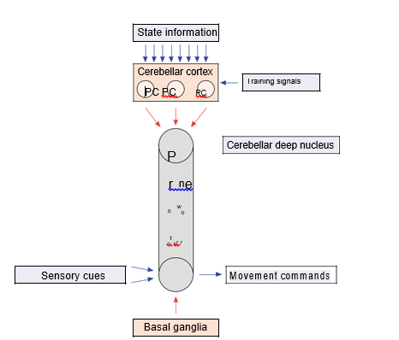
Notes:
Figure 1 Signal flow through the cerebellum and its relationship to sensory–motor integration in the premotor network. The red arrows indicate an exclusively inhibitory projection onto a small cluster of neurons in the cerebellar deep nucleus. PC, Purkinje cell.

Slide 6
Organizational and Operational Principles
Intermediate regions of the cerebellar nuclei; receive excitatory collaterals from mossy fibers labelled the premotor network in Figure 1.
The premotor network for the intermediate cerebellum is comprised of interconnections between cerebellar nuclei, red nucleus and motor cortex.
Projections throughout the premotor network predominantly excitatory; they transmit positive feed-back; promote regenerative activity.
Cerebellar cortex climbing fibers; transmit relatively specific error information to those Purkije cells that are capable of reducing a particular movement error.

Slide 7
Regulation of Voluntary Movement Commands by the Intermediate Cerebellum
Neural signals that command the production of voluntary limb movements are transmitted from the brain to the spinal cord by the axons of neurons in the motor cortex (M1) and the red nucleus.
Each of the numbered neurons is assumed to command movement in one of four directions: output unit 1 commands upward movement, 2 rightward, 3 downward and 4 leftward.
Divergence of fibers within the premotor pathways allows activation to spread between adjacent modules.
Consequently, a sensory stimulus might activate unit 1, which could serve to start positive feedback and regenerative activity within its loop
The resultant command signal would activate an agonist muscle for upward movement.

Slide 8
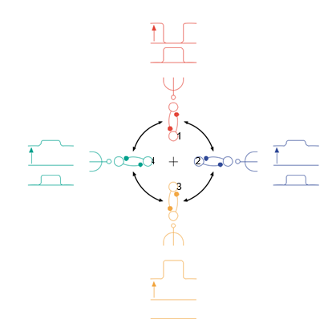
Notes:
Figure 2 Regulation of movement direction by coordinating a small array of four cortical–cerebellar modules.
Illustrates some of the operational principles by using a simplified system including just four M1 command neurons, together with their cerebellar modules. Each of the numbered neurons is assumed to command movement in one of four directions: output unit 1 commands upward movement, 2 rightward, 3 downward and 4 leftward. Each of the output units is reciprocally connected to a cerebellar nucleus unit that is regulated by inhibitory input from a PC.

Slide 9
Regulation of Voluntary Movement Commands by the Intermediate Cerebellum
Activity would tend to spread to the modules controlling units 2 and 4, because their PCs are producing only moderate inhibition.
This would activate a co-contraction of right and left muscles that would stabilize the limb.
In contrast, activity would not spread to the module controlling unit 3, because its PC is bursting and producing strong inhibition.
Therefore, muscles that tend to move the limb downwards would be relaxed.
The motor cortex and red nucleus are organized not in terms of preferred directions of hand movement, but rather in terms of functionally useful groups of muscles.

Slide 10
Compartmentalization: Microscopic and Macroscopic Modules
    The microscopic anatomy of the cerebellum is remarkably uniform.
    The cells and their processes form well-defined circuits in parasagittally aligned compartments.
    The basic signal-processing functions of one of these modules within either the vermis or the hemisphere is analogous to that of a module within the intermediate cerebellum.
    A microscopic module includes a parasagittally aligned row of about 100 PCs, , which send a focused inhibitory projection to a small cluster of nuclear cells.
    If the module giving rise to these projections is in the intermediate cerebellum, the axons of the nuclear cells project to the motor cortex and red nucleus.
    Participate in regulating the movement command that is sent to hand and arm muscles.

Slide 11
Compartmentalization: Microscopic and Macroscopic Modules
If the module is in the vermis, the targeted cluster of nuclear cells may project to a focus in the brainstem, in order to regulate the movement command sent to eye muscles.
If the module is in the hemisphere of the cerebellum, the targeted cluster of nuclear cells may ultimately project to the prefrontal cortex, to regulate the neural representation of a cognitive function.
Microscopic modules regulate neuronal targets in diﬀerent regions of the brainstem and cerebrum, utilizing the diﬀerent kinds of state information

Slide 12
Regulatory Functions of the Midline Cerebellum
The midline portion of the cerebellum is involved in several regulatory functions; for example, the stabilization of head and body posture, the coordination of locomotion and the control of gaze, using combined eye and head movements.
The midline cerebellum has separate macroscopic modules for each of these regulatory functions.
Special inputs that are critical for this part of the cerebellum are vestibular signals, visual signals and signals from various cerebral cortical areas.
The down-stream projections of these modules target many discrete regions within the brainstem, including a group of nuclei comprising the ventromedial descending system.
The various muscles must be well coordinated to control automatic movements, a process that is accomplished by the combined actions of the many microscopic modules subserving each macroscopic function.

Slide 13
Cognitive Functions of the Cerebellar Hemispheres
. The frontal lobes have been viewed as the brain regions where higher cognitive functions reside.
The prominent projection from the cerebellum to these areas implicates the cerebellum in higher cognitive function.
Lateral cerebellum becomes active when a person participates in cognitive tasks or engages in the solution of diﬃcult problems.
Neurons in localized areas of the prefrontal cortex show sustained discharges during the memory period that represent a neural correlate of the animal’s working memory.
Specific group of neurons in the dentate nucleus projects via the thalamus to this particular area of cerebral cortex.

Slide 14
Summary
The cerebellum has a number of compartmentalized modules that share a similar circuitry and appear to be involved in the amplification and regulation of activity in the other parts of the nervous system with which they interconnect.
Studies of the compartment that regulates voluntary movement commands have helped neuroscientists to understand some of the fundamental signal-processing mechanisms that occur in the various microscopic and macroscopic modules.
Loops between neurons in the cerebellar nuclei and the nerve cells in the brainstem and cerebral cortical areas with which they connect provide a mechanism for amplifying signals in specific modules.
This amplification is then regulated by the Purkinje cells in the cerebellar cortex.

Slide 15
References
Barto AG, Fagg AH, Sitkoﬀ N and Houk JC (1999) A cerebellar model of timing and prediction in the control of reaching. Neural Computa-tion 11: 565–594.
Courchesne E and Allen G (1997) Prediction and preparation, fundamental functions of the cerebellum. Learning and Memory 4: 1–35.
Holdefer RN, Miller LE, Chen LL and Houk JC (2000) Functional connectivity between cerebellum and primary motor cortex in the awake monkey. Journal of Neurophysiology 84: 585–590.
Houk JC (2001) Neurophysiology of frontal–subcortical loops. In: Lichter DG and Cummings JL (eds) Frontal–Subcortical Circuits in Psychiatry and Neurology, chap. 4, pp. 92–113. New York: Guilford Publications.

Slide 16
References Cont…
Kim S-G, Ugurbil K and Strick PL (1994) Activation of a cerebellar output nucleus during cognitive processing. Science 265: 949–951.
Mason CR, Miller LE, Baker JF and Houk JC (1998) Organization of reaching and grasping movements in the primate cerebellar nuclei as revealed by focal muscimol inactivations. Journal of Neurophysiology 79: 537–554.
Middleton FA and Strick PL (1997) Cerebellar output channels: substrates for the control of motor and cognitive function. Interna-tional Review of Neurobiology 41: 61–82.
Raymond JL, Lisberger SG and Mauk MD (1996) The cerebellum: a neuronal learning machine? Science 272: 1126–1131. Stein JF and Glickstein M (1992) Role of the cerebellum in visual guidance of movement. Physiological Reviews 72: 967–1017.
Stein JF and Glickstein M (1992) Role of the cerebellum in visual guidance of movement. Physiological Reviews 72: 967–1017.

