Slide 1
Assistive Technology Chart
Name
Institution of Affiliation

Slide 2
Digital Citizenship
The norms and rules of using the internet.
Most current students born in the digital age; thus digital citizens.
They learned using digital devices and the internet at a very tender age.
It is imperative to know the rules; become a good digital citizen.
Students are empowered; think critically and collaborate and connect effectively.
Notes:
Just like regular citizenship, digital citizenship is the norms and rules we follow to act appropriately when using technology. Current students were most likely born as a digital citizen. They were probably given a tablet or smartphone at some point when they were very young to entertain themselves. Each student has grown up using this technology and, therefore, must learn how to be a good digital citizen (Ribble, Bailey, and Ross, 2004).

Slide 3
Motion Math Zoom
Motion Math Zoom
An assistive math learning app for children in elementary school
Available at https://apps.apple.com/us/app/id451793073?ref=edshelf

Slide 4

Notes:
Motion Math Zoom (for iPad, iPhone, and iPod Touch) features the most interactive number line of all time. The intuitive pinch gesture on iDevices allows kids to navigate among concrete objects (animals) that represent abstract numbers: from dinosaurs in the thousands to amoebas in the thousandths

Slide 5
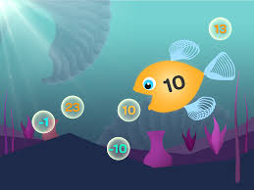

Motion Math Zoom engage learners in elementary school.
It helps them master the fundamental concepts of math.
Learners freely play with the relation between quantity and space.
Notes:
The app engages learners in elementary school and helps them master the fundamental concepts of math. They freely play with the relation between quantity and space.

Slide 6
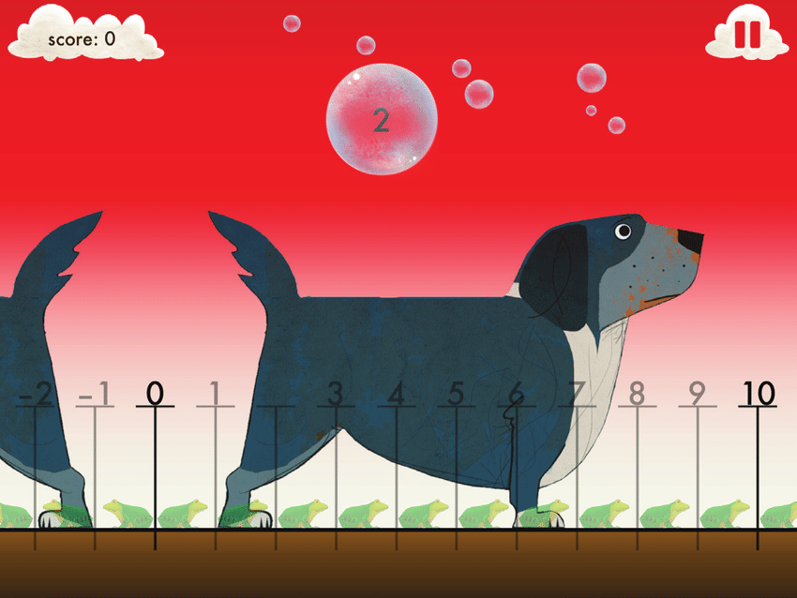
Motion Math Zoom
Notes:
The graphics in the app are top notch while the concepts are unique. It is a must have for children wishing to excel in numbers.

Slide 7
Key Features
A multi-touch gaming for children that is intuitive.
Animals at the different levels help understand number size.
Delightful sounds and quirky animations.
Time trials for advanced learners.
Scaffolding and hints for struggling learners.
Notes:
The program is intuitive allowing a multi-touch game play. It facilitate concretized learning with animals at the different levels helping children to understand number sizes. The app is complemented delightful sounds and quirky animations. There are numbers up to 1000 for children while advanced learners are able to unlock timed trials, decimals, and negatives. The leaderboard and achievement at the game center provides additional challenges to the learners. There is scaffolding and hints that help learners who are struggling. The learning goals for kids include mastering place values and locating fractions, negatives, and integers on the number line. The motion math zoom app is free and compatible with ipad, ipod touch, and iphone requiring iOS 4.0 and above (Teach Thought Staff, 2019).

Slide 8
References
Ribble, M. S., Bailey, G. D., & Ross, T. W. (2004). Digital citizenship: Addressing appropriate technology behavior. Learning & Leading with technology, 32(1), 6.
Teach Thought Staff. (2019, Jan 1). 34 Assistive Technology Apps. Teach thought we grow teachers. Retrieved from https://www.teachthought.com/technology/34-assistive-technology-apps-from-edshelf/

