Slide 1
Assistive Tools for Students with Disabilities
Name:
Institution:

Slide 2
Math Tools
Technological tools offer massive support to students with disabilities.
These students may include those with:
  Hearing and visual impairments
  Autism
  Cognitive disabilities
  Learning disabilities
  Other physical disabilities
  Mathematical technology has been developed to assist these students
  These tools have been organized in categories.
Notes:
Tools are developed according to disability specifications. Most of them are aimed at assisting a specific student. However, there are others that are designed for generalized use.

Slide 3
Categories of Math Tools
Low-tech
Middle to high-tech
Calculators
Graph Papers
Graphing tools
Drawing tools
Manipulative tools
Calculators
Text-to-speech
Math Talk
Graphic organizing tools
Equation solving tools
Notes:
The two categories, that is, low-tech and high-tech comprise of the list of subcategories stated under them. These subcategories contain multiple examples of tools that are used by students with various kinds of disabilities. They help in solving different kinds of mathematical problems.

Slide 4
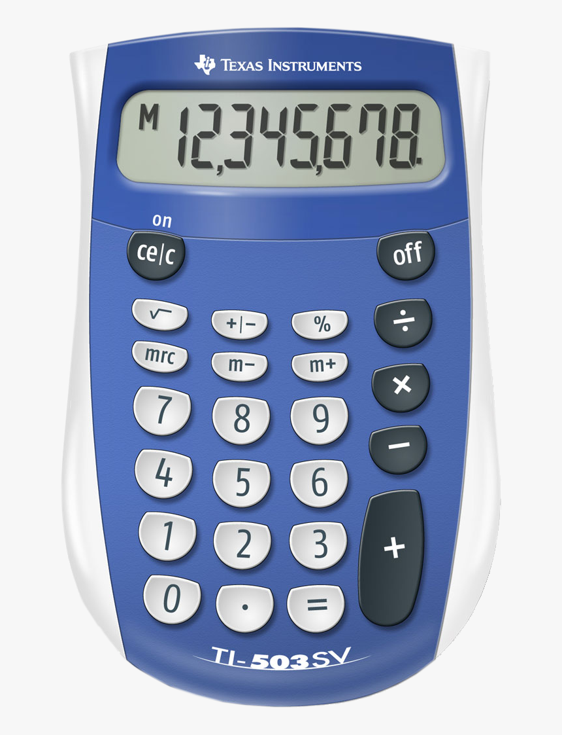
Low-tech tools
Calculators
Calculators assist students with learning disabilities to navigate through math without struggle.
These calculators are designed specially, with large numbers and symbols.
Examples include a 4-function calculator (Kaur et al., 2017).
Notes:
These calculators can be used by students in elementary school to help in easier understanding of mathematics solutions. They are easy to use and reduces understanding difficulties for a student with learning disabilities.

Slide 5
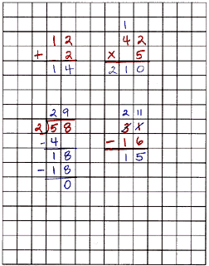
Graph Papers
They include printable math grids that assist students with disabilities such as autism, as well as students with earning difficulties (Shin et al., 2017).
Other graph papers used include those with larger than normal squares.
They help students to line up numbers and symbols when solving a math problem.
Low-Tech tools
Notes:
There are digital graph papers that can be printed as well as graph papers with large squares. A student with special needs may require these graph papers to help in aligning his work. These graph papers are important because they set the writing line for the student.

Slide 6
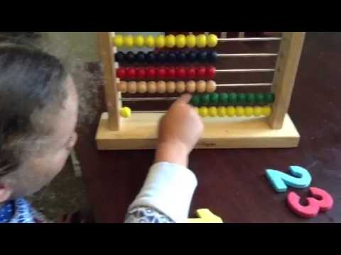
Low-Tech Tools
Manipulative Tools
Manipulative tools include tools such as a number line.
These tools enable students to solve equations in an alternative but easier way.
Tools like the Abacus are also in this category (Shin et al., 2017).
Abacus help students solve math problems through moving beads.
Notes:
Manipulative tools are mainly used in basic mathematics such as addition and subtraction. These tools are effective in assisting students with all sorts of disabilities to build a strong mathematical foundation.

Slide 7
Graphing and Drawing tools
Low-Tech Tools
They help students in drawing as well as analyzing data both in two-dimensional and three-dimensional formats
They may also help in creation of spreadsheets by teachers whenever assessment is being done (Kaur et al., 2017).
MathGrapher is one of the digital tools used for graphing and drawing.
A student needs to only start a demonstration and the tool does the rest.
Notes:
Graphing and drawing tools may be categorized as digital and normal. Drawings assist students especially ones with special needs to concentrate more and understand more easily. Graphs are more sophisticated but by the help of tools such as the MathGrapher, drawings graphs can be made easier. MathGrapher is a software that is used even by high-level scientists to draw graphs without a lot of struggle.

Slide 8
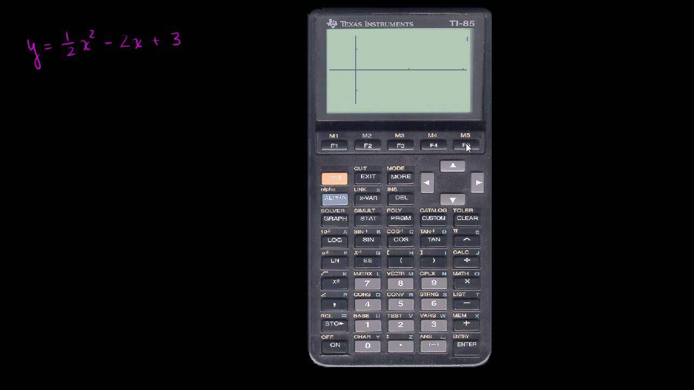
Calculators
High-Tech Tools
High-tech calculators are used to solve more complex mathematical equations, such as algebra (Kaur et al., 2017).
They include graphing calculators and can also be used by high-level elementary students who have learning disabilities.
These calculators can be physical or used online.
Examples of graphing calculators include Casio graphing calculators and HP Prime calculators.
Notes:
Quadratic equations may be a little challenging for students with disabilities. Graphing calculators have been designed to assist students solve these equations more easily.

Slide 9
Text-to-Speech
Text-to-speech is one of the most sophisticated software developed to assist students.
In Mathematics, Test-to-speech is used to read numbers and calculations aloud (Shin et al., 2017).
It helps students with visual impairment to calculate without struggle.
It is mostly combined with tools such as a talking calculator.
High-Tech tools
Notes:
Text-to-speech is important to students who are visually impaired especially ones who use braille keyboards to write. It helps them understand what they are writing and the result of the equation they are solving.

Slide 10
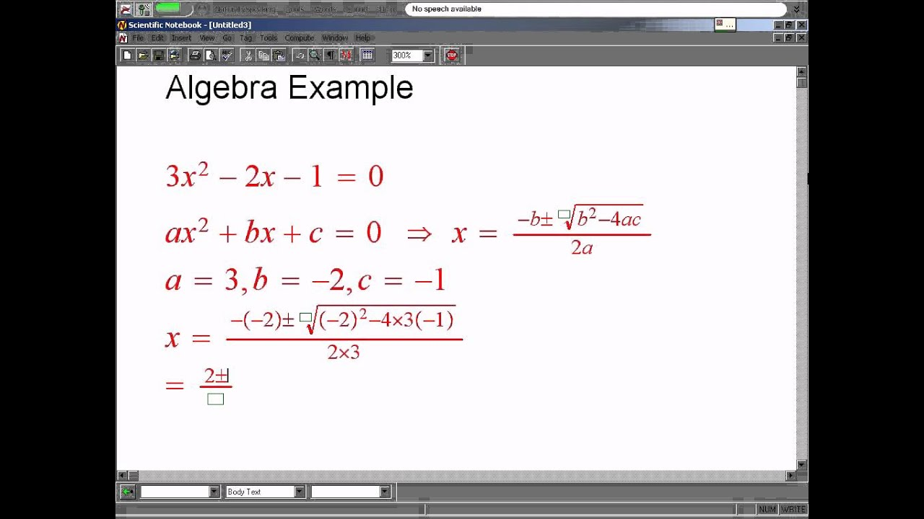
Math Talk
High-Tech Tools
Similar to text-to-speech, math talk uses voice to help in solving equations.
It is also an extremely sophisticated software that uses voice recognition to determine the equation stated (Kaur et al., 2017).
Students talk into a microphone connected to a computer and the software solves the equations.
This software is the opposite of text-to-speech and uses speech-to-text functionality.
Notes:
Software such as Math talk are helpful to students who are physically challenges as it enables them to understand math without having to write it down. Such students include those whose hands have disabilities.

Slide 11
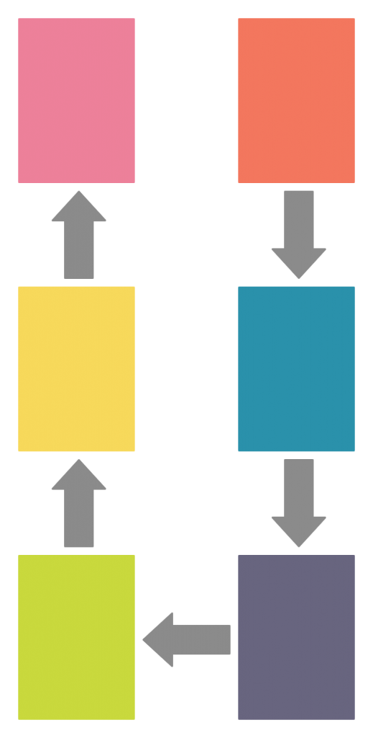
Graphic Organizing Tools
These are software designed to assist a student in drawing graphs, charts as well as other normal drawings.
They help in breaking down the steps in mathematical problem-solving.
They may also be used to help a student easily understand certain concepts in mathematics (Kaur et al., 2017).
Such tools include analogy organizers.
High-Tech tools
Notes:
Graphic organizing tools can be used by teachers to help in elaborating the steps that need to be followed to get a particular equation solved. They can also be used to make drawing or explain mathematical solutions using drawings.

Slide 12
References
Kaur, D., Koval, A., & Chaney, H. (2017). Potential of Using iPad as a Supplement to Teach Math to Students with Learning Disabilities. International Journal of Research in Education and Science, 3(1), 114-121.
Shin, M., Bryant, D. P., Bryant, B. R., McKenna, J. W., Hou, F., & Ok, M. W. (2017). Virtual manipulatives: Tools for teaching mathematics to students with learning disabilities. Intervention in School and Clinic, 52(3), 148-153.

