Slide 1
Asthma
Student’s Name
Institutional Affiliation

Slide 2
Introduction
Asthma is a chronic disease that causes inflammation of airways in the lungs.
The disease causes the airways or bronchial tubes to swell and the muscles around them tighten.
This makes it difficult for air to move in and out of lungs.
It is estimated that about 8.3% of Americans have a form of asthma.

Slide 3
Etiology
Asthma is caused by both environmental and genetic factors.
Exposure to various environmental irritants triggers signs and symptoms of asthma.
Such irritants include airborne substances like dust, pollen grains, pet dander, smoke and mites.
Cold air can also cause asthma.
Genetically, a parent can pass asthma onto her child. Other factors linked to asthma include obesity, smoking, flue, stress and anxiety.

Slide 4
Signs and symptoms
The symptoms of asthma vary from one person to another and with the severity and type of asthma.
The common symptoms of the disease include coughing, shortness of breath, wheezing, chest tightness or pain, irritation and fatigue.
Other signs include lethargy, poor capillary refill (less than 2 seconds) oxygen saturation below the average saturation level (below 95%).

Slide 5
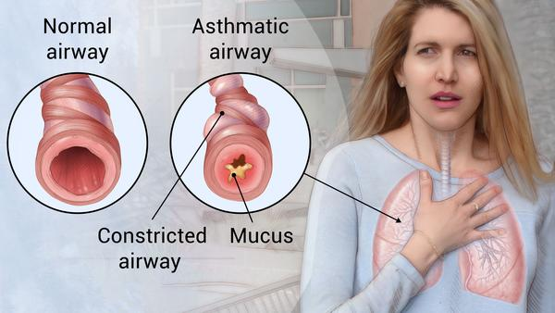
An asthmatic person

Slide 6
Epidemiology
The prevalence of the disease is more in children than in adults.
The average annual asthma prevalence is higher in children (9.5%) than adults (7.7%).
The prevalence of asthma is higher in black persons than white persons.
Asthma is also more prevalent in low income earners compared to high income earners.
People who take poor diet and fail to exercise are likely to develop asthma.

Slide 7
Diagnosis
Differential diagnosis
Some of the differential diagnosis for asthma include bronchitis, chronic obstructive pulmonary disease (COPD), pulmonary edema, pneumonia, pulmonary embolism, and chemical pneumonitis.
These conditions can mimic the signs and symptoms of asthma.
Patients with cystic fibrosis, carcinoid syndrome and sarcoidosis and heart failure may wheeze similar to those suffering from asthma.

Slide 8
Actual diagnosis
The doctor looks at the symptoms correctly to assess asthma.
Some of the symptoms include coughing, wheezing, shortness of breath, and chest tightness.
Physical examination of the ears, chest, eyes, chest, and lungs is conducted. Lung function tests are another component of an asthma diagnosis.
They measure how much air a person inhales and exhales and the speed with which a person can expel air from the lungs.
A spirometry test can provide an indication of lung function.

Slide 9
Treatment
Asthma is an incurable disease.
However the disease can be managed and controlled through medication.
Some of the treatments include antiflammatories, bronchodilators, and corticosteroids.
Inhalers are also very crucial in maintain the life of an asthmatic patient.
The inhalers which might be metered-dose or dry-powder are taken home to assist the patient in breathing.

Slide 10
Conclusion
Asthma is a chronic inflammatory condition that causes swelling and blockage of airways.
Anyone can develop asthma although children are more likely than adults to develop the condition.
Some of the signs and symptoms of the disease are coughing, wheezing, shortness of breath and chest pain.
Asthma can be diagnosed by testing lung function and immune response.
Unfortunately, the disease is incurable but its symptoms can be managed and controlled.

