Slide 1
behavioral ecology
filling out tables and graphs

Slide 2

table 11.1
Relay Distance (meters) | Relay Time (seconds)
3
6
9
(page 155)
Modified Procedure 1, step #8

Slide 3
table 11.2
(page 155)
Trial | Theoretical Points/Time Red | Theoretical Points/Time Blue | Theoretical Prediction
1
2
3
4

Slide 4
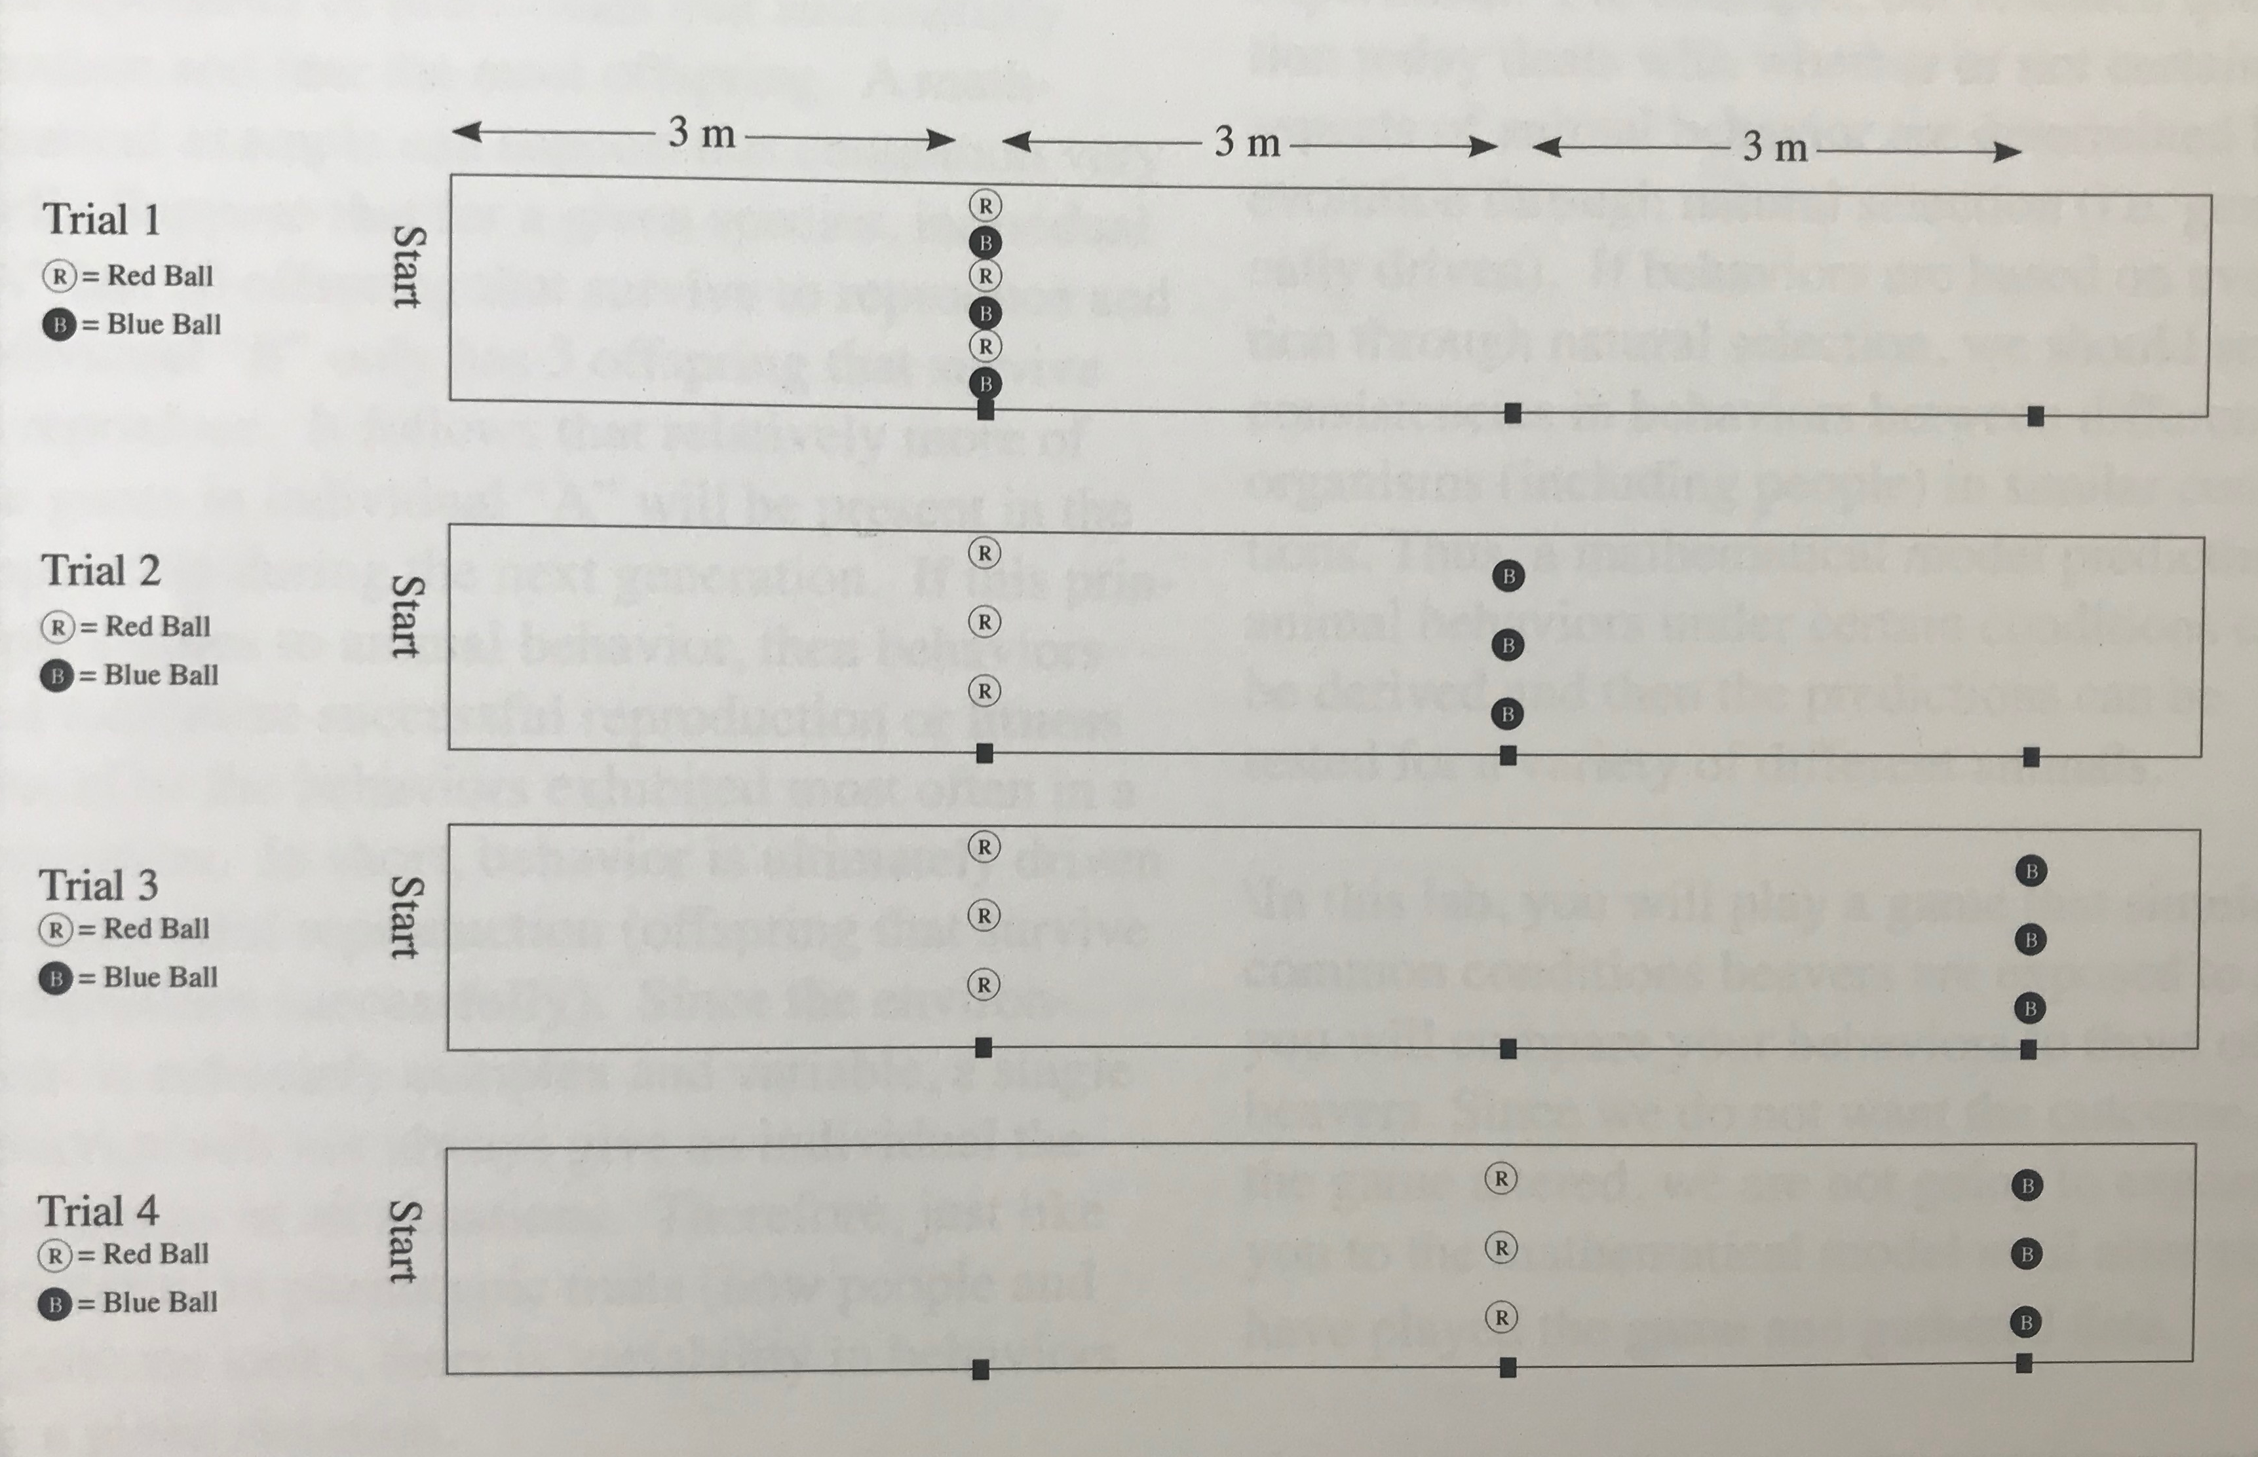
different game setups for each trial
(page 150)

Slide 5
table 11.2
(page 155)
Trial | Theoretical Points/Time Red | Theoretical Points/Time Blue | Theoretical Prediction
1
2
3
4

Slide 6

Trial 2
3 meters
3 meters
3 meters
5 points
8 points

Slide 7
Trial 2
3 meters
3 meters
3 meters
table 11.2
Trial | Theoretical Points/Time Red | Theoretical Points/Time Blue | Theoretical Prediction
2
# Points
3*(5pt)
15 pts
Theoretical Points/Time Red
=
=
=
= 1.5
Amount of Time
Relay Time (3m)
10 seconds

Slide 8
Trial 2
3 meters
3 meters
3 meters
table 11.2
Trial | Theoretical Points/Time Red | Theoretical Points/Time Blue | Theoretical Prediction
2 | 1.5
# Points
3*(8pt)
24 points
Theoretical Points/Time Blue
=
=
=
=1.2
Amount of Time
Relay Time (6m)
20 seconds

Slide 9
table 11.2
(page 155)
Trial | Theoretical Points/Time Red | Theoretical Points/Time Blue | Theoretical Prediction
1
2 | 1.5 | 1.2 | Red
3
4

Slide 10
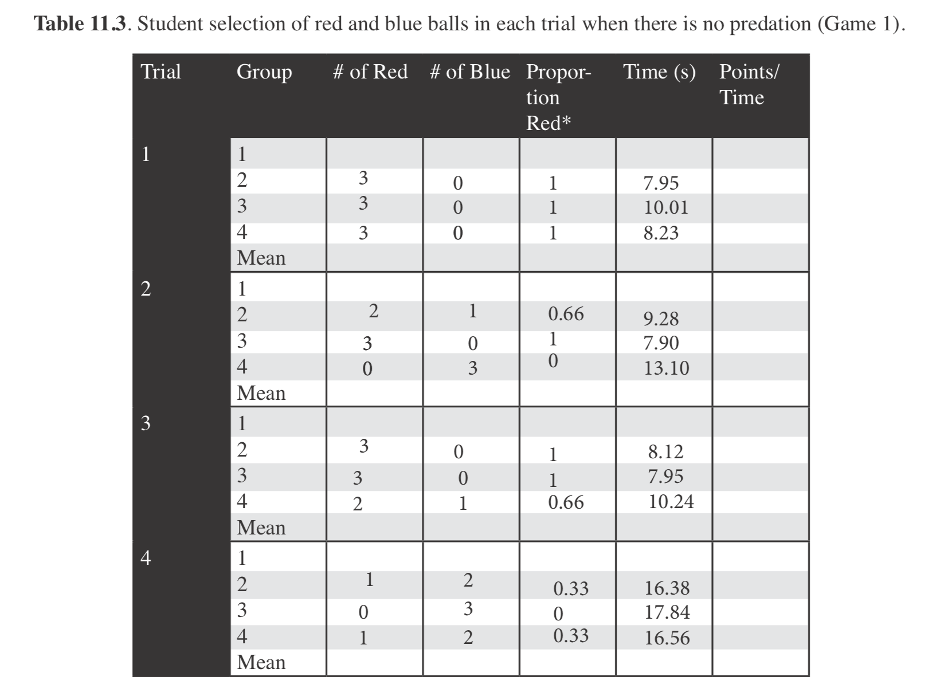
table 11.3
(page 158)
table 11.4
(page 158)

Slide 11
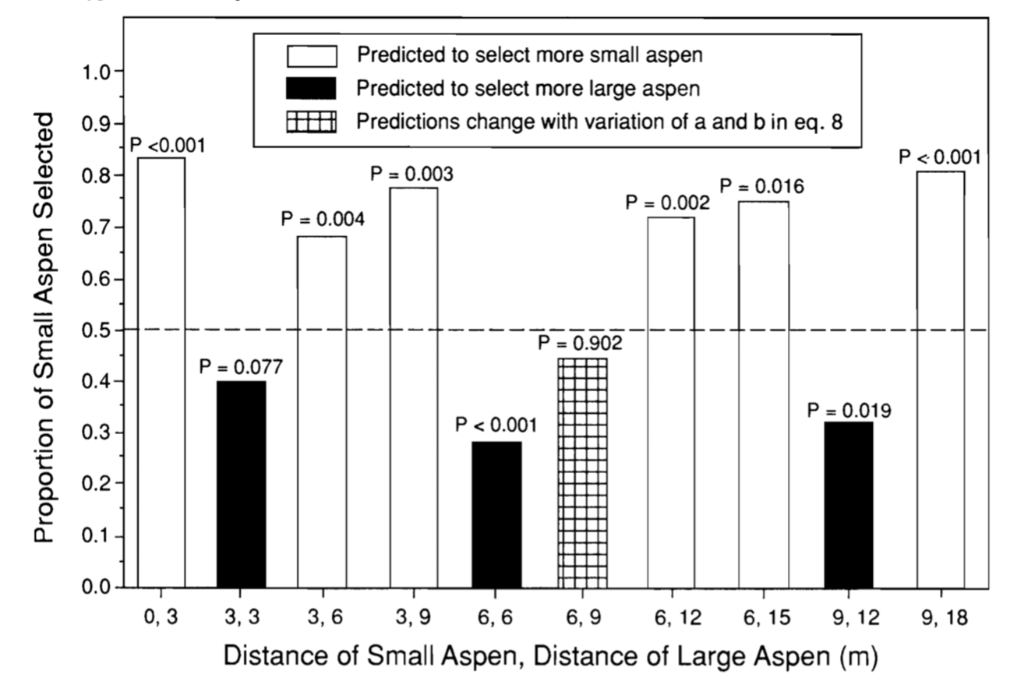
graph
(page 158)

Slide 12
no predation
predation
1.0
proportion
red
0.5
0.0
1
2
3
4
1
2
3
4
trial

Slide 13
no predation
predation
1.0
red predicted
blue predicted
proportion
red
0.5
0.0
1
2
3
4
1
2
3
4
trial

