Slide 1
Global Cultural Intelligence

Slide 2
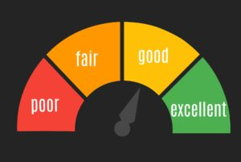
MULTI-RATER ASSESSMENT (360’S)
This model is application high-potential programs.
Organizations rely on this model to measure cultural awareness of their employees.

Slide 3
Financial measurements
The organization can use financial resources to collect 360 feedback through:
  Structured interviews
  Online quantitative method
Reduce costs will be the financial outcome that will be realized out the implementation of the model.

Slide 4
Customer Measurements
By implementing the 360 multi-rater cultural intelligence measure, the organization will gather information that will enable it to connect well with the local people.
  Observe interactions with people from diverse cultures.
  Attracting new customers
  Obtaining a group report

Slide 5
Business Processes
This initiative will make it possible for the organization to align the management expectations with those of employees.
This will make it possible for employees to focus on improving cultural competencies that are a priority to the management.

Slide 6
Learning and Growth
The organization will learn about the positive implications of cultural diversity.
The multi-rater 360 model will inform about the cultural awareness of people working for the organization.
This will be the basis for promoting cultural diversity.

Slide 7
Resources
Cultural diversity learning materials
A diverse workforce
“walk around” 360 assessment reports
Culture coaches

Slide 8
References
Thomas, D. C. (2008). Cultural intelligence: People skills for global business. ReadHowYouWant. com.
Ang, S., & Van Dyne, L. (2015). Handbook of cultural intelligence: Theory, measurement, and applications. Routledge.

