Slide 1
Medical Terminology:
Learning Through Practice, 1e
Paula Bostwick
Chapter 15
The Urinary System
©McGraw-Hill Education. All rights reserved. Authorized only for instructor use in the classroom. No reproduction or further distribution permitted without the prior written consent of McGraw-Hill Education.

Slide 2
Learning Outcomes
15.1 Describe the parts of the urinary system and discuss the function of each part.
15.2 Recognize the major word parts used in building words that relate to the urinary system.
15.3 Identify and understand the common diagnostic tests, laboratory tests, and clinical procedures used in testing and treating disorders of the urinary system.
15.4 Define the major pathological conditions of the urinary system.
15.5 Define the surgical terms related to the urinary system.
15.6 Recognize common pharmacological agents used in treating disorders of the urinary system.
15.7 Identify common abbreviations associated with the urinary system.

Slide 3
LO 15.1 Structure and Function of the Urinary System
Urinary system
Renal system /excretory system
Maintains water balance
Removes waste products
Urology =
Ur(o) urine + ology study of

Slide 4
Function / Structure
Composed of kidneys, ureters, urinary bladder, and urethra
Two kidneys (nephr/o)—posterior mid trunk
Filter toxins / substances / create urine
Two ureters (ureter/o)—carry urine
Urinary bladder (cysto)—stores urine
Urethra (urethr/o)—removes urine

Slide 5
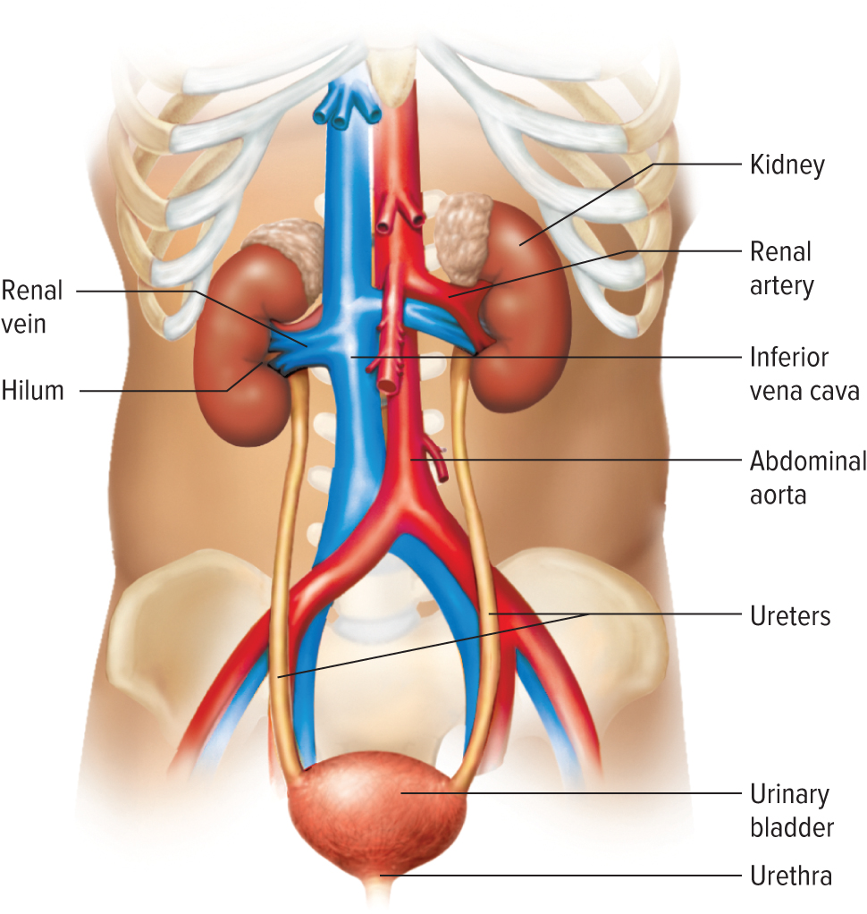
Urinary System

Slide 6
Major Word Parts 1
cali(o), calic(o) | calix
cyst(o) | bladder
glomerul(o) | glomerulus
meat(o) | meatus
nephr(o) | kidney
pyel(o) | renal pelvis
ren(o) | kidney
trigon(o) | trigone

Slide 7
Major Word Parts 2
ur(o), urin(o) | urine
ureter(o) | ureter
urethr(o) | urethra
-uria | of urine
vesic(o) | bladder

Slide 8
Kidneys 1
Bean-shaped organs
Mid to lower back
Filter the blood
Regulate fluids
Kidney = nephr(o)
Test / procedure = ren(o)

Slide 9
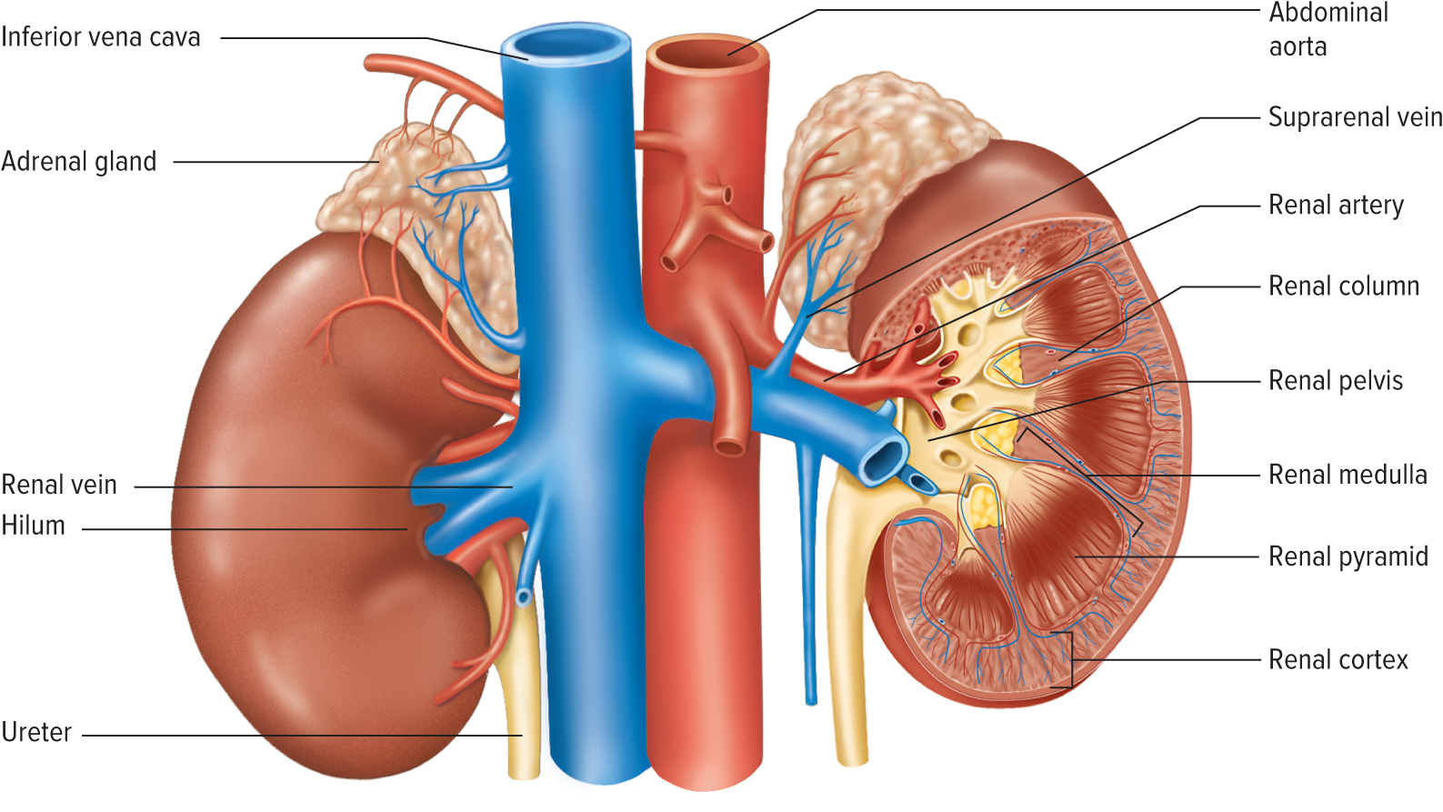
Kidneys 2

Slide 10
Blood Pressure / Kidneys
Homeostasis (equilibrium)
Balance salts, sugars, and water
Two control mechanisms
Automatic dilating/constricting of the arterioles
Release of renin
Affects blood pressure

Slide 11
Ureters, Bladder, Urethra
Ureters—ureter(o)—22-cm long tubes extend from kidney to bladder
Urinary bladder—cyst(o)—sac-like structure sits in the pelvis, muscular for forcing urine out
Urethra—urethr(o)—extends from bladder to the meatus (controls release)

Slide 12
Prostate Gland
Urinary system is the same for both sexes with the exception of the prostate gland.
Only in males, connecting urethra and ejaculatory duct
Prostate = prostat(o)

Slide 13
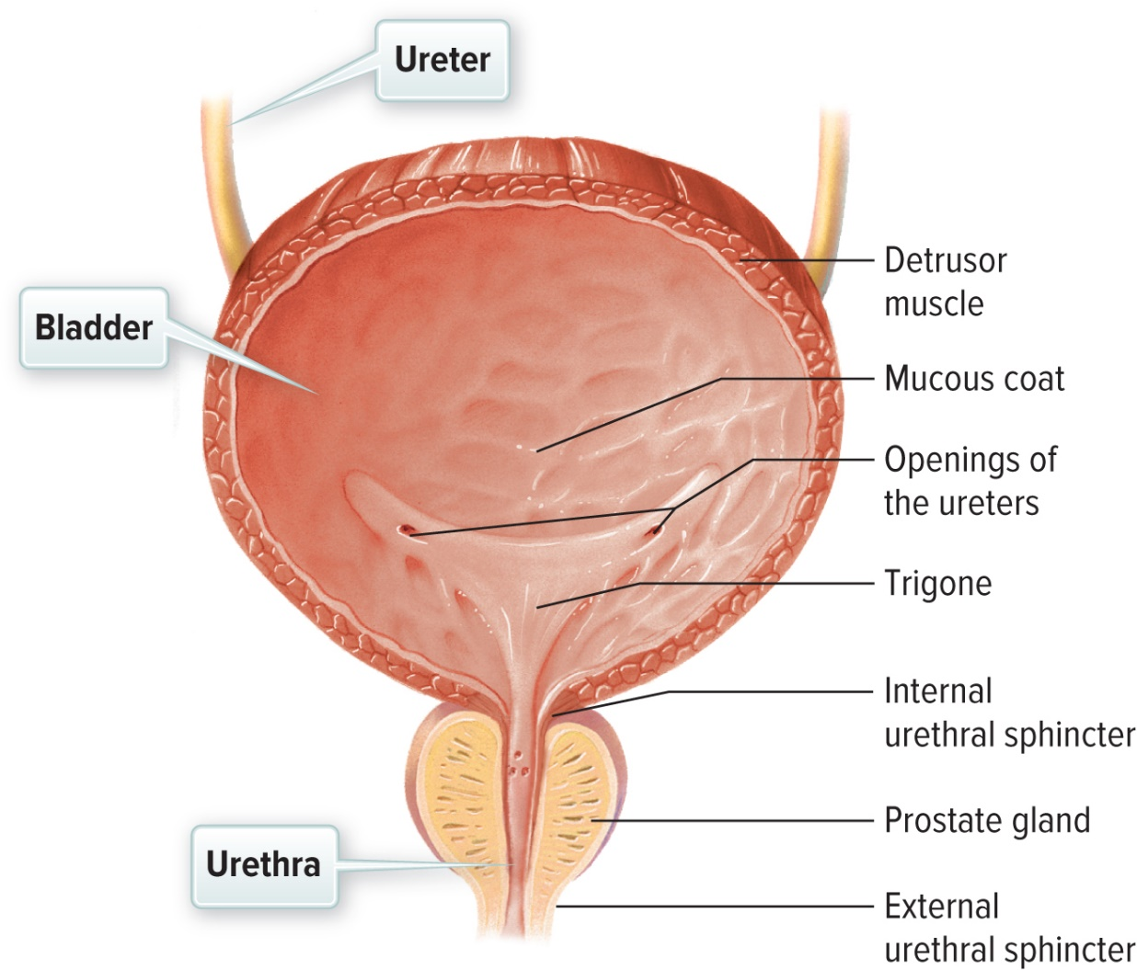
Bladder, Ureter, Urethra
Access the text alternative for these images

Slide 14
Cystitis vs. Pyelonephritis
Cystitis: superficial infection
  dysuria, urgency, frequency
  intracellular, biofilm like pods
Pyelonephritis
  invasion of kidney, +/-bloodstream
  Fever, chill, flank pain, tenderness, increase WBC

Slide 15
LO 15.3 Diagnostic, Procedural, and Laboratory Terms
Urinalysis used to diagnose many urinary disorders, conditions, symptoms, and diseases
Look at urine sample by microscope or machine
Urine sterile in body sample should remain sterile
“Clean catch” not sterile, but used
Foley catheters help control urination

Slide 16
Imaging Tests and Urinary Tract Procedures
KUB = kidney/ureter/bladder—diagnostic radiologic exam
Shows abdominal organs
Ultrasound = sound waves used to visualize the organs
Patients are asked to drink lots of water prior to ultrasound—sound travels better through fluid
Dialysis – mechanical way to maintain kidney or renal functions when kidney failure occurs.
ESWL – procedure used to break up urinary stones using shock waves from outside the body.

Slide 17
15.4 Pathological Terms
Used to assign a disease to symptoms and findings
Many abbreviations used in place of longer medical terms
UTI = urinary tract infection
Nephrosis
Edema
ESRD
Renal failure
Dysuria
Nocturia

Slide 18
LO 15.5 Surgical Terms
Urologists perform surgical procedures to correct, remove, or reconstruct organs and tissue to improve function and quality of life.
  Nephrectomy
  Pyelotomy
  Lithotomy
  Urethroplasty
  Urostomy

Slide 19
LO 15.6 Pharmacological Terms
antispasmodic
diuretic
antihypertensive (ACE inhibitor)
antibiotics
anticholinergics

Slide 20
LO 15.7 Abbreviation 1
ARF | acute renal failure
BUN | blood urea nitrogen
CRF | chronic renal failure
ESRD | end-stage renal disease
ESWL | extracorporeal shock wave lithotripsy
EUD | external urinary drainage
GFR | glomerular filtration rate
GU | genitourinary

Slide 21
LO 15.7 Abbreviation 2
I&O | intake and output
IVP | intravenous pyelogram
KUB | kidney/ureter/bladder
RP | retrograde pyelogram
UA, U/A | urinalysis
UTI | urinary tract infection
VCG | voiding cystogram
VCUG | voiding cystourethrogram

Slide 22
Chapter Summary 1
15.1 The urinary system is comprised of organs and tube-like structures that function to maintain fluid balance and remove waste from the body.
15.2 Word building requires knowledge of word parts and their corresponding meanings to form medical terms within the urinary system.
15.3 Diagnostic, procedural, and laboratory findings assist the health care provider in diagnosing medical conditions. Urinalysis is often used in combination with imaging, and these tests lead to a final diagnosis and assist in treatment planning.

Slide 23
Chapter Summary 2
15.4 Knowledge and understanding of diseases and conditions of the urinary system, including acute and chronic diseases, structure repair and treatment to promote function, and cancer, increase critical thinking related to pathological medical terms.
15.5 Surgical procedures within the urinary system revolve closely around repair of damaged or nonfunctioning structures to restore fluid output and/or treatment of cancer with the system.

Slide 24
Chapter Summary 3
15.6 Primary and common pharmacological agents used in the urinary system are symptomatic antispasmodics, antibiotics to fight bacterial infection, anticholinergics, and diuretic (antidiuretic) drugs.
15.7 Abbreviations are used to describe diseases, conditions, procedures, and treatments associated with the urinary system.

Slide 25
Accessibility Content: Text Alternatives for Images

Slide 26
Bladder, Ureter, Urethra Text Alternative
Two ureters feed into the urinary bladder, and one urethra extends from it. The outer layer of the bladder is the detrusor muscle. An internal urethral sphincter is at the top of the urethra, an external urethral sphincter at the bottom.
Return to slide containing original image

