Slide 1
Medical Terminology:
Learning Through Practice, 1e
Paula Bostwick
Chapter 16
The Male Reproductive System
©McGraw-Hill Education. All rights reserved. Authorized only for instructor use in the classroom. No reproduction or further distribution permitted without the prior written consent of McGraw-Hill Education.

Slide 2
Learning Outcomes
16.1 Recognize the parts of the male reproductive system and discuss the function of each part.
16.2 Recall the major word parts used in building words that relate to the male reproductive system.
16.3 Identify the common diagnostic tests, laboratory tests, and clinical procedures used in testing and treating disorders of the male reproductive system.
16.4 Define the major pathological conditions of the male reproductive system.
16.5 Recall the meaning of surgical terms related to the male reproductive system.
16.6 Recognize common pharmacological agents used in treating disorders of the male reproductive system.
16.7 Identify common abbreviations associated with the male reproductive system.

Slide 3
LO 16.1 Structure and Function of the Male Reproductive System
Male organs produce, maintain, and transport sperm (male sex cells) along with seminal fluid.
Secrete male hormones

Slide 4
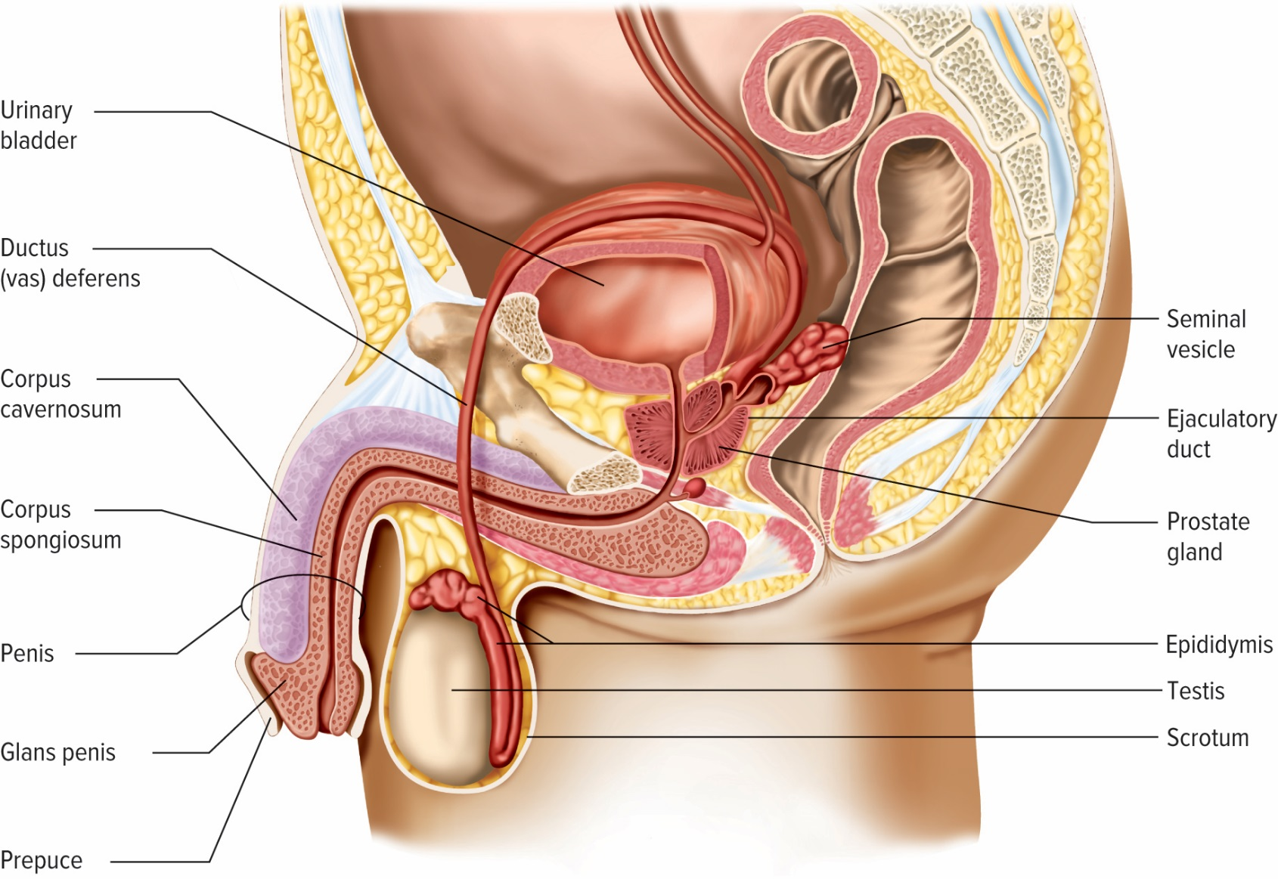
Male Reproductive Organs
Access the text alternative for these images

Slide 5
Building Vocabulary 1
andr(o) | men
balan(o) | glans penis
epididym(o) | epididymis
orch(o), orchi(o), | testes
orchid(o)

Slide 6
Building Vocabulary 2
prostat(o) | prostate gland
scrot(o) | scrotum
semin(o) | semen
sperm(o), | sperm
spermat(o)
vas(o) | vessel; ductus deferens

Slide 7
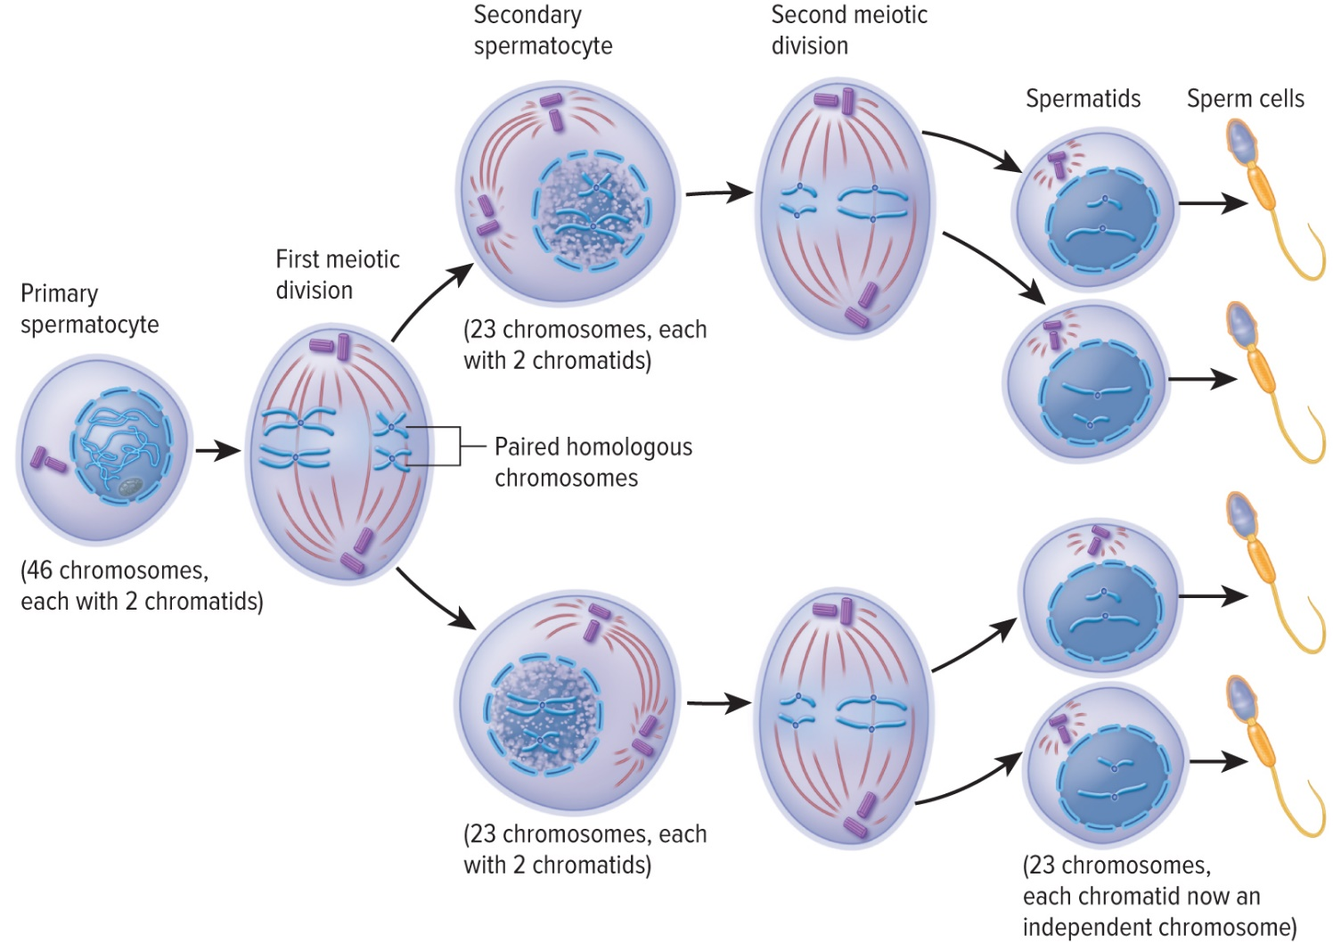
Spermatogenesis

Slide 8
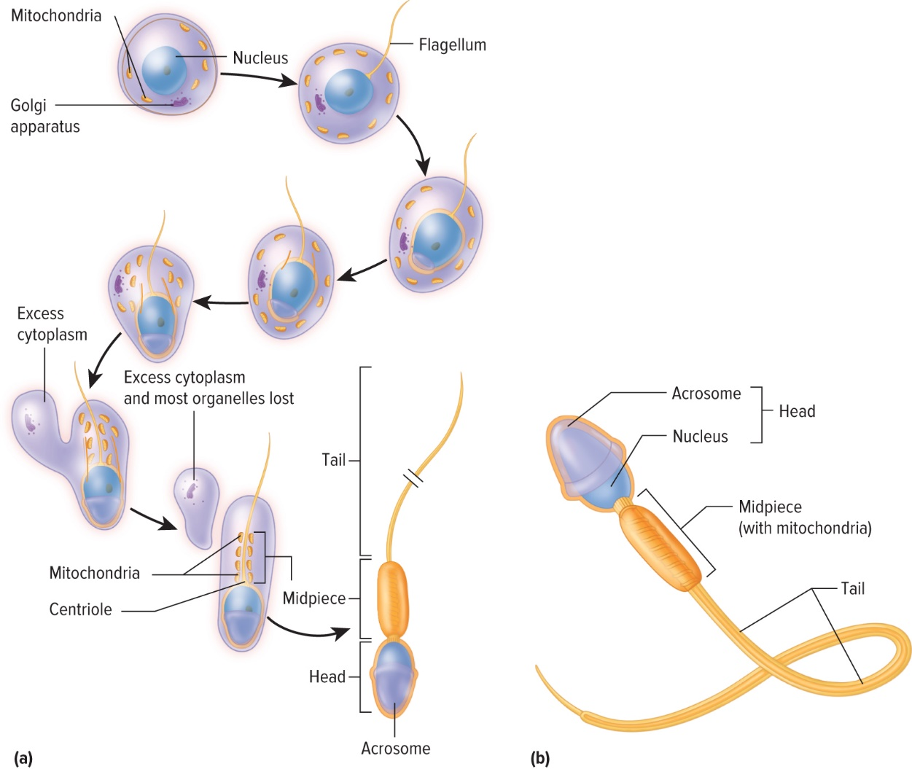
Spermatogenesis Maturation

Slide 9
Male Reproductive Hormones
Testosterone
FSH (follicle-stimulating hormone)
LH (luteinizing hormone)
Inhibin

Slide 10
Prostatitis
Prostat(o) = prostate + itis = inflammation
  Generic term for any prostate inflammation
Benign Prostatic Hypertrophy (BPH)
  non-cancerous enlargement
  middle-aged males

Slide 11
LO 16.3 Diagnostic, Procedural, and Laboratory Terms
Physical examination
Prostate cancer most common male cancer
Prostatitis = enlarged, either benign or malignant
Biopsy to evaluate
Undiagnosed leads to later stages = lower survival rate

Slide 12
LO 16.4 Pathological Terms
Some conditions due to male anatomy, condition of organs, and reproductive abnormalities at birth
Cryptorchidism—crypt(o) = hidden + orchidism = testicle
Testicle does not descend into scrotum before birth. (Premature babies most often affected)
Gynecomastia – swelling of breast tissue in males
Phimosis – birth defect where there is an abnormal narrowing of the foreskin over the glans penis

Slide 13
LO 16.5 Surgical Terms
Circumcision
Epididymectomy
Prostatectomy
Vasectomy
Castration

Slide 14
LO 16.6 Pharmacological Terms
Hormone replacement therapy
Help resolve sexual problems and signs of aging
Impotence
Erectile dysfunction—surgical or mechanical devices
Benign hypertrophic prostatitis (BPH)
  Treatment and medications
  Manageable with treatment and check-ups

Slide 15
Treatment for Prostatitis
Surgical removal
Radiation
Drugs
Microwaves
Balloon dilation
Tumor frozen
Stent placement

Slide 16
LO. 16.7 Abbreviations
BPH | benign prostatic hyperplasia
ED | erectile dysfunction
FSH | follicle-stimulating hormone
HPV | human papillomavirus
LH | luteinizing hormone
STI | sexually transmitted infection
TUR | transurethral resection
TURP | transurethral resection of the prostate

Slide 17
Chapter Review 1
16.1 The male reproductive system is comprised of many anatomical structures that function to work together with the female to produce offspring, as well as share urinary functions and hormone production.
16.2 Word building requires knowledge of word parts and their corresponding meanings to form medical terms within the male reproductive system.
16.3 Diagnostic, procedural, and laboratory findings assist the health care provider in diagnosing medical conditions. Often used in combination, these tests lead to a final diagnosis and assist in treatment planning.

Slide 18
Chapter Review 2
16.4 Knowledge and understanding of diseases and conditions of the male reproductive system, including the prostate, reproductive organs, and sexually transmitted infections, increases critical thinking related to pathological medical terms.
16.5 Surgical procedures within the male reproductive system revolve closely around repair of damaged or immature structures and treatment of cancer with the system.

Slide 19
Chapter Review 3
16.6 Primary and common pharmacological agents used in the male reproductive system are steroids, hormone replacement, and treatment of benign prostate symptoms.
16.7 Abbreviations are used to describe diseases, conditions, procedures, and treatments associated with the male system.

Slide 20
Accessibility Content: Text Alternatives for Images

Slide 21
Male Reproductive Organs Text Alternative
In addition to the commonly known organs of the male reproductive system such as penis, glans penis, prepuce, scrotum, testis, and epidiymis, the male reproductive system also includes ductus (vas) deferens, corpus cavernosum, corpus spongiosum, seminal vesicle, ejaculatory duct, and prostate gland.
Return to slide containing original image

