Slide 1
Chapter 5:
Sampling

Slide 2
Population & Sample
Why take sample? Why not study the whole population?
  Want to study inmates in America
    Want to interview or deliver survey to every inmate in America?
    Is it doable? – NO

Slide 3
Population & Sample
Population
  The entire set of elements in which we are interested
Sample
  A subset of elements from the larger population

Slide 4
Sample Planning
Definition of Sample Components and Population
Elements – the individual entities of the population whose characteristics are to be measured
Sampling Frame – list of all elements in population from which sample is drawn
Enumeration Units – units that contain one or more elements listed in a sampling frame
Sampling Units – units selected at each stage of multistage sampling design
Bachman, Fundamentals of Research in Criminology and Criminal Justice, 4e. SAGE Publishing, 2018.

Slide 5
Evaluation of Generalizability
Scope of Generalizability
  Sample generalizability – when conclusion is based on a sample (subset) of larger population and it holds true for the whole population
  Cross-population generalizability (external validity) – when findings about one group, population, setting holds true for other groups, populations, settings
Sample Generalizability depends on Sample Quality
  Determined by Sampling Error – any difference between the characteristics of a sample and the characteristics of the population which it was drawn; the larger the sampling error, the less representative the sample is of the population
Bachman, Fundamentals of Research in Criminology and Criminal Justice, 4e. SAGE Publishing, 2018.

Slide 6
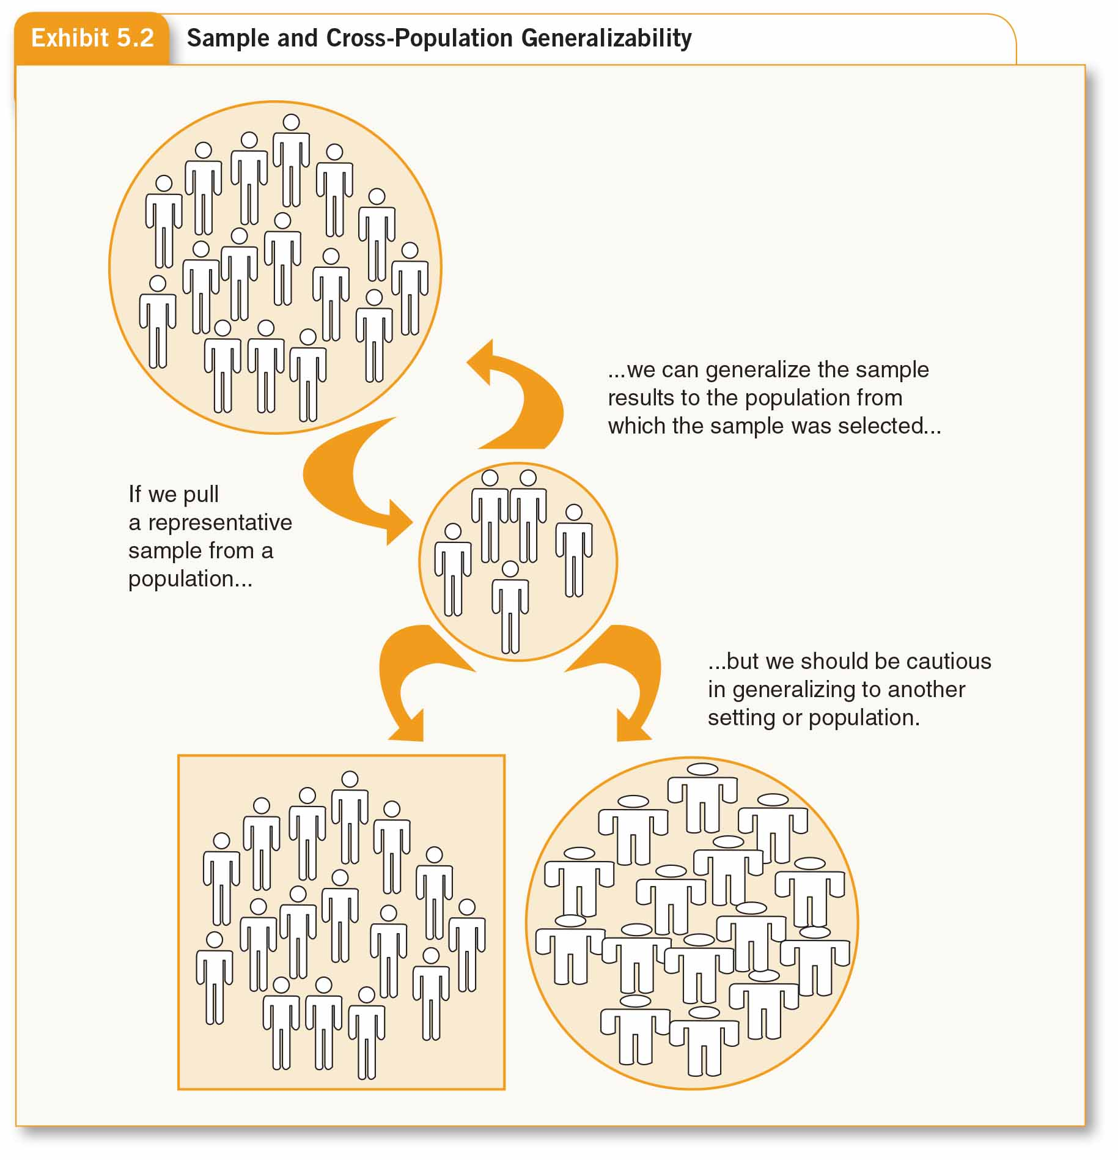
Evaluation of Generalizability

Slide 7
Assess Population Diversity
Need Representative Sample – one that looks similar (in all relevant aspects) to the population from which it is selected
Consider a Census – information obtained though responses from all available members of a population
Bachman, Fundamentals of Research in Criminology and Criminal Justice, 4e. SAGE Publishing, 2018.

Slide 8
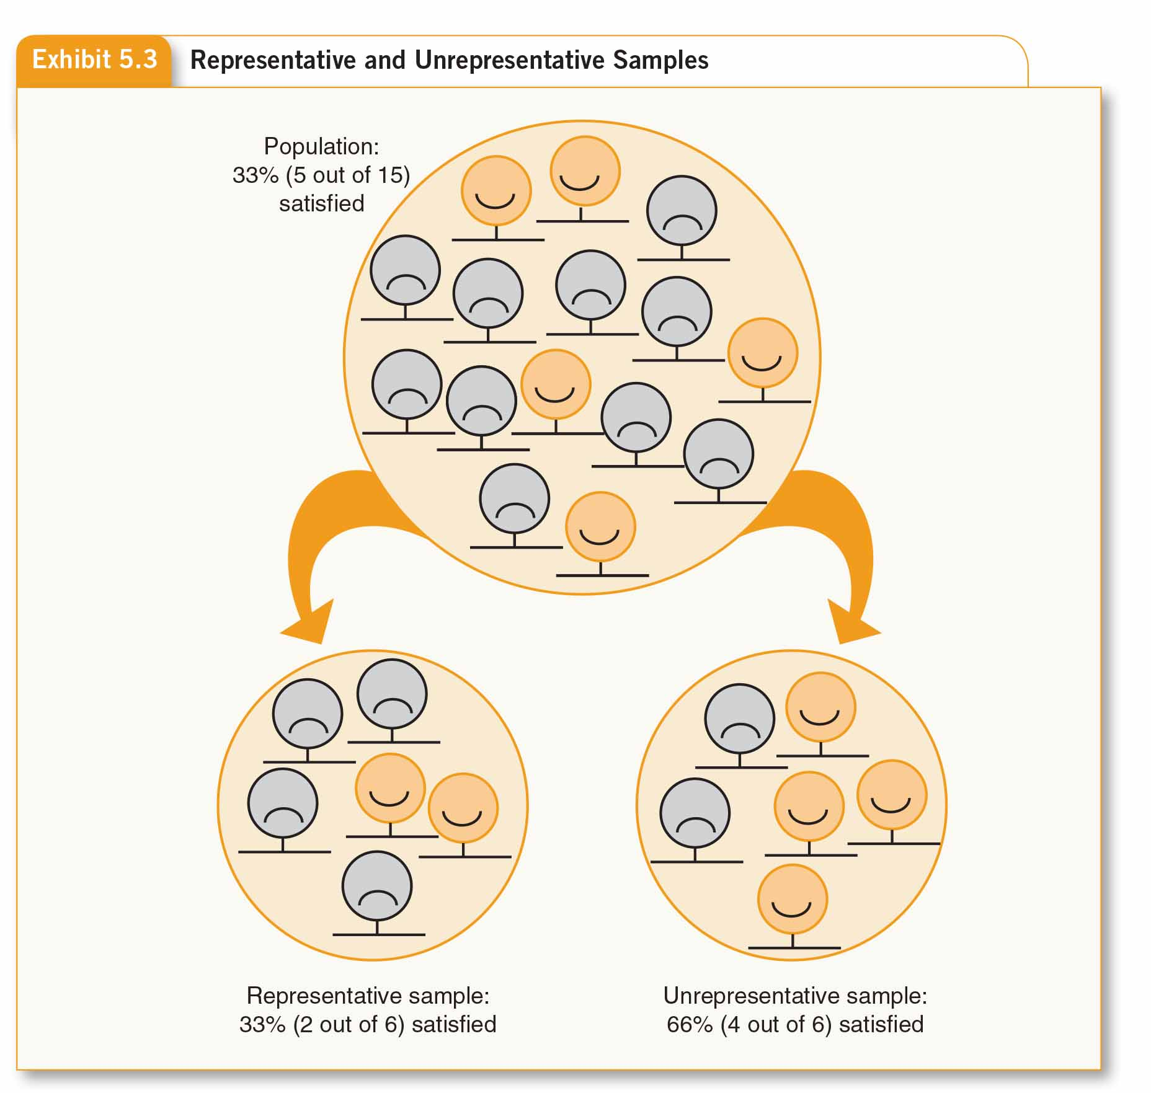
Assess Population Diversity

Slide 9
Sampling Methods
Important Distinction:
  Probability or Nonprobability?
Probability sampling – allows researcher to know the likelihood that any element of a population will be selected for a sample
Nonprobability sampling – probability of selection of population elements is unknown
Bachman, Fundamentals of Research in Criminology and Criminal Justice, 4e. SAGE Publishing, 2018.

Slide 10
Probability Sampling Methods
Probability of selection is known AND is not zero
No systematic bias, as they are randomly selected
Bachman, Fundamentals of Research in Criminology and Criminal Justice, 4e. SAGE Publishing, 2018.

Slide 11
Probability Sampling Methods
Random selection
  The fundamental element of probability samples. The essential characteristic of random selection is that every element of the population has a known and independent chance of being selected into the sample
Systematic bias
  Overrepresentation or underrepresentation of some population characteristics in a sample resulting from the method used to select the sample; a sample shaped by systematic sampling error is a biased sample

Slide 12
Probability Sampling Methods
Systematic bias
  The larger the sample, the more confidence we can have in the sample’s representativeness of the population from which it was drawn
  The more homogeneous the population, the more confidence we can have in the representativeness of a sample of any particular size

Slide 13
Simple Random Sampling
Requires procedure to generate numbers or identify cases strictly on the basis of chance
  Use of Random Number Table
    All elements in a sampling frame numbered, systematic procedure used to pick corresponding numbers from random number table
Bachman, Fundamentals of Research in Criminology and Criminal Justice, 4e. SAGE Publishing, 2018.

Slide 14
Selection process
Random number table may be used – contains lists of telephone numbers, first choice made on random basis
Random digit dialing (RDD) – dialed by machine within designated phone prefixes creates a random sample for phone surveys
Replacement sampling – each element returned to sampling from so it may be sampled again
Bachman, Fundamentals of Research in Criminology and Criminal Justice, 4e. SAGE Publishing, 2018.

Slide 15
Systematic Random Sampling
Less time consuming than simple random sampling
First element selected randomly then every nth element selected thereafter
Convenient method for drawing random sample when elements arranged sequentially
Bachman, Fundamentals of Research in Criminology and Criminal Justice, 4e. SAGE Publishing, 2018.

Slide 16
Systematic Random Sampling
Three steps:
Total # of cases in population divided by # of cases required for sampling
  Sampling interval – # of cases from one sampled case to another
  First number selected randomly from 1 to the sampling interval
  Every nth case (sampling interval) selected for the sample to yield the proper number of cases
Bachman, Fundamentals of Research in Criminology and Criminal Justice, 4e. SAGE Publishing, 2018.

Slide 17
Systematic Random Sampling
Almost always yields a simple random sample
  EXCEPT: when the sequence varies in a regular, periodic pattern known as Periodicity
Bachman, Fundamentals of Research in Criminology and Criminal Justice, 4e. SAGE Publishing, 2018.

Slide 18
Stratified Random Sampling
A method of sampling in which sample elements are selected separately from population strata that are identified in advance by the researcher
  All elements in population (sampling frame) sorted by relevant characteristic
  Elements randomly sampled within strata
  Distinguish individuals by race
  Within each racial category, sample individuals randomly
  May sample proportionately or disproportionately
Bachman, Fundamentals of Research in Criminology and Criminal Justice, 4e. SAGE Publishing, 2018.

Slide 19
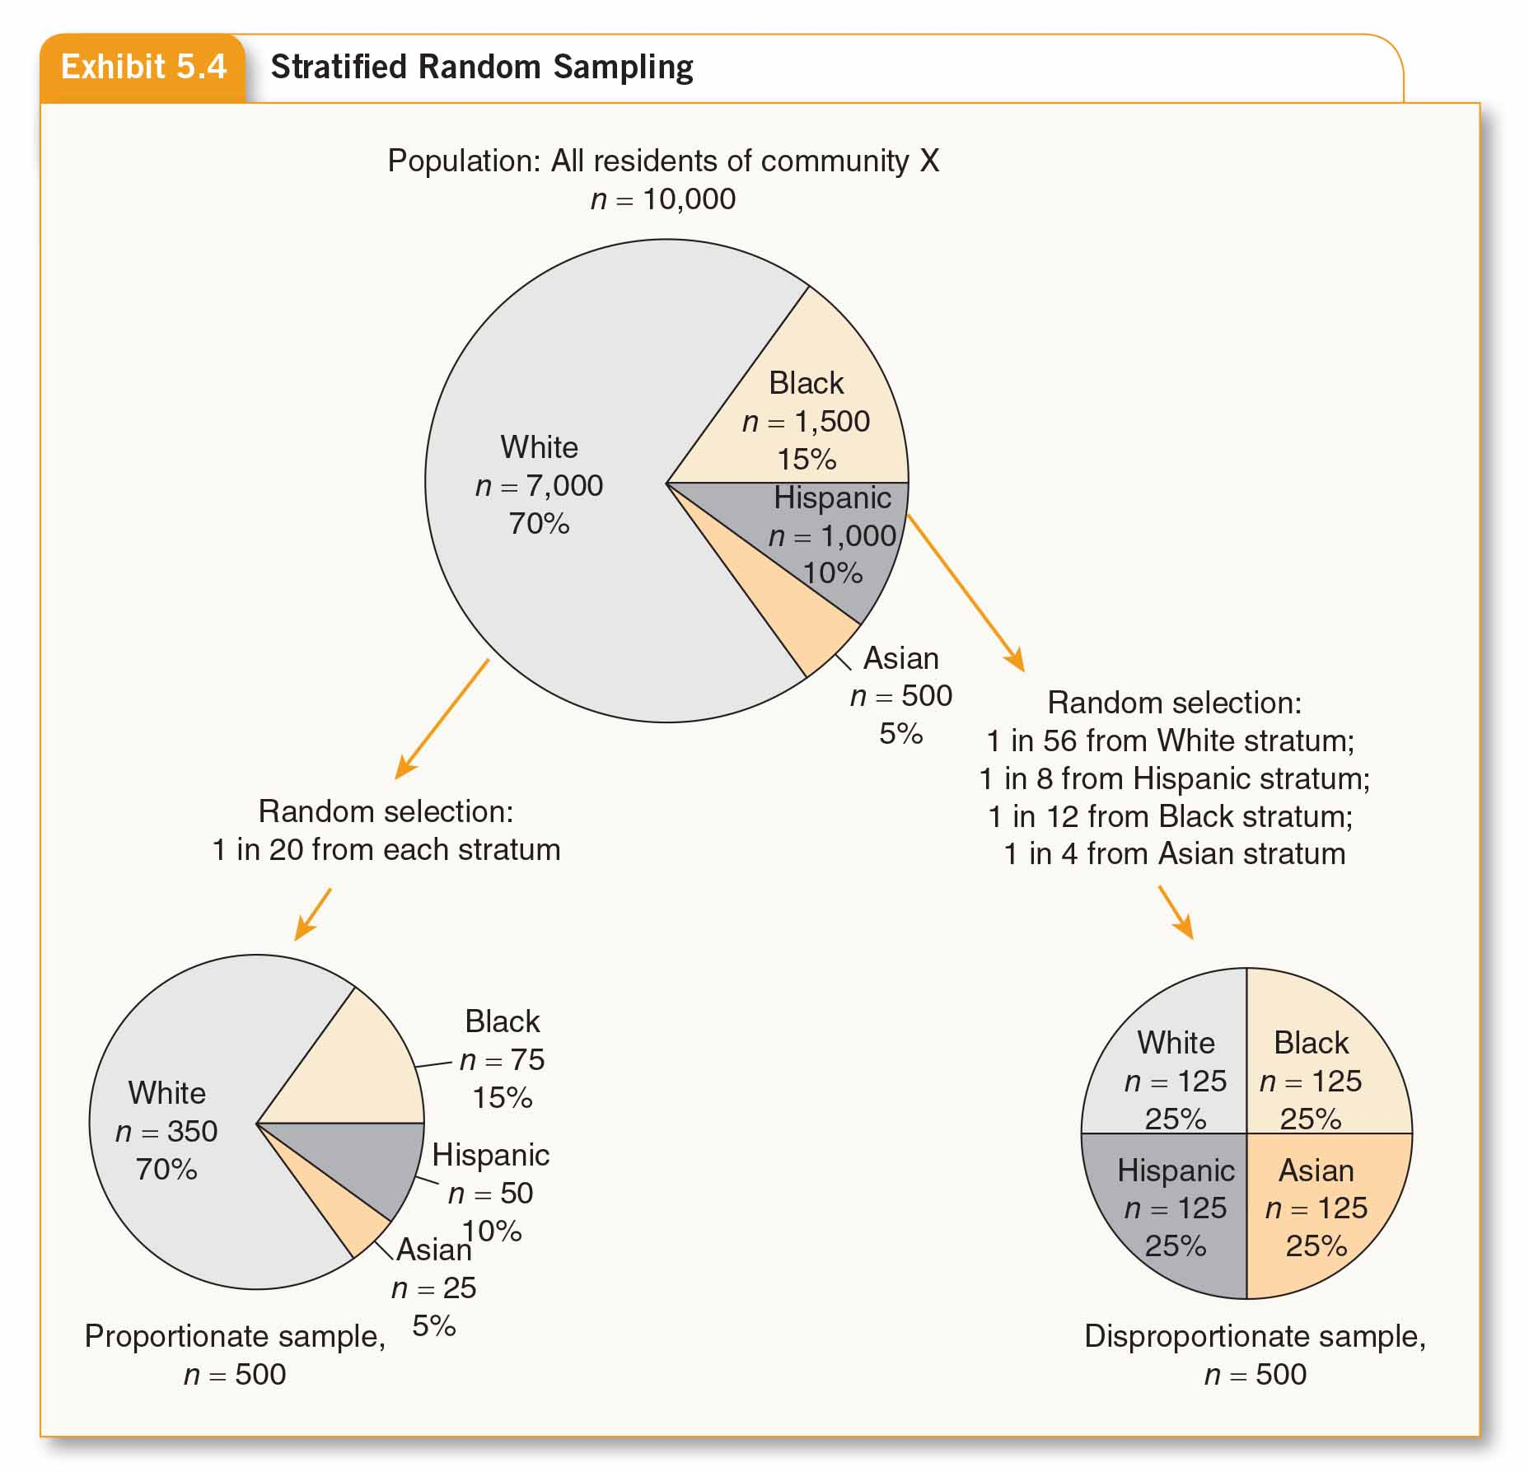
Stratified Random Sampling

Slide 20
Multistage Cluster Sampling
May be used when no sampling frame available
Sampling in which elements are selected in two or more stages, with the first stage being the random selection of naturally occurring clusters and the last stage being the random selection of multilevel elements within clusters
  Cluster – a naturally occurring, mixed aggregate of elements of the population
  Randomly sample individuals from within each cluster
Bachman, Fundamentals of Research in Criminology and Criminal Justice, 4e. SAGE Publishing, 2018.

Slide 21
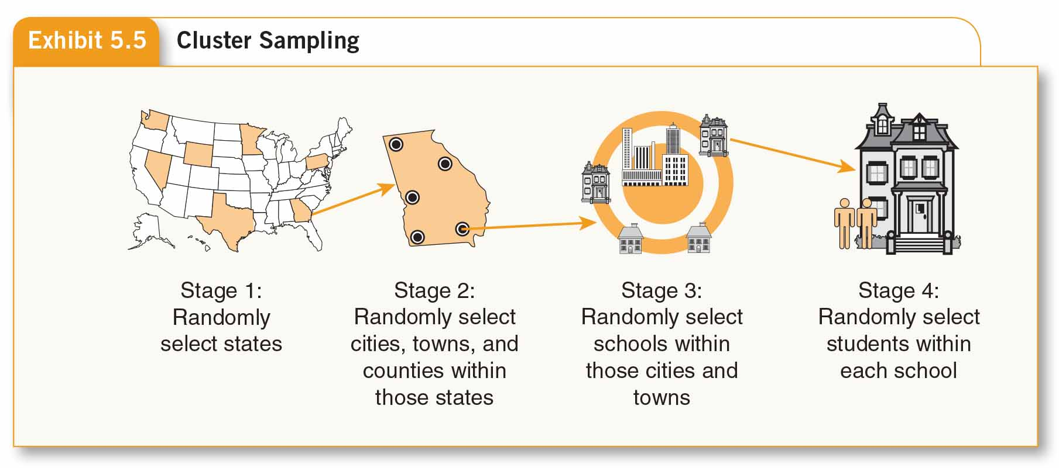
Multistage Cluster Sampling

Slide 22
Nonprobability Sampling Methods
No known probability of being selected into sample
Useful when
  No population list
  Exploring research question that doesn’t concern large population
  Conducting preliminary or exploratory study
Bachman, Fundamentals of Research in Criminology and Criminal Justice, 4e. SAGE Publishing, 2018.

Slide 23
Nonprobability Sampling Methods
Four Common nonprobability methods:
Availability sampling
Subjects easy to find (aka haphazard, accidental, convenience sampling)
Not generalizable but still useful
Quota sampling
Designating sample population into proportions reflecting the general population
Drawbacks – need to know characteristics of entire population; no random selection
Bachman, Fundamentals of Research in Criminology and Criminal Justice, 4e. SAGE Publishing, 2018.

Slide 24
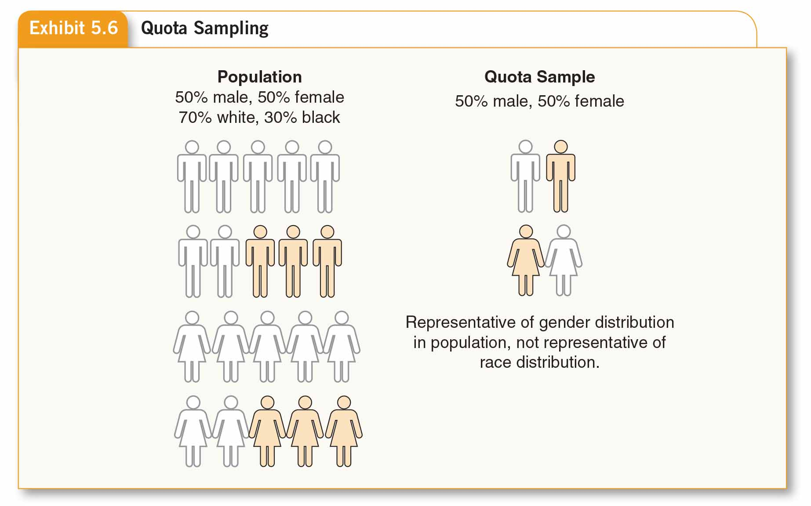
Nonprobability Sampling Methods

Slide 25
Nonprobability Sampling Methods
Purposive sampling
Each element selected for a purpose
May be Key Informant research
Snowball sampling
Identify one member of population, ask him/her to identify others
Bachman, Fundamentals of Research in Criminology and Criminal Justice, 4e. SAGE Publishing, 2018.

Slide 26
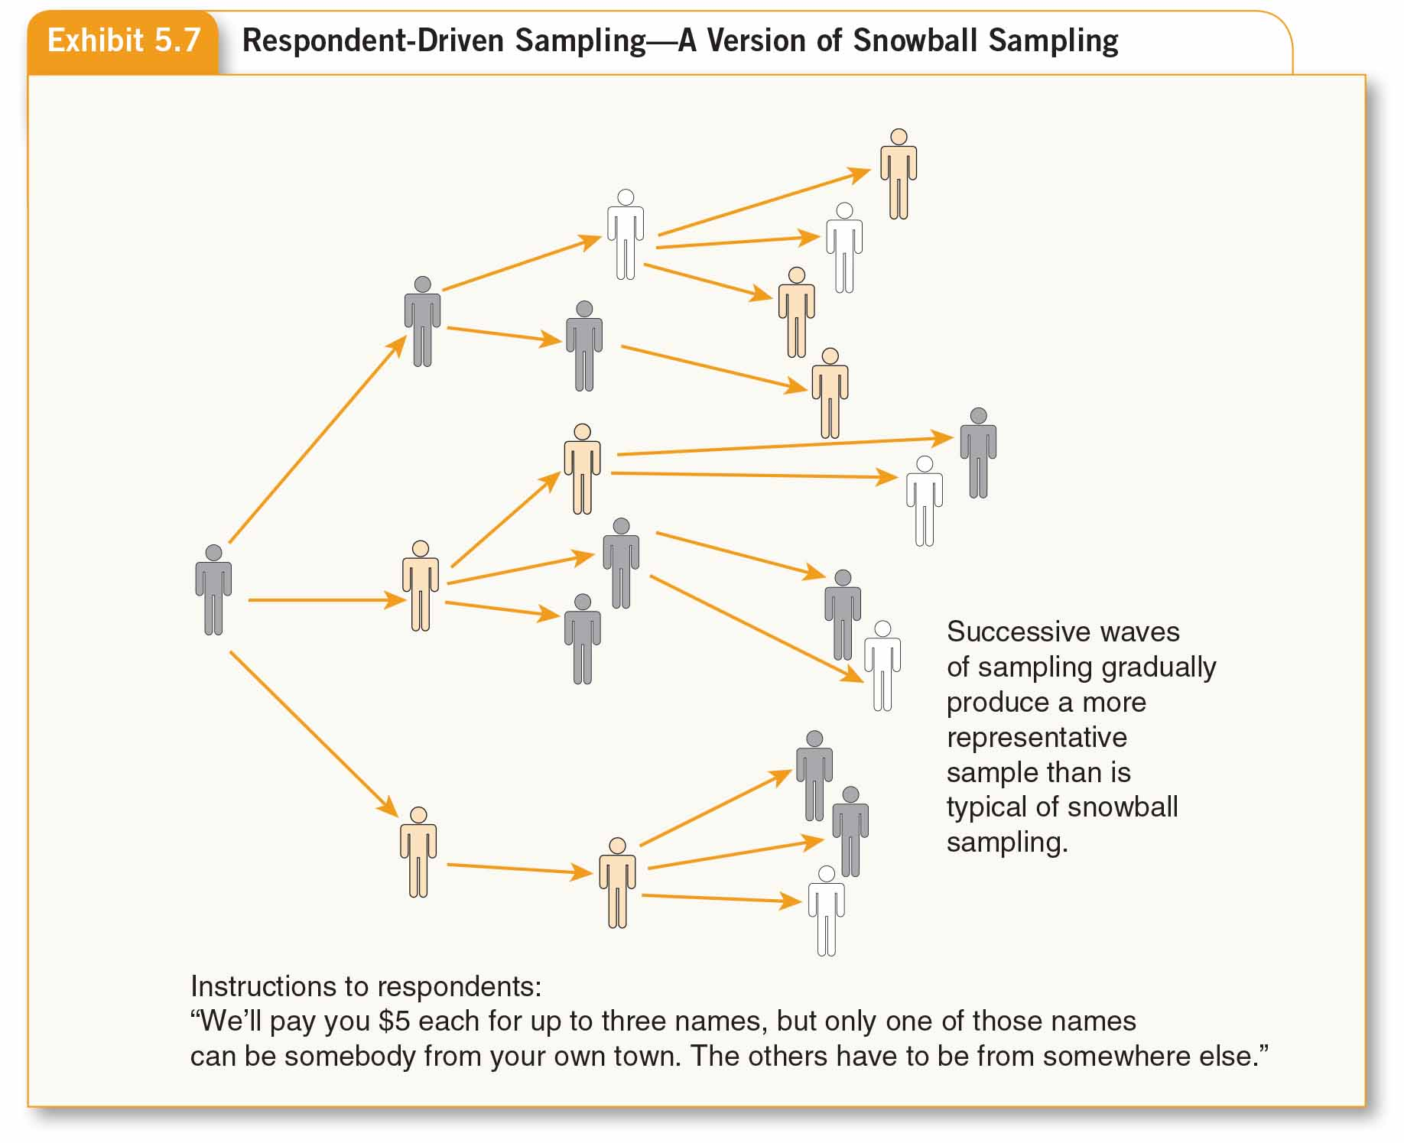
Nonprobability Sampling Methods

Slide 27
Units of Analysis and Errors in Reasoning
Individual and Group Units of Analysis
Individual – data collected from individuals and focus of analysis on individuals
Group – data may be collected from individuals but combined (aggregated) to describe a group (neighborhood, school, prison, city, state, family, etc.)
Artifacts – books, photos, newspapers, indictment, etc.
Bachman, Fundamentals of Research in Criminology and Criminal Justice, 4e. SAGE Publishing, 2018.

Slide 28
Ecological Fallacy and Reductionism
Ecological Fallacy – drawing conclusions about individual-level processes from group-level data
Reductionism/reductionist fallacy – using data about individuals to make inferences about group-level processes
Bachman, Fundamentals of Research in Criminology and Criminal Justice, 4e. SAGE Publishing, 2018.

Slide 29
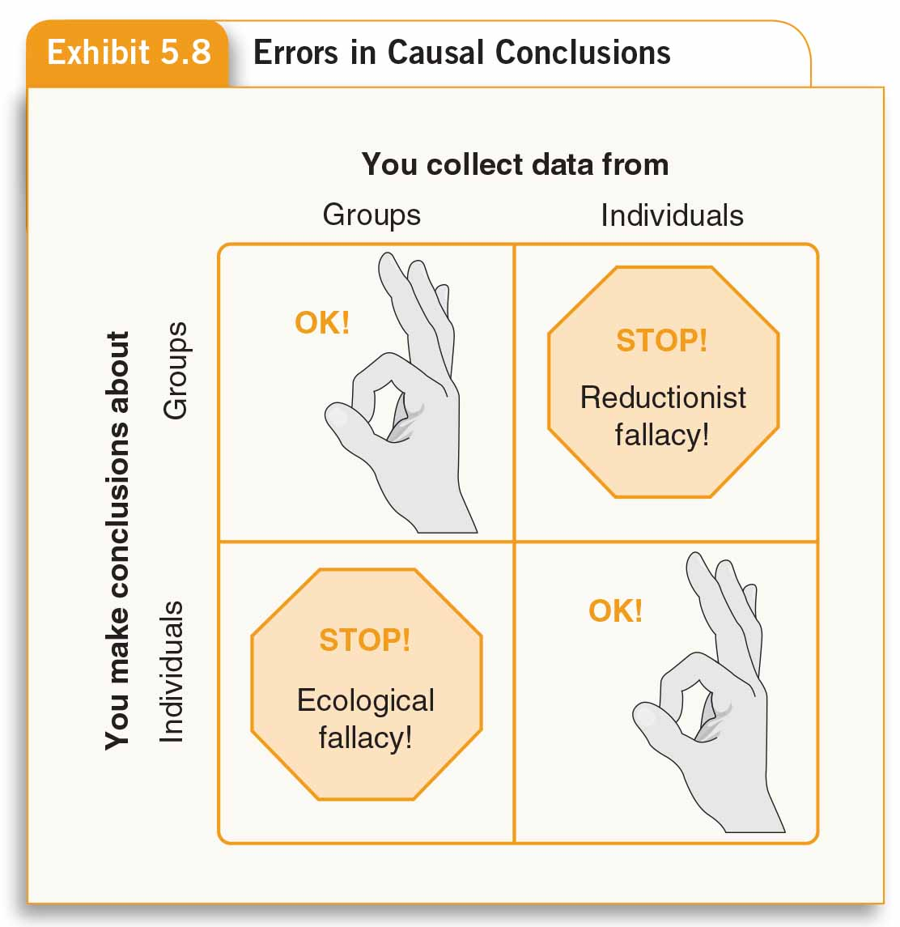
Ecological Fallacy and Reductionism

