Slide 1
Chapter 6:
Causation and Experimentation

Slide 2
Causal Explanation
Quantitative (Nomothetic) Causal Explanation
Variation in an independent variable will be followed by variation in the dependent variable, when all other things are equal (ceteris paribus), or when all other potentially influential conditions and factors are taken into consideration
Qualitative (Idiographic) Causal Explanation
The concrete, individual sequence of events, thoughts, or actions that resulted in a particular outcome for a particular individual or that led to a particular event
Bachman, Fundamentals of Research in Criminology and Criminal Justice, 4e. SAGE Publishing, 2018.

Slide 3
Criteria for Causality
Empirical Association – variation in one variable related to variation in another variable
Appropriate Time Order – variation in independent variable must precede variation in dependent variable
Nonspuriousness – relationship that exists between two variables that is NOT due to variation in a third variable
Conditions important in specifying causal relationships:
Mechanism – a discernible process that creates a causal connection between two variables
Context – relationships between variables that vary between geographic units or other context
Bachman, Fundamentals of Research in Criminology and Criminal Justice, 4e. SAGE Publishing, 2018.

Slide 4
Criteria for Causality
Ice cream and crime
  Ice cream consumption is correlated with crime
  Ice cream → crime?
Hot weather
Easily getting angry? Hanging out a lot? Etc.
Crime
Ice cream

Slide 5
True Experiments
True experiment
  Experiment in which subjects are assigned randomly to an experimental group that receives a treatment or other manipulation of the independent variable and a comparison group that des not receive the treatment or receives some other manipulation; outcomes are measured in a posttest
  Experimental group – the group of subjects that receives the treatment or experimental manipulation
  Control/comparison group – the group of subjects who are either exposed to a different treatment than the experimental group or who receive no treatment at all

Slide 6
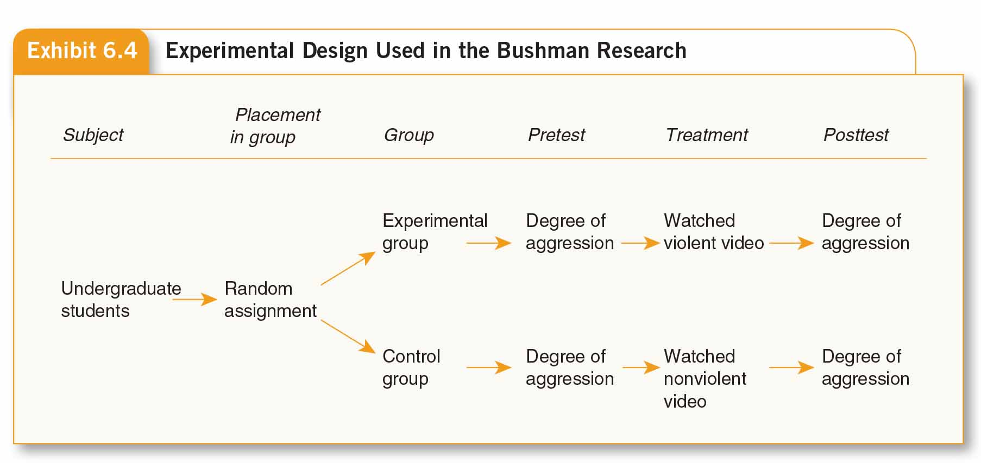
True Experiments

Slide 7
True Experiments
Components of True Experiments:
Two Comparison Groups (more or less equal, through randomization)
Random Assignment – for the purpose of internal validity, not generalizability
  Matching – a procedure for equating the characteristics of individuals in different comparison groups in an experiment; matching can be done on either an individual level or an aggregate basis
Assessment of Change in the Dependent Variable for Both Groups (posttest)
Bachman, Fundamentals of Research in Criminology and Criminal Justice, 4e. SAGE Publishing, 2018.

Slide 8
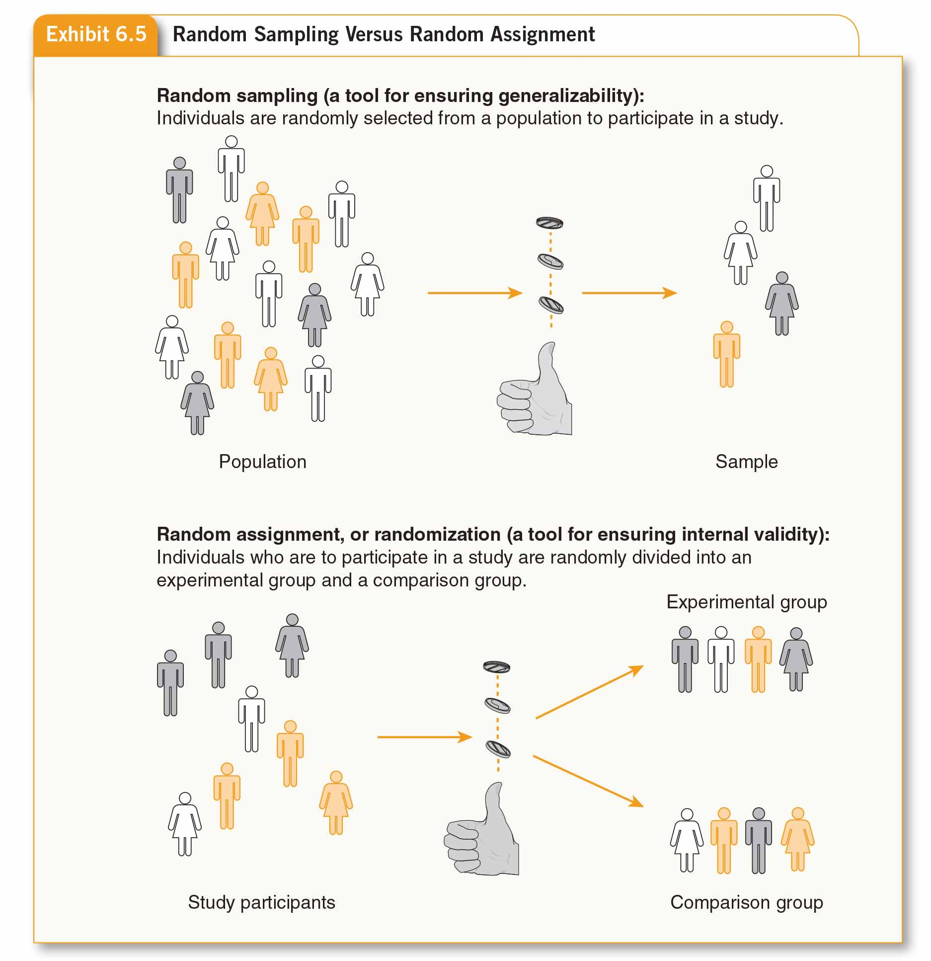
True Experiments

Slide 9
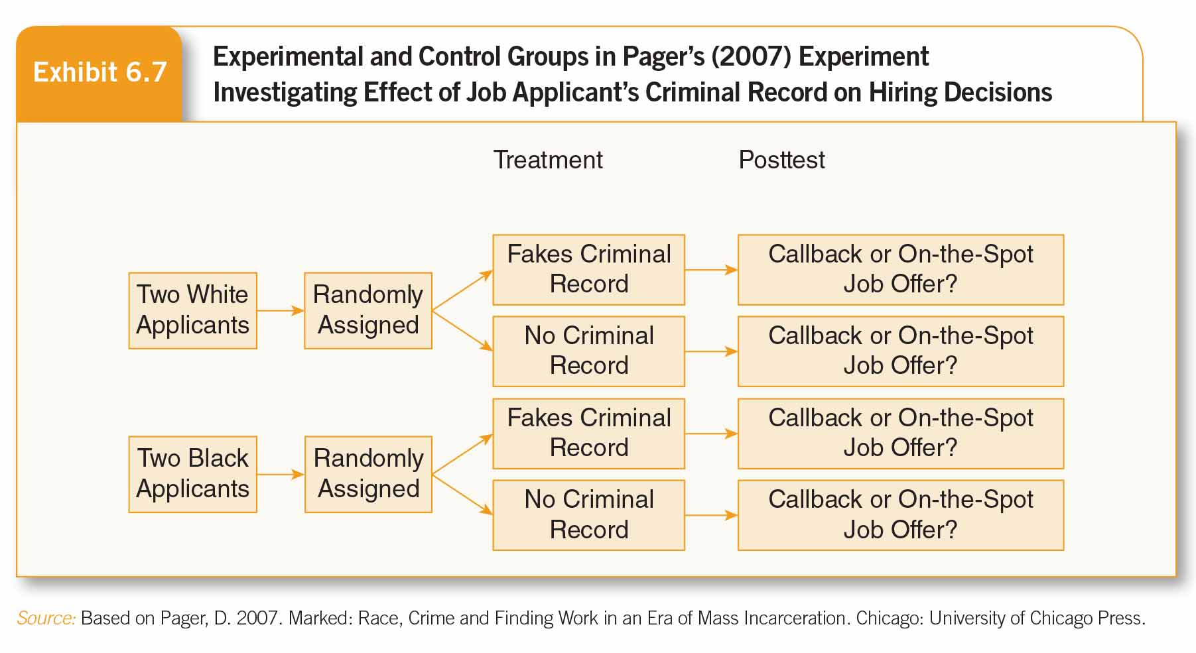
True Experiments
More Examples

Slide 10
Quasi-Experimental Design
Used When True Experiment not Possible (feasible)
Comparison group that is comparable to the experimental group in critical ways, but subjects are not randomly assigned to the comparison and experimental groups
Types of Quasi-experimental Designs:
  Nonequivalent control group designs – have experimental and comparison groups that are not created by random
  Before-and-after designs – has pretest and posttest but no comparison group assignment
  Ex post facto control group designs – use nonrandomized control groups designated after the fact
Bachman, Fundamentals of Research in Criminology and Criminal Justice, 4e. SAGE Publishing, 2018.

Slide 11
Nonequivalent Control Group designs
Two Selection Methods Used for a Comparison group:
Individual Matching – individual cases in treatment group are matched with similar individuals in comparison group
Aggregate Matching – identifying comparison group that matches the treatment group in the aggregate rather than trying to match individual cases
  Often makes most sense when random assignment not possible
  Match on key variables – same average age, same percentage female, etc.
Bachman, Fundamentals of Research in Criminology and Criminal Justice, 4e. SAGE Publishing, 2018.

Slide 12
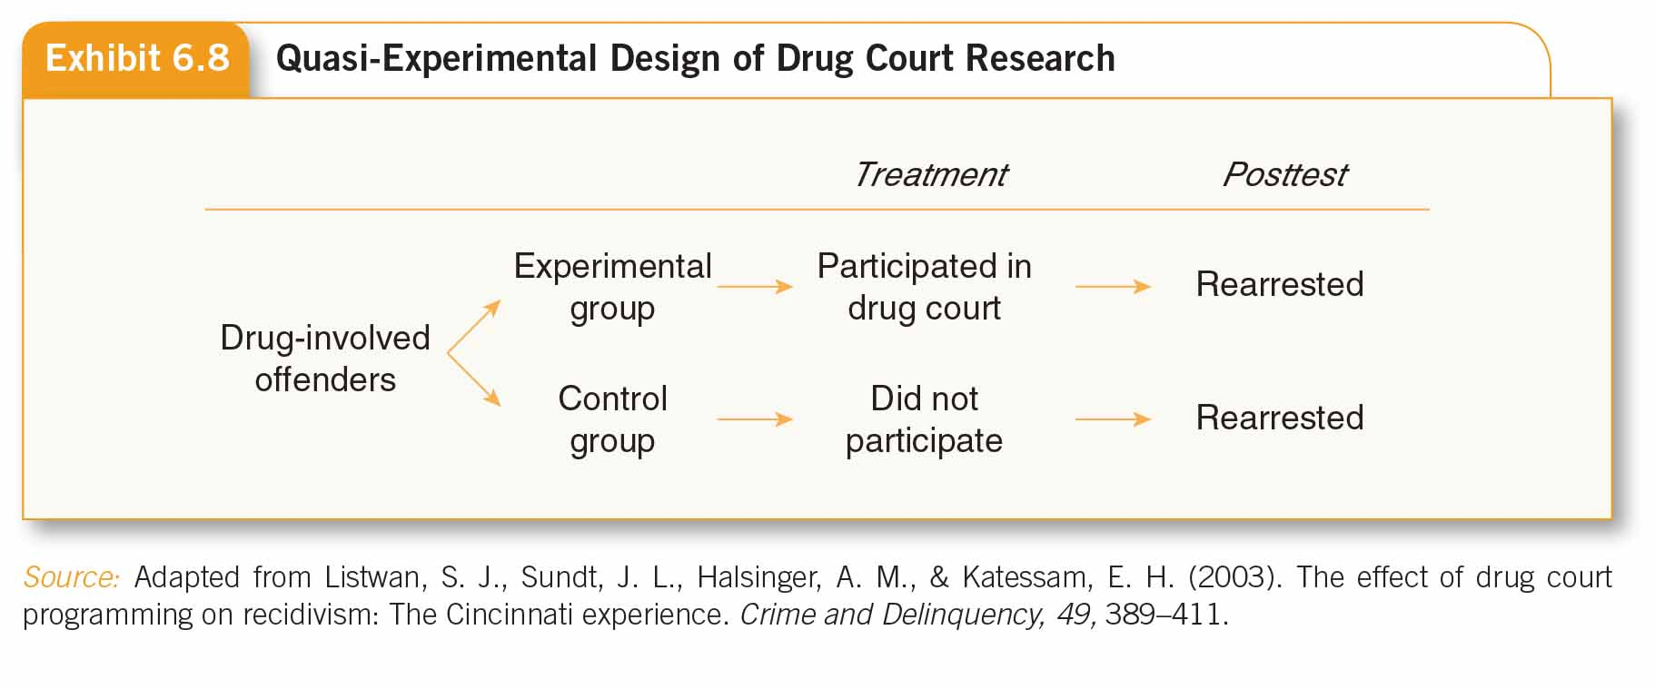
Nonequivalent Control Group designs

Slide 13
Before-and-After designs
Most common feature of before-and-after designs – NO comparison group
Fixed-sample panel design (panel study) –type of longitudinal study, data collected from same individuals (panel) at two or more points in time
Repeated measures panel design – several pretest and posttest observations allowing researcher to study impact of intervention or treatment over time
Bachman, Fundamentals of Research in Criminology and Criminal Justice, 4e. SAGE Publishing, 2018.

Slide 14
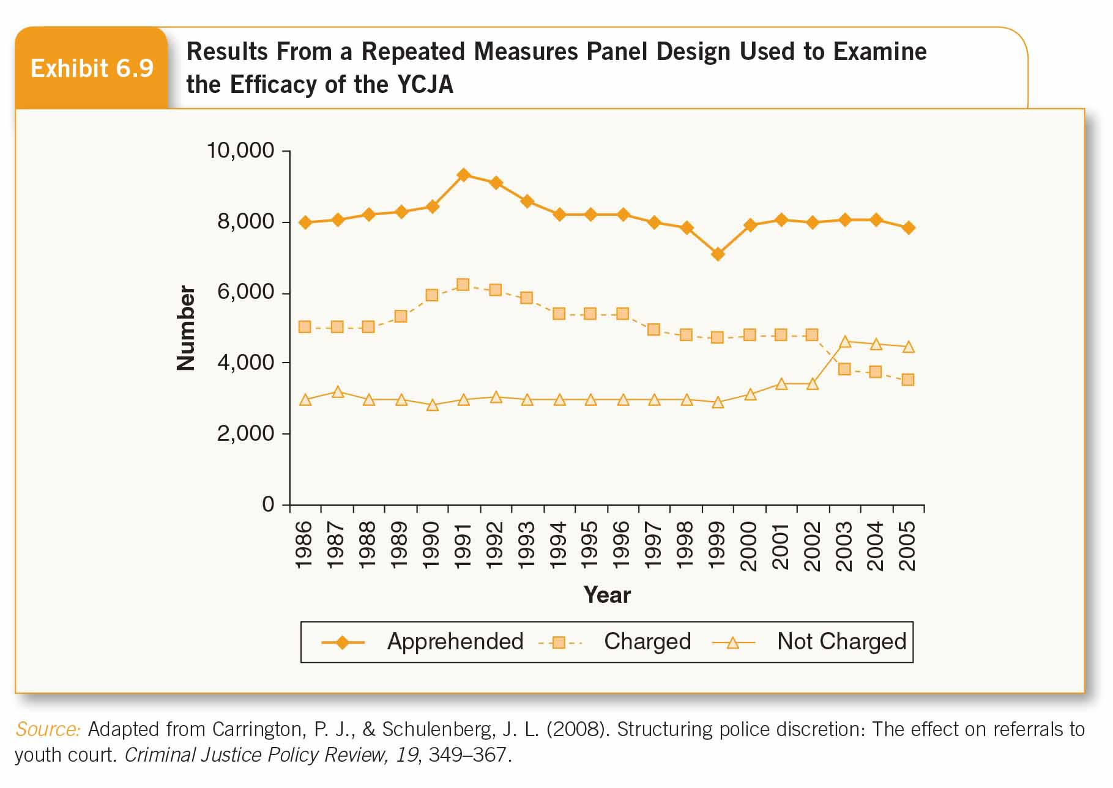
Before-and-After designs

Slide 15
Ex Post Facto Control Group designs
Seems similar to Nonequivalent control group design, but does not meet the criteria for quasi-experimental designs
Has experimental and comparison groups that are not created by random assignment
Groups in Ex Post Facto designs are designated AFTER treatment has occurred
Bachman, Fundamentals of Research in Criminology and Criminal Justice, 4e. SAGE Publishing, 2018.

Slide 16
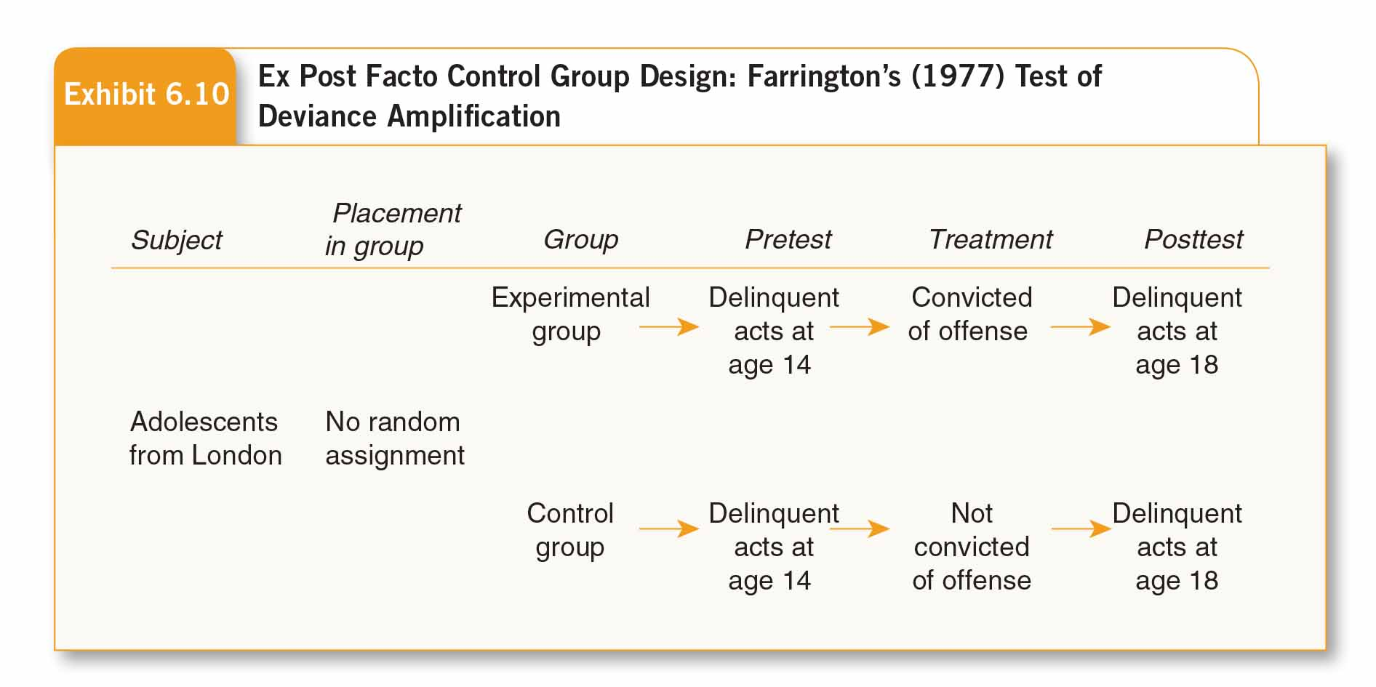
Ex Post Facto Control Group designs

Slide 17
Experiments Design
Practice
Design a true experiment on whether watching a football game will increase customers’ appetite on wings in Buffalo Wild Wings.
Design a true experiment on whether sex offender registration and notification policy will decrease sex offenders’ recidivism rate.

Slide 18
Threats to Internal and External Validity
Causal (Internal) Validity
  Selection bias – characteristics of experimental and control group subjects differ
  Endogenous change – subjects develop or change during experiment independent of experimental treatment
  External events/history effects – something occurs during experiment (outside of it) that influences outcome scores
  Contamination – when either experimental or comparison group is aware of the other and influenced as a result
Bachman, Fundamentals of Research in Criminology and Criminal Justice, 4e. SAGE Publishing, 2018.

Slide 19
  Treatment misidentification – variation in the ‘treatment’ associated with variation in observed outcome but change occurs through process not identified by researcher
    Expectancies of experimental staff: a source of treatment misidentification in experiments and quasi-experiments that occurs when change among experimental subjects is due to the positive expectancies of the staff who are delivering the treatment rather than to the treatment itself
      Double-blind procedure: neither subjects nor the staff know which subjects are getting the treatment and which are receiving a placebo
    Placebo effect: subjects receive a treatment that they consider likely to be beneficial and improve because of that expectation rather than because of the treatment itself
    Hawthorne effect: members of the treatment group change in terms of the dependent variable because their participation in the study makes them feel especial

Slide 20
Interaction of Testing and Treatment
Solomon four-group design – subjects randomly assigned to at least two experimental groups and at least two comparison groups
One experimental group and one comparison group have pretest, other two will not
Bachman, Fundamentals of Research in Criminology and Criminal Justice, 4e. SAGE Publishing, 2018.

Slide 21
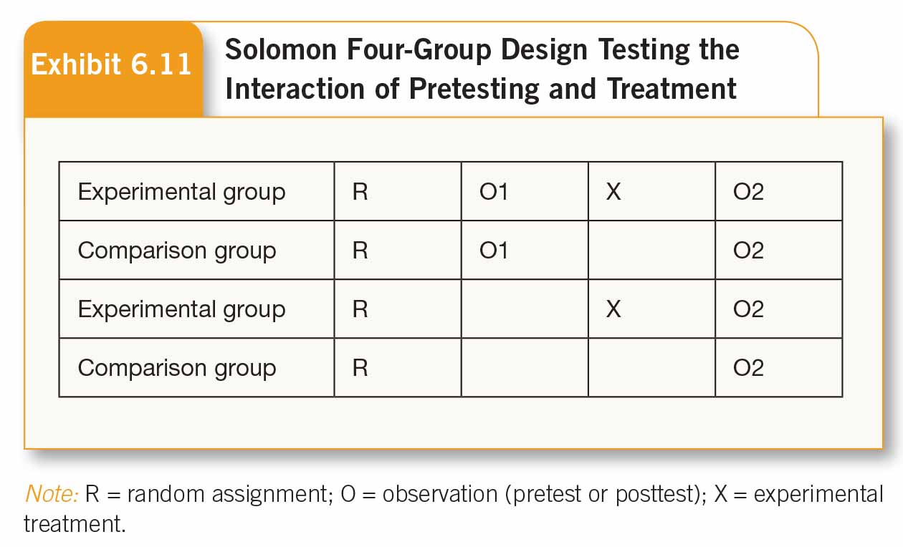
Interaction of Testing and Treatment

Slide 22
Generalizability and Time in Research
Sample generalizability – ability to apply findings to clearly defined, larger population
Cross-sectional vs. Longitudinal research designs
  Cross-sectional research design – data collected at one point in time
  Longitudinal research designs -- data collected at two or more points in time
Bachman, Fundamentals of Research in Criminology and Criminal Justice, 4e. SAGE Publishing, 2018.

Slide 23
Longitudinal Research designs
Repeated Cross-Sectional Designs (Trend Study)
  Sample drawn from population at Time 1 (T1), data collected
  Time passes, some people leave population, others enter
  At Time 2 (T2), different sample drawn from population & data collected
Fixed-Sample Panel Designs
Sample (called “panel”) drawn from population at T1, data collected
Time passes, some panel members unavailable for follow-up, population changes
At T2, data collected from same people at T1 (the “panel”), except those people who cannot be located
Bachman, Fundamentals of Research in Criminology and Criminal Justice, 4e. SAGE Publishing, 2018.

Slide 24
Panel Designs
Drawback:
Expense and Attrition – expensive to keep track of individuals over time, proportion of panel members located for follow-up declines over time
Subject Fatigue – panel members grow weary of repeated interviews and drop out of study, become so used to answering standard questions that they begin giving “stock” answers without thought
Bachman, Fundamentals of Research in Criminology and Criminal Justice, 4e. SAGE Publishing, 2018.

Slide 25
Event-Based Designs
Often called “Cohort Study”
Examples:
  Birth cohorts – share common period of birth (born in 1940s, 1950s, 1970s, etc.)
  Seniority cohorts – have worked at the same place for about 5 years, about 10 years, etc.
  School cohorts – freshmen, sophomores, juniors, seniors
Bachman, Fundamentals of Research in Criminology and Criminal Justice, 4e. SAGE Publishing, 2018.

Slide 26
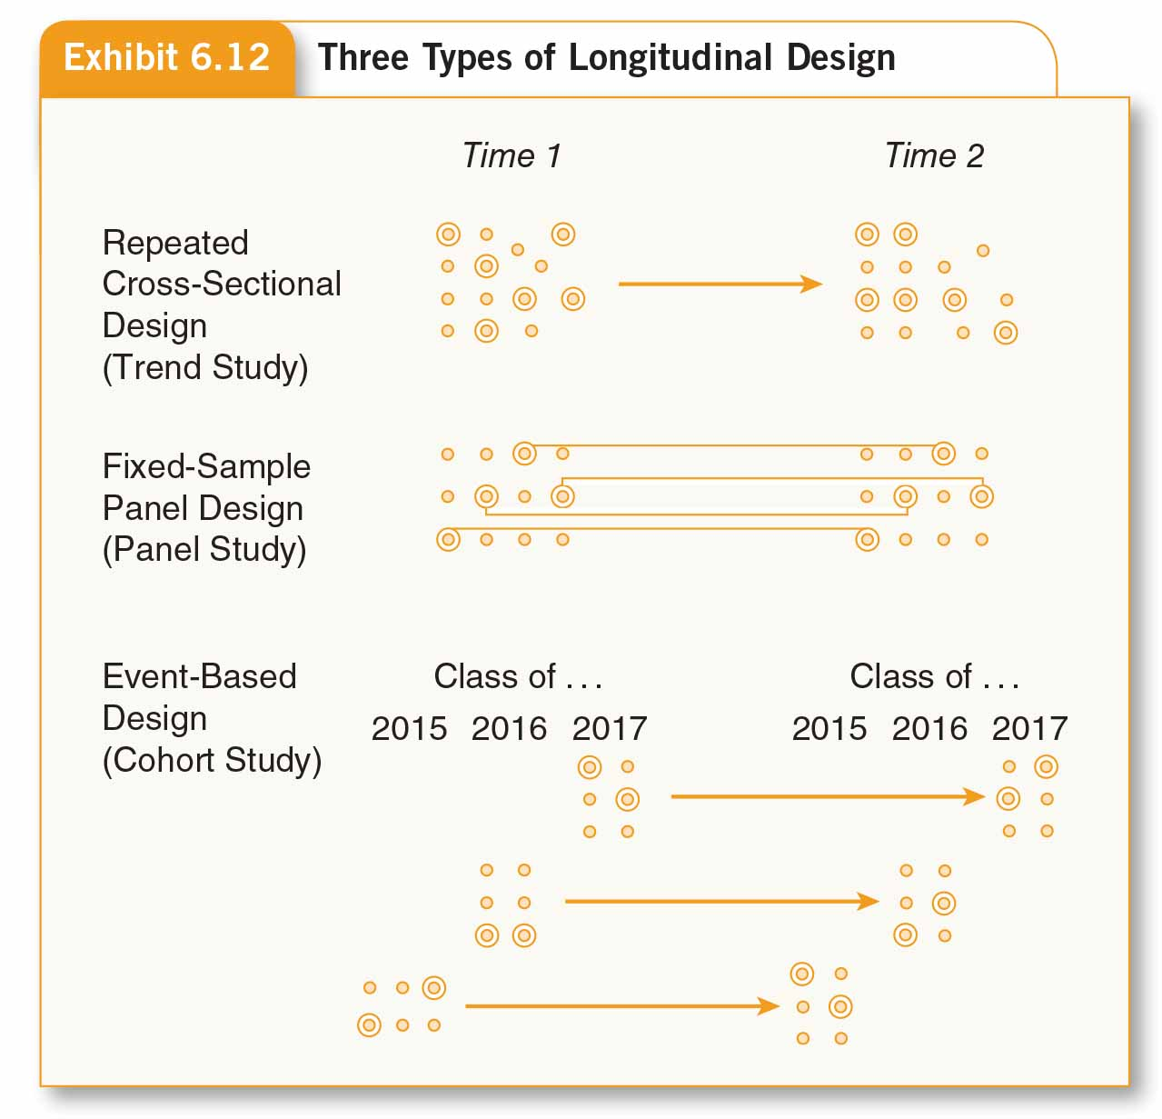
Longitudinal Research designs

Slide 27
Other Issues
Fairly easy to show Empirical Association in nonexperimental designs; Time Order & Nonspuriousness more difficult to show
Use of Statistical Control to reduce risk of nonspuriousness
  Look for Intervening Variable(s)
  Ethical Issue of Protection of Subjects
    Deception – use of debriefing techniques after study concludes to mitigate effects of the deception
    Selective Distribution of Benefits –how much researchers can influence benefit subjects receive as part of treatment in field studies
Bachman, Fundamentals of Research in Criminology and Criminal Justice, 4e. SAGE Publishing, 2018.

