Slide 1
Chapter 7:
Survey Research

Slide 2
What is a Survey?
Collection of information from sample of individuals through responses to questions
Bachman, Fundamentals of Research in Criminology and Criminal Justice, 4e. SAGE Publishing, 2018.

Slide 3
What is a Survey?
Attractive features of survey research
Versatility – can ask about many topics
Efficiency – can be collected from many people, low cost
Generalizability – works well with probability sampling
Bachman, Fundamentals of Research in Criminology and Criminal Justice, 4e. SAGE Publishing, 2018.

Slide 4
What is a Survey?
Survey research is perhaps the most frequently used mode of observation in sociology, political science, and criminal justice.
  Why?
  Target is people
Bachman, Fundamentals of Research in Criminology and Criminal Justice, 4e. SAGE Publishing, 2018.

Slide 5
Questionnaire Development and Assessment
Questionnaire – the survey instrument containing the questions for a self-administered survey
  Maintain Focus
  Build on Existing Instruments
  Consider Translation
Bachman, Fundamentals of Research in Criminology and Criminal Justice, 4e. SAGE Publishing, 2018.

Slide 6
Survey Questions
Writing Survey Questions
  Open-ended Questions: Respondent is asked to provide his or her own answer
  Closed-ended (Fixed-Choice) Questions: Respondent selects an answer/answers from a list provided by the researcher
Bachman, Fundamentals of Research in Criminology and Criminal Justice, 4e. SAGE Publishing, 2018.

Slide 7
Survey Questions
  Constructing Clear, Meaningful Questions
    Avoid Confusing Phrasing and Vagueness
      Be brief and stick to the point
      Be specific about the reference period
    Avoid Negatives and Double-negatives
      Two negatives
    Avoid Double-barreled Questions
      Two questions with only one answer
    Avoid Making Either Disagreement OR Agreement Disagreeable
      People tend to agree with a statement to avoid seeming disagreeable
      Be impartial
Bachman, Fundamentals of Research in Criminology and Criminal Justice, 4e. SAGE Publishing, 2018.

Slide 8
Survey Questions
  Additional Guidelines for Closed-Ended Questions
    Make Response Choices Mutually Exclusive
    Make Response Categories Exhaustive
    Utilize Likert-Type Response Categories
      Respondents indicate the extent to which they agree or disagree with statements
    Minimize Fence-Sitting and Floating
      Fence-sitting: being neutral on an issue and choose a middle response that is offered
      Floating: select a substantive answer even they actually “don’t know”
    Utilize Filter Questions
      Used to identify a subset of respondents who then are asked other questions
Bachman, Fundamentals of Research in Criminology and Criminal Justice, 4e. SAGE Publishing, 2018.

Slide 9
Survey Questions
How do you feel about the police?
What do you think is the biggest problem in your community?
How do you protect your home from burglary?
What do you think of…?
What is your opinion on…?
Bachman, Fundamentals of Research in Criminology and Criminal Justice, 4e. SAGE Publishing, 2018.

Slide 10
Survey Questions
Choices should be exhaustive and mutually exclusive
How many times did you move last year?
  A. 4 or more times
  B. 3 to 4 times
  C. 2
  D. 1
Bachman, Fundamentals of Research in Criminology and Criminal Justice, 4e. SAGE Publishing, 2018.

Slide 11
Survey Questions
How many times did you move last year?
  A. 5 or more times
  B. 3 to 4 times
  C. 2
  D. 1
  E. 0

Slide 12
Survey Questions
Likert scale
 | Strongly Agree | Agree | Neutral | Disagree | Strongly Disagree
I am a lazy person.
I enjoy violent video games.
I always feel hopeless.
I like eating ice-cream.

Slide 13

Survey Questions
Tips on Making Good Questions
Make Items Clear: Avoid ambiguous questions; do not ask “double-barreled” questions
  Do you think Starbucks gift cards are beautiful? (Yes, No)
  Is it good to have a cup of coffee and take a walk on a weekend morning? (Yes, No)
Short Items are Best: Respondents like to read and answer a question quickly
  Do you think it is a good idea to…, that…, which…, when…, where…?
Avoid Negative Items: Leads to misinterpretation
  It is a good idea not to legalize marijuana.
  It is an unwise idea not to legalize marijuana.

Slide 14
Survey Questions
Tips on Making Good Questions
Avoid Biased Items and Terms: Do not ask questions that encourage a certain answer
  Do you agree with the statements below
  Do you agree or disagree with the statements below
Designing Self-Report Items: Use of computer assisted interviewing techniques

Slide 15
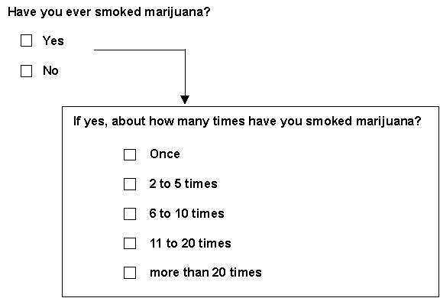
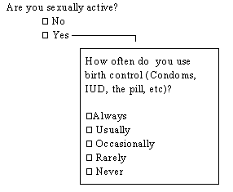
Survey Questions
Contingency Questions
Relevant only to some respondents – answered only based on their previous response

Slide 16
Survey Questions
Combining Questions Into an Index
Helps researchers avoid idiosyncratic variation – particular words or ideas affect how a person responds to it
Index – composite measure based on summing, averaging or otherwise combining responses to multiple questions measuring the same variable
Bachman, Fundamentals of Research in Criminology and Criminal Justice, 4e. SAGE Publishing, 2018.

Slide 17
Survey Questions
Reliability measures
  Special statistics that help researchers decide whether responses are consistent
Reverse code
  Recoding response choices that were originally coded to reflect both favorable unfavorable attitudes toward a phenomenon as indicative of either all favorable or all unfavorable so the index is measuring the same thing

Slide 18
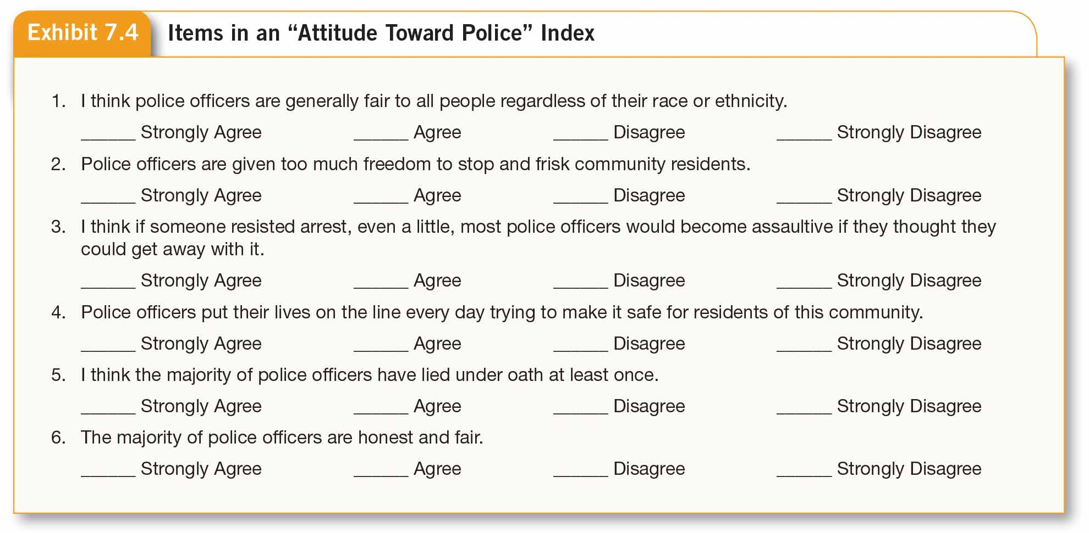
Survey Questions

Slide 19
Other Issues regarding Questionnaires
Demographics – Independent variables such as age, sex, race, ethnicity, income, religion
  Almost all questionnaires would include demographics
Pre-testing – when questionnaire is taken by small subsample of respondent
  New questionnaires need pre-test to get external feedback
Bachman, Fundamentals of Research in Criminology and Criminal Justice, 4e. SAGE Publishing, 2018.

Slide 20
Survey Designs
Manner of administration – Mail? Group? Electronic?
Questionnaire structure – Highly structured? Fixed Questions? More open?
Setting– Home? Telephone? Group?
Cost – in-person interviewing most expensive, phone interviews cost much less, survey by mail much cheaper
Bachman, Fundamentals of Research in Criminology and Criminal Justice, 4e. SAGE Publishing, 2018.

Slide 21
Survey Designs
Mailed (self-administered) surveys
Mail questionnaire to respondents
Respondents administer survey themselves
Often low response rate, incomplete
Bachman, Fundamentals of Research in Criminology and Criminal Justice, 4e. SAGE Publishing, 2018.

Slide 22
Survey Designs
Group-administered Surveys
Completed by individual respondents assembled in a group
Not always feasible because requires an assembled group
Telephone Surveys
Problems reaching sampling units & maximizing response to surveys
Only if respondents have telephones
Bachman, Fundamentals of Research in Criminology and Criminal Justice, 4e. SAGE Publishing, 2018.

Slide 23
**
Survey Designs
In-person Interviews
Time consuming, expensive
CAPI, CASI
Electronic Surveys
Sent & answered on computer
Mixed-Mode Surveys
Allows strengths of one survey design to compensate for weaknesses of another
Bachman, Fundamentals of Research in Criminology and Criminal Justice, 4e. SAGE Publishing, 2018.

Slide 24
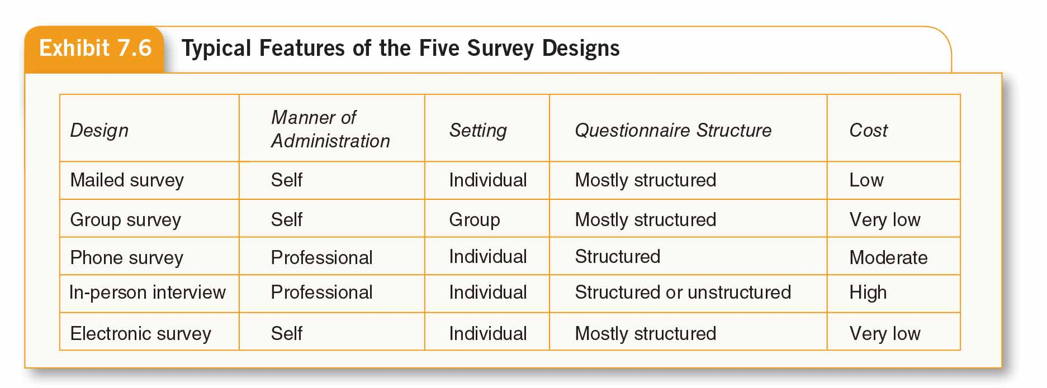
Survey Designs

Slide 25
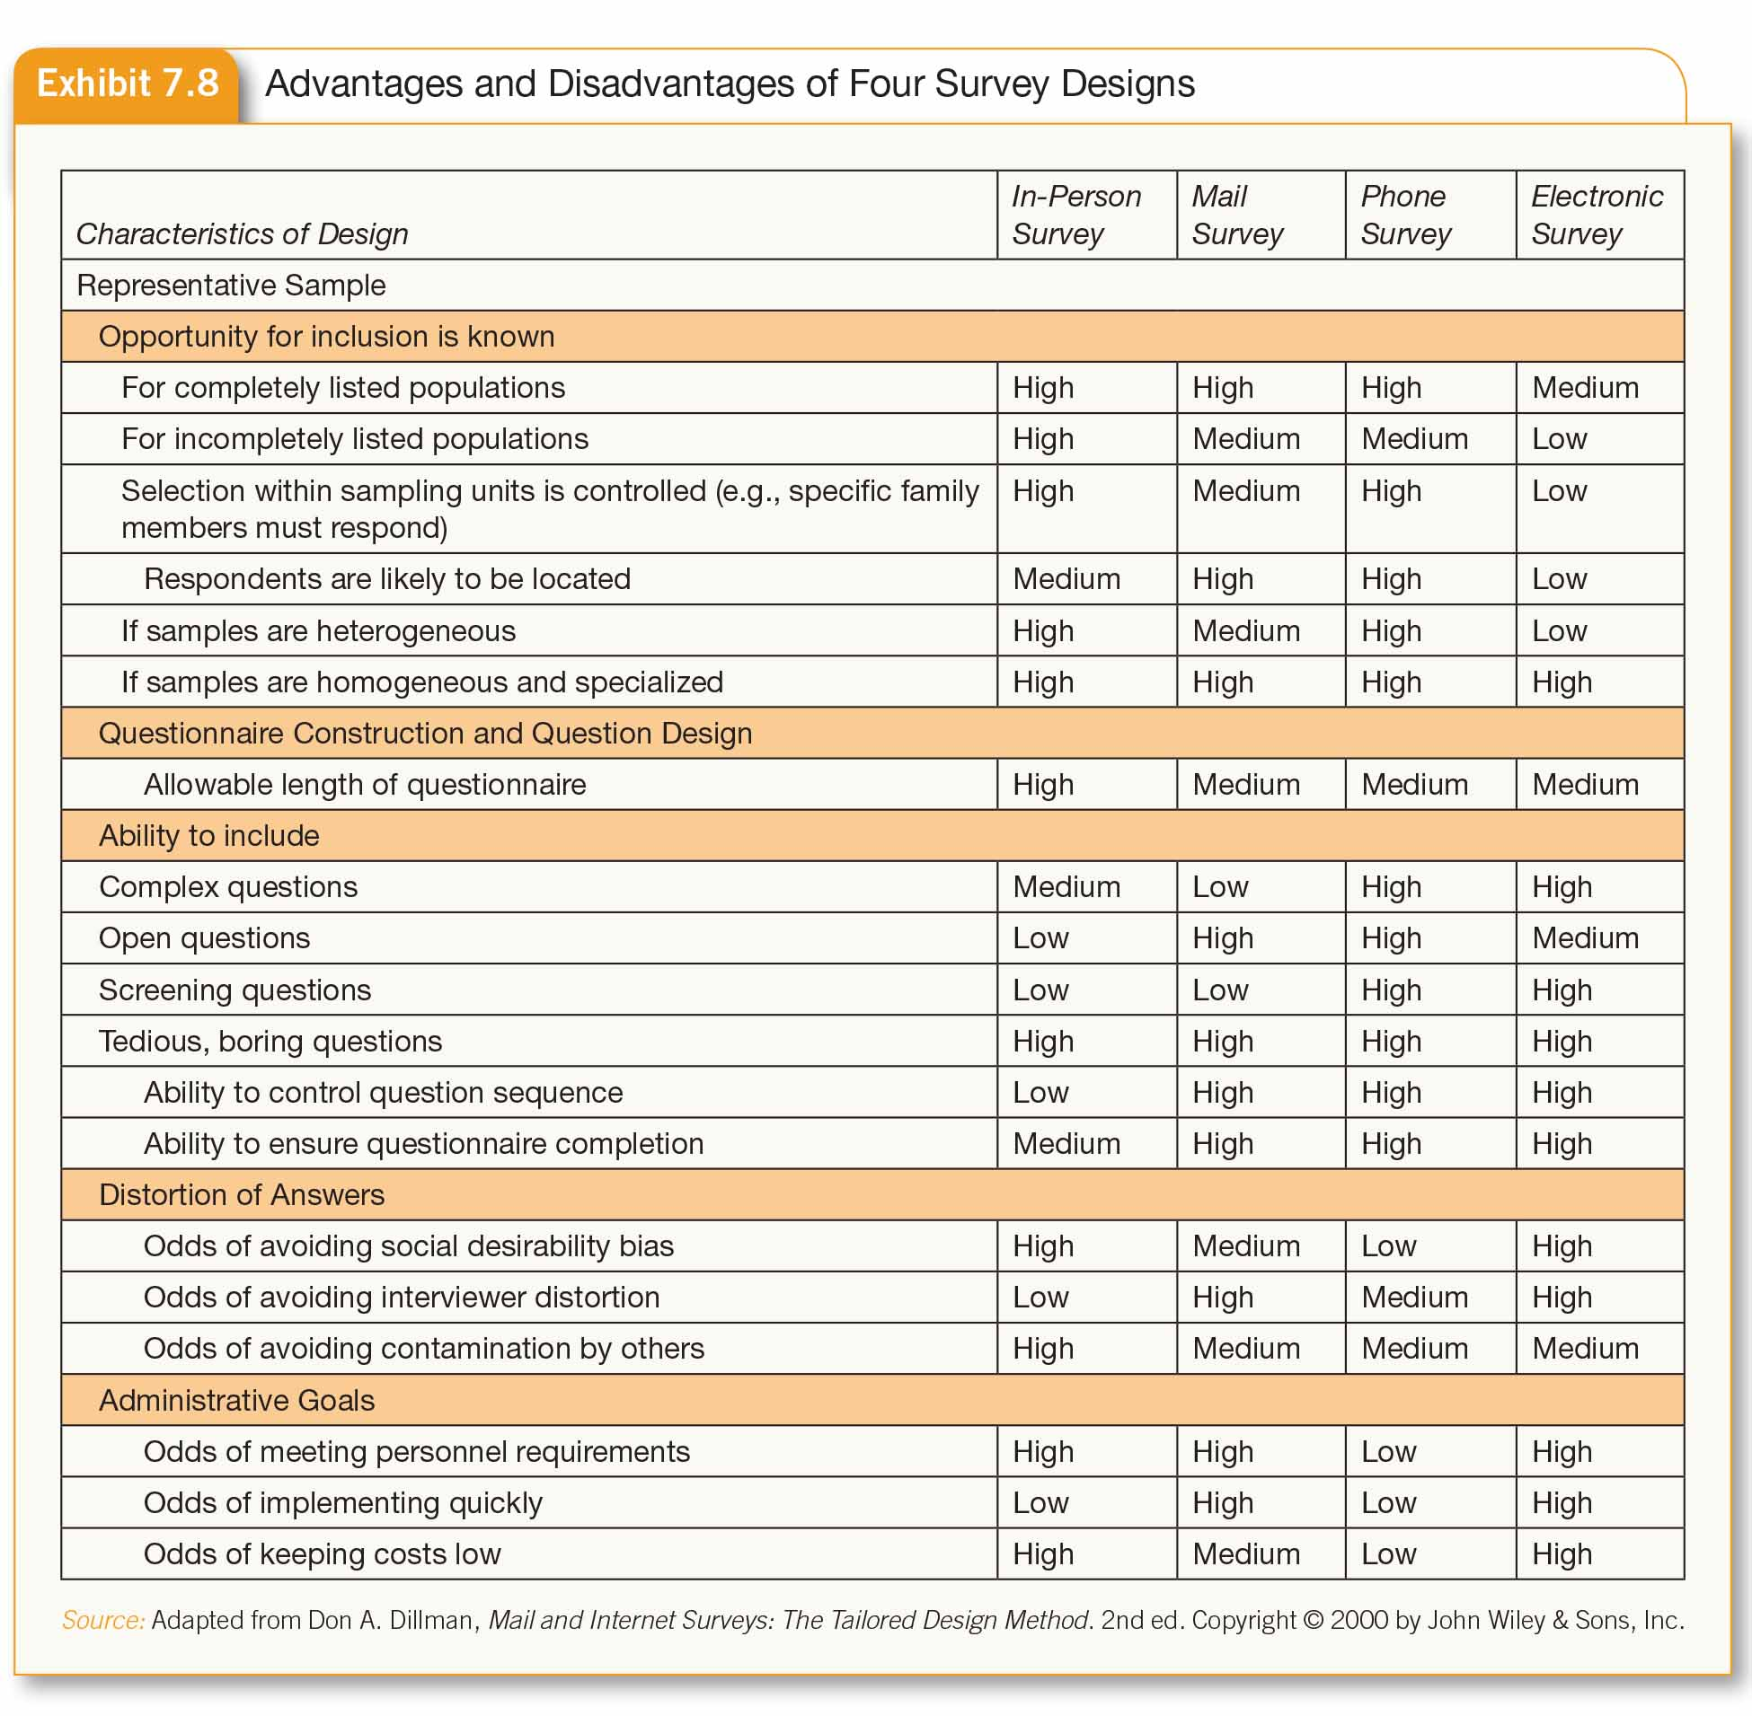
Survey Designs

Slide 26
Ethical Issues
Protection of Respondents
  Possible harmful effects not always clear
  Secondary victimization
Confidentiality & Anonymity
  Published data must be de-identified
Bachman, Fundamentals of Research in Criminology and Criminal Justice, 4e. SAGE Publishing, 2018.

