Slide 1
Berlin Airlift
Name
Institution of Affiliation

Slide 2
Introduction
It happened when the World War II came to an end in 1945.
The allied powers convened at Potsdam and Yalta to divide German territories amongst themselves.
Germany was divided into four allied occupation zones by Britain, United States, Soviet Union, and France.
Berlin, Germany’s capital was divided amongst the allied powers despite being in the deep zone of the Soviet Union.
Notes:
As World War II came to an end in 1945, the Allied powers held peace conferences at Yalta and Potsdam to determine how they would divide up Germany’s territories. Germany was divided into four allied occupation zones by Britain, United States, Soviet Union, and France. Berlin, Germany’s capital was divided amongst the allied powers despite being in the deep zone of the Soviet Union.

Slide 3
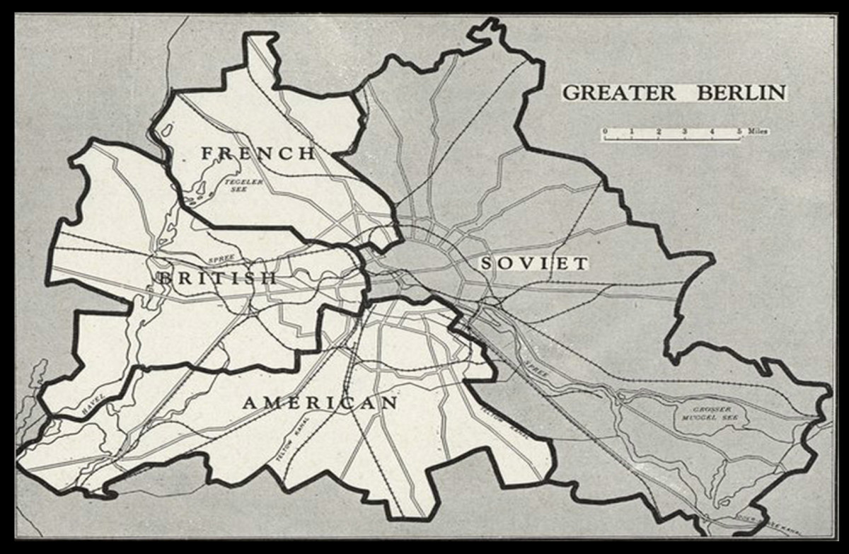
Notes:
Division of Berlin into four territories of the allied powers.
(https://www.google.com/url?sa=i&url=https%3A%2F%2Fwww.history.com%2Ftopics%2Fcold-war%2Fberlin-blockade&psig=AOvVaw2okyBwUsaVCbD418ktgfAu&ust=1590843208523000&source=images&cd=vfe&ved=0CAIQjRxqFwoTCMDu_5eQ2ekCFQAAAAAdAAAAABAR)

Slide 4
Airlift
The friendship between the allied powers turned to hostility.
Soviet Union sought to control the entire Berlin.
In June 24 1948, it blocked water, road, and rail access to the parts of Berlin controlled by the allied powers.
The United States and Britain responded by airlifting food and fuel from western Germany to these areas.
Notes:
The friendship between the allied powers turned to hostility. Soviet Union sought to control the entire Berlin. In June 24 1948 it blocked water, road, and rail access to the parts of Berlin controlled by the allied powers. The United States and Britain responded by airlifting food and fuel from western Germany to these areas (Office of the Historian, n.d.).

Slide 5
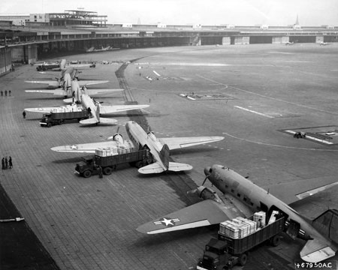
Notes:
U.S. Navy and Air Force aircrafts unload at Tempelhof Airport during the Berlin Airlift (Office of the Historian, n.d.)

Slide 6
Reasons for the Event
The agreement during the Potsdam and Yalta convention was that Berlin will be subdivided to the allied powers.
This was despite being on the zone apportioned to the Soviet Union.
The Soviet Union was dissatisfied with this arrangement; lost interest in reunifying Germany.
Besides, Soviet Union feared the emerging capitalist West Berlin would be aggressively and powerfully anti-Soviet.
Notes:
The agreement during the Potsdam and Yalta convention was that Berlin will be subdivided to the allied powers. This was despite being on the zone apportioned to the Soviet Union. The Soviet Union was dissatisfied with this arrangement and had no interest in reunifying Germany. Besides, Soviet Union feared the emerging capitalist West Berlin would be aggressively and powerfully anti-Soviet (Office of the Historian, n.d.).

Slide 7
Tactics Used
The Soviet authorities announced that the Autobahn shall be closed indefinitely for repairs.
This was the highway connecting Berlin to West Germany.
All road movement from west to east was halted.
All rail traffic and barge was barred from entering Berlin.
Notes:
The Soviet authorities announced that the Autobahn shall be closed indefinitely for repairs. The Autobahn was the highway connecting Berlin to West Germany. All road movement from west to east was halted. All rail traffic and barge was barred from entering Berlin (History.com Editors, 2020).

Slide 8
Response to the Blockade
It was unwise to respond using military force; the cold war could have turned into a cold war.
Reasonable response; find another way to provide for the city.
Allied powers decided to use the airspace to supply their sector of Berlin.
Project coded “Operation Vittles”; Cargo planes would deliver food, fuel and other goods.
Notes:
It was unwise to respond using military force as the cold war could have turned into a cold war. A reasonable response was to find another way to provide for the city. The allied powers decided to use the airspace to supply their portion of the city. They used cargo planes to deliver food and other goods to the west Berliners under the project code “Operation Vittles” (History.com Editors, 2020).

Slide 9
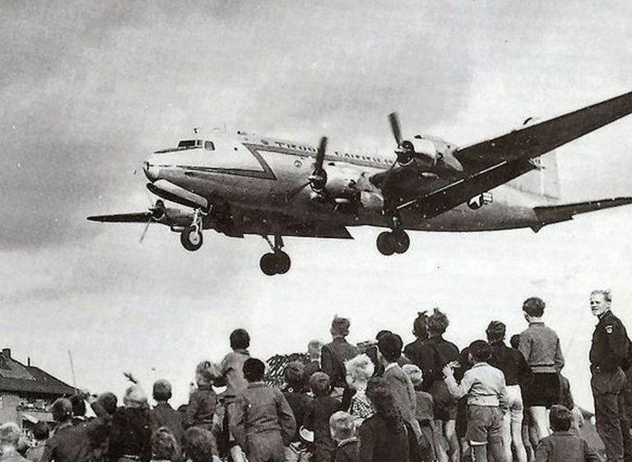
Notes:
Inhabitants of Berlin waiting for food delivery by the U.S. military cargo planes. (https://www.thoughtco.com/thmb/XRn_0PQX1F1Lhnt1lKonXNXgi5w=/768x0/filters:no_upscale():max_bytes(150000):strip_icc()/berlin-airlift-large-56a61c473df78cf7728b647c.jpg)

Slide 10
End of the Blockade
The blockade ended during the spring of 1949.
The Soviet Union failed in persuading the inhabitants of West Berlin to reject the allied powers in the West.
The event hastened the creation of West Germany and North Atlantic Treaty Organization (NATO).
Notes:
The blockade ended during the spring of 1949. The Soviet Union failed in persuading the inhabitants of West Berlin to reject the allied powers in the West. The Soviets were viewed to be cruel and capricious enemy. The event hastened the creation of West Germany and North Atlantic Treaty Organization (NATO) (History.com Editors, 2020).

Slide 11
References
History.com Editors. (2020, Feb). Berlin Airlift. A&E Television Networks. Retrieved on May 29 2020 from https://www.history.com/topics/cold-war/berlin-airlift
Office of the Historian. (n.d.). The Berlin Airlift, 1948–1949. Retrieved on May 29 2020 from https://history.state.gov/milestones/1945-1952/berlin-airlift

