Slide 1
Infectious Disease Presentation
By Student’s Name
Institution of Affiliation
Course Code and Name
Professor
Date

Slide 2
Varicella zoster Virus (VZV)
Introduction
Virus causing Chicken pox (varicella)
One of the herpes viruses
Aka- Human Herpesvirus 3
Herpes means that some of the lesions are creeping in nature
Have become successful pathogens due to their ability to undergo latency and reactivation in various parts of the body

Slide 3
Taxonomic Hierarchy
Kingdom - Heunggongvirae
Phylum - Peploviricota
Class - Verviviricetes
Order - Herpesvirales
Family - Herpesviridae
Subfamily - Alphaherpesvirinae
Genus - Varicellovirus
Species - Human herpesvirus 3
Commonly known as Varicella zoster Virus (VZV)

Slide 4
Type of Microbe
Virus
Viral particle contains:
DNA as the core: single, linear, double-stranded DNA 125,000 nucleotides long
Icosahedral capsid
Large baggy lipid envelope
Carry with it an enzyme: DNA polymerase for its replication in the host
Replicates in the nucleus of host

Slide 5
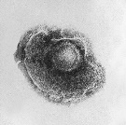
Type of Microbe
Spherical
180-200nm in diameter
Lipid envelope with 100 nm nucleocapsid
Nucleocapsid made up of 162 hexameric and penatmeric capsomeres arranged in an icosahedral form
Stains: Direct Immunofluorescence (IF) staining
Notes:
(Insert: Electron micrograph of VZV
Photo credit: Content Providers: CDC/Dr. Erskine Plamer/ B. G. Partin - CDC)

Slide 6
Portal of Entry
Respiratory system
Through the Nose or mouth
via infectious Respiratory droplets
Virus multiplies in the lungs causing wide variety of symptoms
Route of transmission
Inspiration of infectious respiratory droplets
How does it leave the host?
Through respiratory droplets produced through cough or while speaking

Slide 7
Disease
Causes Chicken pox in children: severe in adults
Undergoes latency in the ganglionic neurons
Shingles (Herpes zoster) in adults: due to reactivation of latent disease; rare in children
Severe in immunocompromised
Characterized by fever with the characteristic rash
Incubation period of between 10-21 days: average 14 days
Duration of illness 3-4 days
1-2 days before characteristic rashes appear: the individual is most infectious
Complications:
Varicella pneumonia
Secondary infections
Nerve palsies
Post herpetic neuralgia

Slide 8
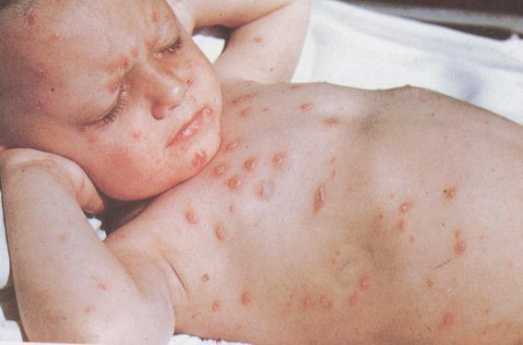
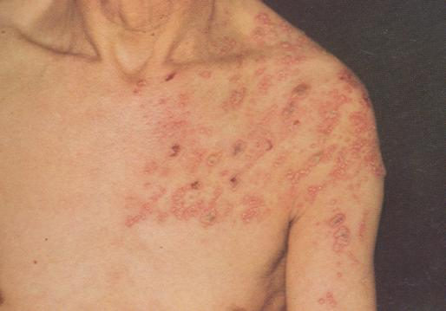
Disease
Notes:
left) Chicken pox
right) shingles

Slide 9
Distinguishing Feature
Ability to remain latent in the ganglionic neurons:
Cranial nerve ganglia
Dorsal root ganglia
Autonomic ganglia
Reactivation (either spontaneously or by a triggering factor) to cause characteristic herpes zoster (shingles) along one dermatome with dermatomal distribution.
Reactivation factors:
Increasing age of the host
Diminished cell-mediated immunity/ immunosuppression
Trauma
X-ray irradiation
Other infections
Malignancy

Slide 10
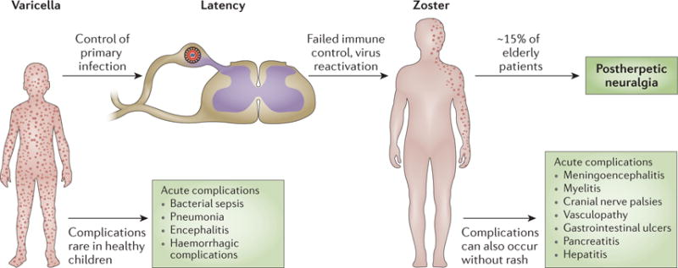
Summary

Slide 11
Treatment
Drug :
Chicken Pox: Acyclovir
Drug of choice for primary VZV infection
Requires IV administration thus complicating its use outside the hospital
Shingles: Famciclovir or Valaciclovir
Other therapuetic agents:
Vidarabine
Zoster-immune globulin (ZIG)
VZV immune globulin

Slide 12
Prevention
Primary Prevention: Immunization
Live Attenuated vaccine
ZIG for at high risk patients as those exposed to patients with primary infection

Slide 13
Why I picked this microbe?
It is associated with considerable complications once the disease occurs despite being easily preventable through vaccination
Affects the nervous system with detrimental consequences as permanent nerve palsies and post herpetic neuralgia
Annual incident rates of 1.8 cases per 100,000 nationals.

Slide 14
References
Gershon, A, A., Breuer, J., Cohen, J., Cohrs, J. R., Gershon, D. M., Gilden, D., Grose, C., Hambleton, S., Kennedy, P. G., Oxman, N. M., Seward, F. J., & Yamanishi, K. (2015). Varicella Zoster Virus Infection. Nat Rev Dis Primers, 1: 15016
Kennedy, P., & Gershon, A. A. (2018). Clinical Features of Varicella-Zoster Virus Infection. Virues, 10(11): 609
McGeoch, J. D. (2009). Lineages of Varicella-Zoster Virus. J Gen Virol., 90(Pt 4): 963-969
Nagel, M. A. & Gilden, D. H. (2007). The Protean Neurologic Manifestations of Varicella-zoster Virus Infection. Cleveland Clinic Journal of Medicine, 74(7): 489-94
Steiner, I., Kennedy, P. G., & Pachner, A. R. (2007). The Neurotropic Herpes Viruses: Herpes Simplex and Varicella-zoster. Lancet Neurol., 6(11): 1015-28

