Slide 1
Bioinformatics Workshop- Day 2
Goldi A. Kozloski PhD
October 24, 2017
Barry University

Slide 2
Projected Time Line
NCBI workshop Schedule |  | CLB 665 - M2 A/S Bioinformatics
Goldi Kozloski PhD
gkozloski@barry.edu
 |  | Day 2. October 24, 2017 9-3 pm.
 | Activity | Description
 | Assignment 1. feedback | Activity page-print
 | Translational research review PPT | Intro to oncogenes and tumor suppressor genes
 | Targeted therapy example and assignment | Bioinformatics workshop day 2 PPT and case study example
 | Tying genetic evidence (gene mutation), in one disease, to specific targeted therapy. The case of targeting the receptor tyrosine kinase FLT3 mutations in AML patients specifically with receptor tyrosine kinase inhibitors. | Guided via introduction to the following databases: PubMed, Gene Card, OMIM, Mala Card, clinicaltrials.gov, dbGaP, UniProt, KEGG, REACTOME, FDA
 | Assignment Q and A

Slide 3
Assignment 1. Feedback Activity
Name (please print) __________________________________
1. Did you use the advanced research mode in PubMed? How comfortable are you
in using the PubMed database?________________________________________________________
2. Do you now have an institutional access (Barry University) for research
articles on line through your library?___________________________________________________
3. Did you identify a useful database that you would like to share with the class?
Please indicate which database. ________________________________________________________
4. Where you able to maintain focus and describe one gene in relation to one
disease? ________________________________________________________________________
5. What was the most difficult aspect for you in assignment 1?
____________________________________________________________________________

Slide 4
Assignment 2. (50%)- See provided document
Using the example provided in class for a specific targeted therapy choice (RTKI) for Leukemia (AML) with FLT3 gene mutation, similarly generate a report for a different case study.
Follow the rationale for the questions being asks, and the approach that is used (databases) to find the answers. Your goal is to provide a good overview of your case in the context of the rationale for the targeted therapy choice ( amongst multiple therapeutic options).
Please chose a gene and/or disease that is different from your selection in assignment 1. Choose a topic that interests you.
You may choose the topic from the two classical examples provided.
Please note that your choice of topic may not fit into all the aspects that are presented here in the example, however, your case study may have other aspects to include.

Slide 5
Targeted Therapy
Genetic evidence has revolutionized scientific discovery and drug development in recent years by providing clear links between genes and disease.
Medicine developed with human genetic evidence (as opposed to chemical library screen for example) have had substantially higher success rates and patient care has benefited.
We are now in a new era of drug discovery in the area of targeted therapy because of a fundamental change in our understanding of human biology, driven largely by advances in human genetics.
Target therapy is to “target” one or several crucial biological molecules of malignant cells
or
A treatment directed toward a group of patients with similar phenotypic, genetic, or epigenetic features.

Slide 6
overview of the rationale for the targeted therapy choice RTKI for Acute Meyloid Leukemia (AML) and FLT3
Using PubMed, conduct an advance search for targeted therapy in leukemia
Possible search terms may include: leukemia, FLT3, targeted therapy, review, English.
Select the most relevant and move to clipboard (you may wish to delete old items for easy navigation).
Share the PubMed citation you used along with a link in your project.
Target therapy is to “target” one or several crucial biological molecules of malignant cells or
Treatment directed toward a group of patients with the similar phenotypic, genetic, or epigenetic features.

Slide 7
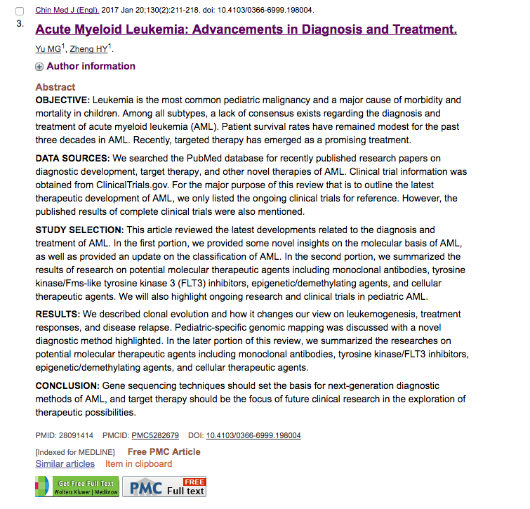
Link: https://www.ncbi.nlm.nih.gov/pubmed/28091414

Slide 8
AML Disease Review
Acute myeloid leukemia (AML) is a heterogeneous hematological malignancy characterized by highly diverse genetic and epigenetic abnormalities.
Traditional diagnosis of AML depends on the morphology, immunology, cytogenetics, and molecular biology (MICM) classification.
With advancements in sequencing technologies, the rationale for clinical decisions is shifting progressively.
Active exploration of the genetic landscape and corresponding prognostic implications in AML is an ongoing research effort.

Slide 9
AML disease is heterogeneous
Current chemotherapy agents have limited therapeutic efficacy-only 20–30% of patients achieve long-term disease-free survival (DFS).
Targeted therapy
Aims to identify mutations with prognostic significance that could be translated into revised risk stratification, advancements in therapeutic development, and advancements in therapeutic choice.

Slide 10
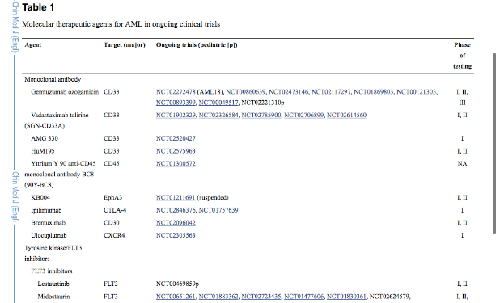
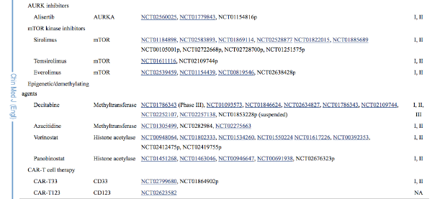
This is a good starting point!

Slide 11
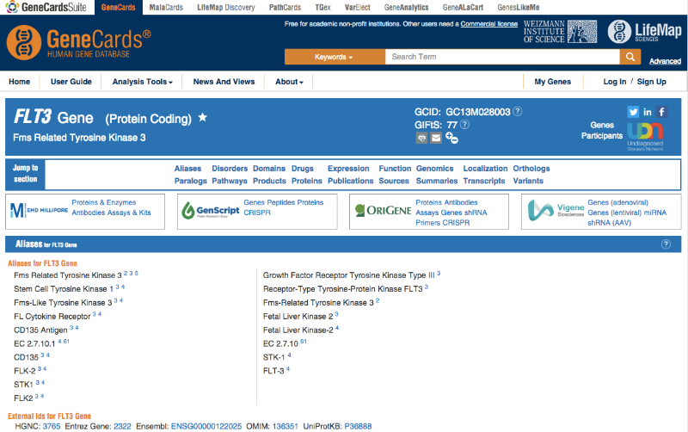
FLT3 in AML- Gene Card
Search for information about genetic variations in this gene in AML patients

Slide 12
FLT3 in AML
Search for information about genetic variations in this gene in AML patients
This gene encodes a class III receptor tyrosine kinase that regulates hematopoiesis.
Mutations that result in the constitutive activation of this receptor result in acute myeloid leukemia and acute lymphoblastic leukemia. The juxtamembrane autoregulatory region is important for normal regulation of the kinase activity and for maintaining the kinase in an inactive state in the absence of bound ligand.
Genomic Location: 13q12.2 (28,003,274- 28,100,592)

Slide 13
FLT3 in AML-OMIM
Search for information about genetic variations in this gene in AML patients
▼ Molecular Genetics
Abu-Duhier et al. (2000) reviewed data from a number of sources suggesting a pathogenic role for FLT3 in acute myeloid leukemia. Internal tandem duplication mutations causing constitutive activation of the receptor, the latter being phosphorylated independently of the ligand, had been identified and the FLT3 mutations found to be the strongest prognostic factor for overall survival in patients under the age of 60 years. Abu-Duhier et al. (2000) screened genomic DNA from 106 cases of adult de novo acute myeloid leukemia for FLT3 internal tandem duplication mutations within the juxtamembrane domain. Such mutations were detected in 14 cases (13.2%) and occurred in 4 different FAB types. Patients lacking the mutation survived significantly longer from diagnosis (mean, 29.1 months) than those with the internal tandem duplication (mean, 12.8 months).

Slide 14
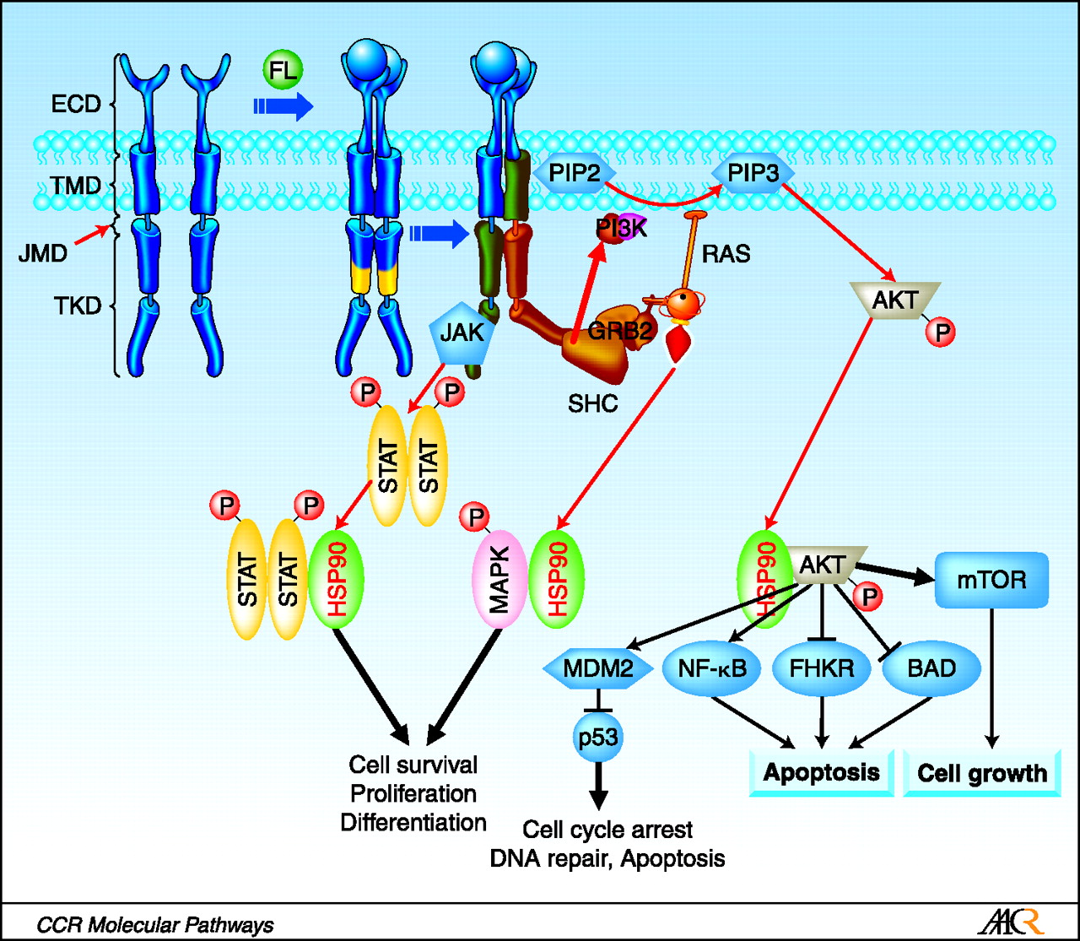
A cartoon of the protein FLT3, showing the relevant features in the context of a signaling pathway
Identify the signaling transduction pathway for your gene

Slide 15
FLT3 in AML-OMIM
Search for information about genetic variations in this gene in AML patients and provide the details!
Yamamoto et al. (2001) and Abu-Duhier et al. (2001) described mutations in the asp835 (D835) codon located within the activation loop of the FLT3 gene in cases of acute myeloid leukemia. D816 mutations have been described in the activation loop of the KIT oncogene (e.g., 164920.0009, 164920.0018, 164920.0021); this suggests that the activation loop represents a hotspot region for activating mutations in class III receptor tyrosine kinases (RTKs), which consist of FLT3, KIT (164920), FMS (164770), and PDGF receptor (173490), and share structural characteristics.
The Cancer Genome Atlas Research Network (2013) analyzed the genomes of 200 clinically annotated adult cases of de novo AML, using either whole-genome sequencing (50 cases) or whole-exome sequencing (150 cases), along with RNA and microRNA sequencing and DNA methylation analysis. The Cancer Genome Atlas Research Network (2013) identified recurrent mutations in the FLT3 gene in 56/200 (28%) of AML samples.

Slide 16
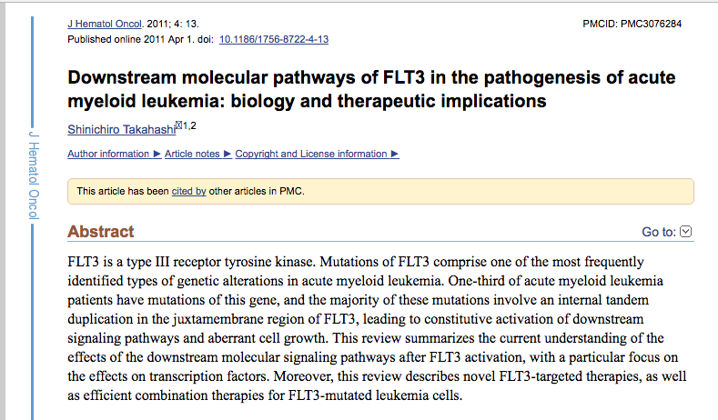
FLT3 mutation- search for disease mechanism in AML

Slide 17
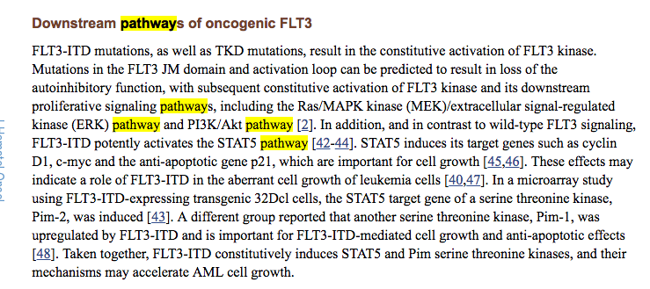
FLT3 mutation- disease mechanism in AML

Slide 18
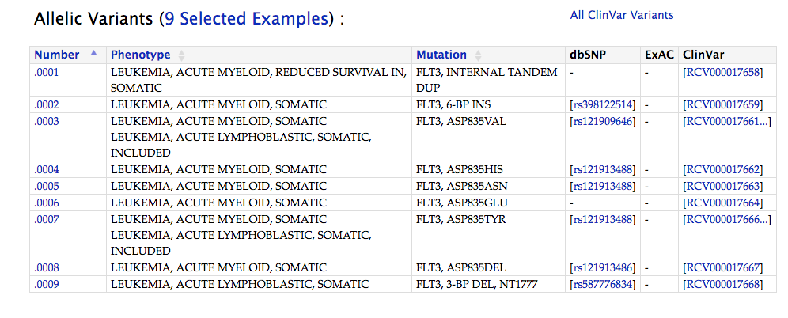
Summary of FLT3 mutations in AML-OMIM
http://omim.org/entry/136351

Slide 19
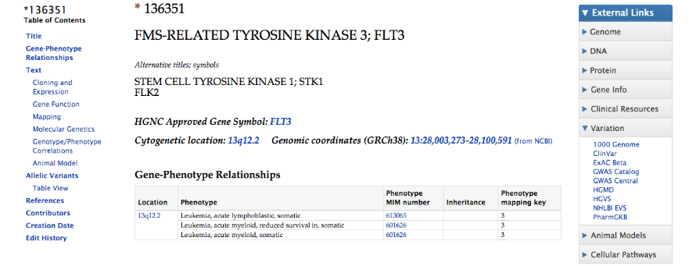
OMIM

Slide 20
FLT3 in AML-OMIM
Search for information about genetic variations in this gene in AML patients
▼ Genotype/Phenotype Correlations
Gale et al. (2008) found that 354 (26%) of 1,425 patients with AML had the FLT3 internal duplication. There was a significant correlation between worse overall survival, relapse risk, and increased white blood cell count with increased mutant level, but the size of the duplication and the number of mutations had no significant impact on outcome. Those patients with the FLT3 duplication had a worse risk of relapse than patients without the FLT3 duplication.
Among a subset of 1,217 patients, 503 (41%) had a mutation in the NPM1 gene (164040), and 208 (17%) had mutations in both genes.
AML classification into subgroups: Gale et al. (2008) identified 3 prognostic groups among AML patients: good in those with only a NPM1 mutation; intermediate in those with either no FLT3 or NPM1 mutations or mutations in both genes; and poor in those with only FLT3 mutations.

Slide 21
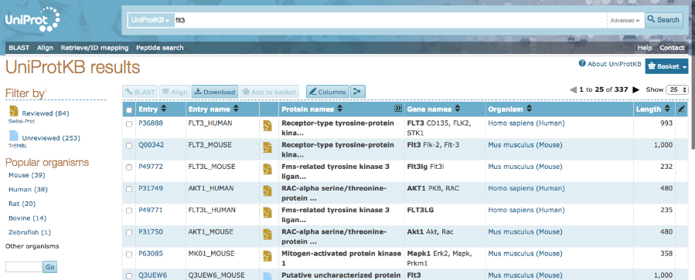
FLT3 protein mutations in relation to function
NCBI Gene
Uniprot
Gene Card
KEGG- Signal Transduction Pathways AND/OR REACTOME

Slide 22
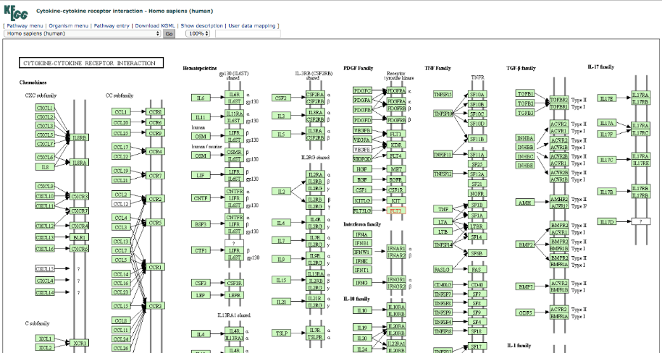
FLT3 KEGG

Slide 23
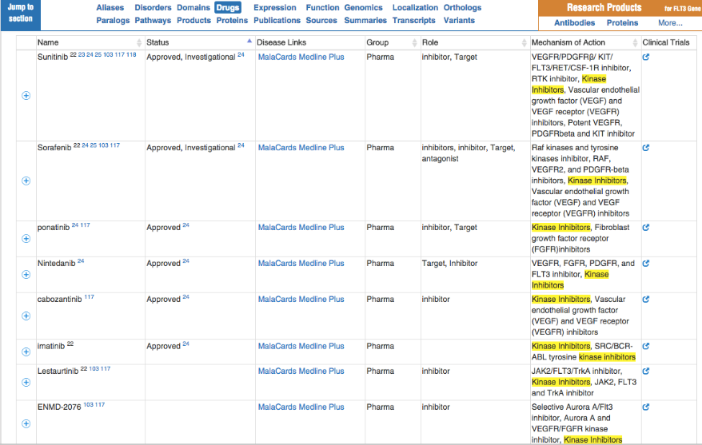
How is the disease treated? Drug names and classification

Slide 24
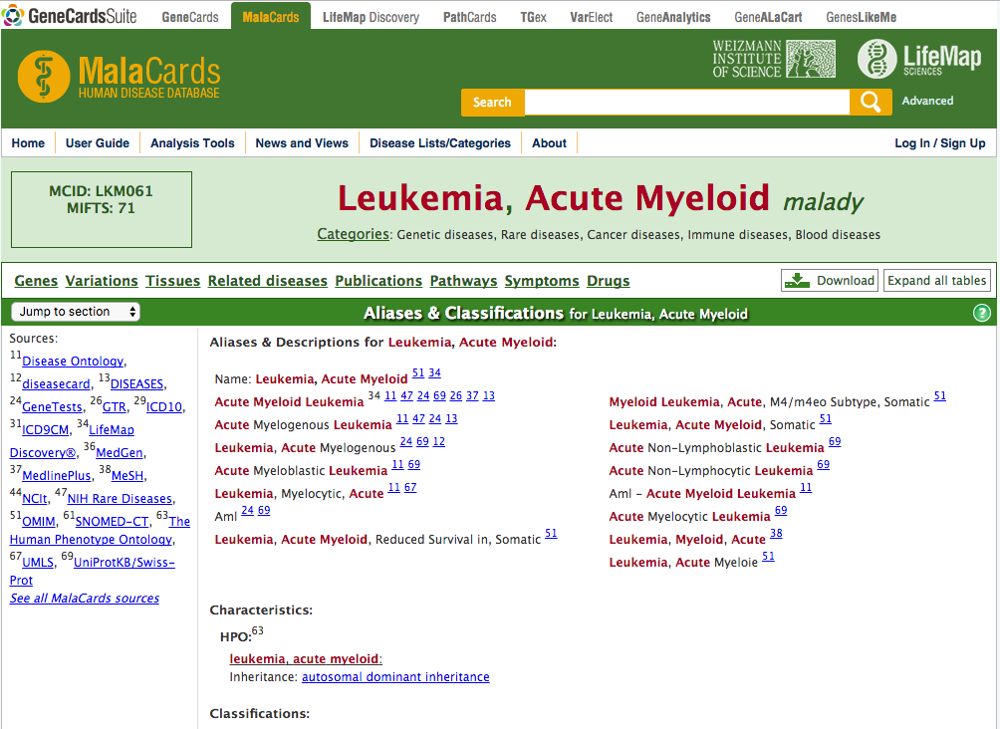

Slide 25
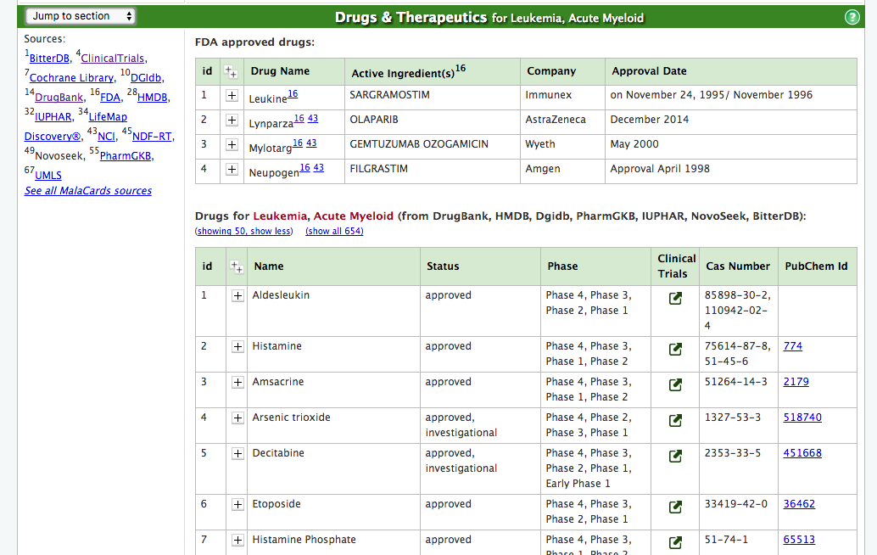

Slide 26
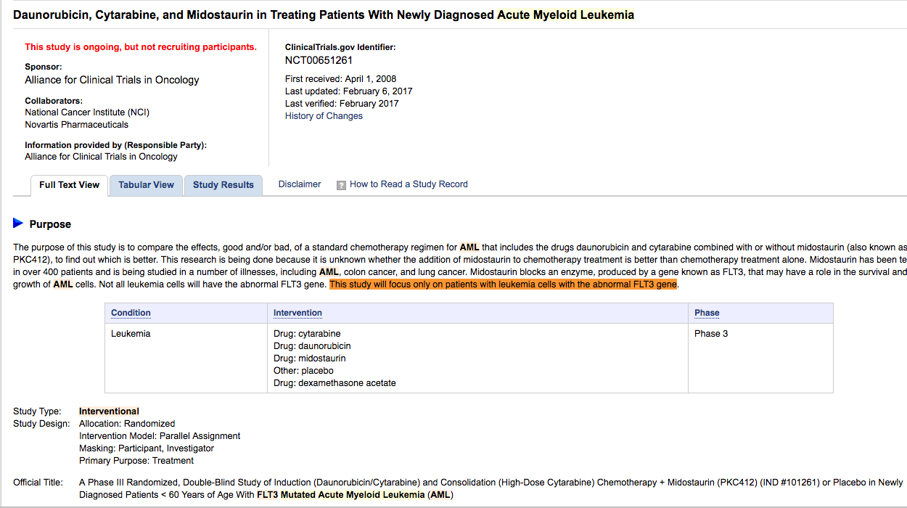
Clinical Trial.gov
Evidence from clinical trials with AML patients treated with RTKI indicate that this drug (Midostaurin) is effective in increasing the overall survival of patients

Slide 27
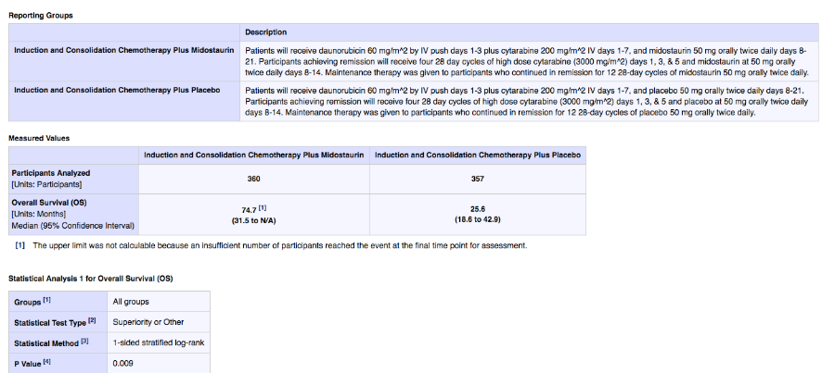
Clinical Trial
Evidence from clinical trials of AML patients with RTKI indicate that targeting AML patients with FLT3 mutation is effective.

Slide 28
Summary of findings
Acute Meyloid Leukemia (MLA) is a heterogeneous hematological malignancy characterized by highly diverse genetic and epigenetic abnormalities.
Current chemotherapy agents have limited therapeutic efficacy-only 20–30% of patients achieve long-term disease-free survival (DFS).
At least 6 categories of drugs are currently being used to treat AML. These include, monoclonal antibodies, RTKI, cell-based therapies, hypomethylating agents and others (see table 1 slide #10).
The Cancer Genome Atlas Research Network (2013) identified recurrent mutations in the FLT3 gene in 56/200 (28%) of AML samples. This positive correlation between FLT3 gene mutation and the disease AML, suggest that FLT3 may play an important role in the pathogenesis of this disease.
There was a significant correlation between worse overall survival, relapse risk, and increased white blood cell count with increased FLT3 mutant level
The FLT3 mutations were used to classify AML patients into different subgroups. Gale et al. (2008) identified 3 prognostic groups among AML patients: good in those with only a NPM1 mutation; intermediate in those with either no FLT3 or NPM1 mutations or mutations in both genes; and poor in those with only FLT3 mutations.

Slide 29
Summary of findings- Cont.
The mechanism of FLT3 mechanism in AML pathogenesis was elucidated though analyses of the effect of the mutation on the function of the FLT3 receptor. FLT3 mutations lead to constitutive activation of the FLT3 receptor with out a ligand, and transmit proliferative signaling in the MAPK, ERK, PI3K signaling pathways (Figure slide # 14).
Together these findings provided the rationale to treat AML patients with receptor tyrosine kinase inhibitors (RTKI).
Currently there are several RTKI drugs available for AML treatment (Table on slide # 25).
Evidence from clinical trial of AML patients with RTKI ( Midosaturin) indicate that targeting the RTK-FLT3 is effective in increasing the OS rates in AMLs.
RTKIs are now specifically chosen as a therapy of choice in AML patients with FLT3 mutation.

