Slide 1

BIPOLAR
Name:
Institutional Affiliation:
Course:
Date:

Slide 2
Introduction
Bipolar disorder is also known as manic depression. It is a treatable illness marked by extreme changes in mood, thought, energy and behaviour
It has symptoms of Mania: The "Highs" of Bipolar Disorder and Depression: The "Lows" of Bipolar Disorder. These changes in mood, or "mood swings" are intense and can last for hours, days, weeks or even months
Bipolar disorder is the sixth leading cause of disability in the world
Contrary to popular belief, as many men have this disorder as women
As many as one in five patients with bipolar disorder complete suicide

Slide 3
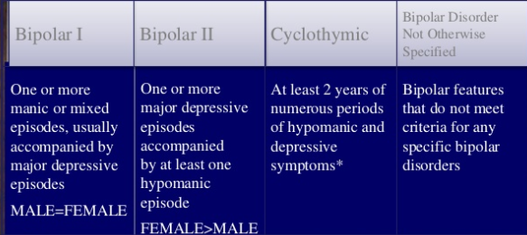
Classification of Bipolar Disorder

Slide 4
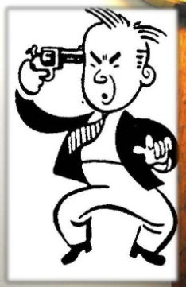
Symptoms of Depression
Prolonged sadness or unexplained crying spells
Loss of appetite and changes in sleep
patterns with sleeping far too much
Irritability, anger, worry, agitation, anxiety
Pessimism, indifference, defeat, feelings of impending doom

Slide 5
Symptoms of Depression
Loss of energy, lethargic
Feelings of guilt, worthlessness
Having problems focusing, remembering,
and making decisions
Unable to enjoy things anymore, social
withdrawal and isolation

Slide 6
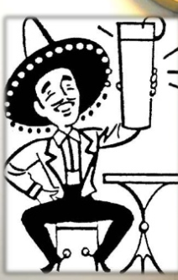
Symptoms of Mania
Excessive energy, racing thoughts and rapid talking
Denial that anything is wrong
Extreme “high” or euphoric feelings
Easily irritated or distracted
Decreased need for sleep – possibly days with little or no sleep without
feeling tired

Slide 7
Symptoms of Mania
Unrealistic beliefs in one’s ability and powers
Unusually poor judgment
Sustained, unusual behavior
Unusual sexual drive
Abuse of drugs and alcohol
Provocative, intrusive, or aggressive behavior

Slide 8
Risk Factors
Family History
Children of adult bipolar patients (majority of children of bipolar adults do not have a diagnosable bipolar disorder)
Genetic influence ( multiple genes affecting activation of areas of the brain such as the amygdala development of bipolar disorder no single gene is either necessary or sufficient cause)
Twin studies suggest that environmental influences play a role.
Stress life events, family relationships, parenting styles, social difficulty with peers and poor social support.

Slide 9
Assessment Tools
Structured Diagnostic Interviews
Young Mania Rating Scales (Rate severity of abnormality)
General Behavioral Inventory (Parent and report measure)
symptoms of depression, hypomania, mania, and mixed mood
Observational
Mood Chart (Can note when mood changes)

Slide 10
Treatment
Requires a multimodal approach to the disorder itself as well as co-occurring difficulties and the considerable involvement of the family
Hospitalization ( risk of harm or suicide, level of support of family, need for medical supervision of medication)
Pharmacotherapy for manic episodes (depends on severity)
suicidal, homicidal or aggressive behavior, psychotic features, poor judgement which places themselves or others at risk to be harmed
Antidepressants are used with caution for depressive aspects because it has been reported to destabilize patients mood or incite a manic episode.

Slide 11
Treatment
Psychoeducation
seeks to educate patient and family on the disorder and important component of intervention.
Individual and Family Therapy
educate on treatment, disorder and cognitive behavioral elements.
Dialectical behavior therapy → focuses on emotional dysregulation, psychoeducation, and behavioral therapies techniques to help family members focus on awareness and gain an increased sense of control over thoughts and emotions

Slide 12
Mortality and Morbidity
Bipolar disorder is a neurobiological brain disorder that affects approximately 2.3 million Americans today, or almost 1 percent of the population
Bipolar disorder has significant mortality and morbidity rates
Roughly 25-50 percent of the people with bipolar disorder usually attempt suicide as well as 11 percent often commit suicide .

Slide 13
Services Available to Manage Bipolar
Black Dog Institute
This organisation specialises in depression and bipolar disorder
They have information about bipolar disorder, including self-tests and suggested actions that you can take
They also offer assessments over the phone for people in rural areas with a GP referral

Slide 14
Services Available to Manage Bipolar
SANE Australia
This national mental health organisation provides information and resources for bipolar disorder
Health Direct
This government health information service provides a general overview of bipolar disorder and links to additional services

Slide 15
Services Available to Manage Bipolar
Mood Swings
A source of information on how to help yourself or a loved one, questionnaires, definitions and resources, as well as chat rooms and a discussion board

Slide 16
Analysis of the data from Mortality and Morbidity Rate
It is estimated that around one in 50 Australians develops this illness, which affects men and women equally .Most of those affected are aged in their 20s when first diagnosed
Bipolar I disorder may be experienced by up to 1% Australians over their lifetime (there being no gender difference).
The lifetime risk of Bipolar II disorder is up to 5% (with rates higher in women)
Early onset of bipolar disorder in childhood is rare. The most common risk period is in mid to late adolescence

Slide 17
Analysis of the data from Mortality and Morbidity Rate
Amongst people with bipolar disorder, there is typically a 10-20 year interval from first mood episode to diagnosis
During that period of undiagnosed and untreated mood volatility, considerable damage can occur both to the individual and others
Some people with bipolar disorder are more likely to have significant problems with alcohol and illicit drugs as they try to self-medicate

Slide 18
References
Geddes, J. R., & Miklowitz, D. J. (2013). Treatment of bipolar disorder. The lancet, 381(9878), 1672-1682.
Merikangas, K. R., Jin, R., He, J. P., Kessler, R. C., Lee, S., Sampson, N. A., ... & Ladea, M. (2011). Prevalence and correlates of bipolar spectrum disorder in the world mental health survey initiative. Archives of general psychiatry, 68(3), 241-251.

