Slide 1
Chapter Fourteen

Slide 2
Approaches to Therapy
This section covers:
  Approaches to therapy
  Therapists
  Providing therapy
Notes:
IMAGE: [© ©Monkey Business Images/Shutterstock.com] (Sue, p. 6)
Approaches to Therapy 1 of 6
What do you think of when you think of psychotherapy? Do you know anyone who has had therapy? What were their experiences like? What ideas do movies and television convey about therapy?
This section covers:
Approaches to therapy
Therapists
Providing therapy

Slide 3

Types of Treatment
Biological & Psychological perspectives
Evidence-based practice
Notes:
IMAGE [© Dlillc/Corbis] (Cacioppo, Fig. 15.3, p. 583): Evidence-Based Practice. Evidence-based practice (EBP) began in medicine and spread to psychotherapy and other helping professions. EBP combines the personal experience of the clinician, the best scientific evidence, and a consideration of patient values and expectations to tailor scientifically valid treatments to the individual.
Approaches to Therapy 2 of 6
Biological approaches to treatment have their roots in our understanding of the biological factors that contribute to psychological disorders.
Along with the overall burst of scientific and medical knowledge beginning in the 18th century, scientists began to learn more about psychological disorders and their causes.
This knowledge, in turn, set the stage for the discoveries of more effective biological treatments.
Improved medical knowledge made psychological disorders less mysterious.
The use of one biological approach to treatment, medication, revolutionized the care of people with some psychological disorders.
In 1949, an Australian psychiatrist named John Cade discovered that lithium salts could produce remarkable improvements in the behavior of patients with bipolar disorder.
Cade’s discovery was followed quickly by breakthroughs in the use of medication to treat schizophrenia.
Bolstered by these successes with some of the most troubling psychological conditions, the pharmaceutical industry quickly introduced medications for depression and anxiety.
These successes not only led to better outcomes for many patients but also strengthened the credibility of using biological approaches to treat abnormal behaviors.
Running parallel to the successes of scientists engaged in biological approaches to disorders were significant contributions from those who focused on the psychological and emotional underpinnings of disorders.
During the 19th century, psychologists and psychiatrists were very interested in “hysteria,” a condition that would be diagnosed today as a somatoform, or somatic symptom, disorder.
Hysteria did not seem to have any biological basis and did not respond to the medical treatments of the day.
Among the first efforts to treat hysteria through nonmedical means was the use of hypnosis by Franz Anton Mesmer.
Despite skepticism regarding Mesmer and his techniques, other scientists continued to explore hypnosis, suggestion, and hysteria.
During the 20th century, psychological approaches to treatment reflected the rise of the behavioral and humanist perspectives.
The behaviorist perspective, unlike the biological and Freudian approaches, focused exclusively on observable behavior and approached the treatment of abnormal behaviors using the principles of classical conditioning, operant conditioning, and observational learning.
The cognitive revolution of the second half of the 20th century added a recognition of the role of cognitions in abnormal behavior.
The rise of humanistic psychology in the second half of the 20th century also led to new humanistic therapies.
The beginning of the 21st century has featured greater demands to tie clinical practice to research on the outcomes of treatment.
Evidence-based practice (EBP) combines research evidence, clinical expertise, and patient values to provide the best outcome for a patient.
The movement toward EBP began in medicine, but has since spread throughout the helping professions, including psychology.
EBP combines five steps:
1. Construct an answerable question, such as “Which treatments produce the best outcomes in cases of post-traumatic stress disorder?”
2. Conduct a search of the most current scientific literature related to the question. In other words, doing something “because I’ve always done it this way in my practice” is no longer an option.
3. Critically evaluate the relevant literature, using the standards for good science that we discussed in our research methods chapter.
4. Integrate this information with data regarding a particular case, including the patient’s values and circumstances.
5. Evaluate the patient’s outcomes and make necessary adjustments.

Slide 4
Types of Mental Health Professionals
Psychologists
Psychiatrists
Counselors
Social Workers
Couples or Family Therapists
Notes:
IMAGE [©Jacky Chapman/Janine Wiedel Photolibrary/Alamy] (Pastorino, p. 594):
Approaches to Therapy 3 of 6
A wide range of professionals provide counseling and psychotherapy. Psychologists, psychiatrists, counselors, social workers, and licensed therapists all receive specialized training and have specific credentials to administer mental health care. Nurses and religious leaders, like pastors or rabbis, sometimes provide counseling services in the course of their duties.
Licensing of these professionals to provide treatment for psychological disorders is administered by state governments in the United States and provincial governments in Canada.
Requirements for licensing can vary widely from state to state and can result in a bewildering array of titles.
For example, the simple term therapist is not regulated consistently across the United States.
We will use the term psychotherapist for any of the many types of licensed professionals described in this section who provide psychotherapy.
Psychiatrists first obtain a standard medical degree (MD or DO), and then spend an additional three to four years specializing in psychiatry.
Because of their training and licensure as physicians, psychiatrists are allowed to perform the medical procedures, particularly the prescribing of medication.
The word psychologist is used to describe professionals who have completed advanced degrees in psychology, including those who become psychotherapists.
Most psychologists, including the professors teaching your introductory course, earn the traditional academic Doctor of Philosophy (PhD) degree in psychology, but not all choose career paths as licensed psychotherapists.
Clinical psychology is the path taken by psychology graduate students who wish to study, teach, or practice psychotherapy.
In addition to completing the academic requirements for a PhD, clinical psychology students must spend an additional year providing treatment in a supervised internship.
Beginning in the 1970s, an alternate route to becoming a clinical psychologist arose from suggestions that the practice of psychology could be modeled after dental and medical schools.
The Doctor of Psychology (PsyD) degree was developed to train students to provide services without undergoing the extensive training in research methods that characterizes the PhD degree.
How do clinical psychologists and psychiatrists differ, other than that they earn different degrees?
One of the traditional distinctions has been psychiatrists’ ability to prescribe medication, but that difference is gradually disappearing.
In 2002, New Mexico became the first state to allow select psychologists to prescribe medication and additional states have followed.
The requirements for already licensed clinical psychologists to gain prescription privileges are quite rigorous.
Psychologists wishing to prescribe medication in these states must go through an additional 450 classroom hours of neuroscience study, 80 hours of clinical practicum, and 400 physician-supervised hours of care with at least 100 patients.
In addition to treating people with diagnosed psychological disorders, clinical psychologists often provide marriage and family counseling, substance abuse counseling, vocational counseling, grief counseling, rehabilitation counseling, and prison counseling.
However, these types of service are also provided by counselors, who typically do not provide services for psychological disorders such as schizophrenia.
In recognition of the historical role of religious leaders in providing counseling to members of their congregations, most states allow religious leaders to provide this service without further licensure.
The Master of Divinity (MDiv) degree typically includes human development and counseling courses taught within schools of divinity.
In a fairly new development, some universities are offering MDiv degrees that prepare students to be either religious leaders or counselors in the outside community.
Among the least frequently regulated practitioners are hypnotherapists.
Few states require that a person using hypnotherapy be a licensed psychotherapist and few even insist that hypnotherapists register with the state.
Another unregulated area in the provision of psychological services is the field of life coaching, which requires no licensing.
According to the International Coach Federation (ICF), “Professional coaches provide an ongoing partnership designed to help clients produce fulfilling results in their personal and professional lives. Coaches help people improve their performances and enhance the quality of their lives” (International Coach Federation [ICF].
Substitute psychotherapist for coach in this definition, and few would disagree with the resulting statements.
Coaches seem to perform the same duties as psychotherapists.
In fact, some psychotherapists have found that referring to themselves as “coaches” expands their practices, possibly because of the lower stigma of seeing a “coach” rather than a “therapist” in the minds of some clients.
Few studies have attempted to evaluate the effectiveness of coaching, but those that have done so note that clients are very satisfied with the services.
Life coaching provides the advantage of being more appealing to men, who generally seek more traditional psychotherapy in much smaller numbers than do women.

Slide 5

Therapy Considerations
Length of treatment
Individual, family, or group therapy
Notes:
IMAGE [© Frank Pedrick/The Image Works] (Cacioppo, p. 588): Family therapy combines individual sessions with sessions that include some combination of family members, like these parents and their young daughter.
Approaches to Therapy 4 of 6
Most psychotherapy occurs in the form of individual therapy, involving face-to-face, hour-long meetings between the therapist and the patient or client
In traditional psychoanalysis, such meetings are quite frequent (four to five times per week) and take place over the course of years.
Modern forms of psychoanalysis use similar theories, but seek to provide help in a much shorter time frame by using slightly different methods.
In cognitive-behavioral therapies, sessions might occur once per week for about six weeks.
Given the approximate rates of up to $150 per hour for individual therapy, insurance providers are pressuring psychotherapists to find faster, more efficient ways to provide treatment.
Many insurance plans place strict limits the number of psychotherapy sessions a patient can have each year.
Brief therapy, advocated by Milton Erickson and others, specifically avoids spending long periods searching for the historical basis of a person’s problems.
Instead, therapists using this approach focus on “solution-building rather than problem- solving.”
Consequently, practitioners argue that only three to five sessions are necessary.
Many brief therapy interventions involve only one session, and no cases require more than eight.
In addition to individual sessions, psychotherapy can take place with groups of patients or clients in group therapy.
It is important to note that group therapy does not imply particular types of treatment approaches.
Although some treatment approaches seem better suited for group work than others, therapists of all persuasions are known to utilize groups in their work.
The groups formed by the therapist can be homogeneous, in the sense that the group members share a common problem, or heterogeneous, in which the group members have diverse diagnoses.
In most cases, groups are limited to between 6 and 12 individuals.
People with severe conditions, such as psychotic, suicidal, or antisocial tendencies, are usually excluded from groups until they progress sufficiently to act as good group members.
Although many groups are organized and supervised by a licensed psychotherapist, leaderless self-help groups are also quite popular.
Weight Watchers, Alcoholics Anonymous (AA), and other groups modeled after AA have become very popular sources of support and self-improvement.
These groups often operate with a member-leader who is not a psychotherapist, and they function outside the realm of government licensure and supervision.
In addition to the obvious cost-effectiveness of having a group split the therapist’s fee, group therapy offers a number of advantages.
For example, group therapy offers hope to members, who benefit from seeing others who have made more progress with their condition.
Group members also benefit from knowing that others share their condition, decreasing their sense of isolation.
Although practitioners generally believe that group therapy is effective, research on group therapy outcomes is very difficult to conduct because of the large number of variables that must be considered.
The need to control for such factors as different disorders and previous treatment history make this area very challenging for researchers.
Family therapy, in which various family members participate in therapy individually and in combination with other family members, is another alternative to the purely individual provision of treatment.
Couples therapy is a type of family therapy that focuses on intimate relationships.
Family therapy is frequently used when a child or teen is experiencing problems, as these problems typically impact and are affected by the behavior of other family members.
Family therapists face a number of significant challenges.
In some cases, the member who seems to need treatment the most refuses to participate.
In others, maintaining the confidentiality of all participants can be difficult.
Teens might disclose information that will help the parents do their job much better, but sharing this information with the parents could interrupt the trust the therapist has built up with the teen.

Slide 6
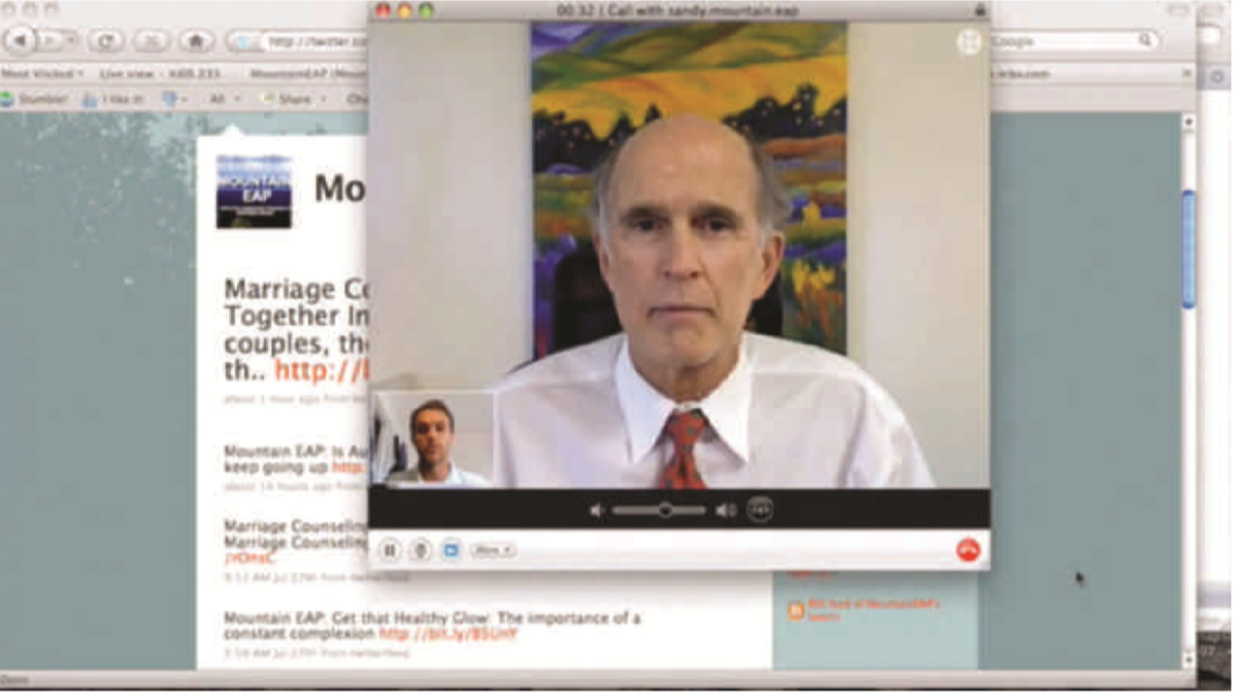
Providing Therapy at a Distance
Innovative approaches to delivering online therapy
Notes:
IMAGE [© Courtesy of Mountain Employee Assistance Program] (Cacioppo, p. 748): The benefits of privacy, engaging in therapy from home, frequent 24-7 coverage, video interactions using Skype or similar technologies, and the ability to choose a suitable therapist regardless of location provide significant advantages for some clients. Online delivery of cognitive-behavioral therapy (CBT) has been shown to be as effective as face-to- face delivery.
Approaches to Therapy 5 of 6
An emerging delivery system for psychotherapy is online therapy.
The benefits of privacy, engaging in therapy from home, and the ability to choose a suitable therapist regardless of location provide significant advantages for some clients.
In its early days, online therapy was conducted through e-mail or chat.
Because the written word conveys less information than a therapist obtains face-to- face, this method could be viewed as a disadvantage.
However, many online therapists have taken advantage of Skype and other voice and video technologies.
In some studies, online delivery of cognitive-behavioral therapy (CBT) is just as effective as face-to-face CBT.
Other technologies have influenced the delivery of psychotherapy.
Therapists can buy products such as Wiley’s TheraScribe, a computer program that includes over 2,500 prewritten interventions, goals, objectives, and suggested diagnoses.
The program generates reports catering to Medicare and other managed care organizations.
The time savings provided by these technologies can be useful in controlling costs, but receiving a prewritten evaluation might seem somewhat impersonal to individuals seeking therapy.
Most forms of online therapy are limited to patients with mild-to-moderate psychological problems. Many clinicians prefer to treat patients with severe conditions face-to-face.
Laws and guidelines that govern online therapy are still being developed.
Patients must be protected from unskilled or unlicensed individuals presenting themselves as therapists.
Likewise, it’s critically important to ensure that patient records are kept private and that online therapy sessions aren’t surreptitiously recorded.

Slide 7
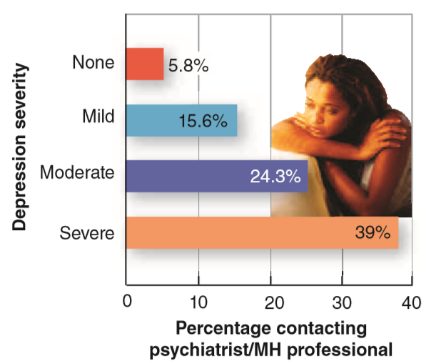
Who Seeks Treatment?
Notes:
IMAGE [Illustration: © Cengage Learning; photo: ©Thinkstock/Photos.com] (Cacioppo, Figure 15.1, p. 581): Many People With Psychological Disorders Do Not Receive Care.
Approaches to Therapy 6 of 6
As symptoms of depression become more severe, people are more likely to obtain treatment from a psychiatrist or mental health professional, which would include clinical psychologists.
It is difficult to tell whether the remaining individuals receive no care at all or are seen by their family physicians or other health care providers.

Slide 8
Psychological Therapies
This section covers:
  Psychoanalysis
  Humanistic therapies
  Behavioral therapies
  Cognitive therapies
Notes:
IMAGE: [© © iStockphoto.com/Alina555] (Bernstein, p. 538): Although we think that dressing and sitting like your client is not necessary to demonstrate empathy, attempting to see situations through the client’s eyes is an important part of humanistic therapies.
Psychological Therapies 1 of 7
When you think of psychotherapy, do you think of Sigmund Freud’s interpretation of dreams, Carl Roger’s unconditional positive regard, behavioral therapies like systematic desensitization, or Aaron Beck’s challenges to faulty thinking?
This section covers:
Psychoanalysis and psychodynamic therapy
Humanistic therapies
Behavioral therapies
Cognitive therapies

Slide 9

Psychoanalysis
Freudian psychoanalysis
Psychodynamic therapy
Notes:
IMAGE: [© Bjanka Kadic/Alamy] (Cacioppo, p. 590): Freud’s study featured not only the famous couch but also Persian rugs and a sample of Freud’s collection of antiquities.
Psychological Therapies 2 of 7
Sigmund Freud’s approach to psychotherapy reflected several key themes from his theory of personality.
In particular, Freud emphasized the importance of conflict between the self (ego), the aggressive energy of the id, and the restrictions supplied by society (superego).
Freud’s view of the ability of the unconscious mind to affect behavior is also central to his therapeutic approach.
Because of Freud’s training as a physician, the psychoanalyst takes a directive role, which means that he or she is definitely in charge of the session.
Like your physician, the psychoanalyst does not expect any contributions from you other than information about your symptoms.
Freud’s psychoanalysis is a classic example of an insight therapy.
Insight therapies assume that people will improve once they understand their problems.
For Freud, many psychological disorders arose from problems that resided in the unconscious mind, out of conscious awareness.
Although the person might not be consciously aware of these continuing conflicts, the conflicts exert their influence on behavior and through dreams.
For example, a patient might arrive at the therapist’s office complaining about her inability to enjoy a satisfactory sex life with a beloved spouse.
Although many different factors could obviously contribute to such problems, the psychoanalyst is likely to suspect the influence of some traumatic experience that is relatively unavailable to the patient’s conscious thoughts.
Perhaps the patient is the victim of childhood sexual abuse, or she might be experiencing a conflict between the ultra-strict morality she learned from her parents and her current desire to have a fulfilling relationship with her partner.
For the psychoanalyst, the “cure” lies in uncovering the unconscious contributions to the patient’s problems.
Once she understands the source of her problems (the insight), her situation should improve.
How does one go about uncovering unconscious material?
Although Freud experimented with the use of hypnosis to access the unconscious mind, he became dissatisfied with the results and abandoned the procedure.
Instead, Freud decided to use the technique of free association.
Free association occurs when a person says whatever comes to mind.
As we mature, most of us become aware that we do not literally “speak our mind” out of consideration for our fellow humans.
Although small children might tell a person, “You’re fat,” such comments, although they may be true, are not the type that most adults consider polite.
We learn to think before we speak.
To engage in free association, this self-censor must be turned off, allowing the patient to verbalize those thoughts that are typically withheld.
Without the self-censor, the famous “Freudian slips” might occur and are assumed to reflect unconscious wishes.
Not all psychoanalysts engage in dream analysis, but it is likely that therapists interested in dream analysis are psychoanalysts.
For Freud, dreaming represented a censored reflection of unconscious wishes and, therefore, a potential source of much useful insight into the unconscious mind.
If the patient is undergoing dream analysis, he or she is taught to awaken following a dream in order to jot some notes that can later be reviewed with the therapist, who will attempt to interpret the dream’s symbolic meanings.
In addition to reviewing the content of free association, dreams, and Freudian slips, the analyst looks for signs of transference and resistance.
Transference occurs when a patient uses an earlier relationship, usually with a parent or other authority figure, as a prototype for a current relationship, such as that between the patient and therapist.
If the patient begins yelling at the therapist, the therapist might infer that the patient reacted similarly to parents and others in authority under similar circumstances in the past.
Resistance occurs when the patient is getting closer to insight.
Freud believed that we have unconscious wishes to maintain infantile fantasies and avoid punishment, and efforts to uncover this material will be resisted by the patient.
Resistance, for the psychoanalyst, can be expressed in many forms.
When a patient changes the subject, disagrees with the analyst’s interpretation, or even misses an appointment because of a flat tire, the analyst might suspect he or she is getting closer to the uncomfortable truth.
In recent years, psychoanalysis has changed in the length and frequency of treatment.
Driven by demands from insurance providers, psychoanalysts have developed new, briefer treatments called psychodynamic therapies.
These briefer approaches tend to be less past-oriented as well.
In other words, the psychoanalyst might ask about a person’s recent experiences at work rather than his or her experiences as a toddler.
Does psychoanalysis work?
Some published meta-analyses suggest that psychoanalysis produces better results than no treatment and occasionally produces results comparable to more modern approaches to therapy.
However, these studies have been criticized on the basis of their methods, such as including Rorschach Inkblot results as measures of patient improvement.

Slide 10

Humanistic Therapies
Empathy
Genuineness
Unconditional positive regard
Notes:
IMAGE: [© Catchlight Visual Services/Alamy] (Cacioppo, p. 592): Although we think that dressing and sitting like your client is not necessary to demonstrate empathy, attempting to see situations through the client’s eyes is an important part of humanistic therapies.
Psychological Therapies 3 of 7
Disillusioned with the goals, methods, and assumptions of psychoanalysis, Carl Rogers developed a different therapy approach that exemplifies the humanistic perspective.
Whereas Freud saw the analyst as all-knowing and responsible for client change, Rogers believed that the therapist should serve more as a facilitator or coach to help move the client in the direction of change.
Such a viewpoint resulted in client-centered therapy, or person-centered therapy.
As the names imply, in client-centered therapy, the focus and direction of therapy comes from the person, or client.
The client decides what to talk about, without interpretation or judgment from the therapist.
The therapist, according to Rogers, creates a positive and accepting environment to facilitate self-awareness and personal growth by providing three key characteristics: empathy, genuineness, and unconditional positive regard.
According to Rogers, empathy is the ability to understand a client’s feelings and thoughts without being judgmental.
The therapist does not express disapproval toward the client but rather indicates understanding of the client’s feelings.
Conveying empathy involves actively listening to the client—making eye contact, nodding as the client speaks, and assuming an interested and attentive pose.
Empathy also involves reflection.
The therapist restates, repeats, or summarizes the thoughts and feelings that he or she hears the client express.
Reflected statements communicate to the client the active attention of the therapist and mirror the client’s perceptions and views of reality.
A second key therapist quality in client-centered therapy is genuineness.
Genuineness is the ability to openly share one’s thoughts and feelings with others.
The therapist expresses his or her true feelings and thoughts to the client and does not hide behind the mask of being the “professional,” “doctor,” or authority figure.
The therapist self-discloses a fair amount to the client, which allows the client to see the therapist as a real, living person.
Such disclosure also creates an open environment that promotes trust and an honest expression of thoughts and feelings.
Rogers believed that such an environment would model to the client how relationships can be built on a foundation of trust and honesty.
The third key quality in client-centered therapy is unconditional positive regard.
Rogers defined unconditional positive regard as the ability to accept and value a person for who he or she is, regardless of his or her faults or problems.
Rogers believed that receiving unconditional positive regard in one’s childhood is a key factor in healthy personality adjustment.
A therapist who offers unconditional positive regard to a client does not indicate shock, dismay, or disapproval to any client statements.
Instead, the therapist communicates caring and respect toward the client regardless of what the client says.
This does not mean that the therapist has to personally agree with everything the client states.
Rather, the therapist’s job is to reflect the client’s feelings and thoughts in order to further the client’s self-knowledge and enable the client to solve problems in his or her own way.
Unconditional positive regard enables the client to believe that he or she has value and is competent at making decisions.
Such attitudes foster self-confidence and self-acceptance that lead to healthier growth choices.
For Rogers, a therapist who demonstrates all three qualities—empathy, genuineness, and unconditional positive regard—establishes a positive and nurturing environment.
A person feels accepted, understood, and valued.
These feelings help the client self-explore a more realistic self-image and perception of the world.
This in turn removes the obstacles to personal growth so that self-actualization can be realized.
Does client-centered therapy work?
Compared to no-treatment control groups, people in client-centered therapy do change their behavior.
Compared to more structured therapy approaches, client-centered therapy is equally effective.

Slide 11

Behavioral Therapies
Systematic desensitization
Flooding
Aversion therapy
Token economies
Notes:
IMAGE: [© Photo by Stephen Dagadakis, copyright Hunter Hoffman www.vrpain.com, World built by Firsthand Inc.] (Cacioppo 1e, p. 594)
Psychological Therapies 4 of 7
Psychoanalytic and humanistic therapies focus on internal reflection by the client.
In contrast, behavior therapy focuses directly on changing current problem behaviors rather than delving into the client’s past.
Behavior therapies, also called behavior modification, consist of techniques and methods that use learning principles to change problem behavior.
One effective tool for treating phobias and anxiety is systematic desensitization .
Systematic desensitization involves replacing a fear or anxiety response with an incompatible response of relaxation and positive emotion.
Anxiety and relaxation are competing responses.
You cannot feel both at the same time; you can only feel one or the other.
So the aim of systematic desensitization is to have a client learn how to relax and then slowly and systematically introduce the feared object, situation, or thought while the client maintains a positive state of pleasure or relaxation.
Systematic desensitization is accomplished in three basic steps.
First, the client is trained in progressive muscle relaxation.
This method involves alternately tensing and relaxing different muscle groups, beginning with the head and working down to the toes, so that the client learns to distinguish when muscles are tense and when they are relaxed.
Once the client has learned progressive relaxation, the client and therapist develop an anxiety hierarchy.
An anxiety hierarchy is a list of situations or items that trigger a client’s anxiety or fear.
The items on the hierarchy start with the least anxiety-provoking situations or items and progress to the most distressing.
In the third step, progressive relaxation and the anxiety hierarchy are combined.
Relaxation is paired with each item in the hierarchy.
As the client becomes able to imagine a feared situation and remain relaxed, the next item in the hierarchy is addressed.
Over several therapy sessions, this systematic process continues until the client has become desensitized to all items in the hierarchy.
Another exposure behavior therapy that relies on classical conditioning processes is flooding.
In flooding, the client remains exposed to the feared object, situation, or image for a prolonged period until his or her anxiety decreases.
This is a process called extinction in which the conditioned stimulus (CS) (the feared item) is presented by itself until it no longer produces the conditioned response (CR) of anxiety and fear.
In contrast to systematic desensitization, flooding starts with the most feared item or situation rather than the least distressing item.
In addition, instead of relaxing, the client is told to experience the fear fully and is prevented from escaping the situation or engaging in any other anxiety-avoiding behaviors.
Whatever terrible consequences the client imagined would happen do not occur, and his or her anxiety decreases.
Flooding can be an effective and efficient way to reduce anxiety and fear.
A client’s anxiety subsides rather quickly; however, relapses (return of the fear) are common .
This should not be surprising if you recall the concept of spontaneous recovery in which the conditioned response (anxiety) can reappear after it has been extinguished.
For this reason, flooding is often used in combination with other therapy techniques.
In addition, because of the discomfort associated with flooding, it is ethically imperative that clients be fully informed and prepared for flooding treatment.
Aversion therapy involves pairing an unpleasant stimulus (like a foul or spicy taste or some painful stimulus like a shock) with a specific undesirable behavior.
Ideally, the aversive stimulus becomes associated with the undesirable response so that the person is less likely to engage in the response again.
Aversive conditioning occurs frequently in everyday life.
Food poisoning is a prime example.
If a particular food has ever made you sick, normally it will be months or even years before you touch that food again.
The food (stimulus) becomes associated with being sick (response) so that you avoid it at all costs.
Therapists use this knowledge to treat a variety of undesirable habits and behaviors.
For example, an aversion therapy method for treating alcoholism involves taking a drug called Antabuse.
Antabuse interacts with alcohol, causing nausea and vomiting.
If a person with alcohol use disorder drinks while using Antabuse, it makes him or her ill.
The unwanted stimulus (alcohol) becomes associated with the response of feeling ill and nauseated.
The person with alcoholism learns to avoid alcohol in order to avoid the associated unpleasant response.
Unfortunately, the person with alcohol use disorder can also simply avoid taking the medication, thereby nullifying the effectiveness of the procedure.
In clinical trials, Antabuse has demonstrated mixed results in helping people abstain from alcohol use.
When Antabuse is given under supervision and in conjunction with a drug that specifically reduces alcohol cravings, its effectiveness on short-term abstinence and days until relapse is improved.
An alternative form of aversion therapy is called covert sensitization therapy.
In this procedure, graphic imagery is used to create unpleasant associations with specific stimuli.
For example, a person who smokes cigarettes may have to repeatedly imagine black and diseased lungs when faced with the stimulus of a cigarette.
At this point, you may be disturbed by the knowledge that therapists use such unpleasant procedures in treatment.
Keep in mind, though, that therapists are ethically bound to get informed consent from clients.
Clients are informed of the procedure and must agree before such a method can be used.
However, because of its potential for misuse and the fact that it intentionally elicits distress, therapists use aversion therapy only in limited circumstances.
Some unscrupulous therapists have attempted to use this approach in cases where it is either inappropriate or ineffective.
A token economy involves rewarding people with tokens, or symbolic rewards, for desired behavior.
Because not everyone is influenced by the same reward, tokens—such as chips, points, or stars—are given each time a person engages in a desired behavior.
These tokens can then be exchanged for a variety of reinforcers such as food, privileges, goods, phone time, and so on.
You may recall having had a treasure chest or goody box in elementary school.
Students who had acquired a certain number of points or tokens could visit the prize box at the end of the week.
Today, your consumer behavior may be unknowingly reinforced by a token economy.
Many credit card companies, restaurants, and retail stores offer points for purchases.
These points can then be exchanged for merchandise, food, or future discounts.
Airlines do the same thing with frequent flyer points.
Their aim is to increase your consumption of their services
The same principle can be used in hospitals, halfway houses, prisons, substance abuse treatment centers, and other institutional settings.
People earn tokens for desired behavior and constructive activities, and then exchange them for passes, free time, snacks, access to television, or private rooms.
In some institutions, patients may lose or be charged tokens for undesired behavior such as fighting, noncompliance, or not completing their chores.
A token economy can be a very effective tool for treating children with intellectual disabilities and autism, and for managing behavior in a group setting

Slide 12
Cognitive Therapies
Cognitive restructuring
Rational Emotive Behavioral Therapy
Cognitive-behavioral therapy
Notes:
IMAGE: [© CLEM MURRAY/MCT/Landov] (Cacioppo, p. 595): Aaron Beck (1921– ), shown here addressing a workshop at the Beck Institute, developed one of the earliest types of cognitive therapies. Beck’s approach featured cognitive restructuring, in which irrational beliefs, such as “everyone must love me or I can’t be happy,” are replaced with more rational beliefs, such as “I can be happy because I have some people who love me.”
Psychological Therapies 5 of 7
As the name implies, cognitive therapies are based on the notion that the way we think about our circumstances is essential to our health and adjustment.
According to this view, situations do not cause abnormal behavior, but the way we think about situations might do so.
One of the earliest examples of cognitive therapy was developed beginning in the 1940s by Aaron Beck.
According to Beck, people run into psychological trouble when they adopt irrational, self-defeating ways of thinking.
An important aspect of the therapy process occurs when the therapist attempts to change the irrational beliefs of the client.
For example, let’s assume a therapist is trying to help a student with test anxiety.
The student has an irrational belief that she is going to flunk out of school, despite her adequate GPA.
To help the student realize that her belief is irrational, the therapist might ask her to provide evidence of the likelihood of flunking out or to identify the worst possible outcome of giving up the belief.
Faced with logic, the student begins to substitute a new, rational belief for the old, irrational belief, and cognitive restructuring has occurred.
A variation of cognitive therapy emerged out of work by Albert Ellis, beginning in the 1950s. Ellis’s version of cognitive therapy is known as Rational Emotive Behavioral Therapy.
Compared to many other types of psychotherapy, REBT is somewhat confrontational, as the therapist is more openly critical of a client’s thinking.
Ellis retained the need to produce cognitive restructuring, but deemphasized the supportive role of the therapist.
As cognitive therapy expanded further, therapists began to use the term cognitive-behavioral therapy (CBT).
In addition to promoting cognitive restructuring, therapists wanted to help clients initiate behavioral changes.
Cognitive-behavioral therapy has an excellent record of success, particularly in the treatment of major depressive disorder.
Because CBT typically requires fewer than 16 sessions and can be used for a wide variety of conditions, it is a favorite among insurance providers.

Slide 13
Experiencing Psychology: Cognitive Distortions
Recognize automatic negative thinking
COGNITIVE ERROR | DESCRIPTION
All-or-nothing thinking | Seeing each event as completely good or bad, right or wrong, a success or a failure
Arbitrary inference | Concluding that something negative will happen or is happening even though there is no evidence to support it
Emotional reasoning | Assuming that negative emotions are accurate without questioning them
Magnification and minimization | Overestimating the importance of negative events and underestimating the impact of positive events
Overgeneralization | Applying a negative conclusion of one event to other unrelated events and areas of one’s life
Notes:
Psychological Therapies 6 of 7
Aaron Beck developed cognitive therapy based on the principle that distorted thinking and negative, automatic thought patterns lead to depression, anxiety, and low self-esteem.
Beck saw the client and therapist as a collaborative team, working together to identify and evaluate the accuracy and biases of the client’s thought patterns.
At first, the therapist teaches the client how to recognize and keep track of negative automatic thoughts, such as “I never do anything right” or “I always fail at whatever I do.”
The therapist and client then test the validity or accuracy of these thoughts.
For example, a client may be asked to list all the tasks assigned to him or her in a week and then indicate whether each task was completed.
The therapist hopes that such an exercise will not only point out the inaccuracy of the client’s beliefs, but also teach the client how to evaluate negative automatic thoughts in the future.

Slide 14
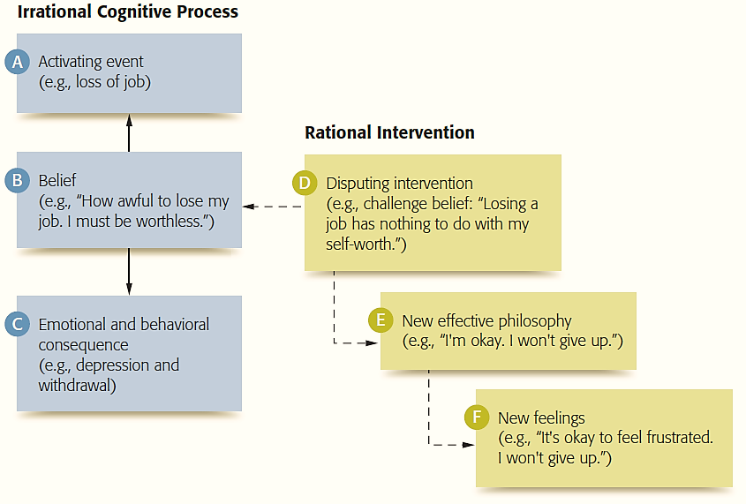
Experiencing Psychology: Irrational Assumptions
Notes:
IMAGE: [© Cengage Learning] (Sue, Figure 2.9, p. 59) Ellis’s A-B-C Theory of Personality
Psychological Therapies 7 of 7
Rational-emotive therapy is based on the premise that many mental health problems stem from how people think about and interpret events in their lives.
It is not the actual event that causes the emotional upset, but rather the person’s interpretation of the event that results in emotional distress.
Specifically, rational-emotive therapy identifies the client’s faulty or irrational beliefs that lead to self-defeating behaviors, anxiety, depression, anger, or other mental health problems.
Ellis identified common irrational beliefs that often impede people’s functioning.
Identifying such irrational beliefs is the first step in rational-emotive therapy.
Once these beliefs have been identified, the therapist challenges their validity.
After a client’s irrational beliefs have been recognized and refuted, they can then be replaced with more realistic and rational beliefs.
Albert Ellis and Aaron Beck developed distinct varieties of therapy based on their views regarding the connection between thought processes and emotional reactions and behaviors. Rational Emotive Behavior Therapy (REBT) has a strong focus on challenging illogical thinking (Ellis, 1997). Ellis believed that mental distress occurs when someone takes a reasonable desire such as “I’d like to perform well and be approved by others” and changes it into an illogical expectation such as “I must perform well and be approved” (Ellis referred to this pattern of thinking as “musturbation”). Ellis often confronted clients about their irrational thinking patterns and encouraged them to change “musts,” or irrational demands, into more rational “preferences.”
Beck’s approach to cognitive therapy, which has strong research support for treating depression and other conditions, involves making clients aware of cognitive distortions and negative schemas and then learning how to change them. A schema is the framework from which we automatically organize and give meaning to information. We develop cognitive schemas so we can process information more efficiently. In effect, a schema is the lens through which we view the world and ourselves. Because dysfunctional schemas such as “I’m stupid,” “I’m helpless,” or “People are dangerous” result in emotional distress, Beck’s therapy helps clients recognize dysfunctional attitudes and beliefs systems. Clients eventually learn to replace automatic negative thinking with more adaptive thoughts.

Slide 15
Biological Therapies
This section covers:
  Medications
  Other biological therapies
Notes:
IMAGE: [© Bruce R. Bennett/The Palm Beach Post/ZUMA Press, Inc/Alamy] (Sue, p. 50):
Repetitive transcranial magnetic stimulation is used to treat a variety of disorders including depression. This man has been undergoing the
treatment for almost two years. He describes his response as “instant” saying he “walks in feeling one way and walks out feeling another”.
Biological Therapies 1 of 3
What do you think of when you think about medical treatments for psychological disorders? What have you heard about psychoactive drugs or about electroconvulsive therapy?
This section covers:
Medications
Other biological therapies

Slide 16
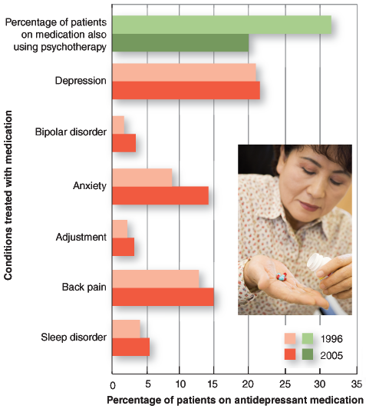
Major Classes of Psychoactive Medications
Antianxiety
Antidepressants
Mood stabilizers
Antipsychotics
  Typical vs. Atypical
Notes:
IMAGE: [Source: Adapted from Olfson & Marcus (2009). Illustration: © Cengage Learning 2013; photo: © Monkey Business Images/Shutterstock] (Cacioppo, Figure 15.14, p. 607): From 1996 to 2005, the number of people in the United States who used antidepressant medications grew over 100% from 13.3 million to 27.0 million people. The number of people using antidepressants for depression remained unchanged, so the growth in use resulted from the use of antidepressants for other conditions. During the same period, use of psychotherapy by patients on medication dropped from 31.5% to 19.87%, and more patients were seen by a general health professional than by a mental health professional for their treatment.
Biological Therapies 2 of 3
This slide covers therapeutic medications.
Barbiturates, developed in 1903, were once used in the treatment of anxiety, but their use as a treatment for anxiety is no longer considered desirable.
Barbiturates were one of the first of several medications used for psychological treatments to become vastly overprescribed.
By the mid-1960s, enough barbiturates were being made to provide every American man, woman, or child with 40 to 50 doses per year.
The addictive properties of barbiturates, as well as their frequent use in suicides, were definite drawbacks.
The discovery of benzodiazepines after World War II changed the treatment of anxiety dramatically, but like the barbiturates, the benzodiazepines became overused.
By the 1970s, chlordiazepoxide (Librium) and diazepam (Valium) were the most frequently prescribed drugs of their day.
Alprazolam (Xanax) remains a widely used benzodiazepine, typically prescribed for panic disorder, general anxiety disorder, and premenstrual syndrome.
In some cases, alprazolam seems to be helpful in treating major depressive disorder, but its mechanism for doing so is not understood.
The most popular method for treating major depressive disorder today is the use of medication.
Nearly 170 million prescriptions for antidepressant medications were written in the United States in 2005.
In the United Kingdom, where health statistics are easier to obtain due to nationalized medicine, annual prescriptions for antidepressants went from less than 10 million in 1991 to nearly 40 million in 2009.
Far from reducing reported problems, this 400% increase in prescriptions was accompanied by an equal increase in the number of disability claims for related disorders.
As the graph shows, antidepressant medications are often prescribed for conditions other than major depressive disorder, such as anxiety disorders, sleep disorders, adjustment disorders, and even back pain.
This raises the possibility that antidepressants are being overprescribed.
In addition, studies have shown that these medications are effective in severe cases of depression, but not as beneficial in mild to moderate cases of depression.
There are several types of antidepressants, each of which target different neurotransmitters.
MAOIs increase dopamine, serotonin, and norepinephrine activity.
Tricyclics increase serotonin and norepinephrine activity.
SNRIs also increase serotonin and norepinephrine activity, but do it in a slightly different way than tricyclics.
The most widely prescribed antidepressant medications are the selective serotonin reuptake inhibitors (SSRIs), which include popular brands like Prozac and Zoloft.
As their name implies, these medications increase serotonin activity at the synapse by interfering with reuptake of the neurotransmitter.
As a result, more serotonin is available in the synapse.
The use of SSRIs is based on a belief that depression results from unusually low serotonin activity and that boosting serotonin activity should therefore improve mood.
In addition to inhibiting the reuptake of neurotransmitters at the synapse, antidepressants provide further benefit by increasing the number of neurons in the hippocampus, at least in rats.
Stress and depression both appear to reduce the number of neurons found in the hippocampus, and the administration of antidepressants may not only halt this loss but also promote the birth of new neurons in this area.
These medications, like any others, have their share of risks and side effects.
Increases in thinking about suicide following use of SSRIs, especially among children and youth, have prompted stronger warnings for close supervision by attending physicians.
Other side effects of SSRIs include nausea, reduction of REM sleep, headache, weight gain, and sexual dysfunction.
The primary method of treating bipolar disorder is the use of medication. The most commonly prescribed medication is a simple salt, lithium carbonate.
Lithium’s actions are very specific to bipolar disorder.
People who do not have bipolar symptoms show no changes in behavior when given lithium.
If we can discover exactly what lithium is doing for patients with bipolar disorder, we should have a much improved understanding of the disorder; however, lithium’s actions are not well understood.
Lithium appears to both promote the birth of new neurons and prevent further loss of neurons.
Administration of lithium in patients with bipolar disorder appears to result in increased gray matter relative to patients who are not treated with lithium.
Unfortunately, lithium carbonate has a number of unpleasant and potentially dangerous side effects.
Toxic levels of lithium produce nausea, vomiting, muscular tremor, coma, and seizures.
Because of these risks, patients must have regular blood tests to monitor their lithium levels.
The unpleasantness of these side effects also contributes to the poor compliance with their treatment plan that characterizes patients with bipolar disorder.
These patients are less likely to follow treatment instructions than any other kind of patient on any other type of medication.
Prior to the 1950s, effective treatment for schizophrenia was virtually nonexistent.
Patients were often subjected to very odd “treatments” that had no basis in any scientific understanding of their condition and that were frankly dangerous in some cases.
They were forcibly restrained in lukewarm baths with canvas covers that prevented their escape.
“Insulin shock therapy,” in which injections of insulin were used to place patients in daily comas, enjoyed a brief fad status, as did the frontal lobotomy.
The discovery of effective medications for schizophrenia, or antipsychotics, was accidental.
A French surgeon, Henri Laborit, was impressed by the calming effects of the phenothiazines.
He experimented with one of the drugs, chlorpromazine (Thorazine), to reduce stress and shock in his surgical patients.
Based on his promising results, Laborit encouraged his psychiatric colleagues to try the drug on their psychotic patients, which they did with dramatic success.
A new era of treatment began.
Largely as a result of this new type of treatment, institutionalized populations dropped by about 50% in the United States between 1955 and 2000.
People responding well to medication could now return to their communities instead of living in institutions.
Initially, nobody understood how the phenothiazines reduced psychosis.
One clue came from the fact that high doses of the drug produced symptoms that were very similar to those of Parkinson’s disease, such as muscular tremor.
Parkinson’s was known to result from the degeneration of motor neurons that used dopamine as their primary neurotransmitter.
Further research indicated that the phenothiazines acted as dopamine antagonists, blocking dopamine at the receptor site.
The phenothiazines are not without their share of problems.
Nearly one quarter of patients with schizophrenia do not respond to these drugs at all.
The drugs successfully reduce psychotic symptoms, such as hallucinations and delusions, but are often less effective in reducing negative symptoms such as social withdrawal and emotional disturbance.
In still other cases, the phenothiazines can produce significant side effects due to their ability to block dopamine activity at the synapse. Tardive dyskinesia, (tardive means “slow” and dyskinesia means “difficulty moving”) is a syndrome that results from the use of phenothiazines by some patients.
The syndrome produces tremors and involuntary movements, especially of the face and tongue.
These problems often continue even when medication stops.
To address these deficits of the phenothiazines, now referred to as “typical” antipsychotic medications, new “atypical” antipsychotic medications, such as clozapine (Clozaril), were introduced.
Approximately half of all patients with schizophrenia are now using the atypical antipsychotics.
These newer drugs are often more effective than the phenothiazines in treating the negative symptoms of schizophrenia, as they affect a wider range of neurotransmitters, including serotonin.
Although risk of tardive dyskinesia seems lower than with the typical antipsychotics, these drugs have their own set of side effects, including diabetes, weight gain, reductions in white blood cell count, aggravation of existing cancers, and seizure disorders.

Slide 17

Other Biological Therapies
Electroconvulsive therapy
Psychosurgery
Brain stimulation
Neurofeedback
Notes:
IMAGE: [© Dr. Lise DeLong/cognitive-connections.com] (Cacioppo, p. 598): Neurofeedback, a type of biofeedback training that focuses on brain activity, can be used to treat attention deficit hyperactivity disorder in children.
Biological Therapies 3 of 3
Electroconvulsive therapy (ECT) is used in some severe cases of depression that do not respond to other treatments.
In ECT, the patient is anesthetized and given a muscle relaxant prior to the induction of general seizures, which are produced by electricity applied through electrodes on the head.
Six to 12 treatments, at a rate of three per week, are typically given.
ECT was first used with patients with schizophrenia in the 1930s, with very poor results.
However, observations of improved mood in these patients following ECT led to further use with patients diagnosed with major depressive or bipolar disorder.
This procedure is used primarily with patients who do not respond to conventional treatments with medication.
Although the exact mode of action of ECT is currently unknown, most patients experience an increase in responsiveness to dopamine and norepinephrine, along with the desired reduction in subjective feelings of depression.
Other research has suggested that ECT might stimulate neural growth.
Although many people have a negative view of ECT, perhaps as a result of reading Ken Kesey’s One Flew Over the Cuckoo’s Nest or viewing the film or play of the same name, ECT is considered as safe as any minor surgery conducted under general anesthesia.
However, approximately one third of patients experience persistent memory loss following the procedure.
This memory loss specifically affects autobiographical memory, which can be impaired for at least six months following treatment
Trepanation, or the drilling of holes in the skull by ancient people, might represent the very first effort to use psychosurgery.
Although particular functions might be localized to parts of the brain, it is a giant leap of faith from our current understanding of localization and brain networking to the idea that one can use psychosurgery to treat psychological disorders.
Historically, one of the most frequent types of psychosurgery aimed at changing behavior was the frontal lobotomy.
After observing the calm that resulted following the procedure in chimpanzees, Egas Moniz encouraged his col- leagues to try the procedure on psychotic patients in the 1930s.
Between 40,000 and 50,000 patients received the procedure between the 1930s and 1950s, sometimes for very vague problems such as depression in housewives or misbehavior in children.
The deliberate damage to the frontal lobes and their connections to other parts of the brain involved with the lobotomy procedure has harmful effects on a person’s judgment, personality, initiative, social behavior, and sense of self.
Despite the outrage among many in the medical community, frontal lobotomies were performed well into the 1960s, until the use of medications for psychological disorders became an established practice.
Radiation and very precise lesions are still used today to treat small numbers of patients with depression or obsessive-compulsive disorder
One promising form of psychosurgery involves making slight incisions to a region known as the anterior cingulate cortex.
Brain imaging studies have shown that this area is overactive in patients with OCD. Making lesions to this area can help alleviate some of the patient’s symptoms.
Following observations of mood changes in patients undergoing deep brain stimulation through surgically implanted electrodes for the relief of Parkinson’s disease, physicians attempted to use stimulation to address obsessive-compulsive disorder and mood disorders.
Microelectrodes are surgically inserted into specific parts of the brain, and in many cases, the patient controls the application of any current.
Fifty percent of patients with severe depression who had not responded to more conventional treatments achieved improvements in mood following stimulation of the nucleus accumbens
Deep brain stimulation requires surgery to implant the microelectrodes.
Repeated transcranial magnetic stimulation (rTMS) provides an alternative way to stimulate the brain without surgery.
When applied through a handheld device touching the scalp, low-frequency magnetic pulses change activity in underlying cortical regions.
Application of rTMS over the auditory cortex reduced instances of auditory hallucinations in patients with schizophrenia for a period of up to 15 weeks.
This technique has been recommended for use in depression and some cases of schizophrenia, but it appears to have a negative effect in cases of obsessive-compulsive disorder
Neurofeedback is a type of biofeedback that concentrates on the activity of the brain.
Recordings of brain activity, usually from EEG but increasingly from fMRI, are usually displayed for the participant, who is trained to keep readings in a desired range.
In most cases, people are not consciously aware of what they are doing to comply.
Neurofeedback appears to be promising in the treatment of attention deficit hyperactivity disorder in children and appears to reduce the frequency of seizures in patients with epilepsy.
In a preliminary study using fMRI, patients with depression were able to increase activity in parts of the brain that were most active when they viewed positive images.

