Slide 1
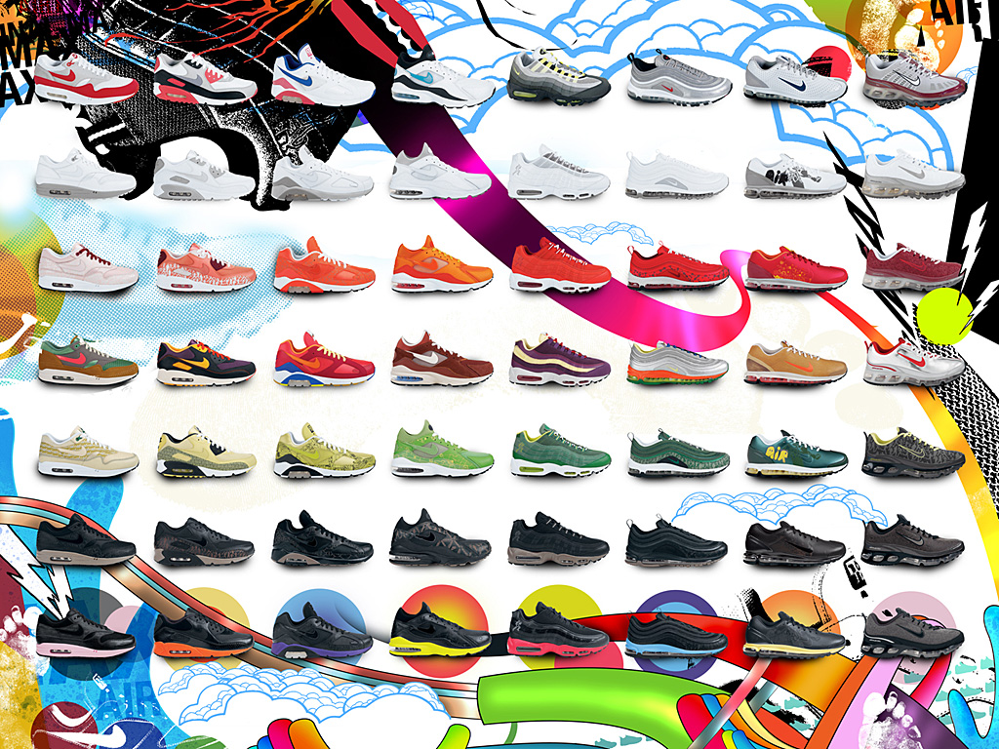

Nike is associated with steadfastness, performance, endurance, character, and resilience.

Slide 2
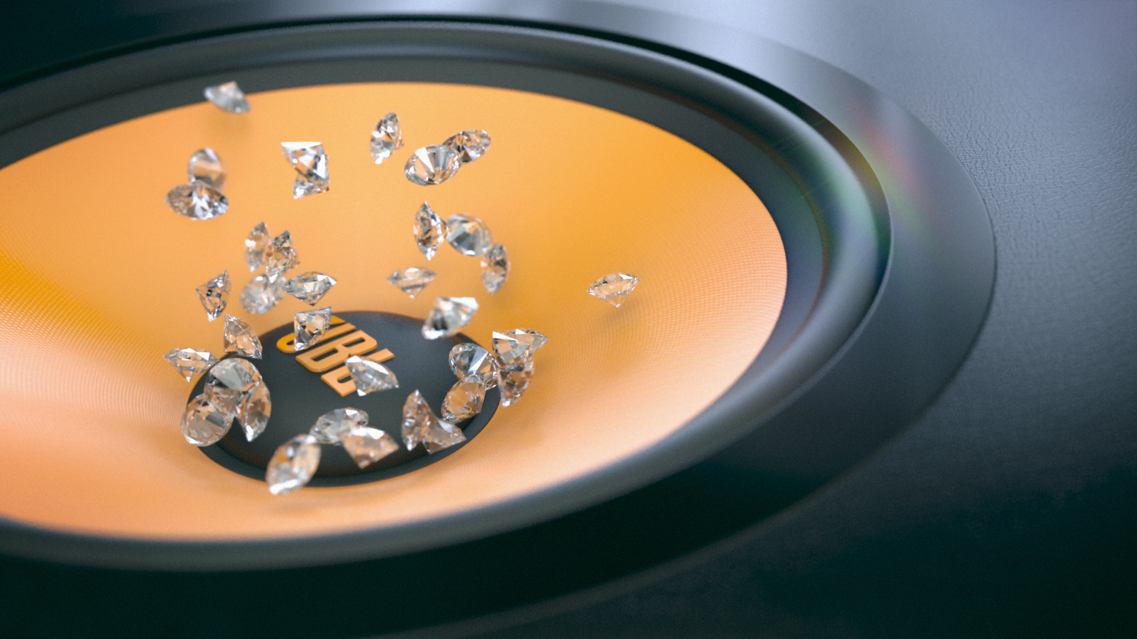
Music is one of my effective ways to escape from reality.

Slide 3
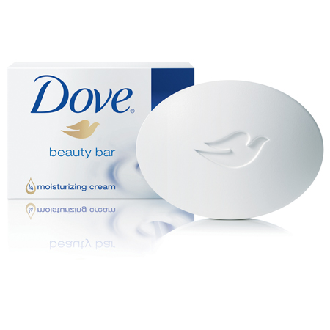
It shows purity, simplicity, ethics, and wholesomeness.

Slide 4

My Education

Slide 5
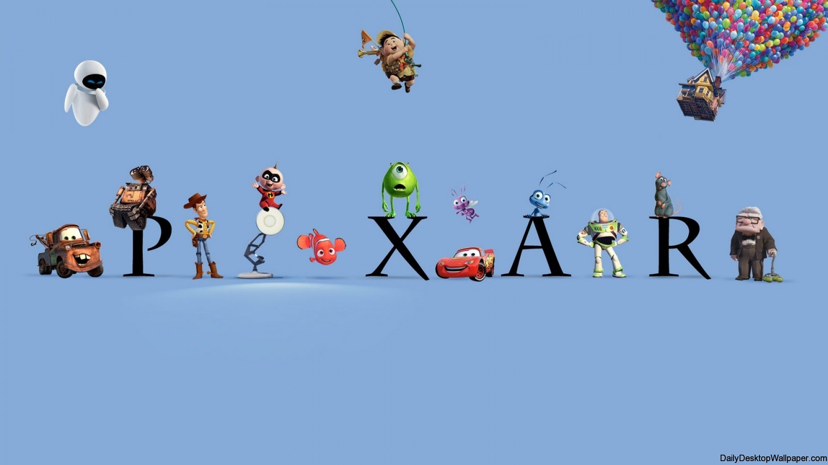
My personality is like a computer-animated superhero wherein it looks like ordinary but transforms into an extraordinary one.

Slide 6
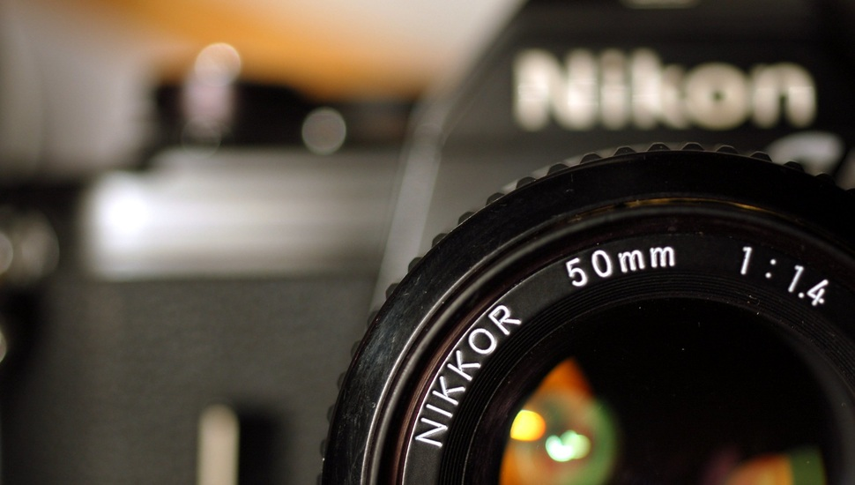
I always focus on the good times or things and if things do not work out, I just take another shot.

Slide 7

It promotes values such as love, care, kindness, and compassion.

Slide 8
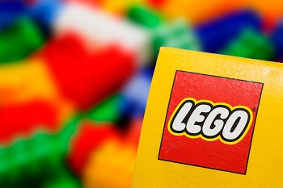
It shows creativity, original thinking, artistry, and vision.

Slide 9
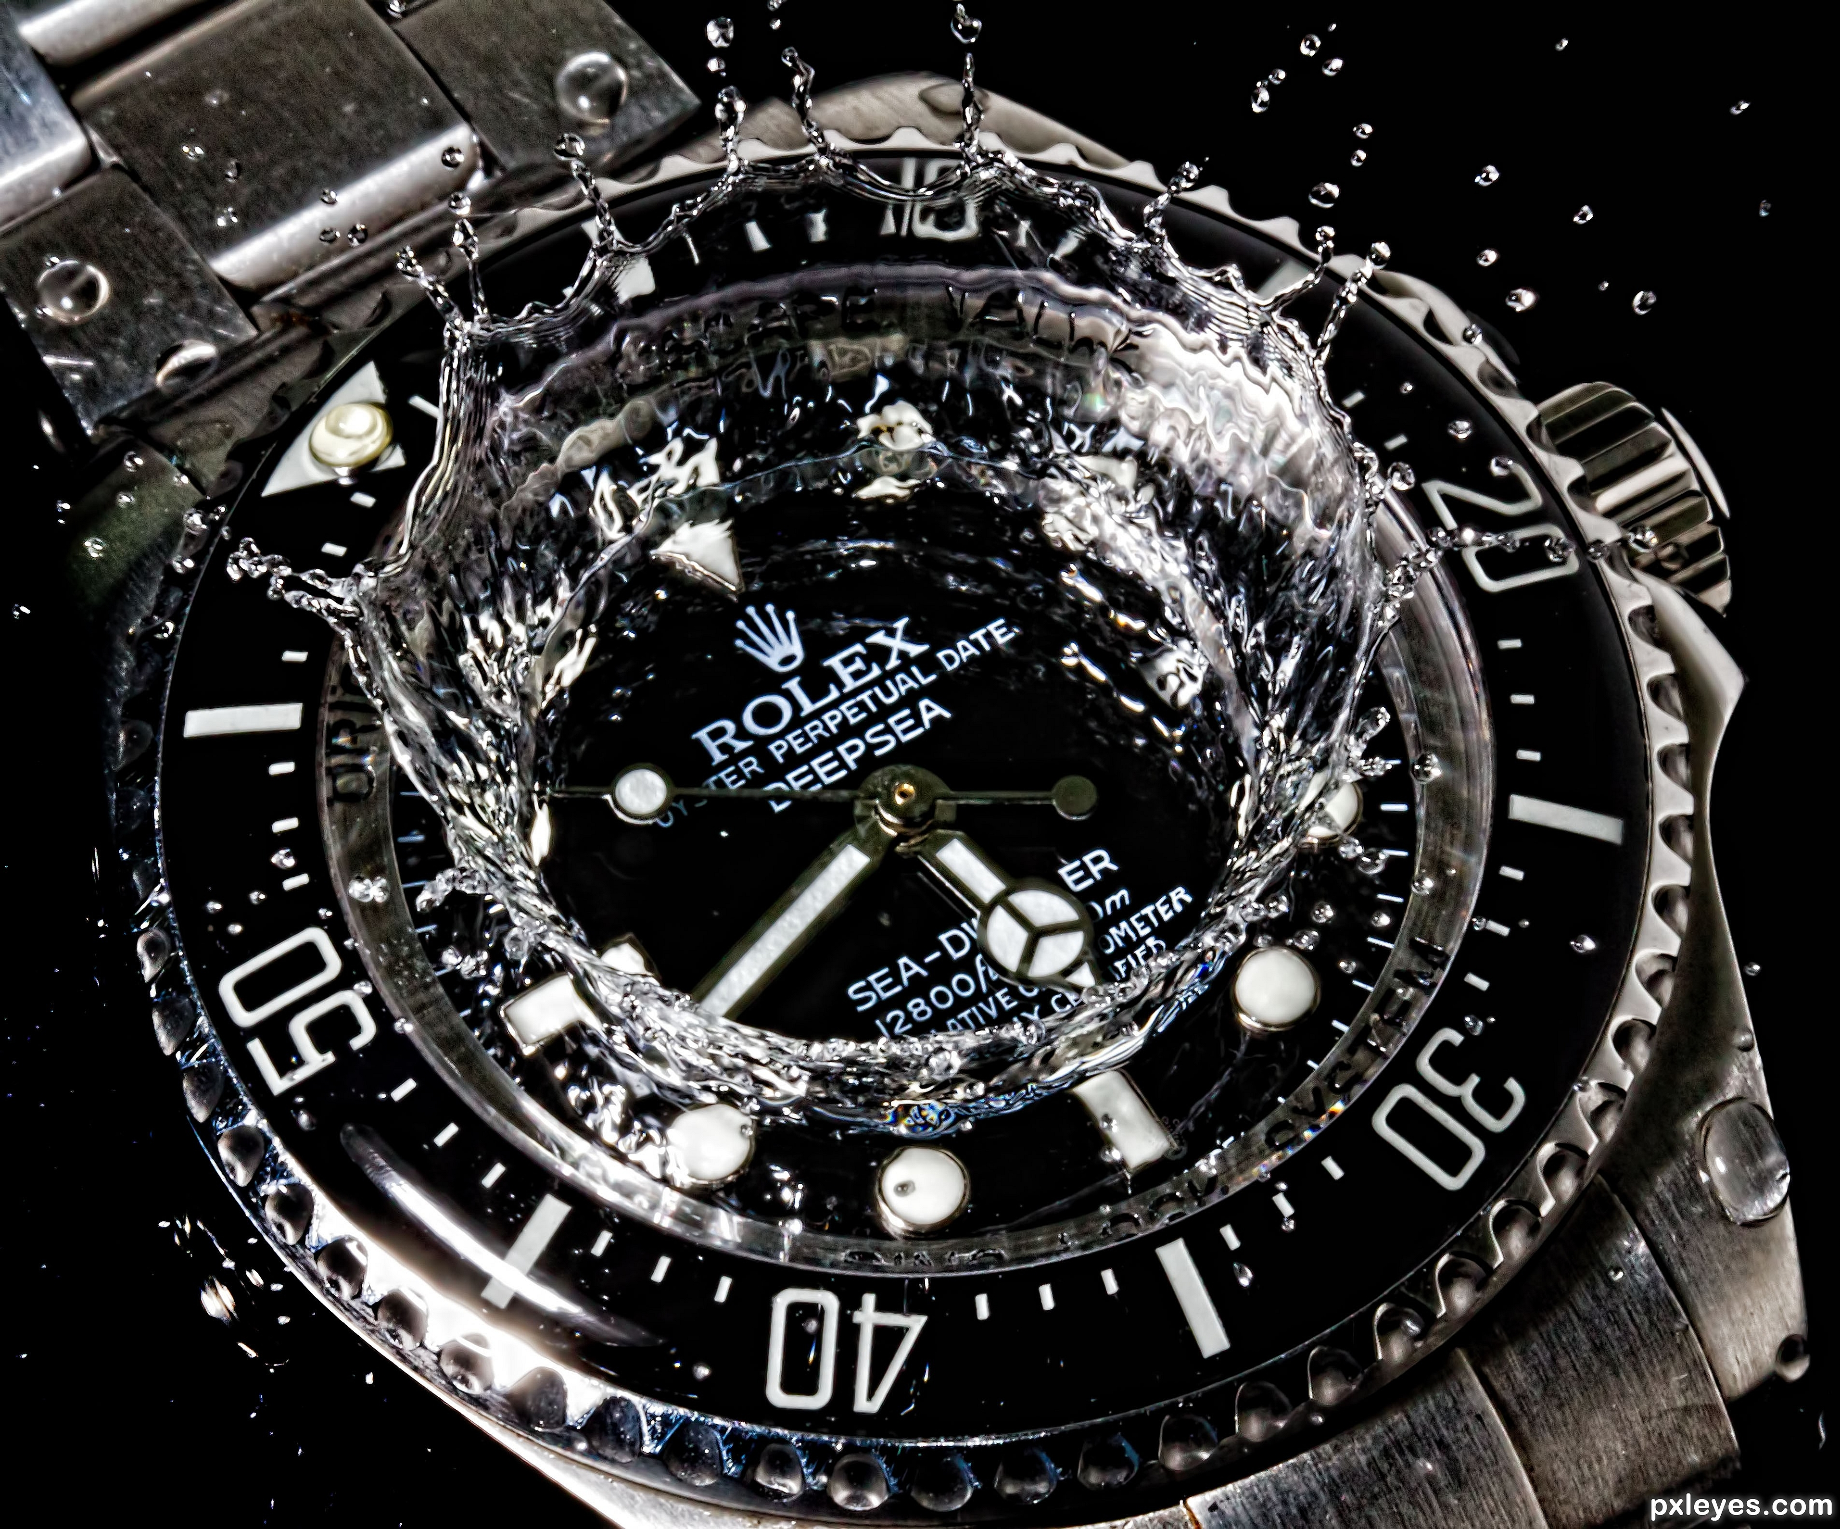
Great extent

Slide 10
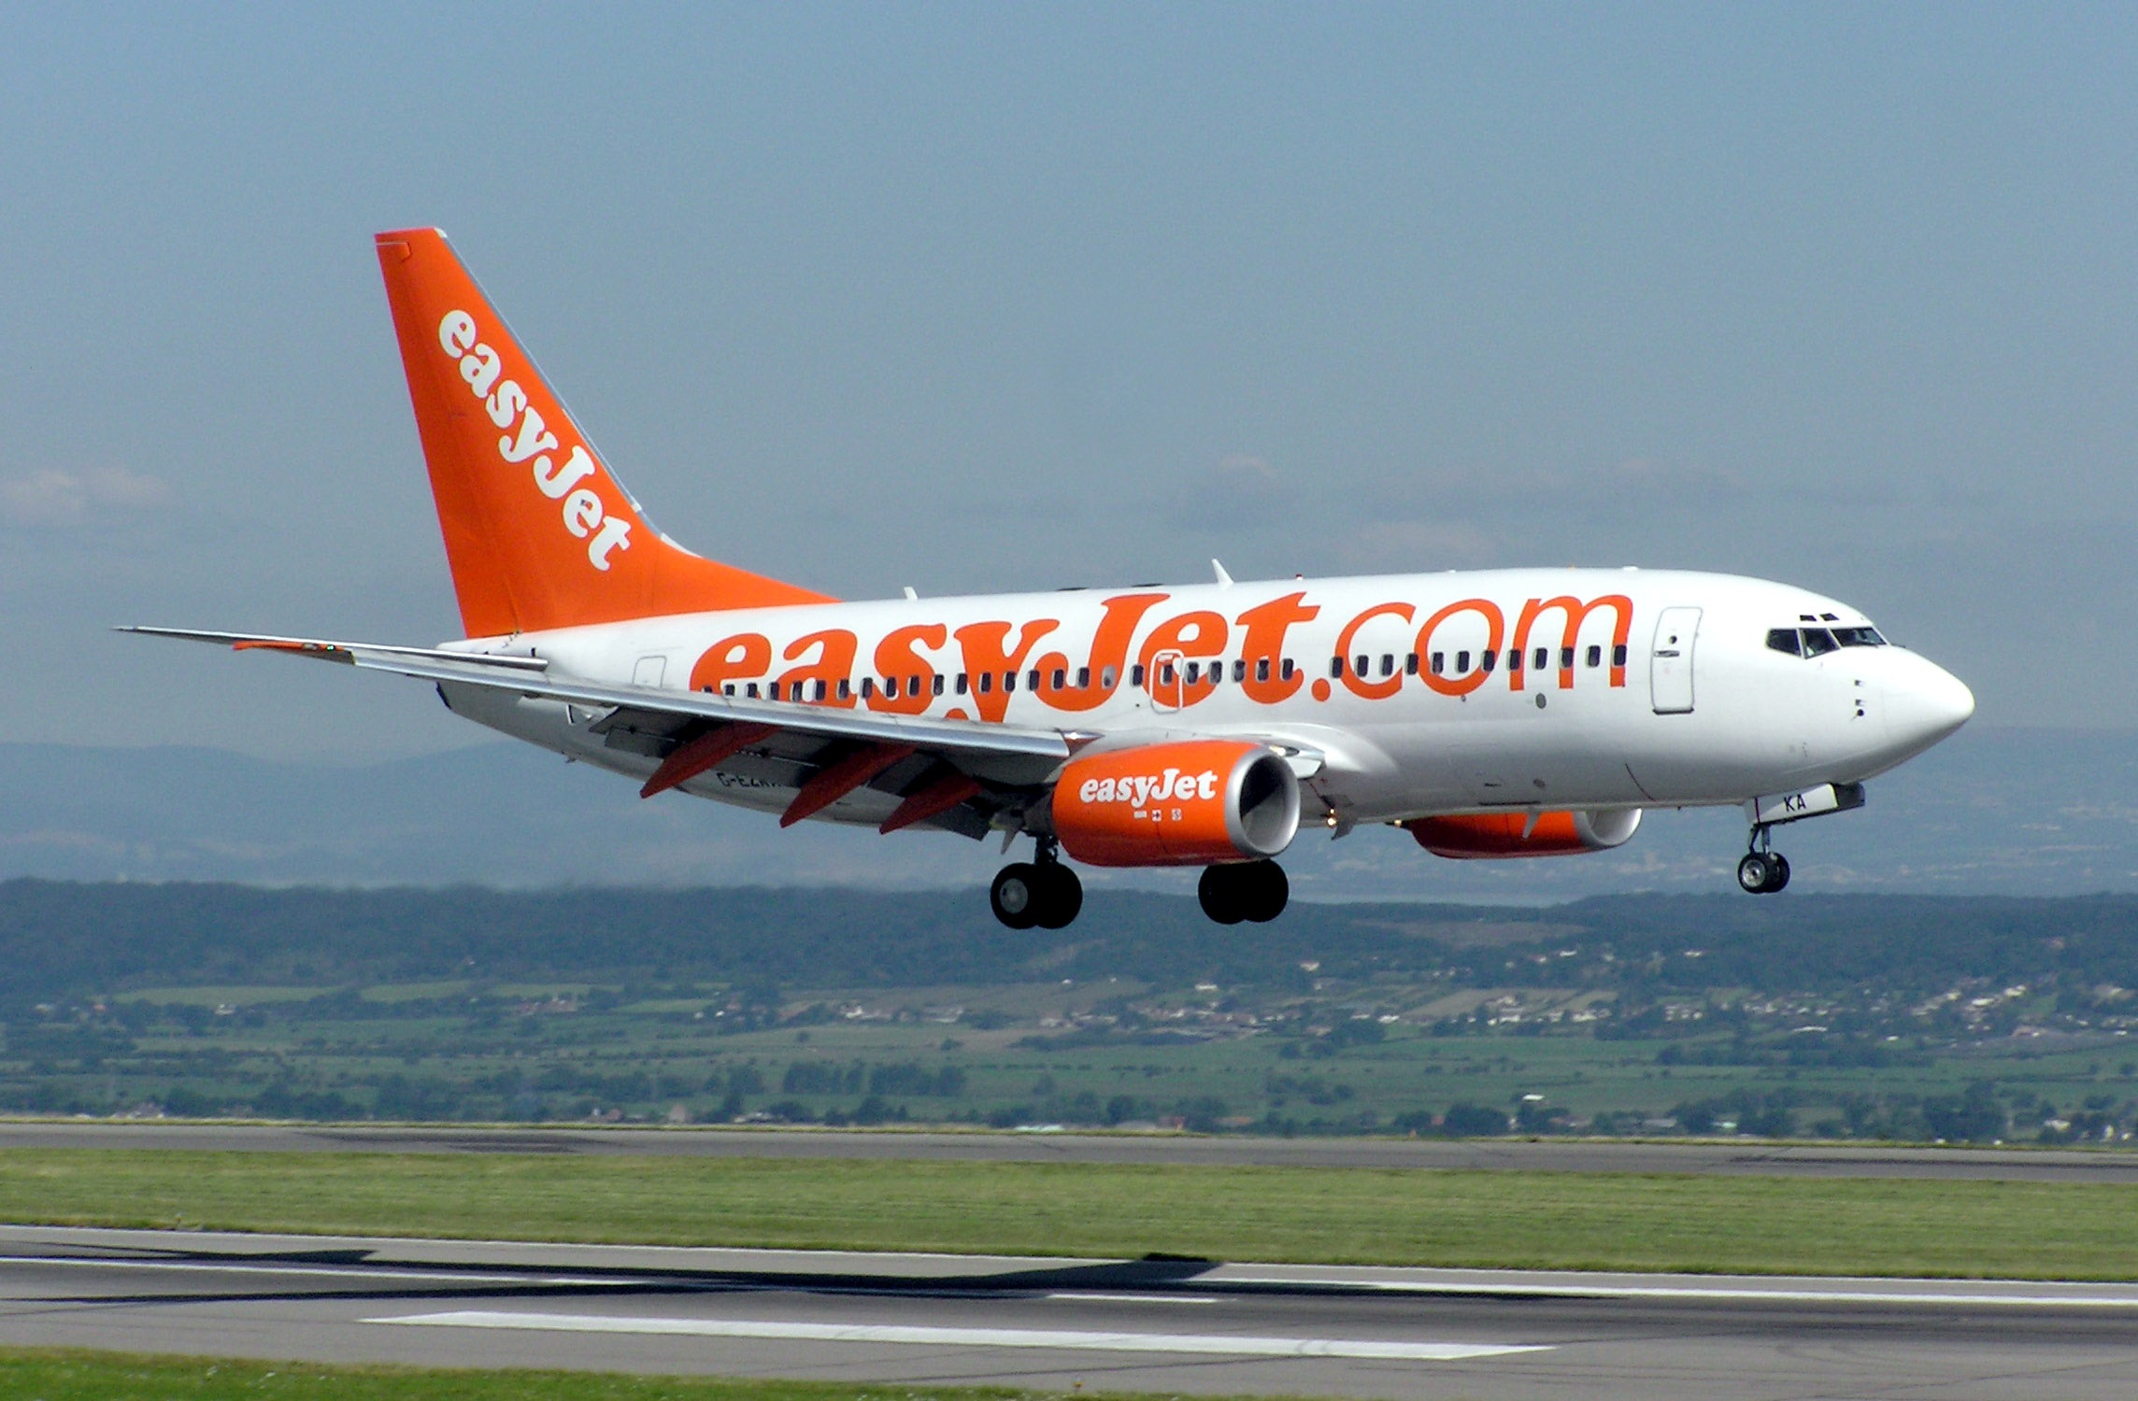
Keeping it real and honest

Slide 11

Simple yet elegant

Slide 12
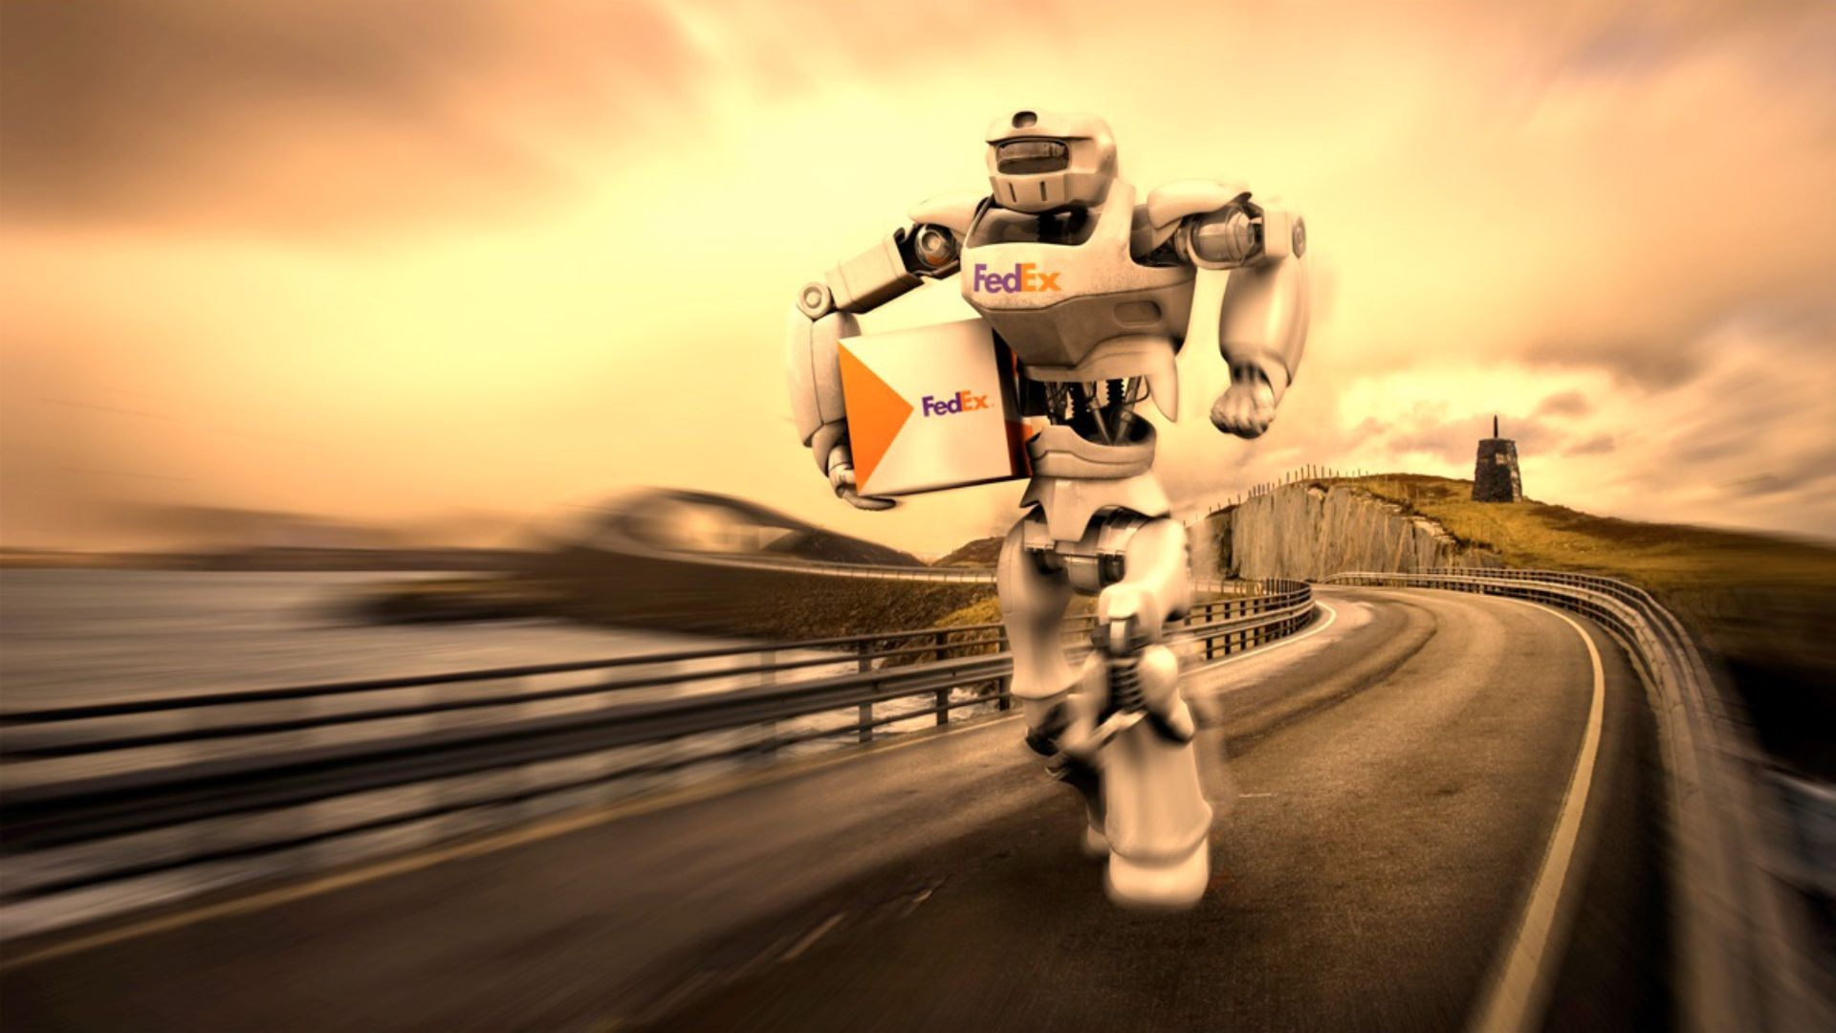
Fast and reliable

Slide 13

Because I keep on going, and going, and going…

Slide 14

Thinks outside of the box

Slide 15

Ambition, determination, & confidence, with this attitude, for me nothing is impossible

Slide 16

Keep life going and never stop walking

Slide 17
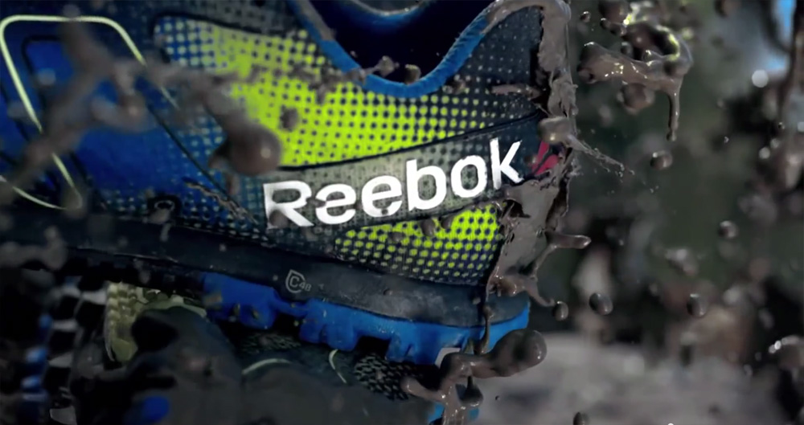
As Reebok says “I am what I am”, I accept my flaws and weaknesses

Slide 18

Love to explore new places and things.

Slide 19
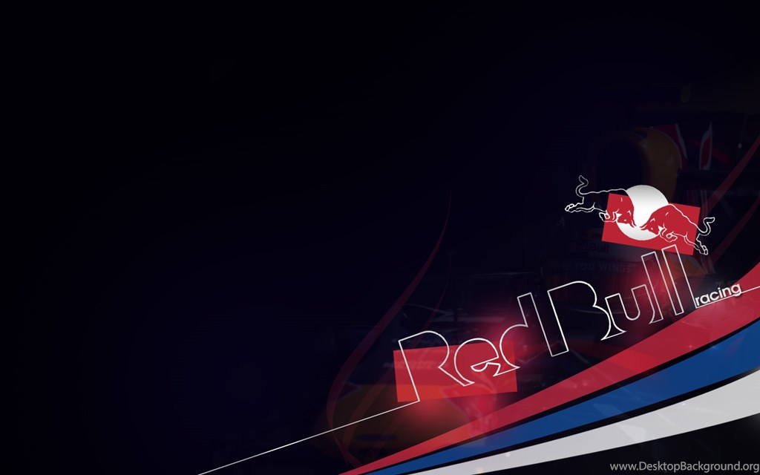
Carefree, daring, and has a youthful attitude

Slide 20

Innocent and young at heart

