Slide 1
Business & Financial Plan for Drizzling Investments
Ian Ki-Hoon Suh
Penn State University
Notes:
Hello, My name Ian Ki-Hoon Suh. Welcome to this presentation of my business plan and financial plan for the intended enterprise.

Slide 2

Business Description
Drizzling Investment will be the name of the business.
They business will be a social enterprise.
Notes:
The business will be called Drizzling investment and will be a social enterprise type of business. The main aim of starting the business will be to ensure the continuous availability of clean water to the community members. The name of the enterprise relates to the sound of water, and it was picked because it resonates with the primary objective of the business. In the target community, the lack of water is the main problem, and it affects various aspects of life, like living standards. The idea is mainly a social enterprise, but profitability will also be factored to make the business sustainable.

Slide 3

Product Selling
Purification of water
Distribution of drinking water
Notes:
The business will mainly concentrate in purification of water. The process is technical because there are a mixture of chemicals that involved. There are particular measurements of chemicals that are supposed to be mixed with the water to make it consumable. If the measurements are not adhered to the water becomes acidic and once consumed by the target population then there will be cases of infection. Additionally, the business will also be distributing the purified drinking water to the different parts of the target market. This cost will be covered by the profits that the business gets from all its revenue streams. However, it is anticipated that the price will be low

Slide 4

Target Market
Institutions
Public and private offices
Local community
Notes:
The business majorly targets to sell the purified water to institutions including schools and healthcare facilities. These facilities have majority of the people that need the product on a daily basis and hence they present a viable market. Additionally, the business also intends to sell the purified water to public and private offices and also to the local community. Public offices include government facilities that give people essential services hence they have a huge customer flow that can increase the demand of the product.

Slide 5

Source of Raw Materials
Nearby Clean water sources
Rooftops
Notes:
The business will be purifying clean water that will be sourced from the nearby clean water bodies. There are two rivers in the local area, although one of them has impurities, it is under reclamation to ensure that it is consumable by the communities around. There are two purification centers that water companies get clean water from before they supply to their markets. Additionally, the business will also seek to get water that is collected from rooftops for purification also. Purifications increases the shelf life of the water and also kills viruses that causes infections.

Slide 6
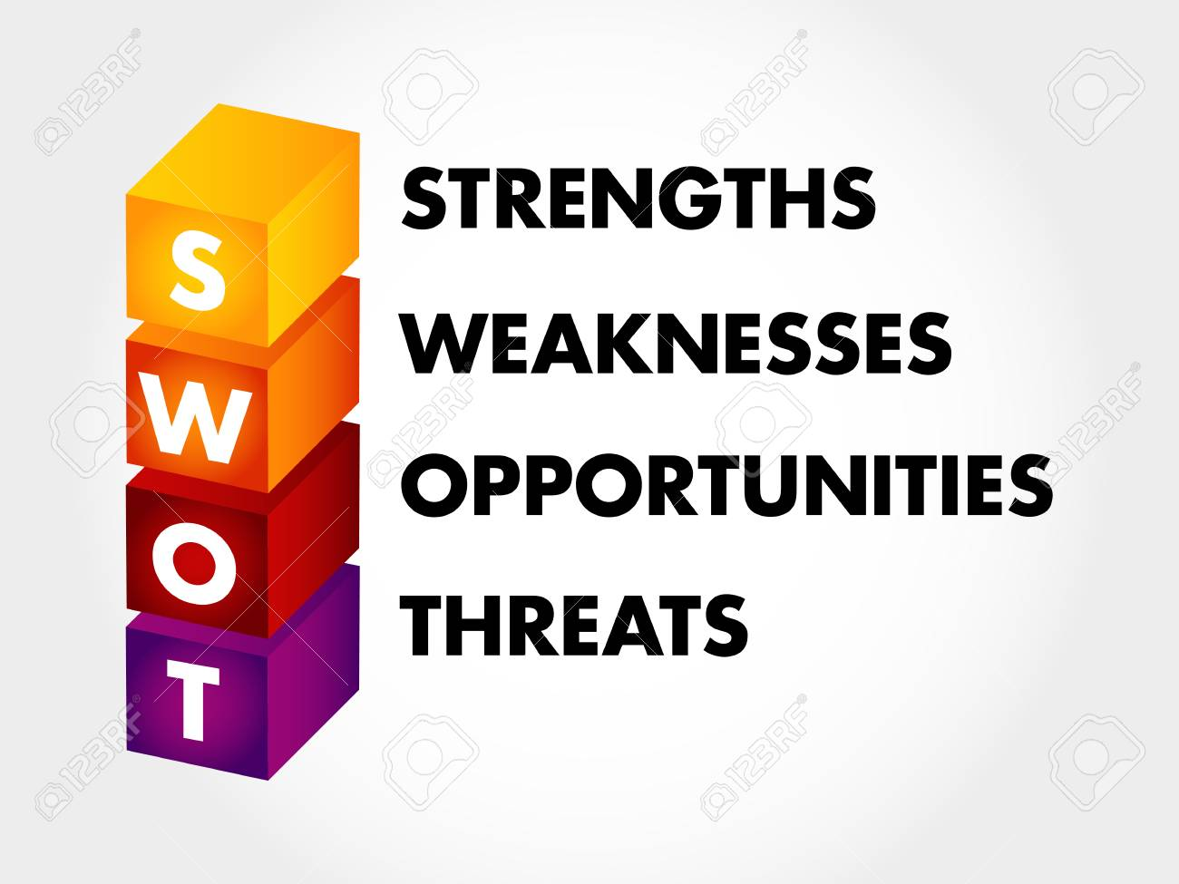
SWOT Analysis: Strengths
Capital strength
Active Management
Marketing strength
Notes:
The enterprise will continuously be maintaining a strong capital base. There is a large number of investors that have show interest in the business idea and have promised to support all the processes. Non-governmental organizations have also promised to distribute the product through their supply chains. The entire management team of the business will be aggressive and remain focused on the business goal. The management team will be selected by a professional human resource team to ensure a positive mentality is maintained. Additionally, the enterprise prides itself on a unique and robust strategy for marketing.

Slide 7

SWOT Analysis: Weaknesses
Knowledge
Capital for a start-up
Trust
Notes:
Most of the employees that the enterprise will hire will have robust experience in purification and distribution but lack experience in social entrepreneurship. In their previous jobs they focused on profitability purely yet this enterprise focuses on improving livelihoods of the communities without prioritizing profits. The enterprise is a capital intensive venture hence needs reliable financial back-up. Without sustainable financial support the business may collapse. Also, due to humble beginnings, there is low chances of trust among most of the key stakeholders.

Slide 8

SWOT Analysis: Opportunities
Activism
Self-help
Donors
Notes:
The enterprise will consider having activists to assist in pushing for activities. There is the increase in number of activism groups that agitate for better living standards and provoke the action of national and local governments. Improving water standards and supply will then be promoted by the activists and the product will become popular. The enterprise will consider its beneficiaries as part of the business implementation. Due to how the project will be community-based, the enterprise will have the opportunity to get valuable donors quickly because they focus on the livelihoods of people.

Slide 9

SWOT Analysis: Threats
Adverse political environment
Stiff Competition
Technological weaknesses
Notes:
Some of the political environments might affect the enterprise especially on capital acquisition. There are lot of political wrangles in the locality and there are political leaders that do not support the idea of social enterprises because they think that they take advantage of the local communities. Additionally, there are several enterprises with activities in the areas hence posing threat to the enterprise. Their primary focus is also water supply because the commodity is on high demand. Next, there are some advanced technologies that are necessary but the business cannot acquire as at now.

Slide 10
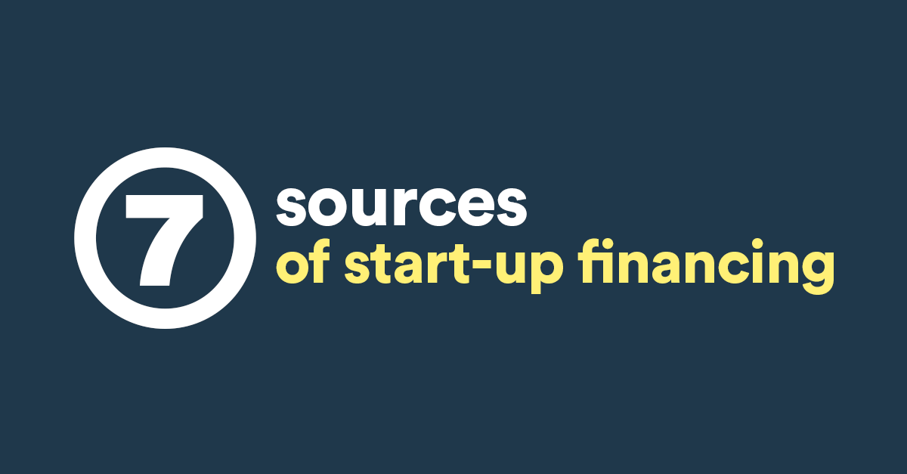
Initial Financials: Initial Capital
First year and second year start up capital of $500,000
Donors
Notes:
The enterprise will have an initial capital of $500,000 that is intended to help the business for the first and second year of investments. Various investors have shown interest in the idea and they expected to raise roughly $400,000. the funds will cover the cost of licenses and permits for the business. The catch in investors is that they expect their money to be paid back plus profits. Additionally, the enterprise will be aggressive in looking for private donors to donate more capital to the business. Donors do not need their monies to be repaid and they reduce the debt burden on the enterprise.

Slide 11

Initial Financials: Assumptions
Favorable economy
Availability of donors
10% interest rate
Notes:
Several assumptions have been made when coming up with the initial financials of the enterprise. First, the enterprise assumes that the economy will be favorable so that all activities are carried out. Factors like increased inflation have not been included and once they occur the enterprise will be negatively affected. Additionally, it assumes that there will be many donors available in the local community. Donors will aid in raising the required funds and help in distribution of the product. Lastly, the enterprise also assumes that the interest rate will be ranging around 10% for the first two tears.

Slide 12

Initial Financials: Expenditure
Rent
Utilities
Employees’ Salaries
Training
Taxes
Marketing
Notes:
Since it’s a start up business, the enterprise projects to incur several expenditures including rent, utilities, employees’ salaries, training, taxes, and marketing. All these expenditures are primary in business organization for it to thrive. Ignoring them will negatively affect the growth of the enterprise and it may fail offer sustainable products and services to the target market. More capital will be allocated to the marketing department to ease the process of looking for new business partners and customers. Once these two are found and retained the market for the product grows exponentially.

Slide 13

Initial Financials: Depreciation Cost
Low depreciation
Notes:
For the first two years, the depreciation cost is predicted to be low to the extend of being insignificant. There are machinery to be bought at the start of the enterprise. They include the office equipment and distilling products. These products depreciate after about five years. At that point is when the enterprise may think of replacing or repairing them. Initially, in the first two years, the replacement or repair cost may be high and negatively affect the financial performance of the company. However, after four years the enterprise will be thriving and the costs will not be high.

Slide 14
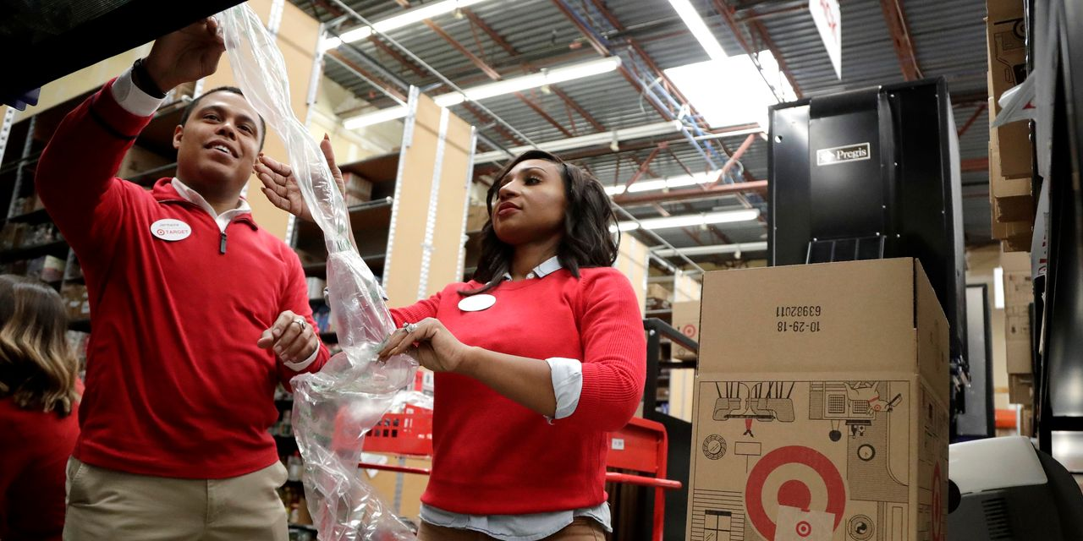
Target Labor Force
Local community youths
Notes:
Since the enterprise will serve the local community, there is need to involve the community members in the process of implementation. Once the local people are involved, they will be loyal to the product because it supports their economic growth and their livelihoods. The enterprise targets the youths will the community to be the first source of labor force because they are energetic than the elderly population. The number of youths is higher than the rest of age brackets and once they feel prioritized, the product will become popular among them. Local labor is also cheap than imported labor and the enterprise can save production costs.

Slide 15
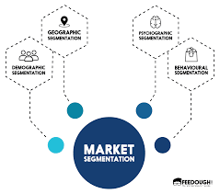
Market Segmentation
Aged Population
Wholesalers
Retailers
Notes:
The market will be divided into three major segments that is aged population, wholesalers and retailers. The aged population will have their bottled water delivered physically to their locations. The delivery will be done to their houses to ensure that there is order in the process. The wholesalers will either have their orders delivered or visit the enterprise to collect their order. The enterprise will deliver bottled water to the local retailers. Some orders will be sent directly to the enterprise and they will be delivered to the local community centers while some will be delivered through the distribution channels.

Slide 16

Funding Model and Scalability Plan
External funding
Yearly subscription
Notes:
For the first two years of operation, the business will much depend on external funding, these are mainly investors and donors. A company has to operational before it receives any funds from government institutions and that is why the company has not factored the government as a financier. The community members will be persuaded to become stakeholders and they will primarily give labor to the organization. The stakeholders will be required to re-subscribe annually to ensure continuous funding. Through this model the enterprise can fund its primary activities.

Slide 17

Stakeholder Benefits
Subsidized prices
Notes:
Membership to the enterprise will accrue some benefits including subsidized prices. This model will use the economies of scale to lower the costs of production and eventually the product can be given to the target market at lower costs. The members will be able to receive some dividends at the end of every financial years as an appreciation token. Investors will be prioritized in the share of dividends so that they can continue supporting the enterprise. Prioritizing them will attract more outside financiers because they will be sure of their financial returns.

Slide 18

Staffing
Management
Purification employees
Drivers
Casual workers
Notes:
The staff of the enterprise will include management team that will coordinate all the activities from the production process to the delivery process. one team will be involved in water purification. This process requires a large number of people to ensure that each stage requires the set standards of water purification before the water is given or sold to the public. Drivers are also crucial to the enterprise because they collect raw materials, transport workers and deliver orders. All these people need to coordinate to ensure that the process is sustainable and meets the highest standards required to run the enterprise.

Slide 19

Enterprise Goals
Ensure availability of clean water
Capture a bigger market share
Increase profit margin
Provide more employment opportunities to the community
Provide better customer service
Notes:
The enterprise has several objectifies that it intends to achieve. Since it is a social entrepreneurship form of business, it intends to ensure availability of clean water to the community, provide more job opportunities to the community members, increase profit margins, offer better customer service, and capture a bigger market share. Meeting the highest standards of production and purification will grow the market share of the enterprise because people will be guaranteed that their health is a priority. Their loyalty grows and eventually the enterprise will become more profitable and serve a larger community.

Slide 20
References
Berry, T. (2020, January 2). A Standard Business Plan Outline [Updated for 2020] | Bplans. Bplans Blog. https://articles.bplans.com/a-standard-business-plan-outline/
SWOT Analysis. (2019, July 2). REDFworkshop. https://redfworkshop.org/tool/swot-analysis/
Sector, F. (2007). A business planning guide for developing a social enterprise. Dalam www. forthsector. org. uk.
Notes:
This marks the end of the presentation. For more information about the business plan, kindly visit the above references. Thank you for your time

