Slide 1
REAL LIFE PUBLIC RELATION CAMPAIGN
A public relations campaign is a prearranged sequence of events which relate to a specific aim in dissimilarity with other areas of public relations such as paid advertising and reacting to events.
A public relation campaign emerges when there is an urgent response need may be to fight against some disease or other bothering situation like environmental management and poverty levels. My study aims at outlining an activity that people may get engaged in to relief stress.

Slide 2
on Fortnite Battle Royale, which is an online shooter whereby one hundred players battle until they die. This is done on a cartoonish island ground. This game is believed to have entered the higher educations’ world. Scholarships have been established for the games in some institutions in the United States of America like Ashland University.

Slide 3
Although the games is not formal, it has been frequently watched on Twitch’s platform in the current time. It has a room for the willing people to participate since it has a kind of fancy stuff and looks cool. This game may help players to increase their creativity and has a lot to learn the skills.
The games have missions based on different sets to build up fortifications around the identified regions. After each game there are payers at the end of the mission given a storm forecast to help understand the right paths to end to.
In most cases human survivors who need help are considered to be optional objectives that are discovered through exploration are saiod to be contained on maps.

Slide 4
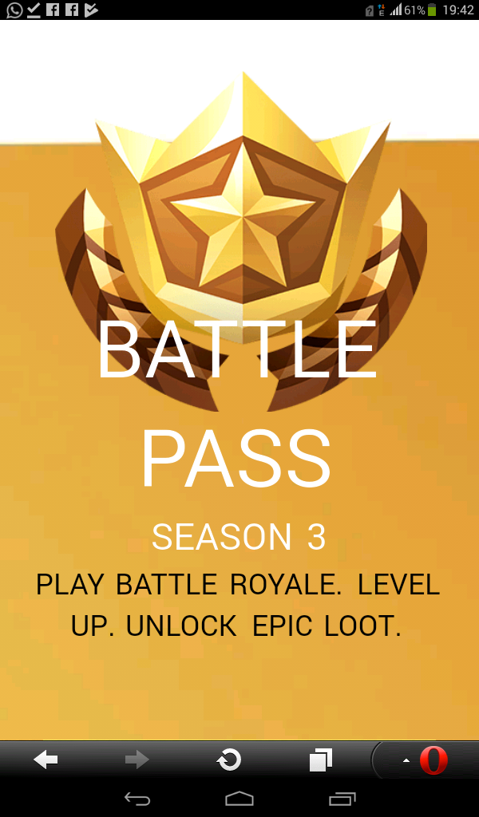
CONCLUSION

Slide 5
In conclusion, games are helpful in ones life and therefore I do comment people to opt for games so as to enable them relief stress. It is actually a good idea for such games to be launch in the syllabus so that most people can learn it. The Fortinite game will highly help most students in increasing their creativity and hence expansion of their capacity to think and come up with new ideas. This increased creativity will help most of the learners to become inventors and this will help in the improvement of technology and its growth as well.

Slide 6
REFERENCE
http://variety.com/2018/gaming/news/fortnite-esports-scholarship-1202764264

