Slide 1

Principles of Economics
Twelfth Edition
Chapter 5
Elasticity
Copyright 2017 Pearson Education, Inc.

Slide 2

Copyright

Slide 3
Chapter Outline and Learning Objectives (1 of 2)
5.1 Price Elasticity of Demand
Understand why elasticity is preferable as a measure of responsiveness to slope and how to measure it.
5.2 Calculating Elasticities
Calculate elasticities using several different methods and understand the eco­nomic relationship between revenues and elasticity.
5.3 The Determinants of Demand Elasticity
Identify the determinants of demand elasticity.

Slide 4
Chapter Outline and Learning Objectives (2 of 2)
5.4 Other Important Elasticities
Define and give examples of income elasticity, cross­-price elasticity, and supply elasticity.
5.5 What Happens When We Raise Taxes: Using Elasticity
Understand the way excise taxes can be shifted to consumers.
Looking Ahead

Slide 5
Chapter 5 Elasticity (1 of 2)
The model of supply and demand tells us a good deal about how a change in the price of a good affects behavior.
But knowing the direction of a change is not enough.
Economists measure market responsiveness using the concept of elasticity.

Slide 6
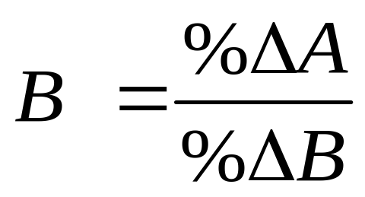
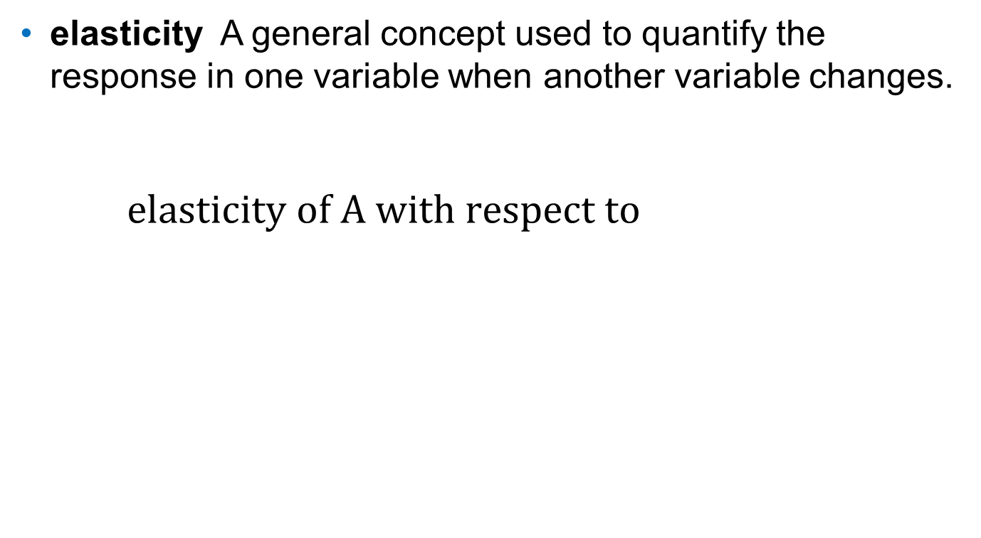
Chapter 5 Elasticity (2 of 2)
elasticity A general concept used to quantify the response in one variable when another variable changes.
$elasticity of A with respect to$

Slide 7
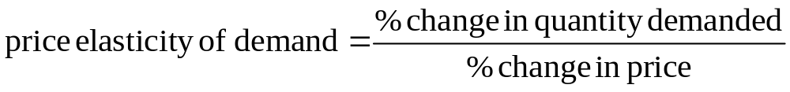
Price Elasticity of Demand
price elasticity of demand The ratio of the percentage change in quantity demanded to the percentage change in price; measures the responsiveness of quantity demanded to changes in price.

Slide 8
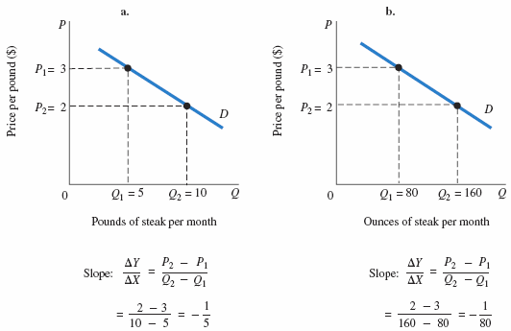
FIGURE 5.1 Slope Is Not a Useful Measure of Responsiveness
Changing the unit of measure from pounds to ounces changes the numerical value of the demand slope dramatically, but the behavior of buyers in the two diagrams is identical.

Slide 9
Types of Elasticity (1 of 4)
perfectly inelastic demand Demand in which quantity demanded does not respond at all to a change in price.
perfectly elastic demand Demand in which quantity drops to zero at the slightest increase in price.

Slide 10

Types of Elasticity (2 of 4)
A good way to remember the difference between the two perfect elasticities is:

Slide 11
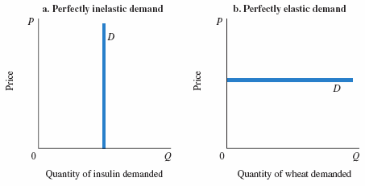
FIGURE 5.2 Perfectly Inelastic and Perfectly Elastic Demand Curves
Panel (a) shows a perfectly inelastic demand curve for insulin. Price elasticity of demand is zero. Quantity demanded is fixed; it does not change at all when price changes.
Panel (b) shows a perfectly elastic demand curve facing a wheat farmer. A tiny price increase drives the quantity demanded to zero. In essence, perfectly elastic demand implies that individual producers can sell all they want at the going market price but cannot charge a higher price.

Slide 12
Types of Elasticity (3 of 4)
elastic demand A demand relationship in which the percentage change in quantity demanded is larger than the percentage change in price in absolute value (a demand elasticity with an absolute value greater than 1).
inelastic demand Demand that responds somewhat, but not a great deal, to changes in price. Inelastic demand always has a numerical value between 0 and 1.

Slide 13
Types of Elasticity (4 of 4)
unitary elasticity A demand relationship in which the percentage change in quantity of a product demanded is the same as the percentage change in price in absolute value (a demand elasticity with an absolute value of 1).
Because it is generally understood that demand elasticities are negative (demand curves have a negative slope), they are often reported and discussed without the negative sign.

Slide 14
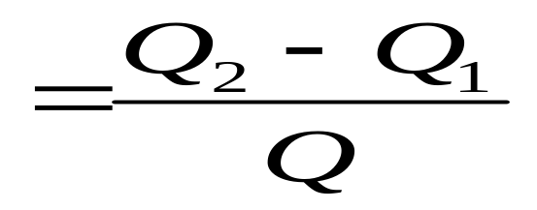
Calculating Elasticities (1 of 2)
Calculating Percentage Changes
Here is how we calculate percentage change in quantity demanded using the initial value as the base:

Slide 15
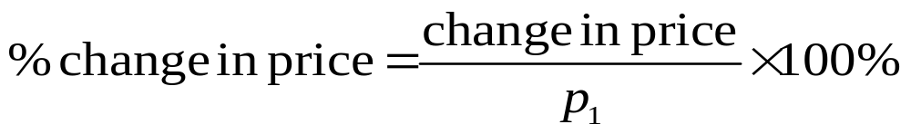
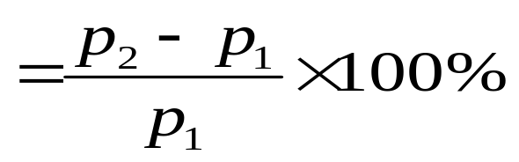
Calculating Elasticities (2 of 2)
We can calculate the percentage change in price in a similar way.
By using P₁ as the base, the percentage of change in P is:

Slide 16
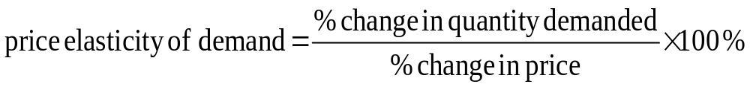
Elasticity Is a Ratio of Percentages
Recall the formal definition of elasticity:

Slide 17
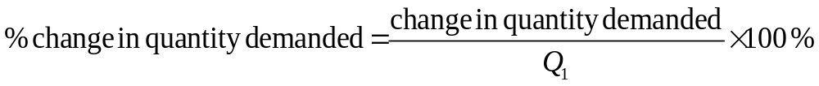
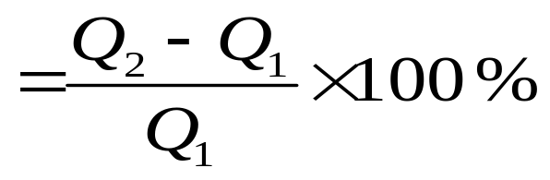
The Midpoint Formula
midpoint formula A more precise way of calculating percentages using the value halfway between P₁ and P₂ for the base in calculating the percentage change in price and the value halfway between Q₁ and Q₂ as the base for calculating the percentage change in quantity demanded.

Slide 18
Point Elasticity (1 of 3)
point elasticity A measure of elasticity that uses the slope measurement.

Slide 19
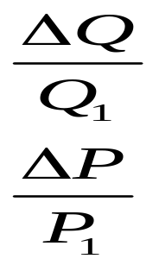

Point Elasticity (2 of 3)
Elasticity is the percentage change in quantity demanded divided by the percentage change in price, i.e.,
  denotes a small change and Q1 and P1 refer to the original price and quantity demanded.

Slide 20

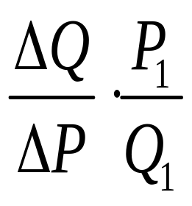
Point Elasticity (3 of 3)
The formula can be rearranged and written as:
Notice that
is the reciprocal of the slope.

Slide 21
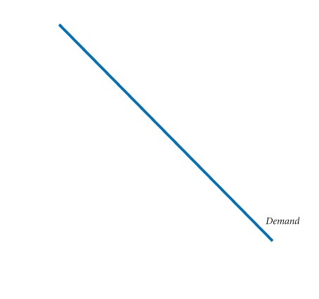
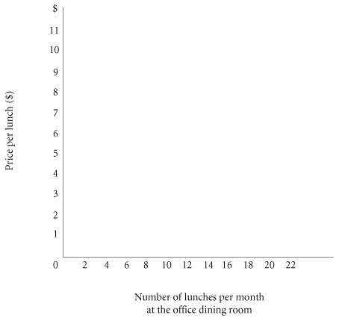
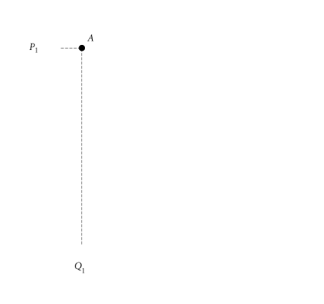
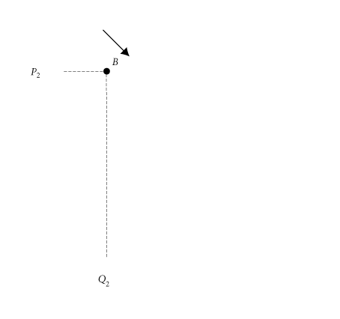
Elasticity Changes along a Straight-Line Demand Curve
TABLE 5.1 Demand Schedule for Office Dining Room Lunches
FIGURE 5.3 Demand Curve for Lunch at the Office Dining Room
Price (per Lunch) | Quantity Demanded (Lunches per Month)
$11 | 0
10 | 2
9 | 4
8 | 6
7 | 8
6 | 10
5 | 12
4 | 14
3 | 16
2 | 18
1 | 20
0 | 22
To calculate price elasticity of demand between points A and B on the demand curve, first calculate the percentage change in quantity demanded:

Slide 22
Elasticity Changes along a Straight-Line Demand Curve (1 of 3)
TABLE 5.1 Demand Schedule for Office Dining Room Lunches
FIGURE 5.3 Demand Curve for Lunch at the Office Dining Room
Price (per Lunch) | Quantity Demanded (Lunches per Month)
$11 | 0
10 | 2
9 | 4
8 | 6
7 | 8
6 | 10
5 | 12
4 | 14
3 | 16
2 | 18
1 | 20
0 | 22
Next, calculate the percentage change in price:

Slide 23
Elasticity Changes along a Straight-Line Demand Curve (2 of 3)
TABLE 5.1 Demand Schedule for Office Dining Room Lunches
FIGURE 5.3 Demand Curve for Lunch at the Office Dining Room
Price (per Lunch) | Quantity Demanded (Lunches per Month)
$11 | 0
10 | 2
9 | 4
8 | 6
7 | 8
6 | 10
5 | 12
4 | 14
3 | 16
2 | 18
1 | 20
0 | 22
Finally, calculate elasticity:

Slide 24
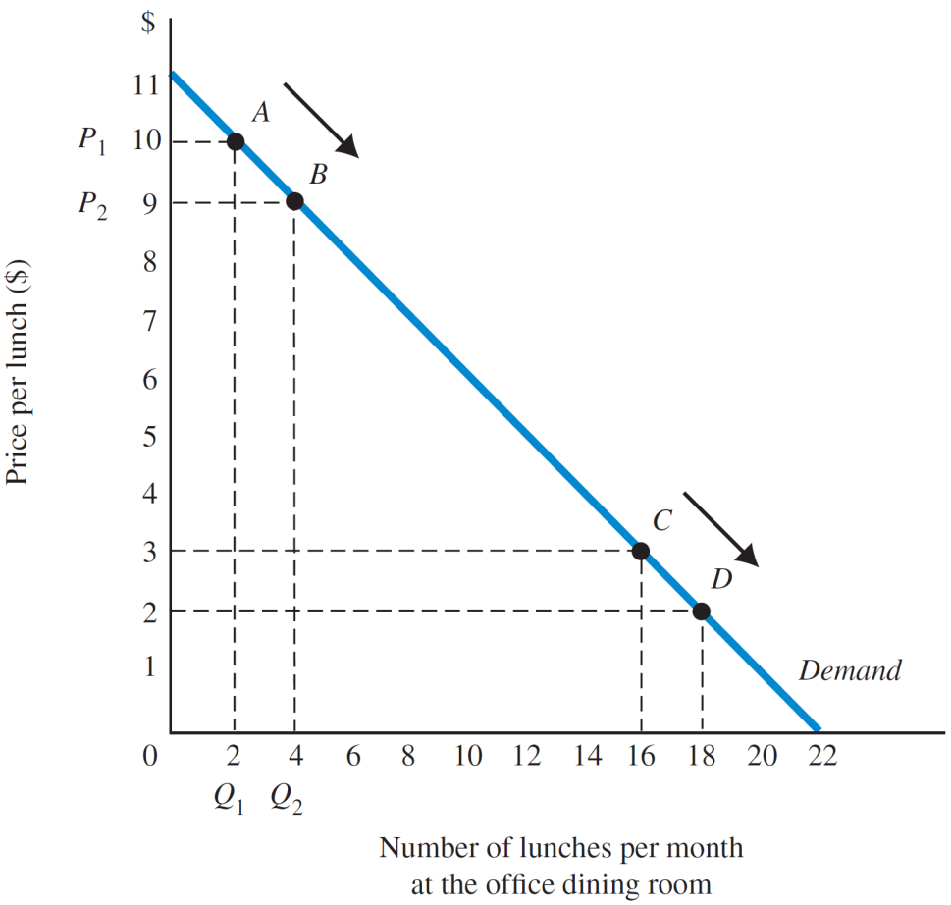
Elasticity Changes along a Straight-Line Demand Curve (3 of 3)
TABLE 5.1 Demand Schedule for Office Dining Room Lunches
FIGURE 5.3 Demand Curve for Lunch at the Office Dining Room
Price (per Lunch) | Quantity Demanded (Lunches per Month)
$11 | 0
10 | 2
9 | 4
8 | 6
7 | 8
6 | 10
5 | 12
4 | 14
3 | 16
2 | 18
1 | 20
0 | 22
Between points A and B, demand is quite elastic, at −6.33.
Between points C and D, demand is quite inelastic, at −.294.

Slide 25
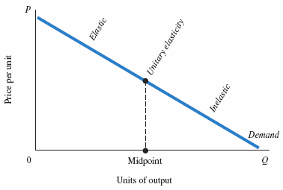
FIGURE 5.4 Point Elasticity Changes along a Demand Curve

Slide 26

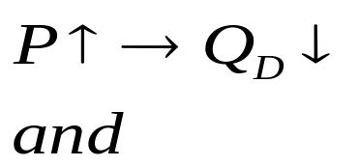
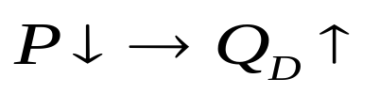
Elasticity and Total Revenue (1 of 4)
In any market, P × Q is total revenue (TR) received by producers:
  Effects of price changes
  on quantity demanded:
  When price (P) declines, quantity demanded (Q_{D}) increases. The two factors, P and Q_{D}, move in opposite directions.

Slide 27
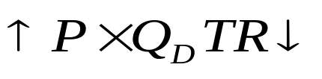
Elasticity and Total Revenue (2 of 4)
Because total revenue is the product of P and Q, whether TR rises or falls in response to a price increase depends on which is bigger: the percentage increase in price or the percentage decrease in quantity demanded.
Effect of price increase on
a product with inelastic demand:

Slide 28
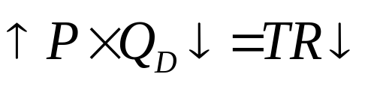
Elasticity and Total Revenue (3 of 4)
If the percentage decline in quantity demanded following a price increase is larger than the percentage increase in price, total revenue will fall.
Effect of price increase on
a product with elastic demand:

Slide 29
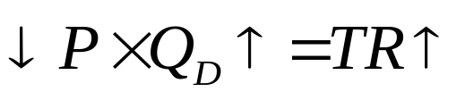

Elasticity and Total Revenue (4 of 4)
The opposite is true for a price cut. When demand is elastic, a cut in price increases total revenue.
Effect of price cut on a product with elastic demand:
Effect of price cut on a product with inelastic demand:
When demand is inelastic, a cut in price reduce`s total revenue.

Slide 30
The Determinants of Demand Elasticity (1 of 2)
Availability of Substitutes
Perhaps the most obvious factor affecting demand elasticity is the availability of substitutes.
The Importance of Being Unimportant
When an item represents a relatively small part of our total budget, we tend to pay little attention to its price.

Slide 31
The Determinants of Demand Elasticity (2 of 2)
Luxuries versus Necessities
Luxury goods (e.g., yachts) tend to have relatively elastic demand, and necessities (e.g., food) have inelastic demand.
The Time Dimension
In the longer run, demand is likely to become more elastic because households make adjustments over time, and producers develop substitute goods.

Slide 32
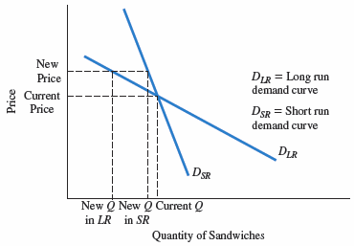
ECONOMICS IN PRACTICE
Elasticities at a Delicatessen in the Short Run and Long Run
The graph shows the expected relationship between long-run and short-run demand for Frank’s sandwiches.
Notice that if you raise prices above the current level, the expected quantity change read from the short-run curve is less than that from the long-run curve.
THINKING PRACTICALLY
Provide an example of a purchasing situation in which you think your own short- and long-run elasticities differ a lot and a second in which they are similar. What drives those differences?

Slide 33
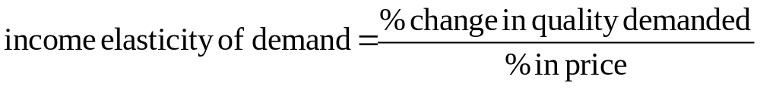
Other Important Elasticities (1 of 2)
Income Elasticity of Demand
income elasticity of demand A measure of the responsiveness of demand to changes in income.

Slide 34
Other Important Elasticities (2 of 2)
Cross-Price Elasticity of Demand
cross-price elasticity of demand A measure of the response of the quantity of one good demanded to a change in the price of another good.

Slide 35
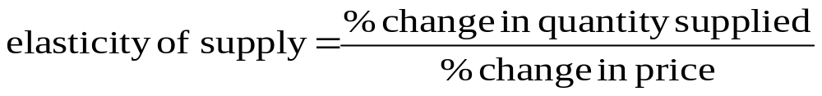
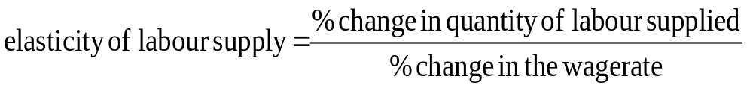
Elasticity of Supply
elasticity of supply A measure of the response of quantity of a good supplied to a change in price of that good. Likely to be positive in output markets.
elasticity of labor supply A measure of the response of labor supplied to a change in the price of labor.

Slide 36

ECONOMICS IN PRACTICE
Tax Rates and Migration in Europe
Denmark is part of the European Union (EU).
In 2009, Denmark enacted a tax relief law aimed at luring highly skilled immigrants.
Researchers found an elasticity of almost 2 for the increase in migration to the reduction in the tax rate.
THINKING PRACTICALLY
1. What features of the EU do you think increase the labor elasticity?

Slide 37
What Happens When We Raise Taxes: Using Elasticity
excise tax A per-unit tax on a specific good.
In the United States, we have excise taxes on gasoline and cigarettes.
Example: A mayor of a city imposes a tax of $1.00 per avocado in a city where 1,000 avocados are sold per day. Will the city add $365,000 per year in taxes?

Slide 38
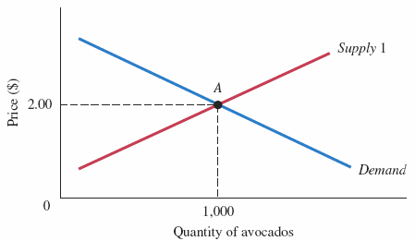
FIGURE 5.5 Original Equilibrium in the Avocado Market
Store owners in the city sells 1,000 avocados per day at the market price of $2.00.

Slide 39
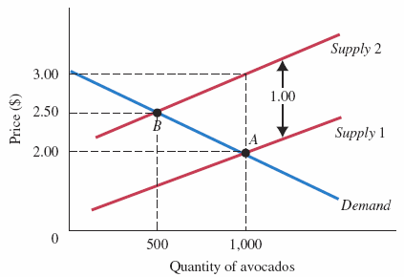
FIGURE 5.6 Equilibrium in the Avocado Market after the $1.00 Tax
After the mayor imposes a tax of $1.00 per avocado, the supply curve shifts up by $1.00, and there is a new equilibrium where supply equals demand at point B.
At the new equilibrium, 500 avocados are sold; the equilibrium price rises to $2.50, and storeowners receive $1.50 per avocado.

Slide 40
REVIEW TERMS AND CONCEPTS
cross-price elasticity of demand
elastic demand
elasticity
elasticity of labor supply
elasticity of supply
excise tax
income elasticity of demand
inelastic demand
midpoint formula
perfectly elastic demand
perfectly inelastic demand
point elasticity
price elasticity of demand
unitary elasticity

