Slide 1


Crime Victims An Introduction to Victimology
Chapter 11
Additional Groups of Victims with Special Problems
© 2020 Cengage. All rights reserved.

Slide 2
Learning Objectives
L01. List the special problems cruise ship passengers face
L02. Describe the difficulties faced by victims of stalking.
L03 Identify trends in the risks of violence and theft middle, high school and college students face on school grounds.
L05. Discuss the patterns and trends in workplace violence.
L06. Identify the characteristics of victims of hate crimes.
L07. Discuss how violence between inmates in jails and prisons is being monitored and addressed.
L08. Identify the assignments that pose the highest risks of injury or death for law enforcement officers.
L09. Discuss measures implemented to enhance officer safety.
L10. Identify factors considered in terrorist threat assessments

Slide 3
Particular groups that face special problems that require special solutions

Slide 4
Rediscovered Groups of Victims
The criminal justice system needs to improve how it handles cases and addresses victims’ needs
  Cruise ship passengers harmed at sea
  Individuals harmed by stalkers
  Students targeted in schools and on college campuses
  Workers attacked while doing their jobs
  Persons singled out for hate crimes
  Prisoners assaulted by other inmates
  Police officers injured in the line of duty
  Innocent Americans targeted by terrorists

Slide 5
Passengers harmed while at sea

Slide 6
Passengers Face Special Problems
No police officers aboard cruise ships
Must wait until the boat docks for investigations to begin
Foreign laws and procedures may prevail
Cruise Ship Vessel Safety Act of 2010
  Ships must have medical personnel aboard
  Ships must improve security measures
In 2017, 10 ships submitted reports to the FBI
  1 murder, 13 injured in attacks, 75 sexual assaults

Slide 7
What do you think about the below scenario?
In July 2018, passengers dismissed the sounds of a woman screaming, believing it was part of a murder-mystery trivia game. She later was found dead from a head wound. Cruise lines claim that these types of murders are rare. Why do they capture the attention of the media and the public? Do you believe them to be increasing?

Slide 8
Individuals menaced by stalkers

Slide 9
Stalking: A New Word for an Old Problem (1 of 2)
Term stalking was coined in the 1980s
Starts as series of noncriminal act and escalates to behaviors signaling an impending attack
Police took action in 40 percent of reported cases; 8 percent arrested
Two types of victim–offender relationships
  Celebrity stalkers—rare
  Ordinary person is repeatedly contacted by an aggressor in a frightening way—most common
Motivated by desires for domination or subjugation

Slide 10
Stalking: A New Word for an Old Problem (2 of 2)
Survey data show most women report being stalked by a former intimate male
Proxy stalking involves a third party
Differential risks of being stalked
  Separated/divorced, low-income, 18–24 years old
  Multiracial people and Native Americans
Victims suffer emotional and financial crises
  Anxiety, panic attacks
  Nightmares
  Damaged possessions
  Lost wages or moving expenses

Slide 11
The Scope of the Problem
Turning to the criminal justice system for relief
  Stalking is criminalized in all 50 states
  Laws focus on complainant’s state of mind and offender’s presumed intentions
  40 percent reporting rate; less than 25 percent are prosecuted
Reducing risks
  Victims can be blamed for facilitating, precipitating, or provoking a stalker
  Victims are often told to change behaviors
    Tell harasser to stop; Keep a log of harassment; Get a restraining order in court; Vary personal routines and change locks

Slide 12
Cyberstalking: A New Word for a New Problem
At first, online stalking was not considered criminal
  Police were not sure who had jurisdiction
Term cyberstalking was coined in 2000
Cyberstalking tends to be shorter lived
  Victims take earlier precautions for prevention
Survey data show
  Most cyberstalkers are male strangers
  Most victims are young females

Slide 13
Victims of crimes committed at school

Slide 14
Threats Facing Middle and High School Students
By law, students must attend school, forcing them to interact with potential victimizers
Table 11.1 shows NCVS data of victimization rates
Type of Crime and Location | Serious Violence at School | Serious Violence Away from School | Thefts at School | Thefts Away from School
Year
1992 | 8 | 44 | 114 | 79
1996 | 14 | 33 | 85 | 60
2000 | 8 | 15 | 49 | 45
2004 | 4 | 10 | 41 | 27
2008 | 5 | 10 | 25 | 19
2012 | 3 | 7 | 24 | 18
2015 | 4 | 4 | 12 | 10
2016 | 3 | 5 | 12 | 10

Slide 15
Threats Facing College Students
Undergraduates are 18–24 years old—the most volatile period for offenders and victims
Students are safer than their nonstudent counterparts
Crime Awareness and Campus Security Act of 1990
Higher Education Act of 1992
Clery Act of 1998
Murders are very rare
  Data inflated by mass shootings
  Box 11.1

Slide 16
Table 11.2 Crimes Committed on College Campuses, United States, 2001–2015
Type of Crime | Number of Incidents per Year: 2001 | Number of Incidents per Year: 2003 | Number of Incidents per Year: 2005 | Number of Incidents per Year: 2007 | Number of Incidents per Year: 2009 | Number of Incidents per Year: 2011 | Number of Incidents per Year: 2013 | Number of Incidents per Year: 2015
Murders | 17 | 9 | 11 | 44 | 16 | 16 | 23 | 28
Forcible sex offenses | 2,200 | 2,600 | 2,670 | 2,700 | 2,540 | 3,440 | 4,980 | 7,970
Robberies | 1,660 | 1,630 | 1,550 | 1,560 | 1,410 | 1,650 | 1,320 | 1,050
Aggravated assaults | 2,950 | 2,830 | 2,660 | 2,600 | 2,330 | 2,500 | 2,040 | 2,250
Burglaries | 26,900 | 28,640 | 29,260 | 29,490 | 23,080 | 20,230 | 15,230 | 12,300
Motor vehicle thefts | 6,220 | 6,290 | 5,530 | 4,620 | 3,980 | 3,620 | 2,970 | 3,250

Slide 17
The Controversy of Hazing on Campus
Expression of organized, institutionalized bullying
Officially outlawed but often tolerated as an integral part of campus culture
50 percent of college students involved in campus activities report having been hazed
  5 percent reported it
Universities adopt a zero-tolerance approach to break the cycle

Slide 18
Casualties of workplace violence

Slide 19
Workplace Violence Was Rediscovered in 1989
Mass shootings in 1980s and 1990s brought about the term “going postal”
Targets include employees, customers, clients, visitors
67 percent of workplace murders stemmed from robberies
  13 percent were due to violent coworkers
Rate of violence declined in the 1990s, as did other violent crimes

Slide 20
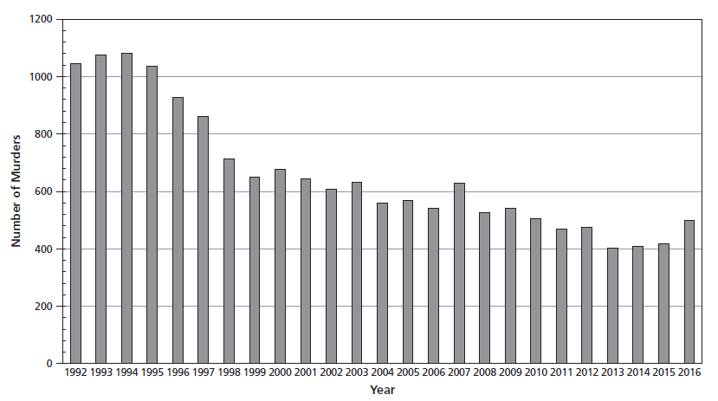
Figure 11.2 Trends in Work-Related Murders, United States, 1992–2016

Slide 21
Differential Risks of Being Wounded or Murdered While on the Job (1 of 2)
Risk factors include
  Handling cash
  Interacting with volatile or unstable people
  Working where alcohol is served
  Performing tasks alone or in isolated areas
  Working late at night
Law enforcement officers and mental health workers suffer highest risks
Employed drivers suffered most workplace homicides

Slide 22
Differential Risks of Being Wounded or Murdered While on the Job (2 of 2)
Four different threat assessment strategies
  Reduce odds that intruder can come into workplace
  Prevent outside disputes from coming into workplace
  Protect employees who deal with irate customers, unruly students, disturbed patients and inmates
  Safeguard employees from disgruntled current or former employees

Slide 23
Targets of hate crimes

Slide 24
Rediscovering a Very Old Problem
Hate crimes or bias crimes have an impact that goes far beyond the injuries inflicted
Hate Crime Statistic Act of 1990 generated data
  Delegated responsibility to the FBI
  Bias incidents are not counted
  Amended to expand the list of targeted groups
When people side with an aggressor, intergroup relations are strained
  Police must move quickly to deter further problems

Slide 25
How Many Outbursts of Hatred?
Victims are part of negatively stereotyped out-groups
Hate crimes stand out
  Excessively brutal
  Target is singled out at random
  Offenders lash out in a group
Calculating differential risks is difficult
  Crimes go unreported
  Some police departments keep inadequate records
  Some attacks are not recognized as inspired by bigotry

Slide 26
Patterns and Trends in Victim–Offender Relationships
In 2016, FBI data show
  Nine murders due to hate
  Of 4,425 people targeted by race, 50 percent were African American, 20 percent were white, 10 percent were Hispanic
  Of 1,600 people targeted by religion, 55 percent were Jewish, 25 percent were Muslim
  Of 1,250 people targeted due to sexual orientation, 60 percent were gay males
NCVS data
  250,000 hate crimes per year
  Hispanics and low-income people suffer the most

Slide 27
Criminal Justice System Reforms
New laws penalize hate crimes more severely
  46 states have adopted statutes
  Most have civil provisions making lawsuits easier
Police departments take special steps to investigate
  Hate crime squads
  Respond promptly, keep victim informed, provide aid
District attorneys prosecute more vigorously

Slide 28
Violence between prisoners

Slide 29
Inmates Face Unique Problems
They cannot escape interactions with dangerous people
They fear reporting—being branded a “snitch”
Attacks are often motivated by race or ethnicity
Murders under the government’s control breach the social contract
Without appropriate rehabilitation, recidivism can create another wave of victims

Slide 30
Discovering Differential Risks of Getting Slain Behind Bars (1 of 2)
Deaths in Custody Reporting Act of 2000
  Jail data: 325 homicides, 2000–2014
  Prison data: 845 homicides, 2001–2014
Most dangerous prison systems are in New Mexico, Maine, and California. Safest are in Minnesota, North Dakota, New Hampshire, and Vermont
Jail data: Highest risks are faced by men over 55, convicted of misdemeanors (race rates similar)
Prison data: Same, but whites slayed the most, followed by Latinos, African Americans, and Asians

Slide 31
Discovering Differential Risks of Getting Slain Behind Bars (2 of 2)
Murder rates should be zero
  Government is responsible for prisoners’ well-being
Best predictors of being assaulted or stabbed
  Having been placed in segregation as punishment
  Having been convicted of sex offenses
  Suffering from mental illness
  Instigating others’ misconduct
  Holding inmates in low regard
  Turning to drugs as a coping mechanism
System must identify vulnerable inmates to deter violence

Slide 32
Think about the below…..
In September of 2018, a Florida prisoner killed his cellmate and made a necklace of his body parts. Why didn’t the story make bigger news? What systemic problems does this suggest in the specific Florida prison that housed these inmates?

Slide 33
Law enforcement officers injured and slain in the line of duty

Slide 34
Officers Face Special Challenges
They interact with criminals on a daily basis
They run toward danger
Their uniforms make them targets of ambush
Killing a police officer is punishable by death

Slide 35
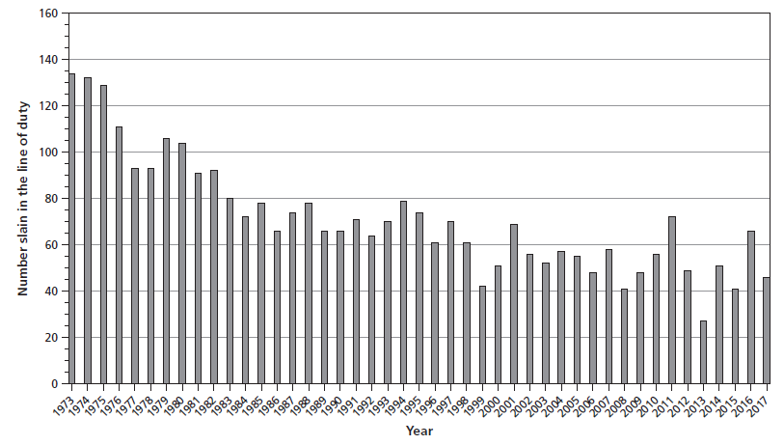
Figure 11.3 Trends in the Murders of Law Enforcement Officers, United States, 1973–2017

Slide 36
Who, Where, When, and How? (1 of 2)
Annual UCR analysis: Law Enforcement Officers Killed and Assaulted (LEOKA)
From 2007 to 2016, 509 officers died
  Making arrests, carrying out traffic stops, investigating suspicious people, responding to disturbances, responding to tactical situations
  In cities with over 250,000 inhabitants
  On Saturdays in December, July, and August
  White males older than 30 with 12 years of policing experience and wearing body armor
  By handguns

Slide 37
Who, Where, When, and How? (2 of 2)
Cop killers: White males, 31 years old, criminal records
Undercover officers face higher risks than uniformed
More officers die by suicides than assaults
Making the job safer
  Bullet-resistant vests, better training, improved weaponry, stun guns, SWAT teams
  DOJ initiatives
    Officer Safety and Wellness Working Group
    Preventing Violence Against Law Enforcement and Ensuring Officer Resilience and Survivability (VALOR)
    Officer Safety Toolkit

Slide 38
Showing Solidarity
In 1984, national self-help group created
  Offers aid, support, and advice
  Monitors killers as they move through criminal justice system
  Trains officers regarding dangerous situations
Pursue justice for fallen fellow officers
  99 percent clearance rate

Slide 39
Casualties of politically inspired violence and terrorism

Slide 40
Terrorism
Attack targets to gain attention of third party
Rely on stealth and deception
Public is affected in several ways
  Become cynical and pessimistic about the enemy or their own side
  Suffer adverse consequences
  Frightened about loss of civil liberties

Slide 41
Assessing the Threat of Terrorism (1 of 2)
Confounding measurement issues
  Groups do not always claim responsibility
    Suspected terrorist attacks versus confirmed attacks
    Domestic terrorism versus international terrorism
  Establishing motivation is difficult
Worst domestic terrorist attack
  1995 Oklahoma City bombing
Worst terrorist suffering
  Sept 11, 2001—Al Qaeda killed 2,838 in World Trade Center Towers, 189 at Pentagon, and 44 in Pennsylvania plane crash, 12,000 people injured

Slide 42
Assessing the Threat of Terrorism (2 of 2)
Since 9/11, two types of domestic terrorism emerged
  Attacks by radical Islamic extremists within the United States
  Attacks by homegrown violent extremists (HVEs)
Most HVE attacks
  Occur in the West and South
  Involve white assailants killing nonwhite victims
Islamic threats get more attention than HVEs
  More HVE attacks
  Islamic attacks are deadlier

Slide 43
Thinking Critically……………….
Of all of the additional groups of victims covered in this chapter which group do feel compelled to learn more about? Why did you choose this group and what more would you like to know?

