Slide 1


Crime Victims An Introduction to Victimology
Chapter 12
Repaying Victims
© 2020 Cengage. All rights reserved.

Slide 2
Learning Objectives
L01. List the ways that criminal activities impose losses and costs on victims and society.
L02. Describe the different types of restitution.
L03. Summarize the arguments in favor or and in opposition to state-run compensation funds.
L04. Understand the main points of the litigation process
L05. Main points of victim compensation (advocates vs critics).

Slide 3
The costs of victimization

Slide 4
Costs of Crime-Related Expenditures
Intangible
  Pain, suffering, loss of quality of life
  Mental illness, PTSD
  Alcohol or drug abuse
Tangible
  Economic losses of cash and property
  Lost earnings
  Medical costs
  Government expenditures on security measures

Slide 5
Gaining restitution from offenders

Slide 6
Back to Basics
Restitution occurs when offenders repay victims
  Community service
  Symbolic restitution
  Creative restitution
Fairness demands that victims are made whole again
In many states, judges must require restitution
Reformers favor restitution over imprisonment

Slide 7
The Rise, Fall, and Rediscovery of Restitution
Restitution was intended to satisfy a thirst for vengeance as well as to repay losses
From biblical times to colonial America, offenders forced to pay more than they stole. This was referred to as Mosiac Law.
  A captured thief would have to pay the victim with 5 oxen for the one that was stolen
In colonial America, before the revolution criminal acts were handled as private conflicts between individuals.
After the American Revolution, crimes became “acts against the state”

Slide 8
Divergent Goals, Clashing Philosophies
Support for restoring restitution is growing but there is disagreement on priorities and purposes
Repaying victims--Cost of lost items, damages, medical bills, lost wages
Rehabilitating offenders
  Leads to an understanding of personal responsibility
  Must be logical, fair, and just
Reconciling offenders and their victims--Peaceful settlements
Punishing offenders--Additional means of punishment and deterrence, Tends to delay reimbursement

Slide 9
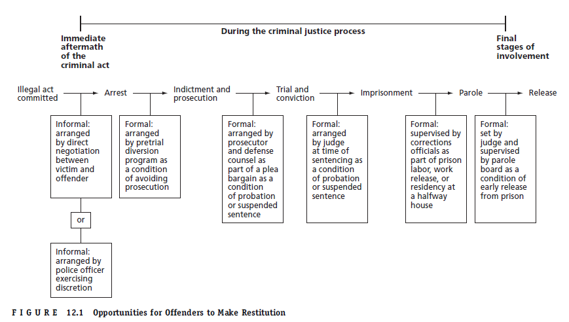
Figure 12.1 Opportunities for Offenders to Make Restitution

Slide 10
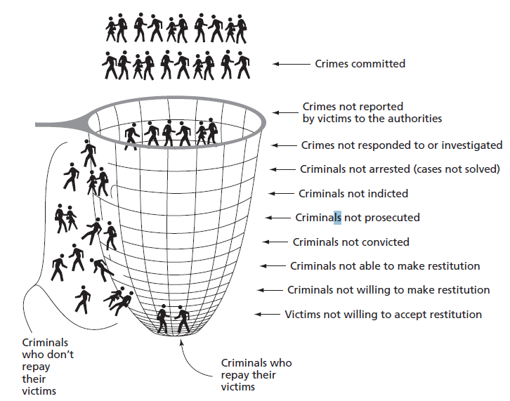
Figure 12.2 Case Attrition, Funneling, or Shrinkage: The Leaky Net

Slide 11
Obstacles Undermining Restitution
Ex-offenders tend to earn low wages
Judges fail to impose restitution for three reasons
  Victims did not request it
  Victims failed to document losses
  Victims cannot calculate exact expenses
In 23 states, judges consider offenders' ability to pay
State laws differ in who gets paid off first

Slide 12
Winning judgments in Civil court

Slide 13
The Revival of Interest in Civil Lawsuits
Under tort law, plaintiffs can sue defendants and win judgments for punitive damages and compensatory damages
Most offenders who commit violent crime are indigent or have modest assets at best

Slide 14
The Litigation Process (1 of 4)
Compensatory damages and pecuniary damages restore victims to former financial condition
Sue for certain intentional torts (a wrongful act or an infringement of a right leading to civil legal liability)
  Wrongful death
  Battery
  Trespass
  Conversion of chattel
  False imprisonment
  Fraud
  Stalking or other extreme conduct

Slide 15
The Litigation Process (2 of 4)
Civil actions
  Plaintiff (second party) files a complaint (pleading), noting jurisdictional issues and causes of action
  An attorney files the complaint in court and pays a fee
  A process server hands the document to the defendant (first party) along with a summons
  Accused either admits to or contests the charges
  Both parties engage in the discovery process for trial
  Typical outcome is a negotiated plea agreement

Slide 16
The Litigation Process (3 of 4)
Benefits for victims
  Control and empowerment
    Choose their own attorneys and courtroom strategies
  Full reimbursement plus damages
  Requires only a preponderance of evidence—51 percent
  Default judgments after 30 days
  Vindication

Slide 17
The Litigation Process (4 of 4)
Drawbacks for victims
  Entire case is fought at their expense
  Their lives are put on hold for years
    Backlogs and delays
  Intense emotions can cause much suffering
  Countersuits harass and intimidate
  Contingency fees are high
  Recovery is difficult
    Defendants do not have deep pockets
    Some defendants are judgment-proof

Slide 18
Think about the below……
Consider the civil lawsuit following the O. J. Simpson trial or that of the Michigan State and USA gymnastics team. Do you believe the victims filed suit to seek financial redress or was vindication a more likely motive? Explain your reasoning.

Slide 19
Collecting Damages from Third Parties (1 of 2)
Suing private enterprises
  Redefined corporate responsibility and financial liability
  Must prove insufficient action to prevent reasonably foreseeable crime
    Chronically disregarded complaints
  Widely used by victims of mass shootings
  Claims against the firearms industry are controversial
    Protection of Lawful Commerce in Arms Act

Slide 20
Collecting Damages from Third Parties (2 of 2)
Suing governmental bodies (pg 486-487 for definitions)
  Some governments have sovereign immunity
  Claims against police
    Nonfeasance
    Malfeasance
  Claims due to injury from prisoners
    Wrongful escape
    Failure to warn
    Wrongful release
  Abuse of discretionary authority

Slide 21
Achieving Reimbursements from insurance companies

Slide 22
Crime Insurance
Positive Aspect- a person can typically be repaid without too much complication as long a formal complaint is filed with the police
Drawbacks include
  Must purchase policies prior to crime
  Premiums can be high
  Deductible clauses
Life insurance policies may have a double indemnity clause
Box 12.1: Challenges Facing Burglary Victims Seeking Reimbursement

Slide 23
Patterns of Loss, Recovery, and Reimbursement
NCVS data confirm
  Medical insurance is more popular than property insurance
  High-income families are more likely to have crime insurance
  Larger losses are more likely reimbursed than smaller losses
More research is needed about insurance reimbursements for burglaries
Purchase of burglary insurance coverage is declining

Slide 24
Recovering losses through victim Compensation programs

Slide 25
The History of Victim Compensation by Governments
Government programs
  Began with Babylonian Code for Hammurabi
  Disappeared in the Middle Ages
  Revived in the 1800s, when the prison reform movement focused attention on the suffering of offenders and the plight of their victims

Slide 26
The Debate over Compensation in the United States (1 of 2)
Advocates of compensation argue (pgs 492-493)
  Shared-risk rationale
  Government-liability rationale
  Social-welfare approach
  Social-justice rationale
  Society tends to offenders but ignores victims
  Compensation encourages the reporting and prosecution of crimes

Slide 27
The Debate over Compensation in the United States (2 of 2)
Critics argue that state-run compensation programs
  Spread governmental paternalism and socialism
  Undermine virtues of individualism, independence, personal responsibility, and calculated risk taking
  Are worse than the fiscal neglect of victims
  Are worse than private insurance policies
  Encourage manipulation of the system
  Are unfair to taxpayers
In 1984, Congress passed the Victims of Crime Act (VOCA)

Slide 28
How Compensation Programs Operate
Similarities
  Victims must be innocent
  Deal only with most serious crimes resulting in physical injury, psychological trauma, or death
Differences
  Time allowed to report crime or apply for reimbursement
  How much can be collected
  Who is eligible to collect
  Where the money comes from

Slide 29
Monitoring and Evaluating Compensation Programs (1 of 2)
Effective evaluations require clearly stated goals
Process evaluations uncover how well programs work
  Focus on internal operations
  Develop profiles of claimants and rewards
  Have found that
    Storefront offices are most effective at reaching the most victims
    Most programs are failing due to limited funds, lack of interest, inadequate outreach efforts, etc.

Slide 30
Take some time to think about the below…
GoFundMe campaigns have been successful in raising millions of dollars for the victims of mass shootings (e.g., in Las Vegas, NV; Newtown, CT; Orlando, FL). What are the benefits and drawbacks of this method for raising funds for victim compensation?

Slide 31
Monitoring and Evaluating Compensation Programs (2 of 2)
Impact evaluations
  Compare program intentions with accomplishments
  Found that
    Programs do not increase cooperation with police
    More research is needed about victims denied compensation
    Programs may be exercises in symbolic politics
    Four problems undermine effectiveness
      Inadequate outreach
      Restrictive eligibility
      Insufficient awards
      Insufficient funds from fines and penalties

Slide 32
Confiscating profits froM notorious criminals

Slide 33
Trying to Make Sure Crime Doesn’t Pay
In 1977, New York passed “Son of Sam Laws”
  By 2011, 42 states and the federal government had enacted similar laws
  In 1991, Supreme Court overturned
    First Amendment right to free speech
Some victims can receive proceeds from murderabilia

Slide 34
Your thoughts…….
Some critics of “Son of Sam” laws believe that allowing offenders to write books, cooperate with movie producers, or speak publicly is a good way to provide victims with much-needed compensation. Do you agree? Explain your reasoning.

