Slide 1
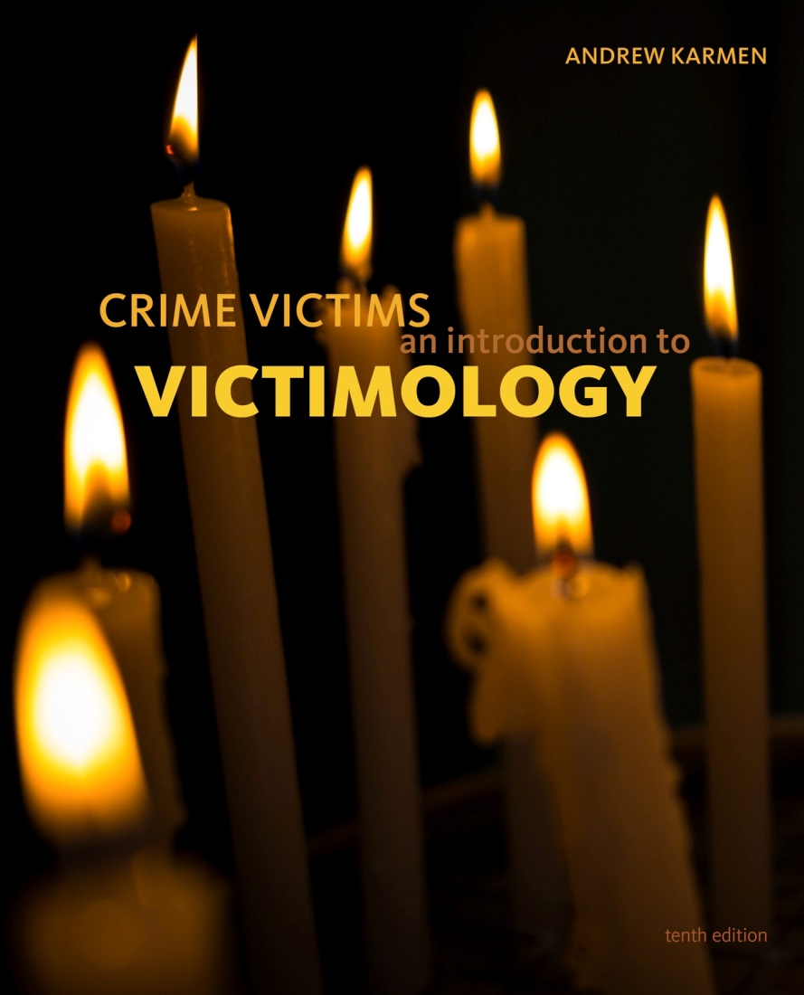

Crime Victims An Introduction to Victimology
Chapter 13
Victims in the Twenty-First Century: Alternative Directions
© 2020 Cengage. All rights reserved.

Slide 2
Learning Objectives
L01. Explain the four rationales that govern the use of force in self-defense.
L02. Summarize the arguments in favor of and in opposition to arming for self-defense.
L03 Identify the characteristics of incidents of "retaliatory justice" and vigilantism.
L04. Discuss the principles and rationales behind restorative justice.
L05. Compare and contrast restorative justice and retributive justice.
L06. Describe how restorative justice programs operate.
L07. List the pros and cons of resolving cases through the process of restorative justice.

Slide 3
Toward countering criminal violence with forceful responses: would victims be better off if they were armed?

Slide 4
The Legitimate Use of Force in Self-Defense
Four rationales shape self-defense statutes
  Punitive rationale
  Rationale of necessity
  Individualist rationale
  Social rationale
Right to self-defense qualifications
  Threat must be imminent
  If the assailant retreats, no force may be used
  Threat of harm must be reasonable
  Degree of force must be proportional to the threat
  Timing must be appropriate

Slide 5
Justifiable Homicides Carried Out by Victims and Law Enforcement Officers
UCR keeps track of justifiable homicide
  By victims acting in self-defense
  By law enforcement officers protecting themselves and others
330 justifiable homicides in 2016
Determining justifiability brings potential for racial discrimination
Box 13.1

Slide 6
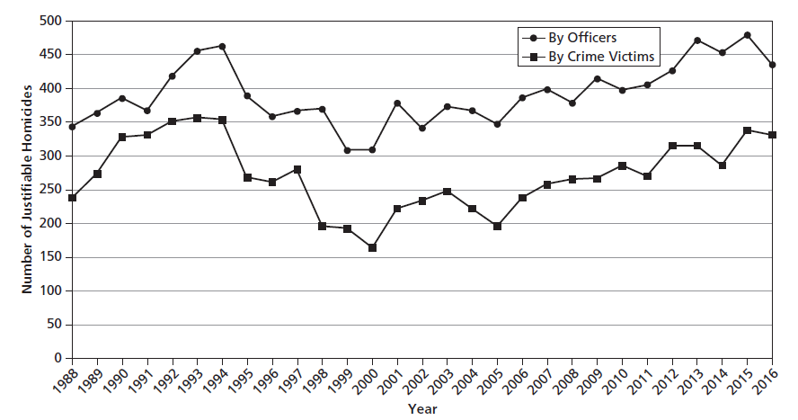
Figure 13.1 Trends in Justifiable Homicides, United States, 1988–2016

Slide 7
Acquiring Firearms for Self-Defense
Advocates of armed self-defense
  Firearms are equalizers
  “If guns are outlawed, only outlaws will have guns.”
Gun control advocates
  Guns are facilitators
  Raises likelihood of accidental discharge
Dickey Amendment of 1996
Two sources of official data about fatal gun violence
  CDC database
  FBI’s SHRs

Slide 8
Discussion Question 1
Former representative Jay Dickey recently has said that the law that bears his name is overinterpreted and that with so many mass shootings making news, he regrets his actions. What do you think? Should the Dickey Amendment be revised? Explain your reasoning.

Slide 9
Gun Laws Directly Affecting Victims
Crafted by special interests groups
Victims are most affected by
  “Stand your Ground” laws
  Red flag laws
Public opinion changes over time—likely in response to mass shootings
States with higher rates of gun ownership have higher suicide rates

Slide 10
Discussion Question 2
Following the 2013 George Zimmerman trial, much discussion centered around the fairness of the Stand your Ground statute. Critics argued that the law was good in theory but increased the chances of racial bias in practice. Do you agree with this assessment? Explain your reasoning.

Slide 11
Gun Ownership in the United States
Information on ownership and permits is restricted
Firearms in circulation have reached record highs
  100 million in 2011
Proportions of individuals and households possessing guns are declining
  33 percent in 2010
People most likely to own guns are
  White
  Men
  Less educated
  Living in rural areas

Slide 12
Arguments Advanced by Proponents of Arming for Self-Protection
Police cannot arrive in time to save victim from harm
Guns at home protect residents from grave danger
  Must be loaded and easily retrievable
Reaching for a gun away from home can save a victim from serious harm
Handy guns save lives
Armed bystanders can be Good Samaritans
Defensive gun uses (DGUs) contribute to public safety
  Deterrence rationale

Slide 13
Counterarguments Advanced by Critics Opposed to Arming for Self-Protection (1 of 2)
Bullet wounds take terrible toll on U.S. population
Accidental discharges kill significant numbers
Few victims draw and use weapons during attacks
Weapons might be stolen and used by criminals
Guns put households in greater danger
Guns escalate hostilities
Law-abiding citizens might use guns for crimes
Guns are used for suicide
Arming does not bring down the crime rate

Slide 14
Counterarguments Advanced by Critics Opposed to Arming for Self-Protection (2 of 2)
Armed victims might engage in retaliatory justice
  Modern-day vigilantism
    End justifies the means
    Lynching
    No statistics available
  Held in check by counterideologies
    Experts should control the justice system, not ordinary citizens
    Innocent people are protected from mob rule by due process safeguards and constitutional guarantees

Slide 15
Discussion Question 3
Popular movies and television shows are full of vigilante characters, many of them from comic books: Suicide Squad, Batman, Spiderman, Zorro, and even the Teenage Mutant Ninja Turtles. Why are these kinds of situations so popular with modern audiences? Do these shows desensitize children to, or even encourage, vigilantism? Why or why not?

Slide 16
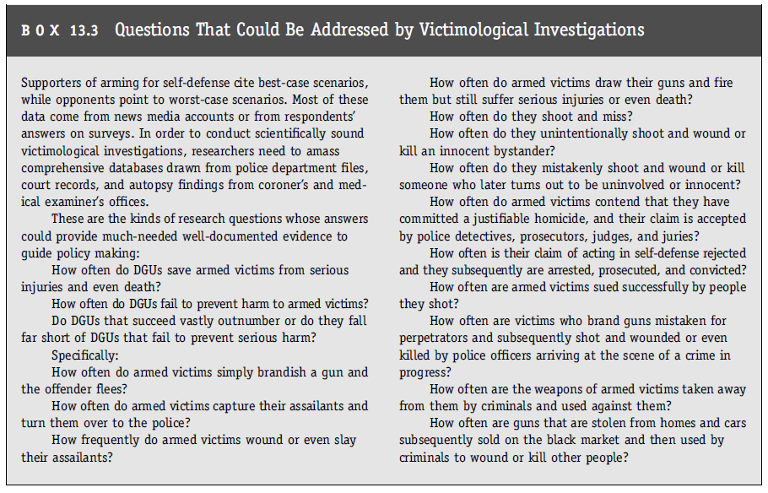
The Potential Contributions of Victimological Investigations

Slide 17
Toward restorative njustice

Slide 18
A Brief History of Restorative Justice (1 of 2)
Restorative justice brings about
  Mutual understanding
  Empathy for the victim’s plight
  Recognition of the offender’s problems
  Lasting settlements that reduce social tensions
Retributive justice
  State-centered
  Offender-focused
  Punishment-oriented

Slide 19
A Brief History of Restorative Justice (2 of 2)
Alternative dispute resolution (ADR)
  Mediation
  Conciliation
  Arbitration
  Multidoor courthouses
  Neighborhood justice centers
  Removes “junk cases” from court system
Dispute Resolution Act of 1980
  Conflict resolution
Table 13.1

Slide 20
The Peacemaking Process: How Reconciliation Programs Work (1 of 2)
Restorative justice programs have four approaches
  Victim–offender mediation
  Community board mediation
  Peacemaking circles
  Family group conferencing
Making restitution is a prerequisite for reconciliation with the community
Chosen cases are due more to the victim–offender relationship than to the offense committed

Slide 21
The Peacemaking Process: How Reconciliation Programs Work (2 of 2)
Process has four distinct stages
  Case selection
  Preparation
  Mediation and negotiation
  Monitoring
Most are run by private, nonprofit organizations
Problems include
  Inadequate funding
  Lack of case referrals
  Victim resistance

Slide 22
Evaluating Efforts at Reconciliation
Advantages include
  Emotional catharsis
  Quickly negotiated agreement
  Avoidance of jail time for offender
  Atmosphere of tolerance, understanding, and redemption
Youthful offenders who pass through mediation commit fewer and less serious further offenses
  Not true of mediated adults

Slide 23
Pros and Cons from the Victim’s Point of View (1 of 2)
Pros
  Ask questions of offenders
  Tell offenders of suffering
  Speedier, cheaper, and more accessible than trials
  Avoid the public spectacle of trials
  Sense of empowerment
  Vindication
  Forgiveness

Slide 24
Pros and Cons from the Victim’s Point of View (2 of 2)
Cons
  Emphasizes healing, not the presumption of innocence
    Wealthy offenders may buy way out of trouble
    May be used for widening the net
  Suspects must be apprehended but not convicted
    Excludes most property crimes
  Harm from violent crime may be beyond what offenders can pay
  Truly innocent victims must assume shared responsibility for the offensive action

Slide 25
The Future of Restorative Justice
Movement toward informality will cause reconciliation programs to grow
  Centralized government coercion has failed to provide social change
  Nonstranger conflicts should not be adjudicated
  A backlogged system mostly serves the state’s interests
Potential problems include
  Large caseloads limiting face-to-face mediation
  Some harms cannot be repaired via restitution
  Losing the victim-centered focus

