Slide 1
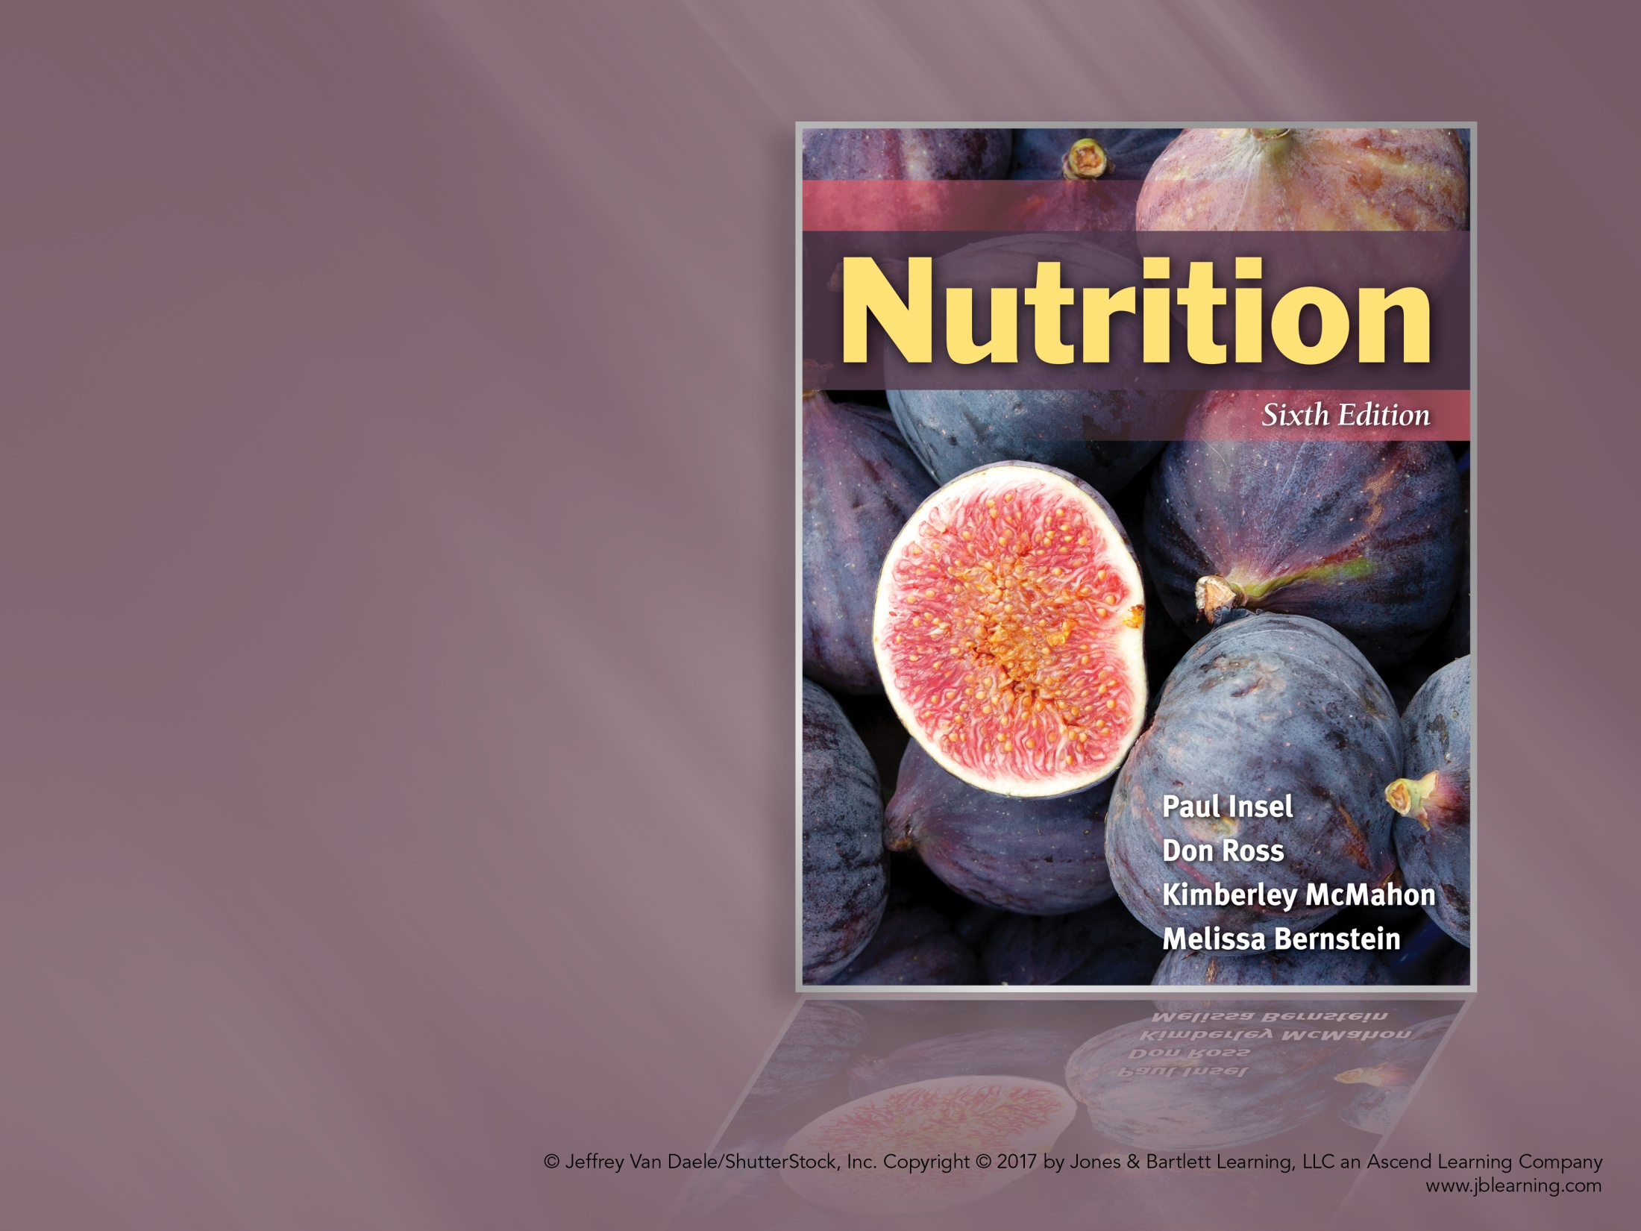
Chapter 18
Food Safety and Technology
Notes:
1

Slide 2
Food Safety
Harmful substances in foods
  Pathogens
    Bacteria, viruses, parasites
  Foodborne illness
    Infection from pathogen
    Toxin produced by microorganism
Notes:
2

Slide 3
Food Safety
Harmful substances in foods
  Pathogens
    Staphylococcus aureus
    Clostridium botulinum
    Salmonella
    Escherichia coli
  Prions and mad cow disease
Notes:
3

Slide 4
Food Safety
Harmful substances in foods
  Chemical contamination
    Pesticides
      Important role in food production
      Concerns: Pollution of soil and water
      Threatens wildlife
Notes:
4

Slide 5
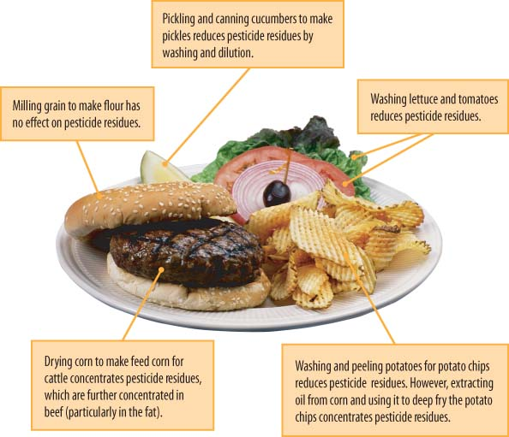
© Photodisc
Figure 18.2 Pesticide pathways to dinner.

Slide 6
Food Safety
Organic alternatives
  “USDA Organic” seal
  Concerns regarding natural fertilizer
  Can use approved pesticides
Animal drugs
  Antibiotics
  Drug residues
Pollutants
  Can contaminate food production areas
Notes:
6

Slide 7
Food Safety: Harmful Substances
Natural toxins
  Aflatoxins
  Ciguatera
  Methyl mercury
  Poisonous mushrooms
  Solanine
Other food contaminants
Notes:
7

Slide 8
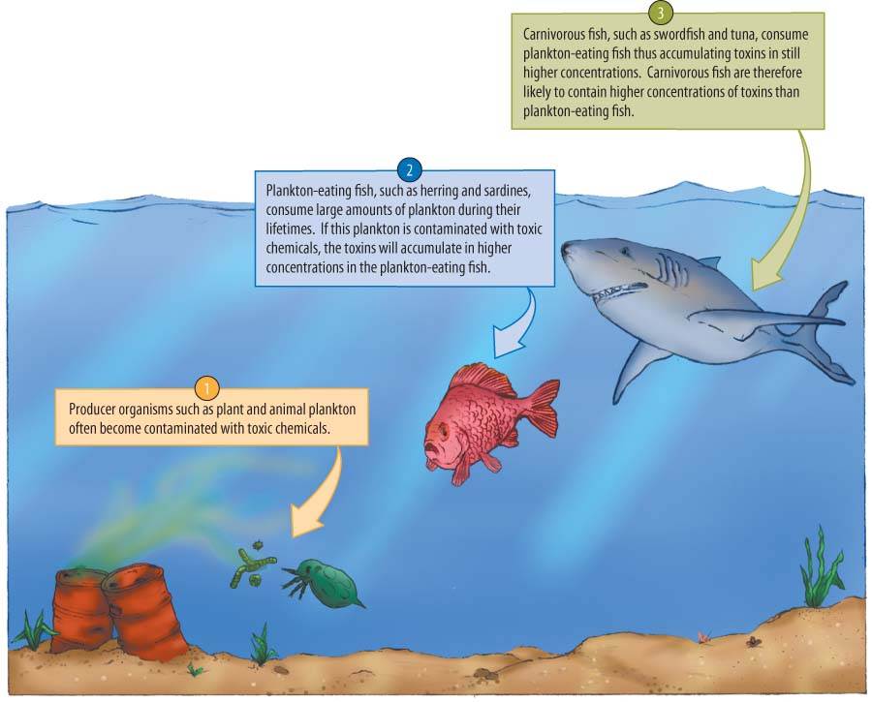
Figure 18.4 Toxins in the food chain.

Slide 9
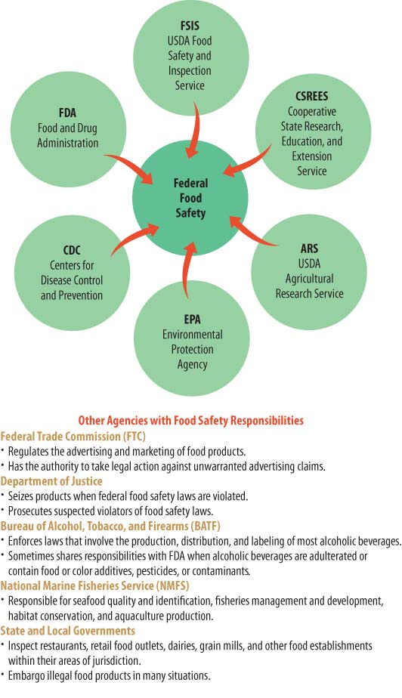
Figure 18.6 Government agencies that help protect our food supply.
Notes:
9

Slide 10
Keeping Food Safe: Food Industry
Hazard Analysis Critical Control Point (HACCP)
  Analyze hazards
  Identify critical control points
  Establish preventive measures with critical limits
  Establish procedures to monitor control points
  Establish corrective actions if critical limit isn’t met
  Establish effective record keeping
  Establish procedures to verify that the system is working consistently
Notes:
10

Slide 11
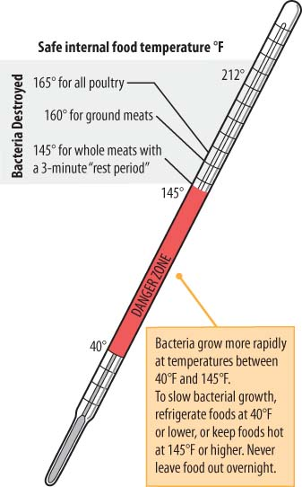
Keeping Food Safe: Consumer
Keep hot foods hot
and cold foods cold
Figure 18.7 Temperature guide.
Notes:
11

Slide 12
Keeping Food Safe: Consumer
Clean
Separate
Cook
Chill (refrigerate promptly)
Notes:
12

Slide 13
Risk for Foodborne Illness
Immune disorders
Cancer
Diabetes
Long-term steroid use
Liver disease
Hemochromatosis
Stomach problems
Notes:
13

Slide 14
Food Technology
Food preservation
  Preservatives
    Added to foods to prevent spoilage and increase shelf life
    Most common: Salt and sugar
    Potassium sorbate and sodium propionate extend shelf life of baked goods
    Antioxidants prevent changes in color and flavor
Notes:
14

Slide 15
Food Technology
Food preservation
  Preparation for preservation
    Salting, drying, fermenting
    Canning
    Freezing
    Heating (e.g., pasteurization)
  Irradiation
    Foods exposed to measured doses of radiation
    Controversial
Notes:
15

Slide 16
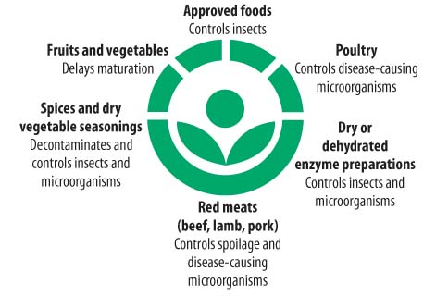
Figure 18.9 Irradiation.
Notes:
16

Slide 17
Food Technology
Food preservation
  Preparation for preservation
    Bacteriophage
      “Bacteria eaters”
      Food additive used to protect people from bacterial infections
Notes:
17

Slide 18
Genetically Engineered Foods
Plant genetics
  Traditional breeding
    Cross two plants and develop hybrids; takes time
  Genetic engineering
    Transform specific genes
    Less time needed to get desired effects
Notes:
18

Slide 19
Genetically Engineered Foods
Benefits of genetic engineering
  Enhanced plant growth
  Reduced pesticide and fertilizer use
  Enhanced nutrient composition
  Enhanced crop yields
Risks
  Potential for new allergens
  Herbicide-resistant weeds
  Loss of biodiversity
Notes:
19

Slide 20
Genetically Engineered Foods
Regulation
  FDA oversees genetically engineered foods.
  Label requirements
    FDA believes the way food is developed or produced irrelevant.
    Labeling of GE foods not required
    Exception: Must disclose any significant difference between bioengineered food and conventional counterpart.
Notes:
20

