Slide 1

Chapter 19
World View of Nutrition
Notes:
1

Slide 2
A Few Definitions
Hunger
  Uneasy or painful sensation caused by lack of food
Malnutrition
  Failure to achieve nutrient requirements
Food insecurity
  Limited or uncertain availability of nutrients or food
Food security
  Access to nutritionally adequate and safe food
Notes:
2

Slide 3
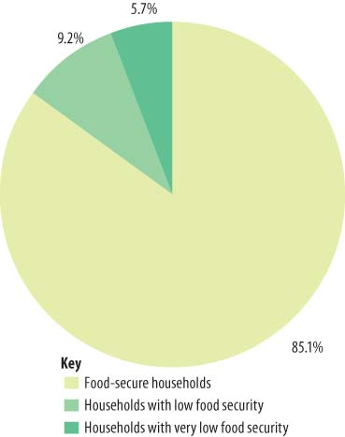
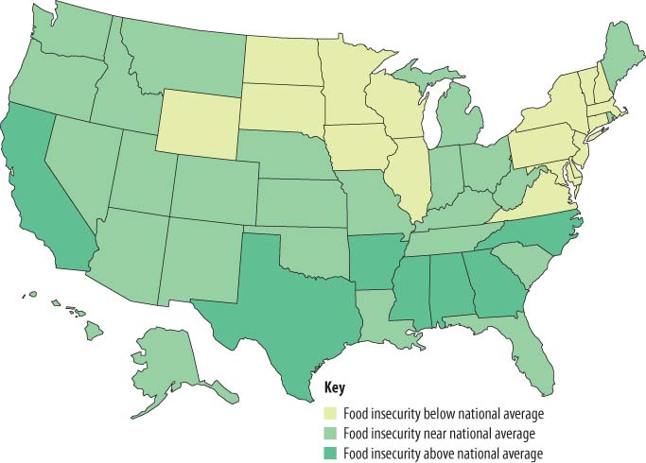
Malnutrition in the United States
The face of American malnutrition
  Coping strategies
  High obesity among low income
Reproduced from ERS using data from the Current Population Survey Food Security Supplement.
Figure 19.1 Prevalence of food insecurity.
Notes:
3

Slide 4
Malnutrition in the United States
Prevalence and distribution
  Working poor
    May or may not qualify for food assistance
  Food deserts (isolation)
    Lack access to food resources
  Older adults
    Economic difficulties
    Physical ailments
Notes:
4

Slide 5
Malnutrition in the United States
Prevalence and distribution
  Homeless or inadequately housed
    Lack consistent cooking facilities
    Limited income, if any
  Children
    Dependent on family circumstances
    Hunger affects school performance
Notes:
5

Slide 6




© Jaimie Duplass/ShutterStock, Inc.
© Jack Star/PhotoLink/Photodisc
© Photodisc
© Photodisc
Figure 19.3 Americans at risk.

Slide 7
Malnutrition in the United States
Attacking hunger in America
  The Supplemental Nutrition Assistance Program
    Extends food buying power
  Special Supplemental Nutrition Program for Women, Infants, and Children (WIC)
    Food and nutrition services for pregnant and lactating women, and children to age 5
Notes:
7

Slide 8
Malnutrition in the United States
Attacking hunger in America
  National School Lunch Program
    Free and reduced-price meals
  Child and Adult Care Food Program
Notes:
8

Slide 9
Malnutrition in the United States
Attacking hunger in America
  Feeding America
    Largest hunger-relief organization in the United States
    Network of food banks and food-rescue organizations
    Works to affect change in public attitude and laws
    Educates the general public about hunger in America
Notes:
9

Slide 10
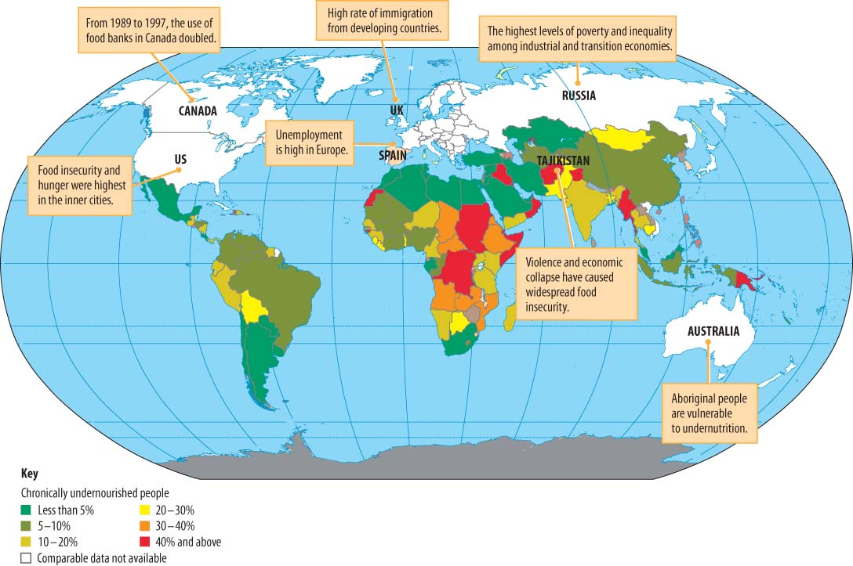
Reproduced from Food and Agriculture Organization of the United Nations, 2015. Hunger: Interactive world hunger map. www.fao.org/hunger/en. Accessed 12/17/2015 Reproduced with permission.
Figure 19.6 Global hunger.
Notes:
10

Slide 11
Malnutrition in the Developing World
Factors that contribute to hunger and malnutrition
  The world food equation
    Soaring food prices
  Global economic boom
    Rapid economic expansion
  Oil prices and biofuels
    Increased food costs
Notes:
11

Slide 12
Malnutrition in the Developing World
Factors that contribute to hunger and malnutrition
  Global climate change and severe events
    Unpredictability and variability in water supplies
  The fight against global hunger
    International relief agencies
    Government programs
Notes:
12

Slide 13
Malnutrition in the Developing World
Factors that contribute to hunger and malnutrition
  Social and economic factors
    Poverty, hunger, and malnutrition
    Population growth
    Urbanization
Notes:
13

Slide 14
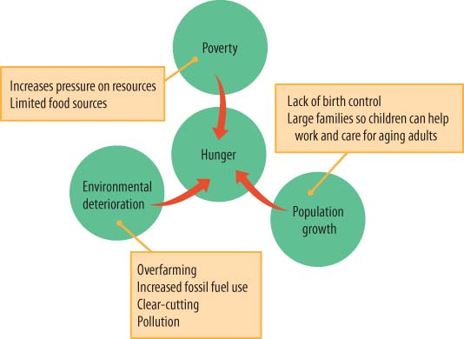
Figure 19.7 Major problems causing hunger.
Notes:
14

Slide 15
Malnutrition in the Developing World
Factors that contribute to malnutrition
  Infection and disease
  Political disruptions
    War
    Refugees
    Sanctions
Notes:
15

Slide 16
Malnutrition in the Developing World
Agriculture and environment: A tricky balance
  Environmental degradation
    Reduced food production
    Nutritional consequences
Notes:
16

Slide 17
Malnutrition in the Developing World
Malnutrition: Its nature, its victims, and its eradication
  Protein-energy malnutrition
    Kwashiorkor
    Marasmus
  Iodine deficiency disorders
    Most common cause of preventable brain damage
Notes:
17

Slide 18
Malnutrition in the Developing World
Vitamin A deficiency
  Leading cause of preventable blindness
Iron-deficiency anemia
  Limits productivity of population
  Timely treatment
    Increase iron intake
    Control infection
    Improve nutrition status
Notes:
18

Slide 19
Malnutrition in the Developing World
Deficiencies of other micronutrients
  Zinc
  Calcium
  Selenium
Overweight and obesity
  Differing cultural attitudes
  High-calorie, low-nutrient-dense foods
Notes:
19

