Slide 1
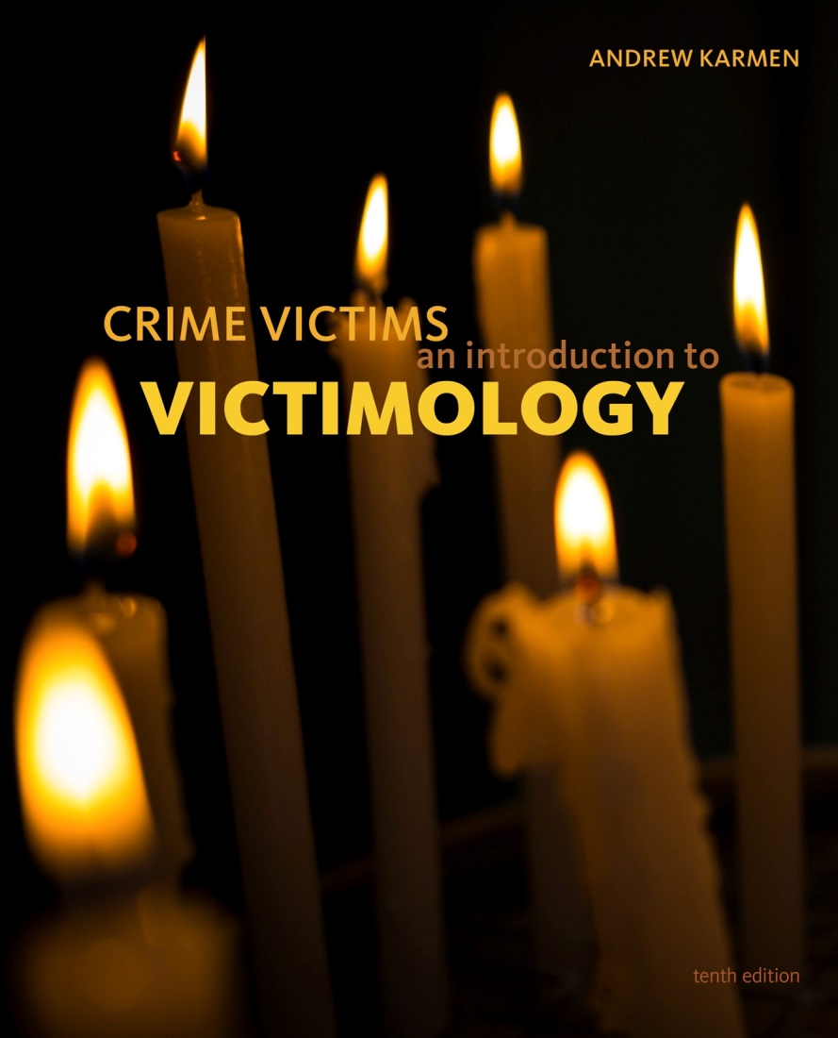

Crime Victims An Introduction to Victimology
Chapter 1
What Is Victimology?
© 2020 Cengage. All rights reserved.

Slide 2
Learning Objectives (1 of 2)
L01. Define victim.
L02. Define victimization.
L03. Define victimology.
L04. Describe the subjective approach to the plight of victims.
L05. Define scientific objectivity.
L06. Discuss why objectivity is critical when examining the plight of crime victims.

Slide 3
Learning Objectives (2 of 2)
LO7. Differentiate victimology from victimization.
LO8. Compare and contrast victimology and criminology.
LO9. List intellectual and practical reasons for studying victimization.
LO10. Identify different types of research about victims.
LO11. Identify different disciplinary contributions to the study of victims.
LO12. List the steps for conducting a victim-centered analysis.

Slide 4
An introduction To victimology

Slide 5
Studying Victimization Scientifically
Victims: Individuals who suffer injuries, losses, or hardships for any reason.
Victimization: An asymmetrical relationship that is abusive, painful, parasitical, destructive, or unfair.
Victimology: Scientific study of the physical, emotional, and financial harm people endure because of illegal activities.
  Includes how victims are handled by criminal justice agencies and officials.

Slide 6
Focusing on the Plight of Crime Victims
Subjective Approach: Uses the standpoint of morality, ethics, philosophy, personalized reactions, and intense emotions.
Objective Approach: Draws conclusions only from evidence and facts.
Victims are classified as:
  Direct or primary victims
  Indirect or secondary victims
    Include loved ones, caregivers, and first responders

Slide 7
What Kinds of Studies Do Victimologists Carry Out? (1 of 4)
Research seeks to predict why certain people are targeted for crime more than others.
Requires objectivity
Victimologists cannot always be pro-victim
  "Legitimate victim” status is socially constructed.
    Menendez Brothers
    John and Lorena Bobbitt

Slide 8
What Kinds of Studies Do Victimologists Carry Out? (2 of 4)
  Difficult to determine the victim and the offender
    Martin/Zimmerman “stand your ground” case
    Young woman fatally shot after a car accident
    Domestic abuse victim fires warning shots
  Many situations do not meet ideal type conditions
    Person who suffered harm was weaker than the aggressor, wrongdoer was unprovoked, etc.
  Predators prey upon each other resulting in victim– offender overlap

Slide 9
Discussion Question 1
Consider the Sandy Hook Elementary School shooting of 2012. A man with a history of mental health issues shot and killed 20 children and 5 adults. Was he a victim or a victimizer or both? Why do you think the general population was so polarized on this issue?

Slide 10
What Kinds of Studies Do Victimologists Carry Out? (3 of 4)
  Victims may be at odds with the “good guys”
    Victims pitted against one another
    Media portrayal of crimes
    Political officials with competing policies

Slide 11
What Kinds of Studies Do Victimologists Carry Out? (4 of 4)
Three sources of bias thwart research objectivity:
  Personal experiences
    Individual preferences and prejudices
  Legacy of the discipline
    Collective preferences and priorities of its founders
  Social environment/mood of the times
    1960s–1970s: demands for financial, medical, and emotional government assistance for victims
    1980s: demands for self-reliance and for cuts in social spending and taxes

Slide 12
WHAT VICTIMOLOGY ISN’T

Slide 13
Victimology versus Detective Work
Detectives
  Victimology refers to background investigations that reconstruct events to solve crimes.
Victimologists
  Do not solve crimes

Slide 14
Victimology versus Victim Services
Victim Services
  Provide hands-on, one-one-one victim assistance
    Doctors, EMTs, psychologists, counselors, clergy
Victomologists
  Study entire populations to reduce suffering

Slide 15
Victimology versus Victimism: A Political Point of View
Victimology has negative connotations in mainstream culture.
  “ology” means “the scientific study of.”
Victimism is the outlook of people who share a sense of victimhood.
  An “ism” is an ideology.

Slide 16
Discussion Question 2
Why do you think high-level politicians are increasingly misusing the term victimology in attacks against political opponents? What does this say about the current mood of society? How might this mood affect objectivity in research?

Slide 17
COMPARING VICTIMOLOGY TO CRIMINOLOGY

Slide 18
The Many Parallels between Criminology and Victimology (1 of 2)
Victimology is a subdiscipline of criminology.
  Scientific study of illegal activities, offenders, their victims, criminal law and the criminal justice system, and societal reactions to the crime problem
  Historically, criminology was more like offenderology.
Both disciplines look for causal relationships.
  Criminologists ask why certain individuals become involved in lawbreaking.
  Victimologists ask why some entities are targeted.

Slide 19
The Many Parallels between Criminology and Victimology (2 of 2)
Both emphasize proper gathering and interpretation of data.
  Criminologists apply findings to devise crime prevention strategies.
  Victimologists scrutinize trends to develop victimization prevention strategies and risk-reduction tactics.
Both study how the criminal justice system actually operates versus how it is supposed to work.
Both assess offender needs and recover program effectiveness.
Both estimate costs of crime.

Slide 20
Some Differences and Issues about Boundaries
Criminology is several hundred years old.
Victimology is several decades old.
Criminology binds studies to illegal activities.
Victimology boundaries are in dispute.
  Some want to study more than criminal victimization.

Slide 21
Differing Political Approaches within the Discipline (1 of 3)
Conservative Tendency
  Focuses primarily on street crimes
  Holds victims strictly accountable for their decisions and actions
  Stresses self-reliance over governmental assistance
  Embraces punishments in proportion to harms inflicted on victims

Slide 22
Differing Political Approaches within the Discipline (2 of 3)
Liberal Tendency
  Extends beyond street crimes to include corporate corruption
  Endorses societal intervention via the government
  Extends safety net mechanisms for all kinds of misfortunes, including crime
  Embraces restorative justice

Slide 23
Differing Political Approaches within the Discipline (3 of 3)
Radical/Critical/Conflict Tendency
  Includes street crimes, corporate offenses, and other harms (e.g., polluters and fraudulent advertisers)
  Victimization is a result of an exploitative and oppressive social system.
  Looks toward societal factors such as poverty, unemployment, and language barriers as explanations behind crime
  Considers the legal system partly to blame

Slide 24
WHY STUDY VICTIMOLOGY?

Slide 25
Benefits of Studying Victimology
Intellectual benefits
Expansion of horizons
Practical applications that ease the suffering of others provide a sense of purpose, worth, accomplishment, and satisfaction
Complete understanding and appreciation of reactions to victimization

Slide 26
WHY PLACE SUCH AN EMPHASIS ON CARRYING OUT RESEARCH?

Slide 27
Different Types of Research Studies in Victimology
Exploratory studies
  Use qualitative methods to understand new forms of victimization
Descriptive studies
  Use quantitative methods to address questions of who, where, when, and how
Explanatory studies
  Attempt to discover causes or problems—the why?
Evaluation studies
  Assess the effectiveness of interventions—the “what would happen if…?”

Slide 28
Discussion Question 3
You are researching cyberstalking.
  What kinds of questions would you pose in order to perform an exploratory research study?
  What questions would you use for a descriptive study?
  What questions are useful for explanatory studies?
  What questions are best for evaluation studies?

Slide 29
Different Disciplinary Approaches When Researching Victim Issues
Psychological approaches
  Emphasize character traits and personalities
Legal and criminal justice approaches
  Focus on laws, regulations, and procedures
Historical approaches
  Look at the past and trace developments to the present
Anthropological approaches
  Study societies that are far away and existed long ago
Economical approaches
  Study finances, gains, losses, costs, and expenses

Slide 30
Sometimes Research Findings Can Be Surprising!
Conventional wisdom is sometimes mistaken or partially true.
An emphasis on research often uncovers unexpected but useful findings.
Victimologists use the same methods as other social scientists
  Case studies, surveys and polls, social experiments, etc.

Slide 31
How to Structure a Victimological Investigation
Step 1: Identify, Define, and Describe the Problem
Step 2: Estimate the True Dimensions of the Problem
Step 3: Investigate How Victims and Their Offenders Interacted
Step 4: Analyze the Findings and Their Policy Implications

