Slide 1
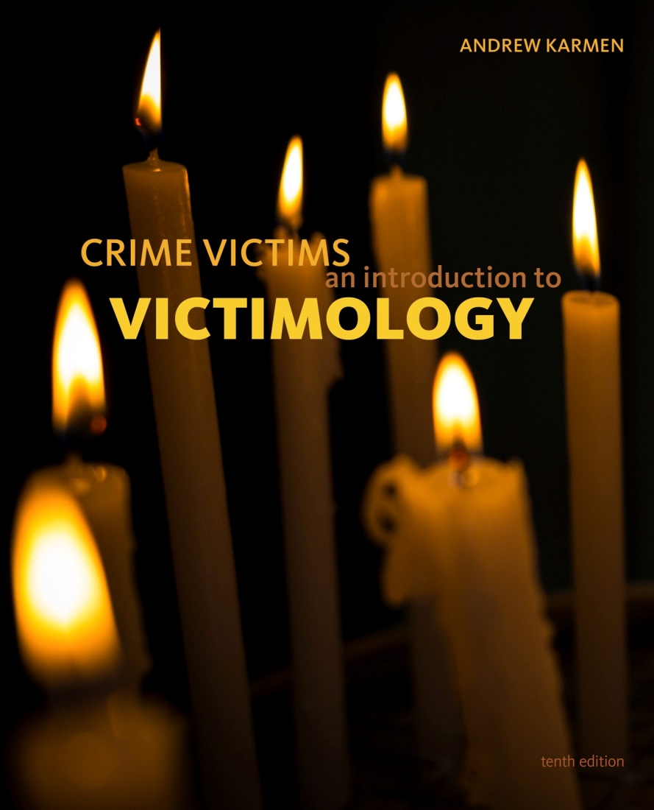

Crime Victims An Introduction to Victimology
Chapter 2
The Rediscovery of Crime Victims
© 2020 Cengage. All rights reserved.

Slide 2
Learning Objectives (1 of 2)
L01. Explain how reforms of the criminal justice system in the twentieth and twenty-first centuries impacted the role of victims in the legal process.
L02. Summarize how the plight of victims has been rediscovered by elected officials, the media, and commercial enterprises.
L03. Describe what exemplary behavior under duress looks like.

Slide 3
Learning Objectives (2 of 2)
L04. Distinguish between the terms victim and survivor.
L05. Explain the possible roles of bystanders who witness a crime in progress.
L06. Describe the stages of the rediscovery process.
LO7. Discuss the rediscovery of groups of victims in contemporary times.

Slide 4
THE DISCOVERY, DECLINE, AND REDISCOVERY OF CRIME VICTIMS

Slide 5
History of Crime Victims
Street crime laws identified victims thousands of years ago.
Victims sought redress for pain and suffering based on religious values and English common law.
Industrialization and urbanization diminished the role of victims.
Over time, criminal courts focused on punishing wrongdoers and left victims’ damage recover to civil courts.

Slide 6
History of Crime Victims in the United States
In Colonial America, victims conducted investigations and paid for warrants for sheriff to make arrests.
The Constitution reconceptualized crimes as hostilities against the state.
  Public prosecutors took over responsibilities of victims
  Focus turned to the protection of criminal rights
Violation of laws is more important than harm to victims.
Plea negotiations cost victims their participation in court proceedings.

Slide 7
The Process of Rediscovery
Victimology helped in the rediscovery of crime victims.
What other groups propelled it forward?
  Elected officials
  The media
  Certain commercial enterprises

Slide 8
Victimology contributes to the Rediscovery process

Slide 9
History of Victimology
Criminologists began researching victims in the 1940s.
First victimologists studied “vulnerabilities” of certain groups.
Benjamin Mendelsohn is the "father of victimology."
During the 1960s, street crime intensified.
By the 1970s, victimology is a recognized field of study.

Slide 10
Rediscovering Exemplary Behavior under Extremely Difficult Circumstances
Criminologists study victims at their worst.
Victimologists study victims at their most vulnerable.
  “Exemplary behavior under duress”
  Range of possible reactions to attacks
Victimologists can create safe, effective ways of responding to attacks.

Slide 11
Rediscovering Survivors Whose Resilience after a Vicious Attack Is Inspiring
Victimologists study “exemplary behavior after harm is inflicted.”
Resilient victims serve as possible role models.

Slide 12
“Survivorology”: Toward a More Upbeat Focus within Victimology
Many victims prefer the more positive term survivor.
Victimology focuses on pain, loss, and recriminations.
Survivorology focuses on personality traits, inner resources, and belief systems.
  Allow victims to reconsider priorities
  Permits a return to a previous (or better) life
Resilience is a muscle to be strengthened at any time.

Slide 13
Rediscovering the Importance of Bystanders Who Intervene
Bystanders date back to biblical “Good Samaritans.”
Rediscovered in 1963 after a rape in New York City
Bystanderology involves criminals, victims, and third parties.
Bystander can ignore crimes or engage.
Bystander effect holds that as bystanders increase,
  Likelihood of intervention decreases.
  Time it takes for someone to intervene increases.
  Assistance requires victim request.

Slide 14
Other groups propel the Rediscovery process forward

Slide 15
Social Movements: Taking Up the Victims’ Cause (1 of 4)
Law and Order Movement
  Reaction to rising crime rates of the 1960s
  Embraced crime control
    Crackdown on social and political deviants
    Lock up criminals quickly and for a longer time
    Fewer loopholes for attorneys

Slide 16
Social Movements: Taking Up the Victims’ Cause (2 of 4)
Women’s Movement
  Focused on females harmed by males and not provided support by the male-dominated justice system
  Included antirape and antibattering campaigns
    Rape crisis centers
    Battered women’s shelters

Slide 17
Social Movements: Taking Up the Victims’ Cause (3 of 4)
Civil Rights Movement
  Focused on opposing racist stereotypes and discriminatory practices
  Recently concerned with bias crimes
  Activists promote idea that black lives matter as much as white lives

Slide 18
Discussion Question 1
How does the #BlackLivesMatter movement promote victims’ rights?

Slide 19
Social Movements: Taking Up the Victims’ Cause (4 of 4)
Other Social Movements
  Civil liberties movement
    Higher education and training requirements for police
  Children’s rights groups
  Elder Abuse
  Gay rights movement
  Self-help movement
  Prisoner’s rights movement

Slide 20
Elected Officials: Proposing and Enacting Pro-Victim Legislation
Garners media support and boost reelection potential.
  Brady Bill
  Jeanne Clery Disclosure of Campus Security Policy and Campus Crime Statistics Act
  Matthew Shepard and James Byrd Jr. Hate Crimes Prevention Act
State laws
  Megan’s Law
Controversial laws
  Kate’s Law

Slide 21
Discussion Question 2
Terms like the Brady Bill and Amber Alerts have become part of the American lexicon. Do these laws still honor the victims after whom they are named?

Slide 22
The News Media: Portraying the Victims’ Plight
Human interest stories detail victims’ plight.
  Intense coverage requires atypical circumstances.
Victims complain about sensationalism.
  Exploits their plight
  Causes a sense of loss of control
Often clashes with a victim’s right to privacy
Approaches to curbing abuses
  Laws protecting identifying victim information
  Self-restraint of reporters and editors
  Code of professional conduct for media

Slide 23
Commercial Interests: Selling Security Products and Services to Victims
Can meet consumer needs
Can also exploit customers
  Fear-mongering
  False advertising
Victimologists must represent public interest and demand proof of product/service claims.

Slide 24
Rediscovering additional groups of victims

Slide 25
Rediscovered Groups
Receiving study and support
  Abused children
  Battered women
  People killed by drunk drivers
  Students shot at school
Awaiting rediscovery
  Disabled victims
  Homeless victims
  Delivery drivers
  Immigrants

Slide 26
The Rediscovery process in action, step by step

Slide 27
Stage One: Calling Attention to an Overlooked Problem
Activists raise public consciousness to a situation.
Self-help groups form
Coalitions form
Involves social construction of a problem, claims-making, and typification

Slide 28
Stage Two: Making Progress, Implementing Reforms
May require pilot programs to prove need
Secure government or private funding
Other agencies copy successful models and take over some responsibilities
Best example: MADD

Slide 29
Stage Three: Emergence of an Opposition and Development of Resistance to Further Changes
Critics argue
  Interests are too one-sided and do not benefit the majority
  Threats are overestimated
  Victim culpability is ignored
  False-memory syndrome

Slide 30
Stage Four: Research Findings Generate Useful Evidence
Data is analyzed to
  Put public fears into perspective
  Attempt to resolve ongoing controversies
  Assess the impact of countermeasures for victims
  Prevent others from victimization
Some types of victimization recede from public concern and reemerges
  Starts the four-stage process anew

Slide 31
Discussion Question 3
Consider the illustration of the four-stages in the rediscovery process in Box 2.7. Why do some critics assert that the casual application of the term "modern-day slavery" is insensitive and historically inaccurate? Is this a case of media sensationalism or exaggeration by politicians?

