Slide 1


Crime Victims An Introduction to Victimology
Chapter 4
A Closer Look at the Victims of Interpersonal Crimes of Violence
© 2020 Cengage. All rights reserved.

Slide 2
Learning Objectives (1 of 2)
L01. Explain differential risks.
L02. Summarize the complications of making international comparisons of victimization rates.
L03. Compare homicide rates around the world.
L04. Identify trends in murders, aggravated assaults, and robberies in the United States according to official statistics.
L05. Describe the profile of a typical murder victim.
L06. Describe the profile of a typical robbery victim.
LO7. Define cumulative risks.

Slide 3
Learning Objectives (2 of 2)
LO7. Define cumulative risks.
LO8. List the strengths and weaknesses of statistical projections related to differential and cumulative risks.
LO9. Describe the suffering of people whose homes are burglarized.
LO1O. Explain why it is complicated to rank which motor vehicles are stolen at the highest rates.
LO11. Identify the key groups that face the greatest risks of becoming victims of robberies and burglaries.

Slide 4
Addressing some Troubling questions

Slide 5
Data Is Used to Answer Questions
Incidence rates
  What are the odds of being attacked during any given year?
Trend analysis
  Is robbery a growing problem in American society, or is it subsiding?
Prevalence rates
  How many people have been robbed?
Cumulative risks
  What are the chances a person will be harmed by violence during his or her lifetime?

Slide 6
Identifying Differential Risks: Which Groups Suffer More Often than Others?
The chances of becoming a victim differ from group to group and according to the type of crime.
Examples:
  Women are at a higher risk of becoming a victim of rape than are men.
  Taxi drivers are more at risk of armed robbery than someone who works at home.
Victimologists look for patterns of victimization when determining differential risks.

Slide 7
Focusing on Murders and near-death experiences

Slide 8
Where It Is Much Safer or Far More Dangerous: Making International Comparisons
Main sources of data
  United Nations Office on Drugs and Crime Control
  European Union (EU)
International comparisons are difficult because
  Some government data is unreliable, old, or untrue
  Different police forces define violent crimes differently
  Record-keeping practices vary

Slide 9
Murder Rates in Various Societies around the World
About 440,000 people die violently each year
  About 6 murders per 100,000 people
    Highest rates are in Central and South America and Caribbean Islands
    Lowest rates are in Austria, Denmark, Germany, Greece, Japan, Norway, and Poland
Cities experience greater differences in yearly homicide rates than do countries.
When big city murder rates are compared to those of the home country, the city’s rates are typically higher.

Slide 10
Discussion Question 1
In early 2018, large numbers of Central American youth sought asylum in the United States. Many said they came due to the record-high youth murder rates in their home countries. Why do you think murder rates are increasing for these young people? What does it say about the conditions in their home countries if they are willing to risk detention in the United States?

Slide 11
Murder Rates in Various Big Cities around the Country
Geographic factors influence differential risks
  Region of the country
    Rates are highest in the South.
    Rates are lowest in the Northeast.
  Proximity to major cities
    The closer to the city, the higher the rate
    Rates vary dramatically within the city limits.
      Upscale neighborhoods have lowest rates.

Slide 12
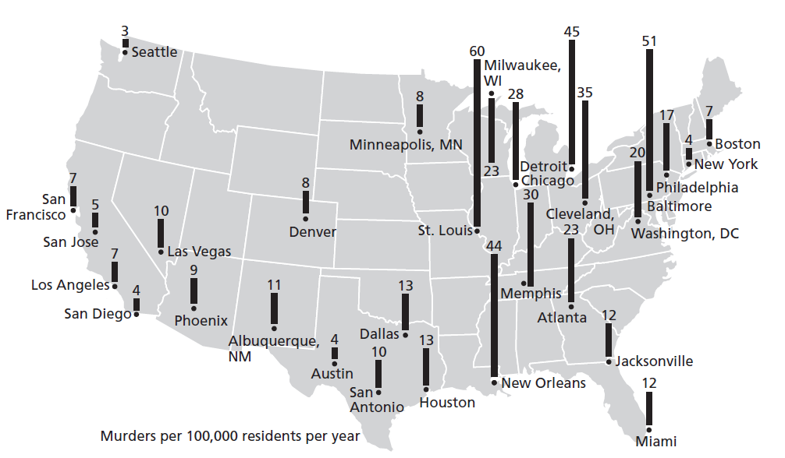
Figure 4.1 Murder Rates in Major Cities, United States, 2016

Slide 13
A victimological investigation of murders in the united states

Slide 14
Finding Commonalities among Murders
Data come from
  Profiles or statistical portraits
  Supplemental Homicide Reports (SHRs)
    Voluntarily completed by homicide detectives
    Victim’s race and age
    Accused’s race, motive, weapon and relationship to victim
  CDC’s National Violent Death Reporting System
    Death certificates
    The situation in which the murder occurred

Slide 15
Who Gets Killed by Whom? How, Where, and Why?
SHR provides details regarding
  Cause of death
    73% of deaths are from bullet wounds.
  Prior relationships between victims and killers
    56% of assailants are friends or acquaintances.
    48% of cases are classified as “unknown relationship.”
  Circumstances of the killing, or the “why”

Slide 16
Differential Risks: Who Faces the Greatest Risk of Being Murdered?
Demographic factors affecting murder rates include
  Gender
    79% of victims were men.
  Age
    62% were between the ages of 16 and 40.
  Race or ethnicity
    52% were black; 44% were white; 3% were “other.”
  Financial status
    Most murders are poor-on-poor crimes.

Slide 17
Discussion Question 2
Many critics argue that poverty rates are down, so crime rates should be as well. Why do you think crime rates do not drop as quickly as poverty rates?

Slide 18
Near-Death Experiences: Trends in Aggravated Assault Rates
Felonious assaults outnumber murders, rapes, and robberies
Result in serious wounds or involve attacks with a deadly weapon
  Many may have been attempted murders
Differential risks of being attacked
  At greatest risk are Latinos living in low-income households in urban areas.
  At least risk are elderly, married, middle-class white women living in rural areas.

Slide 19
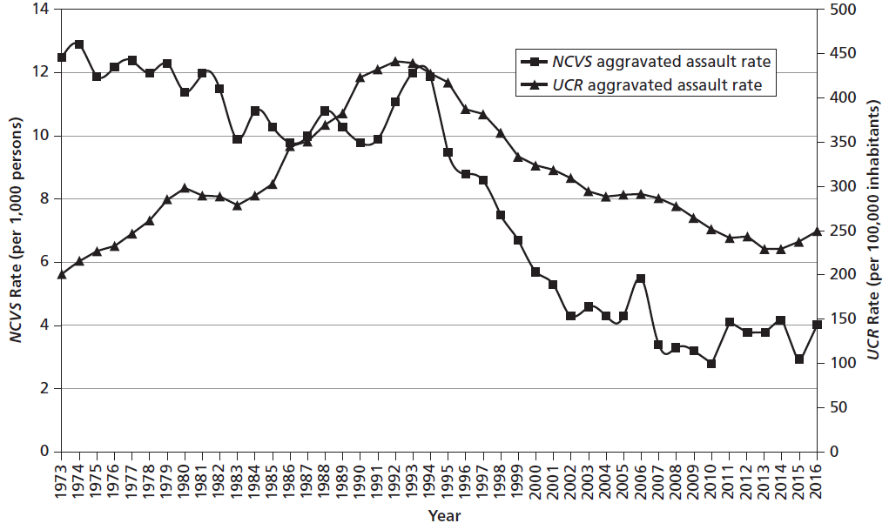
Figure 4.2 Trends in Aggravated Assaults, United States, 1973-2016

Slide 20
Focusing on robberies

Slide 21
Robbers and the People They Prey Upon
Face-to-face confrontations in which perpetrators take something of value directly from victims against their will by either force or by threats of violence
Armed robberies are more serious than strong-arm robberies, muggings, or yokings.

Slide 22
Robberies: Who, How Often, How, Where, and When
NCVS provides information to answer these questions.
  370,000 people were robbed in 2013.
    17% were armed.
    45% were victimized by complete strangers.
    67% reported experiences to police.
  Primary motive is theft.
    27% of attempts unsuccessful
  Few robbery victims are physically harmed.
    40% suffer injuries, few seriously

Slide 23
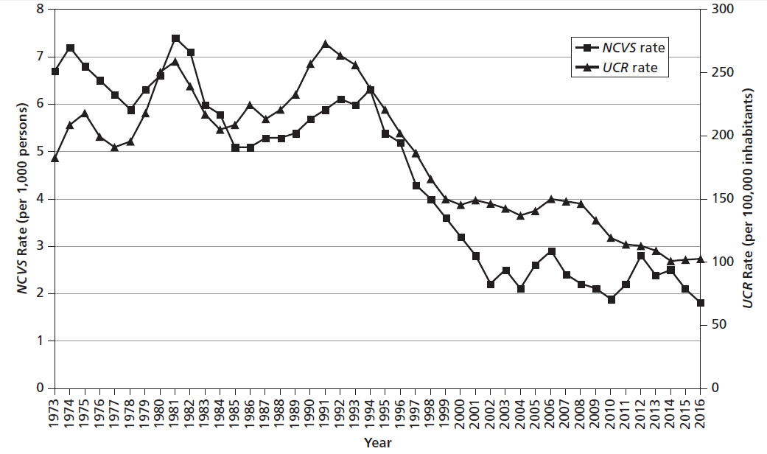
Figure 4.3 Trends in Robberies, United States, 1973-2016

Slide 24
Checking Out Whether More Robberies Are Turning Into Murders
Your Money or Your Life
  Murders where robbery was motive decreased from 2,500 in 1980 to 600 in 2015.
  About 1/10 of 1% of those accosted are murdered.
Table 4.3 Yearly Estimates of Murders Committed during Robberies, 1980, 1990, 2000, 2010, 2015
 | 1980 | 1990 | 2000 | 2010 | 2015
Number of persons murdered (from the UCR) | 23,040 | 23,438 | 15,586 | 14,748 | 13,455
Number of persons murdered during a robbery (from the UCR) | 2,488 | 2,156 | 1,077 | 780 | 595
Total number of robbery victims (from the NCVS) | 1,179,000 | 1,150,000 | 732,000 | 480,750 | 579,000
Murdered victims as a percentage of all robbery victims | 0.21% | 0.19% | 0.15% | 0.16% | 0.10%
SOURCES: FBI’s UCR, 1980, 1990, 2000, 2010, 2015; BJS’s NCVS, 1980, 1990, 2000, 2010, 2015.

Slide 25
Differential Risks: Which Groups Get Robbed the Most and the Least Often?
NCVS data show that robbery victims are likely
  Male
  Of minority status
  Between 21 and 34 years old
  Single

Slide 26
Focusing on burglaries

Slide 27
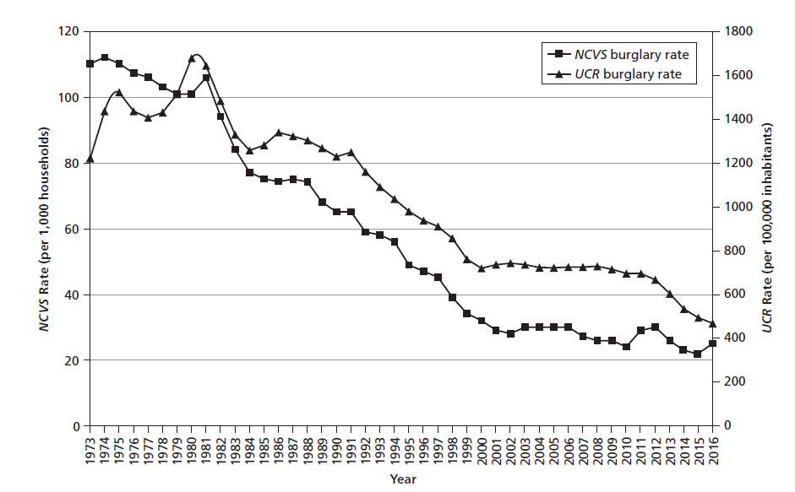
Figure 4.4 Trends in Burglaries, United States, 1973-2016

Slide 28
Differential Risks: Whose Homes Are More Likely to Be Burglarized?
At highest risk are low-income, black families with many members, living in rural areas
Burglars show preference for
  Single-family homes
  Weekdays when no one is home
  Familiar, convenient targets

Slide 29
Discussion Question 3
Recently, 10 gang members burglarized homes of several celebrities. The burglars knew the homes would be empty because the residents were out of town. Has social media made burglaries easier?

Slide 30
Focusing on Motor vehicle theft

Slide 31
Stealing Cars for Fun and Profit
NCVS indicates that “grand theft auto” is the crime most often reported to police.
Sometimes called a “happy crime” assuming
  Victims receive insurance money
  Thief makes money
  Car dealerships make new sales
Most owners are actually distraught
  Devote time and energy into car maintenance
  Feel violated and insecure following a theft
  May have a large deductible or no theft coverage

Slide 32
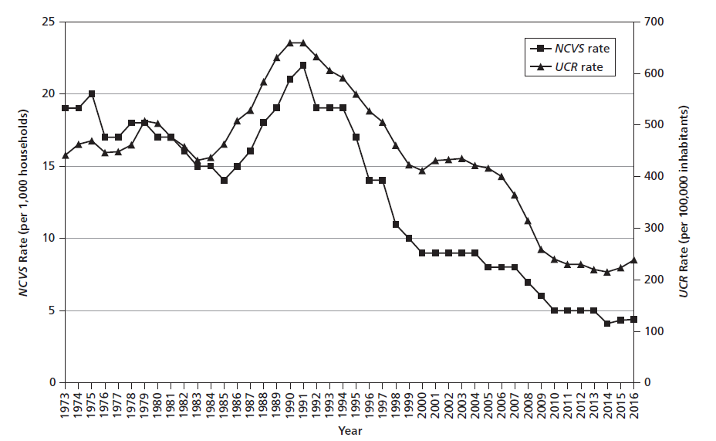
Figure 4.5 Trends in Motor Vehicle Thefts, United States, 1973-2016

Slide 33
Differential Risks: Which Motorists Should Be Most Concerned When Parking?
Chances of losing a car depend on
  Make, model, and year
    Even split between foreign and domestic manufacturers
    Most are older models without smartkeys
    Desirability varies by region (e.g., pickups in Texas)
  Black-market value of the car or its parts
  Antitheft device effectiveness
  Where the car is parked

Slide 34
Differential Risks: Motorcycles and Boats
Motorcycle theft
  Began rising in 2000 with the black market
  Hondas are stolen most often
  California and Florida
  Summer months
Boat theft
  Increased in 2016
  Smaller motorboats are stolen most often
  Florida
  Summer months
  When boats are on land

Slide 35
Predicting the Chances of Becoming a Victim Someday: Projecting Cumulative Risks
Annual victimization rates represent rare events.
Lifetime likelihoods represent cumulative risks over 60 years.
  30% of people will be robbed.
  8% of women will be raped.
  75% of people will be assaulted.
  70% of households will be burglarized.
  20% of people will experience car theft.
Rates are variable; may increase or decrease based on the crime rates over the next 40 years.

