Slide 1

CHAPTER 1
AN INTRODUCTION TO SOCIOLOGY

Slide 2
OBJECTIVEsS
What is Sociology
The History of Sociology
Theoretical Perspectives
Why Study Sociology

Slide 3
What Is Sociology?
SOCIOLOGY
SOCIETY STUDY OF
The systematic study of groups and groups interactions, societies and social interactions, from small and personal groups to very large groups.
Society is a group of people who live in a defined geographical area, who interact with one another, an who share a common culture.
https://www.youtube.com/watch?v=bZYq_r4VXuA

Slide 4
Sociology and
the Social Sciences
Science: Body of knowledge obtained by methods based on systematic observation
  Natural science: Study of physical features of nature and the ways they interact and change
  Social science: Study of social features of humans and the ways they interact and change

Slide 5
The Sociological
Imagination
C. Wright Mills describes sociological imagination as an awareness of the relationship between a person’s behavior and experience and the wider culture that shaped the person’s choices and perceptions.
https://www.youtube.com/watch?v=BINK6r1Wy78

Slide 6
The Development
of Sociology
European theorists in the 19th century made pioneering contributions to the development of the science of human behavior.
  Renaissance Era (1400-1600)
  Age of the Enlightment (18th Century)
  Industrial Revolution (early 19th century)
  Colonalism

Slide 7
ON MY SOCIOLOGICAL TRIP TO EUROPE I MEET:
FRANCE
  Auguste Comte (1798-1857)
    Systematic investigation of behavior
    needed to improve society
    Coined term “sociology
  Emile Durkheim
    Considered the Father of Sociology
    Applied empirical research
    Suicide Study – protestants, unmarried and soldiers were likl

Slide 8
ON MY SOCIOLOGICAL TRIP TO EUROPE I MEET:
GERMANY
  Karl Marx (1818-1883)
Society divided between two classes (bourgeois & proletariats) that clash in pursuit of interests
Chief problem facing modern society is the struggle of individuals to reproduce themselves materially
Known for his political views & Conflict Theory
  Max Weber (1864-1920)
To comprehend behavior, one must learn subjective meaning people attach to actions
Goal oriented (purposeful) vs value-oriented (emotional)
George Simmel
Focused on society as a web patterns
Considered group size in social interaction

Slide 9
ON MY SOCIOLOGICAL TRIP TO EUROPE I MEET:
ENGLAND
  Harriet Martineau (1802–1876)
    Studied social behavior in Britain and U.S.
    Emphasized impact of economy, law, trade, health, and population on social problem
  Herbert Spencer (1820-1903)
    Studied evolution change in society
    Was influenced by Charles Darwin

Slide 10

Major Theoretical Perspectives
Functionalist perspective
Conflict perspective
Interactionist perspective

Slide 11
THEORY
A way in to explain different aspects of social interactions about our society. Theories vary depending on the scale of the issue: If the issue is based on an individual or small group, it’s Microsological. If the issue is based on larged scaled or large group, it’s Macrosological.
3 different viewpoints – there is no right or wrong one.

Slide 12
Functionalist Perspective
Emphasizes the way parts of a society are structured to maintain its stability. This theory is macrosociological.
  Manifest Function – Anticipated
  Latent Function - Unintended
https://www.youtube.com/watch?v=5jOZqVnQmdY

Slide 13
Conflict Perspective
The way inequalities contribute to social differences and perpetuate differences in power. This theory is macrosociological.
https://www.youtube.com/watch?v=d_c2p0Y7mgU

Slide 14
Interactionist Perspective
Focuses on one-to-one interactions and communications This theory is microsociological.
https://www.youtube.com/watch?v=jFQIIM8IRZU

Slide 15
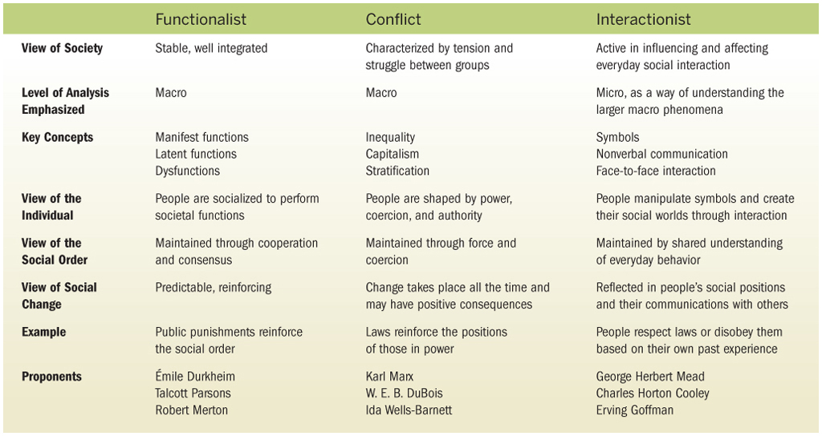
Table 1-2: Major Sociological Perspectives

Slide 16
Why study sociology?
Beneficial for the individual and society
People learn to think critically about social issues and problems that confront our society
Prepares our students for the careers
Make them more informed about social issues as our society continue to become diverse.

