Slide 1
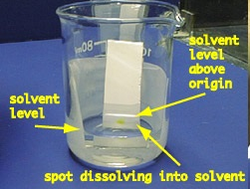
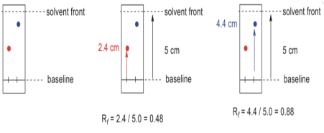
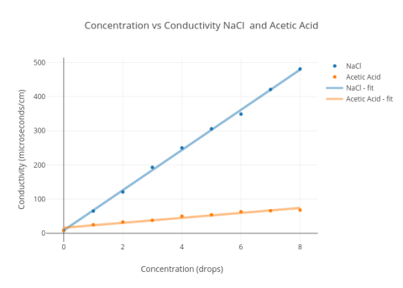
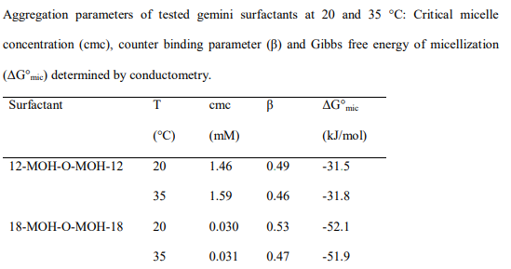
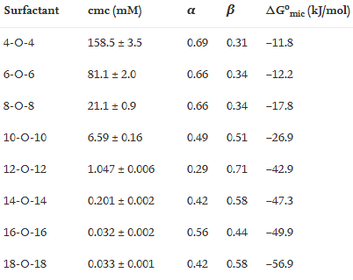
Chemistry Poster
Name
Affiliation
Date
Background
Stereochemistry is a branch under chemistry which is responsible for 3- dimensional arrangements in atom space. By conducting the following experiments of Resolution of enantiomers and preparation of Bis-Oxalamides you will be able to understand fully the properties of enantiomers and diastereomers, solvent and compound polarities and also the retention factor (Rf) values.
References
Nasipuri, D. (1994). Stereochemistry of organic compounds: principles and applications. New Age International.
Eliel, E. L., & Wilen, S. H. (1994). Stereochemistry of organic compounds. John Wiley & Sons.
Aims
The general / specific aims of this experiment is to provide us with the following laboratory skills
Filtration techniques, Seeding crystalation, Fractional crystallisation, Thin-Layer chromatography and Use of separating funnel.
Results
TLC Plate ananlysis
To the right the reaction of amine (racism) and bis-oxalimide gives the combination of diastereoisomers and the three-compound eyes.
Third set, the reaction of chiral amine and oxalimide gives two diastereoisomers, two spots of equal strength.
Discussion
The calculation of ΔG ° mI CMC for surfactants, determined in different ways, is different. According to our data, the formation of interchangeable micelle is the transformation of liquid liquids into a collection of small water systems. Micelles and fluid fluid fluctuations are similar to the jacket and its membrane. 100 years of studying jackets and only reading lining.ic (with errors) from CMC and Q / N to a well-to-do person
When changing the chain length and counterion of a surfactant, it changes the CMC, Q/N and ΔG°_{mic} as shown below
Conclusions and Outlook
Separation of racemates into enantiomers of their material is a process called remodeling. Reversing the initial reaction and then leading to isolated enantiomers and the recovered reagent.
A mixture of enantiomers can contain two isomers of a molecule with a single chiral center. After adding a second chiral center to the fixed area, the two isomers are no longer different, but are no longer mirror images of each other; rather, they became perverts.
It is through this experiment that we were able to clearly understand the simple techniques like ffiltration techniques, seeding crystalation, fractional crystallisation, thin-layer chromatography and use of separating funnel.
References
Nasipuri, D. (1994). Stereochemistry of organic compounds: principles and applications. New Age International.
Eliel, E. L., & Wilen, S. H. (1994). Stereochemistry of organic compounds. John Wiley & Sons.
Sherma, J. (2000). Thin-layer chromatography in food and agricultural analysis. Journal of Chromatography A, 880(1-2), 129-147.

