Slide 1
COOKING.
Art of making food.
Notes:
Welcome to today’s presentation, we are going to talk more about making food and all what it takes to make food. Cooking is dated back to the early ages where when the practice began. We shall see what are the main requirements needed for cooking.

Slide 2
Definition.
It is an art, technology and science of preparing food for consumption.
Takes places at home and in restaurants by chefs.
It is preparation of different ingredients through heat which may be from different sources.
New trends in cooking have taken place.
Notes:
Cooking since the old time period can be as an art since it requires creativity and knowledge about mixing different ingredients to make food. People have different skills in cooking and every other person aims at improving their own skills either at living places or done professionally by chefs in different restaurant. New advancements have however taken place in the field of coockery.

Slide 3
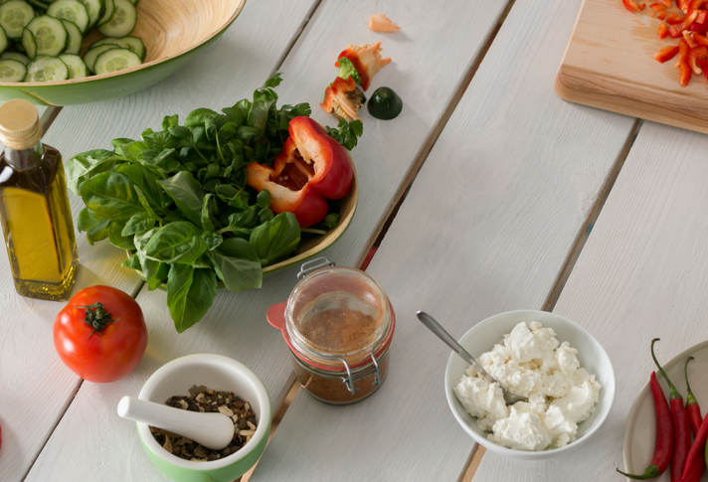
Ingredients.
Water.
Proteins.
Carbohydrates.
Vitamins
Fats.
Notes:
Cooking being an art involves cautiously choosing which type of food to use as ingredient before cooking. Different ingredients however must comprise of all the groups that comprise a balanced diet so as to promote healthy eating habits. The person cooking must determine the quantity to which depending on the amount of people who are to consume the food. Water however is an essential component of cooking process both as an ingredient and also to ensure cleaniliness and hygiene of the process.

Slide 4
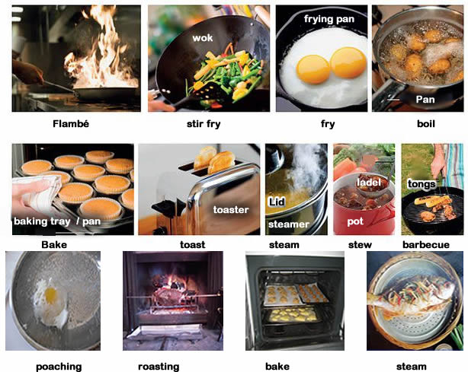
Methods.
Baking.
Roasting.
Boiling.
Frying
Steaming.
Notes:
Different methods can be used for cooking depending on the ingredients being used. All the methods however will also depend on the time available and skills of the cook. Vegetables require less heat so steaming is preferable while cereals will need to undergo boiling first. The method used however will determine the quality of food prepared, best method must be chosen for the best food.

Slide 5
Importance.
Cooking promotes healthy living.
It is a hobby for some hence its entertaining.
Source of employment.
Promotes creativity and innovation.
Notes:
Cooking has different benefits to both the consumers of cooking process and the cooks themselves. Heating has been proved to kill many disease causing bacteria and hence promoting health among individuals. Apart from the health benefits, cooking has been a source of revenue through employment and income from restaurants. Chefs also have an opportunity to come up with different recipes hence promoting innovation in the cooking field.

Slide 6
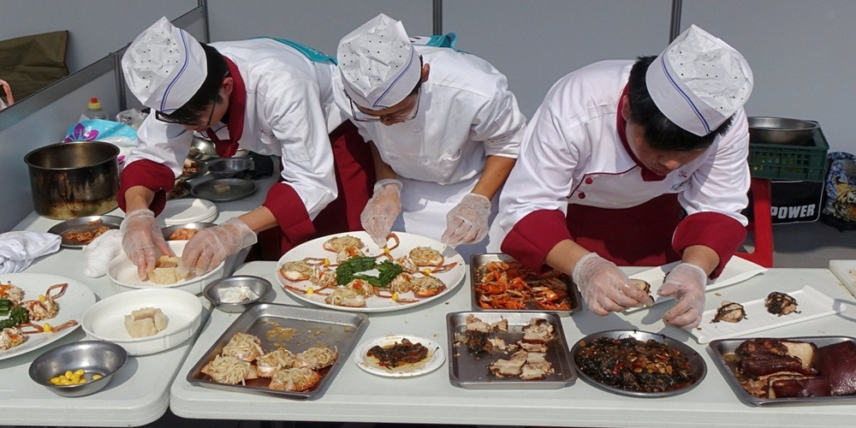
Trends in cooking.
Cooking competitions/games.
Advanced cooking equipment.
Introduction of new recipes.
Food safety issues.
Commercial cooking
Notes:
There has been new changes and mostly improvements in the field of cooking. These trends have made cooking even more interesting and attractive to newbies. There is introduction of cooking competitions and games where different participants cook their recipes aiming to please the judges to win prizes that have been set. New cooking methods and equipments have been introduced with the improvement in technology, they include microwaves among others. It has also become very important to observe health eating habits due to increased food related diseases. Restaurants have also improved their cooking standards to cook more and meet the demand of the customers.

