Slide 1
Covid-19
Student’s Name
Institution
Date

Slide 2
Background Information etiology
Coronavirus disease is an infectious disease that gets caused by a coronavirus.
The virus that causes COVID-19 normally gets transmitted through droplets from an infected person.
Cough exhales and sneezes from an infected person transmits COVID-19 to another party (MacIntyre, 2020).
Covid-19 can get prevented through maintaining social distance, washing hands with alcohol based detergents and wearing mask.

Slide 3
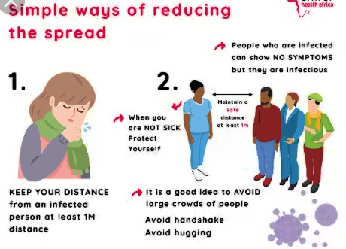
Ways of reducing spread of Covid-19

Slide 4
Background information etiology
The Coronavirus Study Group designated the coronaviral as severe acute respiratory syndrome coronavirus 2 based on phylogeny and taxonomy.
World Health Organization named the disease caused by SARS-COV 2 as COVID-19 (World Health Organization, 2020).
It is believed that bats might have initially hosted COVID-19 which then got transmitted to humans via pangolins sold at Huanan market.
Spike protein is encoded by coronaviral genome that binds to angiotensin to convert enzyme 2 receptor.

Slide 5
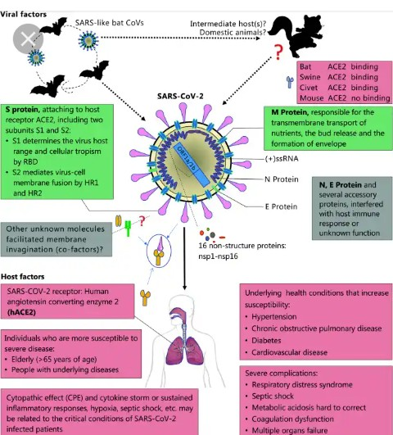

Slide 6
Pathogenesis signs and symptoms
Most people attacked by Covid-19 experiences signs and symptoms such as;
-Fever -Breathing difficulties -Vomiting
-Dry cough -Conjuncvitis (Pink eye) -Reduced body size
-Tiredness -Low appetite -Dyspnea
-Radiographic evidence of pneumonia
Frequent coughs get done by people who have contracted Covid-19 from others.
Patients become weak and often complain of pain around different parts of the body.

Slide 7
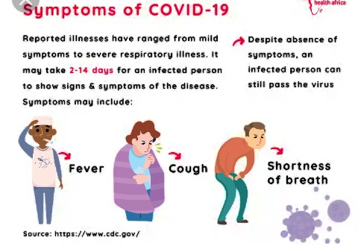
Symptoms of COVID-19

Slide 8
Diagnosis treatment options
According to US National Institute of Health, the use of corticosteroid dexamethasone can get used to treat people. They get used on patients with severe Covid-19.
Also, the use of casirivimab and imdevimab can get used to treat people at higher risk of serious illnesses (Salem, 2020). People living in nursing homes or prisons needs to get treated.
The FDA approved the use of Veklury to treat Covid-19 patients in hospitals. Outpatients can get the dose of Veklury to increase antibodies influence of fighting Covid-19.

Slide 9
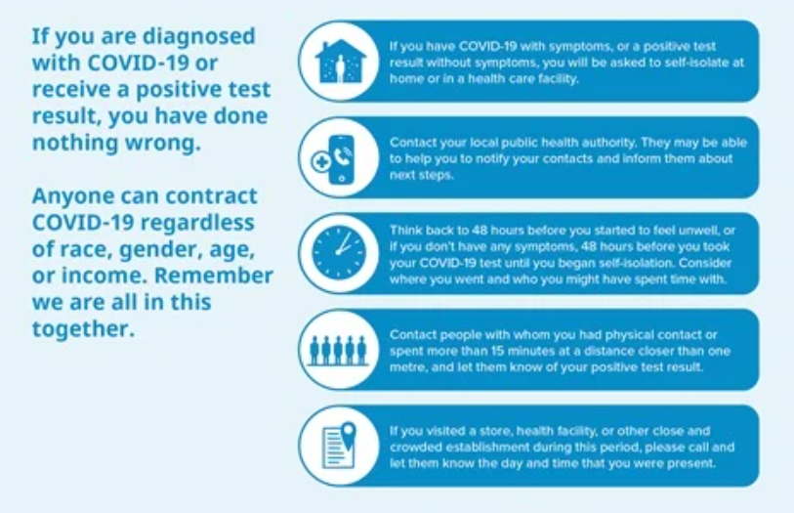
What to do should you get diagnosed with COVID 19
Here is a simple guideline of what to do:

Slide 10
Diagnosis of the disease
The use of Covid-19 maps
The US government uses Covid-19 maps to track hot spots and vaccine rollout. Covid-19 map shows the areas that contain high spread of the disease. Forecasts can get done and help the government track vaccine rates within every state.
Mayo Clinic News Network
Mayo Clinic is influential in tracking Covid-19 diseases spread within the states in US. The locations in which people get screened would get tracked to assist understand the number of treatments made. The tests made would get used to understand the diagnosis of treatment.

Slide 11
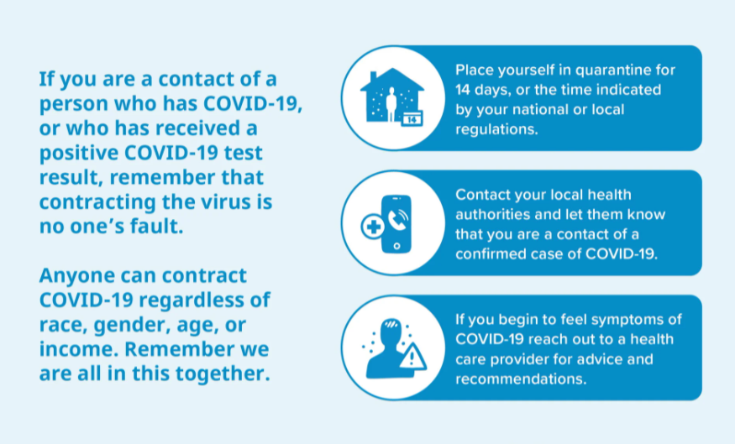
Diagnosis of the disease con’t
Just for emphasis, here is what one should do if result turns positive;

Slide 12
References
MacIntyre, C. R. (2020). The global spread of THE COVID-19 and pandemic potential. Global Biosecurity, 1(3).
Salem, M. (2020). The Impact of the COVID-19 Pandemic. GET, 15(1), 23–23.
World Health Organization. (2020). Infection prevention and control health-care facility response for COVID-19: a module from the suite of health service capacity assessments in the context of the COVID-19 pandemic: interim guidance, 20 October 2020 (No. WHO/2019-nCoV/HCF_assessment/IPC/2020.1). World Health Organization.

