Slide 1
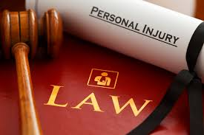
CRIMINAL LAWS
Voluntary Acts

Slide 2
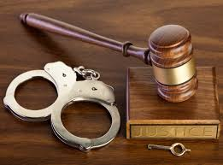
DEFINITION
Criminal Law- is a body of laws that is related to crime and enacted by the legislature and established by legislature (Kadish, 2016).
Voluntary acts- it is an act that has been committed by a conscious mind and causes harm.
Actus Reus- is one of the elements of a crime occurrence which refers to the requirement that a defendant to have committed a voluntary act.
Notes:
A voluntary act is a crime that is committed by conscious choice and independent will. For an act to be a crime to has to be voluntary, which means for a person to be a criminal, the act should be done by a conscious mind. The choice made from the subconscious mind should be through deliberation as long as the person is capable of exercise the requirement of the law.

Slide 3
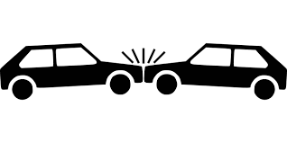
ACCIDENTS
An accident can be either a voluntary act are involuntary. It depends on the act being committed by a person who is in conscious mind or not.
An accident becomes a voluntary act when it is thought of and performed by conscious person.
It becomes involuntary act when is performed by unconscious mind.
Notes:
Many uncertainties are bound to happen without that a person may not be aware of. For instance, an accident is an uncertainty that may happen without planning it (Iyer, 2016). For example, a person with a history of blackouts and seizures accidentally passes out and harms another person. The person may be held responsible for the harm caused if, the court finds out that there was a way that harm could be prevented.

Slide 4
CASE STUDY
Leonard Martin a 13 year old, visiting younger brothers of George, the appellant, was ‘accidently’ shot after he refused to give the appellant a dollar.
The discharged at Martin’s face causing a face injury.
The Appellant denied ever pulling the trigger on Martin’s face claiming it was an accident.
Notes:
The appellant took Martin to a neighbor asking aid but was denied, later on, the ambulance was summoned. The act was voluntary since he knew he was pulling a loaded gun.

Slide 5
REASONS
The court charged the jury with respect to offense of having a loaded gun and not being responsible for it.
Is not presumed that the appellant mental state was considered conscious.
Te act was voluntary act and the appellant was found guilty.
Notes:
The act was either, intentionally, recklessly, and knowingly, which causes bodily injury by shooting him with a handgun. The evidence found supported the act to be a defensive issue of the accident and later was transformed to be as a defense of involuntary conduct. Despite being an accident, Martin received justice after his killer was found guilty.

Slide 6
SLEEPWALKING
An act committed by a sleepwalker is not a crime (Howell, 2015).
A sleepwalker is not considered a criminal any harm is committed.
A sleepwalker at that time is unconscious hence cannot control the activities around.
Notes:
In this case, acts that are committed during sleepwalking are involuntary because the person is in unconscious mind. Acts that are committed by the indifference to human life are voluntary acts even though they are as a result of independent will. There is no way that a sleep walkker could prevenet an event from occurring.

Slide 7
INTOXICATION
Intoxication is a process where a person losses control of their behaviour under drug or alcohol induced.
A person who is intoxicated and passes out and causes harm, not escaping a liability of any criminal acts
The person is aware of the law of drinking and driving.
Notes:
The act is considered voluntary since the person was aware of the drinking and driving rule. The intoxicated person is considered a criminal after harm is caused. The person was conscious of using drugs and alcohol, so the person should take responsibility for any actions done.

Slide 8
SUMMARY
Voluntary acts are made by choices made by a conscious mind.
Criminal law involves punishing and rehabilitating those people who have violated laws .
A criminal requires Actus Reus to be a voluntary act committed by a conscious mind.
Notes:
Acts that a person have no mental or physical control is considered involuntary since no conscious choice was made. Every person is obligated to follow the law and be responsible for their acts. They should also anticipate the consequences that may arise from a particular behavior. If a person slips from the mountain and hits someone unintentionally, the act becomes voluntary. The theory possible is that, there was a way of preventing the accident and be involuntary act if there was no way of preventing the act.

Slide 9

CONCLUSION
Involuntary acts are not the same as acts from acts that result from duress.
People being punished for their behaviour of not having free will means criminal law is not served.
Law protects individuals that succumb to coercion.
Notes:
Crimes committed under duress are considered voluntary. The reason is the act is done under the cost-benefit analysis. Cost-benefit analysis is where the person weighs the consequences of doing the act and refusing to do the cat. For instance, an act is considered a voluntary act since, the person was aware about the seizures but was not responsible for them.

Slide 10
References
Howell, M. (2015). Darwin's predisposition and the restlessness that drives sleepwalking.
Iyer, G., & Singh, S. (2017). Voluntary product safety certification. Management Science, 64(2), 695-714.
Kadish, S. H., Schulhofer, S. J., & Barkow, R. E. (2016). Criminal law and its processes: Cases and materials. Wolters Kluwer Law & Business.

