Slide 1

Chapter 15
Forecasting
Operations Management, 2nd Edition
Gerard Cachon and Christian Terwiesch
15-1

Slide 2
Forecasting Can Be Hard…
“Those who have knowledge, don't predict. Those who predict, don't have knowledge." (Lao Tzu, 6th-century B.C. Chinese poet)
"The best qualification of a prophet is to have a good memory." (Marquis of Halifax)
"Prediction is very difficult, especially if it's about the future." (Niels Bohr, Nobel laureate in Physics)
"An unsophisticated forecaster uses statistics as a drunken man uses lampposts – for support rather than for illumination." (Andrew Lang)
“An economist is an expert who will know tomorrow why the things he predicted yesterday didn't happen today.“ (Evan Esar)
Notes:
#quotes

Slide 3
What is Forecasting?
Process of predicting a future event
Underlying basis
of all business decisions
  Production
  Inventory
  Personnel
  Facilities
??

Slide 4
Forecasting Framework
LO15-1
Forecasting – the process of creating statements about outcomes of variables that presently are uncertain and will only be realized in the future.
Demand forecasting – the process of creating statements about future realizations of demand.
15-4

Slide 5
Forecasting Provides a Competitive Advantage for Disney
Global portfolio includes parks in Hong Kong, Paris, Tokyo, Orlando, and Anaheim
Revenues are derived from people – how many visitors and how they spend their money
Daily management report contains only the forecast and actual attendance at each park
© 2014 Pearson Education, Inc.

Slide 6
Forecasting Provides a Competitive Advantage for Disney
Disney generates daily, weekly, monthly, annual, and 5-year forecasts
Forecast used by labor management, maintenance, operations, finance, and park scheduling
Forecast used to adjust opening times, rides, shows, staffing levels, and guests admitted
© 2014 Pearson Education, Inc.

Slide 7
Forecasting Provides a Competitive Advantage for Disney
20% of customers come from outside the USA
Economic model includes gross domestic product, cross-exchange rates, arrivals into the USA
A staff of 35 analysts and 70 field people survey 1 million park guests, employees, and travel professionals each year
© 2014 Pearson Education, Inc.

Slide 8
Forecasting Provides a Competitive Advantage for Disney
Inputs to the forecasting model include airline specials, Federal Reserve policies, Wall Street trends, vacation/holiday schedules for 3,000 school districts around the world
Average forecast error for the 5-year forecast is 5%
Average forecast error for annual forecasts is between 0% and 3%
© 2014 Pearson Education, Inc.

Slide 9
Forecasting Time Horizons
Short-range forecast
  Up to 1 year, generally less than 3 months
  Purchasing, job scheduling, workforce levels, job assignments, production levels
Medium-range forecast
  3 months to 3 years
  Sales and production planning, budgeting
Long-range forecast
  3⁺ years
  New product planning, facility location, research and development

Slide 10
Distinguishing Differences
Medium/long range forecasts deal with more comprehensive issues and support management decisions regarding planning and products, plants and processes
Short-term forecasting usually employs different methodologies than longer-term forecasting
Short-term forecasts tend to be more accurate than longer-term forecasts

Slide 11
Influence of Product Life Cycle
Introduction – Growth – Maturity – Decline
Introduction and growth require longer forecasts than maturity and decline
As product passes through life cycle, forecasts are useful in projecting
  Staffing levels
  Inventory levels
  Factory capacity

Slide 12
Product Life Cycle
Introduction Growth Maturity Decline
Best period to increase market share
R&D engineering is critical
Practical to change price or quality image
Strengthen niche
Poor time to change image, price, or quality
Competitive costs become critical
Defend market position
Cost control critical
Company Strategy/Issues
Internet search engines
Drive-through restaurants
Xbox 360
DVDs
iPods
Boeing 787
Sales
3D printers
3-D game players
Electric vehicles
Analog TVs
Figure 2.5

Slide 13
Product Life Cycle
Introduction Growth Maturity Decline
Product design and development critical
Frequent product and process design changes
Short production runs
High production costs
Limited models
Attention to quality
Forecasting critical
Product and process reliability
Competitive product improvements and options
Increase capacity
Shift toward product focus
Enhance distribution
Standardization
Fewer product changes, more minor changes
Optimum capacity
Increasing stability of process
Long prod runs
Product improvement and cost cutting
Little product differentiation
Cost minimization
Overcapacity in the industry
Prune line to eliminate items not returning good margin
Reduce capacity
OM Strategy/Issues
Figure 2.5

Slide 14
Types of Forecasts
Economic forecasts
  Address business cycle – inflation rate, money supply, housing starts, etc.
Technological forecasts
  Predict rate of technological progress
  Impacts development of new products
Demand forecasts
  Predict sales of existing products and services

Slide 15
Strategic Importance of Forecasting
Supply-Chain Management – Good supplier relations, advantages in product innovation, cost and speed to market
Human Resources – Hiring, training, laying off workers
Capacity – Capacity shortages can result in undependable delivery, loss of customers, loss of market share

Slide 16
Seven Steps in Forecasting
Determine the use of the forecast
Select the items to be forecasted
Determine the time horizon of the forecast
Select the forecasting model(s)
Gather the data needed to make the forecast
Make the forecast
Validate and implement results

Slide 17
The Realities!
Forecasts are seldom perfect, unpredictable outside factors may impact the forecast
Most techniques assume an underlying stability in the system
Product family and aggregated forecasts are more accurate than individual product forecasts

Slide 18
Types of Forecasting Models
Qualitative methods:
    Forecasts generated subjectively by the forecaster
Quantitative methods:
    Forecasts generated through mathematical modeling
15-5

Slide 19
Forecasting Approaches
Qualitative Methods
Used when situation is vague and little data exist
  New products
  New technology
Involves intuition, experience
  e.g., forecasting sales on Internet

Slide 20
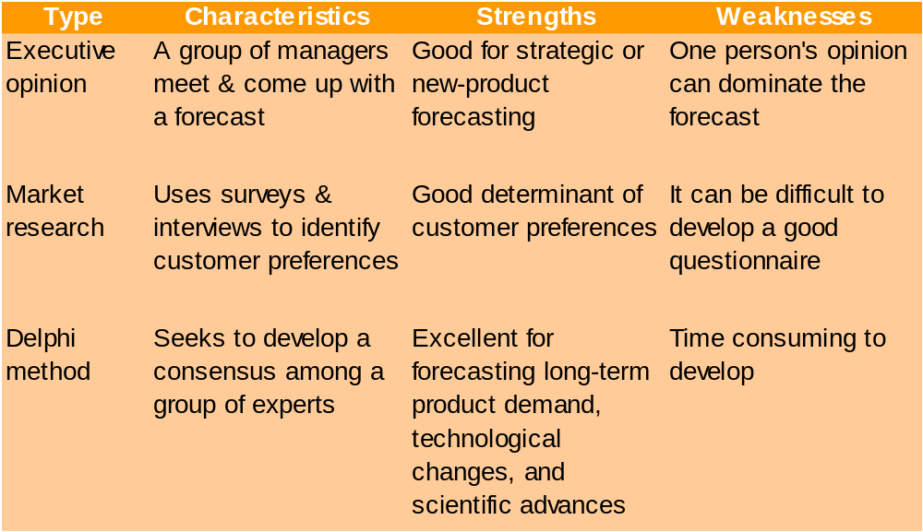
Qualitative Methods

Slide 21
Forecasting Approaches
Quantitative Methods
Used when situation is ‘stable’ and historical data exist
  Existing products
  Current technology
Involves mathematical techniques
  e.g., forecasting sales of color televisions

Slide 22
Quantitative Methods
Time Series Models:
    Assumes the future will follow same patterns as the past
Causal Models:
    Explores cause-and-effect relationships
    Uses leading indicators to predict the future
    E.g. housing starts and appliance sales

Slide 23
Overview of Qualitative Methods
Jury of executive opinion
  Pool opinions of high-level experts, sometimes augment by statistical models
Delphi method
  Panel of experts, queried iteratively

Slide 24
Overview of Qualitative Methods
Sales force composite
  Estimates from individual salespersons are reviewed for reasonableness, then aggregated
Market Survey
  Ask the customer

Slide 25

Jury of Executive Opinion
Involves small group of high-level experts and managers
Group estimates demand by working together
Combines managerial experience with statistical models
Relatively quick
‘Group-think’
disadvantage

Slide 26
Delphi Method
Iterative group process, continues until consensus is reached
3 types of participants
  Decision makers
  Staff
  Respondents
Decision Makers
(Evaluate responses and make decisions)
Staff
(Administering survey)
Respondents
(People who can make valuable judgments)

Slide 27
Sales Force Composite
Each salesperson projects his or her sales
Combined at district and national levels
Sales reps know customers’ wants
May be overly optimistic

Slide 28
Market Survey
Ask customers about purchasing plans
Useful for demand and product design and planning
What consumers say, and what they actually do may be different
May be overly optimistic

Slide 29
Overview of Quantitative Approaches
Naive approach
Moving averages
Exponential smoothing
Trend projection
Linear regression
Time-series models
Associative model

Slide 30
Time-Series Forecasting
Set of evenly spaced numerical data
  Obtained by observing response variable at regular time periods
Forecast based only on past values, no other variables important
  Assumes that factors influencing past and present will continue influence in future

Slide 31
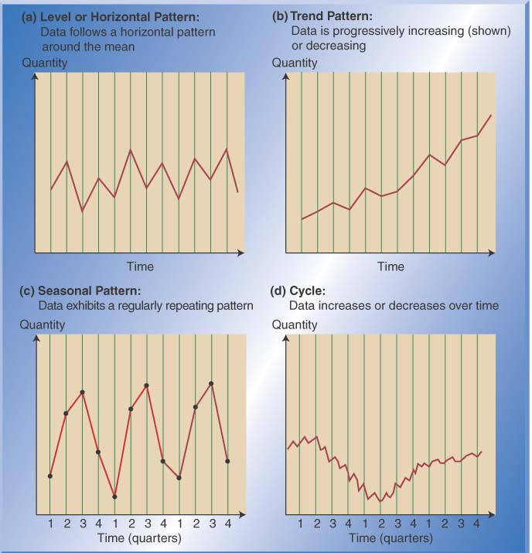
Time Series Patterns

Slide 32
Time-Series Components
Trend
Cyclical
Seasonal
Random

Slide 33
Components of Demand
Trend component
Seasonal peaks
Actual demand line
Demand for product or service
Average demand over 4 years
Random variation
| | | |
1 2 3 4
Time (years)
Figure 4.1

Slide 34
Trend Component
Persistent, overall upward or downward pattern
Changes due to population, technology, age, culture, etc.
Typically several years duration

Slide 35
Seasonal Component
Regular pattern of up and down fluctuations
Due to weather, customs, etc.
Occurs within a single year
PERIOD LENGTH | “SEASON” LENGTH | NUMBER OF “SEASONS” IN PATTERN
Week | Day | 7
Month | Week | 4 – 4.5
Month | Day | 28 – 31
Year | Quarter | 4
Year | Month | 12
Year | Week | 52

Slide 36
Cyclical Component
Repeating up and down movements
Affected by business cycle, political, and economic factors
Multiple years duration
Often causal or
associative
relationships
0 5 10 15 20

Slide 37
Random Component
Erratic, unsystematic, ‘residual’ fluctuations
Due to random variation or unforeseen events
Short duration
and nonrepeating
M T W T F

Slide 38

Naive Approach
Assumes demand in next
period is the same as
demand in most recent period
  e.g., If January sales were 68, then February sales will be 68
Sometimes cost effective and efficient
Can be good starting point
Danger of “old data”

Slide 39
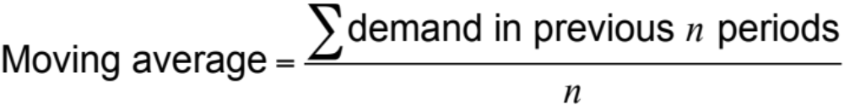
Moving Average Method
MA is a series of arithmetic means
Used if little or no trend
Used often for smoothing
  Provides overall impression of data over time

Slide 40
Moving Average Example
MONTH | ACTUAL SHED SALES | 3-MONTH MOVING AVERAGE
January | 10
February | 12
March | 13
April | 16
May | 19
June | 23
July | 26
August | 30
September | 28
October | 18
November | 16
December | 14
10
12
13
(10 + 12 + 13)/3 = 11 ²/₃
(12 + 13 + 16)/3 = 13 ²/₃
(13 + 16 + 19)/3 = 16
(16 + 19 + 23)/3 = 19 ¹/₃
(19 + 23 + 26)/3 = 22 ²/₃
(23 + 26 + 30)/3 = 26 ¹/₃
(29 + 30 + 28)/3 = 28
(30 + 28 + 18)/3 = 25 ¹/₃
(28 + 18 + 16)/3 = 20 ²/₃

Slide 41
Simple Moving Average
Simple moving average = (P1 + P2 + P3 + P4 + ... + Pn) / n
N = number of periods
  Thus, if Jan forecast (in units) is 151K, Feb is 150K, March is 155K, Apr is 160K
    (P1, 151K + P2, 150K + P3, 155K + P4, 160K) / N)
So…. The May forecast will be 154K Units based on a SMA

Slide 42
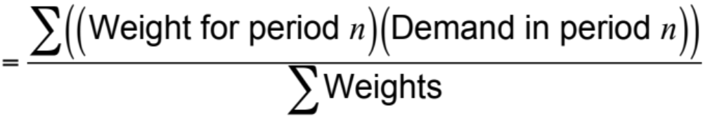
Weighted Moving Average
Used when some trend might be present
  Older data usually less important
Weights based on experience and intuition
Weighted moving average

Slide 43
Weighted Moving Average
MONTH | ACTUAL SHED SALES | 3-MONTH WEIGHTED MOVING AVERAGE
January | 10
February | 12
March | 13
April | 16
May | 19
June | 23
July | 26
August | 30
September | 28
October | 18
November | 16
December | 14
10
12
13
[(3 x 13) + (2 x 12) + (10)]/6 = 12 ¹/₆
[(3 x 16) + (2 x 13) + (12)]/6 = 14 ¹/₃
[(3 x 19) + (2 x 16) + (13)]/6 = 17
[(3 x 23) + (2 x 19) + (16)]/6 = 20 ¹/₂
[(3 x 26) + (2 x 23) + (19)]/6 = 23 ⁵/₆
[(3 x 30) + (2 x 26) + (23)]/6 = 27 ¹/₂
[(3 x 28) + (2 x 30) + (26)]/6 = 28 ¹/₃
[(3 x 18) + (2 x 28) + (30)]/6 = 23 ¹/₃
[(3 x 16) + (2 x 18) + (28)]/6 = 18 ²/₃

Slide 44
Weighted Moving Average
MONTH | ACTUAL SHED SALES | 3-MONTH WEIGHTED MOVING AVERAGE
January | 10
February | 12
March | 13
April | 16
May | 19
June | 23
July | 26
August | 30
September | 28
October | 18
November | 16
December | 14
10
12
13
[(3 x 13) + (2 x 12) + (10)]/6 = 12 ¹/₆
WEIGHTS APPLIED |  |  |  | PERIOD
 |  | 3 |  | Last month
 |  | 2 |  | Two months ago
 |  | 1 |  | Three months ago
 |  | 6 |  | Sum of the weights
Forecast for this month =
3 x Sales last mo. + 2 x Sales 2 mos. ago + 1 x Sales 3 mos. ago
 | Sum of the weights

Slide 45
Weighted Moving Average
Weighted moving average calculation
  Firms will assigns “weight” to a given period of time to use a determination of accuracy or reflection of normal business patterns
For instance, imagine that a firm says that they feel that the weight assignments for Jan is 4/10, Feb is 1/10, March is 3/10, April is 2/10.
The units that actually sold in a given period of time are as follows:
  Jan = 90 units
  Feb = 100 units
  Mar = 88 units
  April = 89 units
You would calculate this as ((90 x (4/10)) + (100 x (1/10)) + (88 x (3/10)) + (89 x (2/10)) = 36 + 10 + 26.4+ 17.8 = 90.2

Slide 46
Graph of Moving Averages
Weighted moving average
30 –
25 –
20 –
15 –
10 –
5 –
Sales demand
Actual sales
Moving average
| | | | | | | | | | | |
J F M A M J J A S O N D
Figure 4.2
Month

Slide 47
Potential Problems With
Moving Average
Increasing n smooths the forecast but makes it less sensitive to changes
Does not forecast trends well
Requires extensive historical data

Slide 48
Focus Forecasting
Developed at American Hardware Supply, based on two principles:
Sophisticated forecasting models are not always better than simple ones
There is no single technique that should be used for all products or services
Uses historical data to test multiple forecasting models for individual items
Forecasting model with the lowest error used to forecast the next demand

Slide 49
Forecasting in the Service Sector
Presents unusual challenges
  Special need for short term records
  Needs differ greatly as function of industry and product
  Holidays and other calendar events
  Unusual events

Slide 50
Fast Food Restaurant Forecast
20% –
15% –
10% –
5% –
Figure 4.12
Percentage of sales by hour of day
11-12 1-2 3-4 5-6 7-8 9-10
12-1 2-3 4-5 6-7 8-9 10-11
(Lunchtime)
(Dinnertime)
Hour of day

Slide 51
FedEx Call Center Forecast
12% –
10% –
8% –
6% –
4% –
2% –
0% –
Figure 4.12
2
4
6
8
10
12
2
4
6
8
10
12
A.M.
P.M.
Hour of day

