Slide 1
Concept Design
Physical principles, Materials, and Geometry.
Clarify the Functional requirements of design.
Explain and use of activity analysis.

Slide 2
Concept design is a phase of design of when alternative concepts are generated, evaluated, and selected for further development.
Physical design are the concepts of the application way and how to be applied in temporary satisfaction.
Materials are the requirements of tools for the concept design.
Geometry is the shape and relative arrangement of the parts of something.

Slide 3
Clarifying Functional Requirements:
It is the engineering design specification that provides information on customer and company requirements.
Ex: a company wants to see the needs of requirements which is a feature that the clarifying function can provide to achieve what the company is in need of to be developed.

Slide 4
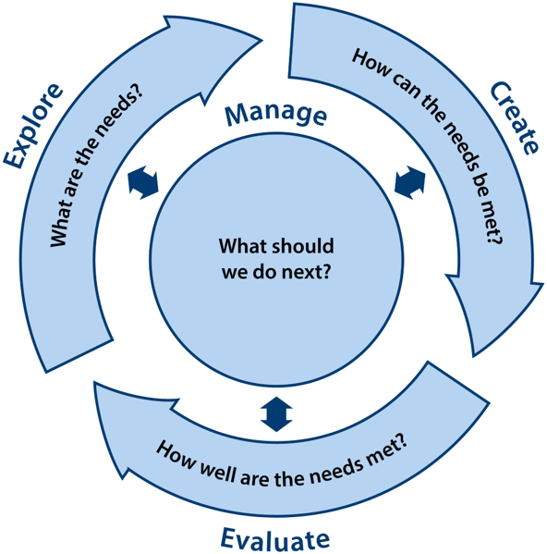

Slide 5
Explain The Activity Analysis:
Activity analysis can be used to learn how the customer will use the ultimately retire the product.
It also helps to show how long the product's use will be lived to be used by the customers.
Ex: The computers will live for 10 years, but will never work as the new ones of generations.

Slide 6
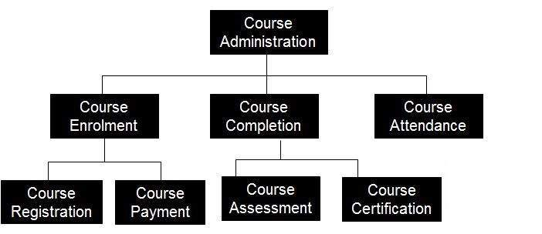
Function decomposition diagrams
Definition: It shows a high-level function, process, organization, data subject area, or other type of object broken down into lower level, more detailed components.

Slide 7
Generating alternative concepts
Identifying alternatives is an important part of decision making.
-It helps lay out the alternatives and determine the best ones to consider.
-There are often biases and errors in judgment .
It is important for a decision maker to receive plenty of input from other to avoid any bias.

Slide 8
Several methods, we might consider:
-Brainstorming is a one of good methods for identifying alternatives. By making lists of possible combinations of actions can generate ides which can be molded into alternatives. This method is best done by small group of people with different opinions, experiences, and knowledges.
-Synectics is a method that requires the problem solver to present the problem from four opinions which are analogy, fantasy, empathy, and inversion. Analogy stimulates idea creation, fantasy asks us to imagine the impossible, empathy asks us to imagine being a product, and how we would be perform each function, and inversion asks us to take an inverted.

Slide 9
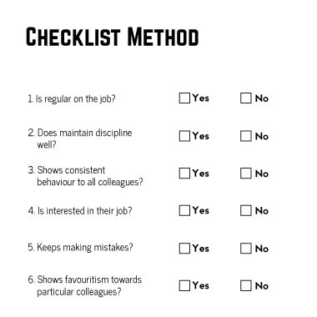
Method 6-3-5 is a refinement of the brainstorming method. Basically, it is a group of six members gather. Each members writes down three ideas on a sheet of paper. Each sheet is circulated to a neighbor. After reading the ideas, the neighbor writes three more ideas. The sheet of paper are circulated five times.
Checklist. Companies and individuals have prepared checklists that simulate creative thinking.

Slide 10


