Slide 1

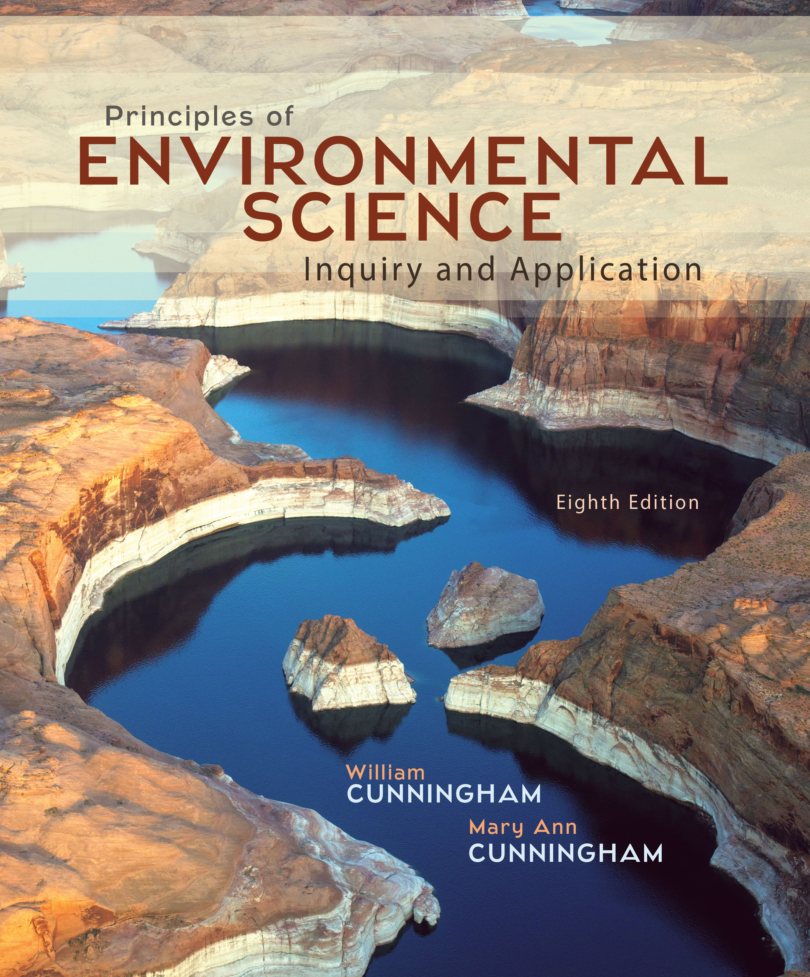
Chapter 5
Lecture
Outline

Slide 2
Learning Outcomes
After studying this chapter, you should be able to answer the following questions:
What are nine major terrestrial biomes and what
environmental conditions control their distribution?
How does vertical stratification differentiate life zones in oceans?
Why are coral reefs, mangroves, estuaries, and wetlands biologically important?
What do we mean by biodiversity? List several regions of high biodiversity.
What are major benefits of biodiversity?
What are the major human-caused threats to biodiversity?
How can we reduce these threats to biodiversity?

Slide 3
In the end, we conserve only what we love.
We will love only what we understand.
We will understand only what we are taught.
–Baba Dioum

Slide 4
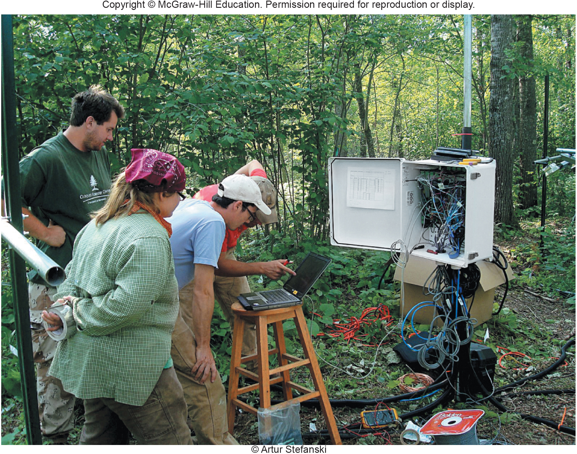
Forest Responses to
Global Warming (1)
Notes:
How will biological communities respond to climate change? This is one of the great unknowns in environmental science today. Will northern regions that now support boreal (northern) forest, for example, shift to another biome—hardwood forest, open savannah, grassland, or something entirely different? One approach is to use field tests in which mixtures of plants are grown in natural settings that include competition for resources, predator/prey interactions, natural climatic variations, and other ecological factors. Professor Peter Reich and his colleagues and student research assistants are now carrying out such a field study in a patch of boreal forest in Minnesota. Calling this experiment B4Warmed, which stands for Boreal Forest Warming at an Ecotone in Danger, they are artificially raising ambient temperatures in a series of boreal forest plots, to emulate warming climate conditions.
It’s too early to know exactly what the long-term effects of warming will be on the northern forest community. It seems likely that species, such as aspen, spruce, and birch, that are now at the southern edge of their range in the study area won’t do as well under a warmer climate as the temperate maple-oak forests now growing farther south. This study attempts to understand how climate changes may affect a broad biological community, or biome, and the species that make it up. The careful, systematic approach demonstrated here is a hallmark of science and a way to reveal those connections.
4

Slide 5
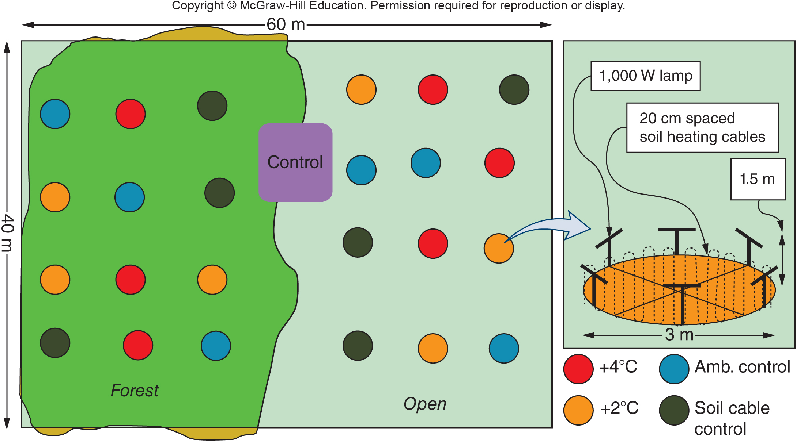
Forest Responses to
Global Warming (2)
Notes:
Experimental design for B4Warmed study.
5

Slide 6
5.1 Terrestrial Biomes (1)
We call large biological communities biomes.
If we know the range of temperature and precipitation in a particular place, we can generally predict what kind of biome is likely to occur there.
An important characteristic of each biome is its biodiversity, or the number and variety of different biological species that live there.
Notes:
As the B4Warmed study shows, the increasing temperatures and drier climate expected if we continue our current path toward global climate change are likely to bring dramatic transformations to the boreal forest along the Canadian border from Minnesota to Maine. To evaluate the potential effects of environmental changes, it’s useful to understand the patterns of plant and animal distribution that occur in various environmental conditions. We call large biological communities biomes. If we know the range of temperature and precipitation in a particular place, we can generally predict what kind of biome is likely to occur there, in the absence of human disturbance (fig. 5.3). An important characteristic of each biome is its biodiversity, or the number and variety of different biological species that live there.
6

Slide 7
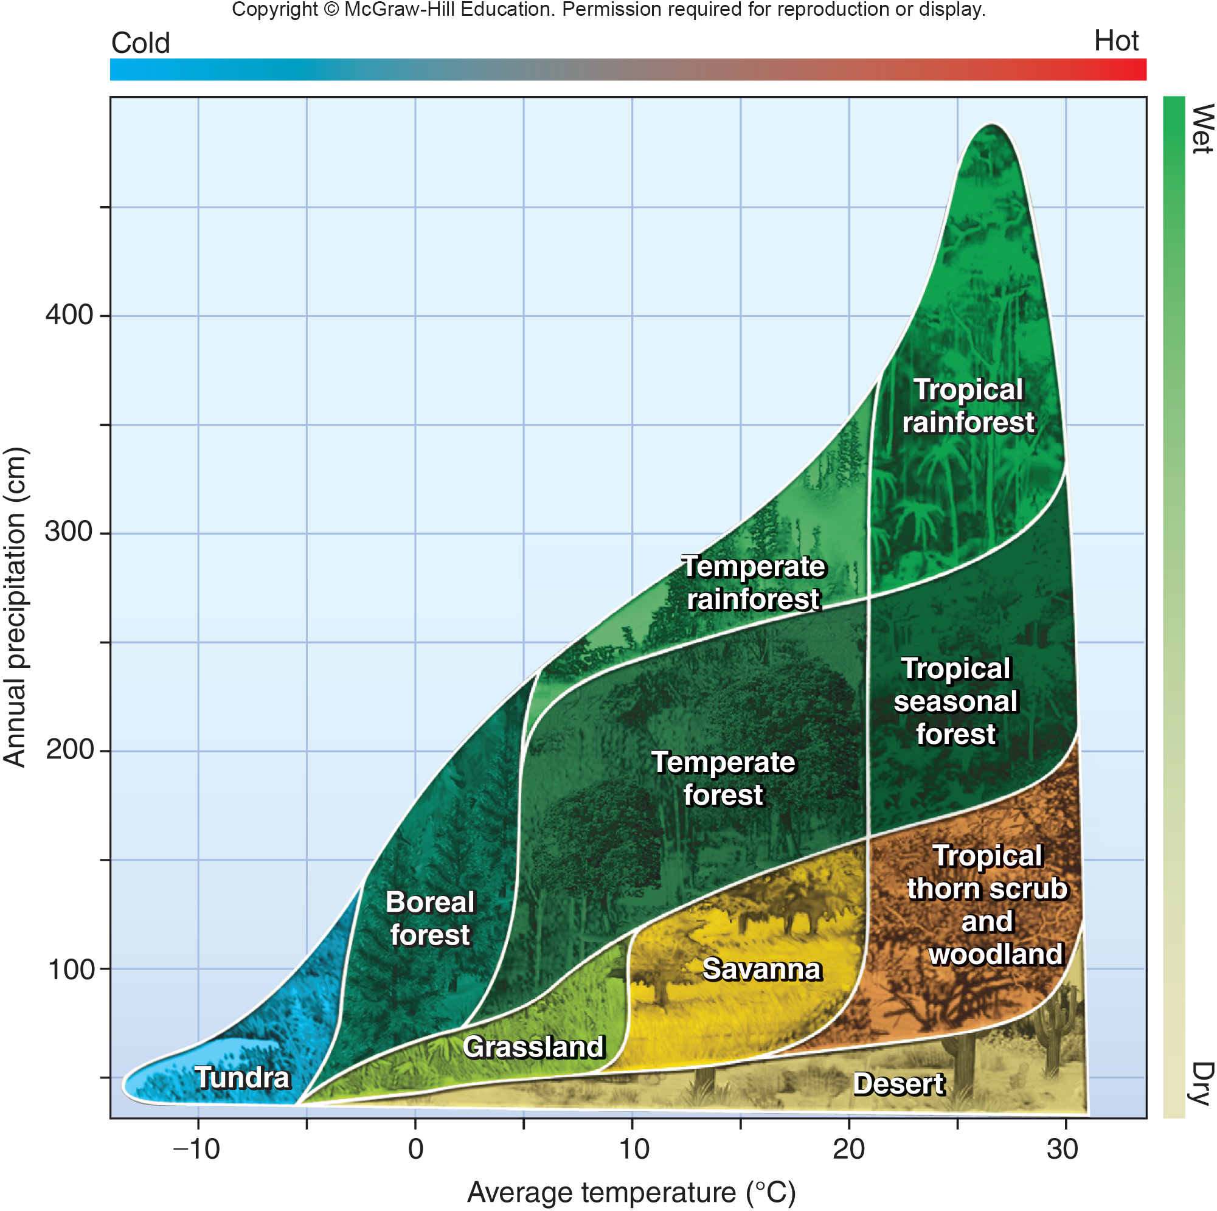
5.1 Terrestrial Biomes (2)
Biome type can be predicted based on the temperature and precipitation found in an area.
Notes:
Biomes most likely to occur in the absence of human disturbance or other disruptions, according to average annual temperature and precipitation. Note: This diagram does not consider soil type, topography, wind speed, or other important environmental factors. Still, it is a useful general guideline for biome location.
7

Slide 8
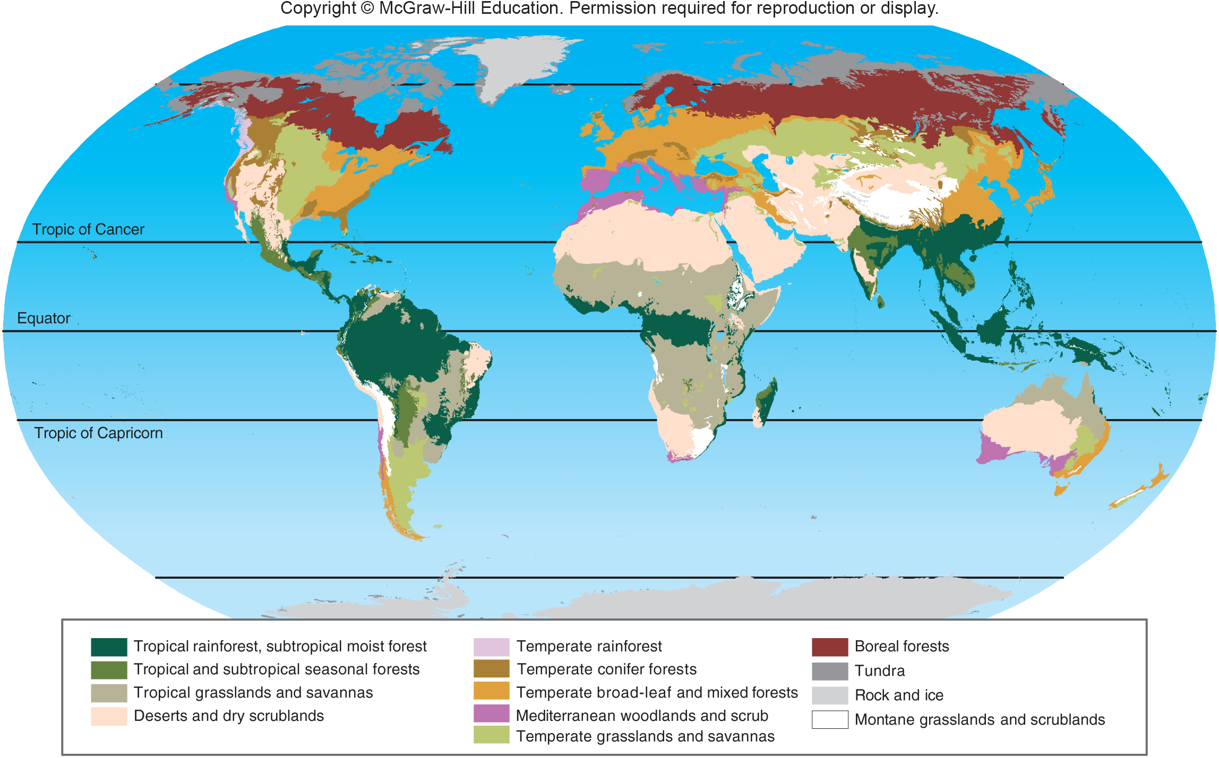
Map of Major World Biomes
Notes:
Compare this map with figure 5.3 for generalized temperature and moisture conditions that control biome distribution. Also compare it with the satellite image of biological productivity (fig. 5.15).
8

Slide 9
Biomes Vary with Latitude
Many temperature-controlled biomes occur in latitudinal bands.
A band of boreal (northern) forest crosses Canada and Siberia.
Tropical forests occur near the equator.
Expansive grasslands lie near—or just beyond—the tropics.
Many biomes are even named for their latitudes: like tropical rainforests or arctic tundra.
Notes:
Some biomes are named for their latitudes: tropical rainforests occur between the Tropic of Cancer (23° north) and the Tropic of Capricorn (23° south); arctic tundra lies near or above the Arctic Circle (66.6° north).
9

Slide 10
Vertical Zonation (1)
Temperature and precipitation change with elevation as well as with latitude.
In mountainous regions, temperatures are cooler and precipitation is usually greater at high elevations.
Mountains are cooler and often wetter, than low elevations.
Vertical zonation is the term applied to vegetation zones which are defined by altitude.
Notes:
A 100 km transect from California’s Central Valley up to Mount Whitney, for example, crosses as many vegetation zones as you would find on a journey from southern California to northern Canada (fig. 5.5).
10

Slide 11
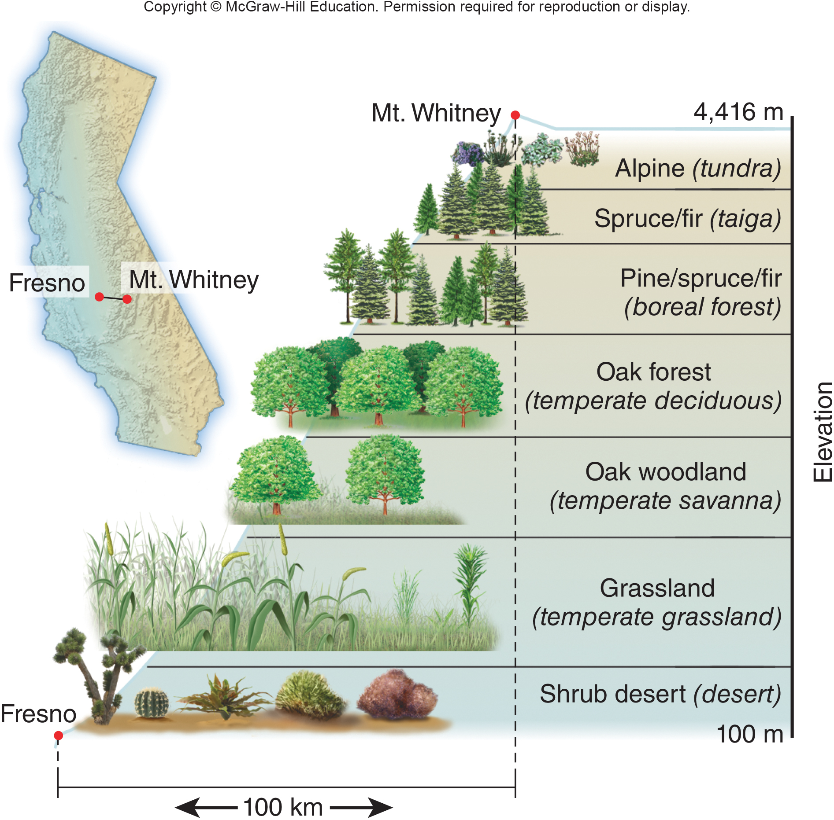
Vertical Zonation (2)
Notes:
Temperature and precipitation change with elevation as well as with latitude. In mountainous regions, temperatures are cooler and precipitation is usually greater at high elevations. Mountains are cooler and often wetter, than low elevations. Vertical zonation is a term applied to vegetation zones defined by altitude. A 100 km transect from California’s Central Valley up to Mount Whitney, for example, crosses as many vegetation zones as you would find on a journey from southern California to northern Canada (fig. 5.5).
11

Slide 12
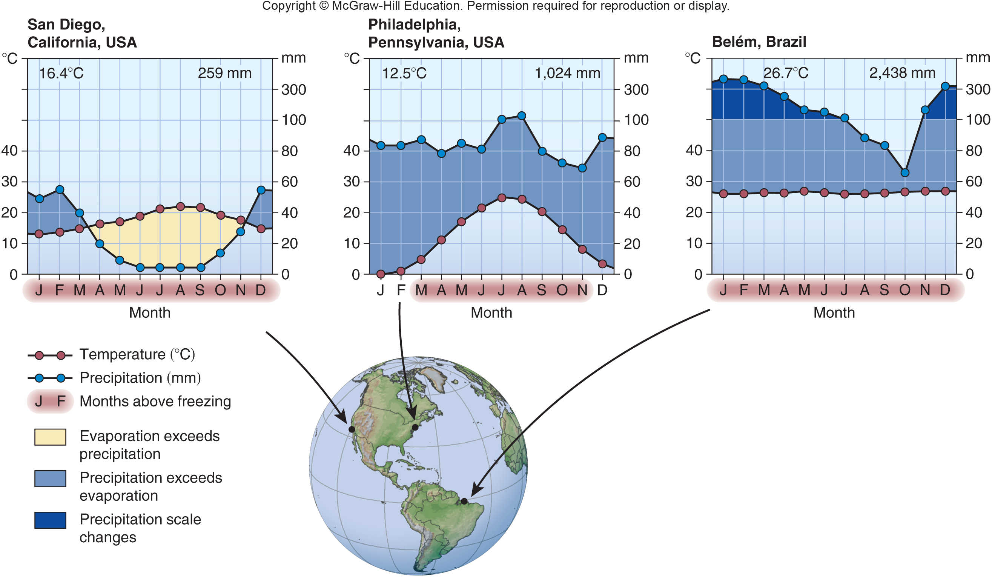
Annual Temperature and Precipitation Levels in Terrestrial Biomes
Notes:
Moisture availability depends on temperature as well as precipitation. The horizontal axis on these climate diagrams shows months of the year, vertical axes show temperature (left side) and precipitation (right). The number of dry months (shaded yellow) and wetter months (blue) varies with geographic location. Year annual temperature (°C) and precipitation (mm) are shown at the top of each graph.
12

Slide 13
5.2 Marine Ecosystems
Most marine communities depend on photosynthetic organisms.
Phytoplankton: tiny, free-floating photosynthetic algae often support a marine food web rather than trees or grasses.
In oceans, photosynthetic activity tends to be greatest near coastlines, where nitrogen, phosphorus, and other nutrients wash offshore and fertilize primary producers.
Notes:
The biological communities in oceans and seas are poorly understood, but they are probably as diverse and as complex as terrestrial biomes. In this section, we will explore a few facets of these fascinating environments. Oceans cover nearly three-fourths of the earth’s surface, and they contribute in important, although often unrecognized, ways to terrestrial ecosystems. Ocean currents also contribute to the distribution of biological productivity, as they transport nutrients and phytoplankton far from shore (fig. 5.15).
13

Slide 14
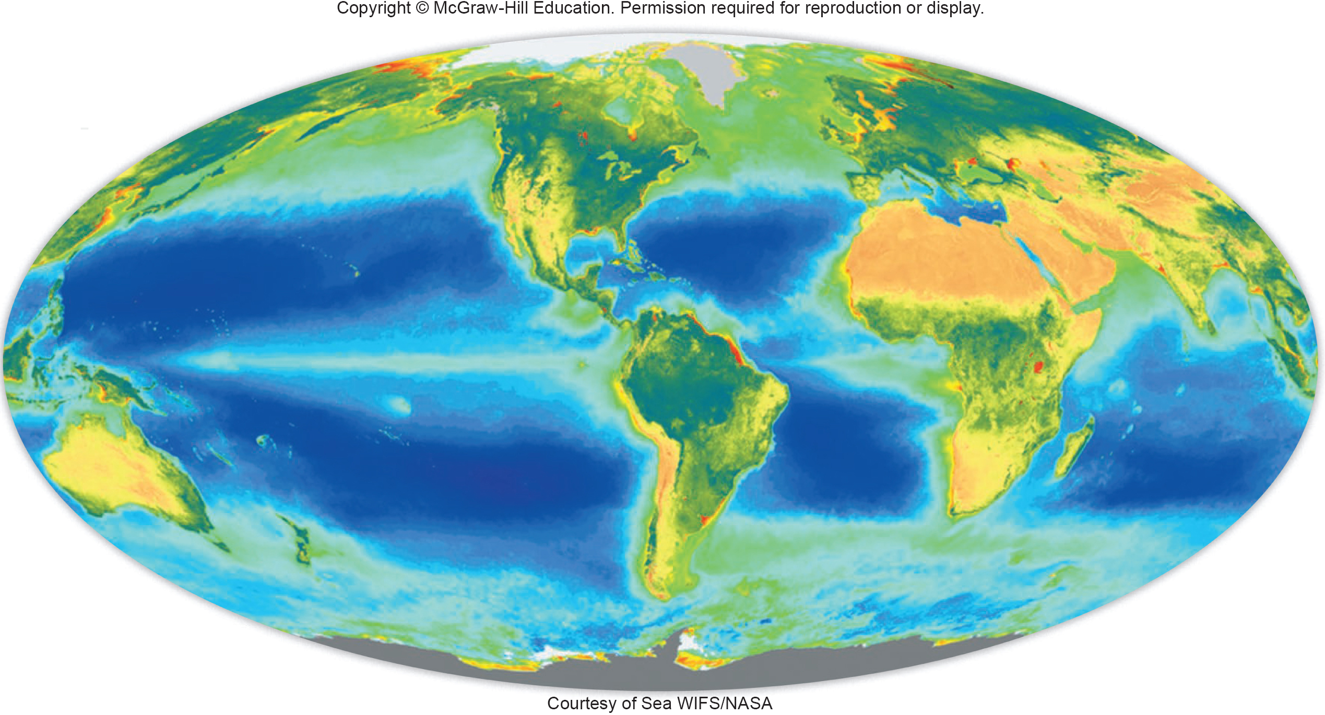
Satellite Measurements of Primary Productivity in the Oceans
Notes:
Satellite measurements of chlorophyll levels in the oceans and on land. Dark green to blue land areas have high biological productivity. Dark blue oceans have little chlorophyll and are biologically impoverished. Light green to yellow ocean zones are biologically rich.

Slide 15
Open Ocean Communities Vary from Surface to Hadal Zone
Ocean systems can be described by depth and proximity to shore:
Benthic communities occur on the bottom.
Pelagic zones are the water column.
The epipelagic zone has photosynthetic organisms.
Below are the mesopelagic and bathypelagic zones.
The deepest layers are the abyssal zone (to 4,000 m) and hadal zone (deeper than 6,000 m).
Shorelines are known as littoral zones, and the area exposed by low tides is known as the intertidal zone.
Notes:
15

Slide 16
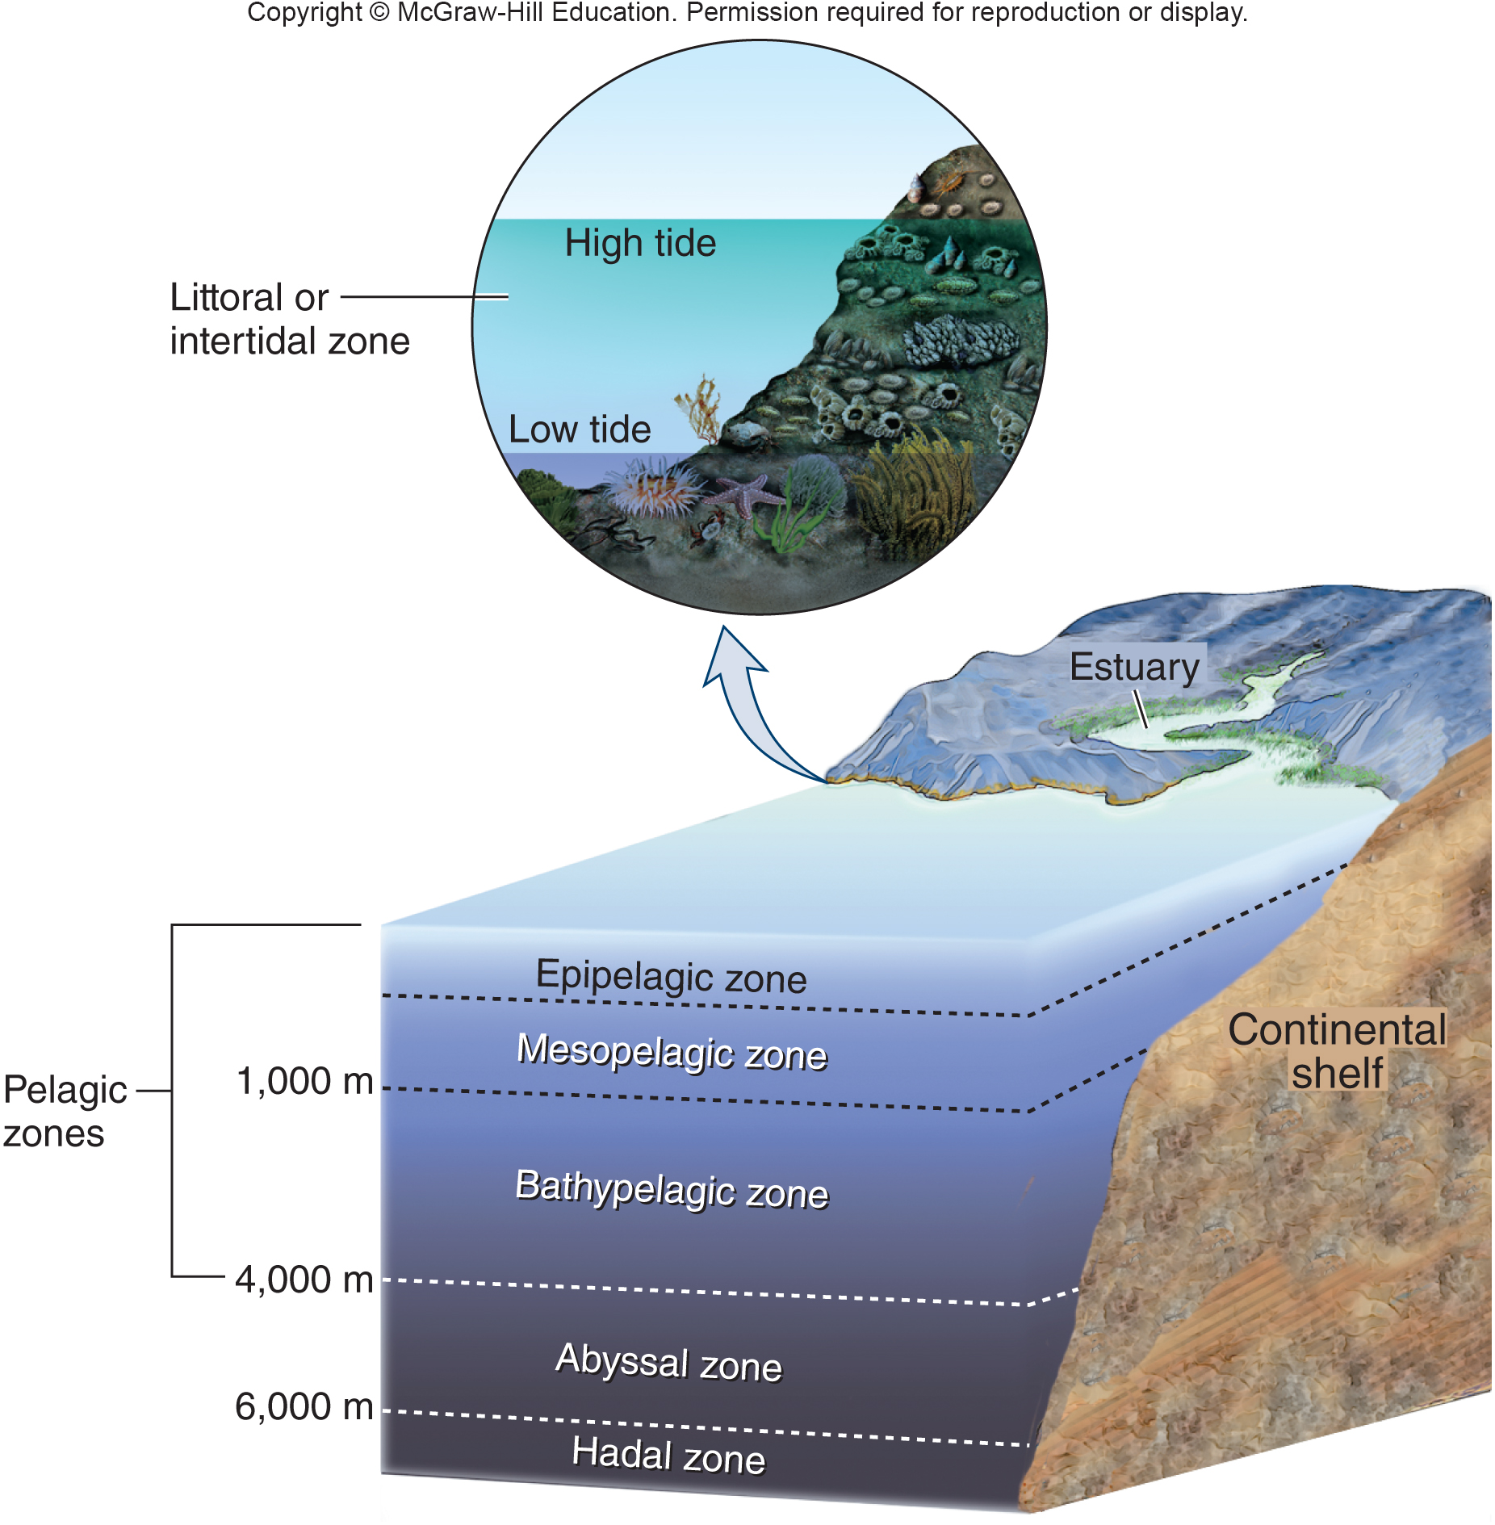
Vertical Stratification is a Key Feature of Aquatic Ecosystems
Notes:
Light penetrates only the top 10–20 m of the ocean. Below this level, temperatures drop and pressure increases. Nearshore environments include the intertidal zone and estuaries.
16

Slide 17
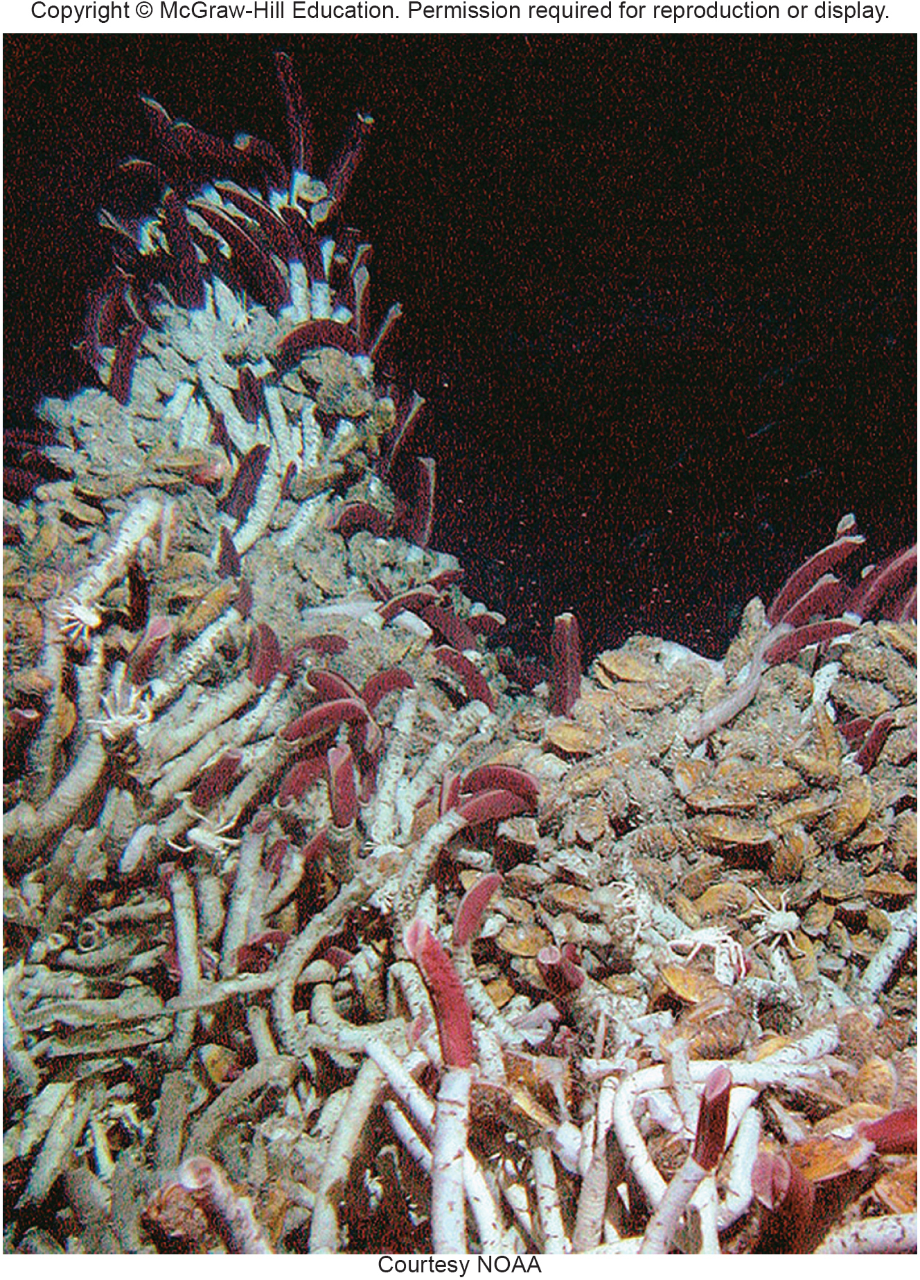
Deep-sea Thermal Vent Communities
Deep-sea thermal vent communities are another remarkable type of marine system.
These communities are based on microbes that capture sulfur compounds released from thermal vents on the ocean floor.
Notes:
Deep-sea thermal vent communities are another remarkable type of marine system that was completely unknown until 1977, when the deep-sea submarine Alvin descended to the deep-ocean floor. These communities are based on microbes that capture chemical energy, mainly from sulfur compounds released from thermal vents—jets of hot water and minerals on the ocean floor (fig. 5.17). Magma below the ocean crust heats these vents. Tube worms, mussels, and microbes on the vents are adapted to survive both extreme temperatures, often above 350°C (700°F), and intense water pressure at depths of 7,000 m (20,000 ft) or more. Oceanographers have discovered thousands of different types of organisms, most of them microscopic, in these communities. Some estimate that the total mass of microbes on the seafloor represents one-third of all biomass on the planet.

Slide 18
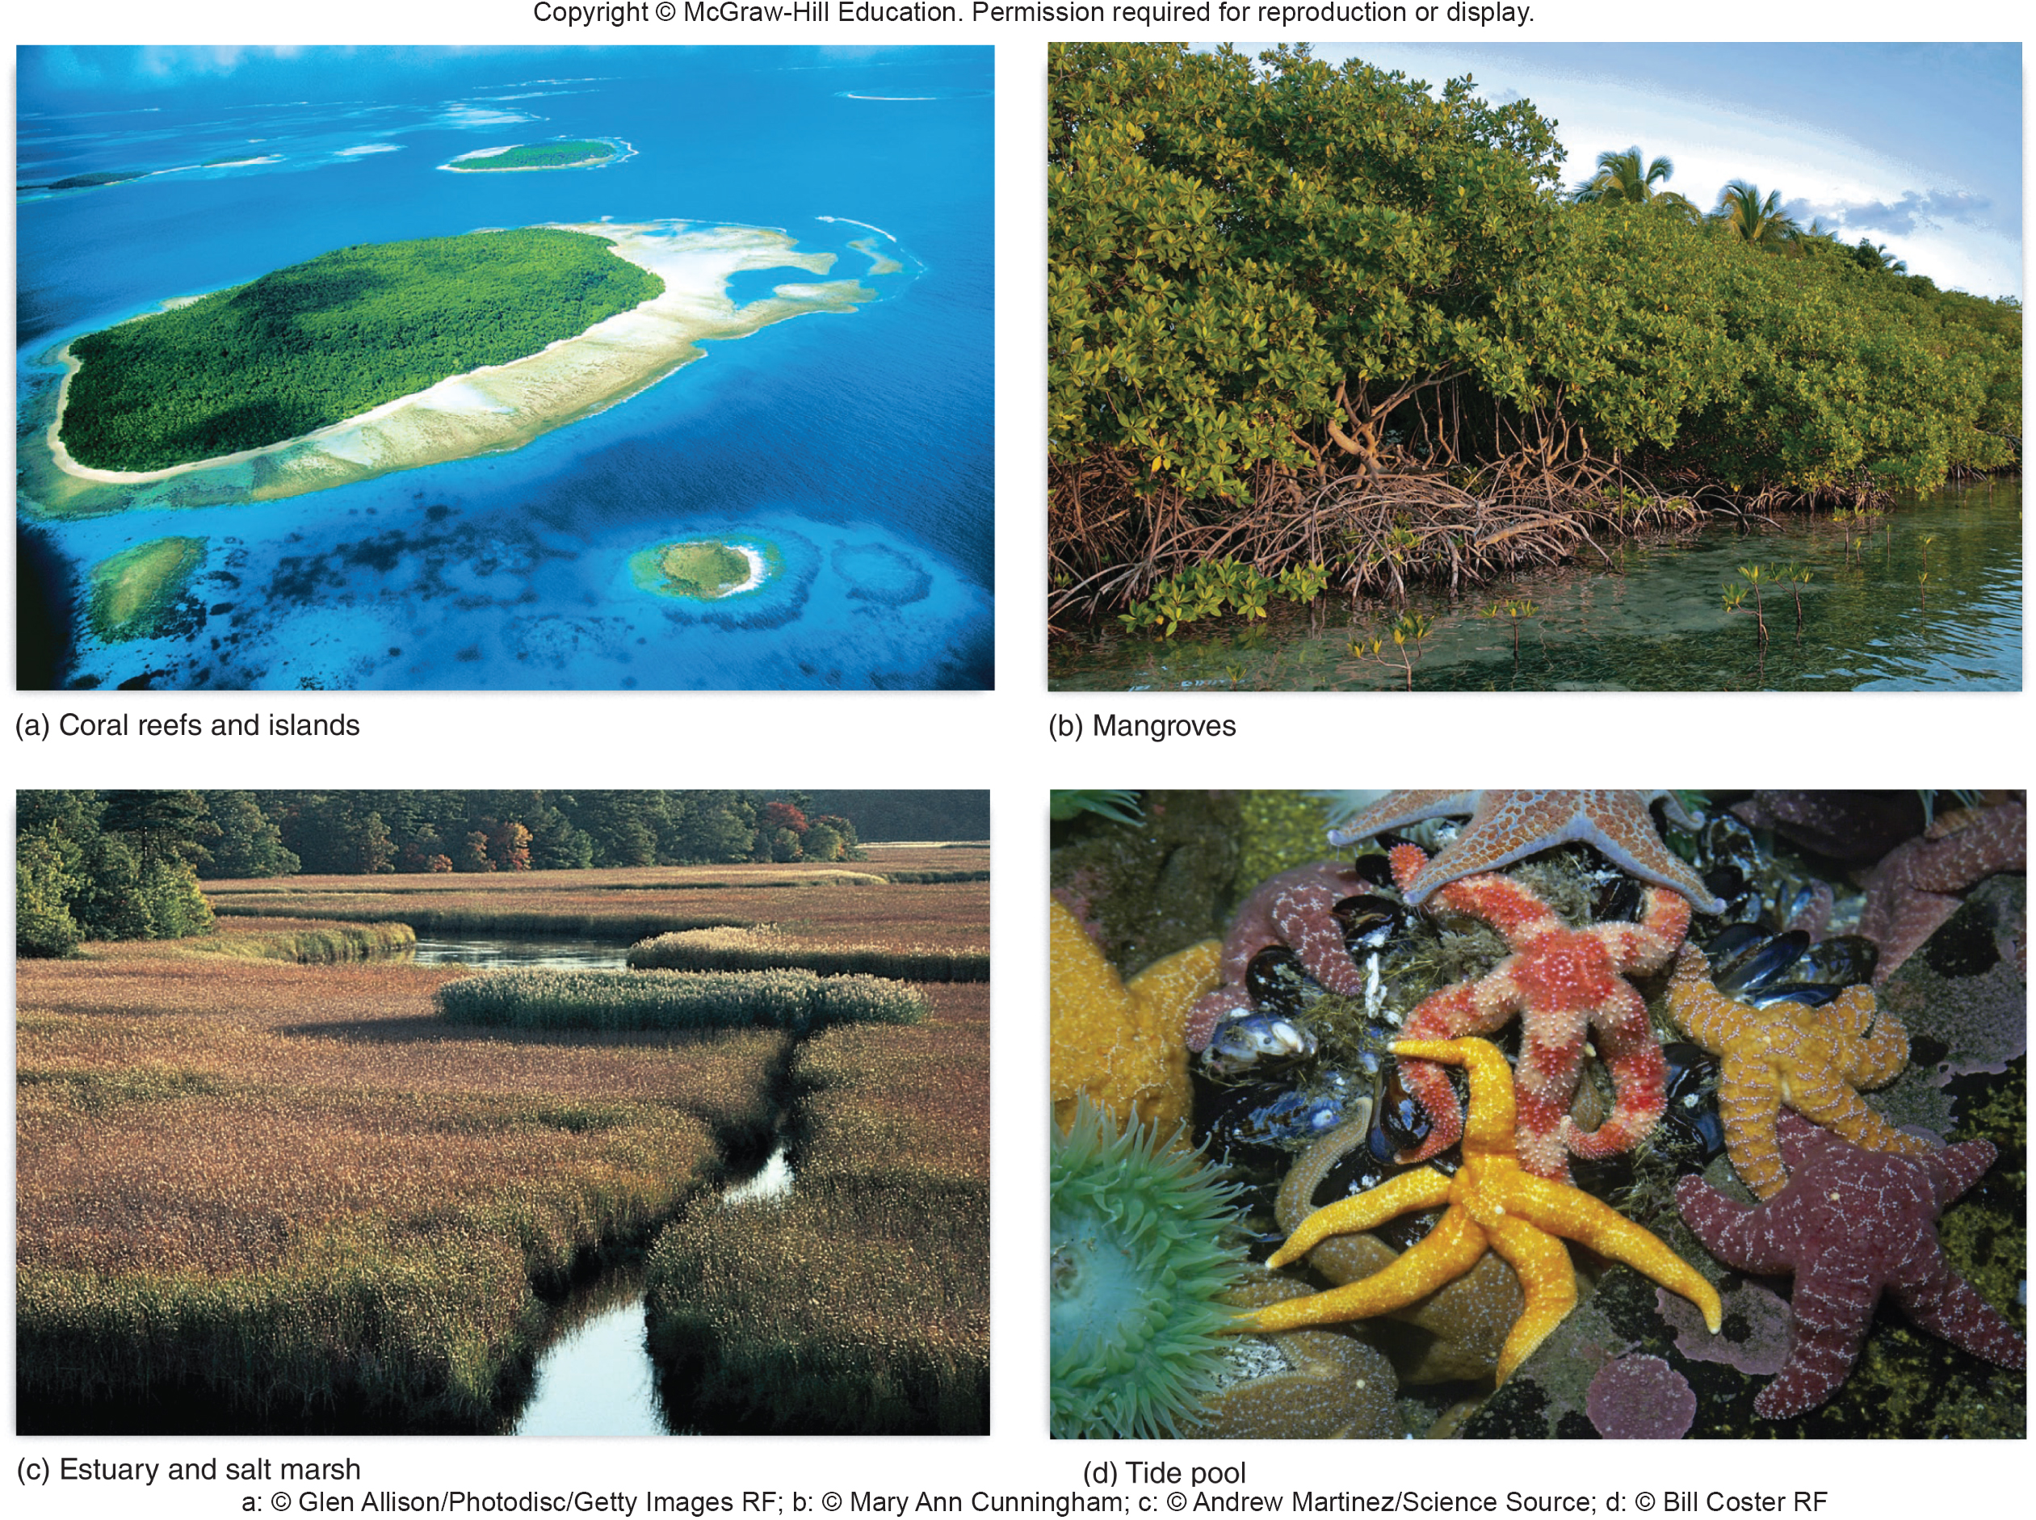
Tidal Shores Support Rich,
Diverse Communities
Coral reefs are among the best-known marine systems, because of their extraordinary biological productivity and their diverse and beautiful organisms.
Notes:
Reefs are colonies of minute, colonial animals (“coral polyps”) that live symbiotically with photosynthetic algae. Calcium-rich coral skeletons shelter the algae, and algae nourish the coral animals. The complex structure of a reef also shelters countless species of fish, worms, crustaceans, and other life-forms. Reefs occur where the water is shallow and clear enough for sunlight to reach the photosynthetic algae. They cannot tolerate abundant nutrients in the water, as nutrients support tiny floating plants and animals called plankton, which block sunlight.
Reefs are among the most endangered biological communities. Sediment from coastal development, farming, sewage, or other pollution can reduce water clarity and smother coral. Destructive fishing practices, including dynamite and cyanide poison, have destroyed many Asian reefs. Reefs can also be damaged or killed by changes in temperature, by invasive fish, and by diseases. Coral bleaching, the whitening of reefs due to stress, often followed by coral death, is a growing and spreading problem that worries marine biologists (chapter 1).
18

Slide 19
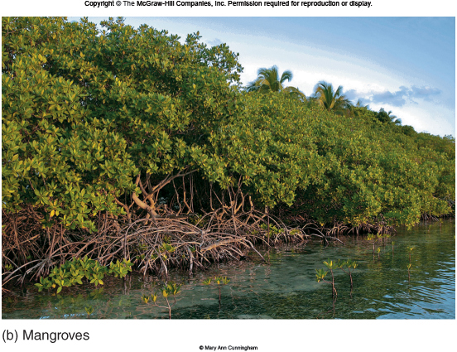
Tidal Shores Continued: Mangroves
Mangroves are a diverse group of salt-tolerant trees that grow along warm, calm marine coasts around the world.
Notes:
Growing in shallow, tidal mudflats, mangroves help stabilize shorelines, blunt the force of storms, and build land by trapping sediment and organic material. After the devastating Indonesian tsunami of 2004, studies showed that mangroves, where they still stood, helped reduce the speed, height, and turbulence of the tsunami waves. Detritus, including fallen leaves, collects below mangroves and provides nutrients for a diverse community of animals and plants. Both marine species (such as crabs and fish) and terrestrial species (such as birds and bats) rely on mangroves for shelter and food.
19

Slide 20
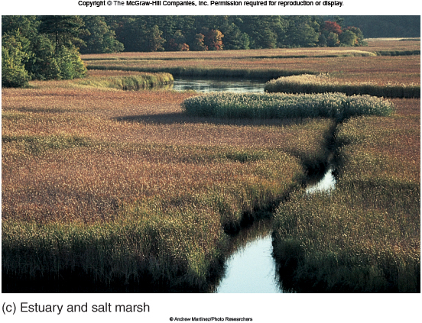
Tidal Shores Continued:
Estuaries & Salt Marshes
Estuaries are bays where rivers empty into the sea, mixing fresh water with salt water. Salt marshes, shallow wetlands flooded regularly or occasionally with seawater, occur on shallow coastlines, including estuaries.
Notes:
Usually calm, warm, and nutrient rich, estuaries and salt marshes are biologically diverse and productive. Rivers provide nutrients and sediments, and a muddy bottom supports emergent plants (whose leaves emerge above the water surface), as well as the young forms of crustaceans, such as crabs and shrimp, and mollusks, such as clams and oysters. Nearly two-thirds of all marine fish and shellfish rely on estuaries and saline wetlands for spawning and juvenile development.
20

Slide 21
Tidal Shores Continued: Tide Pools
Tide pools are depressions in a rocky shoreline that are flooded at high tide, but retain some water at low tide.
Notes:
These areas remain rocky where wave action prevents most plant growth or sediment (mud) accumulation. Extreme conditions, with frigid flooding at high tide and hot, desiccating sunshine at low tide, make life impossible for most species. But the specialized animals and plants that do occur in this rocky intertidal zone are astonishingly diverse and beautiful (fig. 5.18d).
21

Slide 22
5.3 Freshwater Ecosystems
Freshwater environments are far less extensive than marine environments, but they are centers of biodiversity.
Most terrestrial communities rely, to some extent, on freshwater environments.
In deserts, isolated pools, streams, and even underground water systems support astonishing biodiversity as well as provide water to land animals.

Slide 23
Lakes Have Extensive Open Water
Freshwater lakes, like marine environments, have distinct vertical zones.
Near the surface is a subcommunity of plankton, mainly microscopic plants, animals, and protists.
Fish move through the water column, sometimes near the surface and sometimes at depth.
Finally, the bottom, or benthos, is occupied by a variety of snails, burrowing worms, fish, and other organisms
Notes:
Freshwater lakes, like marine environments, have distinct vertical zones (fig. 5.19). Near the surface a subcommunity of plankton, mainly microscopic plants, animals, and protists (single-celled organisms, such as amoebae), float freely in the water column. Insects such as water striders and mosquitoes also live at the air–water interface. Fish move through the water column, sometimes near the surface and sometimes at depth. Finally, the bottom, or benthos, is occupied by a variety of snails, burrowing worms, fish, and other organisms. These make up the benthic community. Oxygen levels are lowest in the benthic environment, mainly because there is little mixing to introduce oxygen to this zone. Anaerobic (not using oxygen) bacteria may live in low-oxygen sediments. In the littoral zone, emergent plants, Such as cattails and rushes, grow in the bottom sediment. These plants create important functional links between layers of an aquatic ecosystem, and they may provide the greatest primary productivity to the system.

Slide 24
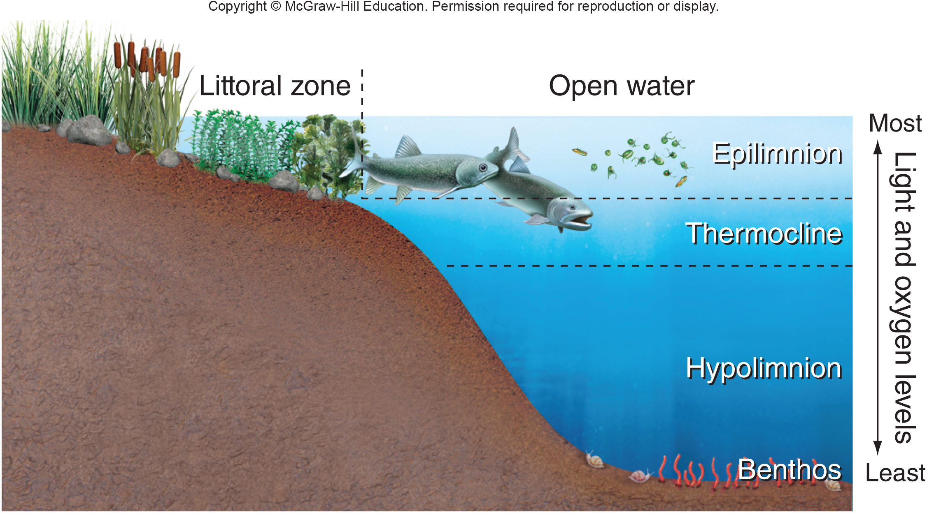
Layers of a Deep Lake
Notes:
The layers of a deep lake are determined mainly by gradients of light, oxygen, and temperature. The epilimnion is affected by surface mixing from wind and thermal convections, while mixing between the hypolimnion and epilimnion is inhibited by a sharp temperature and density difference at the thermocline.
24

Slide 25
Wetlands are Shallow
and Productive
Wetlands are shallow ecosystems in which the land surface is saturated or submerged at least part of the year.
Wetlands have vegetation that is adapted to grow under saturated conditions.
These relatively small systems support rich biodiversity and are essential for both breeding and migrating birds.
As water stands in wetlands, it also seeps into the ground, replenishing groundwater supplies.
Notes:
Wetlands are shallow ecosystems in which the land surface is saturated or submerged at least part of the year. Wetlands have vegetation that is adapted to grow under saturated conditions. These legal definitions are important because, although wetlands make up only a small part of most countries, they are disproportionately important in conservation debates and are the focus of continual legal disputes in North America and elsewhere around the world. Beyond these basic descriptions, defining wetlands is a matter of hot debate. How often must a wetland be saturated, and for how long? How large must it be to deserve legal protection? Answers can vary, depending on political, as well as ecological, concerns.
Although wetlands occupy less than 5 percent of the land in the United States, the Fish and Wildlife Service estimates that one-third of all endangered species spend at least part of their lives in wetlands. Wetlands retain storm water and reduce flooding by slowing the rate at which rainfall reaches river systems. Floodwater storage is worth $3 billion to $4 billion per year in the United States. As water stands in wetlands, it also seeps into the ground, replenishing groundwater supplies. Wetlands filter, and even purify, urban and farm runoff, as bacteria and plants take up nutrients and contaminants in water. They are also in great demand for filling and development. They are often near cities or farms, where land is valuable, and, once drained, wetlands are easily converted to more lucrative uses. At least half of all the wetlands that existed in the United States when Europeans first arrived have been drained, filled, or degraded. In some major farming states, losses have been even greater. Iowa, for example, has lost 99 percent of its original wetlands.
25

Slide 26
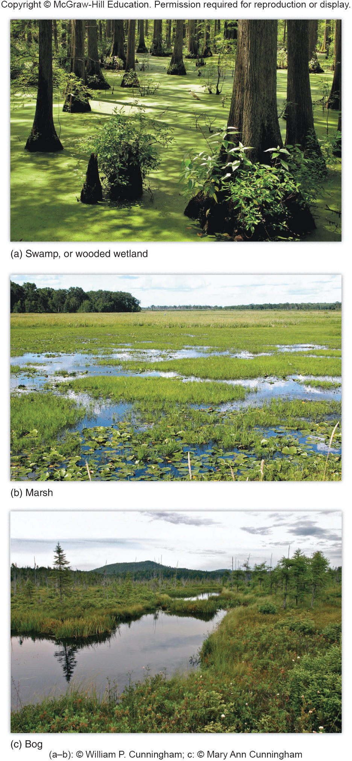
Wetlands are Described by Their Vegetation
Swamps are wetlands with trees.
Marshes are wetlands without trees.
Bogs are areas of water- saturated ground usually composed of deep layers of undecayed vegetation known as peat.
Notes:
Wetlands are described by their vegetation (fig. 5.20a–c). Swamps, also called forested wetlands, are wetlands with trees. Marshes are wetlands without trees. Bogs are areas of water-saturated ground, and usually the ground is composed of deep layers of accumulated, undecayed vegetation known as peat. Fens are similar to bogs except that they are mainly fed by groundwater, so that they have mineral-rich water and specially adapted plant species. Many bogs are fed mainly by precipitation. Swamps and marshes have high biological productivity. Bogs and fens, which are often nutrient-poor, have low biological productivity. They may have unusual and interesting species, though, such as sundews and pitcher plants, which are adapted to capture nutrients from insects rather than from soil.
The water in marshes and swamps usually is shallow enough to allow full penetration of sunlight and seasonal warming. These mild conditions favor great photosynthetic activity, resulting in high productivity at all trophic levels. In short, life is abundant and varied. Wetlands are major breeding, nesting, and migration staging areas for waterfowl and shorebirds.
26

Slide 27
Streams and Rivers are
Open Systems
Streams form wherever precipitation exceeds evaporation and surplus water drains from the land.
As streams collect water and merge, they form rivers. Ecologists consider a river system to be a continuum of constantly changing environmental conditions and community inhabitants from the headwaters to the mouth of a drainage or watershed.
Notes:
Within small streams, ecologists distinguish areas of riffles, where water runs rapidly over a rocky substrate, and pools, which are deeper stretches of slowly moving current. Water tends to be well mixed and oxygenated in riffles; pools tend to collect silt and organic matter. If deep enough, pools can have vertical zones similar to those of lakes. As streams collect water and merge, they form rivers, although there isn’t a universal definition of when one turns into the other. Ecologists consider a river system to be a continuum of constantly changing environmental conditions and community inhabitants, from the headwaters to the mouth of a drainage or watershed. The biggest distinction between stream and lake ecosystems is that, in a stream, materials, including plants, animals, and water, are continually moved downstream by flowing currents. This downstream drift is offset by active movement of animals upstream, productivity in the stream itself, and input of materials from adjacent wetlands or uplands.
27

Slide 28
5.4 Biodiversity
Biodiversity, the variety of living things.
Three kinds of biodiversity are essential to preserve ecological systems and functions:
genetic diversity is a measure of the variety of versions of the same genes within individual species.
species diversity describes the number of different kinds of organisms within a community or ecosystem.
ecological diversity refers to the richness and complexity of a biological community.
Notes:
ecological diversity means the richness and complexity of a biological community, including the number of niches, trophic levels, and ecological processes that capture energy, sustain food webs, and recycle materials within this system.
28

Slide 29
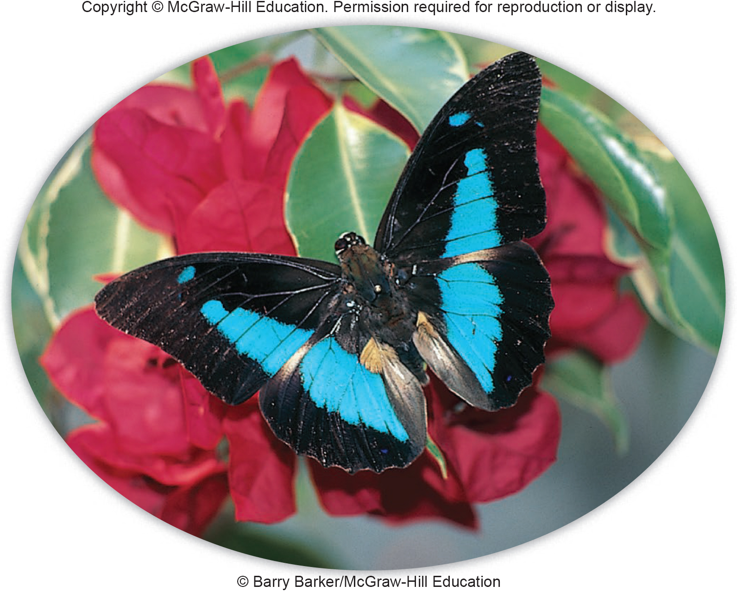
Insects and Invertebrates Make Up
Half of All Known Species
Notes:
Many species of insects and invertebrates, like this blue morpho butterfly, are beautiful as well as ecologically important.

Slide 30
Biodiversity Hot Spots are
Rich and Threatened
Most of the world’s biodiversity concentrations are near the equator, especially tropical rainforests and coral reefs.
Of all the world’s species, only 10 to 15 percent live in North America and Europe. Many of the organisms in megadiversity countries have never been studied by scientists.
Areas isolated by water, deserts, or mountains can also have high concentrations of unique species and biodiversity.
Notes:
The Malaysian Peninsula, for of flowering plants, while Britain, with an area twice as large, has only 1,400 species. There may be more botanists in Britain than there are species of higher plants. South America, on the other hand, has fewer than 100 botanists to study perhaps 200,000 species of plants. Madagascar, New Zealand, South Africa, and California are all mid-latitude areas isolated by barriers that prevent mixing with biological communities from other regions and produce rich, unusual collections of species.

Slide 31
5.5 Benefits of Biodiversity
We benefit from other organisms in many ways, some of which we don’t appreciate until a particular species or community disappears.
Even seemingly obscure and insignificant organisms can play irreplaceable roles in ecological systems or be the source of genes or drugs that someday may be indispensable.

Slide 32
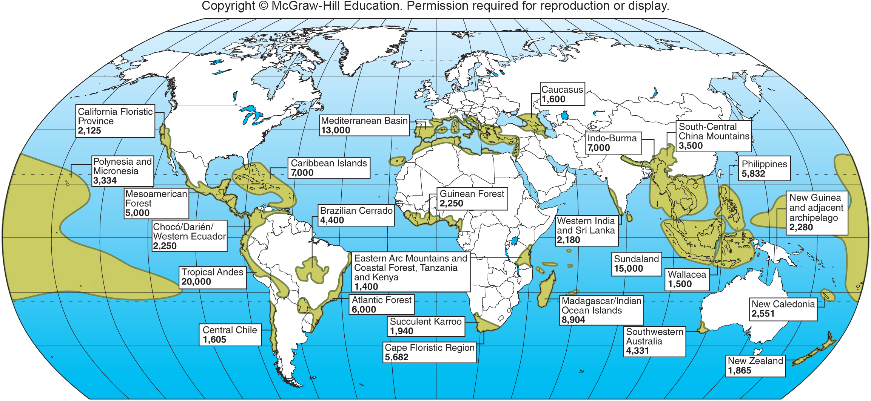
Map of Biodiversity Hot Spots
Notes:
Biodiversity “hot spots” identified by Conservation International tend to be in tropical or Mediterranean climates and on islands, coastlines, or mountains where many habitats exist and physical barriers encourage speciation. Numbers represent estimated endemic (locally unique) species in each area.

Slide 33
Biodiversity Provides Food and Medicines
Wild plant species could make important contributions to human food supplies. Genetic material from wild plants has been used to improve domestic crops.
Wild bees, moths, bats, and other organisms provide pollination for most of the world's agricultural crops.
Pharmaceutical products derived from developing world plants, animals, and microbes bring in more than $30 billion per year.
Notes:
Genetic material from wild plants has been used to improve domestic crops. Noted tropical ecologist Norman Myers estimates that as many as 80,000 edible wild plant species could be utilized by humans. Villagers in Indonesia, for instance, are thought to use some 4,000 native plant and animal species for food, medicine, and other products. Few of these species have been explored for possible domestication or more widespread cultivation.
33

Slide 34
Biodiversity Can Aid
Ecosystem Stability
High diversity may help biological communities withstand environmental stress better and recover more quickly than those with fewer species.
Because we don’t fully understand the complex interrelationships between organisms, we often are surprised and dismayed at the effects of removing seemingly insignificant members of biological communities.
Maintaining biodiversity is essential to preserving ecological services.
Notes:
High diversity may help biological communities withstand environmental stress better and recover more quickly than those with fewer species (see chapter 3). A reason may be that in a diverse community, some species survive disturbance, so ecological functions are maintained. Because we don’t fully understand the complex interrelationships among organisms, we often are surprised and dismayed at the effects of removing seemingly insignificant members of biological communities. For instance, it is estimated that 95 percent of the potential pests and disease-carrying organisms in the world are controlled by natural predators and competitors. Maintaining biodiversity can be essential for pest control and other ecological functions.
34

Slide 35
Aesthetic and Existence
Values are Important
Nature appreciation is economically important. The U.S. Fish and Wildlife Service estimates that Americans spend $104 billion every year on wildlife-related recreation. This is 25 percent more than the $81 billion spent each year on new automobiles.
For many people, just the idea that wildlife exists has value. This idea is termed existence value. Even if they will never see a tiger or a blue whale, many find it gratifying to know they exist.
Notes:
Often recreation is worth even more than the resources that can be extracted from an area. Fishing, hunting, camping, hiking, and other nature-based activities also have cultural value. These activities provide exercise, and contact with nature can be emotionally restorative. In many cultures, nature carries spiritual connotations and observing and protecting nature has religious or moral significance.
35

Slide 36
5.6 What Threatens Biodiversity?
Extinction, the elimination of a species, is a normal process of the natural world; however, human impacts have accelerated that rate recently.
In geologic history, extinctions are common. Studies of the fossil record suggest that more than 99 percent of all species that ever existed are now extinct.
Most of those species were gone long before humans came on the scene.
Periodically, mass extinctions have wiped out vast numbers of species and even whole families
Notes:
36

Slide 37
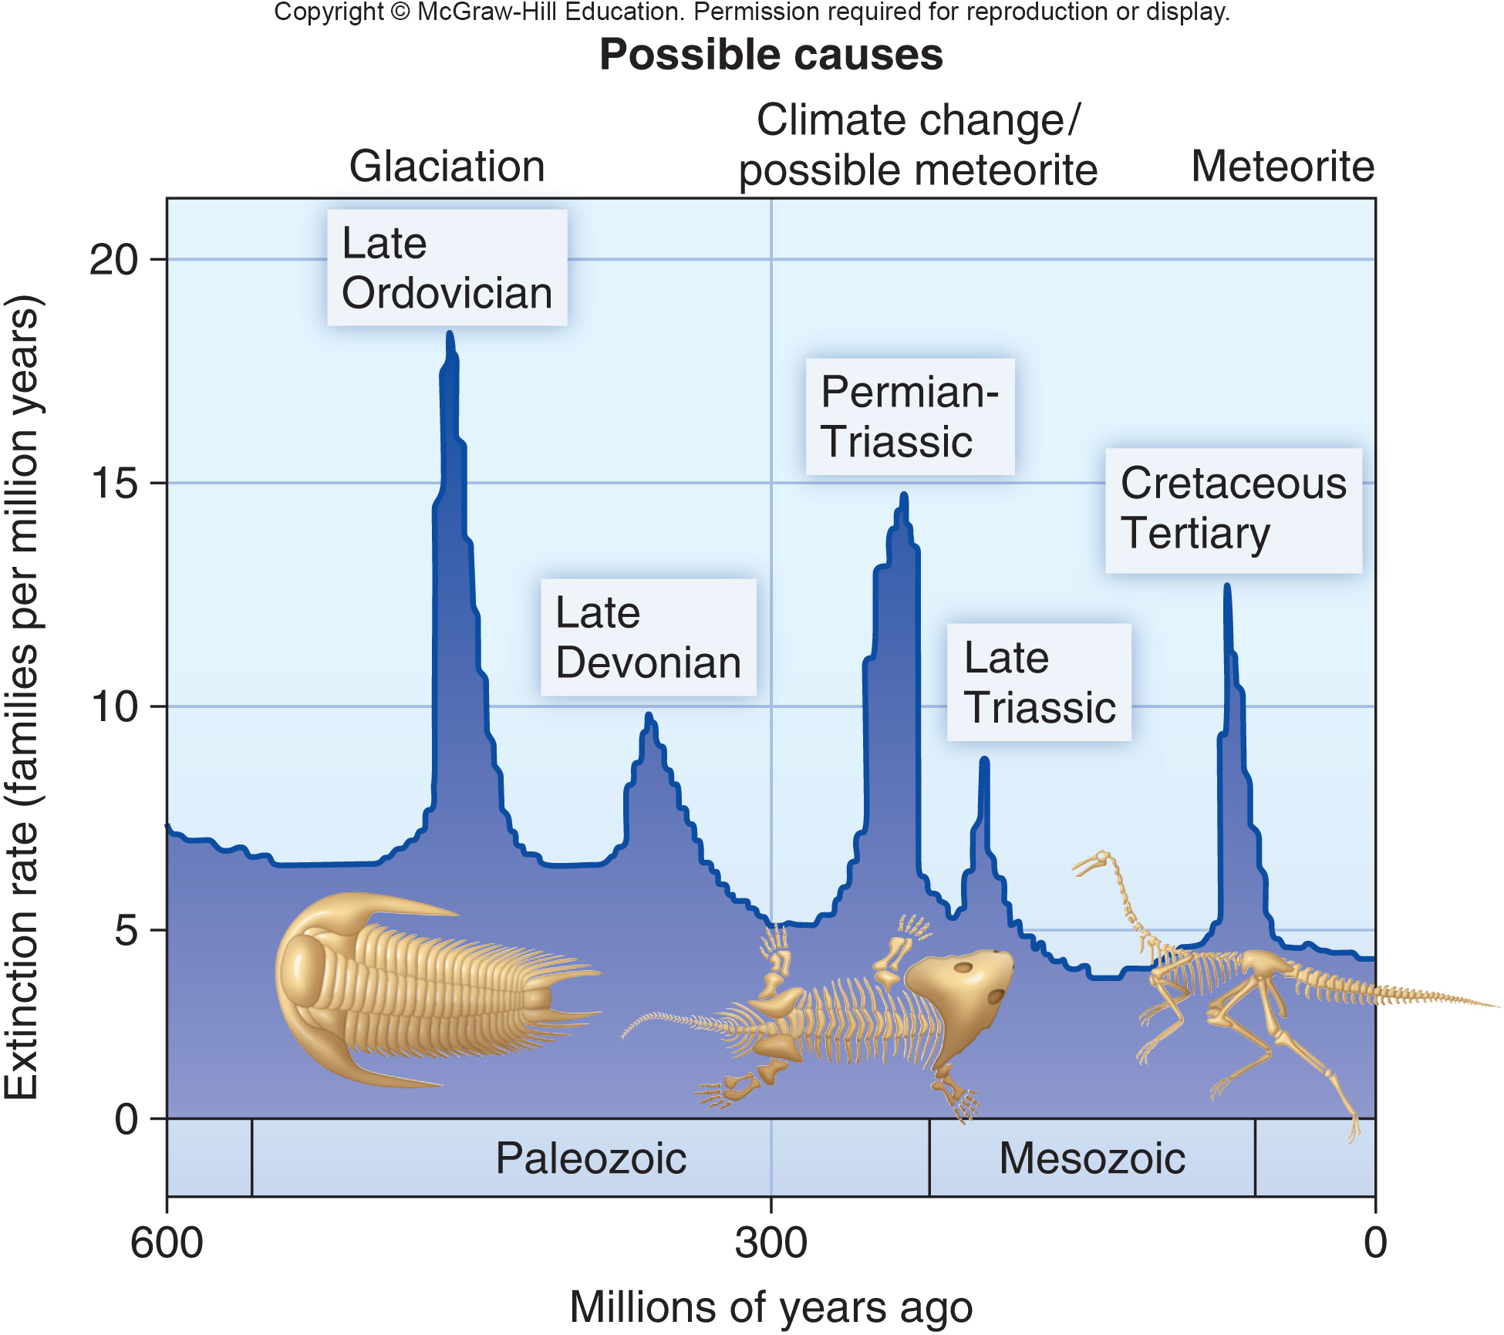
Major Mass Extinctions
Through Geological History
Notes:
Major mass extinctions through history. We may be in a sixth mass extinction now, caused by human activities.

Slide 38
HIPPO Summarizes
Human Impacts
Between A.D. 1600 and 1850, human activities appear to have eliminated two or three species per decade.
In the past 150 years the extinction rate has increased to thousands per decade.
E. O. Wilson summarizes human threats to biodiversity with the acronym HIPPO, which stands for Habitat destruction, Invasive species, Pollution, Population of humans, and Overharvesting.
Notes:
The rate at which species are disappearing has increased dramatically over the past 150 years. Between A.D. 1600 and 1850, human activities appear to have eliminated two or three species per decade, about double the natural extinction rate. In the past 150 years, the extinction rate has increased to thousands per decade. Conservation biologists call this the sixth mass extinction, but note that this time it’s not asteroids or volcanoes but human impacts that are responsible. E. O. Wilson summarizes human threats to biodiversity with the acronym HIPPO, which stands for Habitat destruction, Invasive species, Pollution, Population of humans, and Overharvesting. Let’s look in more detail at each of these issues.

Slide 39
Habitat Destruction is
Usually the Main Threat
The most important extinction threat for most species—especially terrestrial ones—is habitat loss.
Over the past 10,000 years, humans have transformed billions of hectares of former forests and grasslands to croplands, cities, roads, and other uses.
Sometimes we destroy habitat as a side effect of resource extraction, such as mining, dam-building, and indiscriminate fishing methods.
Notes:
Surface mining, for example, strips off the land covering along with everything growing on it. Waste from mining operations can bury valleys and poison streams with toxic material. Dam-building floods vital stream habitat under deep reservoirs and eliminates food sources and breeding habitat for some aquatic species. Our current fishing methods are highly unsustainable. One of the most destructive fishing techniques is bottom trawling, in which heavy nets are dragged across the ocean floor, scooping up every living thing and crushing the bottom structure to lifeless rubble. Marine biologist Jan Lubechenco says that trawling is “like collecting forest mushrooms with a bulldozer.”

Slide 40
Fragmentation Reduces
Habitat to Small, Isolated Areas
Habitat fragmentation is the reduction of habitat into small, isolated patches.
Breaking up habitat reduces biodiversity because many species, such as bears and large cats, require large territories to subsist.
Other species, such as forest interior birds, reproduce successfully only in deep forest far from edges and human settlement.
It can also divide populations into isolated groups, making them much more vulnerable to catastrophes.
Notes:
In addition to the loss of total habitat area, the loss of large, contiguous areas is a serious problem. A general term for this is habitat fragmentation— the reduction of habitat into small, isolated patches.
A very small population may not have enough breeding adults to be viable even under normal circumstances. An important question in conservation biology is what is the minimum viable population size for a species, and when dwindling populations have grown too small to survive.

Slide 41
Invasive Species are a
Growing Threat
A major threat to native biodiversity in many places is from accidentally or deliberately introduced species.
Invasive species are organisms that thrive in new territory where they are free of predators, diseases, or resource limitations.
Humans have always transported organisms into new habitats, but the rate of movement has risen sharply in recent years with the huge increase in speed and volume of travel by air, water, and land.
Notes:
Some species are deliberately released because people believe they will be aesthetically pleasing or economically beneficial. Some of the worst are pets released to the wild when owners tire of them. Many hitch a ride in ship ballast water, in the wood of packing crates, inside suitcases or shipping containers, or in the soil of potted plants (fig. 5.26). Sometimes we introduce invasive species into new habitats thinking that we’re being kind and compassionate without being aware of the ecological consequences.

Slide 42
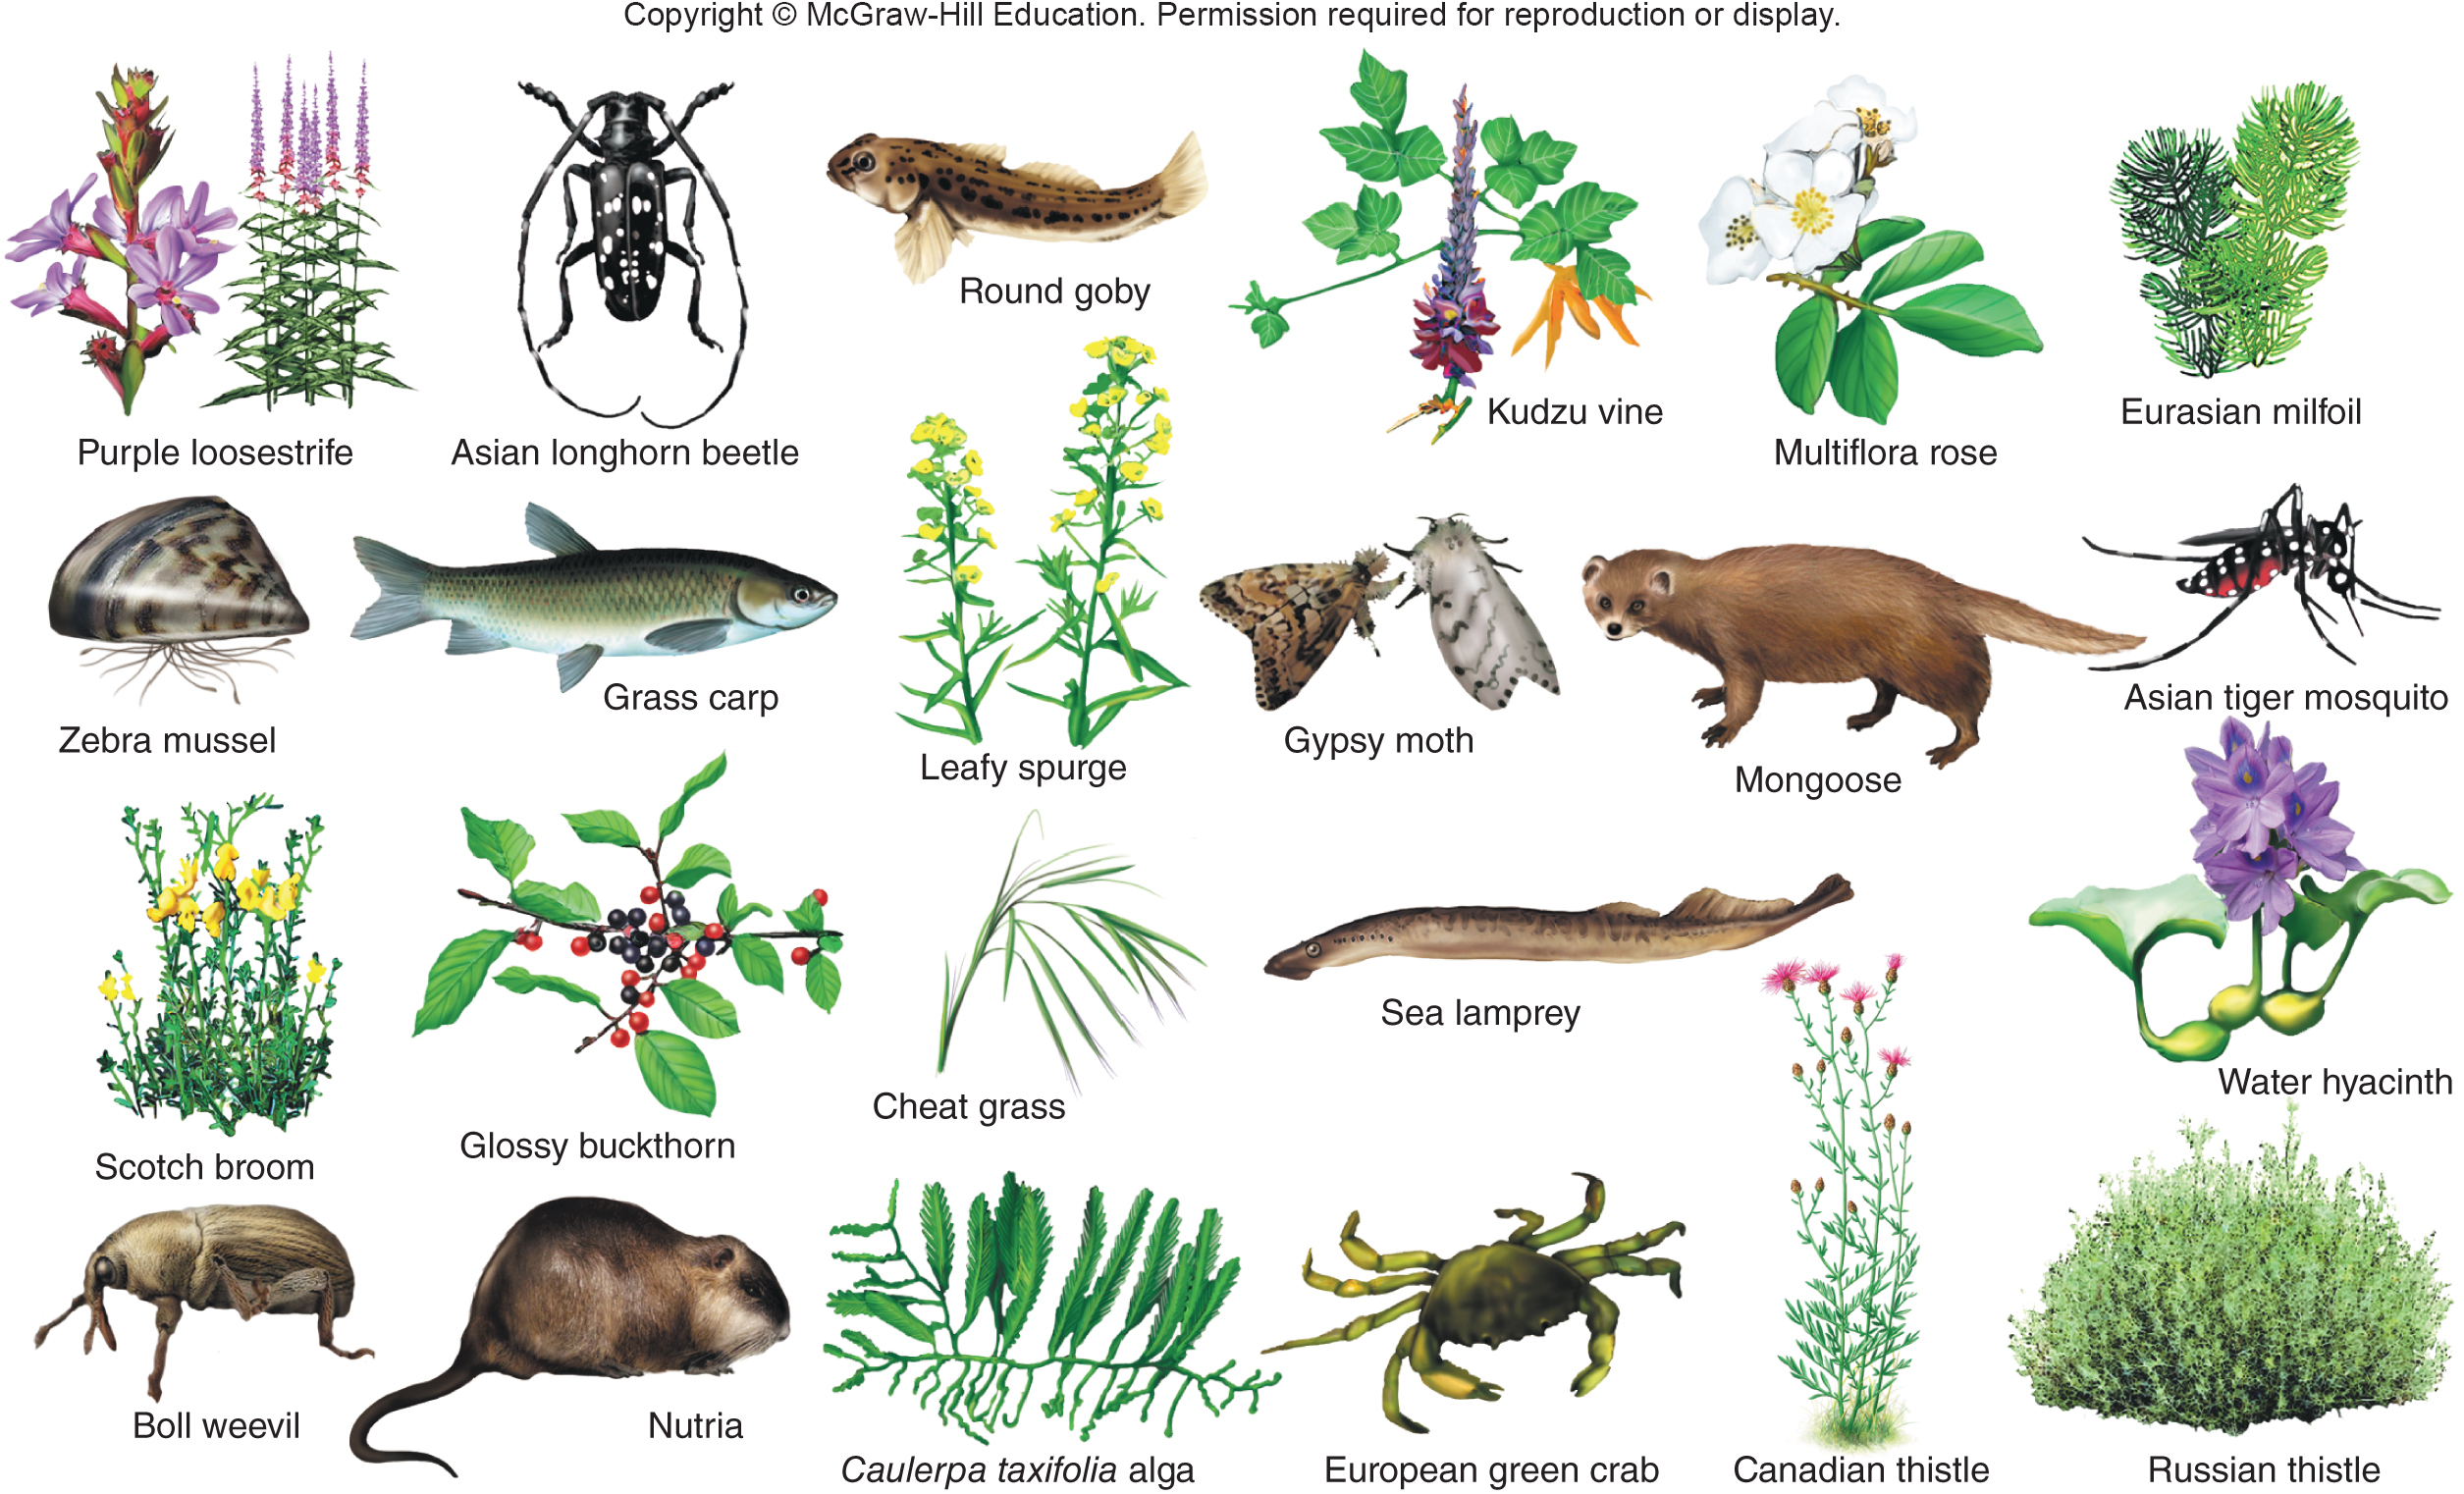
Invasive Species in North America

Slide 43
Pollution Poses Many Types of Risk (1)
We have long known that toxic pollutants can have disastrous effects on local populations of organisms.
The links between pesticides and the declines of fish-eating birds were well documented in the 1970s (fig. 5.28).
Population declines are especially likely in species high in the food chain, such as marine mammals, alligators, fish, and fish-eating birds.
Accumulation of DDT, PCBs, dioxins and lead in the food chain are a major cause of mortality.
Notes:
Lead poisoning is another major cause of mortality for many species of wildlife. Bottom-feeding waterfowl, such as ducks, swans, and cranes, ingest spent shotgun pellets that fall into lakes and marshes. They store the pellets, instead of stones, in their gizzards and the lead slowly accumulates in their blood and other tissues. The U.S. Fish and Wildlife Service (USFWS) estimates that 3,000 metric tons of lead shot are deposited annually in wetlands and that between 2 and 3 million waterfowl die each year from lead poisoning (fig. 5.29).

Slide 44
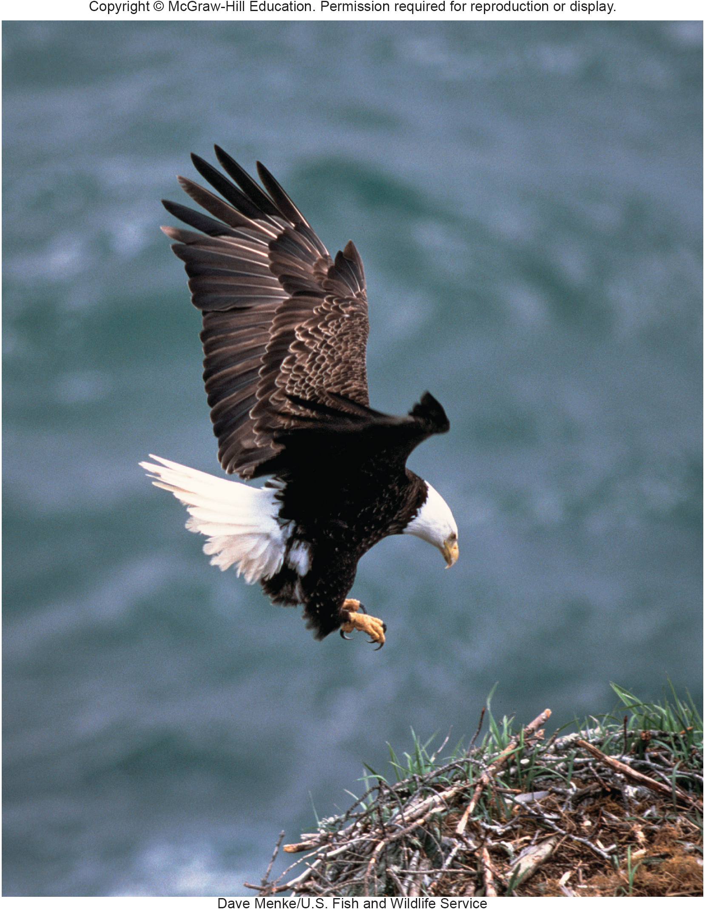
Pollution Poses Many Types of Risk (2)
Bald eagles, and other bird species at the top of the food chain, were decimated by DDT in the 1960s.
Many such species have recovered since DDT was banned in the United States, and because of protection under the Endangered Species Act.

Slide 45
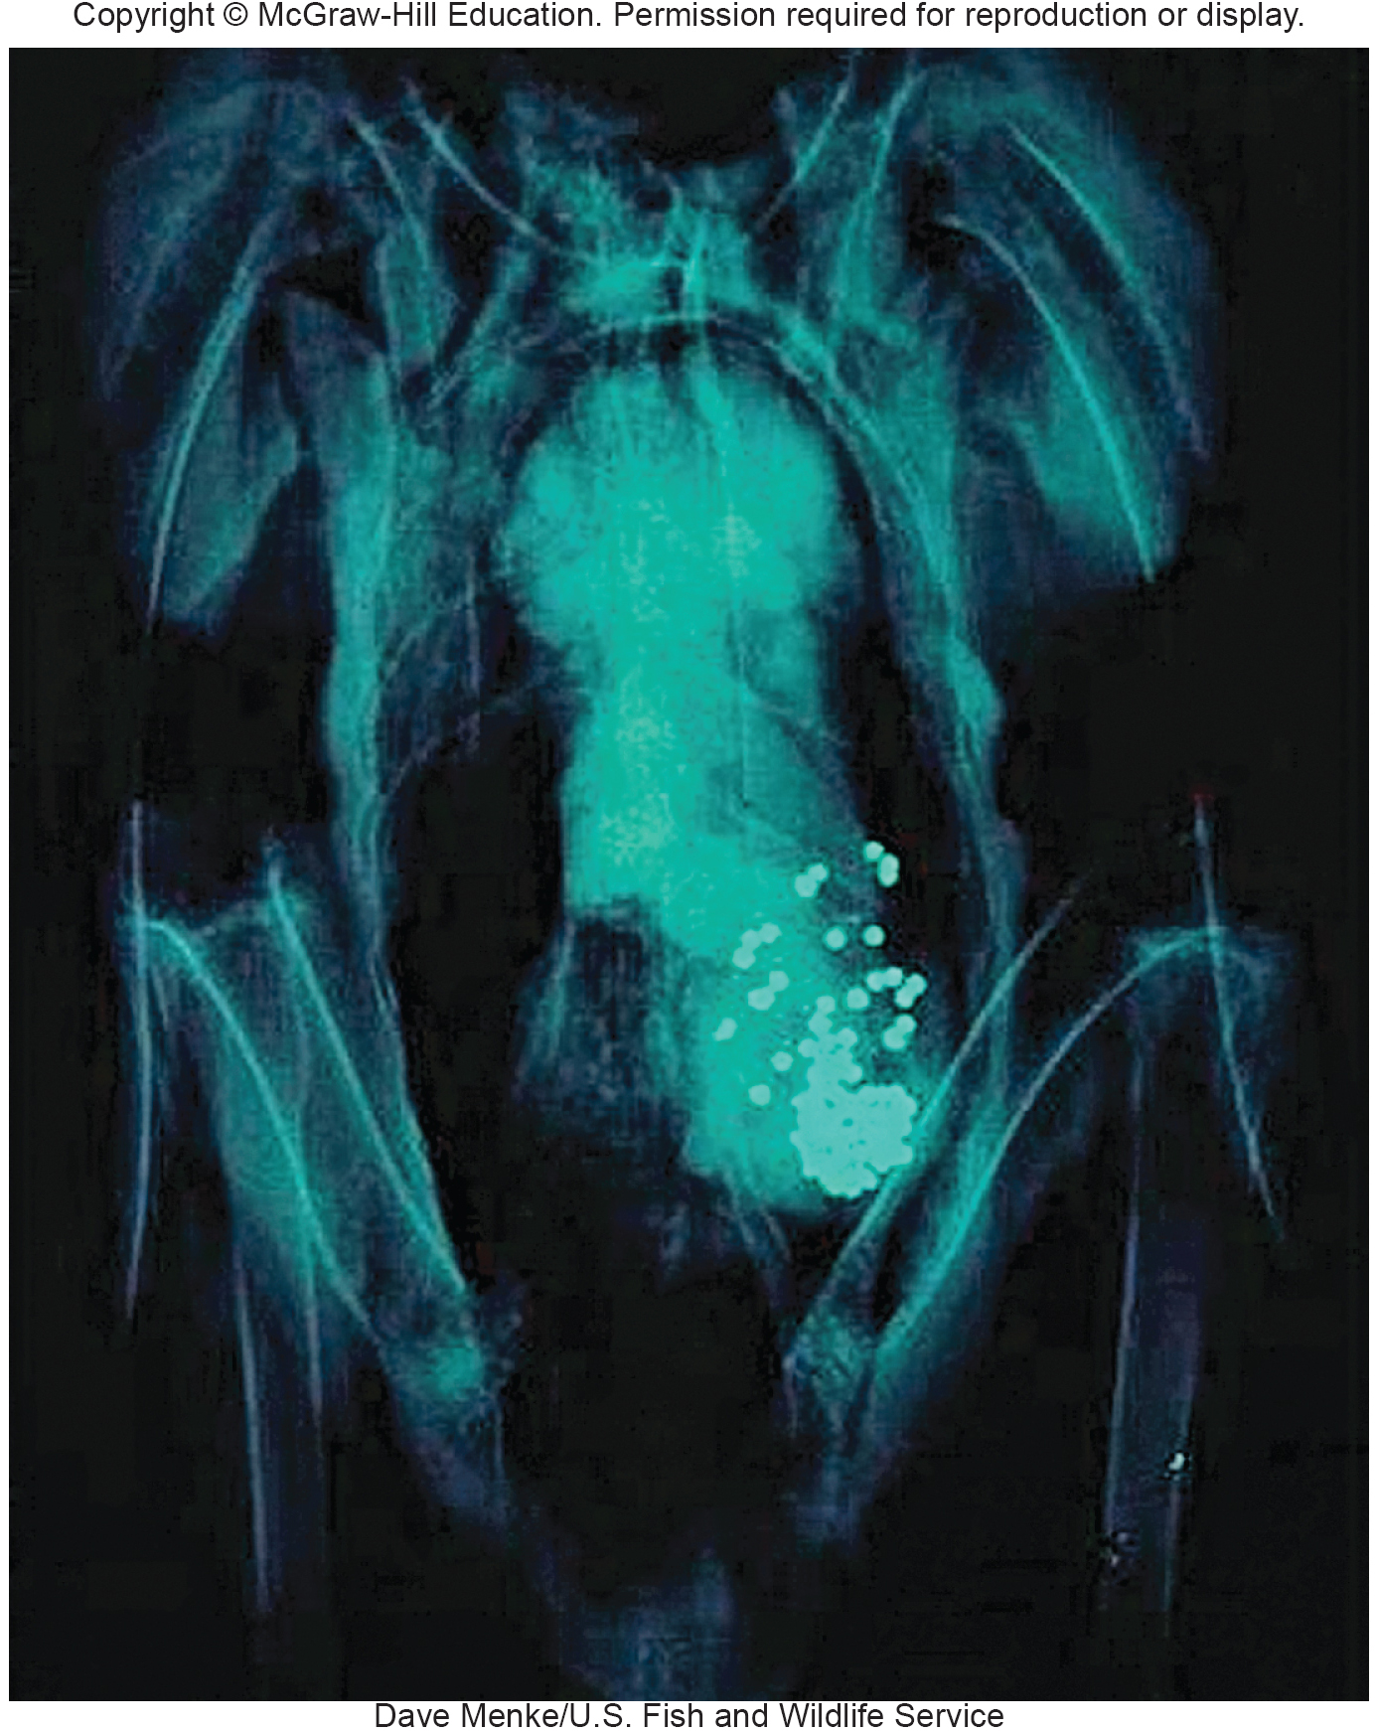
Pollution Poses Many Types of Risk (3)
Lead shot shown in the stomach of a bald eagle, consumed along with its prey.
Fishing weights and shot remain a major cause of lead poisoning in aquatic and fish-eating birds.

Slide 46
Population Growth Consumes
Space, Resources
In the past 40 years, the global population has doubled from about 3.5 billion to about 7 billion.
Even if per capita consumption patterns remain constant, more people will require more timber harvesting, fishing, farmland, and extraction of fossil fuels and minerals.
Notes:
In that time, according to calculations of the Worldwide Fund for Nature (WWF), our consumption of global resources has grown from 60 percent of what the earth can support over the long term to 150 percent. At the same time, global wildlife populations have declined by more than a third because of expanding agriculture, urbanization, and other human activities.

Slide 47
Overharvesting Depletes or
Eliminates Species
Overharvesting involves taking more individuals than reproduction can replace.
A classic example is the extermination of the American passenger pigeon and the near extermination of the American Bison.
Fish stocks have been seriously depleted by overharvesting in many parts of the world. At least three-quarters of all commercial oceanic species are overharvested.
Notes:
A classic example is the extermination of the American passenger pigeon (Ectopistes migratorius). Even though it inhabited only eastern North America, 200 years ago this was the world’s most abundant bird, with a population of 3 to 5 billion Animals. In spite of this vast abundance, market hunting and habitat destruction caused the entire population to crash in only about 20 years between 1870 and 1890. The last known wild bird was shot in 1900 and the last existing passenger pigeon, a female named Martha, died in 1914 in the Cincinnati Zoo.
Fish stocks have been seriously depleted by overharvesting in many parts of the world. A huge increase in fishing fleet size and efficiency in recent years has led to a crash of many oceanic systems. populations. Worldwide, 13 of 17 principal fishing zones are now reported to be commercially exhausted or in steep decline. At least three-quarters of all commercial oceanic species are overharvested. Canadian fisheries biologists estimate that only 10 percent of the top predators, such as swordfish, marlin, tuna, and shark, remain in the Atlantic Ocean. Groundfish, such as cod, flounder, halibut, and hake, also are severely depleted. You can avoid adding to this overharvest by eating only abundant, sustainably harvested varieties.

Slide 48
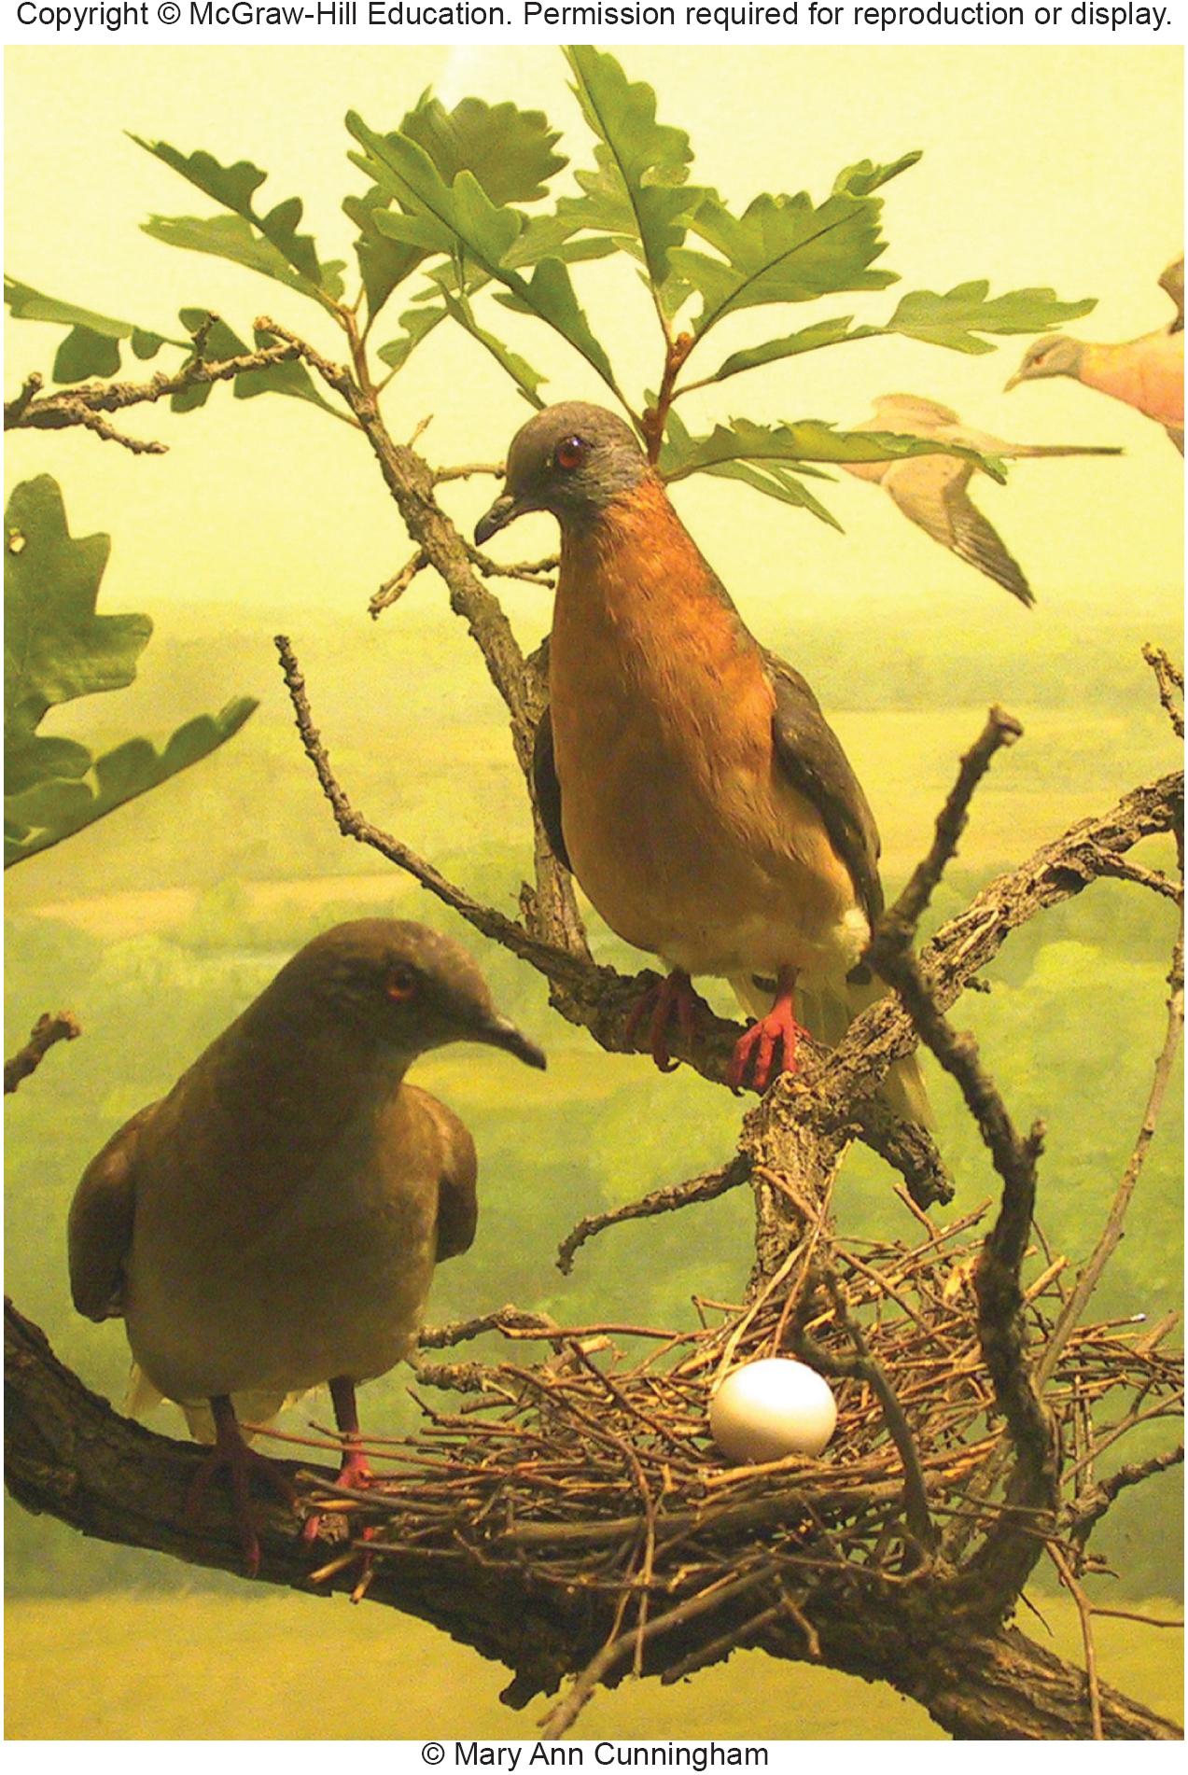
Overharvesting Depletes or Eliminates Species
Overharvesting involves taking more individuals than reproduction can replace.
A classic example is the extermination of the American passenger pigeon.
It inhabited only eastern North America, 200 years ago this was the world’s most abundant bird, with a population of 3 to 5 billion animals
Notes:
A pair of stuffed passenger pigeons (Ectopistes migratorius). The last member of this species died in the Cincinnati Zoo in 1914. Courtesy of Bell Museum, University of Minnesota.

Slide 49
Collectors Serve Medicinal and Pet Trades
Despite international bans on trade in products from endangered species, smuggling of furs, hides, horns, live specimens, and folk medicines amounts to millions of dollars each year.
The profits to be made in wildlife smuggling are enormous.
Plants also are threatened by overharvesting for use in landscaping or as aphrodisiacs.
Notes:
In addition to harvesting wild species for food, we also obtain a variety of valuable commercial products from nature. Much of this represents sustainable harvest, but some forms of commercial exploitation are highly destructive and a serious threat to certain rare species (fig. 5.31).
Tiger or leopard fur coats can bring $100,000 in Japan or Europe. The population of African black rhinos dropped from approximately 100,000 in the 1960s to about 3,000 in the 1980s because of a demand for their horns. In Asia, where it is prized for its supposed medicinal properties, powdered rhino horn fetches $28,000 per kilogram. The entire species is classified as critically endangered, and the western population is officially extinct.
Wild ginseng has been nearly eliminated in many areas because of the Asian demand for the roots, which are used as an aphrodisiac and folk medicine. Cactus “rustlers” steal cacti by the ton from the American Southwest and Mexico. With prices as high as $1,000 for rare specimens, it’s not surprising that many are now endangered.

Slide 50
Predator and Pest Control Is Expensive But Widely Practiced
Some animal populations have been greatly reduced, or even deliberately exterminated, because they are regarded as dangerous to humans or livestock or because they compete with our use of resources.
Every year, U.S. government animal control agents trap, poison, or shoot thousands of coyotes, bobcats, prairie dogs, and other species considered threats to people, domestic livestock, or crops.
Notes:
This animal control effort costs about $20 million in federal and state funds each year and kills some 700,000 birds and mammals, about 100,000 of which are coyotes. Defenders of wildlife regard this program as cruel, callous, and mostly ineffective in reducing livestock losses. Protecting flocks and herds with guard dogs or herders or keeping livestock out of areas that are the home range of wild species would be a better solution, they believe. Ranchers, on the other hand, argue that without predator control western livestock ranching would be impossible.

Slide 51
5.7 Biodiversity Protection
Slowly, we are adopting national legislation and international treaties to protect our biological resources.
Parks, wildlife refuges, nature preserves, zoos, and restoration programs have been established to protect nature and rebuild depleted populations.
Most countries now have laws protecting endangered species and dozens of international treaties aim to reduce the decline of biodiversity worldwide.
Notes:
We have gradually become aware of our damage to biological resources and of reasons for conserving them There has been encouraging progress in this area, but much remains to be done. In this section we examine legal protections for species in the United States, but keep in mind that this is only a small part of species protection measures worldwide. Most countries now have laws protecting endangered species (though many laws remain unenforced), and dozens of international treaties aim to reduce the decline of biodiversity worldwide.
51

Slide 52
Hunting and Fishing Laws
Protect Useful Species
By the 1890s, though, most states had enacted some hunting and fishing restrictions.
The general idea behind these laws was to conserve these resources for future human use rather than to preserve wildlife for its own sake.
The wildlife regulations and refuges established since that time have been remarkably successful for many species.
Notes:
In 1874 a bill was introduced in the U.S. Congress to protect the American bison, whose numbers were falling dramatically. This initiative failed, partly because most legislators could not imagine that wildlife that was so abundant and prolific could ever be depleted by human activity. By the end of the nineteenth century, bison numbers had plunged from some 60 million to only a few hundred animals.
A hundred years ago, there were an estimated half a million white-tailed deer in the United States; now there are some 14 million—more in some places than the environment can support. Wild turkeys and wood ducks were nearly gone 50 years ago. By restoring habitat, planting food crops, transplanting breeding stock, building shelters or houses, protecting these birds during breeding season, and using other conservation measures, we have restored populations of these beautiful and iconic birds to several million each.

Slide 53
The Endangered Species Act Protects
Habitat and Species
What does the ESA do? It provides:
(1) criteria for identifying species at risk,
(2) directions for planning for their recovery,
(3) assistance to land owners to help them find ways to meet both economic needs and the needs of a rare species, and
(4) enforcement of measures for protecting species and their habitat.

Slide 54
Endangered Species Act Terminology
The ESA identifies three levels of risk:
Endangered species are those considered in imminent danger of extinction.
Threatened species are likely to become endangered, at least locally, within the foreseeable future.
Vulnerable species are naturally rare or have been locally depleted by human activities to a level that puts them at risk.
Notes:
Vulnerable species are often candidates for future listing as endangered species. For vertebrates, a protected subspecies or a local race or ecotype can be listed, as well as an entire species.

Slide 55
IUCN Lists Species Internationally
Worldwide, the International Union for Conservation of Nature and Natural Resources (IUCN) lists 17,741 endangered and threatened species.
IUCN has no direct jurisdiction for slowing the loss of those species.
Within the United States, the ESA provides mechanisms for reducing species losses.
Notes:
The listed species include nearly one-fifth of mammals, nearly one third amphibians, reptiles, and fish, and most of the few mosses and flowering plants that have been evaluated (see table 5.1).

Slide 56
Recovery Plans Aim to Rebuild Populations
Once a species is listed, the Fish and Wildlife Service (FWS) is given the task of preparing a recovery plan.
This plan details how populations will be stabilized or rebuilt to sustainable levels.
A recovery plan could include many different kinds of strategies, such as buying habitat areas, restoring habitat, reintroducing a species to its historic ranges, captive breeding programs, and plans for negotiating the needs of a species and the people who live in an area.
Notes:
The FWS can then help landowners prepare Habitat Conservation Plans. These plans are specific management approaches that identify steps to conserve particular pieces of critical habitat. For example, the red-cockaded woodpecker is an endangered species that preys on insects in damaged pine forests from North Carolina to Texas. Few suitable forests remain on public lands, so much of the remaining population occurs on privately owned lands that are actively managed for timber production.
56

Slide 57
ESA Species Terminology
Keystone species are those whose elimination would affect many other members of the biological community.
Indicator species are those tied to specific biotic communities, successional stages, or environmental conditions.
Umbrella species require large blocks of relatively undisturbed habitat to maintain viable populations.
Flagship species are especially interesting or attractive organisms to which people react emotionally.
Notes:
Keystone species examples are prairie dogs (Cynomys ludovicianus) and bison (Bison bison).
• Indicator species example is brook trout (Salvelinus fontinalis).
• Umbrella species examples are the northern spotted owl (Strix occidentalis caurina), tiger (Panthera tigris), and gray wolf (Canis lupus).
• Flagship species can motivate the public to preserve biodiversity and contribute to conservation; an example is the giant panda (Ailuropoda melanoleuca).
57

Slide 58
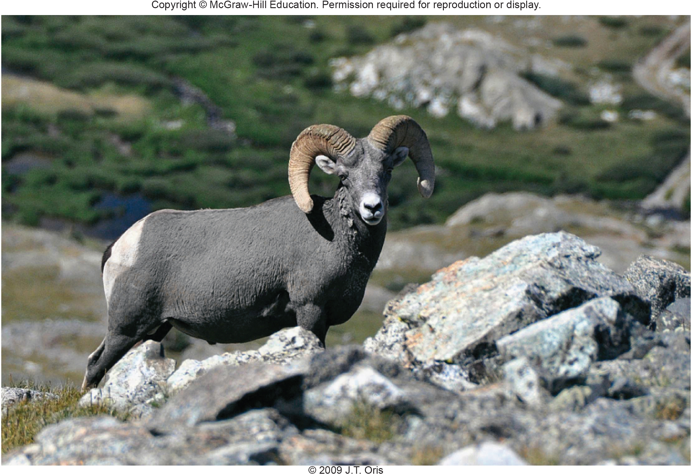
The Bighorn Sheep is a Charismatic Species That Has Been Listed as Endangered
Notes:
The Endangered Species Act seeks to restore populations of species, such as the bighorn sheep, which has been listed as endangered in much of its range. Charismatic species are easier to get listed than obscure ones.
58

Slide 59
Landowner Collaboration is Key
Two-thirds of listed species occur on privately owned lands, so cooperation between federal, state, and local agencies as well as private and tribal land owners is critical for progress.
Often the ESA is controversial because it can require that landowners change their plans for their land.
On the other hand, many land owners and communities appreciate the value of biodiversity on their land and like the idea of preserving species.
A number of provisions in the ESA protect landowners.
Notes:
A number of provisions protect landowners, as incentives to participate in developing habitat conservation plans. For example, permits can be issued to protect landowners from liability if a listed species is accidentally harmed during normal land use activities. In a Candidate Conservation Agreement, the FWS helps landowners reduce threats to a species, in an effort to avoid listing it at all. A Safe Harbor Agreement is a promise that, if land owners voluntarily implement conservation measures, the FWS will not require additional actions that could limit future management options. For example, suppose a landowner's efforts improve red-cockaded woodpecker habitat lead to population increases. A Safe Harbor agreement ensures that the land owners would not be required to do further management for additional woodpeckers attracted to the improved habitat.
59

Slide 60
The ESA has Seen Successes and Controversies (1)
The ESA has held off the extinction of hundreds of species. Some have recovered and been delisted, including the brown pelican, the peregrine falcon, the American alligator and the bald eagle.
However, political and legal debates can drag on over protecting a species for several years.
Several famous controversies have occurred:
The Tennessee Valley Authority fought over protecting a fish called the snail darter from a proposed dam construction.
The timber industry fought over protecting the spotted owl.
Notes:
In 1967, before the ESA was passed, only about 800 bald eagles remained in the contiguous United States. DDT poisoning, which prevented the hatching of young eagles, was the main cause. By 1994, after the banning of DDT, the population rebounded to 8,000 birds; by 2007 the population was up to about 20,000, enough to ensure a stable breeding population. Similarly, peregrine falcons, which had been down to 39 breeding pairs in the 1970s, had rebounded to 1,650 pairs by 1999 and were taken off the list. The American alligator was listed as endangered in 1967 because hunting and habitat destruction had reduced populations to precarious levels. Protection has been so effective that the species is now plentiful throughout its entire southern range. Florida alone may have a population of 1 million or more.
An important test of the ESA occurred in 1978 in Tennessee, when construction of the Tellico Dam threatened a tiny fish called the snail darter. The powerful Tennessee Valley Authority, which was building the dam, convinced the Supreme Court that the dam was more important than the fish. Another important debate over the economics of endangered species protection has been was that of the northern spotted owl. Preserving this owl requires the conservation of expansive, undisturbed areas of old-growth temperate rainforest in the Pacific Northwest, where old-growth timber is extremely valuable and increasingly scarce (fig. 5.33). Timber industry economists calculated the cost of conserving a population of 1,600 to 2,400 owls at $33 billion. Ecologists countered that this number was highly inflated; and that forest conservation would preserve countless other species and ecosystem services, whose values are almost impossible to calculate.
60

Slide 61
Many Countries Have
Species Protection Laws
Canada’s Committee on the Status of Endangered Wildlife in Canada (COSEWIC) of 1977 establishes rules for listing and protecting endangered species.
The European Union’s Birds Directive (1979) and Habitat Directive (1991).
Australia’s Endangered Species Protection Act (1992).
The Convention on Biological Diversity (1992) is an International agreement.
The Convention on International Trade in Endangered Species (CITES) of 1975.
Notes:
In the past 25 years or so, many countries have recognized the importance of legal protection for endangered species. Rules for listing and protecting endangered species are established by Canada’s Committee on the Status of Endangered Wildlife in Canada (COSEWIC) of 1977, the European Union’s Birds Directive (1979) and Habitat Directive (1991), and Australia’s Endangered Species Protection Act (1992). International agreements have also been developed, including the Convention on Biological Diversity (1992).
The Convention on International Trade in Endangered Species (CITES) of 1975 provides a critical conservation strategy by blocking the international sale of wildlife and their parts. The Convention makes it illegal to export or import elephant ivory, rhino horns, tiger skins, or live endangered birds, lizards, fish, and orchids. CITES enforcement has been far from perfect: smugglers hide live animals in their clothing and luggage; the volume of international shipping makes it impossible to inspect transport containers and ships; documents may be falsified.
61

Slide 62
Habitat Protection May Be
Better than Species Protection
Growing numbers of scientists, land managers, policymakers, and developers are arguing that we need a rational, continent-wide preservation of ecosystems that supports maximum biological diversity.
They argue that this would be more effective than species-by-species battles for desperate cases.
Notes:
By concentrating on individual species, we spend millions of dollars to breed plants or animals in captivity that have no natural habitat where they can be released. While flagship species, such as mountain gorillas and Indian tigers, are reproducing well in zoos and wild animal parks, the ecosystems that they formerly inhabited have largely disappeared.
62

Slide 63
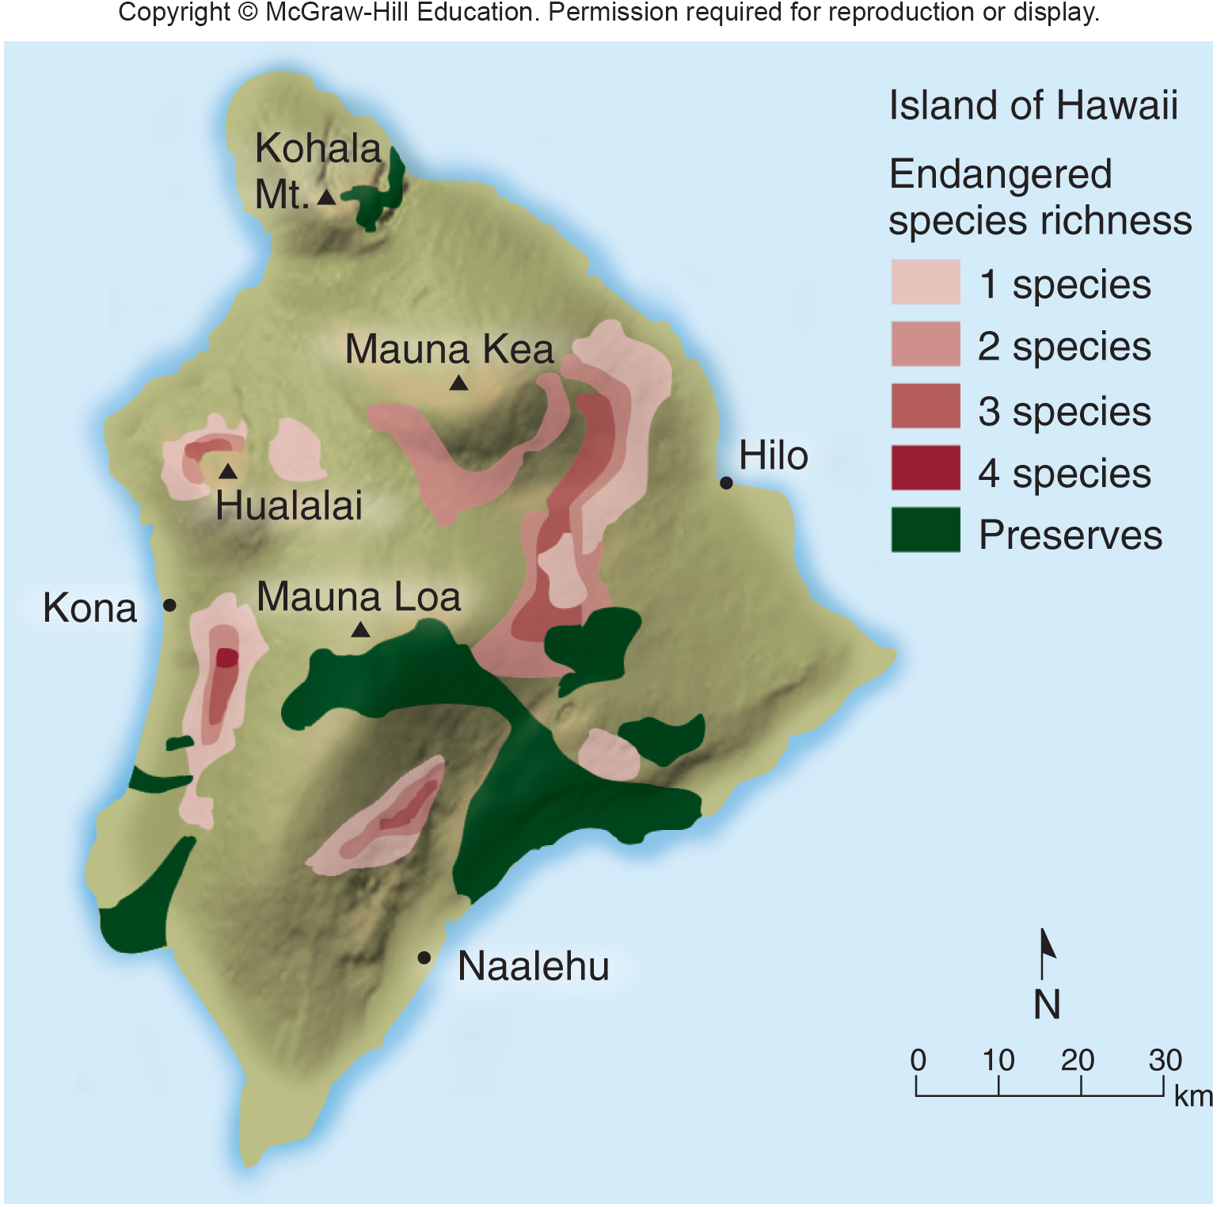
Sometimes Protected Lands Do Not Contain the Highest Species Diversity

Slide 64
Management Principles for Protecting Biodiversity in the Future
Conservation biologist R. E. Grumbine suggests 4 principles for protecting biodiversity in a large-scale, long-range approach:
1. Protect enough habitat for viable populations of all native species in a given region.
2. Manage at regional scales large enough to accommodate natural disturbances.
3. Plan over a period of centuries, so that species and ecosystems can continue to evolve.
4. Allow for human use and occupancy at levels that do not result in significant ecological degradation.

Slide 65
Conclusion
Biodiversity can be understood in terms of the environmental conditions where different organisms live, in terms of biomes, and in terms of habitat types.
Of the world’s species, many are threatened or endangered.
Biodiversity is important to us because it aids in ecosystem stability but many factors threaten biodiversity today. HIPPO describes these threats.
Notes:
65

