Slide 1

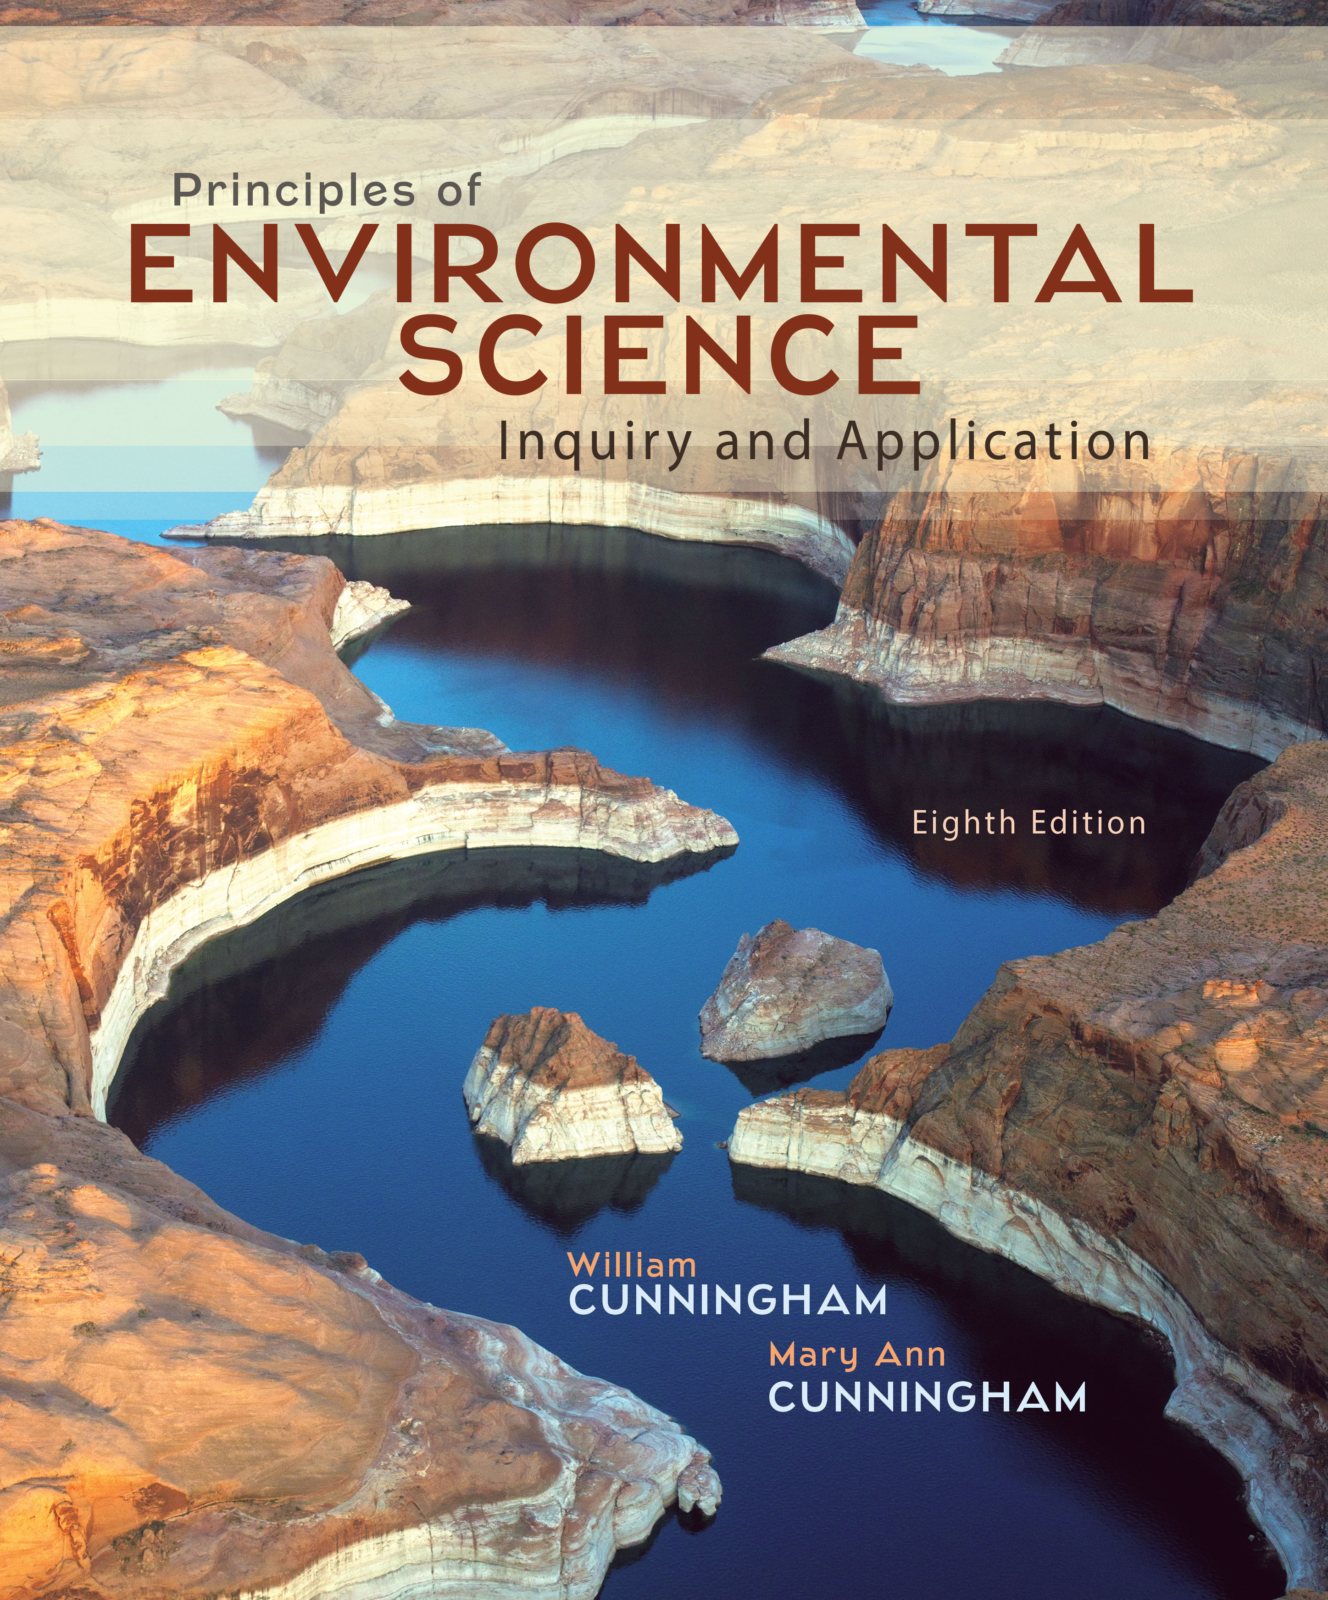
Chapter 8
Lecture
Outline

Slide 2
Learning Outcomes
After studying this chapter, you should be able to answer the following questions:
What is environmental health?
What health risks should worry us most?
Emergent diseases seem to be more frequent now.
What human factors may be involved in this trend?
Are there connections between ecology and our health?
When Paracelsus said, “The dose makes the poison,” what did he mean?
What makes some chemicals dangerous and others harmless?
How much risk is acceptable, and to whom?

Slide 3

CASE STUDY:
How Dangerous Is BPA?
Notes:
Bisphenol A (BPA), a key ingredient of both polycarbonate plastics and epoxy resins, is one of the world’s most widely used chemical compounds. In 2011, total global production was about 3 million metric tons, and the chemical industry expects use to double by 2015 as China and other developing countries manufacture increasing amounts of plastic or plastic-coated wares. BPA is used in items ranging from baby bottles, automobile headlights, eyeglass lenses, CDs, DVDs, water pipes, the linings of cans and bottles, and tooth-protecting sealants.
Traces of BPA are found in humans nearly everywhere. In one study of several thousand ordinary American adults, 95 percent had measurable amounts of this chemical in their bodies. The most likely source of contamination is from food and beverage containers.
How dangerous is BPA? In recent years dozens of scientists around the world have linked BPA to myriad health effects in rodents, including mammary and prostate cancer, genital defects in males, early onset of puberty in females, obesity, and even behavior problems such as attention-deficit hyperactivity disorder. Furthermore, epidemiological studies in humans show a correlation between urine concentrations of BPA and cardiovascular disease, type 2 diabetes, and liver-enzyme abnormalities. Scientists find that BPA, like phthalates, dioxins, and PCBs acts as an endocrine hormone disrupter.
But rodents, especially those raised in laboratory conditions, may not be accurate models for how humans react in the real world. Cross-sectional or retrospective studies of human populations show only correlations, not causality. BPA can leach into food from many sources. Canada, Japan, and most European countries have restricted use of this chemical in most consumer applications. In 2012, the United States Food and Drug Administration banned BPA in baby bottles and children’s drinking cups, but didn’t extend the ruling to other food and beverage containers. Not surprisingly, industry representatives emphasize scientific uncertainty and the need for further research, while most scientists and consumer groups demand a more comprehensive ban now. This case study introduces a number of important themes for this chapter. How dangerous are low-level but widespread exposures to a variety of environmental toxins? What are the effects of disruption of endocrine systems by synthetic (or natural) compounds? And how should we test and evaluate toxic substances?

Slide 4
8.1 Environmental Health
Health is a state of complete physical, mental, and social wellbeing, not merely the absence of disease or infirmity.
A disease is an abnormal change in the body’s condition that impairs important physical or psychological functions.
Morbidity means illness.
Mortality means death.
Environmental health focuses on factors that cause disease, including elements of the natural, social, cultural, and technological worlds in which we live.
Notes:
By definition, we all are ill to some extent. Likewise, we all can improve our health to live happier, longer, more productive, and more satisfying lives if we think about what we do.
Diet and nutrition, infectious agents, toxic substances, genetics, trauma, and stress all play roles in morbidity and mortality.
The World Health Organization (WHO) estimates that 24 percent of all global disease burden and 23 percent of premature mortality are due to environmental factors. Among children (0 to 14 years) deaths attributable to environmental factors may be as high as 36 percent.
4

Slide 5
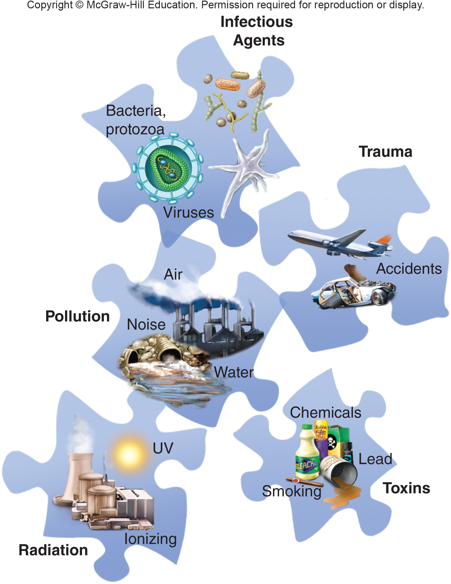
Major Sources of Environmental Health Risks
Notes:
5

Slide 6
Global Disease Burden is Changing
Health organizations used to focus on the leading causes of death as a measure of world health.
Health agencies now calculate disability-adjusted life years (DALYs) as a measure of disease burden.
The world is now undergoing a dramatic epidemiological transition. Chronic conditions, such as cardiovascular disease and cancer, no longer afflict only wealthy people. Meanwhile, traditional killers in developing countries—infections, maternal and perinatal (birth) complications, and nutritional deficiencies—still take a terrible toll.
Notes:
In the past, health organizations have focused on the leading causes of death as the best summary of world health. Mortality data, however, fail to capture the impacts of nonfatal outcomes of disease and injury, such as dementia or blindness, on human well-being. When people are ill, work isn’t done, crops aren’t planted or harvested, meals aren’t cooked, and children can’t study and learn. Health agencies now calculate disability-adjusted life years (DALYs) as a measure of disease burden. DALYs combine premature deaths and loss of a healthy life resulting from illness or disability. This is an attempt to evaluate the total cost of disease, not simply how many people die. The world is now undergoing a dramatic epidemiological transition. Chronic conditions, such as cardiovascular disease and cancer, no longer afflict only wealthy people. Marvelous progress in eliminating communicable diseases, such as smallpox, polio, and malaria, is allowing people nearly everywhere to live longer. As chapter 6 points out, over the past century the average life expectancy worldwide has risen by about two-thirds. In some poorer countries, such as India, life expectancies nearly tripled in the twentieth century. Although the traditional killers in developing countries—infections, maternal and perinatal (birth) complications, and nutritional deficiencies—still take a terrible toll, diseases such as depression and heart attacks that once were thought to occur only in rich countries are rapidly becoming the leading causes of disability and premature death everywhere.
6

Slide 7
Emergent and Infectious Diseases Still Kill Millions of People
TABLE 8.1 Leading Causes of Global Disease Burden
RANK | 1990 | RANK | 2020
1 | Pneumonia | 1 | Heart disease
2 | Diarrhea | 2 | Depression
3 | Perinatal conditions | 3 | Traffic accidents
4 | Depression | 4 | Stroke
5 | Heart disease | 5 | Chronic lung disease
6 | Stroke | 6 | Pneumonia
7 | Tuberculosis | 7 | Tuberculosis
8 | Measles | 8 | War
9 | Traffic accidents | 9 | Diarrhea
10 | Birth defects | 10 | HIV/AIDS
11 | Chronic lung disease | 11 | Perinatal conditions
12 | Malaria | 12 | Violence
13 | Falls | 13 | Birth defects
14 | Iron anemia | 14 | Self-inflicted injuries
15 | Malnutrition | 15 | Respiratory cancer
Communicable diseases are still responsible for about one-third of all disease-related mortality.
SOURCE: Data from World Health Organization, 2002.
Notes:
7

Slide 8
Emergent and Infectious Diseases
Still Kill Millions of People
Although the ills of modern life have become the leading killers almost everywhere in the world, communicable diseases still are responsible for about 1/3 of all disease-related mortality.
Diarrhea, acute respiratory illnesses, malaria, measles, tetanus, and other infectious diseases kill about 11 million children every year in the developing world.
Better nutrition, clean water, improved sanitation, and inexpensive inoculations could eliminate most of those deaths.

Slide 9
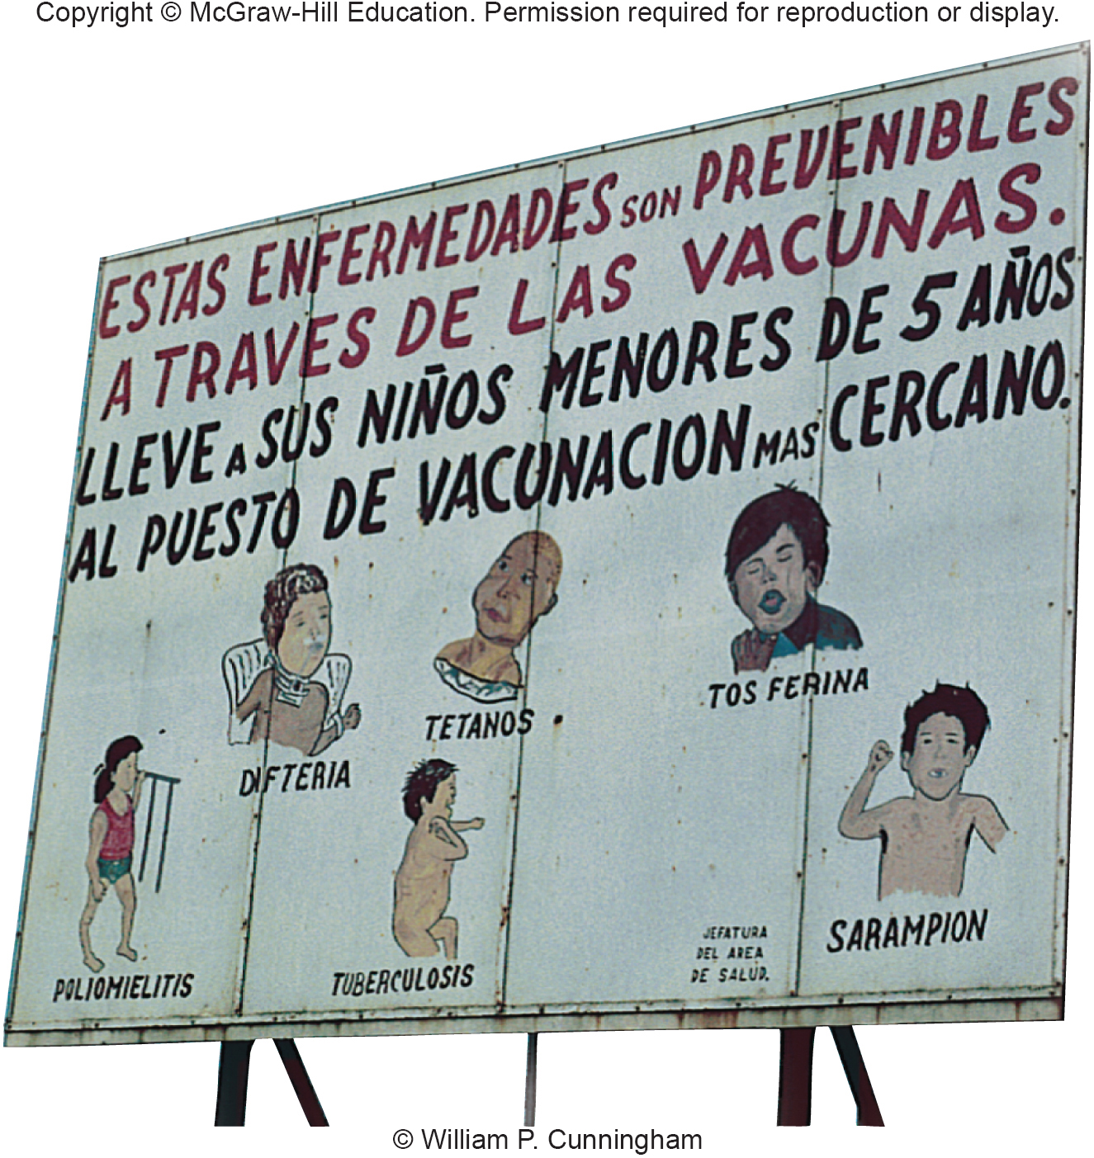
Millions of Children Die From Preventable Childhood Diseases
Notes:
At least 3 million children die every year from easily preventable diseases. This billboard in Guatemala encourages parents to have their children vaccinated against polio, diphtheria, TB, tetanus, pertussis (whooping cough), and scarlet fever.
9

Slide 10
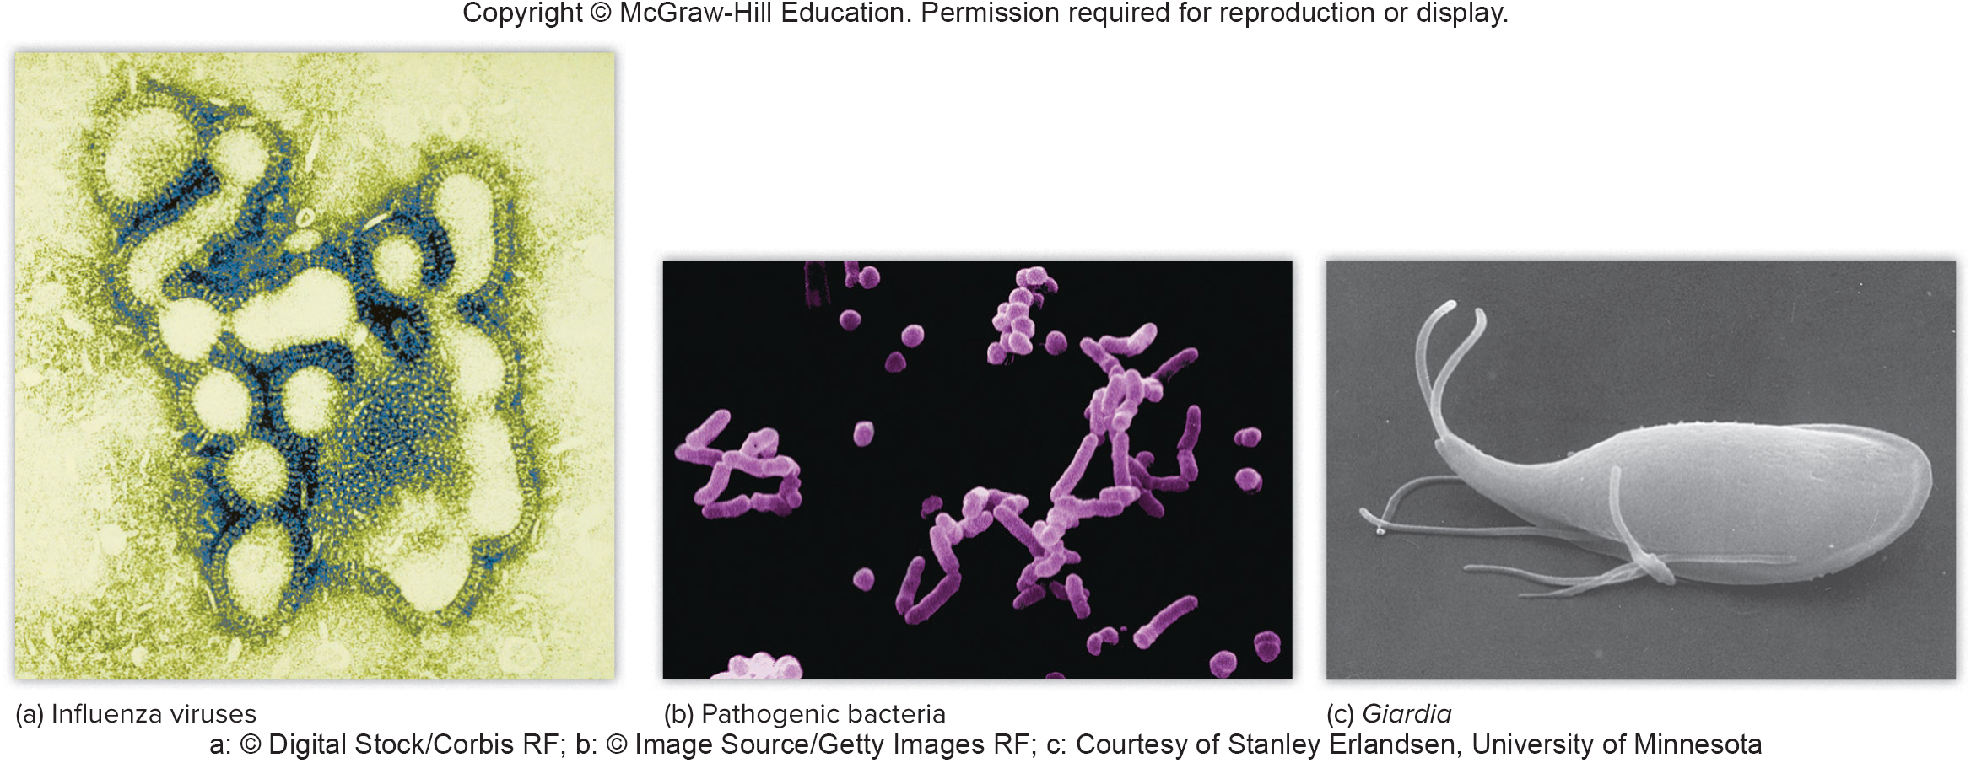
Pathogens are Disease-causing Organisms
A wide variety of pathogens afflict humans, including viruses, bacteria, protozoans (single-celled animals), parasitic worms, and flukes.
The greatest loss of life from an individual disease in a single year was the great influenza pandemic of 1918.
Notes:
Epidemiologists now estimate that at least one-third of all humans living at the time were infected, and that between 50 to 100 million died. Businesses, schools, churches, and sport and entertainment events were shut down for months. There were worries that the H1N1 pandemic that spread around the world in 2009 might sicken 2 billion people, kill up to 150 million, and bring the world economy to a standstill. Fortunately, it hasn’t been nearly as bad—so far—as the 1918 strain. Influenza is caused by a family of viruses (fig. 8.4a) that mutate rapidly and move from wild and domestic animals to humans, making control of this disease very difficult.
10

Slide 11
Outbreaks of Infectious Diseases (1)
Malaria is one of the most prevalent remaining infectious diseases. Every year about 500 million new cases of this disease occur, and about one million people die from it.
Emergent diseases are those not previously known or that have been absent for at least 20 years.
The H1N1 new strain of bird flu that spread around the world in 2009.
There have been at least 40 outbreaks of emergent diseases over the past two decades, including the Ebola and Marburg fevers.
Notes:
Similarly, cholera, which had been absent from South America for more than a century, reemerged in Peru in 1992 (fig. 8.5). Some other examples include a new drug-resistant form of tuberculosis, now spreading in South Africa; dengue fever, which is spreading through Southeast Asia and the Caribbean; and a new human lymphotropic virus (HTLV), which is thought to have jumped from monkeys into people in Cameroon who handled or ate bushmeat. These HTLV strains are now thought to infect 25 million people.
11

Slide 12
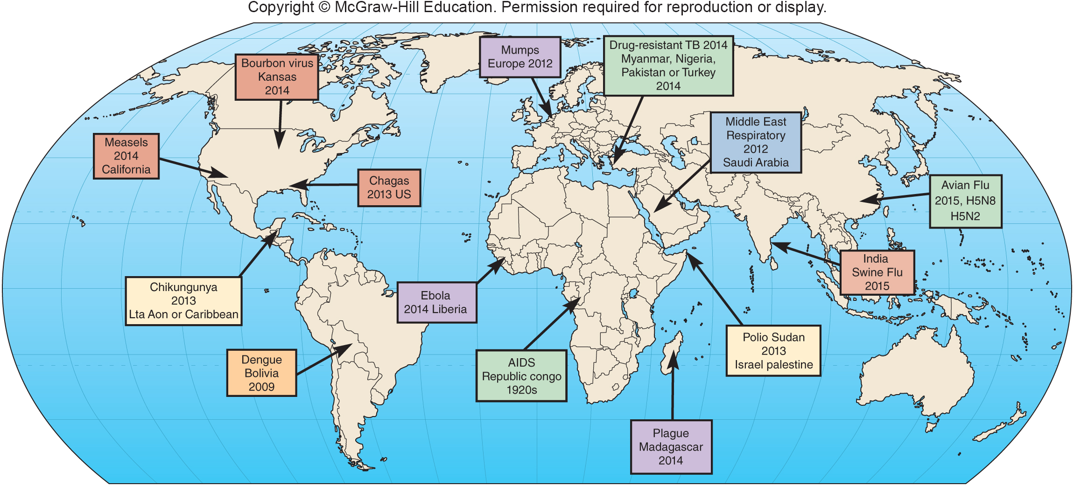
Outbreaks of Infectious Diseases (2)
Notes:
Some recent outbreaks of highly lethal infectious diseases. Why are supercontagious organisms emerging in so many different places?
12

Slide 13
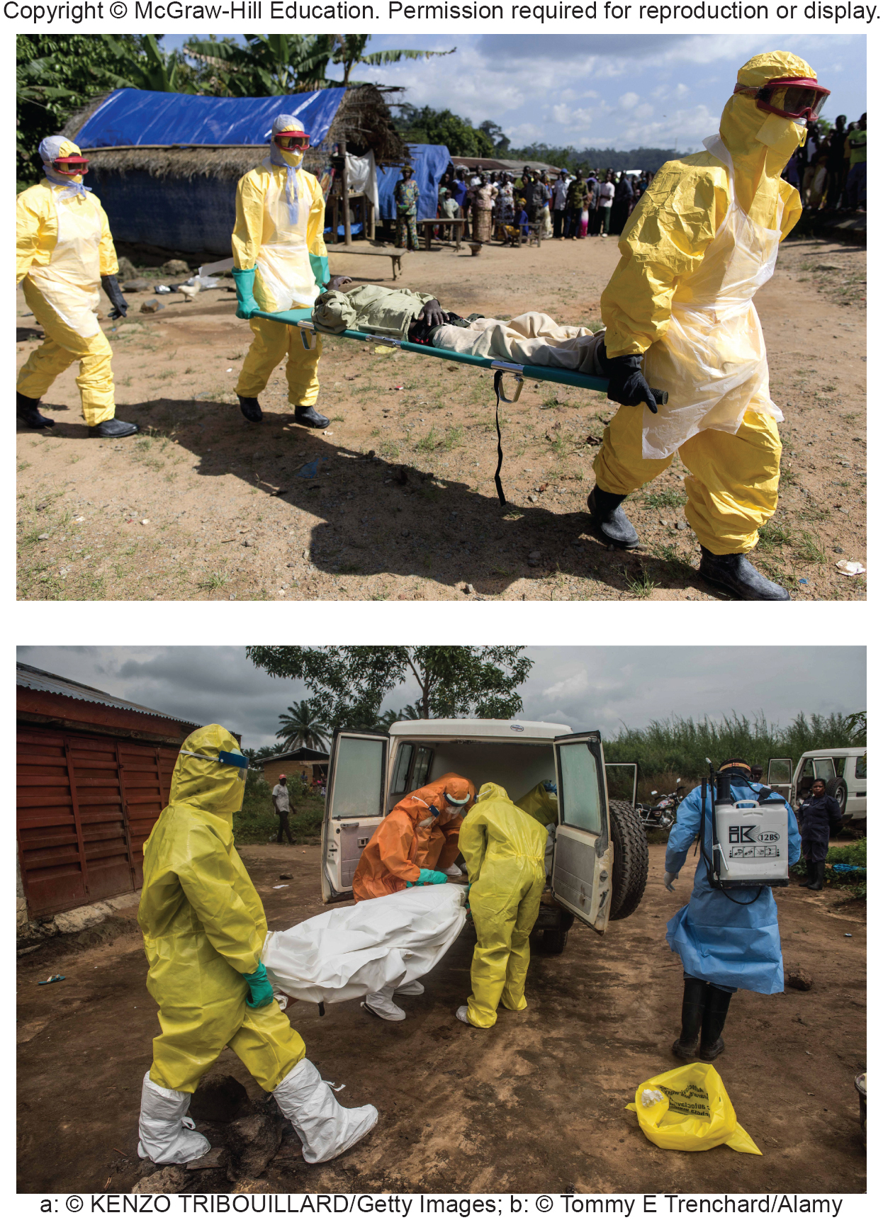
The Spread of West Nile Virus
West Nile virus shows how fast new diseases can travel. The disease spread rapidly from New York, where it was first reported, throughout the eastern U.S. in only two years
West Nile is a mosquito-transmitted viruses that cause encephalitis (brain inflammation).
Notes:
West Nile belongs to a family of mosquito-transmitted viruses that cause encephalitis (brain inflammation). Although recognized in Africa in 1937, the West Nile virus was absent from North America until 1999, when it apparently was introduced by an imported bird or mosquito. The disease spread rapidly from New York, where it was first reported, throughout the eastern United States in only two years (fig. 8.6). Within five years, it was found almost everywhere in the lower 48 states. The virus infects at least 250 bird species and 18 mammalian species. In 2007, about 4,000 people contracted West Nile and about 100 died.
13

Slide 14
Conservation Medicine Combines
Ecology and Health Care
Humans aren’t the only ones to suffer from new and devastating diseases..Wildlife also experience widespread epidemics, which are sometimes called ecological diseases.
We are coming to recognize that the delicate ecological balances that we value so highly—and disrupt so frequently—are important to our own health.
Conservation medicine attempts to understand how our environmental changes threaten our own health as well as that of the natural communities on which we depend for ecological services.
Notes:
Humans aren’t the only ones to suffer from new and devastating diseases. Domestic animals and wildlife also experience sudden and widespread epidemics, which are sometimes called ecological diseases. We are coming to recognize that the delicate ecological balances that we value so highly—and disrupt so frequently—are
important to our own health. Conservation medicine is an emerging discipline that attempts to understand how our environmental changes threaten our own health as well as that of the natural communities on which we depend for ecological services. Although it is still small, this new field is gaining recognition from mainstream funding sources such as the World Bank, the World Health Organization, and the U.S. National Institutes of Health.
Ebola hemorrhagic fever, for example, is one of the most virulent viruses ever known, killing up to 90 percent of its victims. In 2002 an outbreak of Ebola fever began killing humans along the Gabon-Congo border. A few months later, researchers found that 221 of the 235 western lowland gorillas they had been studying in this area disappeared in just a few months. Many chimpanzees also died. Although the study team could find only a few of the dead gorillas, 75 percent of those tested positive for Ebola. Altogether, researchers estimate that 5,000 gorillas died in this small area of the Congo. Extrapolating to all of central Africa, it’s possible that Ebola has killed one-quarter of all the gorillas in the world. It’s thought that the spread of this disease in humans resulted from the practice of hunting and eating primates.
14

Slide 15
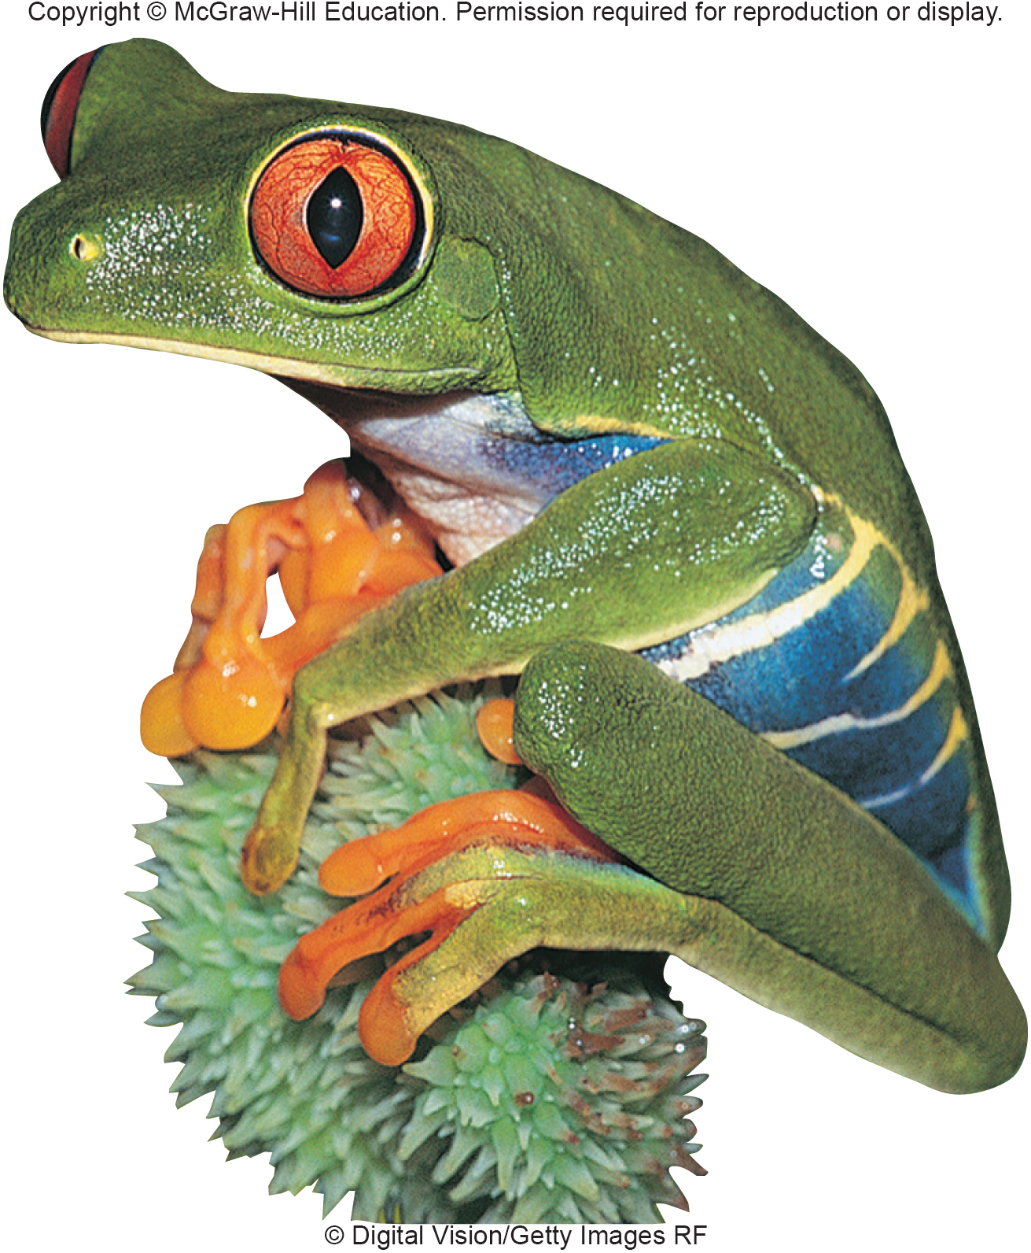
Frogs and Toads Are
Succumbing To a Deadly Disease
Notes:
An even more widespread epidemic is currently sweeping through amphibians worldwide. A disease called Chytridiomycosis is causing dramatic losses or even extinctions of frogs and toads throughout the world (fig. 8.7). A fungus called Batrachochytrium dendrobatidis causes the disease. It was first recognized in
1993 in dead and dying frogs in Queensland, Australia, and now is spreading rapidly, perhaps because the fungus has become more virulent or amphibians are more susceptible due to environmental change. Most of the world’s approximately 6,000 amphibian species appear to be susceptible to the disease, and around 2,000 species have declined or even become extinct in their native habitats as part of this global epidemic.

Slide 16
Resistance to Antibiotics and Pesticides is Increasing
In recent years, health workers have become increasingly alarmed about the rapid spread of methicillin-resistant Staphylococcus aureus (MRSA).
Why have vectors, such as mosquitoes, and pathogens, such as bacteria or the malaria parasite, become resistant to pesticides and antibiotics?
Part of the answer is natural selection and the ability of many organisms to evolve rapidly.
Another factor is the human tendency to use control measures carelessly.
Notes:
Staphylococcus (or staph) is very common. Most people have at least some of these bacteria. They are a common cause of sore throats and skin infections, but are usually easily controlled. This new strain, however, is resistant to penicillin and related antibiotics, and can cause deadly infections, especially in people with weak immune systems. MRSA is most frequent in hospitals, nursing homes, correctional facilities, and other places where people are in close contact. It’s generally spread through direct skin contact. School locker rooms, gymnasiums, and contact sports also are sources of infections. Several states have closed schools as a result of MRSA contamination. In 2006 the U. S. Centers for Disease Control and Prevention estimated that at least 100,000 MRSA infections in the United States resulted in about 19,000 deaths.
Why have vectors, such as mosquitoes, and pathogens, such as bacteria or the malaria parasite, become resistant to pesticides and antibiotics? Part of the answer is natural selection and the ability of many organisms to evolve rapidly. Another factor is the human tendency to use control measures carelessly. Many doctors prescribe penicillin and other antibiotics just in case they might do some good. Similarly, when we discovered that DDT and other insecticides could control mosquito populations, we spread them everywhere. This not only harmed wildlife and beneficial insects but also created perfect conditions for natural selection.
16

Slide 17
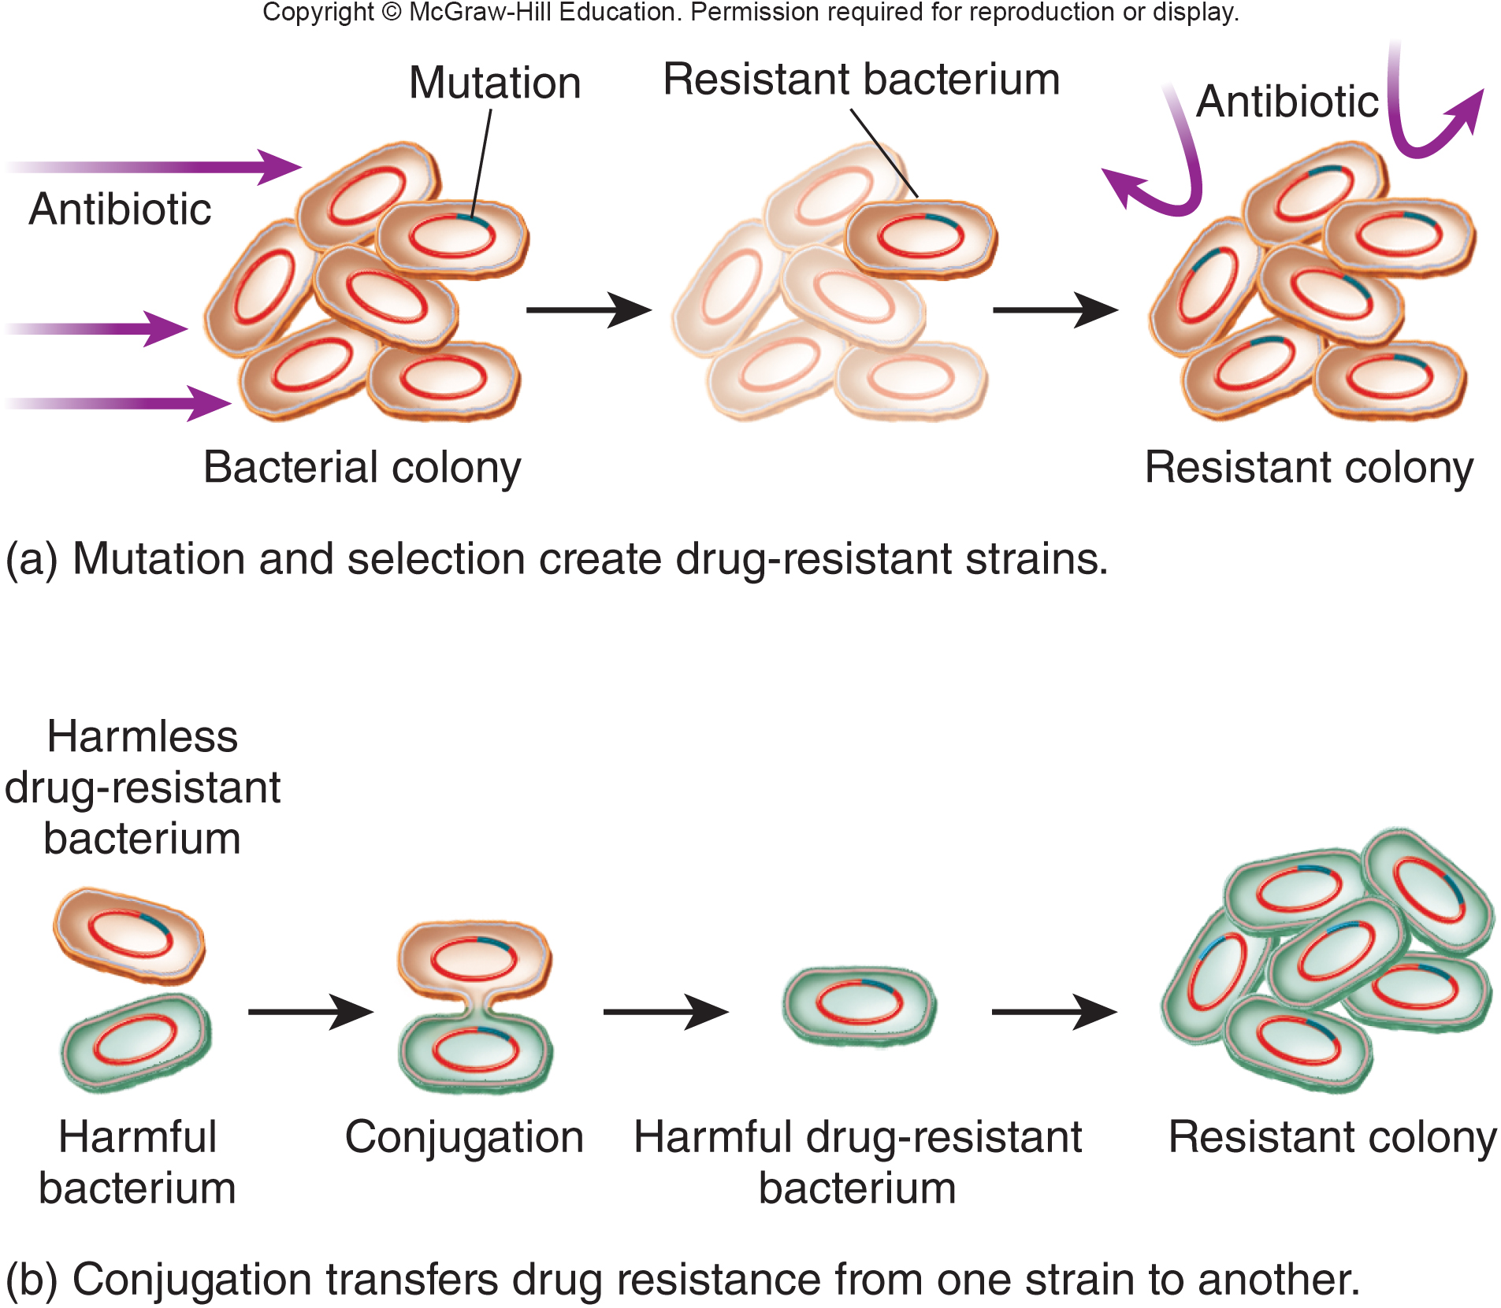
How Microbes Acquire
Antibiotic Resistance
Notes:
(a) Random mutations make a few cells resistant. When challenged by antibiotics, only those cells survive to give rise to a resistant colony. (b) Sexual reproduction (conjugation) or plasmid transfer moves genes from one strain or species to another.
17

Slide 18
Who Should Pay For Health Care?
The heaviest burden of illness is borne by the poorest people, who can afford neither a healthy environment nor adequate health care.
WHO estimates that 90 percent of all disease burden occurs in developing countries, where less than one-tenth of all health care dollars is spent.
The Bill and Melinda Gates Foundation has pledged $200 million for medical aid to developing countries to help fight AIDS, TB, and malaria.
Notes:
WHO estimates that 90 percent of all disease burden occurs in developing countries, where less than one-tenth of all health care dollars is spent. The group Médecins Sans Frontières (MSF, or Doctors without Borders) calls this the 10/90 gap.
Dr. Jeffrey Sachs of the Columbia University Earth Institute says that disease is as much a cause as a consequence of poverty and political unrest. More charities in wealthy countries such as the Gates Foundation need to step up and help eradicate diseases in developing countries.
18

Slide 19
8.2 Toxicology
Toxicology is the study of the adverse effects of external factors on an organism or a system.
This includes environmental chemicals, drugs, and diet as well as physical factors, such as ionizing radiation, UV light, and electromagnetic forces.
Toxins often are harmful even in extremely dilute concentrations. In some cases, billionths, or even trillionths, of a gram can cause irreversible damage.
Environmental toxicology specifically deals with the interactions, transformation, fate, and effects of toxins in the biosphere, including individual organisms, populations, and whole ecosystems.
Notes:
Toxic means poisonous. In addition to studying agents that cause toxicity, scientists in this field are concerned with movement and fate of poisons in the environment, routes of entry into the body, and effects of exposure to these agents. Toxic substances damage or kill living organisms because they react with cellular components to disrupt metabolic functions. Toxins often are harmful even in extremely dilute concentrations. In some cases, billionths, or even trillionths, of a gram can cause irreversible damage.
Environmental toxicology, or ecotoxicology, specifically deals with the interactions, transformation, fate, and effects of toxic materials in the biosphere, including individual organisms, populations, and whole ecosystems. In aquatic systems the fate of the pollutants is primarily studied in relation to mechanisms and processes at interfaces of the ecosystem components. Special attention is devoted to the sediment/water, water/organisms, and water/air interfaces. In terrestrial environments, the emphasis tends to be on effects of metals on soil fauna community and population characteristics.

Slide 20
Top 20 Toxic and Hazardous Substances
TABLE 8.2 Top 20 Toxic and Hazardous Substances
MATERIAL | MAJOR SOURCES
1. Arsenic | Treated lumber
2. Lead | Paint, gasoline
3. Mercury | Coal combustion
4. Vinyl chloride | Plastics, industrial uses
5. Polychlorinated biphenyls (PCBs) | Electric insulation
6. Benzene | Gasoline, industrial use
7. Cadmium | Batteries
8. Benzo(a)pyrene | Waste incineration
9. Polycyclic aromatic hydrocarbons | Combustion
10. Benzo(b)fluoranthene | Fuels
11. Chloroform | Water purification, industry
12. DDT | Pesticide use
13. Aroclor1254 | Plastics
14. Aroclor1260 | Plastics
15. Trichloroethylene | Solvents
16. Dibenz (a, h)anthracene | Incineration
17. Dieldrin | Pesticides
18. Chromium, hexavalent | Paints, coatings, welding, anticorrosion agents
19. Chlordane | Pesticides
20. Hexachlorobutadiene | Pesticides
SOURCE: Data from U.S. Environmental Protection Agency.
Notes:
Table 8.2 is a list of the top 20 toxic and hazardous substances considered the highest risk by the U.S. Environmental Protection Agency. Compiled from the 275 substances regulated by the Comprehensive Environmental Response, Compensation, and Liability Act (CERCLA), commonly known as the Superfund Act, these
materials are listed in order of assessed importance in terms of human and environmental health.
20

Slide 21
How Do Toxins Affect Us?
Allergens are substances that activate the immune system.
Some allergens act directly as antigens.
Antigens are substances (pollen, bacteria, etc.) recognized as foreign by white blood cells and stimulate the production of specific antibodies.
Antibodies are proteins produced by our bodies that recognize and bind to foreign cells or chemicals.
Notes:
21

Slide 22
Sick Building Syndrome
Formaldehyde is a good example of a widely used chemical that is a powerful sensitizer of the immune system.
Widely used in plastics, wood products, insulation, glue, and fabrics, formaldehyde concentrations in indoor air can be thousands of times higher than in normal outdoor air.
Sick building syndrome is a condition characterized by headaches, allergies, and chronic fatigue caused by poorly vented indoor air contaminated by various contaminants.
Notes:
Some people suffer from what is called sick building syndrome: headaches, allergies, and chronic fatigue caused by poorly vented indoor air contaminated by molds, carbon monoxide, nitrogen oxides, formaldehyde, and other toxic chemicals released by carpets, insulation, plastics, building materials, and other sources.
The Environmental Protection Agency estimates that poor indoor air quality may cost the nation $60 billion a year in absenteeism and reduced productivity (see Key Concepts, p. 190).
22

Slide 23
Classes of Harmful Agents
Neurotoxins are a special class of metabolic poisons that specifically attack nerve cells (neurons).
Mutagens are agents, such as chemicals and radiation, that damage or alter genetic material (DNA) in cells.
Teratogens are chemicals or other factors that specifically cause abnormalities during embryonic growth and development.
Carcinogens are substances that cause cancer.
Notes:
Neurotoxins are a special class of metabolic poisons that specifically attack nerve cells (neurons). The nervous system is so important in regulating body activities that disruption of its activities is especially fast-acting and devastating. Different types of neurotoxics act in different ways. Heavy metals, such as lead and
mercury, kill nerve cells and cause permanent neurological damage. Anesthetics (ether, chloroform, halothane, etc.) and chlorinated hydrocarbons (DDT, Dieldrin, Aldrin) disrupt nerve cell membranes necessary for nerve action. Organophosphates (Malathion, Parathion) and carbamates (carbaryl, zeneb, maneb) inhibit acetylcholinesterase, an enzyme that regulates signal transmission between nerve cells and the tissues or organs they innervate (for example, muscle). Most neurotoxics are both acute and extremely toxic. More than 850 compounds are now recognized as neurotoxics.
Mutagens are agents, such as chemicals and radiation, that damage or alter genetic material (DNA) in cells. This can lead to birth defects if the damage occurs during embryonic or fetal growth. Later in life, genetic damage may trigger neoplastic (tumor) growth. When damage occurs in reproductive cells, the results can be passed on to future generations. Cells have repair mechanisms to detect and restore damaged genetic material, but some changes may be hidden, and the repair process itself can be flawed. It is generally accepted that there is no “safe” threshold for exposure to mutagens. Any exposure has some possibility of causing damage.
Teratogens are chemicals or other factors that specifically cause abnormalities during embryonic growth and development. Some compounds that are not otherwise harmful can cause tragic problems in these sensitive stages of life. Perhaps the most prevalent teratogen in the world is alcohol. Drinking during pregnancy can lead to fetal alcohol syndrome— a cluster of symptoms including craniofacial abnormalities, developmental delays, behavioral problems, and mental defects, that last throughout a child’s life. Even one alcoholic drink a day during pregnancy has been associated with decreased birth weight.
Carcinogens are substances that cause cancer—invasive, out-of-control cell growth that results in malignant tumors. Cancer rates rose in most industrialized countries during the twentieth century, and cancer is now the second leading cause of death in the United States, killing about a half a million people per year.
Sixteen of the 20 compounds listed by the U.S. EPA as the greatest risk to human health are probable or possible human carcinogens.
23

Slide 24
Endocrine Hormone Disrupters are of Special Concern
Endocrine hormone disrupters are chemicals that interrupt the normal endocrine hormone functions.
Some of the most insidious effects of persistent chemicals, such as DDT and PCBs, are that they interfere with normal growth, development, and physiology of a variety of animals at very low doses.
These chemicals are sometimes called environmental estrogens or androgens, because they often cause reproductive health problems in females or feminization of males.
Notes:
One of the most recently recognized environmental health threats are endocrine hormone disrupters, chemicals that interrupt the normal endocrine hormone functions. Hormones are chemicals released into the bloodstream by glands in one part of the body to regulate the development and function of tissues and organs elsewhere in the body (fig. 8.9). You undoubtedly have heard about sex hormones and their powerful effects on how we look and behave, but these are only one example of the many regulatory hormones that rule our lives. We now know that some of the most insidious effects of persistent chemicals, such as BPA, DDT and PCBs, are that they interfere with the normal growth, development, and physiology of a variety of animals—-presumably including humans—at very low doses. In some cases, picogram concentrations (trillionths of a gram per liter) may be enough to cause developmental abnormalities in sensitive organisms. These chemicals are sometimes called environmental estrogens or androgens, because they often cause sexual dysfunction (reproductive health problems in females or feminization of males, for example). They are just as likely, however, to disrupt thyroxin functions or those of other important regulatory molecules as they are to obstruct sex hormones.
24

Slide 25
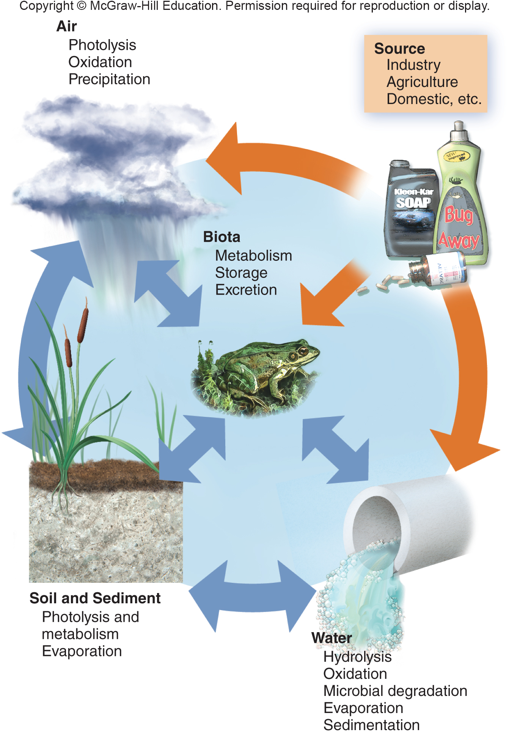
8.3 Movement, Distribution, and Fate of Toxins
We can think of both individuals and
an ecosystem as sets of interacting compartments between which
chemicals move, based on molecular size, solubility, stability, and reactivity
Notes:
The dose (amount), route of entry, timing of exposure, and sensitivity of the organism all play important roles in determining toxicity. In this section, we will consider some of these characteristics and how they affect environmental health.
25

Slide 26
Factors in Environmental Toxicity
TABLE 8.3 Factors in Environmental Toxicity
FACTORS RELATED TO THE TOXIC AGENT
1. Chemical composition and reactivity
2. Physical characteristics (such as solubility, state)
3. Presence of impurities or contaminants
4. Stability and storage characteristics of toxic agent
5. Availability of vehicle (such as solvent) to carry agent
6. Movement of agent through environment and into cells
FACTORS RELATED TO EXPOSURE
1. Dose (concentration and volume of exposure)
2. Route, rate, and site of exposure
3. Duration and frequency of exposure
4. Time of exposure (time of day, season, year)
FACTORS RELATED TO THE ORGANISM
1. Resistance to uptake, storage, or cell permeability of agent
2. Ability to metabolize, inactivate, sequester, or eliminate agent
3. Tendency to activate or alter nontoxic substances so they become toxic
4. Concurrent infections or physical or chemical stress
5. Species and genetic characteristics of organism
6. Nutritional status of subject
7. Age, sex, body weight, immunological status, and maturity

Slide 27
Solubility and Mobility Determine
When and Where Chemicals Move
Solubility is one of the most important characteristics in determining how, a toxic material will move through the environment or through the body to its site of action.
Chemicals can be divided into 2 major groups:
Water soluble compounds move rapidly and widely through the environment because water is ubiquitous.
Molecules that are oil- or fat-soluble generally need a carrier to move through the environment.
Notes:
Water-soluble compounds also tend to have ready access to most cells in the body because aqueous solutions bathe all our cells.
Once inside the body, however, oil-soluble toxics penetrate readily into tissues and cells because the membranes that enclose cells are themselves made of similar oil-soluble chemicals. Once inside cells, oil-soluble materials are likely to accumulate and to be stored in lipid deposits, where they may be protected from metabolic breakdown and persist for many years.
27

Slide 28
Exposure and Susceptibility
Determine How we Respond (1)
There are many routes for toxins to enter our bodies.
Airborne toxins generally cause more ill health than any other exposure source; however, food, water, and skin contact can also expose us to a wide variety of hazards.
Age matters and general health matters: healthy adults, for example, may be relatively insensitive to doses that are very dangerous to young children or to someone already weakened by other diseases.
Lead is the most common toxin in children.
Notes:
Condition of the organism and timing of exposure also have strong influences on toxicity. Healthy adults, for example, may be relatively insensitive to doses that are very dangerous to young children or to someone already weakened by other diseases. Pound for pound, children drink more water, eat more food, and breathe more air than do adults. Putting fingers, toys, and other objects into their mouths increases children’s exposure to toxics in dust or soil.
Furthermore, children generally have less-developed immune systems or processes to degrade or excrete toxics. The developing brain is especially sensitive to damage. Obviously, disrupting the complex and sensitive process of brain growth and development can have tragic long-term consequences. Researchers estimate that one in six children in America has a developmental disability, usually involving the nervous system.
The best-known example of an environmental risk for children is lead poisoning. Before lead paint and leaded gasoline were banned in the 1970s, at least 4 million American children had dangerous levels of lead in their blood. Banning these products has been one of the greatest successes in environmental health. Blood lead levels in children have fallen more than 90 percent in the past three decades. Unfortunately, this tremendous success hasn’t yet extended to developing countries. In 2009, the China Daily reported that 1.1 million children are born in China every year with birth defects attributed to environmental factors.
28

Slide 29
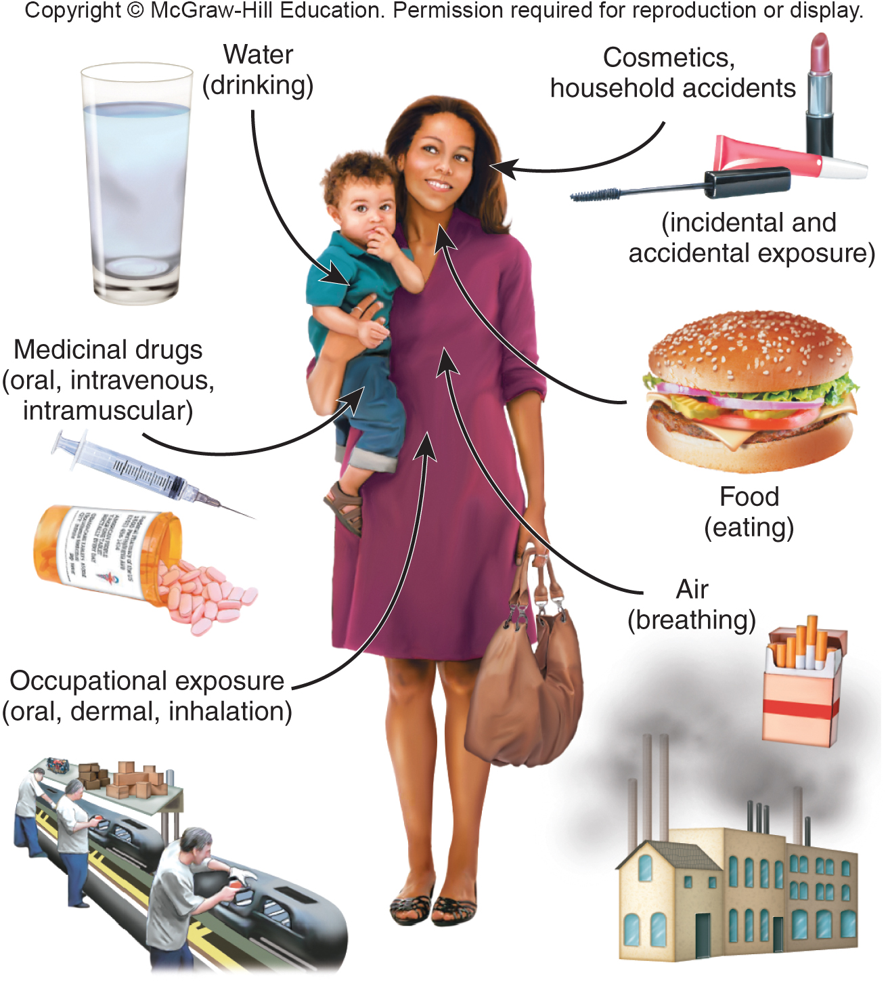
Exposure and Susceptibility
Determine How we Respond (2)
Notes:
Routes of exposure to toxic and hazardous environmental factors.
29

Slide 30
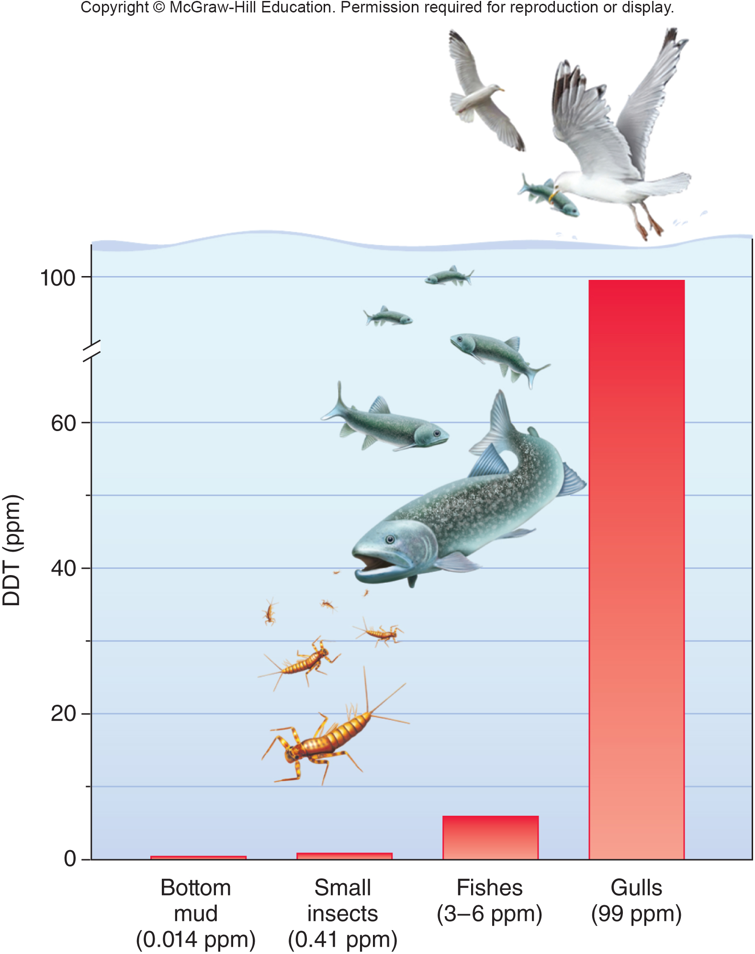
Bioaccumulation and Biomagnification
Bioaccumulation refers to the fact that organisms may selectively absorb and store toxins in their bodies.
Biomagnification occurs when the toxic burden of a large number of organisms at a lower trophic level is accumulated and concentrated by a predator at a higher trophic level.
Notes:
Cells have mechanisms for bioaccumulation, the selective absorption and storage of a great variety of molecules. This allows them to accumulate nutrients and essential minerals, but at the same time they also may absorb and store harmful substances through the same mechanisms. Materials that are rather dilute in the environment can reach dangerous levels inside cells and tissues through this process of bioaccumulation. Toxic substances also can be magnified through food webs.
Biomagnification occurs when the toxic burden of a large number of organisms at a lower trophic level is accumulated and concentrated by a predator in a higher trophic level. Phytoplankton and bacteria in aquatic ecosystems, for instance, take up heavy metals or toxic organic molecules from water or sediments (fig. 8.12).
Their predators—zooplankton and small fish—collect and retain the toxics from many prey organisms, building up higher concentrations of toxics. The top carnivores in the food chain—game fish, fish-eating birds, and humans—can accumulate such high toxic levels that they suffer adverse health effects.
30

Slide 31
Persistence Makes Some
Materials a Greater Threat
Many substances degrade when exposed to sun, air, and water. This can destroy them or convert them to inactive forms.
Some materials are persistent and can last for years or even centuries as they cycle through ecosystems.
Examples:
Heavy metals: lead and mercury.
Many organic compounds, such as PVC plastics and chlorinated hydrocarbon pesticides.
Notes:
Heavy metals, such as lead and mercury, are classic examples. Mercury, like lead, can destroy nerve cells and is particularly dangerous to children. The largest source of mercury in the United States is from burning coal. Every year, power plants in the United States release 48 tons of this toxic metal into the air. It works its way through food chains and is concentrated to dangerous levels in fish. Mercury contamination is the most common cause of lakes and rivers failing to meet pollution regulation standards.
Many organic compounds, such as PVC plastics fire retardants and chlorinated hydrocarbon pesticides, also are highly resistant to degradation.
31

Slide 32
Chemical Interactions can
Increase Toxicity
Some materials produce antagonistic reactions. That is, they interfere with the effects or stimulate the breakdown of other chemicals.
Other materials are additive when they occur together in exposures.
Synergism is an interaction in which one substance exacerbates the effects of another.
Notes:
For instance, vitamins E and A can reduce the response to some carcinogens. Other materials are additive when they occur together in exposures. Rats exposed to both lead and arsenic show twice the toxicity of only one of these elements. Perhaps the greatest concern is synergistic effects. For example, occupational asbestos exposure increases lung cancer rates 20-fold. Smoking increases lung cancer rates by the same amount. Asbestos workers who also smoke, however, have a 400-fold increase in cancer rates. How many other toxic chemicals are we exposed to that are below threshold limits individually but combine to give toxic results?
32

Slide 33
8.4 Mechanisms for Minimizing
Toxic Effects
Each of us consumes lethal doses of many chemicals over the course of a lifetime.
One hundred cups of strong coffee, for instance, contain a lethal dose of caffeine.
Similarly, 100 aspirin tablets, 10 kg (22 lbs) of spinach or rhubarb, or a liter of alcohol would be deadly if consumed all at once.
Taken in small doses, however, most toxins can be broken down or excreted before they do much harm.
Notes:
A fundamental concept in toxicology is that every material can be poisonous under some conditions, but most chemicals have a safe level or threshold below which their effects are undetectable or insignificant. Each of us consumes lethal doses of many chemicals over the course of a lifetime. One hundred cups of strong coffee, for instance, contain a lethal dose of caffeine. Similarly, 100 aspirin tablets, 10 kg (22 lb) of spinach or rhubarb, or a liter of alcohol would be deadly if consumed all at once. Taken in small doses, however, these materials can be broken down or excreted before they do much harm. Furthermore, the damage they cause can be repaired.
33

Slide 34
Metabolic Degradation and
Excretion Eliminate Toxins
Most organisms have enzymes that process waste products and environmental poisons to reduce their toxicity.
In mammals, most of these enzymes are located in the liver, the primary site of detoxification of both natural wastes and introduced poisons.
We also reduce the effects of waste products and environmental toxics by eliminating them from the body through excretion. This can occur through breathing, sweating or urination.
Notes:
Volatile molecules, such as carbon dioxide, hydrogen cyanide, and ketones, are excreted via breathing. Some excess salts and other substances are excreted in sweat. Primarily, however, excretion is a function of the kidneys, which can eliminate significant amounts of soluble materials through urine formation.
34

Slide 35
Repair Mechanisms
Mend Damage
In the same way that individual cells have enzymes to repair damage to DNA and protein at the molecular level, tissues and organs that are exposed regularly to physical wear-and-tear or to toxic or hazardous materials often have mechanisms for damage repair.
Our skin and the epithelial linings of the gastrointestinal tract, blood vessels, lungs, and urogenital system have high cellular reproduction rates to replace injured cells.

Slide 36
8.5 Measuring Toxicity
“The dose makes the poison” — this means that almost everything is toxic at very high levels, but can be safe if diluted enough.
This remains the most basic principle of toxicology.
How a material is delivered and at what rate plays a vital role in determining toxicity.
Notes:
1540 the Swiss scientist Paracelsus said, “The dose makes the poison,” by which he meant that almost everything is toxic at very In high levels, but can be safe if diluted enough. Sodium chloride (table salt), for instance, is essential for human life in small doses. If you were forced to eat a kilogram of salt all at once, however, it would make you very sick. A similar amount injected into your bloodstream would be lethal.
36

Slide 37
We Usually Test Toxic
Effects on Lab Animals
The most commonly used and widely accepted toxicity test is to expose a population of laboratory animals to measured doses of a specific substance under controlled conditions.
It commonly takes hundreds—or even thousands—of animals, several years of hard work, and hundreds of thousands of dollars to thoroughly test the effects of a toxic at very low doses.
Notes:
The most commonly used and widely accepted toxicity test is to expose a population of laboratory animals to measured doses of a specific substance under controlled conditions. This procedure is expensive, time-consuming, and often painful and debilitating to the animals being tested. It commonly takes hundreds—or even thousands—of animals, several years of hard work, and hundreds of thousands of dollars to thoroughly test the effects of a toxic at very low doses. More humane toxicity tests using computer simulations of model reactions, cell cultures, and other substitutes for whole living animals are being developed. However, conventional large-scale animal testing is the method in which scientists have the most confidence and on which most public policies about pollution and environmental or occupational health hazards are based.

Slide 38
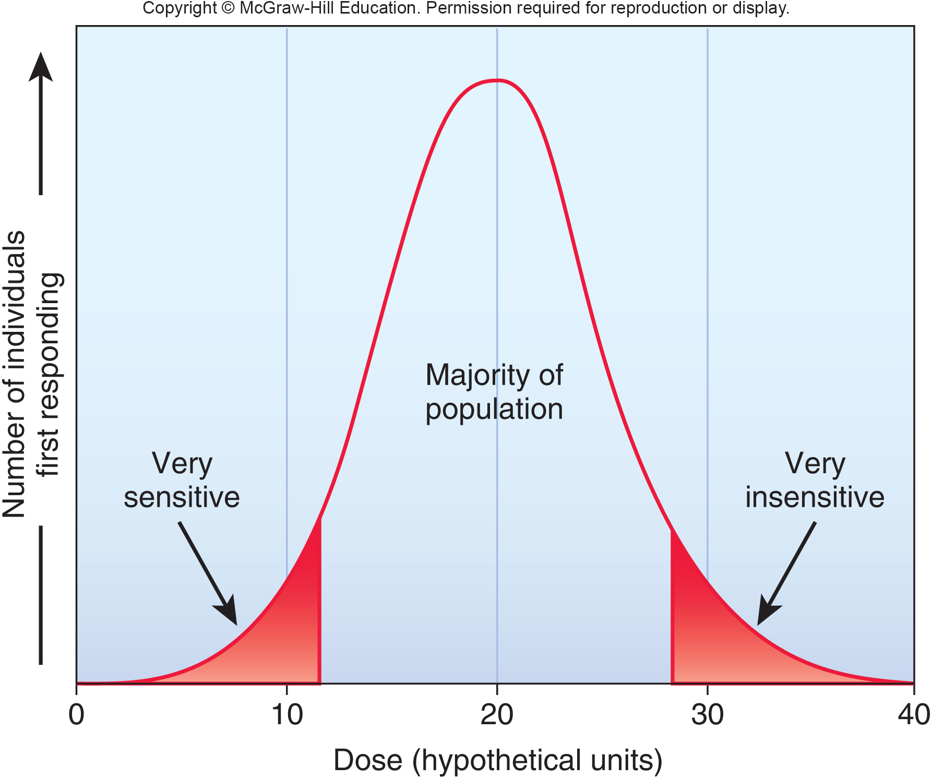
Animal Testing is Complicated by Differences in Toxic Sensitivity Between Individual Animals
Notes:
Probable variations in sensitivity to a toxin within a population. Some members of a population may be very sensitive to a given toxin, while others are much less sensitive. The majority of the population falls somewhere between the two extremes.

Slide 39
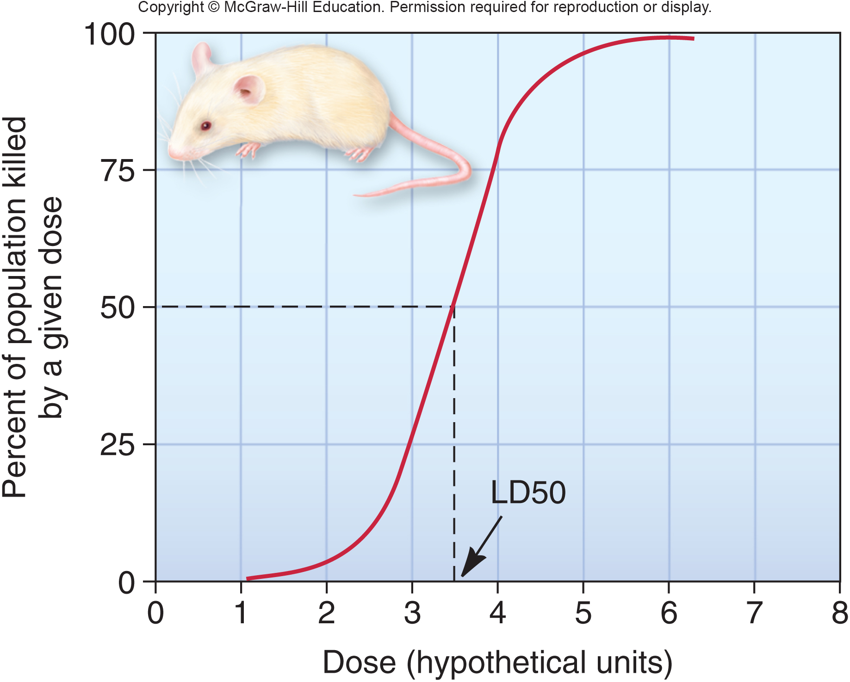
Dose Response Curves Help
Us Determine Toxicity
A convenient way to describe toxicity of a chemical is to determine the dose to which 50 percent of the test population is sensitive.
In the case of a lethal dose (LD), this is called the LD50.
Notes:
One problem is differences in toxic sensitivity among the members of a specific population. Figure 8.13 shows a typical dose/response curve for exposure to a hypothetical chemical. Some individuals are very sensitive to the material, while others are insensitive. Most, however, fall in a middle category, forming a bell-shaped curve. The question for regulators and politicians is whether we should set pollution levels that will protect everyone, including the most sensitive people, or only aim to protect the average person. It might cost billions of extra dollars to protect a very small number of individuals at the extreme end of the curve. What do you think, is that a good use of resources?
Dose/response curves aren’t always symmetrical, making it difficult to compare toxicity of unlike chemicals or different species of organisms. A convenient way to describe toxicity of a chemical is to determine the dose to which 50 percent of the test population is sensitive. In the case of a lethal dose (LD), this is called the LD50 (fig. 8.14). Unrelated species can react very differently to the same poison, not only because body and metabolism differ. Even closely related species can have very dissimilar reactions to a particular chemical. Hamsters, for instance, are nearly 5,000 times less sensitive to some dioxins than are guinea pigs. Of 226 chemicals found to be carcinogenic in either rats or mice, 95 cause cancer in one species but not the other. These variations make it difficult to estimate the risks for humans, because we don’t consider it ethical to perform controlled experiments in which we deliberately expose people to toxins.
39

Slide 40
There is a Wide Range of Toxicity
It is useful to group materials according to their relative toxicity.
A moderately harmful toxin takes about 1 g per kg of body weight to make a lethal dose.
Very toxic materials take about 1/10 of that amount.
Extremely toxic substances take 1/100 as much (only a few drops) to kill most people.
Supertoxic chemicals are extremely potent; for some, a few micrograms (millionths of a gram) is enough for a lethal dose.
Notes:
Very toxic materials take about one-tenth that amount, while extremely poisonous materials take one-hundredth as much (only a few drops) to kill most people. Supertoxic chemicals are extremely potent; for some, a few micrograms (millionths of a gram—an amount invisible to the naked eye) make a lethal dose. These materials aren’t all synthetic. One of the most toxic chemicals known, for instance, is ricin, a protein found in castor bean seeds. It is so poisonous that 0.3 billionths of a gram given intravenously will kill a mouse. If aspirin were this toxic for humans, a single tablet, divided evenly, could kill 1 million people.

Slide 41
Toxins Can Have Acute or Chronic
Doses and Effects
Acute effects are caused by a single exposure to the toxin and result in an immediate health crisis.
Chronic effects are long-lasting, perhaps even permanent. A chronic effect can result from a single dose of a very toxic substance, or it can be the result of a continuous or repeated sublethal exposure.
Unlike acute effects, it is usually difficult to assess the specific health risks of chronic exposures because other factors, such as aging or normal diseases, act simultaneously with the factor under study.
Notes:
Most of the toxic effects that we have discussed so far have been acute effects. That is, they are caused by a single exposure to the threat and result in an immediate health crisis. Often, if the individual experiencing an acute reaction survives this immediate crisis, the effects are reversible. Chronic effects, on the other hand, are long-lasting, perhaps even permanent. A chronic effect can result from a single dose of a very toxic substance, or it can be the result of a continuous or repeated sublethal exposure. We also describe long-lasting exposures as chronic, although their effects may or may not persist after the toxic agent is removed. It usually is difficult to assess the specific health risks of chronic exposures because other factors, such as aging or normal diseases, act simultaneously with the factor under study. It often requires very large populations of experimental animals to obtain statistically significant results for low-level chronic exposures.
41

Slide 42
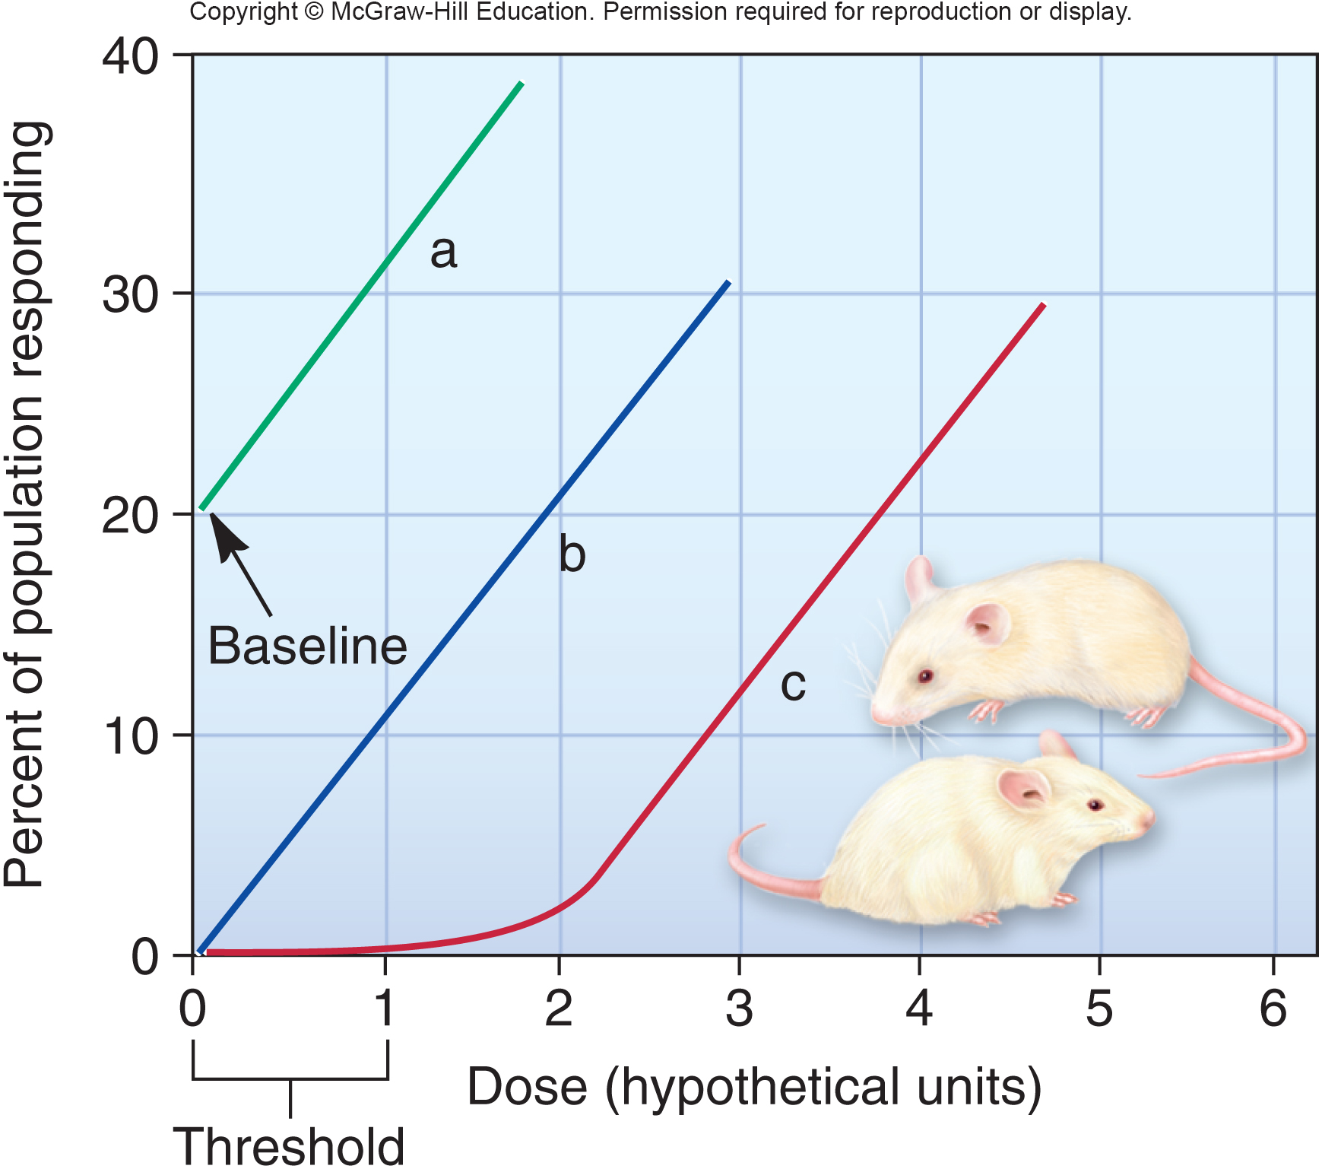
Low Doses can have
Variable Effects (1)
Notes:
This graph shows three possible results from low doses of a toxic material. Curve (a) shows a baseline level of response in the population, even at zero dose. This suggests that some other factor in the environment also causes this response. Curve (b) shows a straight-line relationship from the highest doses to zero exposure. Many carcinogens and mutagens show this kind of response. Any exposure to such agents, no matter how small, carries some risks. Curve (c) shows a threshold for the response where some minimal dose is necessary before any effect can be observed. This generally suggests the presence of a defense mechanism that prevents the toxin from reaching its target in an active form or repairs the damage that the toxic causes. Low levels of exposure to the material in question may have no deleterious effects, and it might not be necessary to try to keep exposures to zero.
42

Slide 43
8.6 Detectable Levels Aren’t
Always Dangerous
Twenty years ago, parts per million were generally the limits of detection for most materials, but now we can detect parts per trillion or even parts per quadrillion in some cases.
Increasingly sophisticated measuring capabilities may lead us to believe that toxic materials have become more prevalent. In fact, our environment may be no more dangerous; we are just better at finding trace amounts.
Notes:
Noxious materials may seem to be more widespread now than in the past, and this is surely a valid perception for many substances (fig. 8.16). The daily reports we hear of new chemicals found in new places, however, are also due, in part, to our more sensitive measuring techniques. Twenty years ago, parts per million were generally the limits of detection for most materials. Anything below that amount was often reported as “zero” or “absent,” rather than more accurately as “undetected.” A decade ago, new machines and techniques were developed to measure parts per billion. Suddenly, substances were found where none had been suspected. Now we can detect parts per trillion or even parts per quadrillion in some cases. Increasingly sophisticated measuring capabilities may lead us to believe that toxic materials have become more prevalent. In fact, our environment may be no more dangerous; we’re just better at finding trace amounts.
43

Slide 44
Low Doses can have
Variable Effects (2)
A complication in assessing risk is that the effects of low doses of some toxins and health hazards can be nonlinear.
They may be either more or less dangerous than would be predicted from exposure to higher doses.
For example, low doses of DHEP suppress activity of an enzyme essential for rat brain development. This is surprising because higher doses stimulated this enzyme.
Notes:
In another example, very low amounts of radiation seem to be protective against certain cancers. This is perplexing, because ionizing radiation has long been recognized as a human carcinogen. It’s thought now, however, that very low radiation exposure may stimulate DNA repair along with enzymes that destroy free radicals (atoms with unpaired, reactive electrons in their outer shells). Activating these repair mechanisms may defend us from other, unrelated hazards. These nonlinear effects are called hormesis.
44

Slide 45
8.6 Risk Assessment and Acceptance
Even if we know with some certainty how toxic a specific chemical is in laboratory tests, it is still difficult to determine risk.
Risk is the probability of harm times the probability of exposure if that chemical is released into the environment.
Many factors complicate the movement and fate of chemicals both around us and within our bodies.
Public perception of environmental hazards can be inconsistent with actual risks.
Notes:
As we have seen, many factors complicate the movement and fate of chemicals both around us and within our bodies. Furthermore, public perception of relative dangers from environmental hazards can be skewed so that some risks seem much more important than others.

Slide 46
Our Perception of Risks Isn’t Always Rational
A number of factors influence how we perceive relative risks associated with different situations.
People with social, political, or economic interests tend to downplay certain risks and emphasize others that suit their own agendas.
Our personal experiences often are misleading. When we have not personally experienced a bad outcome, we feel it is more rare and unlikely to occur than it actually may be.
We have an exaggerated view of our own abilities to control our fate.
Notes:
• Most people have difficulty understanding and believing probabilities. We feel that there must be patterns and connections in events, even though statistical theory says otherwise. If the coin turned up heads last time, we feel certain that it will turn up tails next time. In the same way, it is difficult to understand the meaning of a 1-in-10,000 risk of being poisoned by a chemical. We tend to have an irrational fear or distrust of certain technologies or activities that leads us to overestimate their dangers. Nuclear power, for instance, is viewed as very risky, while coal-burning power plants seem to be familiar and relatively benign; in fact, coal mining, shipping, and combustion cause an estimated 10,000 deaths each year in the United States, compared with none known so far for nuclear power generation. An old, familiar technology seems safer and more acceptable than does a new, unknown one.
• Alarmist myths and fallacies spread through society, often fueled by xenophobia, politics, or religion. For example, the World Health Organization campaign to eradicate polio worldwide has been thwarted by religious leaders in northern Nigeria—the last country where the disease remains widespread—who claim that oral vaccination is a U.S. plot to spread AIDS or infertility among Muslims.
• Our personal experiences often are misleading. When we have not personally experienced a bad outcome, we feel it is more rare and unlikely to occur than it actually may be. Furthermore, the anxieties generated by life’s gambles make us want to deny uncertainty and to misjudge many risks (fig. 8.17).
• We have an exaggerated view of our own abilities to control our fate. We generally consider ourselves above-average drivers, safer than most when using appliances or power tools, and less likely than others to suffer medical problems, such as heart attacks. People often feel they can avoid hazards because they are wiser or luckier than others.
• News media give us a biased perspective on the frequency of certain kinds of health hazards, overreporting some accidents or diseases, while downplaying or underreporting others. Sensational, gory, or especially frightful causes of death, such as murders, plane crashes, fires, or terrible accidents, receive a disproportionate amount of attention in the public media. Heart disease, cancer, and stroke kill nearly 15 times as many people in the United States as do accidents and 75 times as many people as do homicides, but the emphasis placed by the media on accidents and homicides is nearly inversely proportional to their relative frequency, compared with either cardiovascular disease or cancer. This gives us an inaccurate picture of the real risks to which we are exposed.
46

Slide 47
How Much Risk is Acceptable?
How much is it worth to minimize and avoid exposure to certain risks?
Most people will tolerate a higher probability of occurrence of an event if the harm caused by that event is low. Conversely, harm of greater severity is acceptable only at low levels of frequency.
The EPA generally assumes that a risk of 1 in 1 million is acceptable for most environmental hazards. For activities that we enjoy, we are often willing to accept far greater risks than this general threshold.
Notes:
A 1-in-10,000 chance of being killed might be of more concern to you than a 1-in-100 chance of being injured. For most people, a 1-in-100,000 chance of dying from some event or some factor is a threshold for changing what they do. That is, if the chance of death is less than 1 in 100,000, we are not likely to be worried enough to change our ways. If the risk is greater, we will probably do something about it. The Environmental Protection Agency generally assumes that a risk of 1 in 1 million is acceptable for most environmental hazards. Critics of this policy ask, acceptable to whom?
For activities that we enjoy or find profitable, we are often willing to accept far greater risks than this general threshold. Conversely, for risks that benefit someone else, we demand far higher protection. For instance, your chance of dying in a motor vehicle accident in any given year are about 1 in 5,000, but that doesn’t deter many people from riding in automobiles. Your chances of dying from lung cancer if you smoke one pack of cigarettes per day are about 1 in 1,000. By comparison, the risk from drinking water with the EPA limit of trichloroethylene is about 2 in 1 billion. Strangely, many people demand water with zero levels of trichloroethylene while continuing to smoke cigarettes.
47

Slide 48
Relative Risks of Death from Various Causes
TABLE 8 4 Lifetime Chances of Dying in the United States
SOURCE | ODDS (1 IN x)
Heart disease | 2
Cancer | 3
Smoking | 4
Lung disease | 15
Pneumonia | 30
Automobile accident | 100
Suicide | 100
Falls | 200
Firearms | 200
Fires | 1,000
Airplane accident | 5,000
Jumping from high places | 6,000
Drowning | 10,000
Lightning | 56,000
Hornets, wasps, bees | 76,000
Dog bite | 230,000
Poisonous snakes, spiders | 700,000
Botulism | 1 million
Falling space debris | 5 million
Drinking water with EPA limit of trichloroethylene | 10 million
SOURCE: Data from U.S. National Safety Council, 2003.
Notes:
Notice that you are 50 times more likely to die in an auto accident than in a plane accident!
48

Slide 49
8.7 Establishing Public Policy
Risk management combines principles of environmental health and toxicology with regulatory decisions based on socioeconomic, technical, and political considerations.
In spite of often vague and contradictory data, public policymakers must make decisions.
Notes:
The biggest problem in making regulatory decisions is that we are usually exposed to many sources of harm, often unknowingly. It is difficult to separate the effects of all these different hazards and to evaluate their risks accurately, especially when the exposures are near the threshold of measurement and response. In spite of often vague and contradictory data, public policymakers must make decisions.
The case of the sweetener saccharin is a good example of the complexities and uncertainties of risk assessment in public health. Studies in the 1970s at the University of Wisconsin and the Canadian Health Protection Branch suggested a link between saccharin and bladder cancer in male rats. Critics of these studies pointed out that humans would have to drink 800 cans of diet soda per day to get a saccharin dose equivalent to that given to the rats. Furthermore, they argued this response may be unique to male rats. In 2000 the U.S. Department of Health concluded a study that found no association between saccharin and cancer in humans. Congress ordered that all warnings be removed from saccharin-containing products.
49

Slide 50
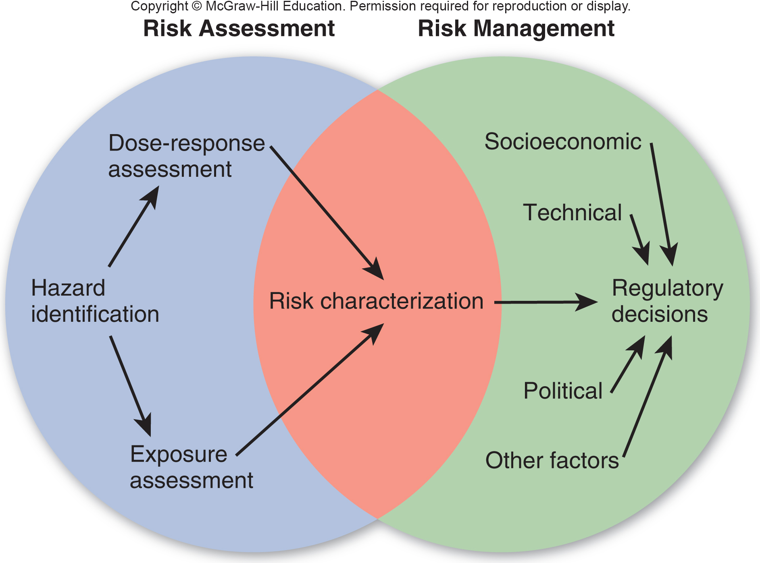
Risk Assessment vs. Risk Management
Notes:
How much is it worth to minimize and avoid exposure to certain risks? Most people will tolerate a higher probability of occurrence of an event if the harm caused by that event is low. Conversely, harm of greater severity is acceptable only at low levels of frequency. A 1-in-10,000 chance of being killed might be of more
concern to you than a 1-in-100 chance of being injured. For most people, a 1-in-100,000 chance of dying from some event or some factor is a threshold for changing what they do. That is, if the chance of death is less than 1 in 100,000, we are not likely to be worried enough to change our ways. If the risk is greater, we will
probably do something about it. The Environmental Protection Agency generally assumes that a risk of 1 in 1 million is acceptable for most environmental hazards. Critics of this policy ask, acceptable to whom? For activities that we enjoy or find profitable, we are often willing to accept far greater risks than this general threshold. Conversely, for risks that benefit someone else, we demand far higher protection. For instance, your chance of dying in a motor vehicle accident in any given year are about 1 in 5,000, but that doesn’t deter many people from riding in automobiles. Your chances of dying from lung cancer if you smoke one pack of cigarettes per day are about 1 in 1,000. By comparison, the risk from drinking water with the EPA limit of trichloroethylene is about 2 in 1 billion. Strangely, many people demand water with zero levels of trichloroethylene while continuing to smoke cigarettes.

Slide 51
Conclusion
We have made marvelous progress in reducing some of the worst diseases that have long plagued humans.
However, chronic conditions that once were confined to richer countries have now become leading health problems nearly everywhere.
New, emergent diseases are appearing at an increasing rate. With increased international travel, diseases can spread around the globe in a few days.
In addition, modern industry is introducing thousands of new chemicals every year, most of which aren’t studied thoroughly for long-term health effects.

